Slide 1
Stock Market Prediction with Historical Time Series Data and Sentimental Analysis over stock News
Done by
Praateek gunday (221710311017)
Sai kiran marla (221710311038)
Suraj raj (221710311014)

Slide 2
ABSTRACT:
The art of forecasting the stock prices has been a difficult task for many of the researchers and analysts. In fact, investors are highly interested in the research area of stock price prediction. For a good and successful investment, many investors are keen in knowing the future situation of the stock market. Good and effective prediction systems for stock market help traders, investors, and analyst by providing supportive information like the future direction of the stock market.
In this project, we present several Machine Learning algorithms and Long Short-Term Memory (LSTM) approach to predict stock market indices through two ways one is by analysis time series data and one is by processing news for stock prediction.

Slide 3
INTRODUCTION:
Time series forecasting has been widely used to determine the future prices of stock, and the analysis and modelling of finance time series importantly guide investors’ decisions and trades .This work proposes an intelligent time series prediction system that uses optimization for the purpose of predicting the stock prices
Stock prices are predicted to determine the future value of companies’ stock or other financial instruments that are marketed on financial exchanges. However, the stock market is influenced by many factors such as political events, economic conditions and traders’ expectation Stock Market Prediction
The prediction of the market value is of great importance to help in maximizing the profit of stock option purchase while keeping the risk low. Supervised Classifier has proved powerful models for processing sequential data.

Slide 4
Existing Work:
Financial Market Prediction, In the past few decades, financial market prediction has become a new hot research topic in the machine learning field.
With the aid of powerful models such as SVM (Support Vector Machine), feed forward neural network and recurrent neural network, researchers overcame numerous difficulties and achieved considerable progress.

Slide 5
Proposed Work:
To generalize the application of the existing system, our work uses the system to estimate other stocks in similar emerging markets and mature markets .
We are using Machine learning algorithms like Random Forest , Logistic Regression , Support Vector Machine and analyzing the evaluation metric in terms of accuracy
In our proposed approach , we applied k-fold cross validation over SVM algorithm to get optimized results and we have make 10 folds over training data. Another approach we used is neural network where LSTM stands out to be good for text processing.

Slide 6
Modules
DATA COLLECTION
DATA PRE-PROCESSING
FEATURE EXTRATION
NATURAL LANGUAGE PROCESSING
EVALUATION MODEL

Slide 7
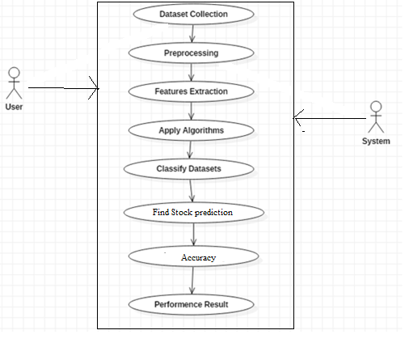
UML Diagram :Use Case Diagrams

Slide 8
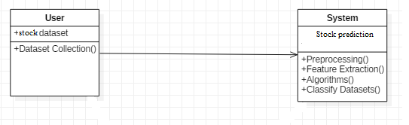
Class Diagram

Slide 9
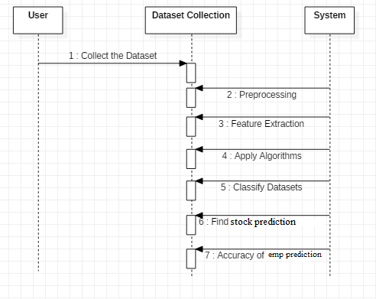
Sequence Diagram

Slide 10
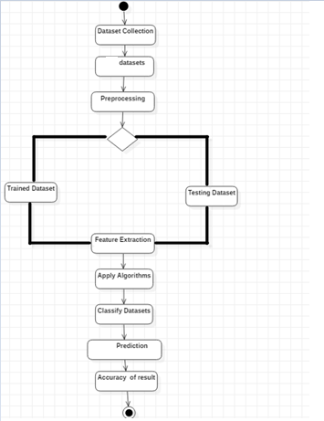
Activity Diagram:

Slide 11
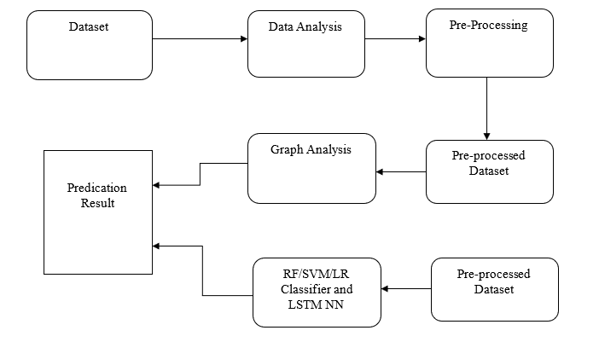
System Architecture

Slide 12
SYSTEM REQUIREMENTS :
Hardware:
Windows 7,8,10 64 bit
RAM 4GB
Software:
Python 3.x / Anaconda Navigator

Slide 13
THANK YOU

