Slide 1
From broker PDF to live marketplace listing, in one chat
FlowSpace listing bot · July to August 2026 · one engineer plus coding agents
Prabhavit Gupta · Forward Deployed Engineer conversation with Mainloop
Notes:
This is the project I want to walk you through. Eight weeks from a blank page to a live tool the operations team used, then a handover pack. I will go in your order: the mess, the functional architecture, how I built it with agents, what I put in front of people, where I said no, and what I handed over. Stop me anywhere. The slide I most want you to stop me on is the decision slide.

Slide 2
Eight businesses, seven countries, three years. Same loop each time.
UK
Spain
France
Italy
Germany
Luxembourg
Netherlands
FlowSpace
Urlink
UltraStrategy
Qomodo
Get2Germany
Clubee
Tractionboard
1
Understand the running business
2
Find the admin that eats time
3
Build with AI, hand it over
Take over a live product, sit with the people doing the work, map how it really runs.
Re-keyed listings, hand-read CVs, manual data migration: where the hours go.
Working in front of people in weeks, then a pack the next team can run without me.
TypeScript / Next.js · Laravel · Python · Claude Code · n8n · Supabase / Postgres Venice, Italy · EU long-term resident · English C2, Italian B2
Notes:
Quick who. I have worked inside eight European companies in about three years, remote and on site. FlowSpace, a London workspace marketplace, is the longest and most hands-on: I took over a live product, helped migrate it off a legacy stack onto Next.js and Laravel while members kept booking, and then built the AI listing pipeline I will show you. Before that: a CV-parsing pipeline for UltraStrategy in France, a client platform for Urlink in Barcelona where I was both project manager and builder, and search automations for Get2Germany in Berlin. The pattern is the same every time: a business that already runs, an administrative process nobody wrote down, and something working in front of them fast.

Slide 3
Experience, one page
Mar 2024 – Aug 2026
FlowSpace · Lead Developer · London (remote)
Live marketplace off a legacy stack onto Next.js + Laravel, 2,000 to 4,500+ users. AI listing bot, 900+ drafts. Support agents on live data. OfficeRnD + Nexudus booking integrations. CRM and GTM automations.
Apr – Jul 2025
Urlink · Project Manager + AI-assisted Developer · Barcelona
Built the client platform and its client-driven automations from requirements: Next.js, Supabase, Netlify.
Dec 2024 – May 2025
UltraStrategy · AI Automation Developer · France
CV-parsing and profile-assessment pipeline inside their platform: Affinda, Claude API, n8n, Eden AI; standardised Ultra CV output.
2024 – Jan 2025
Qomodo · AI Developer · Milan
Branch-management dashboard for companies; Figma designs to working UI.
Jan – May 2024
Get2Germany · Developer + Automation Specialist · Berlin
Google API integrations, AI tools that find courses, internships and jobs, database optimisation; n8n.
Sep 2023 – Aug 2024
Clubee · Developer + QA · Luxembourg
Clubee API across the frontend, unit testing and QA, shop, domain-integration and federation-dashboard tools.
Aug – Oct 2023
Tractionboard · Developer (internship) · Utrecht
OpenAI and Sendgrid integrations, responsive UI, debugging.
Ca' Foscari University of Venice, BA Philosophy, International Studies and Economics, 2020 to 2024 · Microsoft Copilot Studio Agent Academy, Microsoft Power Automate, Tray.AI Build Practitioner · Hindi native, English C2, Italian B2
Notes:
One page of where I have worked, newest first, in case it is useful to have on screen. FlowSpace is the anchor: two and a half years as lead developer, the migration and the AI work. Around it, shorter engagements where I went into someone else's product: Urlink as project manager and builder, UltraStrategy for the CV pipeline, Qomodo and Get2Germany for dashboards and search automations, Clubee for API integration and QA, Tractionboard as my first internship. No computer science degree; the shipped work carries the case.

Slide 4
The mess: one listing took 30 to 45 minutes of re-keying
What arrives
~30
Ops opens each one, finds the building, types about 40 fields, sources 5 photos, builds the offices table.
Brochure PDF
Google Sheet
operator feeds in the internal availability sheet
xlsx or SharePoint folder
Pitch deck
812
available buildings not yet on the platform
Availability email (.eml)
Operator website
30–45 min
per listing by hand, when nothing went wrong
What the feeds hid: house numbers drifting within a street (22 vs 4 City Road), 17 dead or malformed postcodes, the same suite arriving under four broker labels.
Notes:
FlowSpace lists flexible office space. Operators and brokers send availability in whatever format they have: a brochure PDF, a Google Sheet, an Excel workbook on SharePoint, a pitch deck, an email, or just their website. Someone in operations opened each one, found the building, typed about forty fields, found five photos, and built the offices table. Thirty to forty-five minutes when nothing went wrong. The internal availability sheet aggregated about thirty feeds and had 812 available buildings not yet on the platform. Sitting with that sheet is where the real findings came from. Broker feeds drift house numbers within a street. Postcodes are dead. The same suite arrives under four broker names with slightly different prices. That shaped the design more than any model choice did.

Slide 5
Functional architecture: the flow, the actors, the rules
1
Sources
2
Ingest
3
Extract
4
Build
PDF, sheet, xlsx, SharePoint, deck, email, URL
classify by magic bytes, not file name; crawl the row's own links, depth 2, 12 fetches max
Claude Haiku by default, Sonnet on a switch; fixed schema
spec.ts: every value coerced; closed amenity enum; sheet values byte-exact
5
Check prod
6
Human
7
Push
exact name, then fuzzy + operator, then postcode; UPDATE or NEW
draft card: edit, dry-run, send
two phases: space, then amenities + facilities, then offices
Operator or broker: sends
Model: extracts and drafts
Ops reviewer: decides
FlowSpace API: receives
Model output is untrusted until coerced at the boundary
Source values are byte-exact; disagreements become flags, never substitutions
Nothing reaches prod without a person
Notes:
This is the document I wrote before the TypeScript build. Seven stages. Sources come in any shape. Ingest classifies by bytes, not by file name, because a link labelled brochure is often a floor plan or a licence page, and it follows the row's own links two levels deep with hard caps on fetches, size and time. Extraction is a Claude call against a fixed schema, Haiku by default because it was good enough and cheap, Sonnet on a switch when a source is hard. Build is where the model stops being trusted: every value is coerced against a spec derived from the production database, and anything from the source sheet stays byte-exact; if the model disagrees with the sheet, that becomes a flag on the card, not a substitution. Then we check prod: is this building already live? That decides update versus create. Then a person sees a card and decides. Then a two-phase push to the FlowSpace API. Four actors, three rules. Everything else in the project is an implementation of this slide.

Slide 6
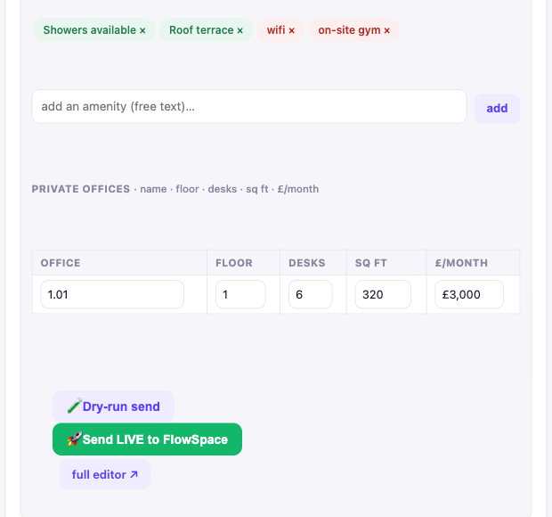
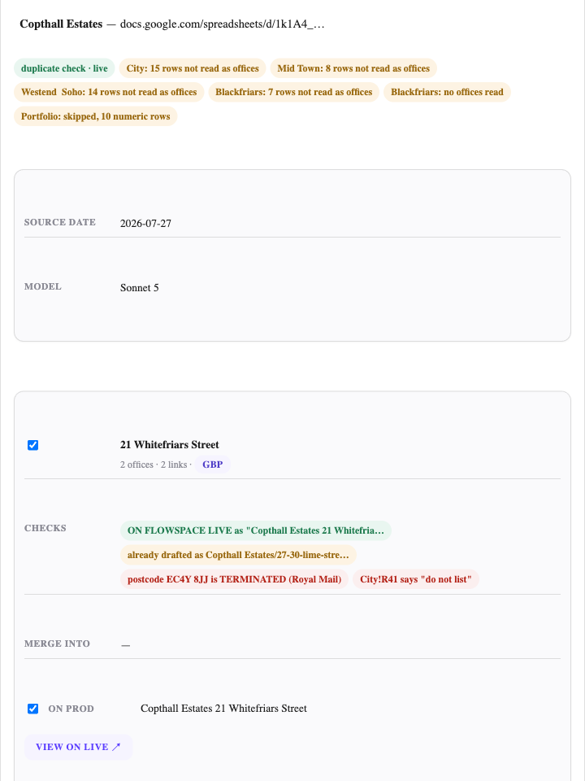
What the reviewer sees
Chat draft card, lower half: amenity chips (green mapped to the catalogue, red unmapped and never force-fit), the offices table, and Dry-run vs Send LIVE.
Batch checkpoint for a whole broker workbook: ON FLOWSPACE LIVE, already drafted, postcode TERMINATED, operator note “do not list”.
Notes:
Two surfaces. On the left, the chat card: name a building, attach the brochure or paste the sheet link, and you get a card you can edit. Red chips are amenities the model found that our catalogue does not have; they stay red rather than being forced into the nearest match. Dry-run shows the exact API calls without sending anything. On the right, the batch checkpoint for a whole broker workbook. Each building carries its checks before drafting: already live on production, already drafted under another broker's name, a dead postcode, an operator note saying do not list. The reviewer resolves these first. Both screens exist because the first version of review, a separate page, was slower than reviewing inside the conversation, so I removed it after a week.

Slide 7
The decision to stop me on: nothing reaches prod without a person
Claim — Three gates, all closed by default: dry-run is on unless switched off; every card needs a person to press Send; batch auto-push sits behind three switches and ships off.
Check prod first — exact, then fuzzy, then postcode; update, do not duplicate. 916 backlog rows became 446 UPDATE and 375 NEW.
Why — A wrong price or address goes public under an operator's brand. Inputs arrive in six formats from thirty feeds with known defects. A slow listing costs minutes; a wrong one costs trust.
Untrusted model output — coerce at the boundary. 550 drafts once carried a bad tenure value; an enum guard caught it before push.
Cost — Throughput. Over 900 drafts produced, 114 sent live. Review time per card remains.
Photos on Supabase, not backend S3 — shipped, measured 720x405 on live, reverted the same week, wrote the re-instate condition.
What would change my mind — The correction log (AI draft vs the human's final edit, recorded at push) showing a field the reviewer never touches. Loosen per field, not globally.
Migration per entity — live entities by API sync, frozen records by one-time CSV; per-entity cutover, not one weekend.
Notes:
If you stop me anywhere, stop me here. The obvious alternative was auto-publish, and the volume argument for it is real: eight hundred buildings waiting. I kept three gates closed by default. Dry-run is on unless you switch it off, and it shows you the exact calls that would be made. Every card needs a person to press Send. The batch auto-push exists, but behind three separate switches, and it ships off. The reason is what a wrong listing costs: a wrong price or a wrong address goes public under an operator's brand, and the inputs come from thirty feeds I had already caught drifting house numbers. The cost is honest: over nine hundred drafts, a hundred and fourteen live. What would change my mind is data, not confidence. I built a correction log that records the AI draft against the human's final edit at push time. When a field shows zero corrections over a few hundred pushes, that field earns auto-publish. Per field, not globally. There are four more decisions on the right if you would rather pull on one of those.

Slide 8
Built with agents: eight weeks, one engineer
2 Jul
8 Jul
20 Jul
29 Jul
31 Jul
13 Aug
Python prototype pipeline
TypeScript app started
live on Vercel, listing.flowspace.co
batch acceptance run, 12 of 12
handover pack
backlog consolidated
143
How
Claude Code daily. Agents routed by cost: a cheap model locates and does small edits, a mid model drafts and reviews, the top model decides architecture. Standing rules live in hooks, not in prompts.
Test-first against the Python prototype: regenerate its output as fixtures, watch parity go red, port until green.
Anything touching the live push path: own branch, forked route, additive-only shared library. The live route stays byte-identical until the new one proves itself.
commits
600+
tests, plus 20 parity checks against the Python prototype over 77 real listings
12 / 12
buildings drafted in the acceptance run, 65 photos verified by full download
Agents are fast and confident when wrong. One agent per building, and verify on disk, not on the agent's report.
Notes:
Timeline first. Second of July, a Python prototype of the pipeline. Eighth of July, I started the TypeScript app that became the product. Twentieth, live on Vercel. Twenty-ninth, the batch flow passed an acceptance run on a real broker workbook: twelve of twelve buildings, sixty-five photos verified by downloading every one. Thirty-first, the handover pack. Thirteenth of August, the backlog consolidated. One engineer, using coding agents all day. How: agents are routed by cost. A cheap model finds files and makes small edits, a mid-tier model drafts and reviews, the top model only for architecture and anything touching production data. My standing rules live in hooks so I never restate them. I tested against the Python prototype: regenerate its output as fixtures, port until parity is green; that is the twenty parity checks over seventy-seven real listings. For anything on the live push path I never edited the live route: own branch, a forked copy of the route, and shared code changes that are additive only. The lesson I would underline: agents are fast and confident when wrong. When I ran drafting agents in parallel, a parent agent that delegated to children could not tell me whether they had finished. So: one agent per building, and the source of truth is what is on disk, never what the agent reports.

Slide 9
Saying no, and handing over
Held back on purpose
Handover pack, 31 July 2026
31 units listed by a code instead of an address. Every route to identify them was tried and written down; I refused to guess, because a wrong guess publishes a real building under someone else's floor.
README — what is finished, what is left, what cannot be run from where you are
STATE — counts, verdicts, two pipeline bugs found and closed
PIPELINE — how to resume the machinery
23 update candidates paired to the wrong live building. Flagged, not pushed.
DEFECTS_FOR_TEAM — source-sheet bugs to fix upstream
PROD_CLEANUP — 13 duplicate pairs live on the site
7 of 10 Runway East sites already live. Paused, not drafted.
OPEN_ACTIONS — the human to-do list, with draft emails
9 drafts left with tenure null. Evidence did not resolve; null means nobody could tell, not nobody looked.
ledgers and validators — the working record, verbatim
114 live · 445 create drafts + 134 update candidates as proposals · roughly 450 to 675 hours of re-keying turned into minutes of review
Notes:
Two things your ad says most teams skip. Saying no, with reasons. Thirty-one units arrived as a code instead of an address. I tried every route to identify them, wrote each one down, and held them back, because a wrong guess publishes a real building under someone else's floor. Twenty-three update candidates turned out to be paired to the wrong live building; they are flagged and were never pushed. For Runway East, seven of ten sites were already on the platform, so I paused them rather than draft duplicates. Nine drafts kept a null tenure because the evidence genuinely did not resolve, and the spec says null means nobody could tell, not nobody looked. Then the handover. On the thirty-first of July I wrote a pack for people who were not in the room: what is done, what is left, how to resume, the defects report for the team that owns the source sheet, the duplicates already live, the open actions with the emails already drafted. Outcome: a hundred and fourteen live, five hundred and seventy-nine proposals waiting on a human, and roughly four hundred and fifty to six hundred and seventy-five hours of re-keying replaced by a few minutes of review per card.

Slide 10
Same loop, other businesses
UltraStrategy · France · 2024 to 2025
FlowSpace · London · 2024 to 2026
Urlink · Barcelona · 2025
Mess — Recruiters reading every CV by hand; no comparable format across candidates.
Mess — A live marketplace on a legacy stack; members booking every day during the migration.
Mess — Client requirements, no specification, a platform to build.
Built — CV-parsing pipeline inside their platform: upload, Affinda extraction, Claude assesses relevance per role type, result shown in the frontend, then a standardised Ultra CV is generated. n8n and Eden AI in the workflow.
Built — Next.js and Laravel, with the per-entity data migration automated.
Built — The platform and its client-driven automations, AI-assisted: Next.js, Supabase, Netlify.
Decision — Three separate steps, extraction, assessment, generation, so each could be checked on its own.
Decision — API sync for anything still changing (bookings, users), one-time CSV for frozen records; each entity cut over on its own date. 2,000 to 4,500+ users.
Decision — One seat for project manager and builder: write the requirement with the client, then build it.
Also at FlowSpace: support agents answering from live platform data with escalation on low confidence; OfficeRnD and Nexudus booking integrations; CRM and go-to-market automations in n8n. Earlier: Get2Germany (Google APIs, n8n search tools), Clubee (API integration, QA), Qomodo (dashboards), Tractionboard (OpenAI, Sendgrid).
Notes:
The listing bot is the deepest example, but the loop is the same elsewhere. UltraStrategy in France: recruiters were reading every CV by hand. I built the parsing pipeline into their platform: a candidate uploads a CV, Affinda extracts it, Claude assesses relevance per role type, the result shows in the frontend, and a standardised CV is generated. I kept extraction, assessment and generation as separate steps so each could be checked on its own. FlowSpace, the migration: a live marketplace moving off a legacy stack while members booked every day. The decision you already have from my application: anything still changing synced through the API until cutover, anything frozen went by CSV once, and each entity cut over on its own date instead of one weekend. Urlink in Barcelona: a client with requirements and no spec, so I sat in one seat as project manager and builder. Requirement with the client, then build it. Underneath those: support agents on live data, the OfficeRnD and Nexudus booking integrations, CRM and go-to-market automations, and earlier roles in Germany, Luxembourg and the Netherlands.

Slide 11
What I would do differently, and what I want to ask you
Would change
Questions for you
One store, not two. Listing rows in Neon and photos plus review sessions in Supabase grew from constraints, and every newcomer asks why.
The reverse check, prod against source, never shipped: the API searches names, not postcodes.
The correction log was built and never switched on, so the data to loosen the gates was never collected.
114 live listings still carry an untyped tenure; fixing them is one admin edit each.
How does your portfolio code-intelligence agent answer “what of ours already does this”, and how often is it wrong?
What is the MVP bar at handover, and what does the Tech Lab most often send back?
How do you size a benefit in week one when nobody has measured the manual process?
Notes:
What I would change, so you do not have to find it. Two data stores instead of one; they grew from constraints, and every newcomer asks why. The reverse check, production against source, never shipped, because the API I had could search names but not postcodes. The correction log was built and never switched on, so the data I said would loosen the gates was never collected. And a hundred and fourteen live listings still carry an untyped tenure from an early brief error; fixing them is one admin edit each. Then three questions for you, if we have time.

Slide 12
Appendix: numbers and where they come from
Figure | Source
~30 feeds, 812 backlog buildings, 480 to draft, 134 update candidates, 445 drafted, 31 held back, 114 sent | Handover pack README and STATE, 31 Jul 2026
17 dead postcodes, house-number drift, 22 duplicate suite pairs | Handover DEFECTS_FOR_TEAM
916 rows = 821 buildings; 446 UPDATE / 375 NEW | Backlog consolidation, 13 Aug 2026 (scripts/backlog-sessions.ts)
143 commits, 8 Jul to 13 Aug 2026 | git log, flowspace-listing-web
600+ tests, 20 parity checks, 77 seeded listings | tests/ directory, PORT_LEDGER.md
12 of 12 buildings, 65 photos verified | Batch acceptance run, 29 Jul 2026 (Copthall workbook)
550 drafts with a bad tenure value; 2,038 offices affected | Handover STATE, pipeline bug 1
720x405 vs up to 2560 px; revert commit aa06b05 | git show aa06b05, 22 Jul 2026
900+ drafts; 30 to 45 min per listing by hand | Consolidated backlog; my own estimate of the manual process
2,000 to 4,500+ users; company dates and stacks | My CV and experience record
Notes:
Backup slide. Every number on the previous slides with the file or commit it comes from, in case you want to pull on one.

