Slide 1

Team : Shemakes.py
Team Members: Diksha Walia
Prabjot Kaur

Slide 2
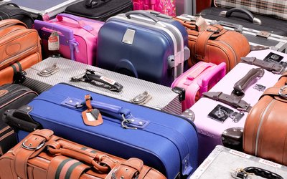
Problems Covered
According to the annual report of airline information technology company SITA on airline baggage handling, 6 bags per 1,000 passengers were mishandled last year. That's down 12.5 percent year over year. About 26 billion bags get misplaced each year. This number is huge and this problem cost large amount of money to airlines.

Slide 3
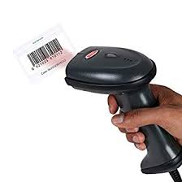
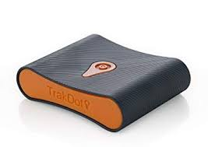
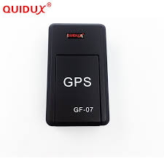
Present Solutions
The most popular methods are long-range tracking solutions like LugLock and Trakdot, and new luggage with built-in sensors. Trakdot, a $49 gadget uses cellular technology to keep tabs. In order to use Trakdot's mobile app, you need cellular service or access to Wi-Fi. It also needs batteries which supply power to the system.
The next evolutionary step in tracking technology is luggage with the systems already built in. The bags, called "smart" luggage, use a variety of technologies, including global positioning (GPS) and Bluetooth, to round up lost bags.
The biggest names in smart luggage are Bluesmart and Raden. Bluesmart's One carry-on, for example, uses integrated GPS technology to follow your valuables, with no monthly service fee. Raden's A22 Carry ($295) uses Bluetooth technology to track your bag in an airport. Both have their own apps that can find and even weigh your luggage.
Existing solutions also include baggage tracking with the help of barcodes.

Slide 4
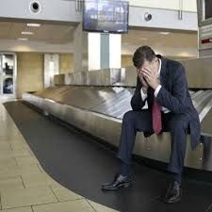
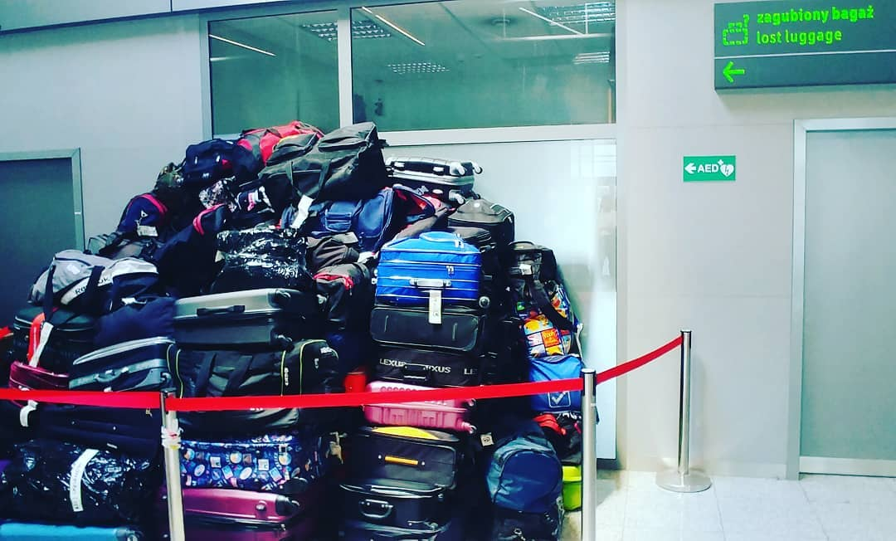
Limitations of present solutions
Although solutions like Trakdot do indeed last long enough for an entire lengthy trip with full service on a single charge, it does require two AA batteries. This inherently increases the total cost of ownership, especially if the person travel often and purchase durable batteries. Apart from this it won’t be able to track luggage if it does not have access to cellular network or WiFi.
Barcode scanners need direct line of sight to detect the codes and may produce erroneous solutions.
GPS trackers also need batteries and constant connectivity which is impossible to achieve when the aircraft is flying.

Slide 5
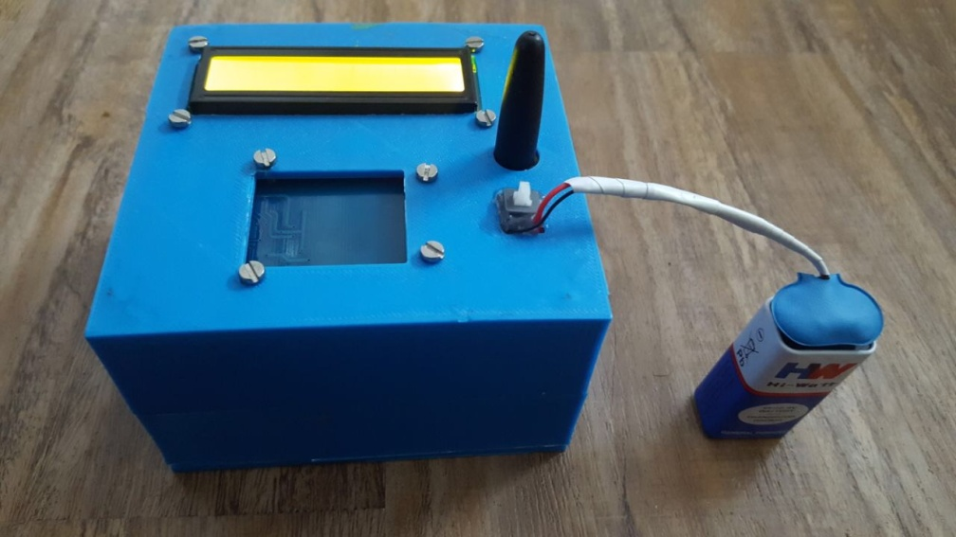
Proposed Solution
RFID tag readers will be placed at various places such as at security check in, where bags are loaded at the plane, where bags are deloaded from plane, when they are placed on the conveyer belt etc. When the bag crosses each of these stages a corresponding message will be sent to the respective passenger as well as airport staff about the status of bag. Also when the baggage taps on first card reader, entire information of that passenger will be stored in the database created for the airline which will further help the airline to provide better services and will reduce paper work and make entire system digital. If a baggage gets misplaced in the process, it becomes much easier to relocate it as we know exactly the stage at which it had got misplaced.

Slide 6
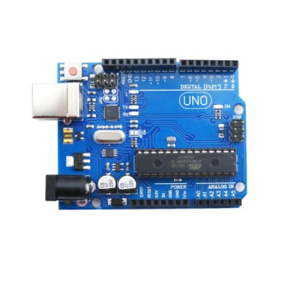
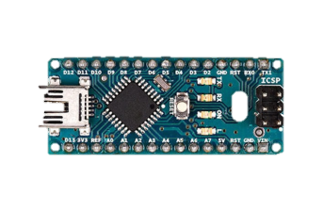
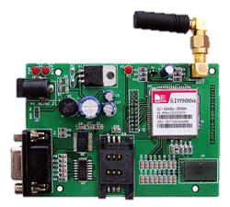
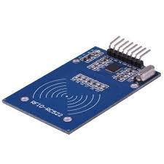
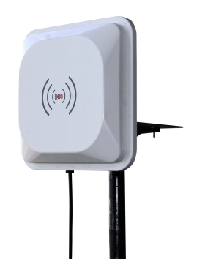
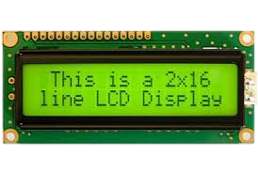
Arduino UNO/Nano
OR
Power Supply
OR
RC522/UHF Rfid
GSM
LCD

Slide 7
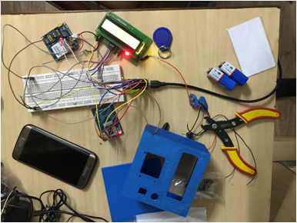
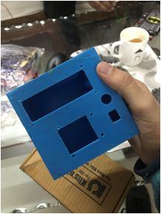


Slide 8
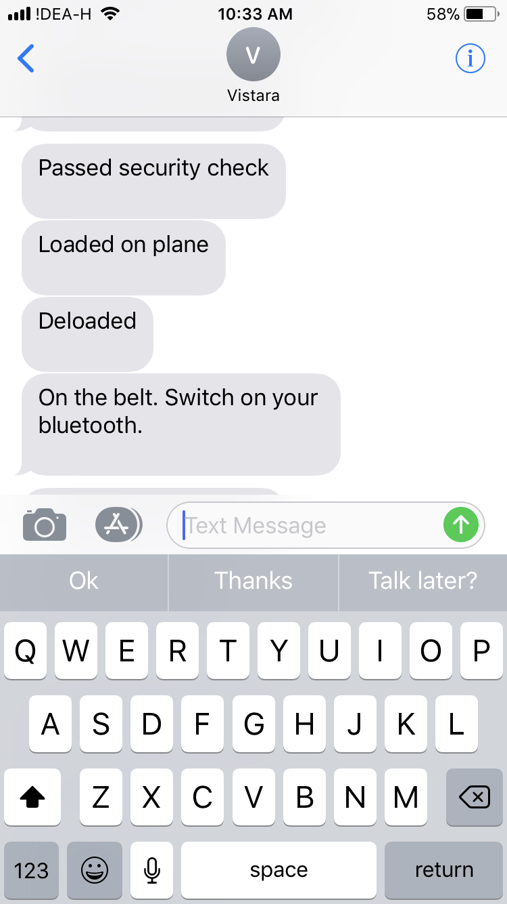
CP1
CP2
CP3
CP4
Customer’s Mobile

Slide 9
Advantages
Advantages of using RFID based tracking system are as follows:-
Allows passengers to track baggage in real-time and creates passenger loyalty
Lower the number of delayed and lost baggage, which have a potential saving of at least $100 per bag.
Decrease need for manual processing, which helps you free up staff for other value adding tasks
Full compliance of IATA 753 done in the most cost-effective way
Shorter loading/off loading time with automatic on and off-load scannings, which results in a reduction of ground time and a higher average miles pr. seat.
Better read rates on transfer bags, which increases capacity and enables growth without new infrastructure investments.
Not requiring line-of-sight reading unlike barcodes
Read points are relatively low cost
Can be read from a distance
RFID tag does not tear apart from handling
Can read multiple tags simultaneously, unlike barcodes
Can read bag tags more accurately and efficiently compared to barcodes
Readers are easy and cost-effective to deploy

Slide 10
Thankyou

