Slide 1
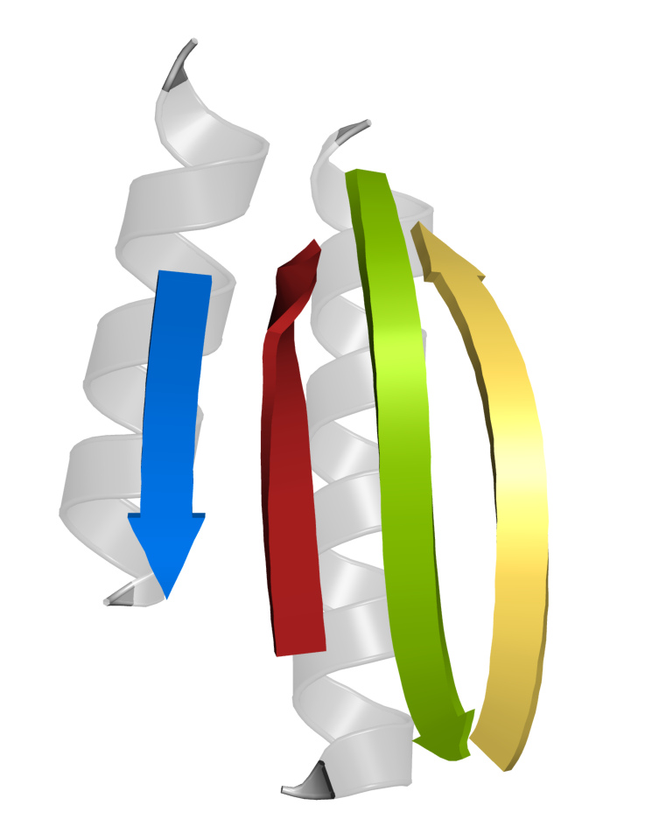
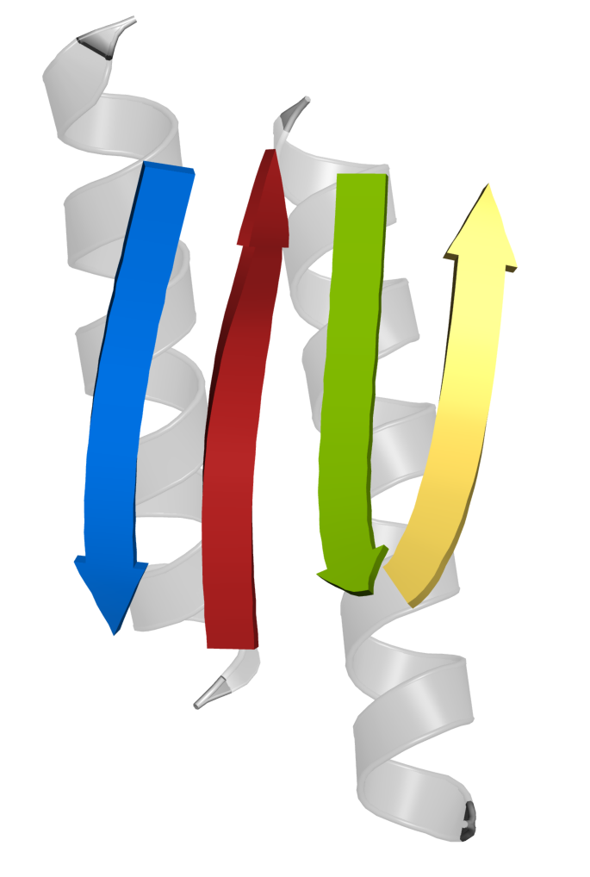
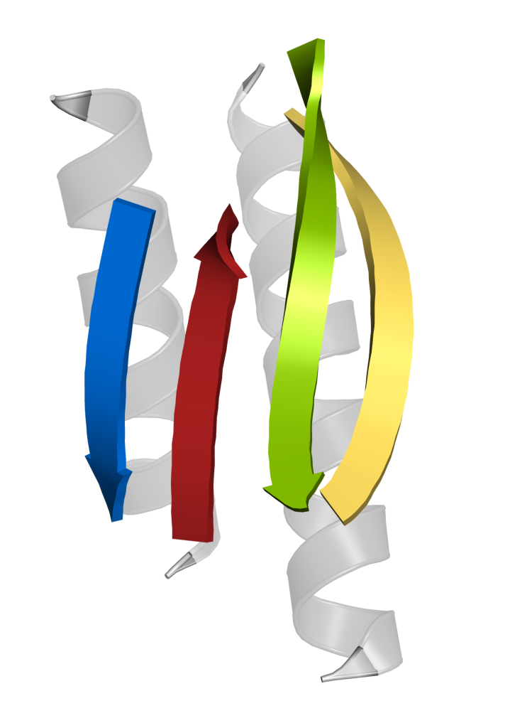
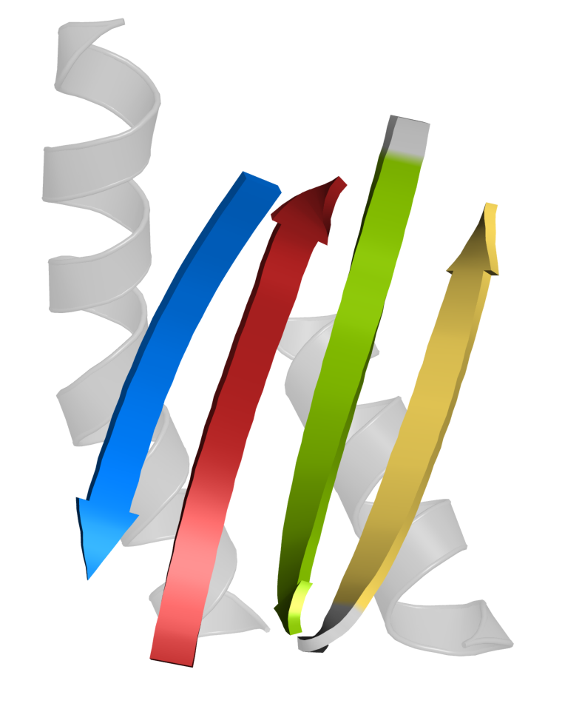
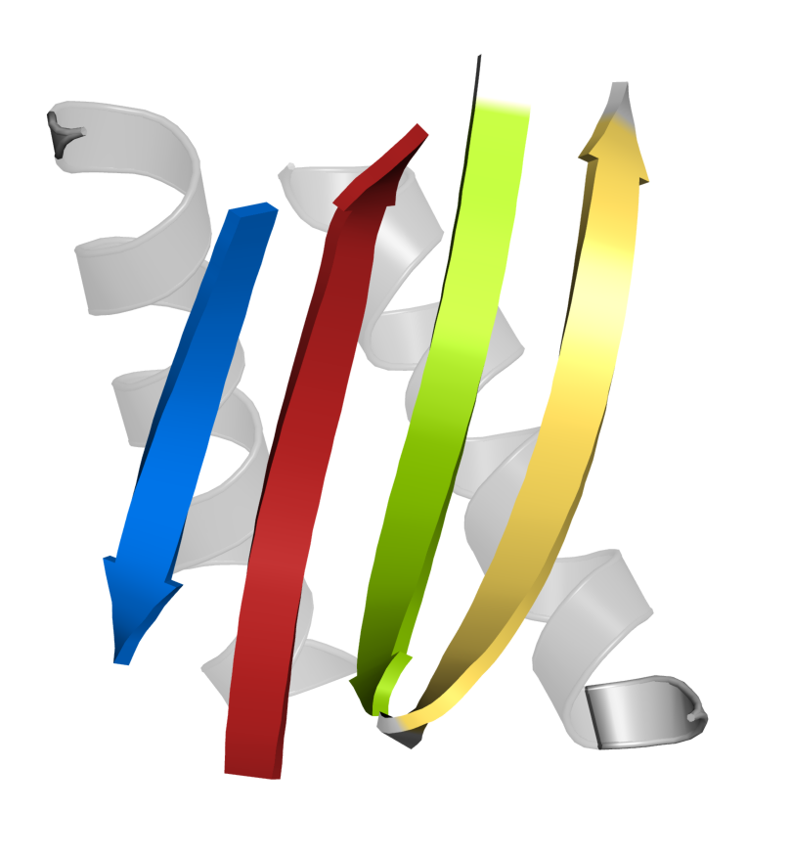
(a)
LNG
XM2H
AM2M
Pol IV LF
Dbh LF
(b)
Figure 1. Three designed proteins and two natural Y-family polymerase little-finger domains share the same H2E4 topology. (a) Experimental structures of LNG (9BK5:A), designed by RFdiffusion against α-cobratoxin, XM2H (7DKK) and AM2M (7DKO), designed by SCUBA from an architecture sketch with no target, and the natural little-finger domains of Pol IV (4R8U:A, residues 233–341) and Dbh (1K1S:A, residues 240–341), shown in a common orientation after superposition onto Pol IV LF. Only the principal secondary-structure elements are displayed; connecting loops and terminal extensions are omitted. Strands are numbered in polypeptide-chain order and coloured E1 blue, E2 green, E3 yellow, E4 red; helices are grey. (b) Schematic of the topology shared by all five structures. Connectors indicate chain connectivity, E1-H1-E2-E3-H2-E4; the four-stranded sheet is antiparallel with the non-sequential spatial strand order E1-E4-E2-E3.

