Slide 1

Rented Wheels
Proposed By:
Binamra Acharya (181707)
Prabesh Pokharel (181727)
Sunandan Ghimire (181745)
Aakriti Thapa (181701)

Slide 2
Introduction
Rented Wheels is a web platform for renting and adding vehicles for rental purposes.
Users can create accounts, search for available vehicles, and book them for a specified duration.
Vehicle owners can also register their vehicles on the platform, set rental prices, and manage bookings.
The platform has a seamless booking process, payment options, and a feedback system for customer satisfaction.
Features such as service ratings, vehicle filtering, and personalized recommendations enhances decision-making for users.

Slide 3
Problem Statement
Manual procedures for generating monthly or annual reports in a vehicle rental service can be laborious and challenging due to a large number of clients.
Some platforms require users to provide extensive information and wait for a quote, making it impossible to rent a vehicle in an emergency.
Even the most prominent sites aren’t transparent about vehicle’s availability prior to booking.
Manual procedure means more paper works and tedious process.
Most prominent sites do not have any rating and review features that would make users aware about the condition of vehicle they are using.

Slide 4
Project Objectives
To develop a user-friendly web-based system for affordable vehicle rental and management which includes recommendations for vehicles with excellent functionality and the best user experience.
To design a system that assists users in managing vehicles, featuring payment processing and a scalable platform which can accommodate increasing demand and expand to new markets.

Slide 5
Scopes and Limitations
Scopes:
Our platform provides a user-friendly interface for renting a diverse range of vehicles based on specific requirements.
The implementation of a vehicle filtering.
The ability to access, change, or delete information is restricted for unregistered members or users.
Online payment with service ratings and personalized recommendations improve the rental experience.
Administrators can monitor usage, analyze sales data, and identify improvement opportunities through our platform.

Slide 6
Scopes and Limitations
Limitations:
It is not possible to monitor the movement of vehicles.
Customers need to log in before they can rent a vehicle.
There is no availability of chat feature that allows users and admin to connect with each other.
You have to provide information every time you wish to make a vehicle reservation

Slide 7
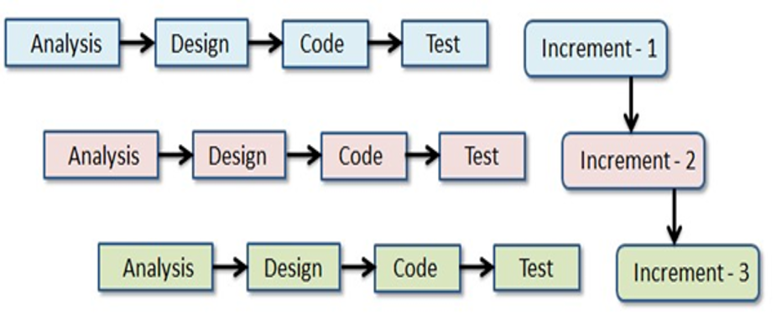
Methodology
Why Iterative and Incremental Model?
Iterative development is a process of creating software in small, frequent increments, incorporating new features with each iteration. It enables better management of changing requirements and results in a polished, comprehensive system over time.
Incremental Development Model

Slide 8
Programming Languages and Other Tools
Programming Language
JavaScript
Java
Python
Database
MY SQL
Core Libraries and Frameworks
Front End - React JS , Tailwind CSS
Back End - JAVA Spring Boot

Slide 9
Recommendation System
We have used Content-based filtering algorithm for recommendation purpose in our system.
This algorithm suggests items to users based on the similarity of their attributes or content.
The overview of the recommendation algorithm in our system are:
Data Collection
User Profiling
Similarity Calculation
Recommendation Generation
Personalization and Feedback

Slide 10
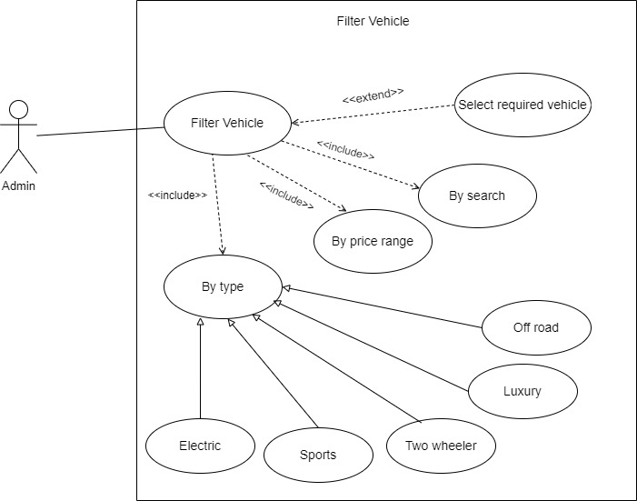
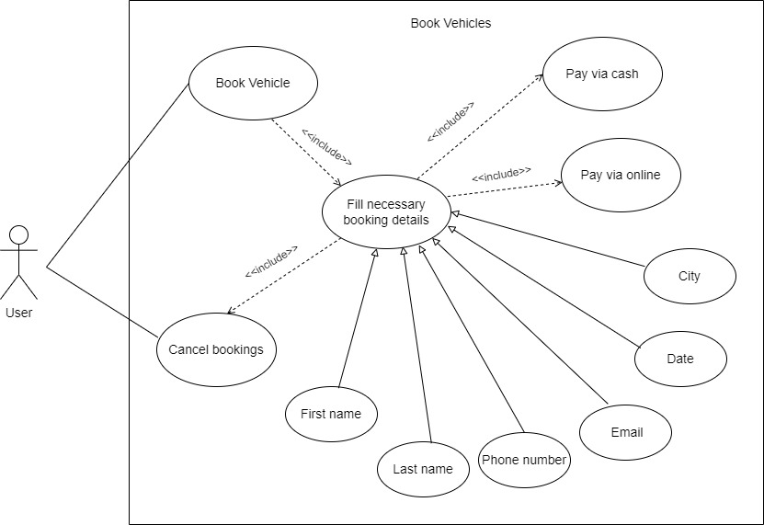
Use Case Diagram

Slide 11
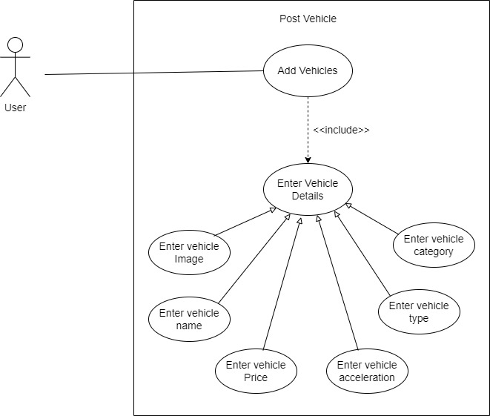
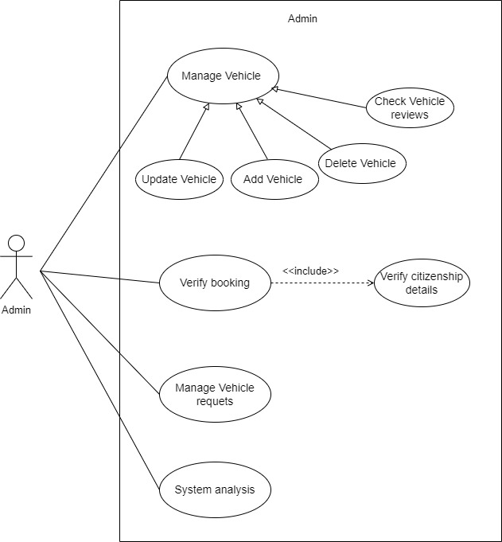

Slide 12
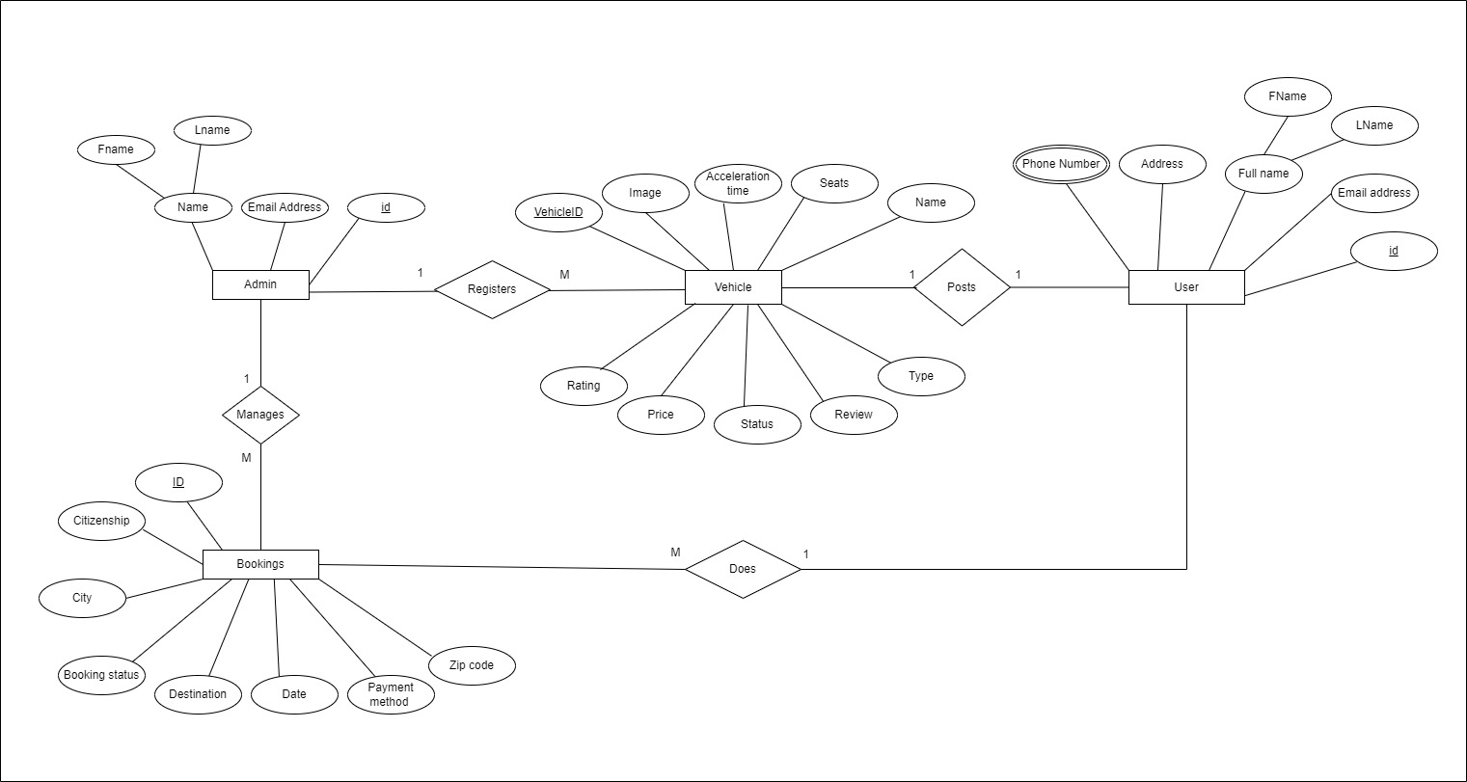
ER Diagram

Slide 13
Time Scheduled
Task | Iteration 1 | Iteration 2 | Iteration 3 | Total Approximated Duration (in days)
Requirements Analysis | 4 | 2 | 2 | 8
System Design | 3 | 3 | 2 | 8
Coding | 11 | 11 | 9 | 31
Overall System Test | 3 | 2 | 2 | 7
Producing Documentation | 4 | 4 | 3 | 11

Slide 14
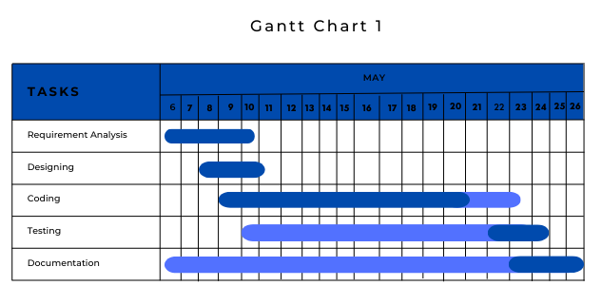
Gantt Chart For Iteration 1

Slide 15
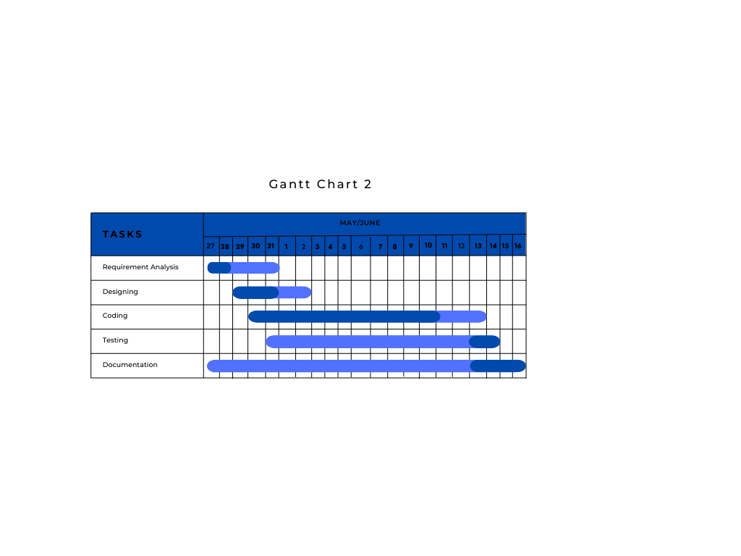
Gantt Chart For Iteration 2

Slide 16
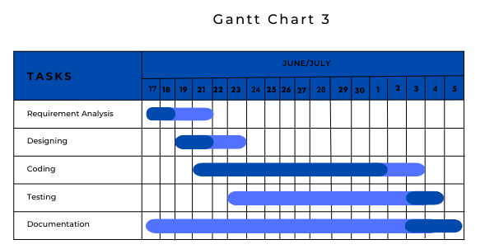
Gantt Chart For Iteration 3

Slide 17
Project Output
User authentication, i.e. signing in and signing up.
Ability to rent two wheelers and four wheelers for number of days.
Customer has the facility to cancel the booking if he wishes to.
Customers can narrow search using filter.
Admin can view all the details of the bookings made.
Users have option to rent their own vehicles.
Recommendation for vehicles based on vehicle type is presented to the user.
Online payment methods is also available.
At the end of booking customer can rate and review our service.

Slide 18
Further Works
Develop an engaging Android/iOS app to boost user interaction.
Introduce notifications for booking reminders and important rental updates.
Enhance user experience through iterative improvements based on feedback and usability tests.

Slide 19
Thank You

