Slide 1
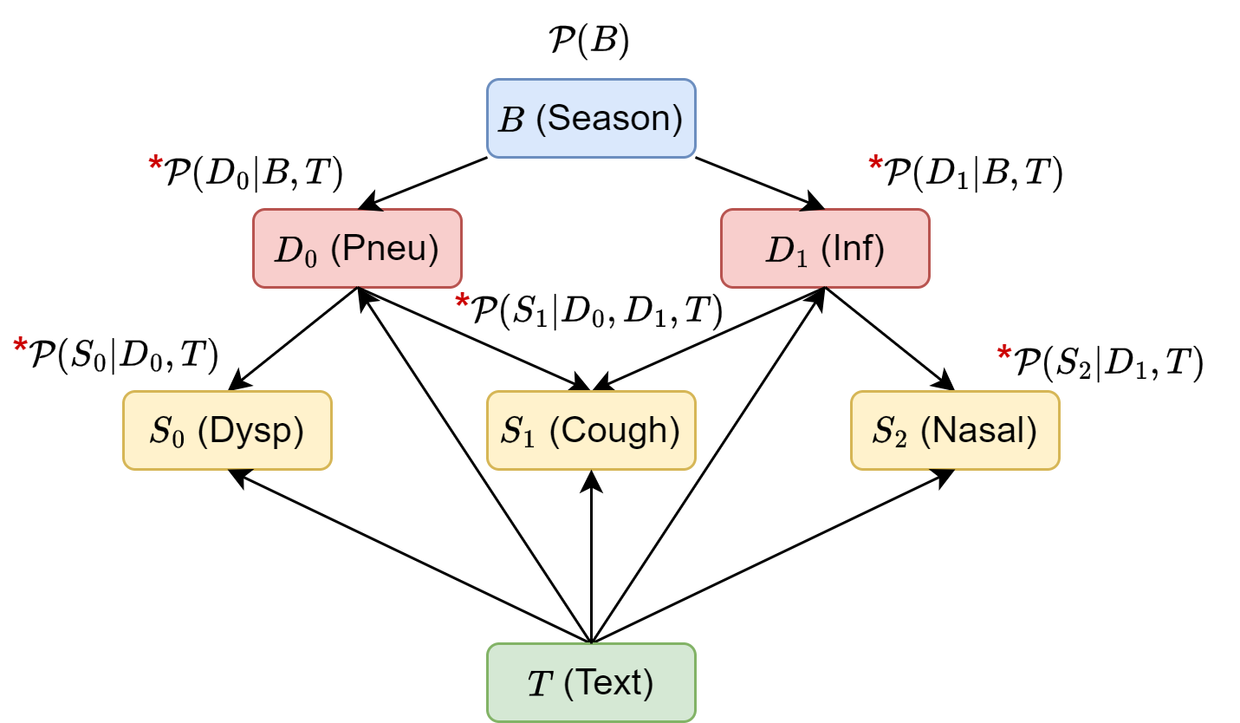




Clinical Reasoning over Tabular Data and Text with Bayesian Networks
Paloma Rabaey, Johannes Deleu,
Stefan Heytens, Thomas Demeester
Research funded by

Slide 2

You’re not feeling well…
Clinical Reasoning
Coughing could mean a common cold… However, they don’t have any nasal symptoms, which occurs in 70% of patients with common cold. High fever is alarming, especially combined with dyspnea and long-term cough… Maybe pneumonia? Do they experience pain related to airways? Yes? Then it must be pneumonia. I better prescribe antibiotics to be sure it doesn’t evolve into something worse...
Symptoms
Fever (39°C/102°F)
Trouble breathing
Cough for a week
No runny nose or sneezing
Diagnosis: pneumonia
Notes:
Imagine that a week ago, you started coughing. You thought nothing of it, until other symptoms started to arise. Yesterday, you woke up with a high fever, of 39 degrees Celsius (102 Fahrenheit). Throughout the day, you also started to experience difficulty breathing. By now you are pretty worried, so you go to the doctor and tell him your symptoms. At this point, whether consciously or subconsciously, a mental process kicks in for the clinician, called clinical reasoning, where they take in all these symptoms, and integrate it with their own medical knowledge to put the puzzle pieces together. In this case, the clinician decided that there is a high chance you have pneumonia, which warrants prescribing antibiotics and further follow-up.

Slide 3
You’re not feeling well…
Back- ground
Diag- noses
Symp- toms
P(Pneu=yes|Season=summer) = 0.005
Bayesian network
Season
Pneu
Inf
Symptoms
Fever (39°C/102°F)
Trouble breathing
Cough for a week
No runny nose or sneezing
Dysp
Cough
Fever
Pain
Nasal
P(Dysp=yes|Pneu=yes) = 0.3
P(Dysp=yes|Pneu=no) = 0.05
P(Nasal=yes|Inf=yes) = 0.7
P(Nasal=yes|Inf=no) = 0.2
Notes:
Of course, a doctor is only human, and certain biases and lack of knowledge in particular areas, can cause them to arrive at an incorrect diagnosis. To help doctors avoid these pitfalls, it can be helpful to partially automate the process of clinical reasoning. For this, Bayesian networks are the perfect candidate. These define a graphical structure over some relevant variables. For example, in our case, they relate a background factor with two possible diagnoses (pneumonia and upper respiratory tract infection, better known as common cold) to relevant symptoms. This structure makes it easy to define conditional probability for all variables which are directly related. For example, we could fill in that the prior probability of encountering a patient with pneumonia in summer is only 0.5%. Furthermore, within the population of people with pneumonia, the probability of experiencing dyspnea or shortness of breath could be 30%, while in the general population of a certain physician’s practice, it could be only 5%. Note that these probabilities could either be filled in by an expert or be learned from a dataset.

Slide 4
You’re not feeling well…
P(Pneu = yes | Dysp=yes, Cough=yes, Fever=high, Nasal=no, Season=summer)
= 0.94
summer
Season
∑
Inf=no
Inf=yes
?
P(Pneu=yes | Season=summer)
Pneu
Pneu
Inf
Symptoms
Fever (39°C/102°F)
Trouble breathing
Cough for a week
No runny nose or sneezing
Dysp
Cough
Fever
Pain
Nasal
yes
yes
high
no
P(Dysp=yes | Pneu=yes)
P(Cough=yes | Pneu=yes, Inf=?)
P(Fever=high | Pneu=yes, Inf=no)
P(Fever=high | Pneu=yes, Inf=?)
P(Nasal=no | Inf=?)
P(Cough=yes | Pneu=yes, Inf=no)
P(Nasal=no | Inf=no)
P(Cough=yes | Pneu=yes, Inf=yes)
P(Fever=high | Pneu=yes, Inf=yes)
P(Nasal=no | Inf=yes)
Notes:
Then, we could fill in all the evidence we have, and use the Bayesian network to get the probability of pneumonia. The inference procedure combines all the probabilities for the evidence that it has, summing out the variables about which nothing is known, in this case infection. In the example, the bayesian network arrives at a probability of 94% for pneumonia given all the available evidence, just like the clinician did. Note that we automatically have an assessment of confidence in this diagnosis, due to the probabilistic nature of the Bayesian network.

Slide 5
Bayesian Networks (BNs) are ideally suited for automated clinical reasoning
Why?
Model complex problems involving uncertainty
Interpretable graphical structure
Combine data and expert knowledge
Season
Pneu
Inf
Dysp
Cough
Fever
Pain
Nasal
However, limited adoption in clinical practice due to their inability to deal with realistic medical data
Notes:
To summarize, there are multiple reasons why Bayesian networks are ideally suited to automate clinical reasoning. Why is this? They can model complex problems involving uncertainty, they have an interpretable graphical structure, and they can combine data and expert knowledge (where the expert knowledge is used to build the structure, and the data can be used to learn each conditional probability). However, there seems to be limited adoption of these Bayesian networks in clinical practice. We believe that this is due to their inability to deal with realistic medical data. What do I mean by this?

Slide 6
Electronic Health Records are a mix of tabular data and unstructured text
Electronic Health Records
Encoded, Tabular
Electronic Health Record
Consultation 11/07
Primary complaint: dyspnea
Diagnosis: pneumonia
Treatment: antibiotics
Patient has been coughing for the past few days.
Yesterday morning, they woke up with a high fever and could not go to work.
Throughout the day, breathing started to become difficult. The patient described a pressing feeling on the chest when taking deep breaths. No complaints of runny nose or sneezing.
Symptoms
Fever (39°C/102°F)
Trouble breathing
Cough for a week
No runny nose or sneezing
Free
text
Notes:
Let’s go back to our example. During the consultation, the clinician will store some key points of the consultation in their electronic patient record. Usually, they will note down the primary complaint and diagnosis, any objective measurements, and the treatment they prescribed. These things will be encoded using a disease or symptom code part of a universal system, such as ICD-10. Since encoding everything takes a large effort, many symptoms will not be encoded. However, most clinicians write down the key points of the consultation in free text. This means that patient electronic health records consist of two parts: an encoded, tabular portion and a free text portion.
Note that some parts of the free text are also encoded but the text conveys additional context, for example with the symptom dyspnea. Other parts of the text are not encoded at all, and some parts of the encoded portion are not described in the text either. We want Bayesian networks to be able to deal with these mixed data types.

Slide 7

Joint clinical reasoning over structured tabular data and unstructured text
Tabular data
Dyspnea = yes
Season
Text
?
Patient has been coughing for the past few days.
Yesterday morning, they woke up with a high fever and could not go to work.
Throughout the day, breathing started to become difficult. The patient described a pressing feeling on the chest when taking deep breaths. No complaints of runny nose or sneezing.
Pneu
Pneu
Inf
Dysp
Dysp
Cough
Fever
Fever
Pain
Nasal
yes
Text
Text
Notes:
In other words, our goal is to do joint clinical reasoning over structured tabular data and unstructured text. For example in this case, we have the dysp symptom directly from the tabular data, but the others (cough, fever and nasal) are implicitly mentioned in the text. Importantly, we don’t want to first extract these other symptoms from the text, and then fill them in as tabular symptoms. Rather, we want to keep the text as is, and reason over it together with the tabular symptoms to reach a diagnosis.

Slide 8
Artificial dataset for pneumonia prediction
Season
Expert-defined…
Causal structure
Conditional probability tables
Pneu
Inf
Generate text with ChatGPT
Dysp
Cough
Fever
Pain
Nasal
 | Pneu | Inf | Season | Dysp | Cough | Fever | Pain | Nasal
0 | No | No | Warm | No | No | None | No | No
1 | No | No | Warm | Yes | No | Low | No | No
2 | No | Yes | Cold | No | Yes | None | No | Yes
 | Pneu | Inf | Season | Dysp | Cough | Fever | Pain | Nasal | Text
0 | No | No | Warm | No | No | None | No | No | Patient complaining of abdominal pain after eating; referred for further evaluation.
1 | No | No | Warm | Yes | No | Low | No | No | Patient reports shortness of breath on exertion for the past two weeks. No associated cough or chest pain. Low-grade fever occasionally present.
2 | No | Yes | Cold | No | Yes | None | No | Yes | Patient presents with a dry cough and sneezing.
Notes:
Before I reveal how we will do this, let’s take a small detour. In order to build a prototype of such a system, we needed a dataset. Since real clinical datasets with free unstructured text are hard to obtain due to privacy reasons, we made our own dataset, ensuring that its characteristics are realistic. The use case we considered is the one in our running example, where a general practitioner is tasked with distinguishing pneumonia from a common cold. We used a ground truth bayesian network defined by an expert to generate the diagnoses, symptoms and background. We then used the GPT3.5 language model to automatically generate some short descriptive texts for each of the symptom combinations.

Slide 9
Artificial dataset for pneumonia prediction
Mix of unstructured text and structured tabular variables
Some symptoms are partially encoded
Some symptoms are never encoded in tabular form
 | Pneu | Inf | Season | Dysp | Cough | Fever | Pain | Nasal | Text
0 | No | No | Warm | No | No | None | No | No | Patient complaining of abdominal pain after eating; referred for further evaluation.
1 | No | No | Warm | Yes | No | Low | No | No | Patient reports shortness of breath on exertion for the past two weeks. No associated cough or chest pain. Low-grade fever occasionally present.
2 | No | Yes | Cold | No | Yes | None | No | Yes | Patient presents with a dry cough and sneezing.
 | Pneu | Inf | Season | Dysp | Cough | Fever | Pain | Nasal | Text
0 | No | No | Warm | No | No | None | No | No | Patient complaining of abdominal pain after eating; referred for further evaluation.
1 | No | No | Warm | / | / | / | / | / | Patient reports shortness of breath on exertion for the past two weeks. No associated cough or chest pain. Low-grade fever occasionally present.
2 | No | Yes | Cold | No | Yes | None | No | Yes | Patient presents with a dry cough and sneezing.
Notes:
Finally, we took some additional steps to make the dataset more realistic. First of all, text is only partially encoded into tabular symptoms: sometimes, we have the encoded symptoms, sometimes we don’t. Second, there are two symptoms, fever and pain, which are never encoded as text, but can be highly predictive for pneumonia. This way, we make sure that any system that wants to predict pneumonia well needs to take the text into account.

Slide 10
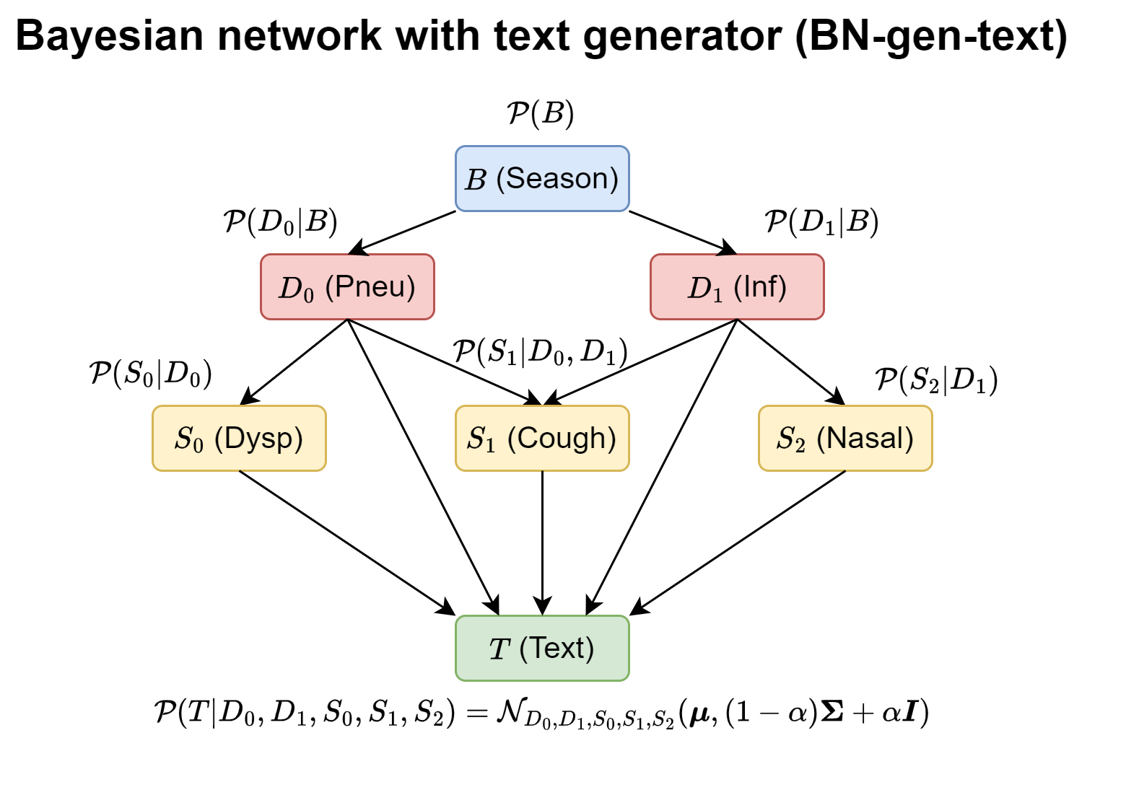
Training the Bayesian network
?
?
?
Learn all conditional probabilities
?
?
?
 | Pneu | Inf | Season | Dysp | Cough | Nasal | Text
0 | No | No | Warm | No | No | No | Patient complai…
1 | No | No | Warm | / | / | / | Patient reports…
2 | No | Yes | Cold | No | Yes | Yes | Patient present…
Notes:
In short, this is the Bayesian network which depicts our data generating process, from which we can generate a training set of samples. Note the arrows from pneumonia and inf to the text, which are there because of the unobserved symptoms fever and pain. Remember that in order to generate the data, we had to ask an expert to predefine all conditional probabilities. However, in a realistic setting, the whole point is that we want to learn these probabilities from the data. So from now on, we forget the predefined conditional probabilities and instead, we aim to learn them from the data.

Slide 11

Training the Bayesian network
?
Notes:
Of course, the conditional probabilities for all the diagnoses and symptoms in the Bayesian network are not the only thing we want to learn. We also need to learn how they’re connected through the text. While learning the conditional probabilities at the top of the network turned out to be very doable, learning this conditional distribution for the text was a different story. It’s very difficult to define a probabilistic space over all possible texts (which are infinite) and learning a distribution over that, for all possible combinations of these parent variables. So we realised we need a different approach.

Slide 12
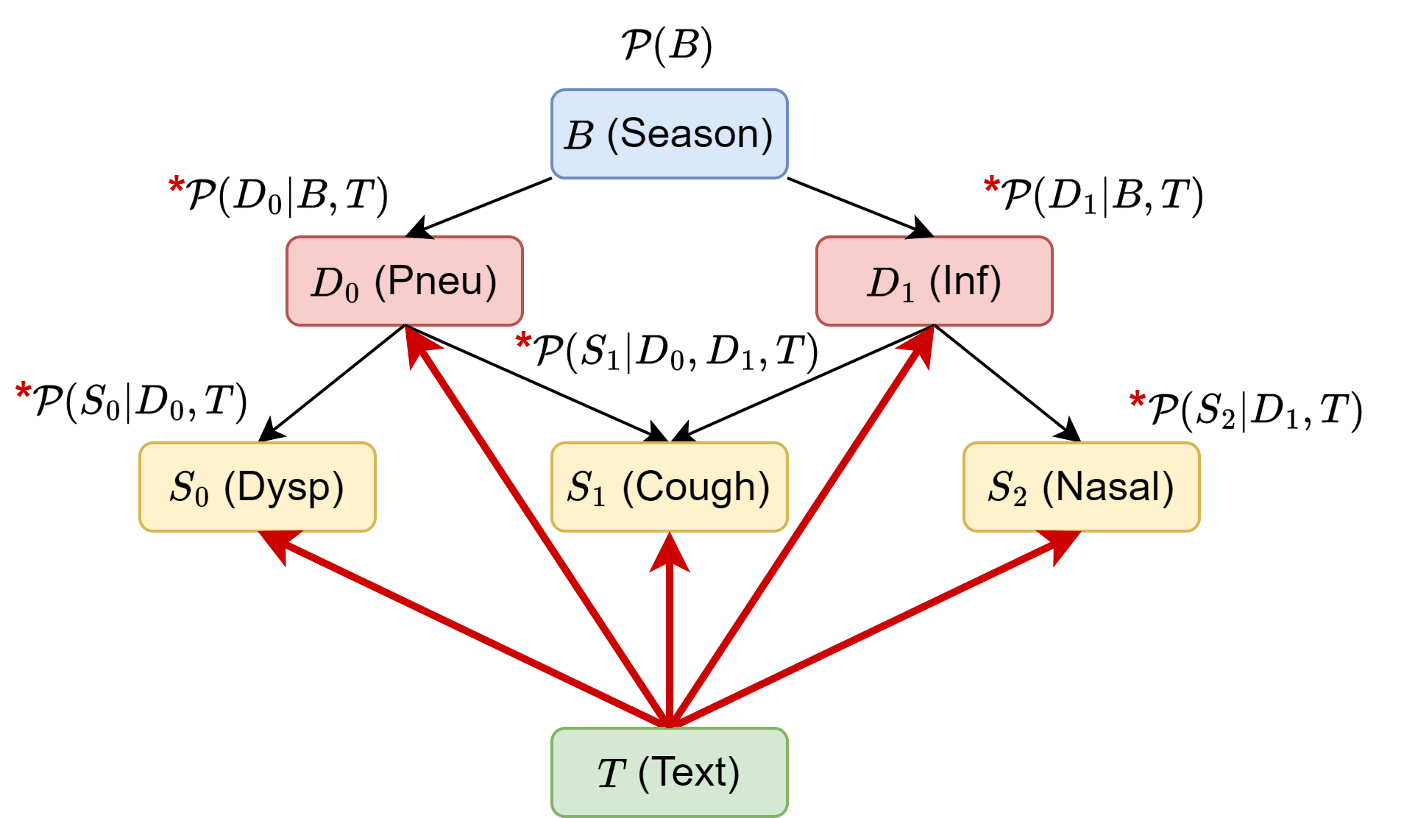
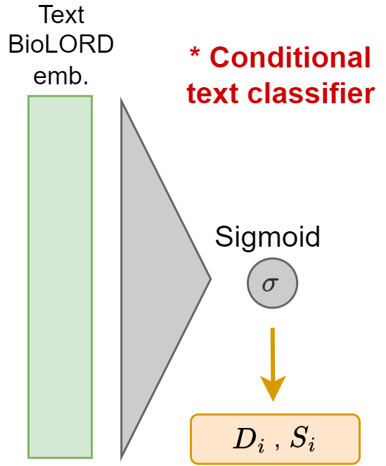
We need another approach…
Bayesian network with text classifiers
pre-trained
embedding
P(Dysp=yes|Pneu=yes, T)
P(Dysp=yes|Pneu=no, T)
Notes:
Can you tell what changed? Indeed, we placed the arrows away from the text, instead of coming into it. This means that we can avoid learning a generative distribution for the text. Instead, we learn some classifiers, which take in the text as an input and output a prediction for the symptoms. I’ve drawn a small classifier on the right here. It’s fairly simple, we just transform the text into an embedding using a pretrained clinical language model, and then we learn some simple neural network weights for transforming this into a probability for the diagnosis or symptom, depending on the variable we are modelling. We train the weights of the classifiers using the training data. It’s called conditional, because we have a different classifier for different values of the parent variable. For example, we have two classifiers for dysp: one for pneu = 0 and one for pneu = 1.

Slide 13
Inference proceeds like in a normal BN
P(Pneu | Tabular data, Text)
= 0.74
Tabular data
summer
Dyspnea = yes
Cough = yes
Nasal = no
Season = summer
∑
Inf=yes
Inf=no
Text
?
Patient has been coughing for the past few days.
Yesterday morning, they woke up with a high fever and could not go to work.
Throughout the day, breathing started to become difficult. The patient described a pressing feeling on the chest when taking deep breaths. No complaints of runny nose or sneezing.
yes
yes
no
Notes:
Once we have learned all the conditional probabilities in our text-enhanced Bayesian network, we can do inference over both tabular variables and text at the same time, more or less like in a normal BN. We sum out the variables we don’t have as evidence, which in our case is Inf, like we did in the normal Bayesian inference procedure as well. We fill in all the evidence that we have, but now instead of evaluating conditional probabilities, we look at the output of all our little text classifiers. Eventually, we arrive at a prediction for pneumonia, which in this case is 74%.

Slide 14
What if we only used tabular data?
= 0.12
P(Pneu | Tabular data)
Tabular data
Tabular data
Dyspnea = yes
Cough = yes
Nasal = no
Season = summer
summer
Dyspnea = yes
Cough = yes
Nasal = no
Season = summer
∑
Inf=yes
Inf=no
?
yes
yes
no
Notes:
What if we had only used the tabular features available, like in a normal Bayesian network? Then we arrive at a probability of only 12% for pneumonia. This is because we did not know that the patient is experiencing high fever, which is only written in the text and not encoded as a tabular feature.

Slide 15
Conclusion
Bayesian networks are ideally suited to automate clinical reasoning
But we need to take into account realistic medical data
By incorporating text into a Bayesian network, we get the best of both worlds
Interpretable background knowledge
I’ve been coughing for the past few days and yesterday I woke up with…
Unstructured text
Notes:
We can conclude that Bayesian networks are ideally suited to automate clinical reasoning. They are the perfect marriage between interpretable background knowledge, which is injected through the expert-defined graphical structure, and learning from data, which is how the conditional probabilities are filled in.
However, to make them useable in realistic cases, we need to take into account what realistic medical data looks like. This data is often a mix of tabular and unstructured text.
We proposed a way to incorporate this text directly into the Bayesian network, which gives us the best of both worlds. On the one hand, we are able to leverage information on unobserved symptoms which are expressed in the text, in our case fever and pain. At the same time, we still retain the interpretable structure of the background knowledge which helps us make a reliable prediction for the diagnosis of pneumonia.
So, maybe the next time you go to the doctor because you’re not feeling well, they may be helped by a Bayesian network to form your diagnosis.

