Slide 1
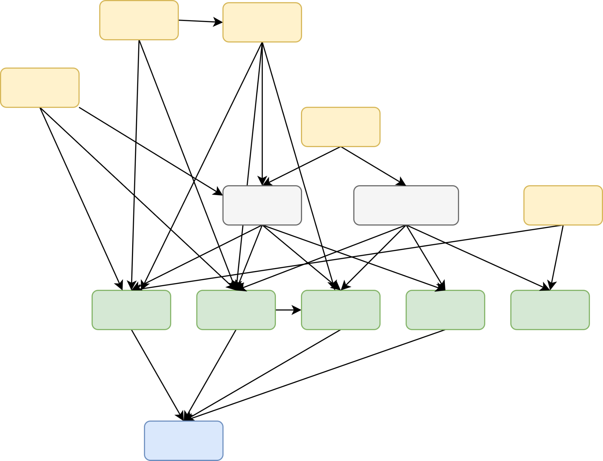



Neuro-Symbolic Methods for
Clinical Information Extraction:
Why?
Paloma Rabaey,
Stefan Heytens, Thomas Demeester
Research funded by

Slide 2


You’re not feeling well…
Electronic Health Record
Electronic Health Record
Consultation 12/07
primary complaint: cough
observation: 39°C/102°F
diagnosis: pneumonia
treatment: antibiotics
Asthma: yes
Hay fever: no
…
Nimodipine: daily
…
R05
R81
C05AB
Patient has been coughing for the past few days.
Yesterday morning, they woke up with a high fever and could not go to work.
Throughout the day, breathing started to become difficult. The patient described a pressing feeling on the chest when taking deep breaths.
Symptoms
Fever (39°C/102°F)
Dyspnea (trouble breathing)
Cough for a week
Notes:
Imagine, you’re not feeling well. A week ago you started coughing, and you thought nothing of it until other symptoms started to arise. This morning, you woke up with a fever of 39 degrees Celsius (102 degrees Fahrenheit), and throughout the day, you started to have some trouble to take deep breaths. By now, you’re pretty worried, so you decide to go to the doctor and tell him your symptoms. Using these symptoms, together with the information the doctor already knows about you, which is stored in your electronic health record, the doctor comes up with a diagnosis and possible treatment. If anyone saw my talk yesterday, this clinical reasoning part of the consultation is what we focused on then. Now, we’re going in a different direction.
The clinician still has one more task: storing the important information in the electronic health record. While the exact protocol for what information is stored about the visit differs everywhere, it’s going to look something like this. The clinician will encode part of the information in a structured way, using a coding system. Usually, they will encode the primary complaint, some objective observations such as temperature, the diagnosis they arrived at, which is pneumonia in this case, and the treatment they prescribed, which is a type of antibiotics. But this is not all. Often times, they will also store some free, unstructured text describing the consultation, which contains additional context. Some info described in the text, such as cough, is also encoded. Some other info is only available in the text (such as the symptoms dyspnea), and other info is not mentioned in the text and is only available in encoded format (diagnosis of pneumonia, treatment of antibiotics).

Slide 3
are a gold mine
Electronic Health Records
Encoded, Tabular
Electronic Health Record
Mix of encoded tabular data and unstructured free text
Consultation 12/07
primary complaint: cough
observation: 39°C/102°F
diagnosis: pneumonia
treatment: antibiotics
R05
Essential to…
Train clinical decision support systems
Accelerate research
R81
C05AB
Patient has been coughing for the past few days.
Yesterday morning, they woke up with a high fever and could not go to work.
Throughout the day, breathing started to become difficult. The patient described a pressing feeling on the chest when taking deep breaths.
Free
text
Notes:
So, in summary, these electronic health records contain a mix of encoded, tabular information, and free text. The fact that so much information is stored in these electronic health records makes them a gold-mine of information. All this information can form a good basis for training clinical decision support systems, which at least partially automate some process in the clinical world, such as systems to write treatment plans, automatic prediction of diagnoses, etc.

Slide 4

How can we leverage this information?
Electronic Health Record
Language models
Can deal with text directly
But… black-box
Consultation 12/07
primary complaint: cough
observation: 39°C/102°F
diagnosis: pneumonia
treatment: antibiotics
R05
R81
We need interpretable systems built on tabular features
C05AB
Patient has been coughing for the past few days.
Yesterday morning, they woke up with a high fever and could not go to work.
Throughout the day, breathing started to become difficult. The patient described a pressing feeling on the chest when taking deep breaths.
Automatically extract information from free text
Dyspnea
Notes:
So how can we leverage this information? While language models nowadays can directly deal with this text and have shown promising capabilities in many medical tasks, they are a black box, and lack interpretability and therefore reliability. For medical applications, we prefer robust and transparent systems built on simpler, more interpretable models. Think of feature-based methods such as decision trees, logistic regression, etc. However, such models need tabular features as an input. For this reason, automated information extraction is needed, to build big structured datasets that can serve as training data for such systems. For example, from this part of the text, which is describing difficulty breathing as a symptom, we want to extract the concept dyspnea.

Slide 5
SOTA Clinical Information Extraction
Text
Neural
classifier
Patient has been coughing for the past few days.
Yesterday morning, they woke up with a high fever and could not go to work.
Throughout the day, breathing started to become difficult. The patient described a pressing feeling on the chest when taking deep breaths.
Pretrained sentence embedding model
P(dysp) = 0.56
e.g. BioLORD [1]
[1] Remy, F. (2023). “BioLORD-2023: semantic textual representations fusing large language models and clinical knowledge graph insights” Journal of the American Medical Informatics Association, ocae029.
Embedding vector
Notes:
A simple current state of the art information extraction system could look a bit like this. First, the free text is turned into an embedding that sums up its meaning. For this, we would preferably use a pretrained sentence embedding model built for the clinical use-case, such as BioLORD. It has seen many clinical sentences and has learned how to cluster them into embeddings that convey their meaning. This embedding can then be used as the input to a neural classifier, which can be trained on a dataset of say 1000 pairs of text and annotated concepts we are interested in extracting. This classifier then predicts the probability of dysp being expressed in the text.
Remy, F. (2023). “BioLORD-2023: semantic textual representations fusing large language models and clinical knowledge graph insights” Journal of the American Medical Informatics Association, ocae029.

Slide 6
Can we do better?
Clinical notes are hard to understand
Clinical jargon and abbreviations
Leave out contextual details
Extract information, taking into account…
Electronic Health Record
Domain knowledge
Background:
Asthma = yes
Hay fever = no
Nimodipine: daily
Season: winter
Consultation 12/07:
primary complaint: fever
observation: 39°C
diagnosis: pneumonia
treatment: antibiotics
Encoded tabular features
Notes:
While the approach on the previous slide might work for simple texts, clinical notes are usually not simple at all. They might contain clinical jargon or abbreviations, and leave out important contextual details that an inexperienced reader might not know about, and which an automated system would need to make an accurate classification.
We think there’s two things that might help us extract the symptoms more accurately. On the one hand, we already have some information on the patient which could help extracting further information: we have the tabular features encoded in the electronic health record, both regarding the background of the patient and regarding the current visit we are trying to encode. On the other hand, we can connect this background with the current symptoms we are trying to extract using domain knowledge. Don’t worry if that’s still abstract at this point, I will get into how that works now.

Slide 7
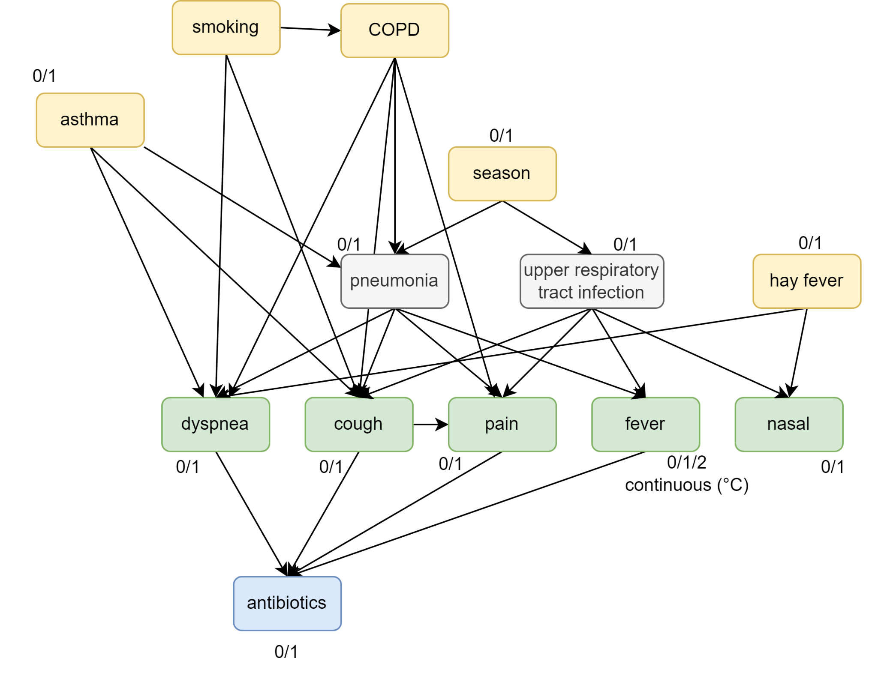
Bayesian
network
Structure
diagnoses
symptoms
background
treatment
Notes:
What would this domain knowledge look like? For this, we can use a Bayesian network. The Bayesian network in this slide models some background knowledge related to respiratory diseases pneumonia and upper respiratory tract infection (better known as the common cold). This Bayesian network was constructed by a primary care expert, who decided how the diagnoses are related to their relevant symptoms and background factors.

Slide 8
Bayesian
network
Conditional probabilities
P(asthma) = 0.095
P(dyspnea|asthma) = 0.9
P(dyspnea|smoking) = 0.3
etc.
Notes:
The bayesian network models the joint probability distribution of all these variables by defining a conditional probability for each variable. This means we define a probability for asthma being present in a random patient, which could be less than 1 percent in the population of a particular clinical practice. For the symptoms, we assign an activation probability for each parent. For example, when a patient has asthma, there is a 90% probability upfront that they suffer from dyspnea. When they’re a smoker, this probability is 30%. We do the same for all variables in the graph. The structure of the Bayesian network, together with the conditional probabilities, constitutes our background knowledge. If we have a big dataset where we observe tabular values for all these variables, we can learn these probabilities automatically.

Slide 9
Bayesian
network
Expressed in free text
Notes:
We now want to use this background knowledge when extracting concepts from the text. In the setup we consider, the 5 symptoms in the graph might be present in the unstructured text, and these are the ones we want to extract. The other variables are tabular, but it depends on the patient which ones are known. Before even looking at the text, we can use these tabular variables to get a probability for dyspnea to occur in the patient, and therefore for it to be expressed in the clinical text note. Let’s go back to our example.

Slide 10
Electronic Health Record
Background:
Asthma = yes
Hay fever = no
Nimodipine: daily
Season: winter
Consultation 12/07:
Primary complaint: cough
Observation: 39°C
Diagnosis: pneumonia
Treatment: antibiotics
Notes:
since we know the patient has asthma, the probability of dyspnea is already higher

Slide 11
Electronic Health Record
Background:
Asthma = yes
Hay fever = no
Nimodipine: daily
Season: winter
Consultation 12/07:
Primary complaint: cough
Observation: 39°C
Diagnosis: pneumonia
Treatment: antibiotics
Notes:
since we know the patient received the diagnosis of pneumonia, and we know that dyspnea is associated with pneumonia as a symptom (and with which probability), this increases our confidence in dyspnea

Slide 12
Electronic Health Record
Background:
Asthma = yes
Hay fever = no
Nimodipine: daily
Season: winter
Consultation 12/07:
Primary complaint: cough
Observation: 39°C
Diagnosis: pneumonia
Treatment: antibiotics
Notes:
Both dyspnea and fever contribute to the decision to prescribe antibiotics. We know that both fever and antibiotics are positive, so due to something known as the explaining away effect, the probability for dyspnea becomes a little lower than if fever was not observed. But for example, if we knew that the patient had no fever, it becomes a little more likely that the antibiotics prescription is caused by the presence of the symptom dyspnea instead.

Slide 13
Electronic Health Record
Background:
Asthma = yes
Hay fever = no
Nimodipine: daily
Season: winter
Consultation 12/07:
Primary complaint: cough
Observation: 39°C
Diagnosis: pneumonia
Treatment: antibiotics
Notes:
cough is encoded in tabular format as the primary complaint. through their common cause of smoking, we know that dyspnea and cough often occur together. so observing cough makes the probability for dyspnea a little higher.

Slide 14
We need a neuro-symbolic approach
Neural
Text
Patient has been coughing for the past few days.
Yesterday morning, they woke up with a high fever and could not go to work.
Throughout the day, breathing started to become difficult. The patient described a pressing feeling on the chest when taking deep breaths.
P_{text}(dyspnea)
= 0.56
Electronic Health Record
Background:
Asthma = yes
Hay fever = no
Nimodipine: daily
Season: winter
Consultation 12/07:
primary complaint: fever
observation: 39°C
diagnosis: pneumonia
treatment: antibiotics
P_{tab}(dyspnea)
= 0.85
Symbolic
Notes:
Like we saw from the examples, there’s a lot of information in the tabular portion of the EHR which can be used as evidence in the Bayesian network. Through bayesian inference, we can get an initial probability for the symptom we are trying to extract, before ever seeing the text. Remember that our text classifier also outputs a probability for this symptom, but by only taking the text into account. We now want to find a way to combine the two methods. The method at the bottom is called a symbolic AI approach, because it uses symbols and abstract reasoning. This is in contract to the approach on the top, which is a neural approach, since a neural network is used to automatically learn how to transform text into a prediction. Here, there’s no implicit reasoning. To combine these two types of approaches, we need a neuro-symbolic approach.

Slide 15
How can we combine the two?
P_{text}(dyspnea)
= 0.56
Text
Neuro-Symbolic Reasoning Engine
P(dyspnea) = ?
P_{tab}(dyspnea)
= 0.85
Tabular
Notes:
Conceptually, we need a neuro-symbolic reasoning engine, which can take in these two probabilities, and turn them into a well-calibrated probability for dyspnea. It turns out that combining these two predictions is more difficult than you might think, and there is currently no out-of-the-box solution.

Slide 16
How can we update parameters?
?
Weights
P_{text}(dyspnea)
= 0.21
Text
Neuro-Symbolic Reasoning Engine
P(dyspnea) = 0.25
P_{tab}(dyspnea)
= 0.38
Tabular
?
Conditional probabilities
Notes:
Apart from combining these two outputs at inference time, we would also like to train the whole model based on observed data points and update the parameters. In the neural leg, the parameters are the neural network weights, and in the tabular leg, the parameters are the conditional probabilities in the bayesian network. What if we observe that the probability for dyspnea that is currently predicted is too low: it predicts 25%, but dyspnea is actually present in the patient, so we want this to be higher. In this case, we want to update all parameters so the probability becomes higher in the next pass. In neural networks, this process is called backpropagation. This backpropagation would need to go through the neuro-symbolic reasoning engine, but it’s unclear how this would work.

Slide 17
We need a dataset to solve these questions
Patient 1
Smoking | yes | Dyspnea | yes
Asthma | no | Cough | no
COPD | no | Pain | no
Hay fever | no | Fever | none
Season | winter | Nasal | yes
Pneumonia | no | Antibiotics | no
Infection | yes
Expert-defined…
Causal structure
Conditional probability tables
Notes:
It’s clear there’s a lot of challenges related to building the neuro-symbolic approach. The reason why this research has not been done properly before, or at least not in the context of clinical information extraction, is because there is a lack of adequate datasets. The dataset we need, needs to be a mix of tabular data reflecting the background on the patient and text data from which clinical context needs to be extracted. Because such a dataset did not exist yet, we built an artificial yet realistic one. We started from our expert-defined Bayesian network structure, where we additionally asked the expert to provide some realistic conditional probabilities for all variable combinations. This way, we get a fully defined joint probability distribution, from which we can generate realistic datapoints. For example, we can sample the patient on the slide, with the following characteristics. This makes up the tabular portion of our dataset.

Slide 18


We need a dataset to solve these questions
Tabular
Text
The patient presents with complaints of dyspnea, which is notably worse in the morning hours. While they deny any cough or chest pain, there is a report of nasal symptoms, specifically nasal congestion and rhinorrhea, leading them to frequently have difficulty breathing through the nose particularly during the night or early morning. The patient has a history of smoking, which may contribute to their respiratory issues, though they have not experienced similar problems before.
Patient 1
Smoking | yes | Dyspnea | yes
Asthma | no | Cough | no
COPD | no | Pain | no
Hay fever | no | Fever | none
Season | winter | Nasal | yes
Pneumonia | no | Antibiotics | no
Infection | yes
GPT-4
10.000
Notes:
We now need some texts describing these fictional patient encounters. It would be too labour-intensive to create these manually. For this reason, we prompted GPT-4, providing it with the patient’s characteristics and asking it to generate a text describing this patient’s symptoms. We found that we got realistic and diverse descriptions of patient encounters using this method, but we are currently conducting a quality evaluation together with multiple experts. The final dataset, consisting of 10000 such patients, will be published in the upcoming months, once we have completed this evaluation.

Slide 19
How can we combine the two?
Text
Neuro-Symbolic Reasoning Engine
Clinical Information Extraction
Neuro-Symbolic Reasoning Engine
Tabular
Notes:
We will use this dataset to research how to best build the neuro-symbolic reasoning block, to investigate how tabular background knowledge can be infused in the clinical information extraction task for improved outcomes. We invite anyone who is interested in this research to do the same.

Slide 20
Conclusion
Electronic health records are a gold mine, but contain unstructured text
Automated clinical information extraction must leverage…
Encoded tabular features
Domain knowledge
Bayesian network
We need neuro-symbolic methods to merge…
Neural text classifiers
Symbolic domain knowledge
Text
Tabular + text dataset
Neuro-Symbolic Reasoning Engine
Contact me!
paloma.rabaey@ugent.be
Tabular
Notes:
To conclude, electronic health records are a gold mine of information, upon which many clinical decision support systems can be built. However, they contain a lot of unstructured text.
In order to leverage their potential, we need to facilitate automated clinical information extraction. To deal with the challenges of these types of text, we propose that better systems can be built if they take into account the encoded tabular features in the electronic health record, as well as domain knowledge, linking this with the concepts we are trying to extract from the text. For this, Bayesian networks are a good candidate.
In order to merge this background knowledge with the output of the SOTA neural text classifiers, we need neuro-symbolic methods. We believe research on this front has been lacking.
To facilitate this research, we built a dataset of realistic but synthetic patient records which contain tabular background features and unstructured text describing their symptoms, which will be released at the end of this summer. I would invite anyone who is interested in this type of problem to use the dataset and come talk to me about it or send me an email. This way, we can make reliable clinical information extraction a reality.

