Slide 1
Avoid Food Wastage (Dynamic Website to invest your food for others)

Slide 2
Problem Statement..
Food Food Everywhere,
But Not a Bite to Eat

Slide 3
☹HIGHLIGHTS☹
Some 795 million people in the world do not have enough food to lead a healthy active life. That’s about one in nine people on earth.
The vast majority of the world’s hungry people live in developing countries, where 12.9% of the population is undernourished.
Poor nutrition causes nearly half (45%) deaths in children under five—3.1 million children each year.
One out of six children—roughly 100 million—in developing countries is underweight.
One in four of the world’s children are stunted. In developing countries the proportion can rise to one in three.
9. 66 million primary school-age children attend classes hungry across the developing world, with 23 million in Africa alone.

Slide 4
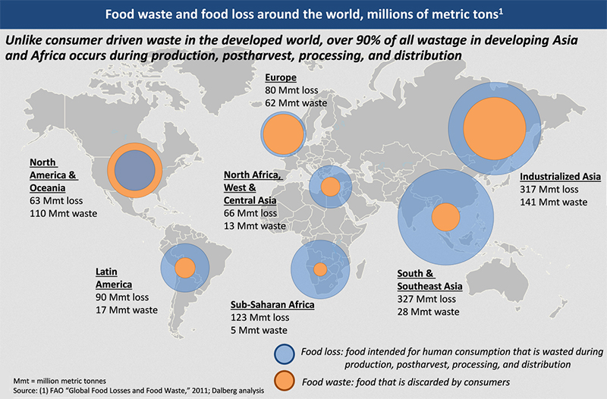
Maps
our office

Slide 5
Place your screenshot here
ABSTRACT

Slide 6
->Abstract<-
This project is used to manage wastage foods in a useful way. Every day the people are wasting lots of food. So we have to reduce that food wastage problem through online. If anyone having left over food they can entering their food quantity details and their address in that application and then the admin maintain the details of food donator.
The donator can create the account and whenever they are having wastage food they can login and give request to the admin. And the admin also maintain the buyer (orphanage, poor, people,..etc) details too.
After the admin view the donator request and give the alert message like time to come and collect the food.

Slide 7
Abstract(cont..)
And the admin collect foods from donator through their nearby agent then provide to nearest orphanages or poor people. After receiving the food from the agent by admin and give alert message to that donator.
This project is food redistribution is an enormously successful social innovation that tackles food waste and food poverty. The user’s details are maintained confidential because it maintains a separate account for each user.

Slide 8
What this system is preferred to do?
In existing system if anyone have extra food because of any function or in their home it will be become waste because instantly there is no way to share with anyone if they are having lots of food, Even if they want to give that extra food to any orphanage or poor people they don’t have time or don’t have an idea about that.
So that we have create a application for sponsor that extra food to poor people or nearby orphanage.

Slide 9
Place your screenshot here
MODULES

Slide 10
Modules of the proposed system;
In this project consist of the different types of module. The modules are:-
1.Admin Module.
2.Donator Module.
3.Agent Module.
4.Comments Module.

Slide 11
1.Admin Module:-
In admin module, The administrator maintain the agent details as well as the donator details. The administrator collect the food from the agent. The administrator also send the agent details to donator.
2.Donator Module:-
In donator module, the donator give the wastage of food to the orphanage. The donator give the request to the admin for the purpose of to collect the wastage food. The donator view the agent details.

Slide 12
3. Agent Module:-
In Agent module, the agent maintain the donator details. The agent give the request to the admin for collect the food from the donator. After collect the food the agent give the alert message for the donator.
4.Comments Module:-
In this module the user give the comments for this site. While entering the comments, user must enter the following details such as, user name, email id and user comment. The admin can view user comments and details.

Slide 13
SYSTEM REQUIREMENT SPECIFICATION

Slide 14
Software requirements:-
Operating System : Windows
Technology : PHP(Back-end)
Web Technologies : Html, JavaScript, CSS (Front-end)
IDE : Sublime
Web Server : XAMPP
Database : My SQL

Slide 15
Hardware requirements:-
Hardware - Pentium
Speed - 1.1 GHz
RAM - 1GB
Hard Disk - 20 GB
Key Board - Standard Windows Keyboard
Mouse - Two or Three Button Mouse
Monitor - SVGA

Slide 16
Some Internals of Proposed System

Slide 17
Designs used in System
INPUT DESIGN:-
The input design is the link between the information system and the user. It comprises the developing specification and procedures for data preparation and those steps are necessary to put transaction data into a usable form
(DEVELOPER’S END)
OUTPUT DESIGN:-
A quality output is one, which meets the requirements of the end user and presents the information clearly.
(CLIENT’S END)

Slide 18
Types of tests:-
System
Testing
Blackbox
Testing
Unit Testing
Whitebox Testing
Integration Testing
Functional testing

Slide 19
DATAFLOW DIAGRAMS

Slide 20
Dataflow Diagram:- 1.User

Slide 21
Dataflow Diagram:- 2.Agent

Slide 22
Dataflow Diagram:-3.Admin

Slide 23
SNAPSHOTS

Slide 24
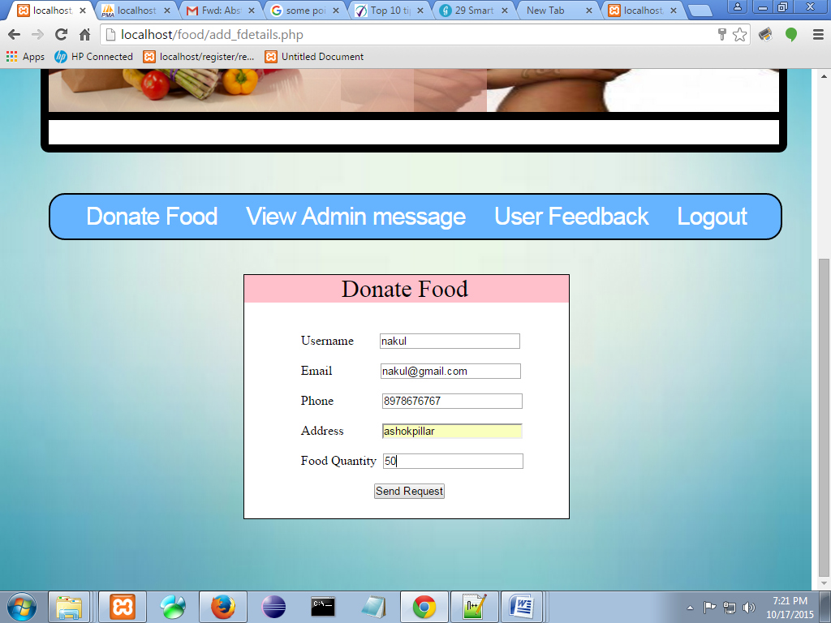
Donate Food.
.
Place your screenshot here

Slide 25
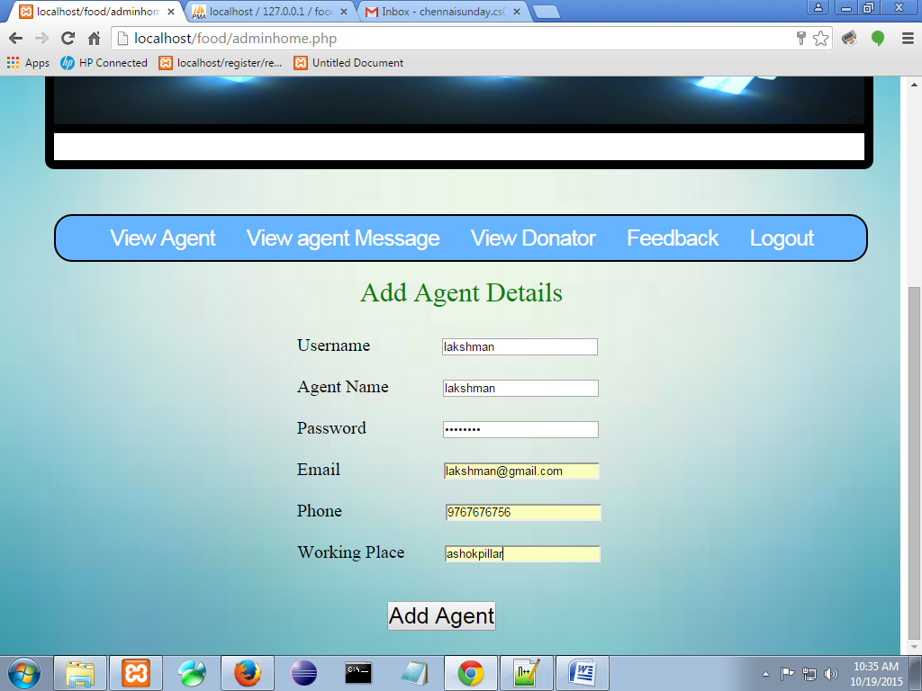
Add Agent Details.
.
Place your screenshot here

Slide 26
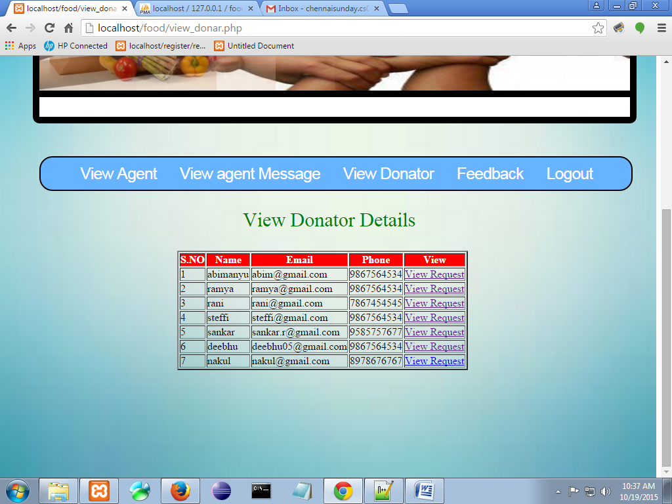
View Donator Details.
Place your screenshot here

Slide 27
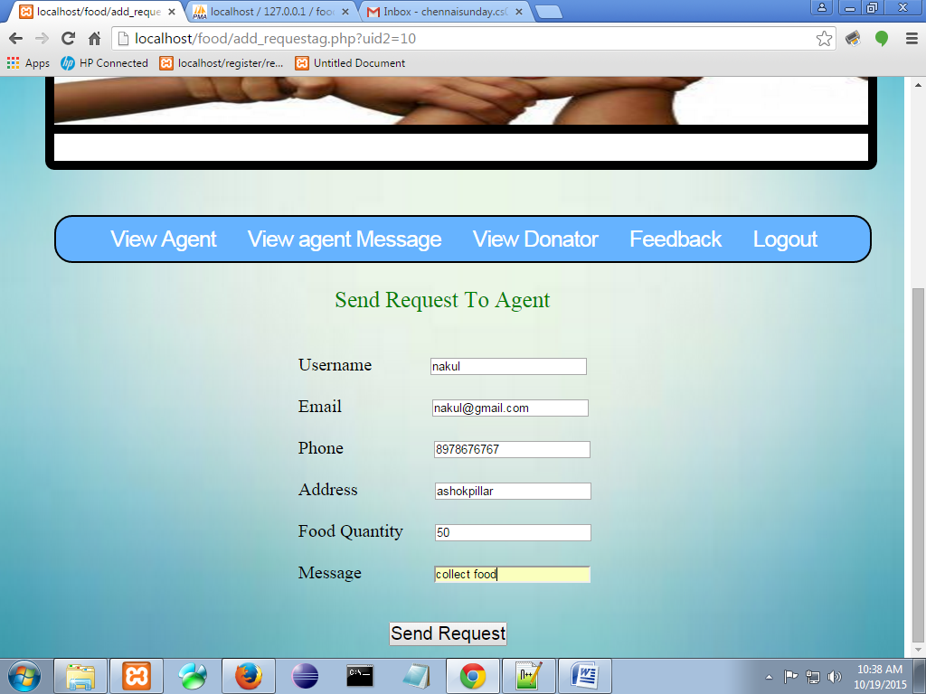
Send Request To Agent.
Place your screenshot here

Slide 28
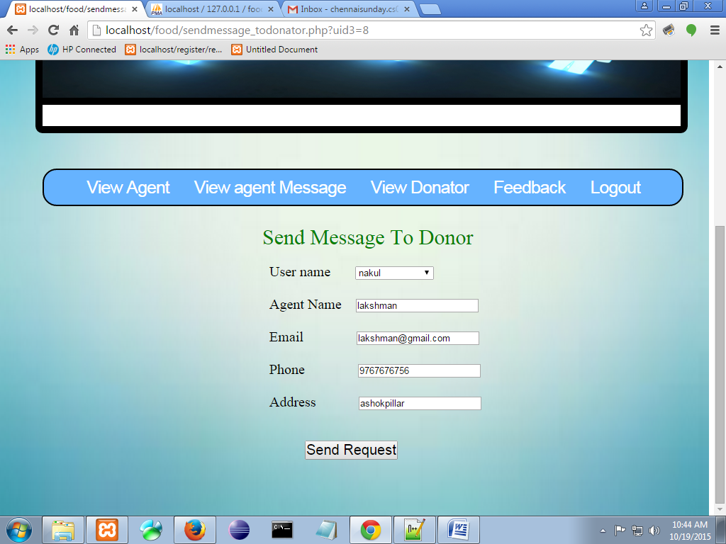
Send Message To Donor.
Place your screenshot here

Slide 29
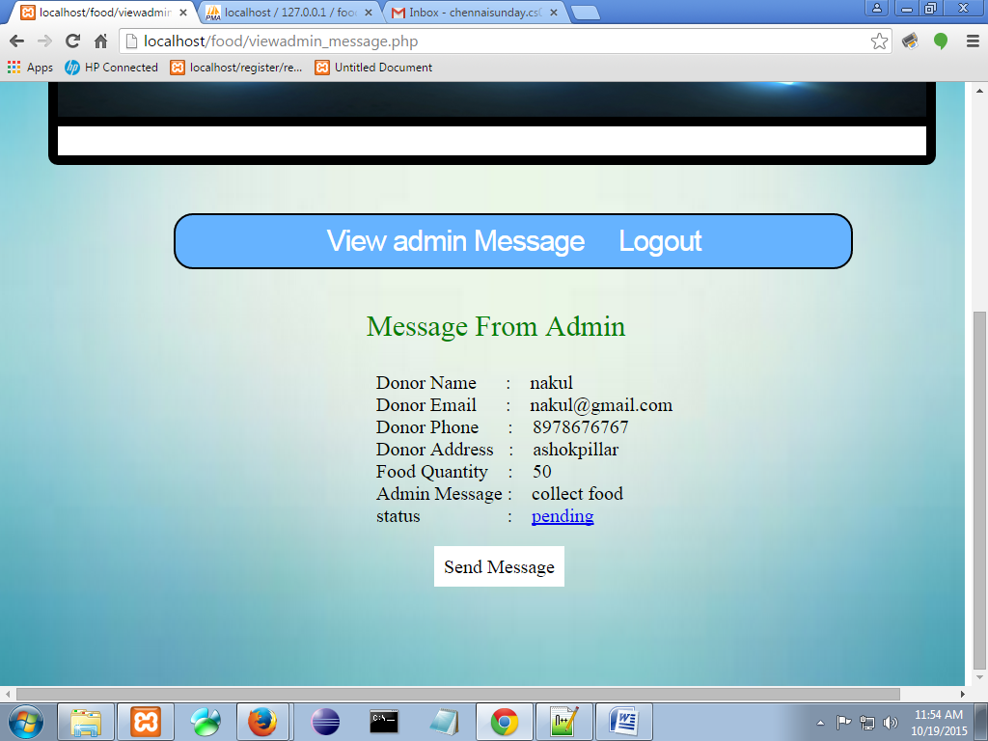
Donor View message from Admin.
Place your screenshot here

Slide 30
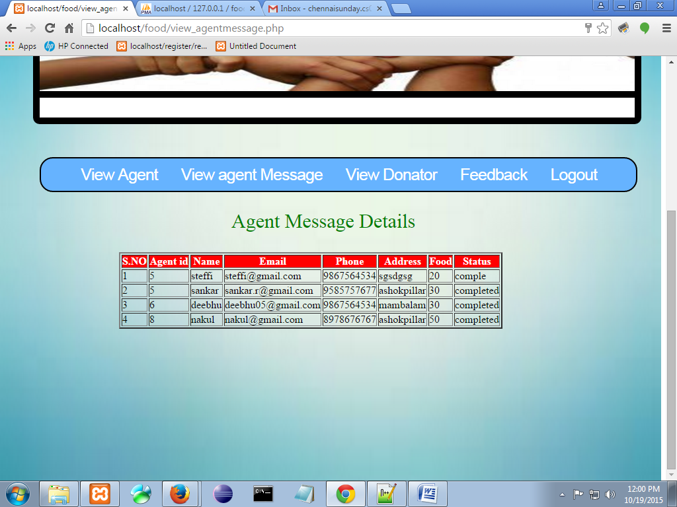
View Agent Message
Place your screenshot here

Slide 31
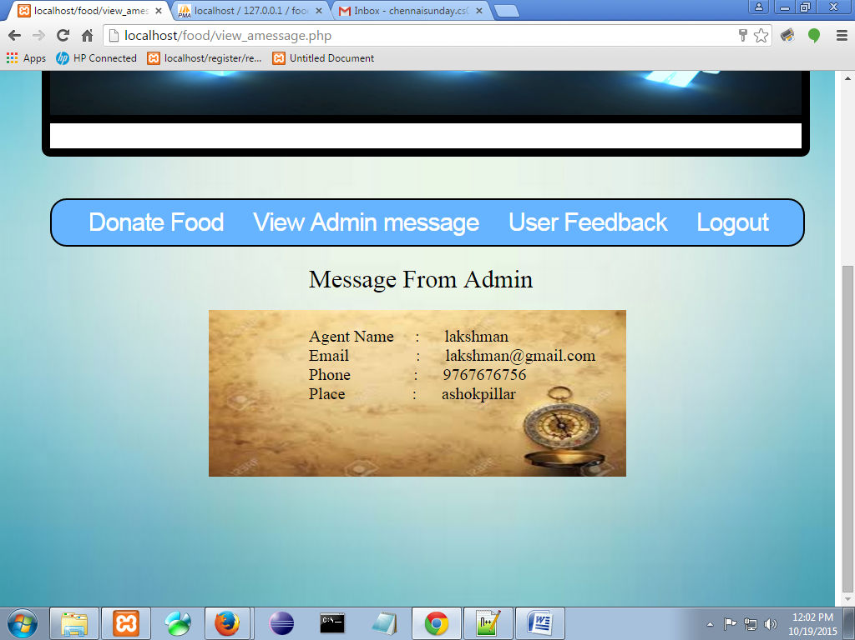
View Message From Admin.
Place your screenshot here

Slide 32
A child dies every 5 seconds as a result of hunger.
DON’T WASTE FOOD,START CONTRIBUTING BCOZ EVERY SINGLE STEP COUNTS.....

Slide 33
Thanks!
Any questions?

