Slide 1
Movie Recommendation System
Name: Prabal Kumar Pathak
Enrollment No.: 0301CS191037
BRANCH: CSE 7th sem
SUBMITTED TO: Prof. Sanjay Verma

Slide 2
Problem Statement
Aim: Build a movie recommendation system based on ‘MovieLens’ dataset.
We wish to integrate the aspects of personalization of user with the overall features of movie such as genre, popularity etc.
Notes:
Implemented popularity model, content based model, collaborative filtering model and latent factor based model and combining the above to form a hybrid model.
Hyperparameter tuning, testing accuracy and evaluation of recommendations of each model

Slide 3
DataSet
MovieLens review dataset (ml-latest-small)
Ratings: 100k
Movies: 9k
Users: 600
Integrated the dataset with IMDB and TMDB data set publically available.
Split the dataset into 80% training and 20% testing based on the User ID.
Notes:
The primary dataset used for this project is the movielens review dataset. consisting of 27,753,444 reviews over 58,098 different movies by 283,228 users.

Slide 4
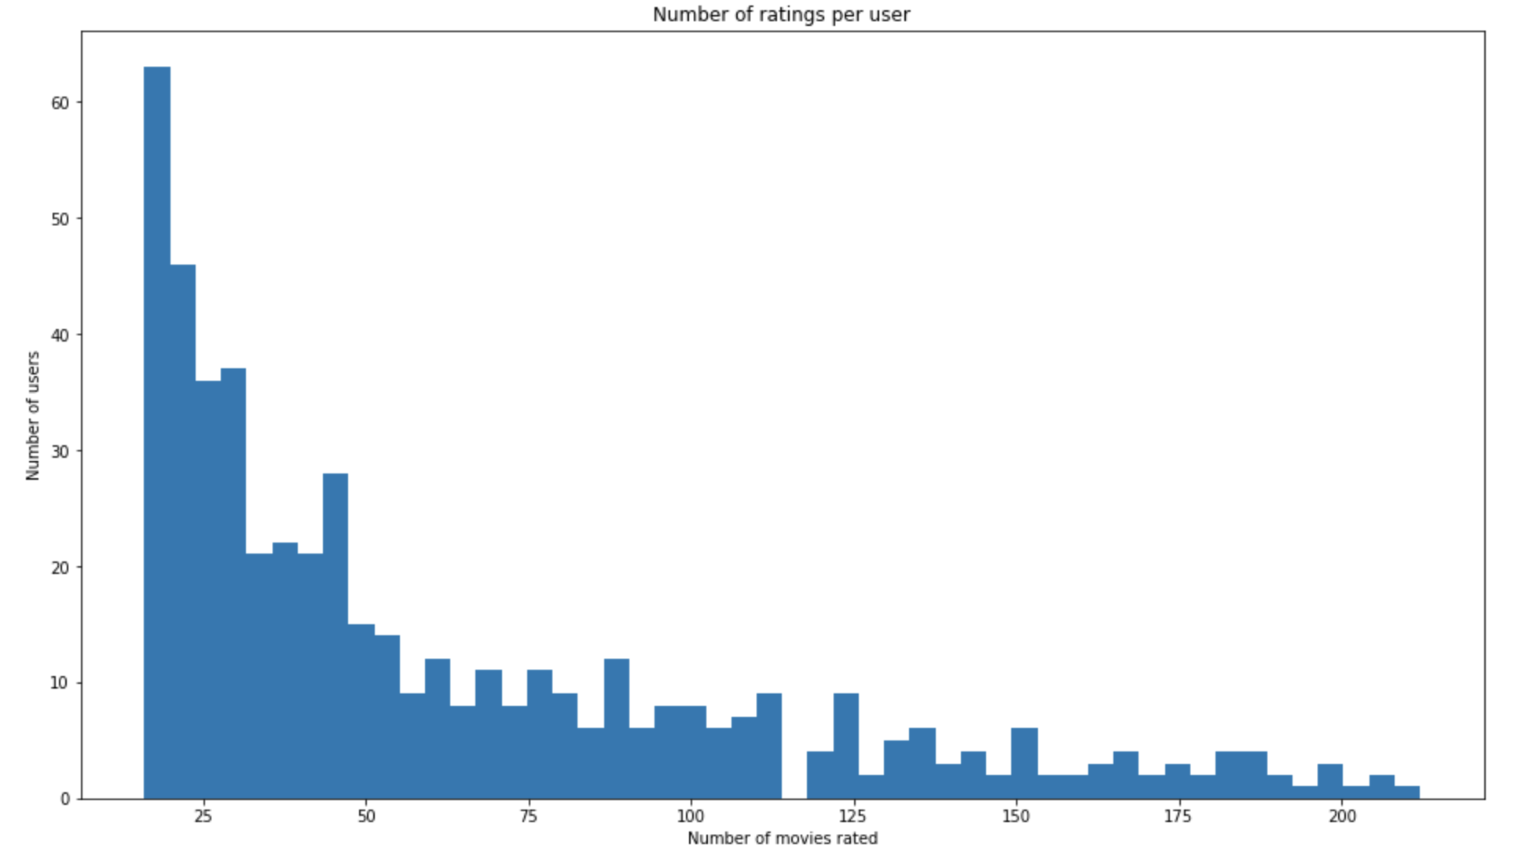
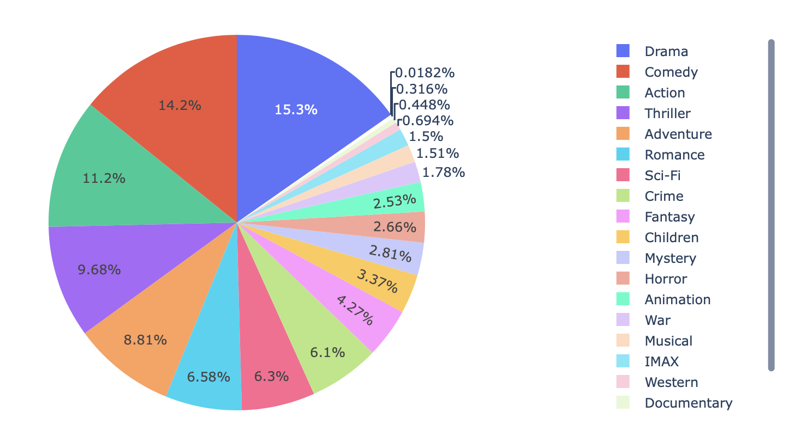
Data Analysis
Genre Distribution:
Number of ratings per user:

Slide 5
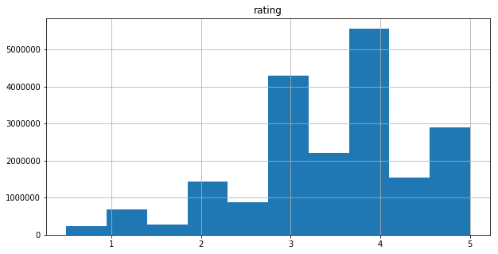
Histogram of Ratings:

Slide 6
Models
Popularity based model
Content based model
Collaborative Filtering
Matrix Factorization method
Combined model ( SVD + CF)
Hybrid model

Slide 7
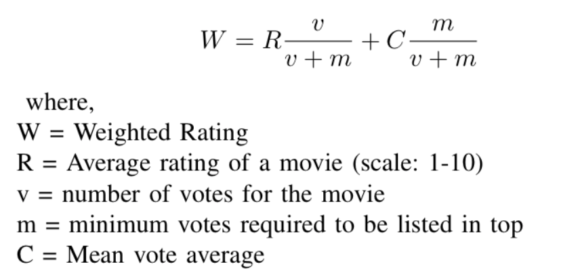
Popularity Model
Genre wise popular movies
Computed on:
Popularity metric from TMDB data
Weighted Rating from IMDB

Slide 8
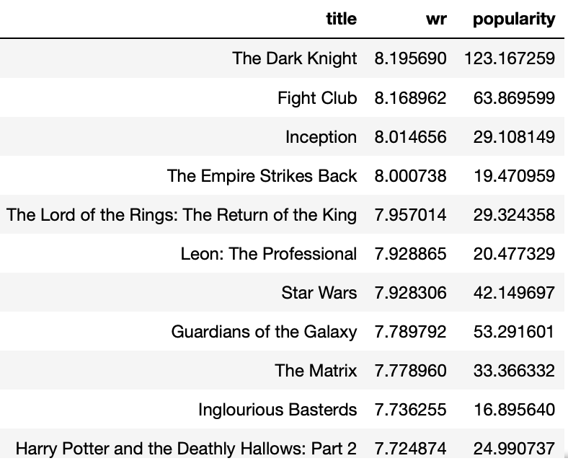
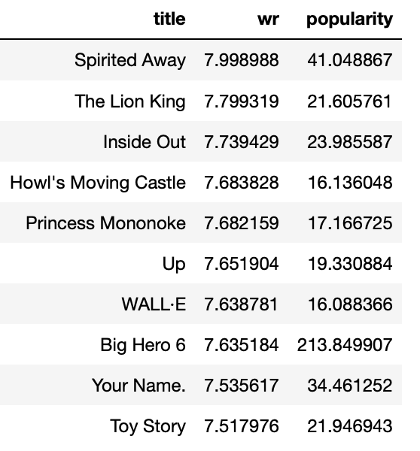
Action Movies
Animated Movies

Slide 9
Content-Based Recommendation
User profile based on item profiles
Genre
Year of release of movie
Movie - Movie similarity

Slide 10
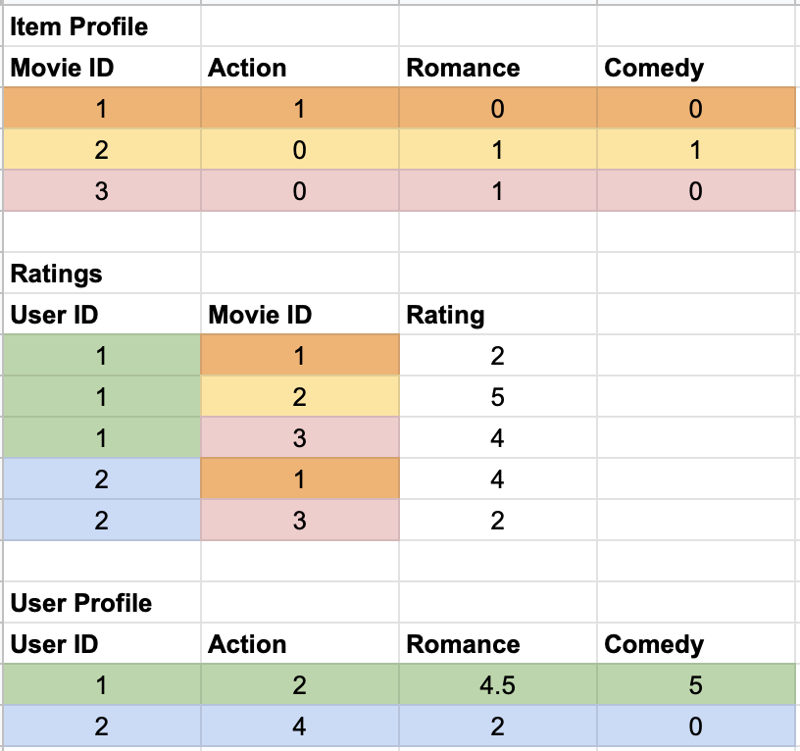
User and Item Vectors
Item Vector:
Vector of length total genres with 1 at relevant indices
User Vector:
Vector of length total genres with the value of average rating for each genre based on ratings in train set
Notes:
Item profile = Based on the the genre list for each movie, we build a movie profile. Example movie 1 belongs to genre [“Action”],movie 2 is a RomCom movie, and so on.
Using the ratings data, which has ratings for a movie by the user, we build a user profile.
Each entry in the user profile vector depicts the affinity of the user for that specific genre.

Slide 11
Evaluation metrics
Metric | Content based (Genre)
RMSE | 0.9185
MAE | 0.7095
Metric | Content based (Genre)
Precision | 0.800932214
Recall | 0.495168862
F-Measure | 0.6119842046
NDCG | 0.945576877

Slide 12
Movie-Movie Similarity
TF-IDF using overview and tagline of movies (from TMDb)
Issue: This just gives movies having similar description.
Notes:
As it is clearly seen from the movie title, movies with Christmas and Santa Claus are returned

Slide 13
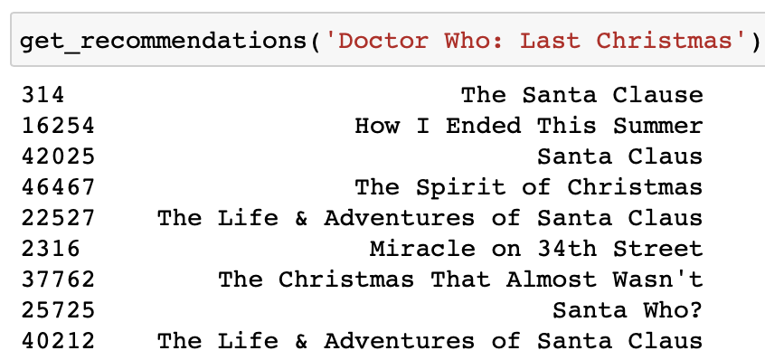
Movie-Movie Similarity (Cont.)
Overview of ‘Doctor Who: Last Christmas’
'The Doctor and Clara face their Last Christmas. Trapped on an Arctic base, under attack from terrifying creatures, who are you going to call? Santa Claus!'

Slide 14
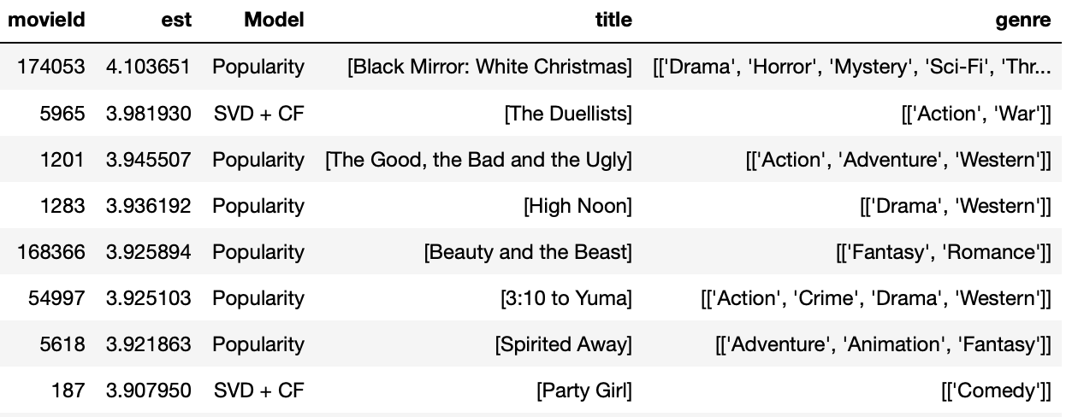

Slide 15
Takeaways:
Content based with genre is good when a user has less ratings.
Movie similarity metric based on features like overview, taglines and genre.
Item-item collaborative filtering works better than user-user collaborative filtering.
KNN based and SVD algorithms improve when global baselines are added.
Combining the predictions and recommendations of different models gives better results in terms of accuracy and quality of recommendations.

Slide 16
References:
Surprise library: https://surprise.readthedocs.io/en/stable/
Hybrid recommendation system: https://arxiv.org/pdf/1901.03888.pdf
Evaluating recommendation system: http://fastml.com/evaluating-recommender-systems/

Slide 17
Thank you!
Questions?

