Slide 1
PROBLEM BACKGROUND
Multi-Server System Analysis

Slide 2
Index
Problem Background: Multi-Server System Analysis
Simulation: Convergence till test T_{β}
Simulation: Distribution of T_{β}
Simulation: Convergence till time t_{β}
Simulation: Distribution of t_{β}

Slide 3
Multi-Server System Analysis
We aim to demonstrate that for any large t, the number of busy servers converge to a constant:
Busy servers at time t
Request arrival rate
Mean service duration

Slide 4

Multi-Server System Analysis
Let,
Arrival time of request k
Service duration for request k
where,
Then if $Z_{k}=u\left(t−X_{k}\right)−u(t−\left(X_{k}+S_{k}\right))$,

Slide 5
SIMULATION RESULTS
Section 1: Convergence till test T_{β}

Slide 6
Section 1: Convergence till test T_{β}
Question: “What does B(t) converge to for some large t?”
Solution:
Conduct multiple tests.
Sample value of B(t) at some t=k
Find mean of B(k) over T_{β} tests.
Terminate testing if B(k) ∈ B(t → ∞) ± 0.1%

Slide 7
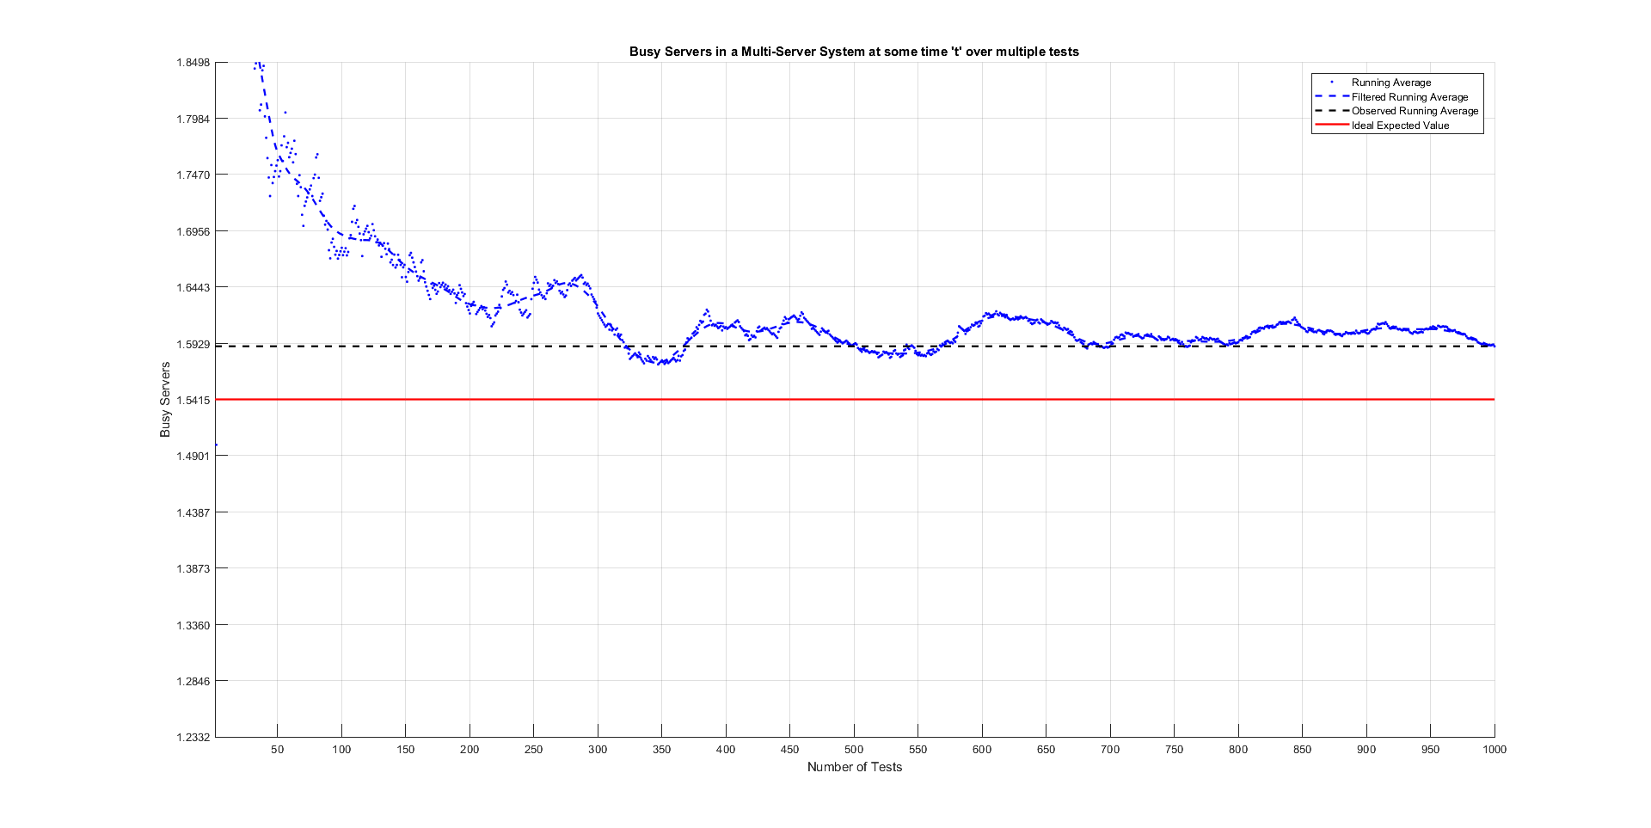
Section 1: Convergence till test T_{β}

Slide 8
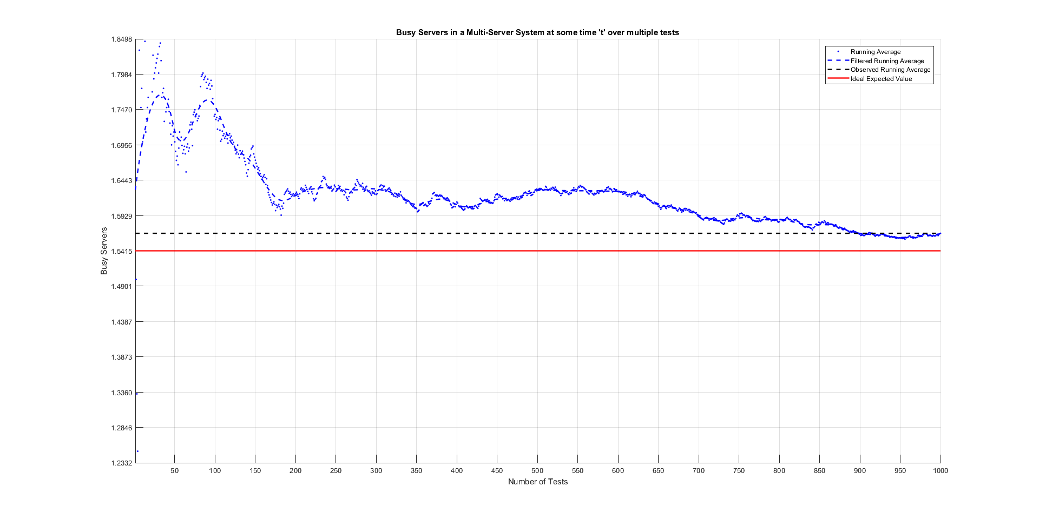
Section 1: Convergence till test T_{β}

Slide 9
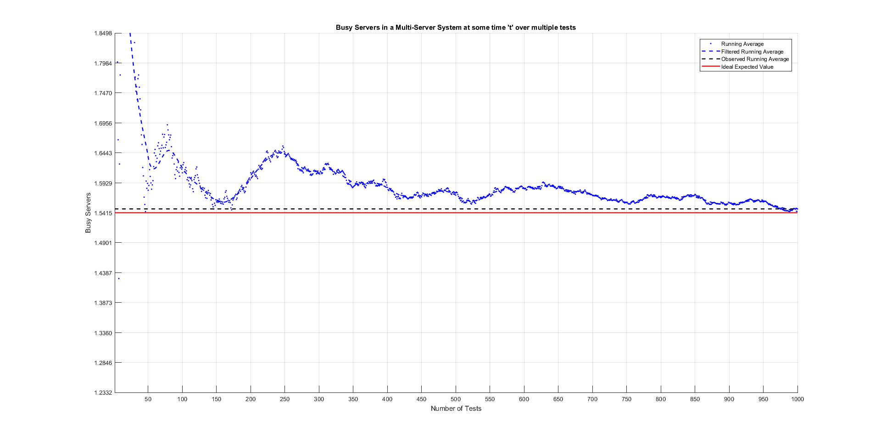
Section 1: Convergence till test T_{β}

Slide 10
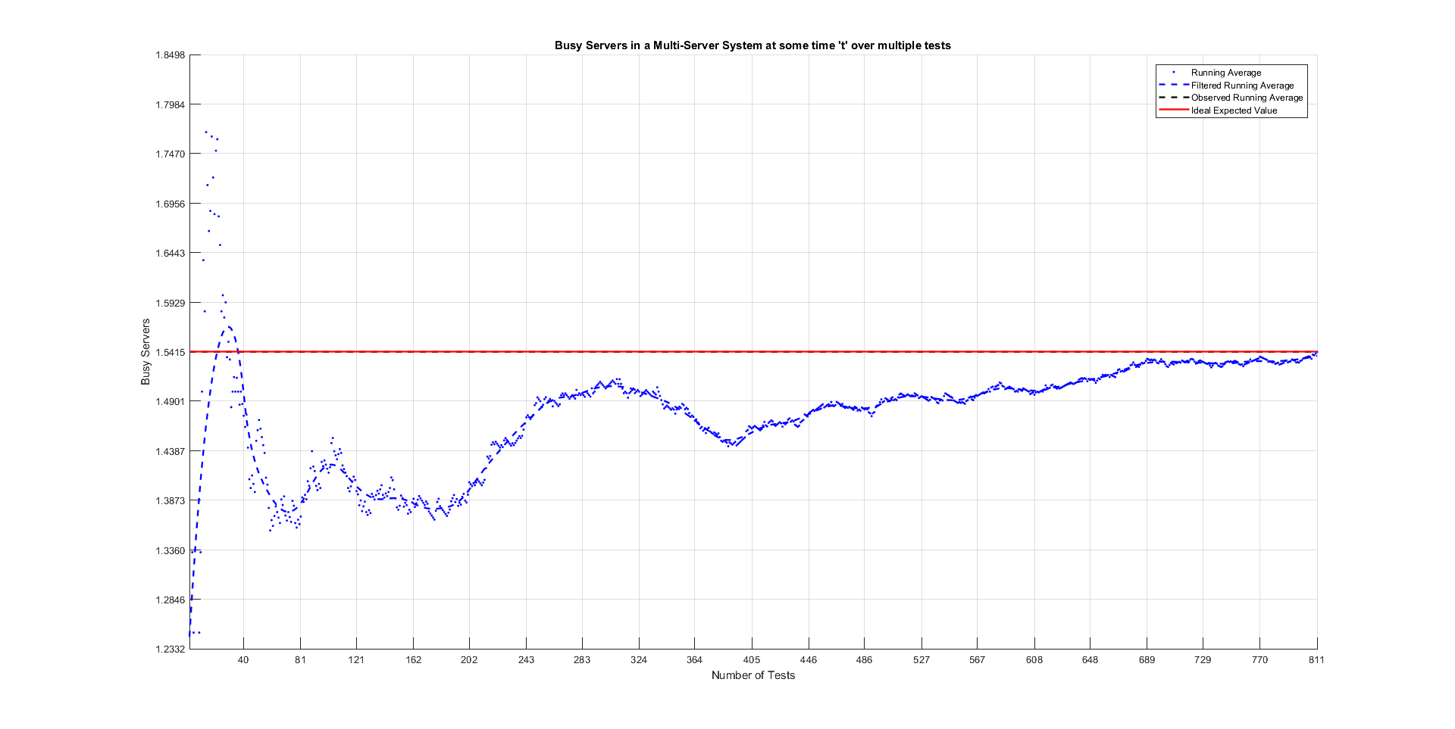
Section 1: Convergence till test T_{β}

Slide 11
SIMULATION RESULTS
Section 2: Distribution of T_{β}

Slide 12
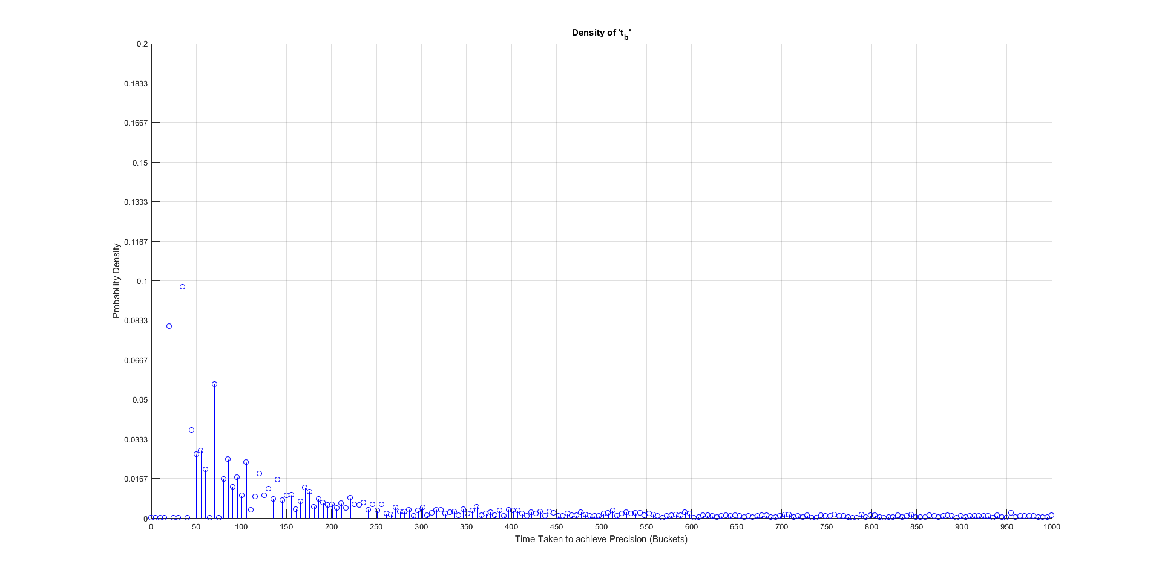
Section 2: Distribution of T_{β}
Density of T_{β} for λ=64, 1/μ=0.03125

Slide 13
SIMULATION RESULTS
Section 3: Convergence till time t_{β}

Slide 14

Section 2: Distribution of T_{β}
Question: “What time guarantees that the system is stationary?” or
Question: “What does $\lim_{n→∞}{\sum_{k=1}^{n}{\frac{\text{B}\text{(}\text{k}\text{λ}\text{)}}{\text{n}\text{λ}}}}$ converge to?”
Solution:
Conduct multiple tests.
Sample value of B(t) at some t=k
Find mean of B(k) over T_{β} tests.
Terminate testing if B(k) ∈ B(t → ∞) ± 0.1%

Slide 15
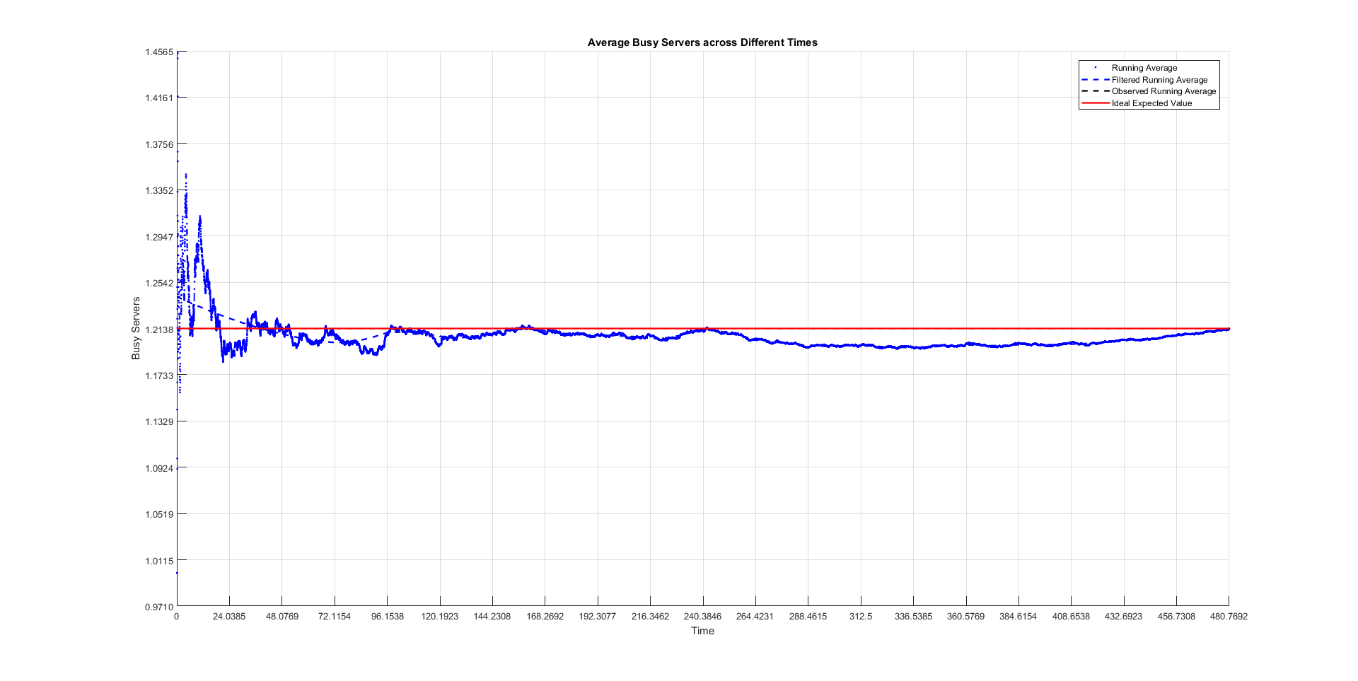
Section 3: Convergence till time t_{β}

Slide 16
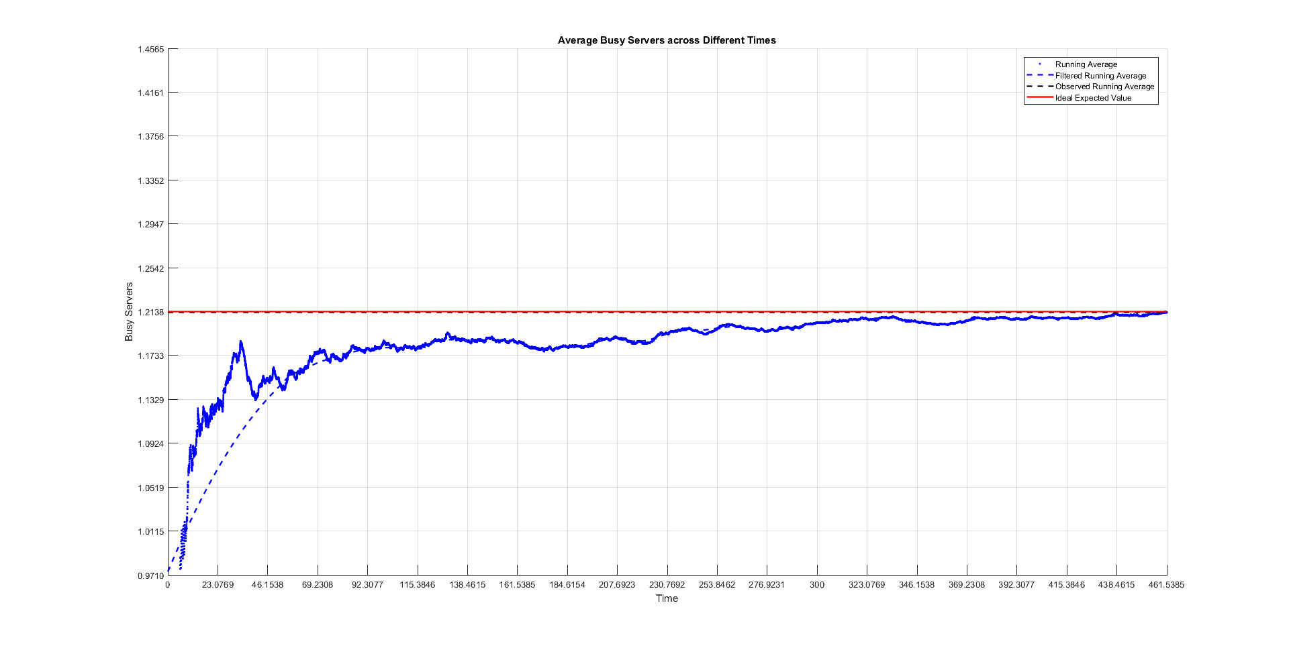
Section 3: Convergence till time t_{β}

Slide 17
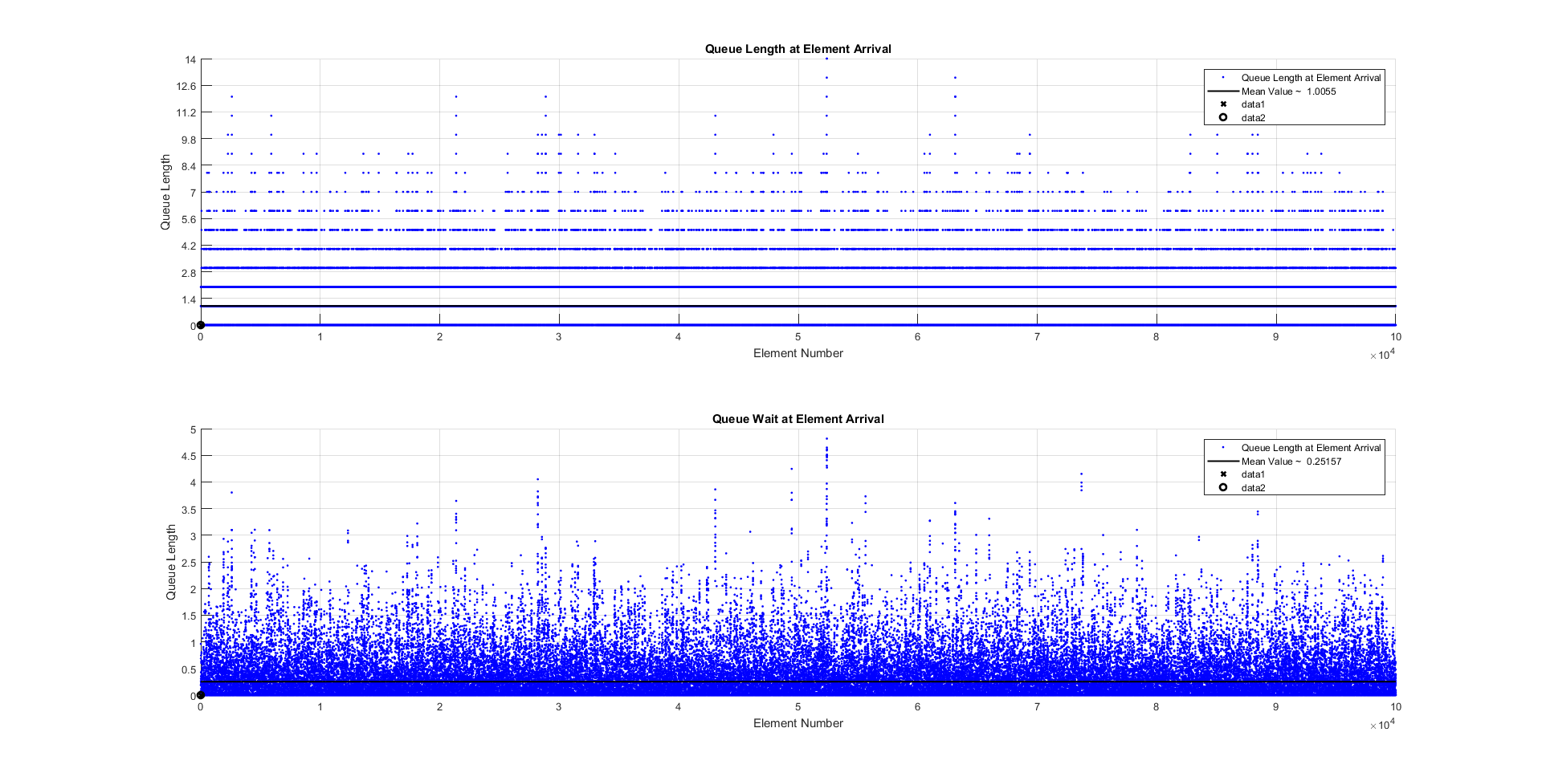
Section 3: Convergence till time t_{β}

Slide 18
Section 3: Convergence till time t_{β}

Slide 19
Section 3: Convergence till time t_{β}

Slide 20
SIMULATION RESULTS
Section 4: Distribution of t_{β}

Slide 21
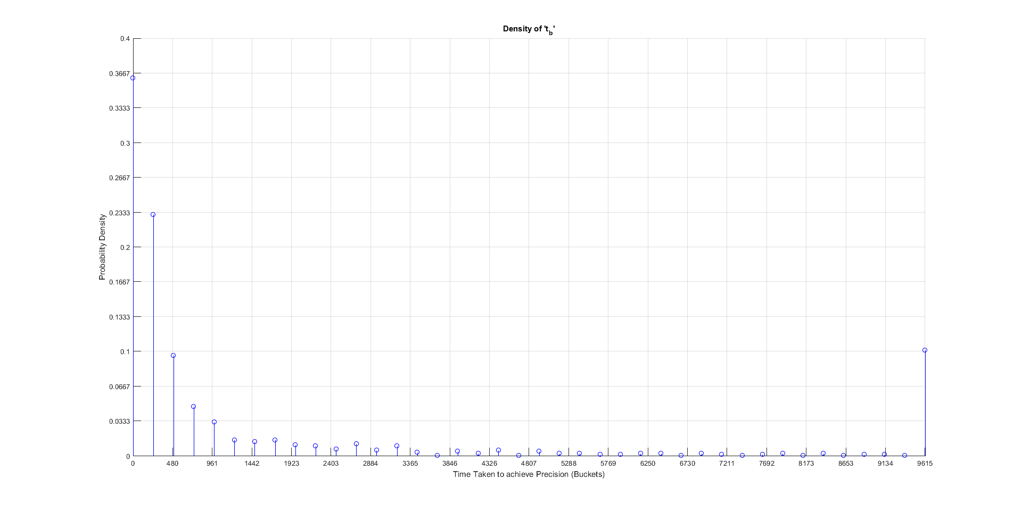
Section 4: Distribution of t_{β}
Density of t_{β} for λ=52, 1/μ=0.032

