Slide 1
PROBLEM BACKGROUND
Multi-Server System Analysis

Slide 2
Index
Problem Background: Multi-Server System Analysis
Simulation: Convergence till test T_{β}
Simulation: Distribution of T_{β}
Simulation: Convergence till time t_{β}
Simulation: Distribution of t_{β}
Theory: Summary of Proof

Slide 3
Multi-Server System Analysis
We aim to perform the simulation under this constraint:
Sum of Exponential Random Variables for Service Time
Sum of Exponential Random Variables for Inter-arrival Delay

Slide 4
Multi-Server System Analysis
Let,
with,
where,

Slide 5
SIMULATION RESULTS
Section 1: Convergence till test T_{β}

Slide 6
Section 1: Convergence till test T_{β}
We iterate through a range of n values with λ_{D}⁻¹= 0.5, λ_{S}⁻¹ = 0.25:
n_{D} | Number of Points | Mean Queue Length | Mean Queue Wait Time
2⁰ | 100,000 | 1.0081 | 0.2519
2¹ | 100,000 | 0.6203 | 0.15614
2² | 100,000 | 0.43436 | 0.10816
2³ | 100,000 | 0.34816 | 0.088109
2⁴ | 100,000 | 0.30009 | 0.074664
2⁵ | 100,000 | 0.27533 | 0.068502
2⁶ | 100,000 | 0.27046 | 0.067925
2⁷ | 100,000 | 0.25605 | 0.063816
2⁸ | 100,000 | 0.25729 | 0.063594
2⁹ | 100,000 | 0.2577 | 0.064077

Slide 7
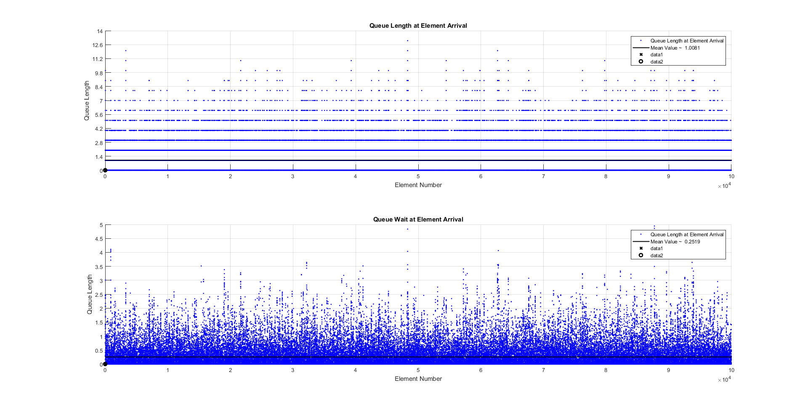
Section 1: Convergence till test T_{β}

Slide 8
SIMULATION RESULTS
Section 2: Distribution of T_{β}

Slide 9
Section 2: Distribution of T_{β}
We iterate through a range of n values with λ_{D}⁻¹= 0.5, λ_{S}⁻¹ = 0.25:
n_{S} | Number of Points | Mean Queue Length | Mean Queue Wait Time
2⁰ | 100,000 | 0.99336 | 0.24662
2¹ | 100,000 | 0.87405 | 0.18754
2² | 100,000 | 0.81063 | 0.15581
2³ | 100,000 | 0.77732 | 0.13941
2⁴ | 100,000 | 0.76748 | 0.13342
2⁵ | 100,000 | 0.74584 | 0.12602
2⁶ | 100,000 | 0.74792 | 0.12591
2⁷ | 100,000 | 0.75703 | 0.12699
2⁸ | 100,000 | 0.75266 | 0.12607
2⁹ | 100,000 | 0.74236 | 0.12377

Slide 10
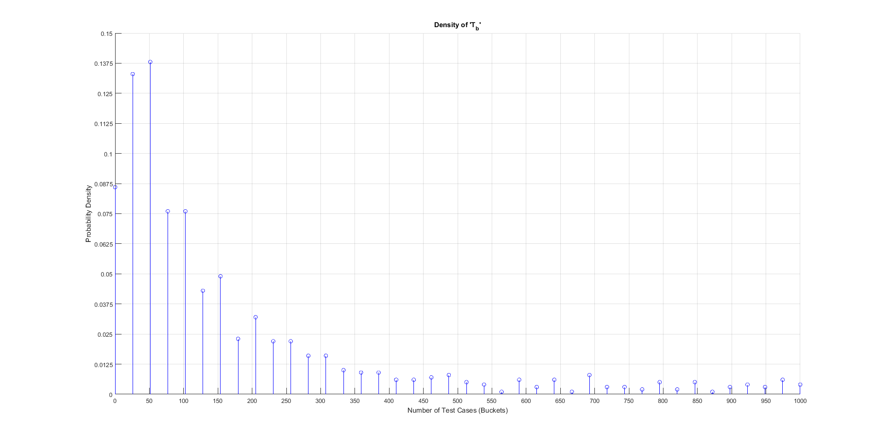
Section 2: Distribution of T_{β}
Density of T_{β}

Slide 11
SIMULATION RESULTS
Section 3: Convergence till time t_{β}

Slide 12
Section 3: Convergence till time t_{β}
We iterate through a range of n values with λ_{D}⁻¹= 0.5, λ_{S}⁻¹ = 0.25:
n_{D,} n_{S} | Number of Points | Mean Queue Length | Mean Queue Wait Time
2⁰ | 100,000 | 1.0055 | 0.25157
2¹ | 100,000 | 0.48158 | 0.95086
2² | 100,000 | 0.24013 | 0.032588
2³ | 100,000 | 0.10152 | 0.0084182
2⁴ | 100,000 | 0.02834 | 0.0012837
2⁵ | 100,000 | 0.00333 | 8.9225e-05
2⁶ | 100,000 | 5e-05 | 7.9388e-07
2⁷ | 100,000 | 0 | 0
2⁸ | 100,000 | 0 | 0
2⁹ | 100,000 | 0 | 0

Slide 13
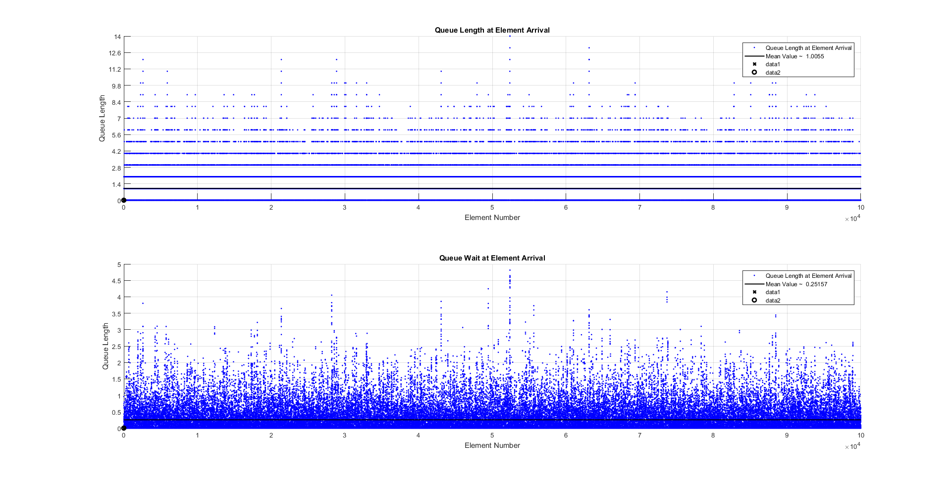
Section 3: Convergence till time t_{β}

Slide 14
SIMULATION RESULTS
Section 4: Distribution of t_{β}

Slide 15
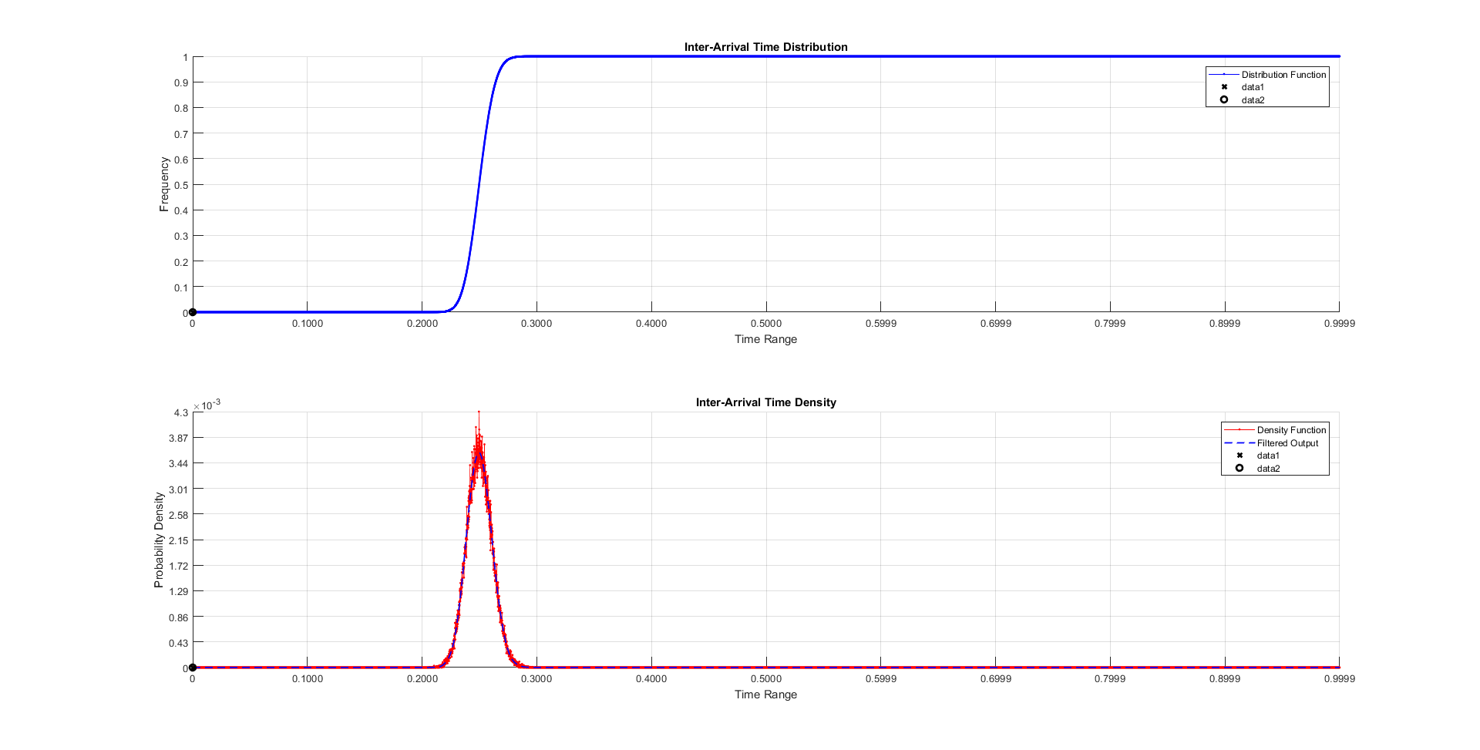
Section 4: Distribution and Density Functions
Service Duration Distribution with λ_{S}⁻¹ = 0.25 with n_{S} = 9 convolutions
Service Duration Density with λ_{S}⁻¹ = 0.25 with n_{S} = 9 convolutions

