Slide 1
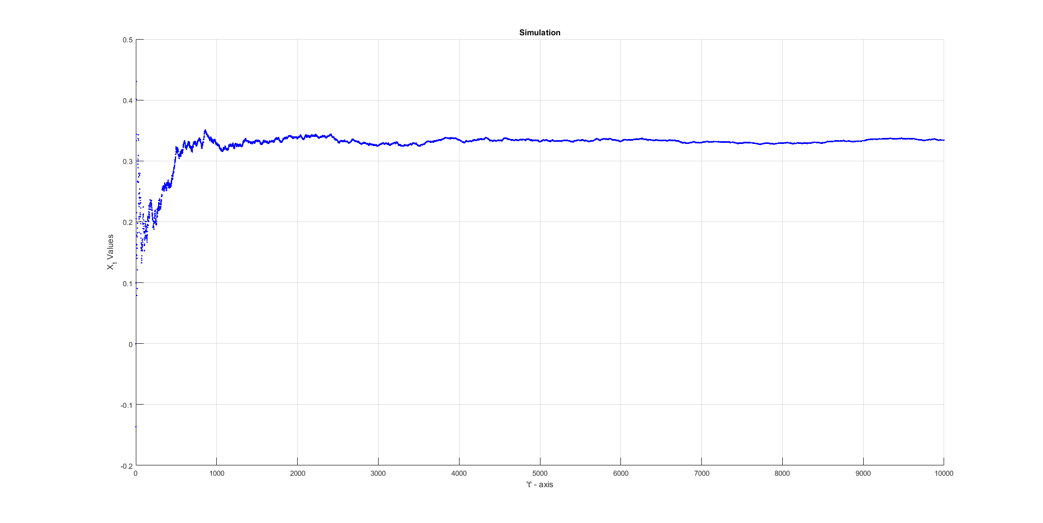
Recursive Convergence

Slide 2
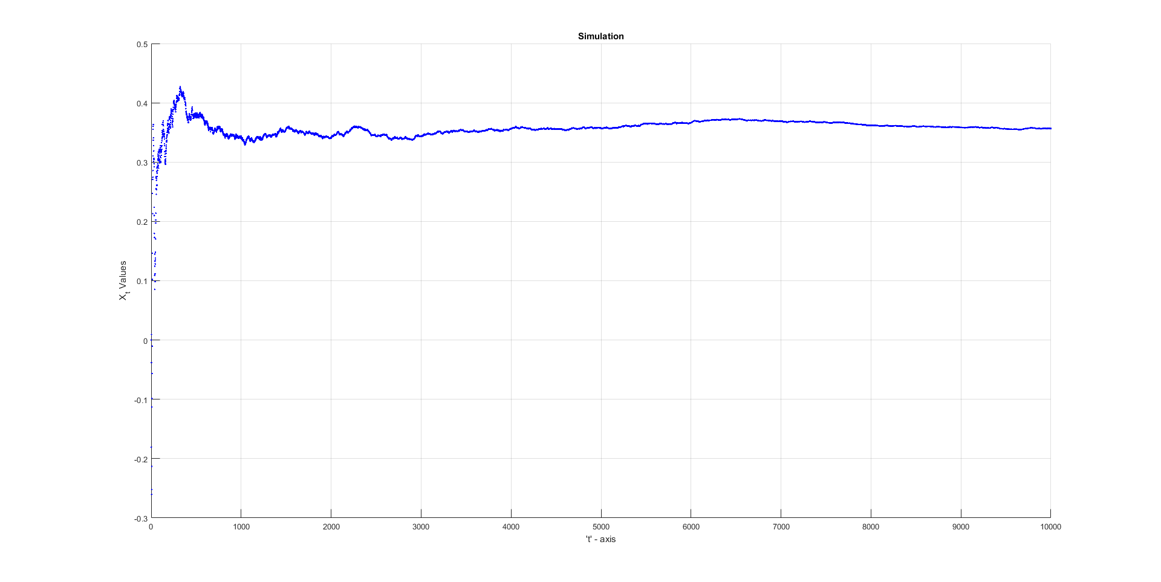
Recursive Convergence

Slide 3
Recursive Convergence

Slide 4
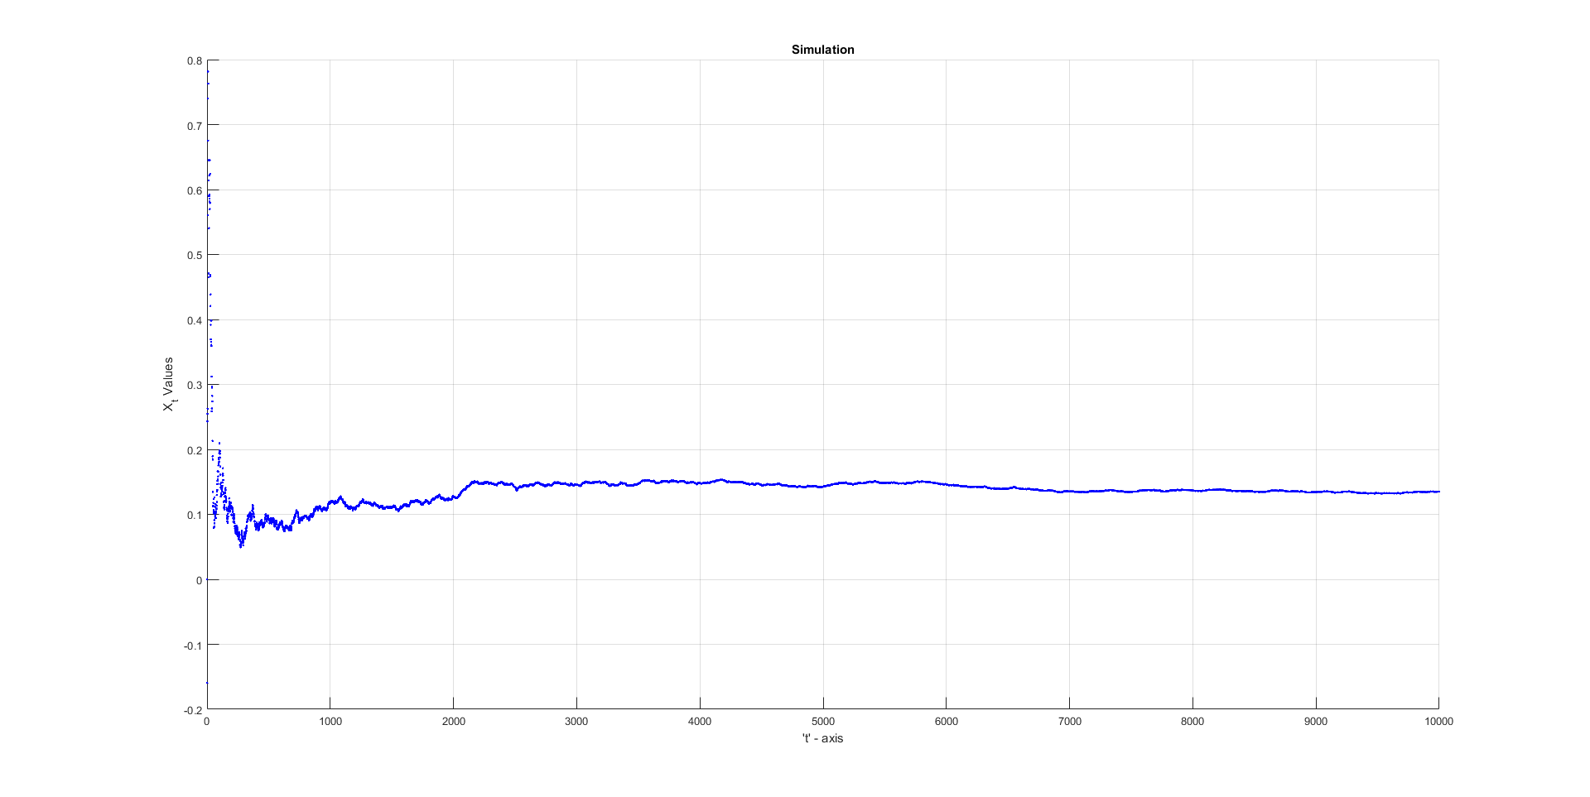
Recursive Convergence

Slide 5
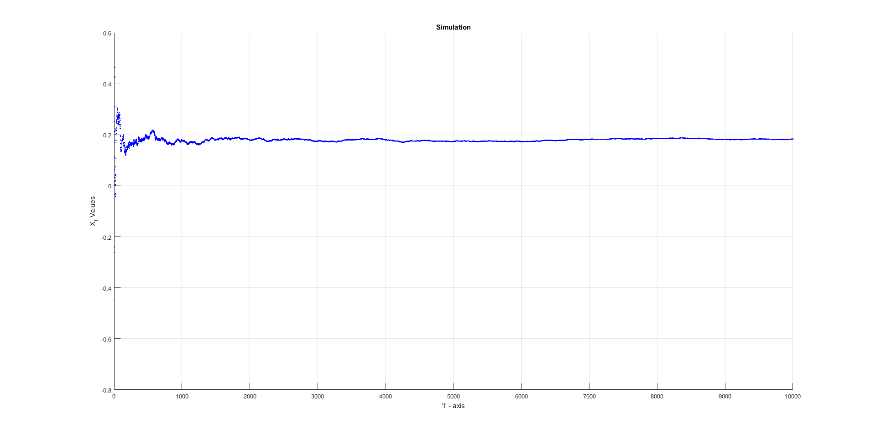
Recursive Convergence

Slide 6
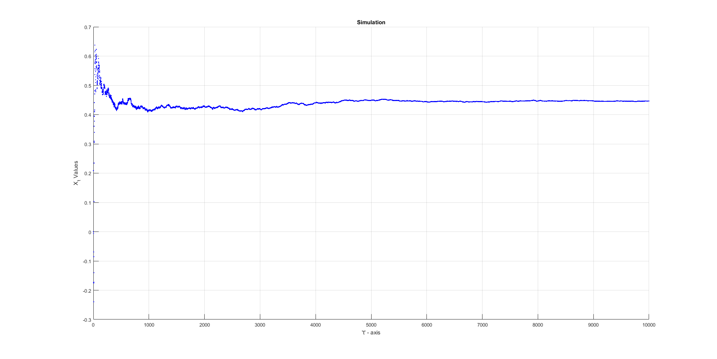
Recursive Convergence

Slide 7
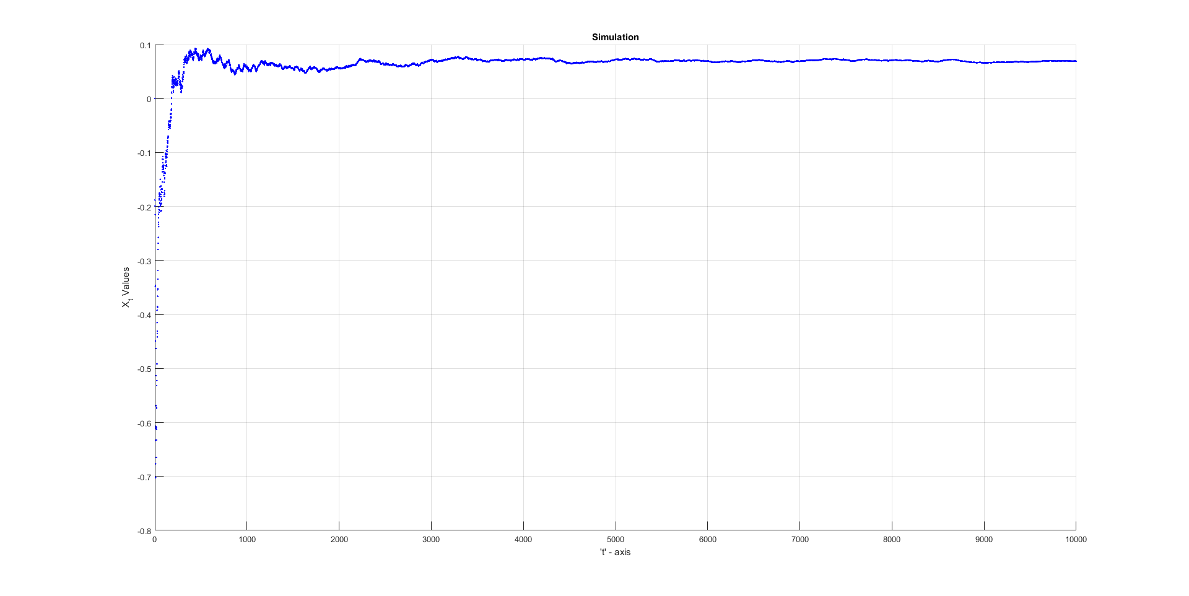
Recursive Convergence

