Slide 1
Machine Learning Project
Prabal Ghosh
MSc DSAI Université Côte d'Azur Date- 16/12/2023

Slide 2
Introduction
In predicting Site Energy Use Intensity (EUI) for buildings, the key to accurate forecasts lies in data preprocessing. Each dataset row signifies a unique building observed in a specific year, challenging us to employ regression techniques effectively.
Data preprocessing plays a pivotal role in refining, cleaning, and transforming raw data for machine learning algorithms. This presentation explores how preprocessing techniques optimize datasets for regression analysis, ensuring enhanced model accuracy and reliable EUI predictions.
By implementing effective preprocessing methods, we aim to contribute to informed decision-making and sustainable energy management in building analytics.

Slide 3


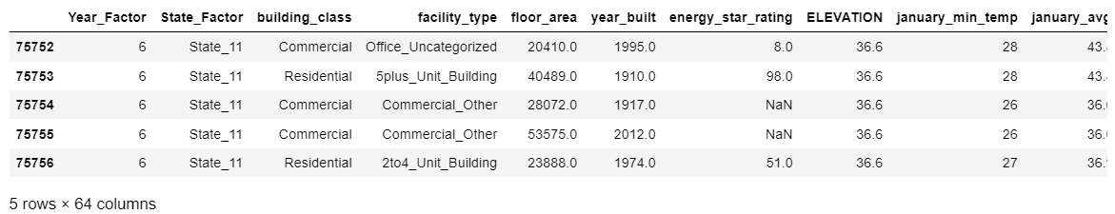
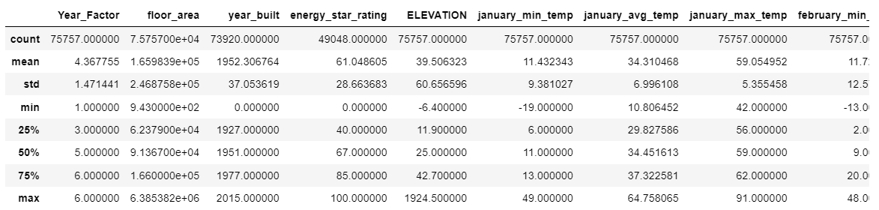
Data set Overview
Size:
Summary statistics (size, features, data types)
Removal of 'id' column as all are unique and irrelevant.
There are a total of six different values for the 'Year_Factor' feature in this dataset. Therefore, I will use one-hot encoding for these values, considering them as distinct levels as categorical entries.

Slide 4
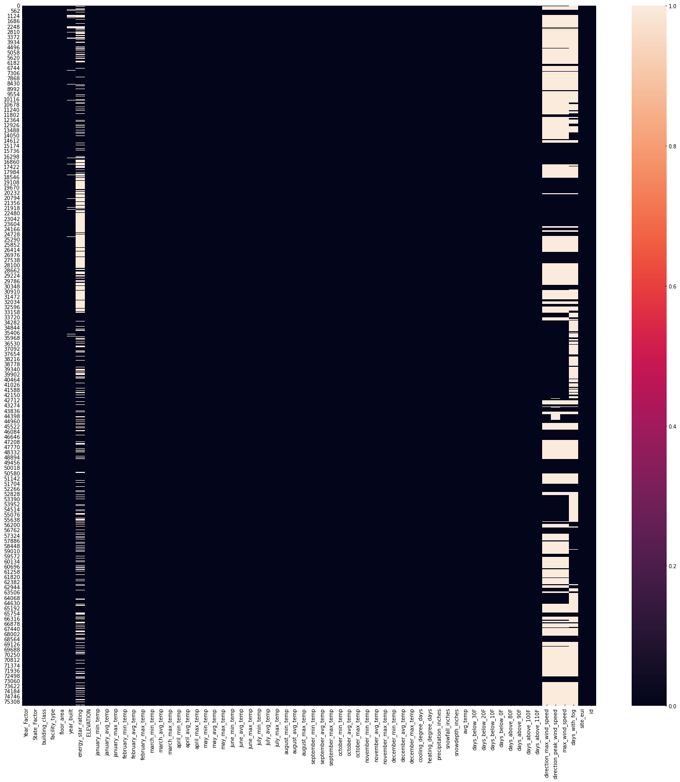
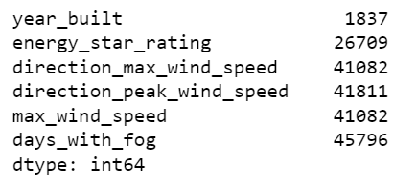
Missing Data Analysis
Data Preprocessing:
Approach for handling missing data (imputation strategy)
Dropping columns with excessive null values (>40,000 instances)
'direction_max_wind_speed',
'direction_peak_wind_speed',
'max_wind_speed',
'days_with_fog'
Filling null values in 'year_built' and 'energy_star_rating' using mean.

Slide 5
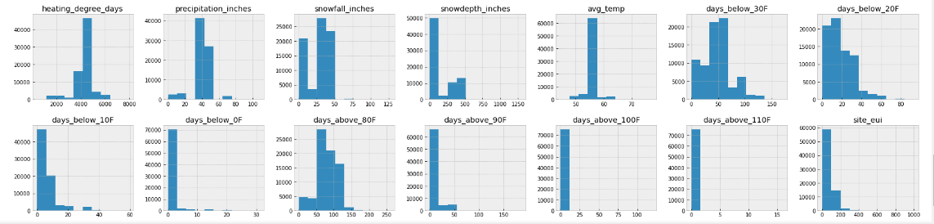
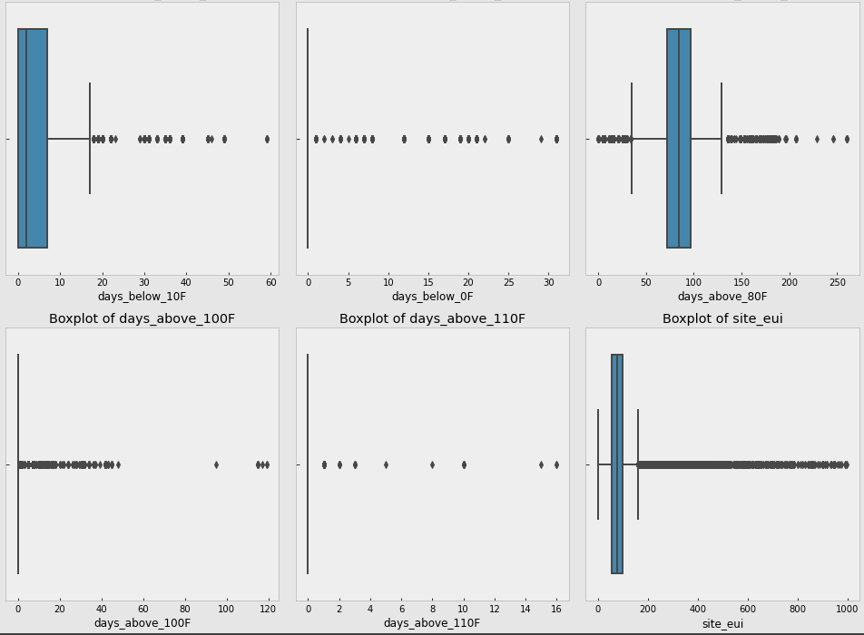
Outlier Detection and Treatment
Boxplot visualization for outlier detection
Identification of columns with predominantly zero values and decision to drop them
droped = ['days_above_110F', 'days_above_100F','days_below_0F']
Approach for handling outliers
The presence of a large number of outliers does not necessarily indicate their irrelevance. decision not to remove those outliers.

Slide 6
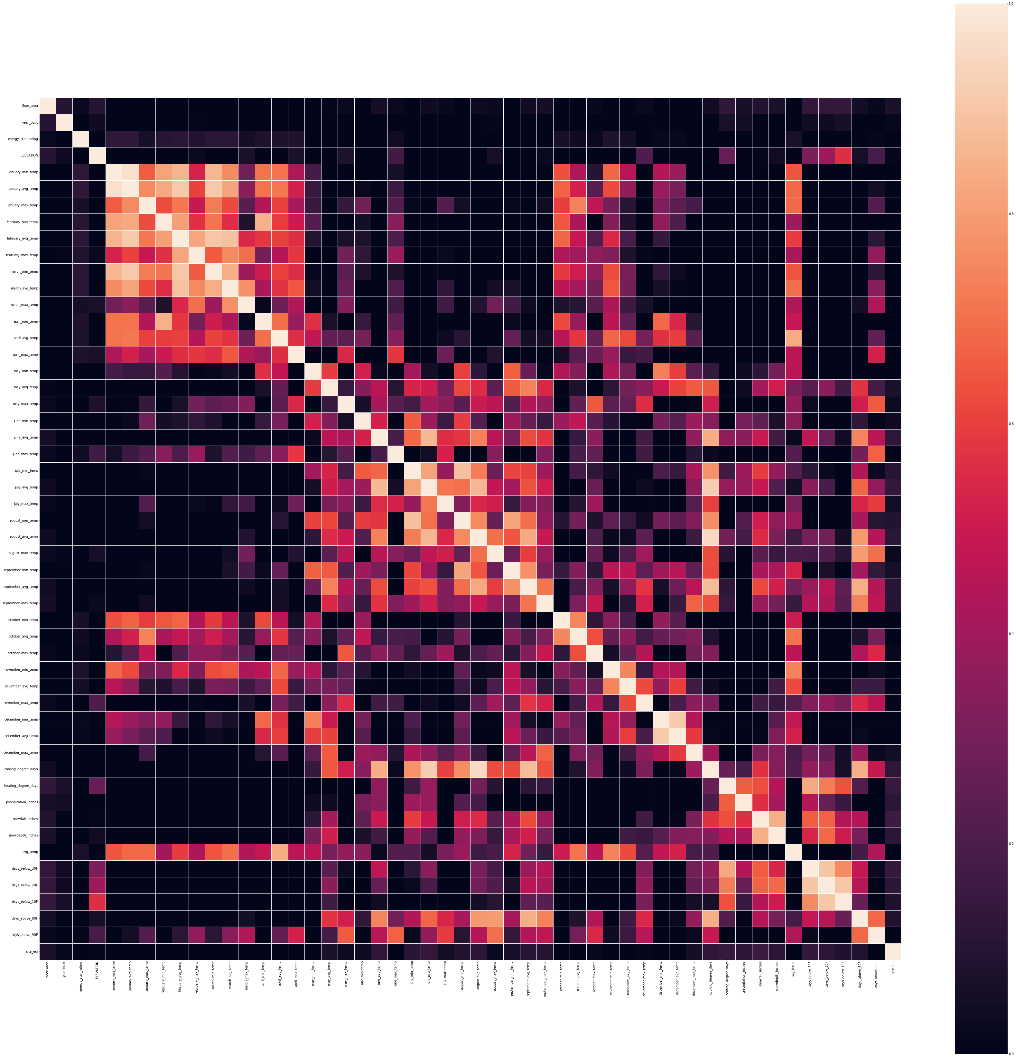
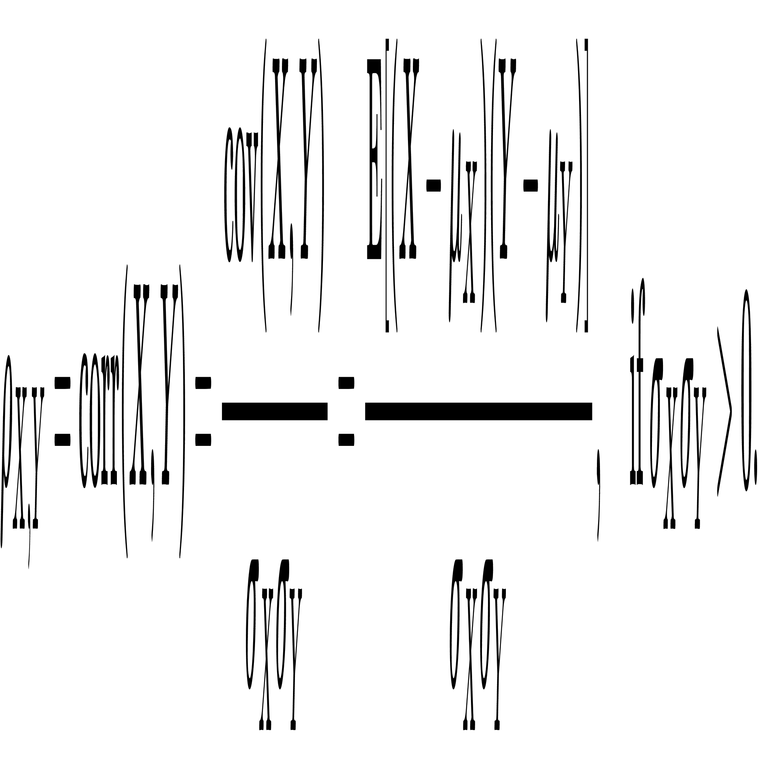
Correlation Analysis
Correlation matrix to check highly correlated features
Procedure for removing highly correlated features (threshold = 0.9)

Slide 7
Train test split
X = energy_df.drop(['site_eui'],axis=1)
y = energy_df['site_eui']
train_test_split is 80 to 20

Slide 8
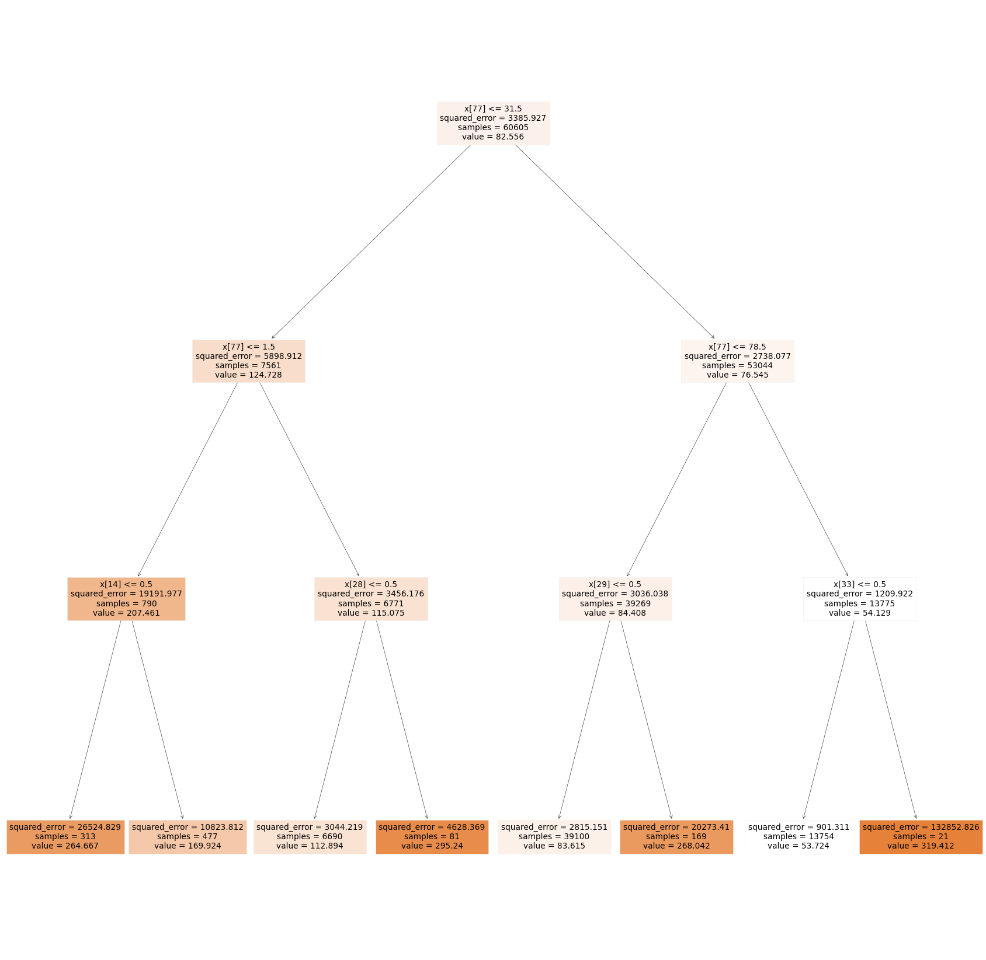
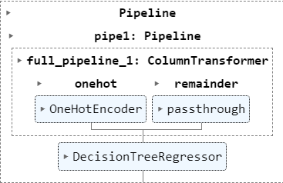
Decision Tree Model Preparation
For the decision tree Regressor model:
Before fitting the data into the decision tree model apply one-hot encoding to categorical features.
No need to perform normalization on numerical features as they are not sensitive to the scale of numerical features.

Slide 9
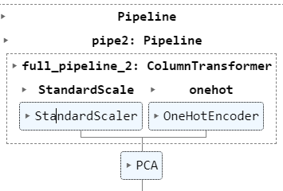
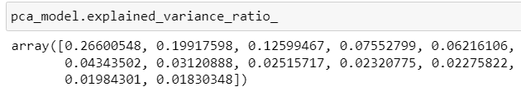
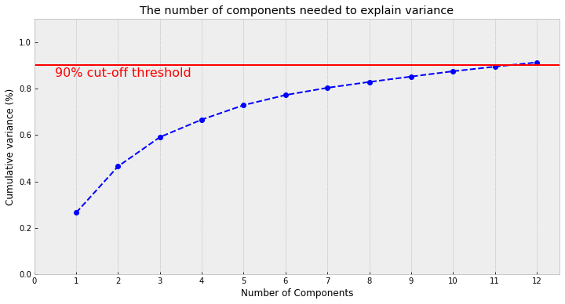
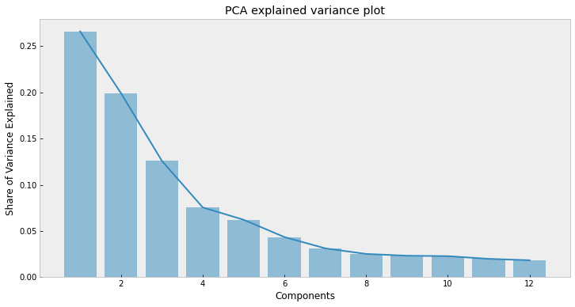
PCA (Principal Component Analysis)
Steps taken for PCA, including normalization and handling categorical features
Principal Component Analysis (PCA) is a dimensionality reduction technique used to reduce the number of features (variables) while retaining the most important information or patterns present in the original dataset.

Slide 10
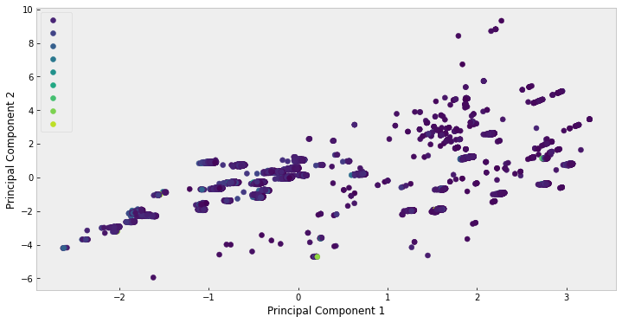
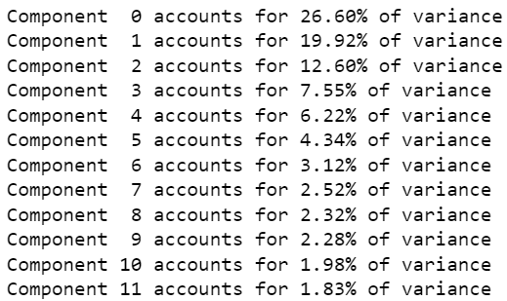
Determining Optimal Number of Principal Components Methods
Examining the Knee in Explained Variance Plot.-----> 4 - 6 Components
80% of the explained variance threshold-->encompass the first 7 components.
n_components= 12 will capture 90% of feature knowledges(variance).
These methods assist in striking a balance between computational efficiency and model performance by selecting an appropriate number of principal components for dimensionality reduction.
PLOT THE DATA WITH 2 PCA COMPONENTS-

Slide 11
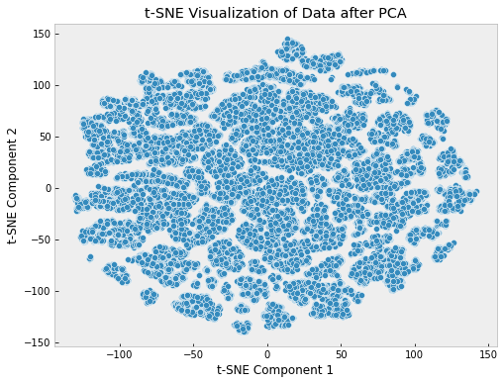
Visualization with t-SNE
Plot t-SNE on the PCA-transformed data
Dimensionality reduction using PCA (Principal Component Analysis) followed by t-SNE (t-distributed Stochastic Neighbor Embedding) for visualizing the dataset in a 2D space.
# Apply PCA
pca_t = PCA(n_components=2) X_pca = pca_t.fit_transform(X_train_transformed2)
# Apply t-SNE on the PCA-transformed data
tsne = TSNE(n_components=2, random_state=42)
X_tsne = tsne.fit_transform(X_pca)

Slide 12
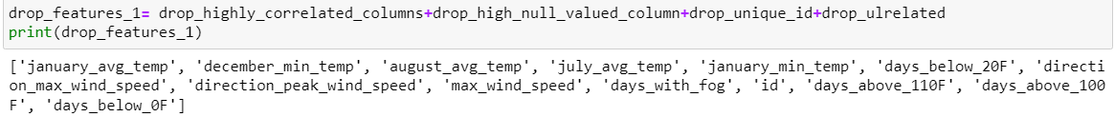
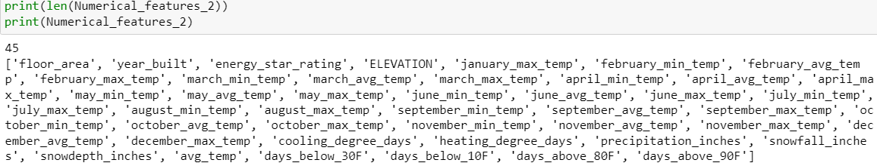
Scikit-Learn's Pipeline
Benefits of Using Pipelines: 1. Simplified Workflow: Pipelines allow us to combine several data processing steps into a single object, making it easier to manage and reproduce the workflow. 2. Preventing Data Leakage: Pipelines help in avoiding data leakage by ensuring that preprocessing steps (e.g., scaling, imputation) are applied consistently to training and testing data. 3. Cross-Validation Handling:
It's simpler to perform cross-validation with a pipeline since transformations occur within each fold, preventing data leakage and ensuring a more accurate estimation of model performance.
# Initialze the estimators
clf1 = RandomForestRegressor()
clf2 = Lasso()
clf3 = LinearRegression()
clf4 = Ridge()
clf5 = ElasticNet()
clf6 = DecisionTreeRegressor()

Slide 13
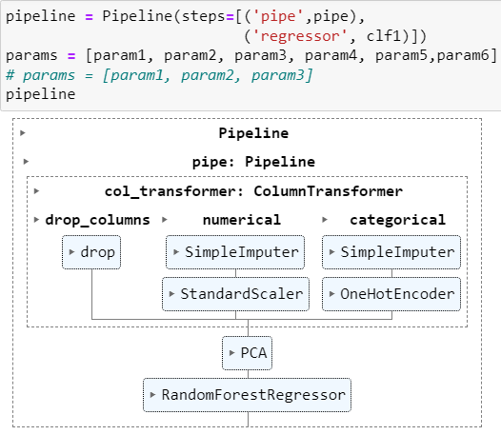
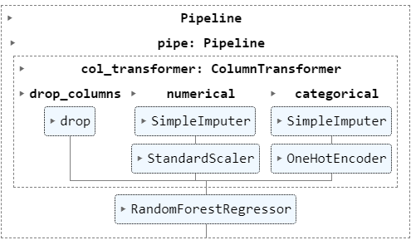
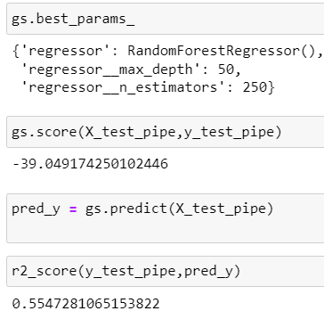
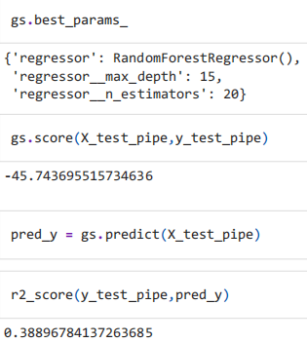
GridSearchCV(pipeline, params, cv=3, n_jobs=-1, scoring='neg_root_mean_squared_error', verbose=3,error_score='raise')
# Initiaze the hyperparameters for each dictionary
#hyperparameters for RandomForestRegressor
param1 = {}
param1['regressor__n_estimators'] = [10,20]
param1['regressor__max_depth'] = [10,25]
param1['regressor'] = [clf1]
#hyperparameters for Lasso
param2 = {}
param2['regressor__alpha'] = [0.1, 1, 10]
param2['regressor'] = [clf2]
#hyperparameters for LinearRegression
param3 = {}
param3['regressor'] = [clf3]
#hyperparameters for Ridge
param4 = {}
param4['regressor__alpha'] = [0.1, 1]
param4['regressor'] = [clf4]
#hyperparameters for ElasticNet
param5 = {}
param5['regressor__alpha'] = [0.1, 1]
param5['regressor__l1_ratio'] = [0.2, 0.5, 0.7]
param5['regressor'] = [clf5]
#hyperparameters for DecisionTreeRegressor
param6 = {}
param6['regressor__max_depth'] = [3, 6]
param6['regressor'] = [clf6]

Slide 14
Conclusion
Using Gridsearch I found that RandomForestRegressor is the best model with max_depth 15 and n_estimators 20 which shows R2 score 0.38896 and negative root mean square error is -45.18.
Without PCA with that same Model it shows R2 score 0.56 and negative root mean square error -39.
So proper hyperparameter tuning is very important.

Slide 15
Thank you

