Slide 1

Physically-Informed Machine Learning for Modelling the Dynamics of Plant-Pathogens Molecular Interactions
Name - Prabal Ghosh
Supervisor - Silvia Bottini
Course- Research Project
Msc Data Science and Artificial Intelligence (M2)
Université Côte d’Azur, Sophia Antipolis, France

Slide 2
Agenda
Introduction
Research Objectives
Dataset
Methodology
Experimental Setup
Results and Discussion
Comparison of Models
Conclusion
Limitations and Future Work

Slide 3
Introduction
Horticulture & Biotic Threats:
Plants face pathogen attacks, triggering complex immune responses.
Understanding molecular mechanisms is crucial for disease resistance.
Role of Omics Technologies:
Transcriptomics helps study gene expression changes over time.
Challenges:
Traditional models fail to capture temporal gene expression patterns.

Slide 4
Research Objectives
Understanding Time-Dependent Transcriptomics Data
Integrating Physical Constraints with Data-Driven Methods
Developing Robust Models for Gene Expression Analysis and prediction.

Slide 5
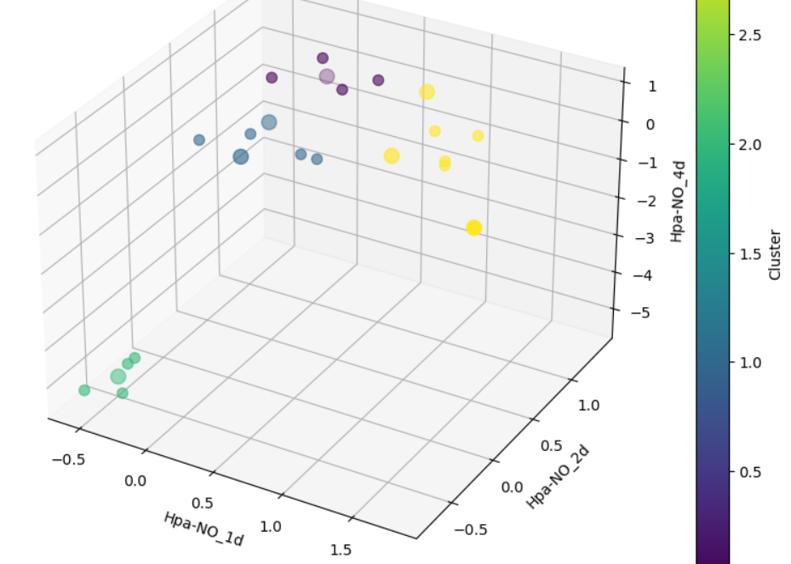
Dataset
Dataset Description:
Tomato plants infected by three distinct pathogens.
Data collected from leaves and roots across 3 time points.
Analytical Challenges:
Sparsity: Few time points and limited samples.
High noise levels in transcriptomic measurements.

Slide 6
Why Physics-Informed Machine Learning?
Traditional statistical methods do not account for underlying physical principles.
Physics-informed methods allow for the inclusion of known dynamics.
Enhanced interpretability by embedding physical laws.
Improved prediction accuracy in sparse, noisy datasets.

Slide 7
Methodology
Key Techniques Used:
Inverse Physics-Informed Neural Networks (IPINN)
Neural Ordinary Differential Equations (Neural ODEs) (parametric)
Hybrid Model (IPINN + Neural ODEs(parametric))
General Workflow:
Data Preprocessing → Model Training → Parameter Estimation → Clustering (Kmeans) and Analysis (prediction)

Slide 8
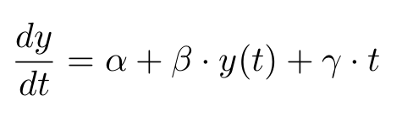
Ordinary Differential Equation Model
First-Order Linear ODE Model:
α (Basal Rate): Represents the constant rate of change in gene expression.
β (Feedback Effect): Determines whether genes are self-activating or inhibiting.
γ: Time-dependent external factors.

Slide 9
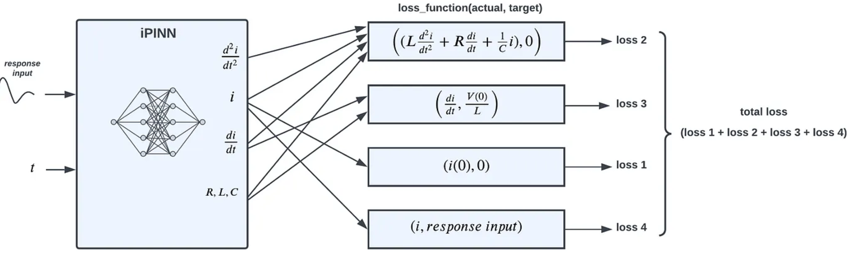
Inverse Physics-Informed Neural Networks (IPINN)
Inverse problem:
The governing equations (ODEs/PDEs) are known, but some parameters are unknown.
Neural network is trained to approximate both the solution y(t) and the unknown ODE parameters.
Data Loss= MSE between predicted and observed data.
Physics_loss = MSE between the learned network's derivatives and the governing ODE.
Initial_condition_loss = (y_pred[0] - y_data[0])**2
total_loss = data_loss + physics_loss + initial_condition_loss
Architecture:
3 layers, 50 neurons per hidden layer, Tanh activation.
Advantages:
Ensures physics-consistent predictions.
Works well with limited data.

Slide 10
Neural ODE Framework
Key Features:
Neural network models ODE dynamics directly.
Parameterized Neural ODEs) extend the standard Neural ODE framework by incorporating additional parameters
Learns parameters by minimizing Mean Squared Error (MSE).
Architecture:
2 layers, 16 neurons each, Tanh activation.
Trained using Adjoint Sensitivity Method.
Advantages:
Handles irregular time intervals efficiently.

Slide 11
Hybrid Model (IPINN + Neural ODEs (parametric))
Combines Both Models:
Data-driven flexibility from Neural ODEs.
Physics constraints from PINNs.
Loss Function:
Data loss - MSE between numerically solved predicted and observed data.
Physics Loss: MSE between autograd-computed derivatives and the derivatives defined by the learned ODE parameters
Architecture:
Similar to Neural ODE, optimized for both data and physics consistency.

Slide 12
Experimental Setup
! pip install torch
!pip install torchdiffeq

Slide 13
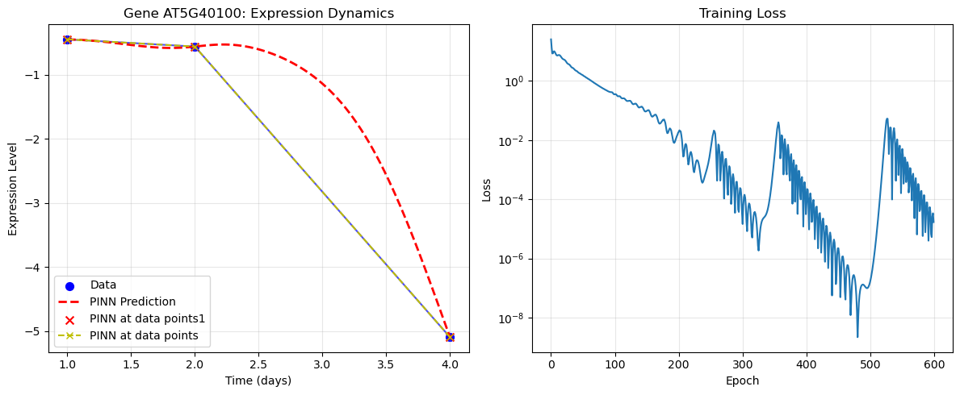
Result
For Gene AT5G40100, the left graph shows the observed data, predicted data, and model predictions, while the right graph displays the training loss curve in the case of IPINN.

Slide 14
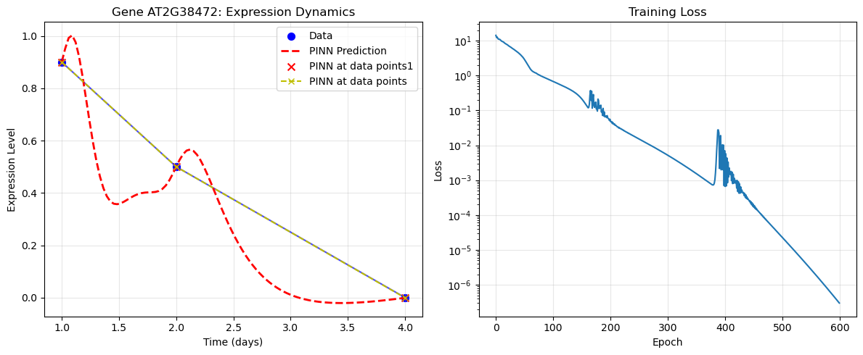
Result
For Gene AT2G38472, the left graph shows the observed data, predicted data, and model predictions, while the right graph displays the training loss curve in the case of IPINN.

Slide 15
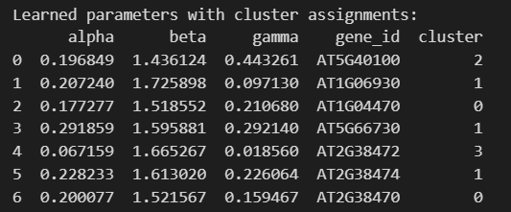
Result
Parameters and the clusters of the genes in the case of the IPINN

Slide 16
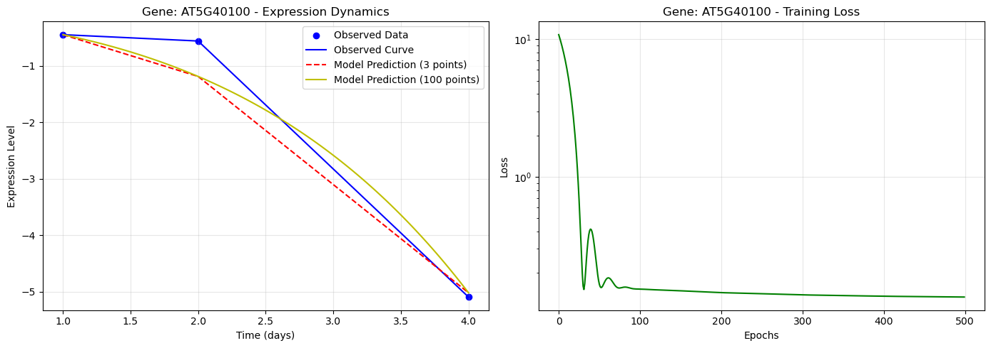
Result
For Gene AT5G40100, the left graph shows the observed data, predicted data, and model predictions, while the right graph displays the training loss curve in the case of Neural ODE (parametric).

Slide 17
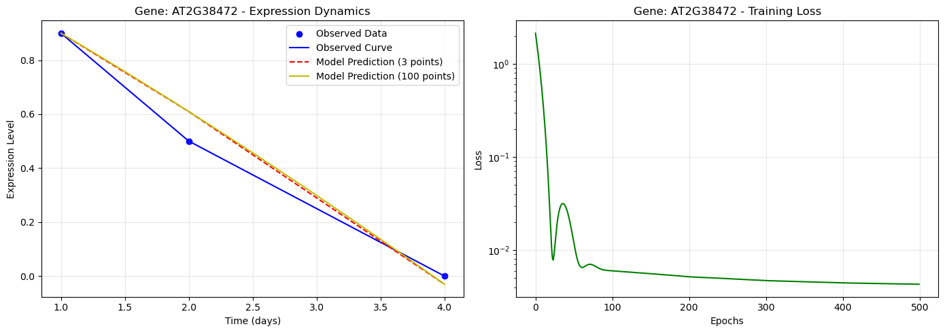
Result
For Gene AT2G38472, the left graph shows the observed data, predicted data, and model predictions, while the right graph displays the training loss curve in the case of Neural ODE (parametric).

Slide 18
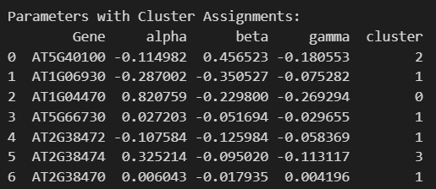
Result
Parameters and the clusters of the genes in the case of Neural ODE (parametric).

Slide 19
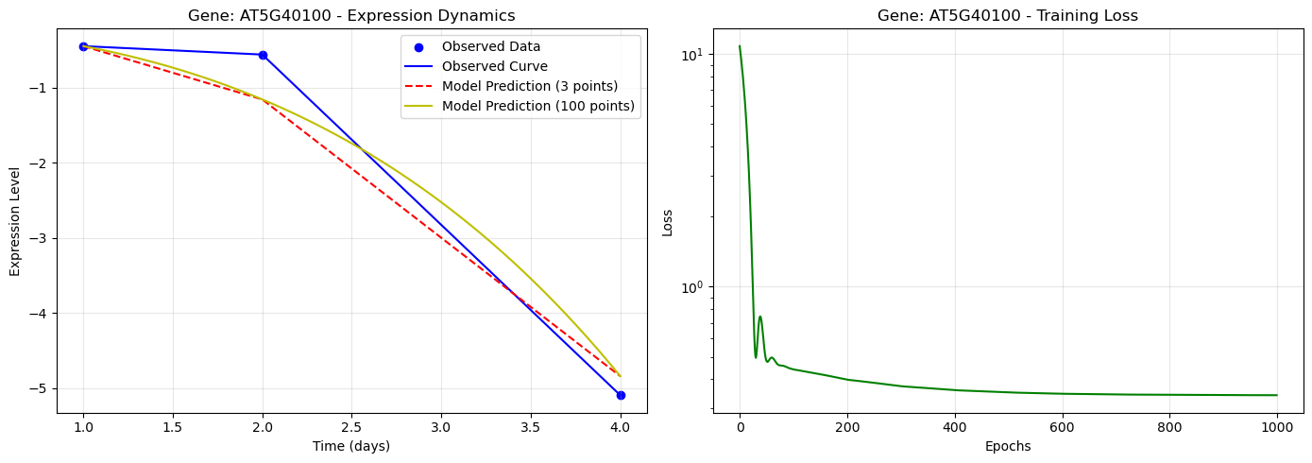
Result
For Gene AT5G40100, the left graph shows the observed data, predicted data, and model predictions, while the right graph displays the training loss curve in the case of the hybrid model(IPINN+Neural ODE (parametric).).

Slide 20
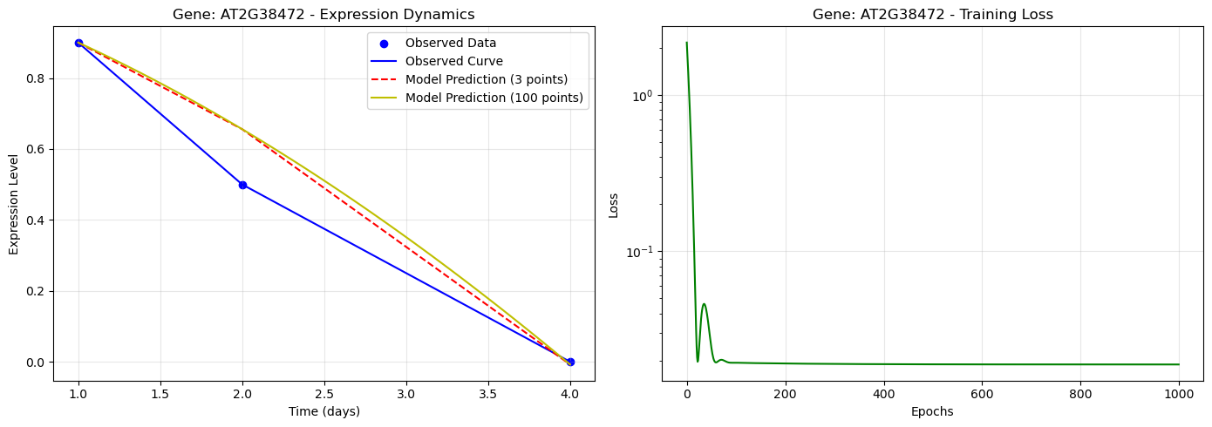
Result
For Gene AT2G38472, the left graph shows the observed data, predicted data, and model predictions, while the right graph displays the training loss curve in the case of the hybrid model(IPINN+Neural ODE (parametric)).

Slide 21
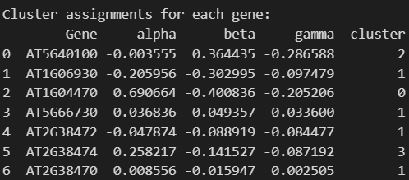
Result
Parameters and the clusters of the genes in the case of the hybrid model(IPINN+Neural ODE (parametric))

Slide 22
Discussion
Key Findings:
PINNs accurately capture underlying gene dynamics.
Neural ODEs (parametric) effectively model continuous-time behavior.
Hybrid Model performs not good in generalization & parameter estimation.
Clustering of Gene Expression:
Identified 4 distinct gene response groups using kmeans.

Slide 23
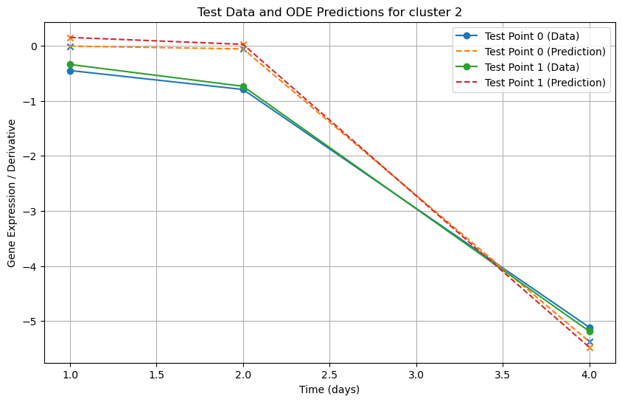
Result (Comparison of Models)
For test data, predicted data in the case of the IPINN. Cluster 2 (α = 0.196849, β = 1.436124, γ = 0.443261)

Slide 24
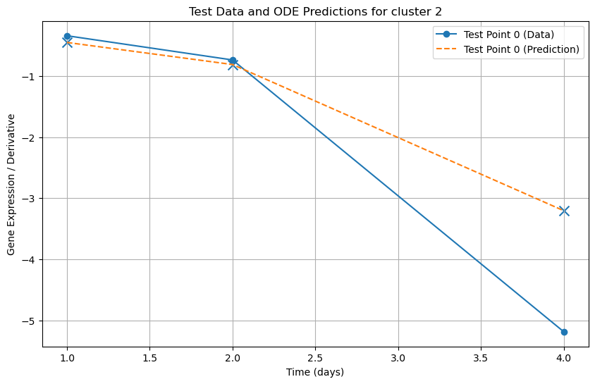
Result (Comparison of Models)
For test data, predicted data in the case of the Neural ODE. Cluster 2 (α = −0.114982, β = 0.456523, γ =−0.180553)

Slide 25
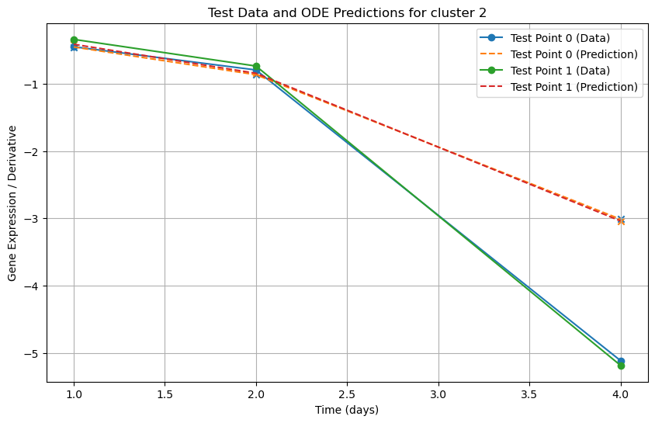
Result (Comparison of Models)
For test data, predicted data in the case of the (IPINN+Neural ODE (parametric)). Cluster 2 (α = −0.003555, β = 0.364435, γ=−0.286588)

Slide 26
Conclusion
By integrating physical constraints with data-driven approaches, the framework effectively captures the underlying biological processes governing plant-pathogen interactions.
PINNs works effectively to capture the underlying physics of plant-pathogen interactions.
This study highlights the potential of physics-informed machine learning in systems biology, particularly for analyzing transcriptomics data.
This approach improves forecasting capabilities

Slide 27
Limitations
Limited time points in data.
Simplified Dynamics: Linear ODE ignores gene-gene interactions.
Generalization: Model struggles with unseen parameter spaces (mostly to predict the 3rd time point).

Slide 28
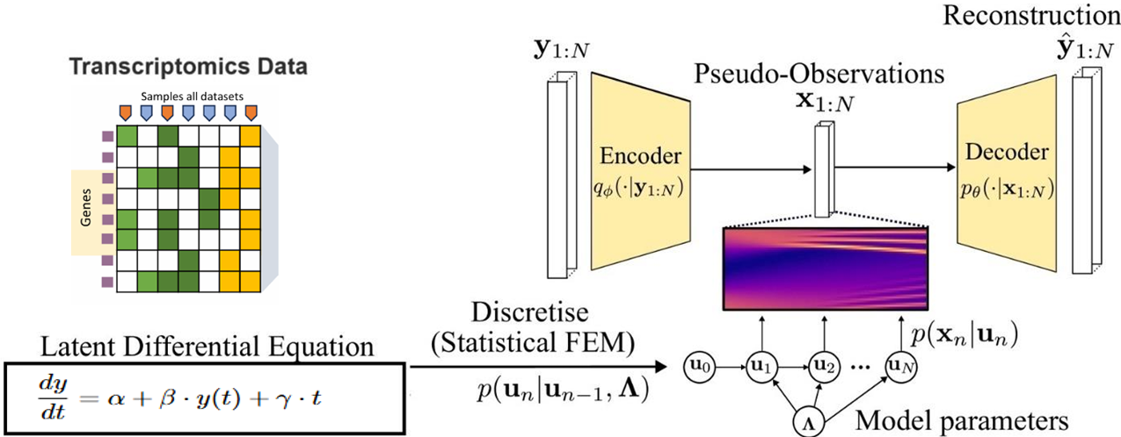
Future Work
Multi-omics Integration: Combine transcriptomics with proteomics/metabolomics (multi-omics datasets).
Coupled ODEs: Exploring coupled ODE models for gene-gene interactions.
Physics-Informed DVAEs (φ-DVAE):
Latent space modelling with stochasticity.
Incorporating Dynamical Variational Autoencoders (DVAEs
Architecture under development.

Slide 29
Acknowledgments
Mentor: Prof. Silvia Bottini
Institution: INRAe/UniCA

Slide 30
References
S¨ oren Becker, Michal Klein, Alexander Neitz, Giambattista Parascandolo, and Niki Kilbertus. Discovering ordinary differ ential equations that govern time-series. arXiv preprint arXiv:2211.02830, 2022.
YunpengCao,XiaoxuLi, Hui Song, MuhammadAbdullah,andMuhammadAamirManzoor. Multi-omicsandcomputational biology in horticultural plants: from genotype to phenotype, volume ii, 2024.
Ricky TQ Chen, Yulia Rubanova, Jesse Bettencourt, and David K Duvenaud. Neural ordinary differential equations. Advances in neural information processing systems, 31, 2018.
Salvatore Cuomo, Vincenzo Schiano Di Cola, Fabio Giampaolo, Gianluigi Rozza, Maziar Raissi, and Francesco Piccialli. Scientific machine learning through physics–informed neural networks: Where we are and what’s next. Journal of Scientific Computing, 92(3):88, 2022. PIMLfor modelling the dynamics of plant-pathogens molecular interactions 13
Rossin Erbe, Genevieve Stein-O’Brien, and Elana J Fertig. Transcriptomic forecasting with neural ordinary differential equations. Patterns, 4(8), 2023.
Laurent Girin, Simon Leglaive, Xiaoyu Bie, Julien Diard, Thomas Hueber, and Xavier Alameda-Pineda. Dynamical varia tional autoencoders: A comprehensive review. arXiv preprint arXiv:2008.12595, 2020.
Alex Glyn-Davies, Connor Duffin, O Deniz Akyildiz, and Mark Girolami. ϕ-dvae: Physics-informed dynamical variational autoencoders for unstructured data assimilation. Journal of Computational Physics, 515:113293, 2024.
Paguiel Javan Hossie, B´eatrice Laroche, Thibault Malou, Lucas Perrin, Thomas Saigre, and Lorenzo Sala. Simulating interactions in microbial communities through physics informed neural networks: towards interaction estimation. 2024.
George Em Karniadakis, Ioannis G Kevrekidis, Lu Lu, Paris Perdikaris, Sifan Wang, and Liu Yang. Physics-informed machine learning. Nature Reviews Physics, 3(6):422–440, 2021.
Diederik P Kingma, Max Welling, et al. An introduction to variational autoencoders. Foundations and Trends® in Machine Learning, 12(4):307–392, 2019.
Isaac E Lagaris, Aristidis Likas, and Dimitrios I Fotiadis. Artificial neural networks for solving ordinary and partial differential equations. IEEE transactions on neural networks, 9(5):987–1000, 1998.
Lu Lu, Xuhui Meng, Zhiping Mao, and George Em Karniadakis. Deepxde: A deep learning library for solving differential equations. SIAM review, 63(1):208–228, 2021.
Chuizheng Meng, Sungyong Seo, Defu Cao, Sam Griesemer, and Yan Liu. When physics meets machine learning: A survey of physics-informed machine learning. arXiv preprint arXiv:2203.16797, 2022.
Maziar Raissi, Paris Perdikaris, and George E Karniadakis. Physics-informed neural networks: A deep learning framework for solving forward and inverse problems involving nonlinear partial differential equations. Journal of Computational physics, 378:686–707, 2019.
Yulia Rubanova, Ricky TQ Chen, and David K Duvenaud. Latent ordinary differential equations for irregularly-sampled time series. Advances in neural information processing systems, 32, 2019.
Jeyachandran Sivakamavalli and Baskaralingam Vaseeharan. An overview of omics approaches: Concept, methods and perspectives. 2020.
Xiaoyu Zhang, Jingqing Zhang, Kai Sun, Xian Yang, Chengliang Dai, and Yike Guo. Integrated multi-omics analysis using variational autoencoders: application to pan-cancer classification. In 2019 IEEE International Conference on Bioinformatics and Biomedicine (BIBM), pages 765–769. IEEE, 2019
Kookjin Lee and Eric J Parish. Parameterized neural ordinary differential equations: Applications to computational physics problems. Proceedings of the Royal Society A, 477(2253):20210162, 2021.

Slide 31
Thank You

