Slide 1
Handling massive data

Slide 2
Functions
Writing functions is a core activity of an R programmer. It represents the key step of the transition from a mere “user” to a developer who creates new functionality for R. Functions are often used to encapsulate a sequence of expressions that need to be executed numerous times, perhaps under slightly different conditions. Functions are also often written when code must be shared with others or the public.
The writing of a function allows a developer to create an interface to the code, that is explicitly specified with a set of parameters. This interface provides an abstraction of the code to potential users. This abstraction simplifies the users’ lives because it relieves them from having to know every detail of how the code operates. In addition, the creation of an interface allows the developer to communicate to the user the aspects of the code that are important or are most relevant.

Slide 3
Functions in R
Functions in R are “first class objects”, which means that they can be treated much like any other R object.
Importantly,
Functions can be passed as arguments to other functions.
Functions can be nested, so that you can define a function inside of another function
Notes:
Nested = imbriqué

Slide 4
Custom Functions
Function name
Function Arguments
bmi <- function(weight, height) {
height/100 -> height
height^2 -> height
return(weight/height)
}
Code Block
Return value
> bmi(90,175)
[1] 29.38776
> bmi(c(90,102), c(175,183))
[1] 29.38776 30.45776

Slide 5
Your First Function
Functions are defined using the function() directive and are stored as R objects just like anything else. In particular, they are R objects of class “function”.
Here’s a simple function that takes no arguments and does nothing.
Here we create a function that actually has a non-trivial function body.
> f <- function() {
+ ## This is an empty function
+ }
> ## Functions have their own class
> class(f)
[1] "function"
> ## Execute this function
> f()
NULL
> f <- function() {
+ cat("Hello, world!\n")
+ }
> f()
Hello, world!

Slide 6
Your First Function
The last aspect of a basic function is the function arguments. These are the options that you can specify to the user that the user may explicity set.
This next function returns the total number of characters printed to the console.
For this basic function, we can add an argument that determines how many times “Hello, world!” is printed to the console.
> f <- function(num) {
+ hello <- "Hello, world!\n"
+ for(i in seq_len(num)) {
+ cat(hello)
+ }
+ chars <- nchar(hello) * num
+ chars
+ }
> meaningoflife <- f(3)
Hello, world!
Hello, world!
Hello, world!
> print(meaningoflife)
[1] 42
> f <- function(num) {
+ for(i in seq_len(num)) {
+ cat("Hello, world!\n")
+ }
+ }
> f(3)
Hello, world!
Hello, world!
Hello, world!

Slide 7
Your First Function
Here, for example, we could set the default value for num to be 1, so that if the function is called without the num argument being explicitly specified, then it will print “Hello, world!” to the console once.
> f <- function(num = 1) {
+ hello <- "Hello, world!\n"
+ for(i in seq_len(num)) {
+ cat(hello)
+ }
+ chars <- nchar(hello) * num
+ chars
+ }
> f() ## Use default value for 'num'
Hello, world!
[1] 14
> f(2) ## Use user-specified value
Hello, world!
Hello, world!
[1] 28
At this point, we have written a function that
has one formal argument named num with a default value of 1. The formal arguments are the arguments included in the function definition. The formals() function returns a list of all the formal arguments of a function
prints the message “Hello, world!” to the console a number of times indicated by the argument num
returns the number of characters printed to the console

Slide 8
Argument Matching
Calling an R function with arguments can be done in a variety of ways. This may be confusing at first, but it’s really handing when doing interactive work at the command line. R functions arguments can be matched positionally or by name. Positional matching just means that R assigns the first value to the first argument, the second value to second argument, etc. So in the following call to rnorm()
> str(rnorm)
function (n, mean = 0, sd = 1)
> mydata <- rnorm(100, 2, 1) ## Generate some data
100 is assigned to the n argument, 2 is assigned to the mean argument, and 1 is assigned to the sd argument, all by positional matching.

Slide 9
Argument Matching
The following calls to the sd() function (which computes the empirical standard deviation of a vector of numbers) are all equivalent. Note that sd() has two arguments: x indicates the vector of numbers and na.rm is a logical indicating whether missing values should be removed or not.
> ## Positional match first argument, default for 'na.rm'
> sd(mydata)
[1] 1.014325
> ## Specify 'x' argument by name, default for 'na.rm'
> sd(x = mydata)
[1] 1.014325
> ## Specify both arguments by name
> sd(x = mydata, na.rm = FALSE)
[1] 1.014325

Slide 10
Lazy Evaluation
Arguments to functions are evaluated lazily, so they are evaluated only as needed in the body of the function.
In this example, the function f() has two arguments: a and b.
> f <- function(a, b) {
+ a^2
+ }
> f(2)
[1] 4
This function never actually uses the argument b, so calling f(2) will not produce an error because the 2 gets positionally matched to a. This behavior can be good or bad. It’s common to write a function that doesn’t use an argument and not notice it simply because R never throws an error.

Slide 11
Lazy Evaluation
This example also shows lazy evaluation at work, but does eventually result in an error.
> f <- function(a, b) {
+ print(a)
+ print(b)
+ }
> f(45)
[1] 45
Error in print(b): argument "b" is missing, with no default
Notice that “45” got printed first before the error was triggered. This is because b did not have to be evaluated until after print(a). Once the function tried to evaluate print(b) the function had to throw an error.

Slide 12
The ... Argument
There is a special argument in R known as the ... argument, which indicate a variable number of arguments that are usually passed on to other functions. The ... argument is often used when extending another function and you don’t want to copy the entire argument list of the original function
For example, a custom plotting function may want to make use of the default plot() function along with its entire argument list. The function below changes the default for the type argument to the value type = "l" (the original default was type = "p").
myplot <- function(x, y, type = "l", ...) {
plot(x, y, type = type, ...) ## Pass '...' to 'plot' function
}
Generic functions use ... so that extra arguments can be passed to methods.
> mean
function (x, ...)
UseMethod("mean")
<bytecode: 0x7fe2e9aead40>
<environment: namespace:base>

Slide 13
Summary
Functions can be defined using the function() directive and are assigned to R objects just like any other R object
Functions can be defined with named arguments; these function arguments can have default values
Functions arguments can be specified by name or by position in the argument list
Functions always return the last expression evaluated in the function body
A variable number of arguments can be specified using the special ... argument in a function definition.

Slide 14
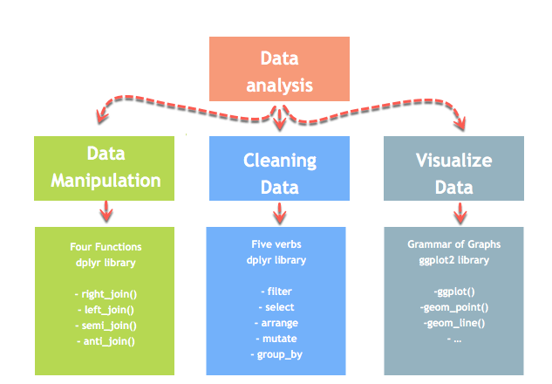
Introduction to Data Analysis
Data analysis can be divided into three parts:
Extraction: First, we need to collect the data from many sources and combine them.
Transform: This step involves the data manipulation. Once we have consolidated all the sources of data, we can begin to clean the data.
Visualize: The last move is to visualize our data to check irregularity.
One of the most significant challenges faced by data scientists is the data manipulation. Data is never available in the desired format. Data scientists need to spend at least half of their time, cleaning and manipulating the data. That is one of the most critical assignments in the job. If the data manipulation process is not complete, precise and rigorous, the model will not perform correctly.

Slide 15





Tidyverse Packages
Tibble - data storage
ReadR - reading data from files
TidyR - Model data correctly
DplyR - Manipulate and filter data
Ggplot2 - Draw figures and graphs

Slide 16
The dplyr Package
The dplyr package was developed by Hadley Wickham of RStudio and is an optimized and distilled version of his plyr package. The dplyr package does not provide any “new” functionality to R per se, in the sense that everything dplyr does could already be done with base R, but it greatly simplifies existing functionality in R.
One important contribution of the dplyr package is that it provides a “grammar” (in particular, verbs) for data manipulation and for operating on data frames. With this grammar, you can sensibly communicate what it is that you are doing to a data frame that other people can understand (assuming they also know the grammar). This is useful because it provides an abstraction for data manipulation that previously did not exist. Another useful contribution is that the dplyr functions are very fast, as many key operations are coded in C++.

Slide 17
Loop Functions
Writing for and while loops is useful when programming but not particularly easy when working interactively on the command line. Multi-line expressions with curly braces are just not that easy to sort through when working on the command line. R has some functions which implement looping in a compact form to make your life easier.
lapply(): Loop over a list and evaluate a function on each element
sapply(): Same as lapply but try to simplify the result
apply(): Apply a function over the margins of an array
tapply(): Apply a function over subsets of a vector
mapply(): Multivariate version of lapply
An auxiliary function split is also useful, particularly in conjunction with lapply.

Slide 18
apply()
The apply() function is used to a evaluate a function (often an anonymous one) over the margins of an array. It is most often used to apply a function to the rows or columns of a matrix (which is just a 2-dimensional array). However, it can be used with general arrays, for example, to take the average of an array of matrices. Using apply() is not really faster than writing a loop, but it works in one line and is highly compact.
> str(apply)
function (X, MARGIN, FUN, ...)
The arguments to apply() are
X is an array
MARGIN is an integer vector indicating which margins should be “retained”.
FUN is a function to be applied
... is for other arguments to be passed to FUN

Slide 19
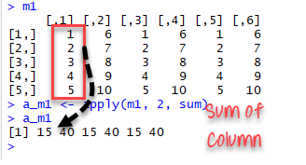
apply()
The simplest example is to sum a matrice over all the columns. The code apply(m1, 2, sum) will apply the sum function to the matrix 5×6 and return the sum of each column accessible in the dataset.
m1 <- matrix(C<-(1:10),nrow=5, ncol=6)
m1
a_m1 <- apply(m1, 2, sum)
a_m1
Output:
Best practice: Store the values before printing it to the console.

Slide 20
apply()
Here I create a 20 by 10 matrix of Normal random numbers. I then compute the mean of each column.
> x <- matrix(rnorm(200), 20, 10)
> apply(x, 2, mean) ## Take the mean of each column
[1] 0.02218266 -0.15932850 0.09021391 0.14723035 -0.22431309 -0.49657847
[7] 0.30095015 0.07703985 -0.20818099 0.06809774
Note that in both calls to apply(), the return value was a vector of numbers.
I can also compute the sum of each row.
> apply(x, 1, sum) ## Take the mean of each row
[1] -0.48483448 5.33222301 -3.33862932 -1.39998450 2.37859098 0.01082604
[7] -6.29457190 -0.26287700 0.71133578 -3.38125293 -4.67522818 3.01900232
[13] -2.39466347 -2.16004389 5.33063755 -2.92024635 3.52026401 -1.84880901
[19] -4.10213912 5.30667310

Slide 21
apply()
You’ve probably noticed that the second argument is either a 1 or a 2, depending on whether we want row statistics or column statistics. What exactly is the second argument to apply()?
The MARGIN argument essentially indicates to apply() which dimension of the array you want to preserve or retain. So when taking the mean of each column, I specify
> apply(x, 2, mean)
because I want to collapse the first dimension (the rows) by taking the mean and I want to preserve the number of columns. Similarly, when I want the row sums, I run
> apply(x, 1, sum)
because I want to collapse the columns (the second dimension) and preserve the number of rows (the first dimension).

Slide 22
Col/Row Sums and Means
For the special case of column/row sums and column/row means of matrices, we have some useful shortcuts.
rowSums = apply(x, 1, sum)
rowMeans = apply(x, 1, mean)
colSums = apply(x, 2, sum)
colMeans = apply(x, 2, mean)
The shortcut functions are heavily optimized and hence are much faster, but you probably won’t notice unless you’re using a large matrix. Another nice aspect of these functions is that they are a bit more descriptive. It’s arguably more clear to write colMeans(x) in your code than apply(x, 2, mean).

Slide 23
lapply()
The lapply() function does the following simple series of operations:
it loops over a list, iterating over each element in that list
it applies a function to each element of the list (a function that you specify)
and returns a list (the l is for “list”).
This function takes three arguments: (1) a list X; (2) a function (or the name of a function) FUN; (3) other arguments via its ... argument. If X is not a list, it will be coerced to a list using as.list().
The body of the lapply() function can be seen here.
> lapply
function (X, FUN, ...)
{
FUN <- match.fun(FUN)
if (!is.vector(X) || is.object(X))
X <- as.list(X)
.Internal(lapply(X, FUN))
}
<bytecode: 0x7ff2f68331c0>
<environment: namespace:base>
Note that the actual looping is done internally in C code for efficiency reasons.
It’s important to remember that lapply() always returns a list, regardless of the class of the input.

Slide 24
lapply()
A very easy example can be to change the string value of a matrix to lower case with to lower function. We construct a matrix with the name of the famous movies. The name is in upper case format.
movies <- c("SPYDERMAN","BATMAN","VERTIGO","CHINATOWN")
movies_lower <-lapply(movies, tolower)
str(movies_lower)
We can use unlist() to convert the list into a vector.
movies_lower <-unlist(lapply(movies,tolower)) str(movies_lower)
Output:
## chr [1:4] "spyderman" "batman" "vertigo" "chinatown"

Slide 25
lapply()
Here’s an example of applying the mean() function to all elements of a list. If the original list has names, the names will be preserved in the output.
> x <- list(a = 1:5, b = rnorm(10))
> lapply(x, mean)
$a
[1] 3
$b
[1] 0.1322028
Notice that here we are passing the mean() function as an argument to the lapply() function. Functions in R can be used this way and can be passed back and forth as arguments just like any other object. When you pass a function to another function, you do not need to include the open and closed parentheses () like you do when you are calling a function.

Slide 26
lapply()
Here is another example of using lapply().
> x <- list(a = 1:4, b = rnorm(10), c = rnorm(20, 1), d = rnorm(100, 5))
> lapply(x, mean)
$a
[1] 2.5
$b
[1] 0.248845
$c
[1] 0.9935285
$d
[1] 5.051388
You can use lapply() to evaluate a function multiple times each with a different argument.

Slide 27
lapply()
Below, is an example where I call the runif() function (to generate uniformly distributed random variables) four times, each time generating a different number of random numbers.
> x <- 1:4
> lapply(x, runif)
[[1]]
[1] 0.02778712
[[2]]
[1] 0.5273108 0.8803191
[[3]]
[1] 0.37306337 0.04795913 0.13862825
[[4]]
[1] 0.3214921 0.1548316 0.1322282 0.2213059

Slide 28
lapply()
When you pass a function to lapply(), lapply() takes elements of the list and passes them as the first argument of the function you are applying. In the above example, the first argument of runif() is n, and so the elements of the sequence 1:4 all got passed to the n argument of runif().
Functions that you pass to lapply() may have other arguments. For example, the runif() function has a min and max argument too. In the example above I used the default values for min and max. How would you be able to specify different values for that in the context of lapply()?
Here is where the ... argument to lapply() comes into play. Any arguments that you place in the ... argument will get passed down to the function being applied to the elements of the list.
Here, the min = 0 and max = 10 arguments are passed down to runif() every time it gets called.
> x <- 1:4
> lapply(x, runif, min = 0, max = 10)
[[1]]
[1] 2.263808
[[2]]
[1] 1.314165 9.815635
[[3]]
[1] 3.270137 5.069395 6.814425
[[4]]
[1] 0.9916910 1.1890256 0.5043966 9.2925392

Slide 29
lapply()
The lapply() function and its friends make heavy use of anonymous functions. Anonymous functions have no names. These are functions are generated “on the fly” as you are using lapply(). Once the call to lapply() is finished, the function disappears and does not appear in the workspace.
Here I am creating a list that contains two matrices.
> x <- list(a = matrix(1:4, 2, 2), b = matrix(1:6, 3, 2))
> x
$a
[,1] [,2]
[1,] 1 3
[2,] 2 4
$b
[,1] [,2]
[1,] 1 4
[2,] 2 5
[3,] 3 6

Slide 30
lapply()
Suppose I wanted to extract the first column of each matrix in the list. I could write an anonymous function for extracting the first column of each matrix.
> lapply(x, function(elt) { elt[,1] })
$a
[1] 1 2
$b
[1] 1 2 3
Notice that I put the function() definition right in the call to lapply(). This is perfectly legal and acceptable. You can put an arbitrarily complicated function definition inside lapply(), but if it’s going to be more complicated, it’s probably a better idea to define the function separately.
For example, I could have done the following.
> f <- function(elt) {
+ elt[, 1]
+ }
> lapply(x, f)
$a
[1] 1 2
$b
[1] 1 2 3
Now the function is no longer anonymous; it’s name is f. Whether you use an anonymous function or you define a function first depends on your context. If you think the function f is something you’re going to need a lot in other parts of your code, you might want to define it separately. But if you’re just going to use it for this call to lapply(), then it’s probably simpler to use an anonymous function.

Slide 31
sapply()
The sapply() function behaves similarly to lapply(); the only real difference is in the return value. sapply() will try to simplify the result of lapply() if possible. Essentially, sapply() calls lapply() on its input and then applies the following algorithm:
If the result is a list where every element is length 1, then a vector is returned
If the result is a list where every element is a vector of the same length (> 1), a matrix is returned.
If it can’t figure things out, a list is returned

Slide 32
sapply()
Here’s the result of calling lapply()
> x <- list(a = 1:4, b = rnorm(10), c = rnorm(20, 1), d = rnorm(100, 5))
> lapply(x, mean)
$a
[1] 2.5
$b
[1] -0.251483
$c
[1] 1.481246
$d
[1] 4.968715

Slide 33
sapply()
Here’s the result of calling sapply() on the same list.
Here’s the result of calling lapply()
> x <- list(a = 1:4, b = rnorm(10), c = rnorm(20, 1), d = rnorm(100, 5))
> lapply(x, mean)
$a
[1] 2.5
$b
[1] -0.251483
$c
[1] 1.481246
$d
[1] 4.968715
> sapply(x, mean)
a b c d
2.500000 -0.251483 1.481246 4.968715
Because the result of lapply() was a list where each element had length 1, sapply() collapsed the output into a numeric vector, which is often more useful than a list.

Slide 34
tapply
tapply() is used to apply a function over subsets of a vector. It can be thought of as a combination of split() and sapply() for vectors only.
> str(tapply)
function (X, INDEX, FUN = NULL, ..., default = NA, simplify = TRUE)
the arguments to tapply() are as follows:
X is a vector
INDEX is a factor or a list of factors (or else they are coerced to factors)
FUN is a function to be applied
… contains other arguments to be passed FUN
simplify, should we simplify the result?

Slide 35
tapply
Given a vector of numbers, one simple operation is to take group means.
> ## Simulate some data
> x <- c(rnorm(10), runif(10), rnorm(10, 1))
> ## Define some groups with a factor variable
> f <- gl(3, 10)
> f
[1] 1 1 1 1 1 1 1 1 1 1 2 2 2 2 2 2 2 2 2 2 3 3 3 3 3 3 3 3 3 3
Levels: 1 2 3
> tapply(x, f, mean)
1 2 3
0.1896235 0.5336667 0.9568236

Slide 36
tapply
We can also take the group means without simplifying the result, which will give us a list. For functions that return a single value, usually, this is not what we want, but it can be done.
> tapply(x, f, mean, simplify = FALSE)
$`1`
[1] 0.1896235
$`2`
[1] 0.5336667
$`3`
[1] 0.9568236
We can also apply functions that return more than a single value. In this case, tapply() will not simplify the result and will return a list. Here’s an example of finding the range of each sub-group.
> tapply(x, f, range)
$`1`
[1] -1.869789 1.497041
$`2`
[1] 0.09515213 0.86723879
$`3`
[1] -0.5690822 2.3644349

Slide 37
mapply()
The mapply() function is a multivariate apply of sorts which applies a function in parallel over a set of arguments. Recall that lapply() and friends only iterate over a single R object. What if you want to iterate over multiple R objects in parallel? This is what mapply() is for.
> str(mapply)
function (FUN, ..., MoreArgs = NULL, SIMPLIFY = TRUE, USE.NAMES = TRUE)
The arguments to mapply() are
FUN is a function to apply
... contains R objects to apply over
MoreArgs is a list of other arguments to FUN.
SIMPLIFY indicates whether the result should be simplified
The mapply() function has a different argument order from lapply() because the function to apply comes first rather than the object to iterate over. The R objects over which we apply the function are given in the ... argument because we can apply over an arbitrary number of R objects.

Slide 38
mapply()
For example, the following is tedious to type
list(rep(1, 4), rep(2, 3), rep(3, 2), rep(4, 1))
With mapply(), instead we can do
rep: Replicate Elements of Vectors and Lists
> mapply(rep, 1:4, 4:1)
[[1]]
[1] 1 1 1 1
[[2]]
[1] 2 2 2
[[3]]
[1] 3 3
[[4]]
[1] 4
This passes the sequence 1:4 to the first argument of rep() and the sequence 4:1 to the second argument.

Slide 39
mapply()
Here’s another example for simulating random Normal variables.
> noise <- function(n, mean, sd) {
+ rnorm(n, mean, sd)
+ }
> ## Simulate 5 random numbers
> noise(5, 1, 2)
[1] -0.5196913 3.2979182 -0.6849525 1.7828267 2.7827545
>
> ## This only simulates 1 set of numbers, not 5
> noise(1:5, 1:5, 2)
[1] -1.670517 2.796247 2.776826 5.351488 3.422804

Slide 40
mapply()
Here’s another example for simulating random Normal variables.
we can use mapply() to pass the sequence 1:5 separately to the noise() function so that we can get 5 sets of random numbers, each with a different length and mean.
> noise <- function(n, mean, sd) {
+ rnorm(n, mean, sd)
+ }
> ## Simulate 5 randon numbers
> noise(5, 1, 2)
[1] -0.5196913 3.2979182 -0.6849525 1.7828267 2.7827545
>
> ## This only simulates 1 set of numbers, not 5
> noise(1:5, 1:5, 2)
[1] -1.670517 2.796247 2.776826 5.351488 3.422804
> mapply(noise, 1:5, 1:5, 2)
[[1]]
[1] 0.8260273
[[2]]
[1] 4.764568 2.336980
[[3]]
[1] 4.6463819 2.5582108 0.9412167
[[4]]
[1] 3.978149 1.550018 -1.192223 6.338245
[[5]]
[1] 2.826182 1.347834 6.990564 4.976276 3.800743

Slide 41
split()
The split() function takes a vector or other objects and splits it into groups determined by a factor or list of factors.
The arguments to split() are
> str(split)
function (x, f, drop = FALSE, ...)
where
x is a vector (or list) or data frame
f is a factor (or coerced to one) or a list of factors
drop indicates whether empty factors levels should be dropped
The combination of split() and a function like lapply() or sapply() is a common paradigm in R. The basic idea is that you can take a data structure, split it into subsets defined by another variable, and apply a function over those subsets. The results of applying that function over the subsets are then collated and returned as an object. This sequence of operations is sometimes referred to as “map-reduce” in other contexts.

Slide 42
split()
Here we simulate some data and split it according to a factor variable. Note that we use the gl() function to “generate levels” in a factor variable.
> x <- c(rnorm(10), runif(10), rnorm(10, 1))
> f <- gl(3, 10)
> split(x, f)
$`1`
[1] 0.3981302 -0.4075286 1.3242586 -0.7012317 -0.5806143 -1.0010722
[7] -0.6681786 0.9451850 0.4337021 1.0051592
$`2`
[1] 0.34822440 0.94893818 0.64667919 0.03527777 0.59644846 0.41531800
[7] 0.07689704 0.52804888 0.96233331 0.70874005
$`3`
[1] 1.13444766 1.76559900 1.95513668 0.94943430 0.69418458 1.89367370
[7] -0.04729815 2.97133739 0.61636789 2.65414530

Slide 43
split()
A common idiom is split followed by an lapply.
> lapply(split(x, f), mean)
$`1`
[1] 0.07478098
$`2`
[1] 0.5266905
$`3`
[1] 1.458703

Slide 44
Summary
The loop functions in R are very powerful because they allow you to conduct a series of operations on data using a compact form
The operation of a loop function involves iterating over an R object (e.g. a list or vector or matrix), applying a function to each element of the object, and the collating the results and returning the collated results.
Loop functions make heavy use of anonymous functions, which exist for the life of the loop function but are not stored anywhere
The split() function can be used to divide an R object in to subsets determined by another variable which can subsequently be looped over using loop functions.

Slide 45
dplyr Grammar
Some of the key “verbs” provided by the dplyr package are
select: return a subset of the columns of a data frame, using a flexible notation
filter: extract a subset of rows from a data frame based on logical conditions
arrange: reorder rows of a data frame
rename: rename variables in a data frame
mutate: add new variables/columns or transform existing variables
summarise / summarize: generate summary statistics of different variables in the data frame, possibly within strata
%>%: the “pipe” operator is used to connect multiple verb actions together into a pipeline
The dplyr package has a number of its own data types that it takes advantage of. For example, there is a handy print method that prevents you from printing a lot of data to the console. Most of the time, these additional data types are transparent to the user and do not need to be worried about.

Slide 46
Common dplyr Function Properties
All of the functions that we will discuss will have a few common characteristics. In particular,
The first argument is a data frame.
The subsequent arguments describe what to do with the data frame specified in the first argument, and you can refer to columns in the data frame directly without using the $ operator (just use the column names).
The return result of a function is a new data frame
Data frames must be properly formatted and annotated for this to all be useful. In particular, the data must be tidy. In short, there should be one observation per row, and each column should represent a feature or characteristic of that observation.
> install.packages("dplyr")
> library(dplyr)

Slide 47
select()
For the examples we will be using a dataset containing air pollution and temperature data for the city of Chicago in the U.S.
> chicago <- read _csv("chicago.rds")
> dim(chicago)
[1] 6940 8
> str(chicago)
'data.frame': 6940 obs. of 8 variables:
$ city : chr "chic" "chic" "chic" "chic" ...
$ tmpd : num 31.5 33 33 29 32 40 34.5 29 26.5 32.5 ...
$ dptp : num 31.5 29.9 27.4 28.6 28.9 ...
$ date : Date, format: "1987-01-01" "1987-01-02" ...
$ pm25tmean2: num NA NA NA NA NA NA NA NA NA NA ...
$ pm10tmean2: num 34 NA 34.2 47 NA ...
$ o3tmean2 : num 4.25 3.3 3.33 4.38 4.75 ...
$ no2tmean2 : num 20 23.2 23.8 30.4 30.3 ...
You can see some basic characteristics of the dataset with the dim() and str() functions.

Slide 48
select()
The select() function can be used to select columns of a data frame that you want to focus on. Often you’ll have a large data frame containing “all” of the data, but any given analysis might only use a subset of variables or observations. The select() function allows you to get the few columns you might need.
Suppose we wanted to take the first 3 columns only. There are a few ways to do this. We could for example use numerical indices. But we can also use the names directly.
> names(chicago)[1:3]
[1] "city" "tmpd" "dptp"
> subset <- select(chicago, city:dptp)
> head(subset)
city tmpd dptp
1 chic 31.5 31.500
2 chic 33.0 29.875
3 chic 33.0 27.375
4 chic 29.0 28.625
5 chic 32.0 28.875
6 chic 40.0 35.125
Note that the : normally cannot be used with names or strings, but inside the select() function you can use it to specify a range of variable names.

Slide 49
select()
You can also omit variables using the select() function by using the negative sign. With select() you can do
> select(chicago, -(city:dptp))
which indicates that we should include every variable except the variables city through dptp. The equivalent code in base R would be
> i <- match("city", names(chicago))
> j <- match("dptp", names(chicago))
> head(chicago[, -(i:j)])
Not super intuitive, right?

Slide 50
select()
The select() function also allows a special syntax that allows you to specify variable names based on patterns. So, for example, if you wanted to keep every variable that ends with a “2”, we could do
> subset <- select(chicago, ends_with("2"))
> str(subset)
'data.frame': 6940 obs. of 4 variables:
$ pm25tmean2: num NA NA NA NA NA NA NA NA NA NA ...
$ pm10tmean2: num 34 NA 34.2 47 NA ...
$ o3tmean2 : num 4.25 3.3 3.33 4.38 4.75 ...
$ no2tmean2 : num 20 23.2 23.8 30.4 30.3 ...
Or if we wanted to keep every variable that starts with a “d”, we could do
> subset <- select(chicago, starts_with("d"))
> str(subset)
'data.frame': 6940 obs. of 2 variables:
$ dptp: num 31.5 29.9 27.4 28.6 28.9 ...
$ date: Date, format: "1987-01-01" "1987-01-02" ...

Slide 51
filter()
The filter() function is used to extract subsets of rows from a data frame. This function is similar to the existing subset() function in R but is quite a bit faster.
Suppose we wanted to extract the rows of the chicago data frame where the levels of PM2.5 are greater than 30 (which is a reasonably high level), we could do
> chic.f <- filter(chicago, pm25tmean2 > 30)
> str(chic.f)
'data.frame': 194 obs. of 8 variables:
$ city : chr "chic" "chic" "chic" "chic" ...
$ tmpd : num 23 28 55 59 57 57 75 61 73 78 ...
$ dptp : num 21.9 25.8 51.3 53.7 52 56 65.8 59 60.3 67.1 ...
$ date : Date, format: "1998-01-17" "1998-01-23" ...
$ pm25tmean2: num 38.1 34 39.4 35.4 33.3 ...
$ pm10tmean2: num 32.5 38.7 34 28.5 35 ...
$ o3tmean2 : num 3.18 1.75 10.79 14.3 20.66 ...
$ no2tmean2 : num 25.3 29.4 25.3 31.4 26.8 ...
You can see that there are now only 194 rows in the data frame and the distribution of the pm25tmean2 values is.
> summary(chic.f$pm25tmean2)
Min. 1st Qu. Median Mean 3rd Qu. Max.
30.05 32.12 35.04 36.63 39.53 61.50

Slide 52
filter()
We can place an arbitrarily complex logical sequence inside of filter(), so we could for example extract the rows where PM2.5 is greater than 30 and temperature is greater than 80 degrees Fahrenheit.
> chic.f <- filter(chicago, pm25tmean2 > 30 & tmpd > 80)
> select(chic.f, date, tmpd, pm25tmean2)
date tmpd pm25tmean2
1 1998-08-23 81 39.60000
2 1998-09-06 81 31.50000
3 2001-07-20 82 32.30000
4 2001-08-01 84 43.70000
5 2001-08-08 85 38.83750
6 2001-08-09 84 38.20000
7 2002-06-20 82 33.00000
8 2002-06-23 82 42.50000
9 2002-07-08 81 33.10000
10 2002-07-18 82 38.85000
11 2003-06-25 82 33.90000
12 2003-07-04 84 32.90000
13 2005-06-24 86 31.85714
14 2005-06-27 82 51.53750
15 2005-06-28 85 31.20000
16 2005-07-17 84 32.70000
17 2005-08-03 84 37.90000
Now there are only 17 observations where both of those conditions are met.

Slide 53
arrange()
The arrange() function is used to reorder rows of a data frame according to one of the variables/columns. Reordering rows of a data frame (while preserving corresponding order of other columns) is normally a pain to do in R. The arrange() function simplifies the process quite a bit.
Here we can order the rows of the data frame by date, so that the first row is the earliest (oldest) observation and the last row is the latest (most recent) observation.
> chicago <- arrange(chicago, date)
We can now check the first few rows
and the last few rows.
> head(select(chicago, date, pm25tmean2), 3)
date pm25tmean2
1 1987-01-01 NA
2 1987-01-02 NA
3 1987-01-03 NA
> tail(select(chicago, date, pm25tmean2), 3)
date pm25tmean2
6938 2005-12-29 7.45000
6939 2005-12-30 15.05714
6940 2005-12-31 15.00000
Columns can be arranged in descending order too by using the special desc() operator.
> chicago <- arrange(chicago, desc(date))

Slide 54
arrange()
Looking at the first three and last three rows shows the dates in descending order.
> head(select(chicago, date, pm25tmean2), 3)
date pm25tmean2
1 2005-12-31 15.00000
2 2005-12-30 15.05714
3 2005-12-29 7.45000
> tail(select(chicago, date, pm25tmean2), 3)
date pm25tmean2
6938 1987-01-03 NA
6939 1987-01-02 NA
6940 1987-01-01 NA

Slide 55
rename()
The dew point is the temperature below which the water vapour in a volume of air at a constant pressure will condense into liquid water. It is the temperature at which the air is saturated with moisture.
Renaming a variable in a data frame in R is surprisingly hard to do! The rename() function is designed to make this process easier.
Here you can see the names of the first five variables in the chicago data frame.
> head(chicago[, 1:5], 3)
city tmpd dptp date pm25tmean2
1 chic 35 30.1 2005-12-31 15.00000
2 chic 36 31.0 2005-12-30 15.05714
3 chic 35 29.4 2005-12-29 7.45000
The dptp column is supposed to represent the dew point temperature and the pm25tmean2 column provides the PM2.5 data. However, these names are pretty obscure or awkward and probably be renamed to something more sensible.
> chicago <- rename(chicago, dewpoint = dptp, pm25 = pm25tmean2)
> head(chicago[, 1:5], 3)
city tmpd dewpoint date pm25
1 chic 35 30.1 2005-12-31 15.00000
2 chic 36 31.0 2005-12-30 15.05714
3 chic 35 29.4 2005-12-29 7.45000
The syntax inside the rename() function is to have the new name on the left-hand side of the = sign and the old name on the right-hand side.

Slide 56
mutate()
The mutate() function exists to compute transformations of variables in a data frame. Often, you want to create new variables that are derived from existing variables and mutate() provides a clean interface for doing that.
For example, with air pollution data, we often want to detrend the data by subtracting the mean from the data. That way we can look at whether a given day’s air pollution level is higher than or less than average (as opposed to looking at its absolute level).
Here we create a pm25detrend variable that subtracts the mean from the pm25 variable.
> chicago <- mutate(chicago, pm25detrend = pm25 - mean(pm25, na.rm = TRUE))
> head(chicago)
city tmpd dewpoint date pm25 pm10tmean2 o3tmean2 no2tmean2
1 chic 35 30.1 2005-12-31 15.00000 23.5 2.531250 13.25000
2 chic 36 31.0 2005-12-30 15.05714 19.2 3.034420 22.80556
3 chic 35 29.4 2005-12-29 7.45000 23.5 6.794837 19.97222
4 chic 37 34.5 2005-12-28 17.75000 27.5 3.260417 19.28563
5 chic 40 33.6 2005-12-27 23.56000 27.0 4.468750 23.50000
6 chic 35 29.6 2005-12-26 8.40000 8.5 14.041667 16.81944
pm25detrend
1 -1.230958
2 -1.173815
3 -8.780958
4 1.519042
5 7.329042
6 -7.830958

Slide 57
transmute()
There is also the related transmute() function, which does the same thing as mutate() but then drops all non-transformed variables.
Here we detrend the PM10 and ozone (O3) variables.
> head(transmute(chicago,
+ pm10detrend = pm10tmean2 - mean(pm10tmean2, na.rm = TRUE),
+ o3detrend = o3tmean2 - mean(o3tmean2, na.rm = TRUE)))
pm10detrend o3detrend
1 -10.395206 -16.904263
2 -14.695206 -16.401093
3 -10.395206 -12.640676
4 -6.395206 -16.175096
5 -6.895206 -14.966763
6 -25.395206 -5.393846
Note that there are only two columns in the transmuted data frame.

Slide 58
group_by()
The group_by() function is used to generate summary statistics from the data frame within strata defined by a variable. For example, in this air pollution dataset, you might want to know what the average annual level of PM2.5 is. So the stratum is the year, and that is something we can derive from the date variable. In conjunction with the group_by() function we often use the summarize() function (or summarise() for some parts of the world).
The general operation here is a combination of splitting a data frame into separate pieces defined by a variable or group of variables (group_by()), and then applying a summary function across those subsets (summarize()).
First, we can create a year variable using as.POSIXlt().
Date-time Conversion Functions
Functions to manipulate objects of classes "POSIXlt" and "POSIXct" representing calendar dates and times.
> chicago <- mutate(chicago, year = as.POSIXlt(date)$year + 1900)
Now we can create a separate data frame that splits the original data frame by year.
> years <- group_by(chicago, year)

Slide 59
group_by()
Finally, we compute summary statistics for each year in the data frame with the summarize() function.
> summarize(years, pm25 = mean(pm25, na.rm = TRUE),
+ o3 = max(o3tmean2, na.rm = TRUE),
+ no2 = median(no2tmean2, na.rm = TRUE))
`summarise()` ungrouping output (override with `.groups` argument)
# A tibble: 19 x 4
year pm25 o3 no2
<dbl> <dbl> <dbl> <dbl>
1 1987 NaN 63.0 23.5
2 1988 NaN 61.7 24.5
3 1989 NaN 59.7 26.1
4 1990 NaN 52.2 22.6
5 1991 NaN 63.1 21.4
6 1992 NaN 50.8 24.8
7 1993 NaN 44.3 25.8
8 1994 NaN 52.2 28.5
9 1995 NaN 66.6 27.3
10 1996 NaN 58.4 26.4
11 1997 NaN 56.5 25.5
12 1998 18.3 50.7 24.6
13 1999 18.5 57.5 24.7
14 2000 16.9 55.8 23.5
15 2001 16.9 51.8 25.1
16 2002 15.3 54.9 22.7
17 2003 15.2 56.2 24.6
18 2004 14.6 44.5 23.4
19 2005 16.2 58.8 22.6
summarize() returns a data frame with year as the first column, and then the annual averages of pm25, o3, and no2.

Slide 60
group_by()
In a slightly more complicated example, we might want to know what are the average levels of ozone (o3) and nitrogen dioxide (no2) within quintiles of pm25. A slicker way to do this would be through a regression model, but we can actually do this quickly with group_by() and summarize().
First, we can create a categorical variable of pm25 divided into quintiles.
> qq <- quantile(chicago$pm25, seq(0, 1, 0.2), na.rm = TRUE)
> chicago <- mutate(chicago, pm25.quint = cut(pm25, qq))
Now we can group the data frame by the pm25.quint variable.
> quint <- group_by(chicago, pm25.quint)
Finally, we can compute the mean of o3 and no2 within quintiles of pm25.
> summarize(quint, o3 = mean(o3tmean2, na.rm = TRUE),
+ no2 = mean(no2tmean2, na.rm = TRUE))
`summarise()` ungrouping output (override with `.groups` argument)
# A tibble: 6 x 3
pm25.quint o3 no2
<fct> <dbl> <dbl>
1 (1.7,8.7] 21.7 18.0
2 (8.7,12.4] 20.4 22.1
3 (12.4,16.7] 20.7 24.4
4 (16.7,22.6] 19.9 27.3
5 (22.6,61.5] 20.3 29.6
6 <NA> 18.8 25.8
From the table, it seems there isn’t a strong relationship between pm25 and o3, but there appears to be a positive correlation between pm25 and no2. More sophisticated statistical modeling can help to provide precise answers to these questions, but a simple application of dplyr functions can often get you most of the way there.

Slide 61
%>%
The pipeline operater %>% is very handy for stringing together multiple dplyr functions in a sequence of operations. Notice above that every time we wanted to apply more than one function, the sequence gets buried in a sequence of nested function calls that is difficult to read, i.e.
> third(second(first(x)))
This nesting is not a natural way to think about a sequence of operations. The %>% operator allows you to string operations in a left-to-right fashion, i.e.
> first(x) %>% second %>% third

Slide 62
%>%
Take the example that we just did in the last section where we computed the mean of o3 and no2 within quintiles of pm25. There we had to
create a new variable pm25.quint
split the data frame by that new variable
compute the mean of o3 and no2 in the sub-groups defined by pm25.quint
That can be done with the following sequence in a single R expression.
> mutate(chicago, pm25.quint = cut(pm25, qq)) %>%
+ group_by(pm25.quint) %>%
+ summarize(o3 = mean(o3tmean2, na.rm = TRUE),
+ no2 = mean(no2tmean2, na.rm = TRUE))
`summarise()` ungrouping output (override with `.groups` argument)
# A tibble: 6 x 3
pm25.quint o3 no2
<fct> <dbl> <dbl>
1 (1.7,8.7] 21.7 18.0
2 (8.7,12.4] 20.4 22.1
3 (12.4,16.7] 20.7 24.4
4 (16.7,22.6] 19.9 27.3
5 (22.6,61.5] 20.3 29.6
6 <NA> 18.8 25.8
This way we don’t have to create a set of temporary variables along the way or create a massive nested sequence of function calls.

Slide 63
%>%
> mutate(chicago, month = as.POSIXlt(date)$mon + 1) %>%
+ group_by(month) %>%
+ summarize(pm25 = mean(pm25, na.rm = TRUE),
+ o3 = max(o3tmean2, na.rm = TRUE),
+ no2 = median(no2tmean2, na.rm = TRUE))
`summarise()` ungrouping output (override with `.groups` argument)
# A tibble: 12 x 4
month pm25 o3 no2
<dbl> <dbl> <dbl> <dbl>
1 1 17.8 28.2 25.4
2 2 20.4 37.4 26.8
3 3 17.4 39.0 26.8
4 4 13.9 47.9 25.0
5 5 14.1 52.8 24.2
6 6 15.9 66.6 25.0
7 7 16.6 59.5 22.4
8 8 16.9 54.0 23.0
9 9 15.9 57.5 24.5
10 10 14.2 47.1 24.2
11 11 15.2 29.5 23.6
12 12 17.5 27.7 24.5
Another example might be computing the average pollutant level by month. This could be useful to see if there are any seasonal trends in the data.
Here we can see that o3 tends to be low in the winter months and high in the summer while no2 is higher in the winter and lower in the summer.

Slide 64
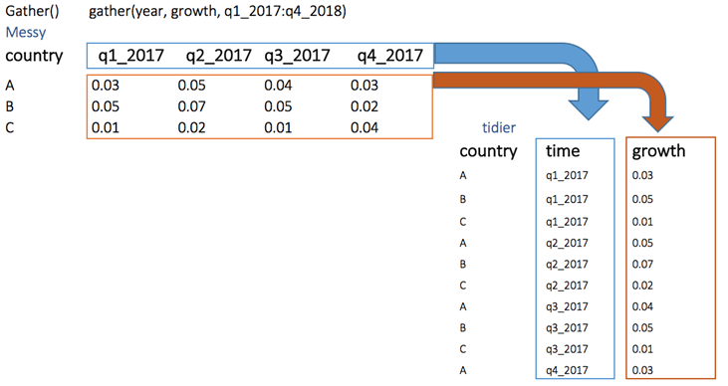
gather()
The objectives of the gather() function is to transform the data from wide to long.
library(tidyr) # Create a messy dataset
messy <- data.frame( country = c("A", "B", "C"), q1_2017 = c(0.03, 0.05, 0.01), q2_2017 = c(0.05, 0.07, 0.02), q3_2017 = c(0.04, 0.05, 0.01), q4_2017 = c(0.03, 0.02, 0.04))
# Reshape the data
tidier <-messy %>% gather(quarter, growth, q1_2017:q4_2017) tidier
Below, we can visualize the concept of reshaping wide to long. We want to create a single column named growth, filled by the rows of the quarter variables.
Output:
## country quarter growth
## 1 A q1_2017 0.03
## 2 B q1_2017 0.05
## 3 C q1_2017 0.01
## 4 A q2_2017 0.05
## 5 B q2_2017 0.07
## 6 C q2_2017 0.02
## 7 A q3_2017 0.04
## 8 B q3_2017 0.05
## 9 C q3_2017 0.01
## 10 A q4_2017 0.03
## 11 B q4_2017 0.02
## 12 C q4_2017 0.04

Slide 65
spread()
The spread() function does the opposite of gather.
We can reshape the tidier dataset back to messy with spread()
# Reshape the data
messy_1 <- tidier %>%
spread(quarter, growth)
messy_1
Output:
## country q1_2017 q2_2017 q3_2017 q4_2017
## 1 A 0.03 0.05 0.04 0.03
## 2 B 0.05 0.07 0.05 0.02
## 3 C 0.01 0.02 0.01 0.04

Slide 66
separate()
The separate() function splits a column into two according to a separator. This function is helpful in some situations where the variable is a date. Our analysis can require focussing on month and year and we want to separate the column into two new variables.
We can split the quarter from the year in the tidier dataset by applying the separate() function.
separate_tidier <-tidier %>%
separate(quarter, c("Qrt", "year"), sep ="_")
head(separate_tidier)
Output:
## country Qrt year growth
## 1 A q1 2017 0.03
## 2 B q1 2017 0.05
## 3 C q1 2017 0.01
## 4 A q2 2017 0.05
## 5 B q2 2017 0.07
## 6 C q2 2017 0.02

Slide 67
unite()
The unite() function concatenates two columns into one.
In the above example, we separated quarter from year. What if we want to merge them. We use the following code:
unit_tidier <- separate_tidier %>%
unite(Quarter, Qrt, year, sep ="_")
head(unit_tidier)
Output:
## country Quarter growth
## 1 A q1_2017 0.03
## 2 B q1_2017 0.05
## 3 C q1_2017 0.01
## 4 A q2_2017 0.05
## 5 B q2_2017 0.07
## 6 C q2_2017 0.02

Slide 68
Summary
The dplyr package provides a concise set of operations for managing data frames. With these functions we can do a number of complex operations in just a few lines of code. In particular, we can often conduct the beginnings of an exploratory analysis with the powerful combination of group_by() and summarize().
Once you learn the dplyr grammar there are a few additional benefits
dplyr can work with other data frame “backends” such as SQL databases. There is an SQL interface for relational databases via the DBI package
dplyr can be integrated with the data.table package for large fast tables
The dplyr package is handy way to both simplify and speed up your data frame management code. It’s rare that you get such a combination at the same time!

Slide 69
Data Frames
The data frame is a key data structure in statistics and in R. The basic structure of a data frame is that there is one observation per row and each column represents a variable, a measure, feature, or characteristic of that observation. R has an internal implementation of data frames that is likely the one you will use most often. However, there are packages on CRAN that implement data frames via things like relational databases that allow you to operate on very very large data frames (but we won’t discuss them here).
Given the importance of managing data frames, it’s important that we have good tools for dealing with them. In previous chapters we have already discussed some tools like the subset() function and the use of [ and $ operators to extract subsets of data frames. However, other operations, like filtering, re-ordering, and collapsing, can often be tedious operations in R whose syntax is not very intuitive. The dplyr package is designed to mitigate a lot of these problems and to provide a highly optimized set of routines specifically for dealing with data frames.
Notes:
brackets, parentheses and braces

Slide 70
Data Frame
Collection of vectors with same lengths
Gain the concept of 'rows'
all.results
all.results$mon
mean(all.results$mon)
“mon”
“tue”
“wed”
“pass”
1
2
3
4
1
0.8
0.9
0.8
T
0.6
0.7
0.5
F
2
0.2
0.3
0.3
F
3
0.8
0.8
0.9
T
4
0.6
1.0
0.9
T
5

Slide 71
Tibble
Collection of vectors with same lengths
Gain the concept of 'rows'
all.results
all.results$mon
mean(all.results$mon)
“mon”
“tue”
“wed”
“pass”
1
2
3
4
1
0.8
0.9
0.8
T
0.6
0.7
0.5
F
2
0.2
0.3
0.3
F
3
0.8
0.8
0.9
T
4
0.6
1.0
0.9
T
5

Slide 72
Tibbles are nicer dataframes
> head(as.data.frame(data))
Probe Chromosome Start End Probe Strand Feature
1 AL645608.2 1 911435 914948 + AL645608.2
2 LINC02593 1 916865 921016 - LINC02593
3 SAMD11 1 923928 944581 + SAMD11
4 TMEM51-AS1 1 15111815 15153618 - TMEM51-AS1
5 TMEM51 1 15152532 15220478 + TMEM51
6 FHAD1 1 15247272 15400283 + FHAD1
Description
1 novel transcript
2 long intergenic non-protein coding RNA 2593 [Source:HGNC Symbol;Acc:HGNC:53933]
3 sterile alpha motif domain containing 11 [Source:HGNC Symbol;Acc:HGNC:28706]
4 TMEM51 antisense RNA 1 [Source:HGNC Symbol;Acc:HGNC:26301]
5 transmembrane protein 51 [Source:HGNC Symbol;Acc:HGNC:25488]
6 forkhead associated phosphopeptide binding domain 1 [Source:HGNC Symbol;Acc:HGN

Slide 73
Tibbles are nicer dataframes
> head(as_tibble(data))
# A tibble: 6 x 12
Probe Chromosome Start End `Probe Strand` Feature ID Description
<chr> <dbl> <dbl> <dbl> <chr> <chr> <chr> <chr>
1 AL64~ 1 9.11e5 9.15e5 + AL6456~ ENSG~ novel tran~
2 LINC~ 1 9.17e5 9.21e5 - LINC02~ ENSG~ long inter~
3 SAMD~ 1 9.24e5 9.45e5 + SAMD11 ENSG~ sterile al~
4 TMEM~ 1 1.51e7 1.52e7 - TMEM51~ ENSG~ TMEM51 ant~
5 TMEM~ 1 1.52e7 1.52e7 + TMEM51 ENSG~ transmembr~
6 FHAD1 1 1.52e7 1.54e7 + FHAD1 ENSG~ forkhead a~
# ... with 4 more variables: `Feature Strand` <chr>, Type <chr>, `Feature
# Orientation` <chr>, Distance <dbl>

Slide 74
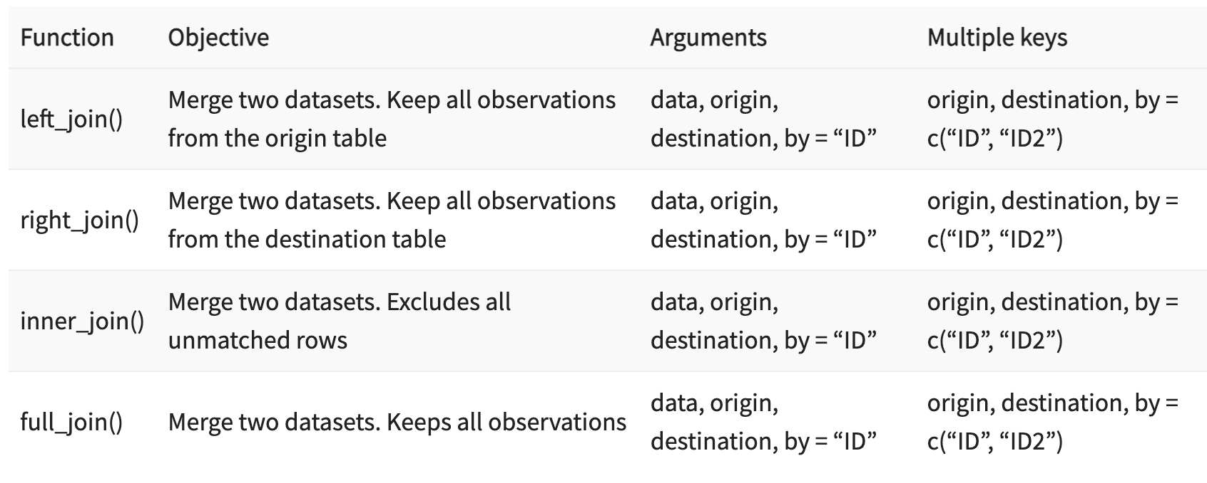
Merge Data with R Dplyr
dplyr provides a nice and convenient way to combine datasets. We may have many sources of input data, and at some point, we need to combine them. A join with dplyr adds variables to the right of the original dataset.

Slide 75
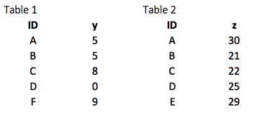
Dplyr Joins
We will study all the joins types via an easy example.
First of all, we build two datasets. The table 1 contains two variables, ID, and y, whereas Table 2 gathers ID and z. In each situation, we need to have a key-pair variable. In our case, ID is our key variable. The function will look for identical values in both tables and bind the returning values to the right of table 1.
library(dplyr)
df_primary <- tribble( ~ID, ~y, "A", 5, "B", 5, "C", 8, "D", 0, "F", 9)
df_secondary <- tribble( ~ID, ~z, "A", 30, "B", 21, "C", 22, "D", 25, "E", 29)

Slide 76
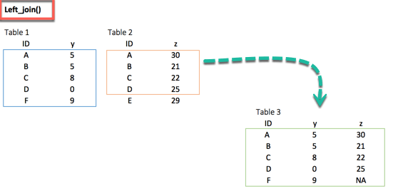
Dplyr left_join()
The most common way to merge two datasets is to use the left_join() function. We can see from the picture below that the key-pair matches perfectly the rows A, B, C and D from both datasets. However, E and F are left over. How do we treat these two observations? With the left_join(), we will keep all the variables in the original table and don’t consider the variables that do not have a key-paired in the destination table. In our example, the variable E does not exist in table 1. Therefore, the row will be dropped. The variable F comes from the origin table; it will be kept after the left_join() and return NA in the column z. The figure below reproduces what will happen with a left_join().
left_join(df_primary, df_secondary, by ='ID')
Output:
## # A tibble: 5 x 3
## ID y.x y.y
## <chr> <dbl> <dbl>
## 1 A 5 30
## 2 B 5 21
## 3 C 8 22
## 4 D 0 25
## 5 F 9 NA

Slide 77
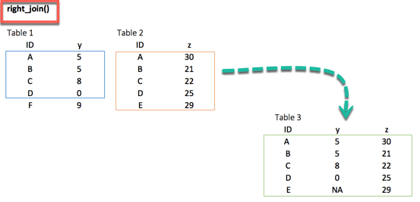
Dplyr right_join()
The right_join() function works exactly like left_join(). The only difference is the row dropped. The value E, available in the destination data frame, exists in the new table and takes the value NA for the column y.
right_join(df_primary, df_secondary, by = 'ID')
Output:
##
# A tibble: 5 x 3
## ID y.x y.y
## <chr> <dbl> <dbl>
## 1 A 5 30
## 2 B 5 21
## 3 C 8 22
## 4 D 0 25
## 5 E NA 29

Slide 78
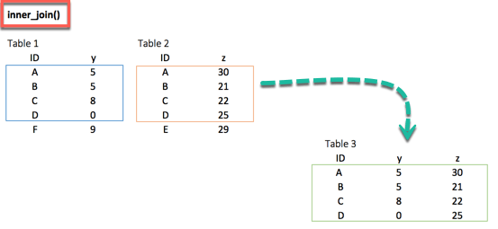
Dplyr inner_join()
When we are 100% sure that the two datasets won’t match, we can consider to return only rows existing in both dataset. This is possible when we need a clean dataset or when we don’t want to impute missing values with the mean or median.
The inner_join()comes to help. This function excludes the unmatched rows.
inner_join(df_primary, df_secondary, by ='ID')
Output:
##
# A tibble: 4 x 3
## ID y.x y.y
## <chr> <dbl> <dbl>
## 1 A 5 30
## 2 B 5 21
## 3 C 8 22
## 4 D 0 25

Slide 79
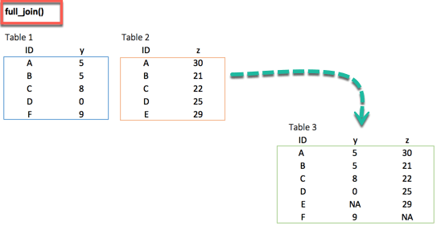
Dplyr full_join()
Finally, the full_join() function keeps all observations and replace missing values with NA.
full_join(df_primary, df_secondary, by = 'ID')
Output:
##
# A tibble: 6 x 3
## ID y.x y.y
## <chr> <dbl> <dbl>
## 1 A 5 30
## 2 B 5 21
## 3 C 8 22
## 4 D 0 25
## 5 F 9 NA
## 6 E NA 29

Slide 80
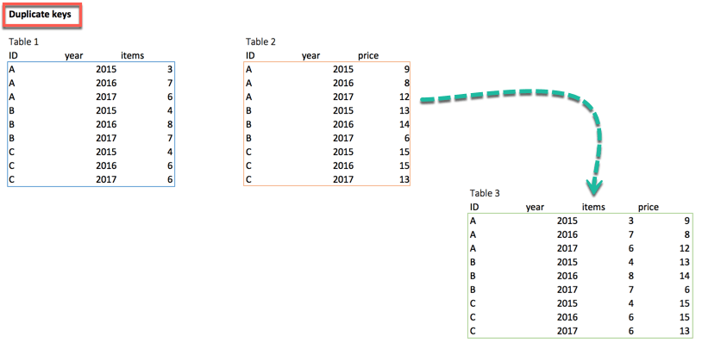
Multiple Key pairs
Last but not least, we can have multiple keys in our dataset. Consider the following dataset where we have years or a list of products bought by the customer.
If we try to merge both tables, R throws an error. To remedy the situation, we can pass two key-pairs variables. That is, ID and year which appear in both datasets. We can use the following code to merge table1 and table 2
df_primary <- tribble( ~ID, ~year, ~items,
"A", 2015,3,
"A", 2016,7,
"A", 2017,6,
"B", 2015,4,
"B", 2016,8,
"B", 2017,7,
"C", 2015,4,
"C", 2016,6,
"C", 2017,6)
df_secondary <- tribble( ~ID, ~year, ~prices,
"A", 2015,9,
"A", 2016,8,
"A", 2017,12,
"B", 2015,13,
"B", 2016,14,
"B", 2017,6,
"C", 2015,15,
"C", 2016,15,
"C", 2017,13)
left_join(df_primary, df_secondary, by = c('ID', 'year'))

Slide 81
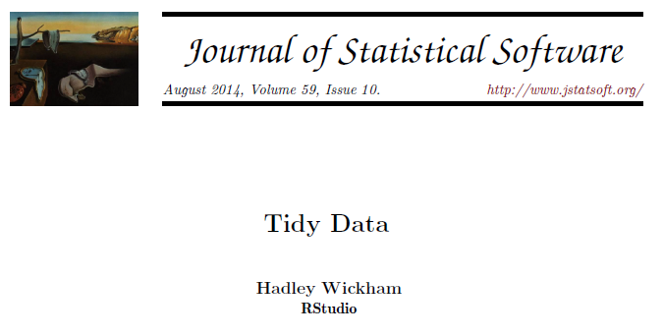
'Tidy' Data Format
Tibbles give you a 2D data structure where each column must be of a fixed data type
Often data can be put into this sort of structure in more than one way
Is there a right / wrong way to structure your data?
Tidyverse has an opinion!

Slide 82
Wide Format
Gene | WT_1 | WT_2 | WT_3 | KO_1 | KO_2 | KO_3
ABC1 | 8.86 | 4.18 | 8.90 | 4.00 | 14.52 | 13.39
DEF1 | 29.60 | 41.22 | 36.15 | 11.18 | 16.68 | 1.64
Compact
Easy to read
Shows linkage for genes
No explicit genotype or replicate
Values spread out over multiple rows and columns
Not extensible to more metadata

Slide 83

Long Format
Gene | Genotype | Replicate | Value
ABC1 | WT | 1 | 8.86
ABC1 | WT | 2 | 4.18
ABC1 | WT | 3 | 8.90
ABC1 | KO | 1 | 4.00
ABC1 | KO | 2 | 14.52
ABC1 | KO | 3 | 13.39
DEF1 | WT | 1 | 29.60
DEF1 | WT | 2 | 41.22
DEF1 | WT | 3 | 36.15
DEF1 | KO | 1 | 11.18
DEF1 | KO | 2 | 16.68
DEF1 | KO | 3 | 1.64
More verbose (repeated values)
Explicit genotype and replicate
All values in a single column
Extensible to more metadata

Slide 84
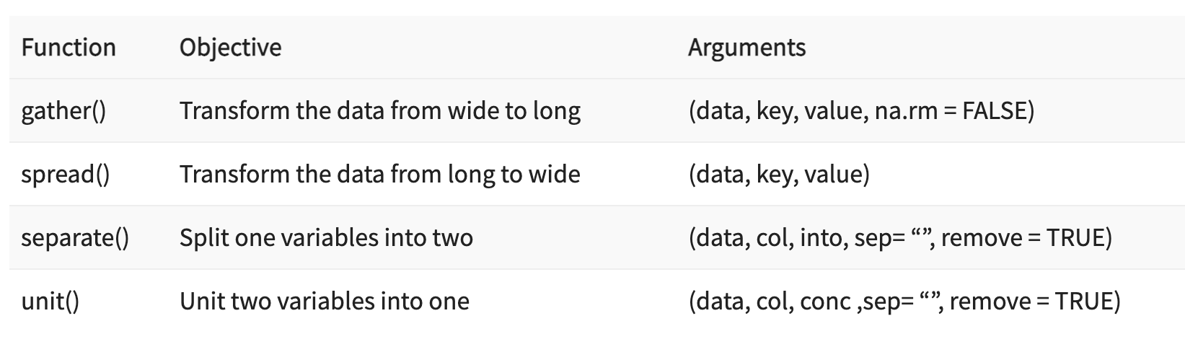
Data Cleaning Functions
Following are the four important functions to tidy (clean) the data:
We use the tidyr library. This library belongs to the collection of the library to manipulate, clean and visualize the data. If we install R with anaconda, the library is already installed. We can find the library here, https://anaconda.org/r/r-tidyr.
If not installed already, enter the following command to install tidyr:
install tidyr : install.packages("tidyr")

Slide 85
Tidying operations
pivot_longer
Takes multiple columns of the same type and puts them into a pair of key-value columns
separate
Splits a delimited column into multiple columns
pivot_wider
Takes a key-value column pair and spreads them out to multiple columns of the same type
unite
Combines multiple columns into one
Wide to Long
A
B
C
A
A
A
B
B
B
WT_D1
WT
D1
C
C
C
Long to Wide
A
B
C
A
A
A
B
B
B
C
C
C
WT
D1
WT_D1

Slide 86
Converting to "Tidy" format
# A tibble: 3 x 8
Gene Chr Start End WT_1 WT_2 KO_1 KO_2
<chr> <dbl> <dbl> <dbl> <dbl> <dbl> <dbl> <dbl>
1 Gnai3 2 163898 167465 9.39 10.9 33.5 81.9
2 Pbsn 5 4888573 4891351 91.7 59.6 45.3 82.3
3 Cdc45 7 1250084 1262669 69.2 36.1 54.4 38.1
Put all measures into a single column
Add a 'genotype' and 'replicate' column
Duplicate the gene information as required
Or separate it into a different table

Slide 87

Converting to "Tidy" format
# A tibble: 3 x 8
Gene Chr Start End WT_1 WT_2 KO_1 KO_2
<chr> <dbl> <dbl> <dbl> <dbl> <dbl> <dbl> <dbl>
1 Gnai3 2 163898 167465 9.39 10.9 33.5 81.9
2 Pbsn 5 4888573 4891351 91.7 59.6 45.3 82.3
3 Cdc45 7 1250084 1262669 69.2 36.1 54.4 38.1
non.normalised %>%
pivot_longer(cols=WT_1:KO_2, names_to="sample", values_to="value") %>%
separate(sample,into=c("genotype","replicate"),convert = TRUE,sep="_")
convert=TRUE makes separate re-detect the type of the column, so replicate becomes a numeric value

Slide 88
Converting to "Tidy" format
# A tibble: 12 x 7
Gene Chr Start End genotype replicate value
<chr> <dbl> <dbl> <dbl> <chr> <int> <dbl>
1 Gnai3 2 163898 167465 WT 1 9.39
2 Pbsn 5 4888573 4891351 WT 1 91.7
3 Cdc45 7 1250084 1262669 WT 1 69.2
4 Gnai3 2 163898 167465 WT 2 10.9
5 Pbsn 5 4888573 4891351 WT 2 59.6
6 Cdc45 7 1250084 1262669 WT 2 36.1
7 Gnai3 2 163898 167465 KO 1 33.5
8 Pbsn 5 4888573 4891351 KO 1 45.3
9 Cdc45 7 1250084 1262669 KO 1 54.4
10 Gnai3 2 163898 167465 KO 2 81.9
11 Pbsn 5 4888573 4891351 KO 2 82.3
12 Cdc45 7 1250084 1262669 KO 2 38.1

Slide 89
Pivoting Examples
> pivot.data
# A tibble: 4 x 3
gene WT KO
<chr> <dbl> <dbl>
1 ABC1 18608 7831
2 DEF1 31988 55502
3 GHI1 7647 93299
4 JKL1 96002 47945
pivot.data %>%
pivot_longer(
cols=WT:KO,
names_to = "Condition",
values_to = "Count"
) -> pivot.long
# A tibble: 8 x 3
gene Condition Count
<chr> <chr> <dbl>
1 ABC1 WT 18608
2 ABC1 KO 7831
3 DEF1 WT 31988
4 DEF1 KO 55502
5 GHI1 WT 7647
6 GHI1 KO 93299
7 JKL1 WT 96002
8 JKL1 KO 47945
Notes:
Log transform all of the values
Pivot longer
Which columns are we pivoting?
What do we want to call the new column of names?
What do we want to call the new column of values?

Slide 90
Pivoting Examples
> pivot.long
# A tibble: 8 x 3
gene Condition Count
<chr> <chr> <dbl>
1 ABC1 WT 14.2
2 ABC1 KO 12.9
3 DEF1 WT 15.0
4 DEF1 KO 15.8
5 GHI1 WT 12.9
6 GHI1 KO 16.5
7 JKL1 WT 16.6
8 JKL1 KO 15.5
pivot.long %>%
pivot_wider(
names_from = Condition,
values_from = Count
)
# A tibble: 4 x 3
gene WT KO
<chr> <dbl> <dbl>
1 ABC1 14.2 12.9
2 DEF1 15.0 15.8
3 GHI1 12.9 16.5
4 JKL1 16.6 15.5
Notes:
Plot WT vs KO
Pivot wider
Which column of names?
Which column of values?

Slide 91
Missing values
Missing values in data science arise when an observation is missing in a column of a data frame or contains a character value instead of numeric value. Missing values must be dropped or replaced in order to draw correct conclusion from the data.

Slide 92
Exclude Missing Values (NA)
The na.omit() method from the dplyr library is a simple way to exclude missing observation. Dropping all the NA from the data is easy but it does not mean it is the most elegant solution. During analysis, it is wise to use variety of methods to deal with missing values
To tackle the problem of missing observations, we will use the titanic dataset. In this dataset, we have access to the information of the passengers on board during the tragedy. This dataset has many NA that need to be taken care of.
We will upload the csv file from the internet and then check which columns have NA. To return the columns with missing data, we can use the following code:
Let’s upload the data and verify the missing data.
df_titanic <- read.csv(PATH, sep = ",")
# Return the column names containing missing observations list_na <- colnames(df_titanic)[ apply(df_titanic, 2, anyNA) ] list_na
Output:
## [1] "age" "fare"

Slide 93
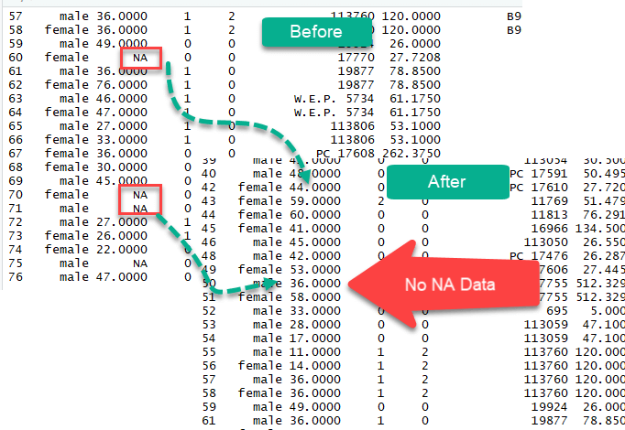
na.omit()
The columns age and fare have missing values.
We can drop them with the na.omit().
library(dplyr)
# Exclude the missing observations
df_titanic_drop <-df_titanic %>% na.omit()
dim(df_titanic_drop)
Output:
## [1] 1045 13
The new dataset contains 1045 rows compared to 1309 with the original dataset.

Slide 94
Impute Missing data with the Mean and Median
We could also impute(populate) missing values with the median or the mean. A good practice is to create two separate variables for the mean and the median. Once created, we can replace the missing values with the newly formed variables. We will use the apply method to compute the mean of the column with NA. Let’s see an example
# Create mean
average_missing <- apply(df_titanic[,colnames(df_titanic) %in% list_na], 2, mean, na.rm = TRUE)
average_missing
Code Explanation:
df: df_titanic[,colnames(df_titanic) %in% list_na]. This code will return the columns name from the list_na object (i.e. “age” and “fare”)
2: Compute the function on the columns
mean: Compute the mean
na.rm = TRUE: Ignore the missing values
## age fare
## 29.88113 33.29548

Slide 95
Impute Missing data with the Mean and Median
The verb mutate from the dplyr library is useful in creating a new variable. We don’t necessarily want to change the original column so we can create a new variable without the NA. mutate is easy to use, we just choose a variable name and define how to create this variable. Here is the complete code
# Create a new variable with the mean and median
df_titanic_replace <- df_titanic %>% mutate(replace_mean_age = ifelse(is.na(age), average_missing[1], age),
replace_mean_fare = ifelse(is.na(fare), average_missing[2], fare))
sum(is.na(df_titanic_replace$age))
Code Explanation:
We create two variables, replace_mean_age and replace_mean_fare as follow:
replace_mean_age = ifelse(is.na(age), average_missing[1], age)
replace_mean_fare = ifelse(is.na(fare), average_missing[2],fare)
If the column age has missing values, then replace with the first element of average_missing (mean of age), else keep the original values. Same logic for fare
Output:
## [1] 263
Perform the replacement
sum(is.na(df_titanic_replace$replace_mean_age))
## [1] 0
The original column age has 263 missing values while the newly created variable have replaced them with the mean of the variable age.

Slide 96
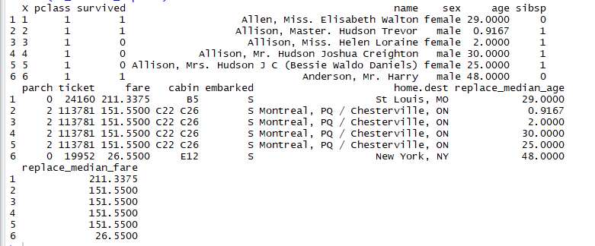
Impute Missing data with the Mean and Median
We can replace the missing observations with the median as well.
median_missing <- apply(df_titanic[,colnames(df_titanic) %in% list_na], 2, median, na.rm = TRUE)
df_titanic_replace <- df_titanic %>% mutate(replace_median_age = ifelse(is.na(age), median_missing[1], age), replace_median_fare = ifelse(is.na(fare), median_missing[2], fare))
head(df_titanic_replace)

Slide 97
Impute Missing data with the Mean and Median
A big data set could have lots of missing values and the above method could be cumbersome. We can execute all the above steps above in one line of code using sapply() method. Though we would not know the vales of mean and median.
sapply does not create a data frame, so we can wrap the sapply() function within data.frame() to create a data frame object.
# Quick code to replace missing values with the mean
df_titanic_impute_mean < -data.frame( sapply( df_titanic, function(x) ifelse(is.na(x), mean(x, na.rm = TRUE), x)))

Slide 98
Exercise 1 - Data normalization
Data normalization
Create a function that normalizes a vector:
x_new = (x-mean(x))/sd(x)
Use this function on the iris dataset so that each column is normalized
You can also make the function more general
x_new = (x-a)/b
4. use it to preprocess the data with « min-max » normalization ( x-min/(max-min))

Slide 99
Exercise 2: Fibonacci Sequence in R
The first two terms of the Fibonacci sequence is 0 followed by 1. All other terms are obtained by adding the preceding two terms.
This means to say the n^{th} term is the sum of (n-1)^{th} and (n-2)^{th} term.
The Fibonacci sequence: 0, 1, 1, 2, 3, 5, 8, 13, 21
Hints:
Here, we ask the user for the number of terms in the sequence.
A recursive function recurse_fibonacci() is used to calculate the nth term of the sequence. We use a for loop to iterate and calculate each term recursively.

Slide 100
Exercise 3: Program to Find GCD
The highest common factor (H.C.F) or greatest common divisor (G.C.D) of two numbers is the largest positive integer that perfectly divides the two given numbers.
For example, the H.C.F of 12 and 14 is 2.
Hints:
This program asks for two integers and passes them to a function which returns the H.C.F.
In the function, we first determine the smaller of the two number since the H.C.F can only be less than or equal to the smallest number.
We then use a for loop to go from 1 to that number.
In each iteration we check if our number perfectly divides both the input numbers.
If so, we store the number as H.C.F. At the completion of the loop we end up with the largest number that perfectly divides both the numbers.

Slide 101
Exercise 4: mean and standard deviation over the columns
Compute the mean of all columns of iris dataset
Compute their standard deviation

Slide 102
Exercise 5
Exercise 1
Select the first three columns of the iris dataset using their column names. HINT: Use select().
Exercise 2
Select all the columns of the iris dataset except “Petal Width”. HINT: Use “-“.
Exercise 3
Select all columns of the iris dataset that start with the character string “P”.
Exercise 4
Filter the rows of the iris dataset for Sepal.Length >= 4.6 and Petal.Width >= 0.5.
Exercise 5
Pipe the iris data frame to the function that will select two columns (Sepal.Width and Sepal.Length). HINT: Use pipe operator.
Exercise 6
Arrange rows by a particular column, such as the Sepal.Width. HINT: Use arrange().
Exercise 7
Select three columns from iris, arrange the rows by Sepal.Length, then arrange the rows by Sepal.Width.
Exercise 8
Create a new column called proportion, which is the ratio of Sepal.Length to Sepal.Width. HINT: Use mutate().
Exercise 9
Compute the average number of Sepal.Length, apply the mean() function to the column Sepal.Length, and call the summary value “avg_slength”. HINT: Use summarize().

Slide 103
Exercise 6: Restructuring data into ‘tidy’ format
You have been provided with three CSV data files (tidy_data1.csv, tidy_data2.csv, tidy_data3.csv). Load each of these and put them into tidy format. After loading each of the data files think about the following.
Which of the columns are annotations and which are measurements
How many different types of measurement are there?
Are all of the measurements of the same type in a single column?
Do any annotation columns contain multiple pieces of information which have been concatenated together and would benefit from being split apart?
Are any of the columns purely for annotation and might benefit from being split into another tibble to avoid duplication?
After tidying are there any NA values which should be removed?

Slide 104
Exercise 7: treating missing values
Use the airquality dataset from base
Compute the percentage p_na of missing values in a column
If p_na > 0,5 → delete the column
If p_na <= 0,5 → replace the missing values by 0 or by the mean of the column, depending on a variable "type_na"

