Slide 1
Basic R

Slide 2
Instructors
Silvia BOTTINI
silvia.bottini@univ-cotedazur.fr
Justine LABORY
Justine.labory@etu.univ-cotedazur.fr

Slide 3
Materials

Slide 4

Why R?
Interactivity
Scripting
Open Source
Multi platform
Notes:
R is not a programming language like C or Java.
It was not created by software engineers for software development.
Instead, it was developed by statisticians and data analysts
as an interactive environment for data analysis.
The interactivity is an indispensable feature in data science
However, like in any other programming language,
you can save your work as scripts, which you can easily execute at any moment.
R is free and open source, meaning that you can look at the code.
There's also a large and growing active community of R users. It's easy for others to contribute add-ons,
which enable developers to share software implementations of new data
science techniques.
It runs across all major platforms--
Windows, Mac OS, Unix, Linux.

Slide 5

Drawbacks
Not user friendly @ start
Data preparation
No easy debugging
Working with large datasets is limited by RAM

Slide 6
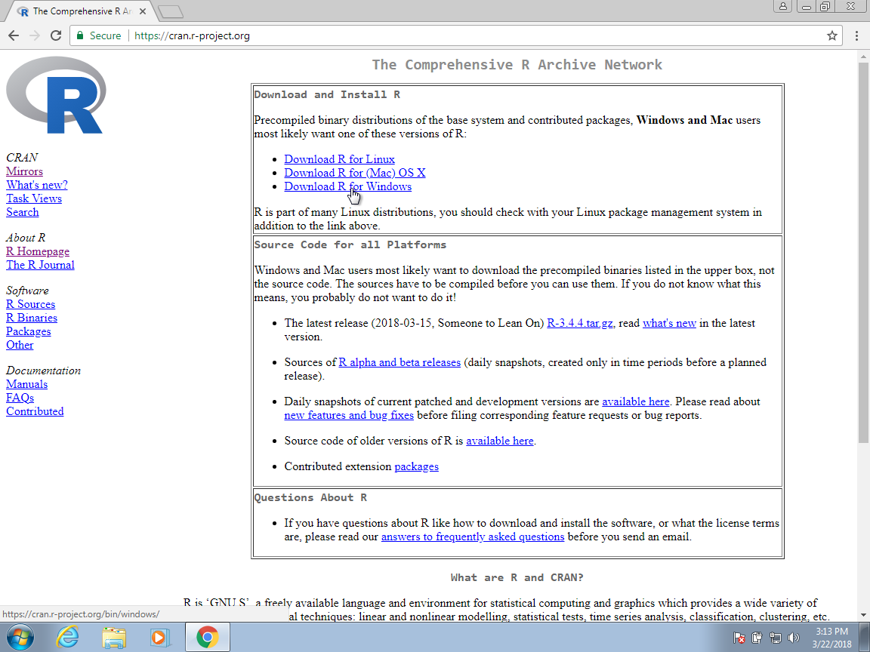



Let’s start
Download R: Console & RStudio

Slide 7
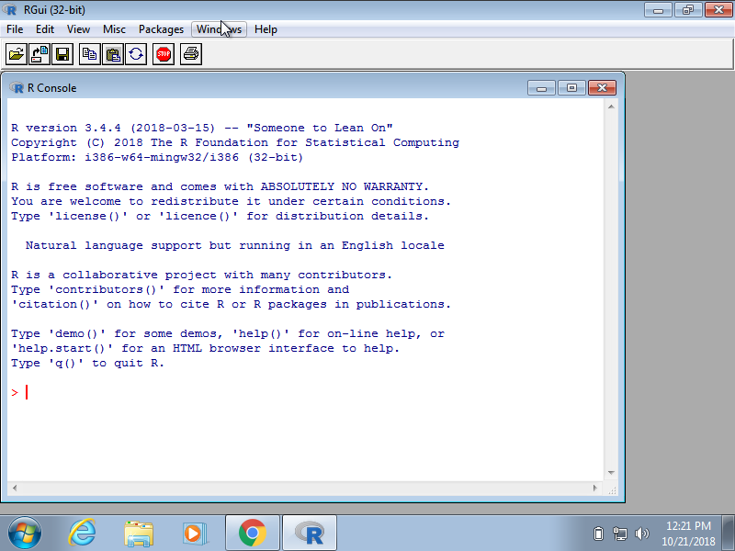
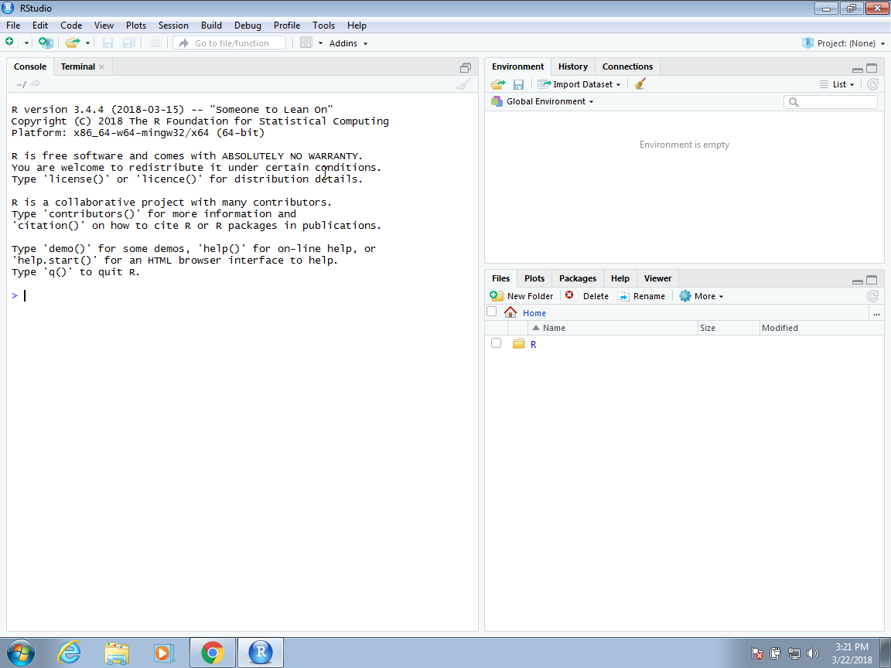
Let’s start
Download R: Console & Rstudio
Open the console

Slide 8
Let’s start
Download R: Console & Rstudio
Open the console
Make simple calculation
> 2 * 2
 [1] 4
> 0.15 * 19.71
 [1] 2.96
> exp(-2)
 [1] 0.1353353

Slide 9
Let’s start
Download R: Console & Rstudio
Open the console
Make simple calculation
Make more complex calculation
> ?t.test
Description: a short description in English of the method implemented in the function
Usage: the way the function should be used, with all input parameters and their default values
Arguments: a detailed explenation of the input parameters
Values: a detailed explenation of the output fields

Slide 10
Let’s start
Download R: Console & Rstudio
Open the console
Make simple calculation
Make more complex calculation
Install libraries
# installing the package
> install.packages("dslabs")
 The downloaded binary packages are in
/var/folders/0t/35l1qfw53xqbdy1ldsnljgmc0000gn/T//Rtmp9XgRWo/downloaded_packages
# loading the package > library(dslabs)
Notes:
The extra functionality comes from add-ons available from developers.
There are currently hundreds of these available from CRAN,
and many others shared via other repositories such as GitHub.
R makes it very easy to install packages from within R itself.
Datasets and functions that can be used for data analysis practice, homework and projects in data science courses and workshops. 26 datasets are available for case studies in data visualization, statistical inference, modeling, linear regression, data wrangling and machine learning.

Slide 11
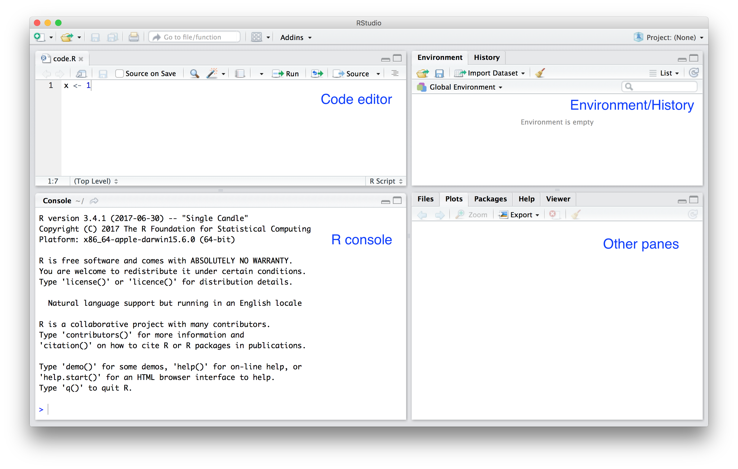
Let’s do some scripting
→ New File → Rscript →
Notes:
One of the great advantages of R over point-and-click analysis software is that you can save your work as scripts. You can edit and save these scripts using a text editor. The material in this book was developed using the interactive integrated development environment (IDE) RStudio. RStudio includes an editor with many R specific features, a console to execute your code, and other useful panes, including one to show figures.
You can see a pane where you write your scripts,
another one where you have the console, and other panes with other information,
as well as a place for your figures and plots to show up.

Slide 12
Let’s do some scripting
Results
→ New File → Rscript →
Notes:
One of the great advantages of R over point-and-click analysis software is that you can save your work as scripts. You can edit and save these scripts using a text editor. The material in this book was developed using the interactive integrated development environment (IDE) RStudio. RStudio includes an editor with many R specific features, a console to execute your code, and other useful panes, including one to show figures.
You can see a pane where you write your scripts,
another one where you have the console, and other panes with other information,
as well as a place for your figures and plots to show up.

Slide 13
The very basic: variables & functions
> a <- 1
> a
 [1] 1
> print a
 [1] 1

Slide 14
The very basic: variables & functions
> a <- 1
> a
 [1] 1
> print a
 [1] 1
> log(8)
 [1] 2.08
> help(“log”)
> ?log
> args(log)
function (x, base = exp(1))

Slide 15
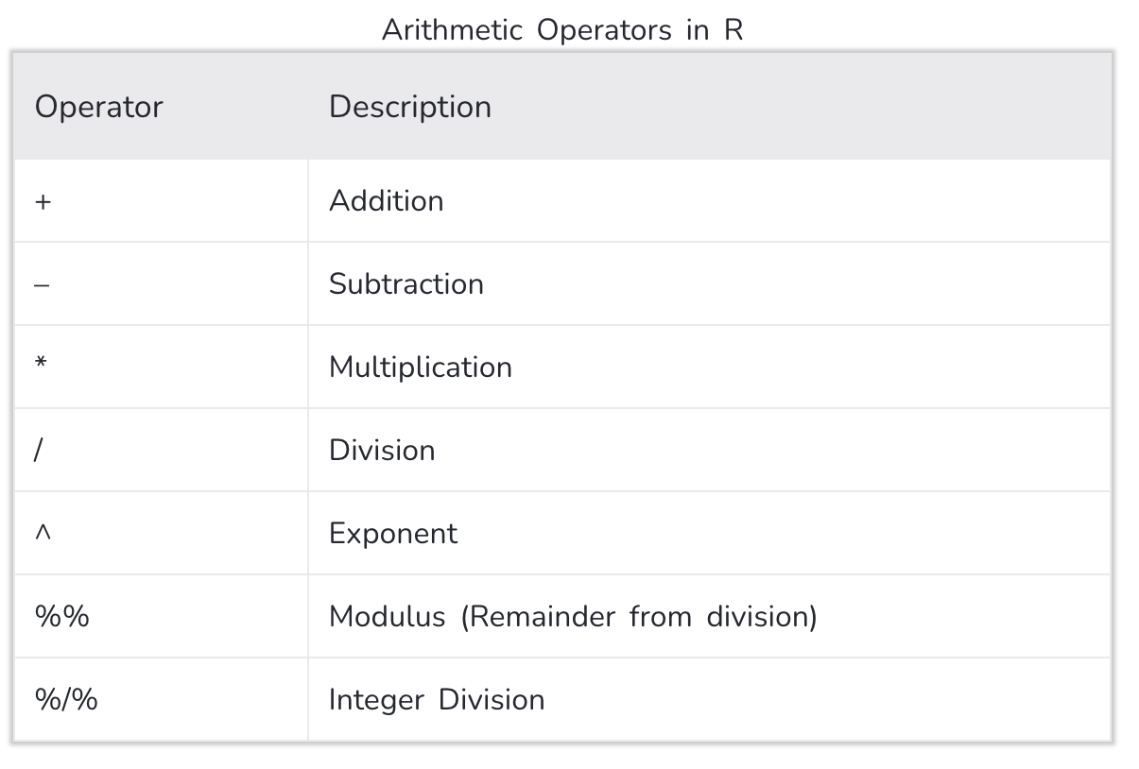
Arithmetic Operators

Slide 16
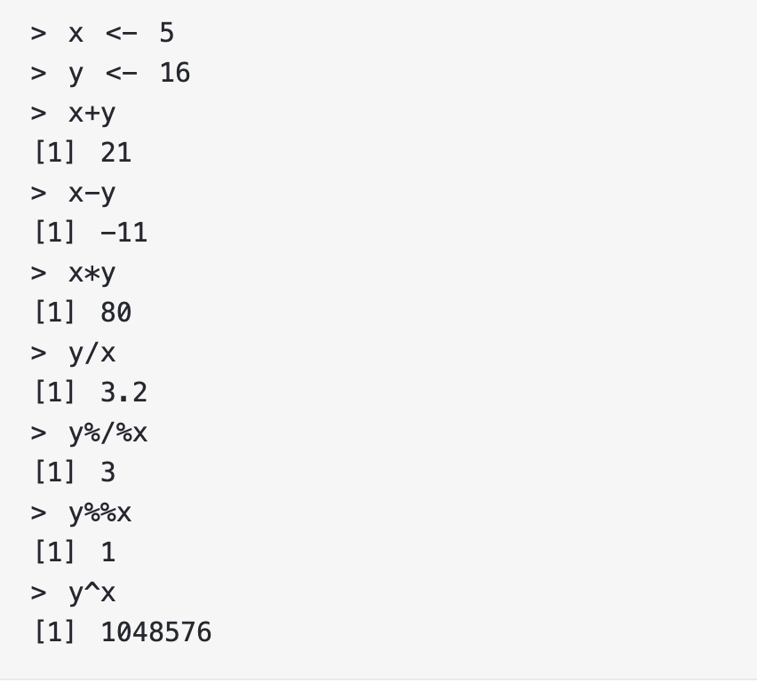
Arithmetic Operators

Slide 17
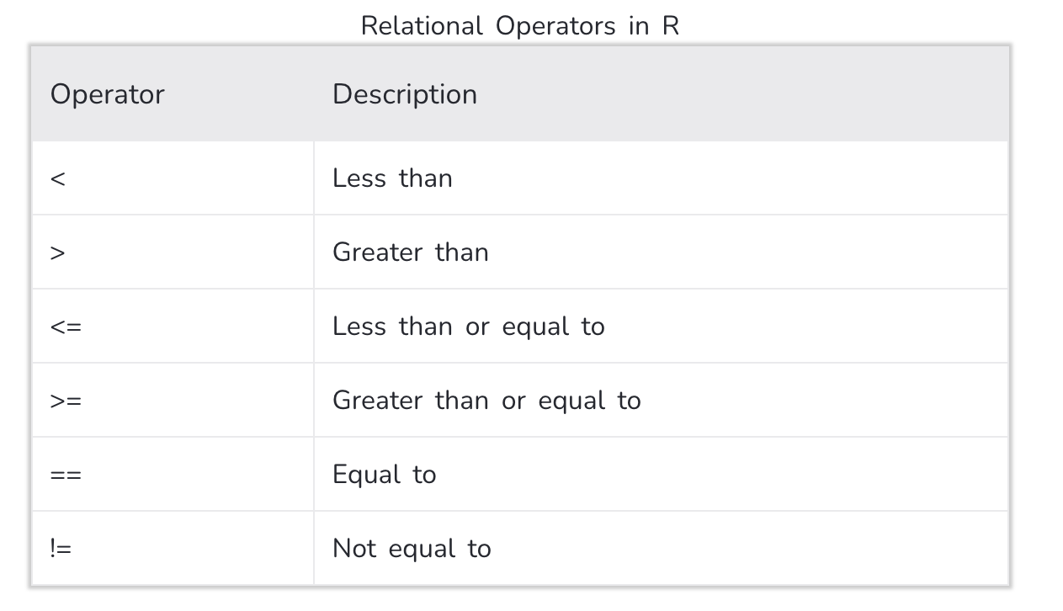
Relational Operators
Relational operators are used to compare between values.

Slide 18
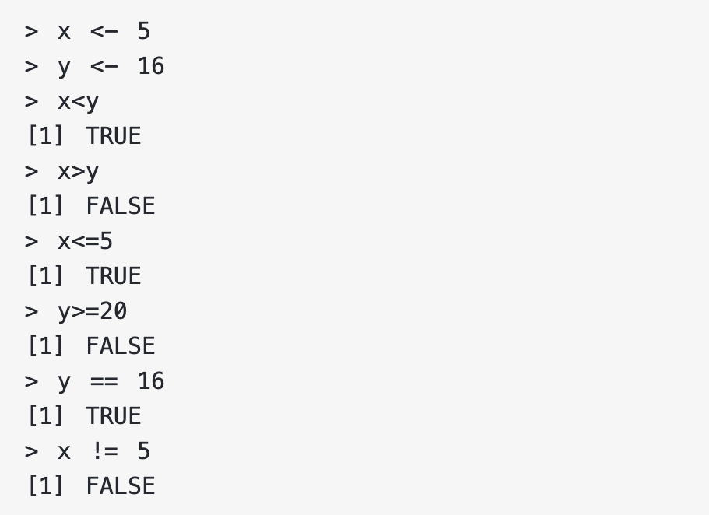
Relational Operators

Slide 19
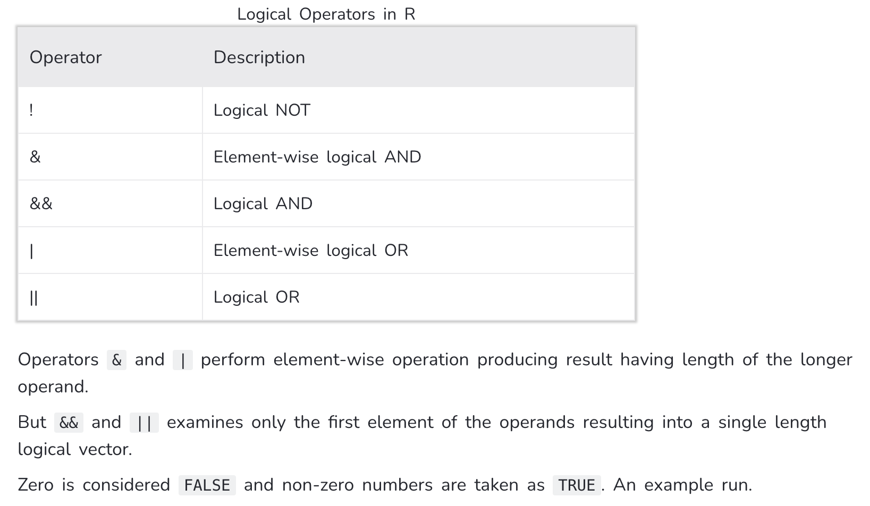
Logical Operators
Logical operators are used to carry out Boolean operations like AND, OR etc.

Slide 20
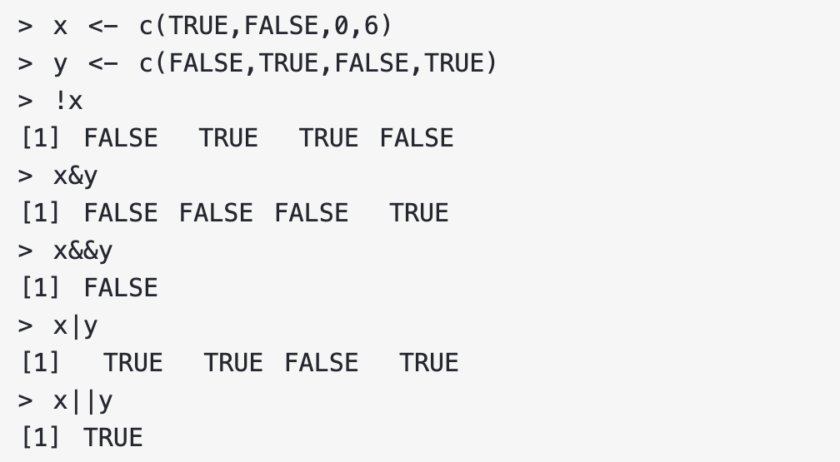
Logical Operators

Slide 21
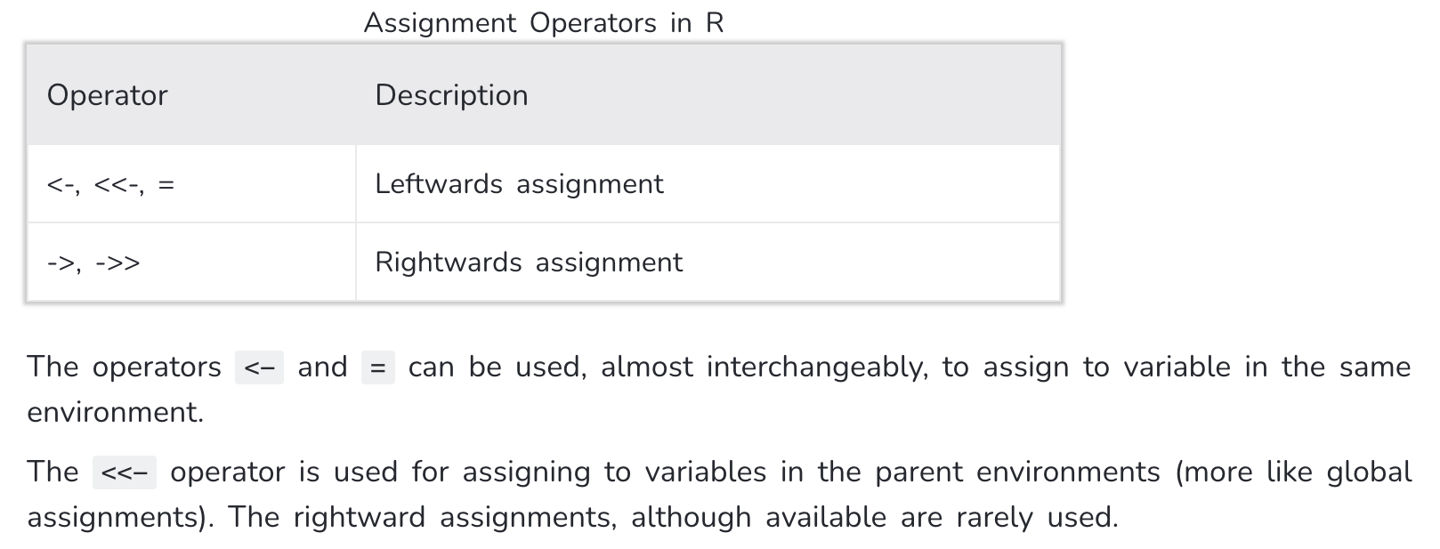
Assignment Operators

Slide 22
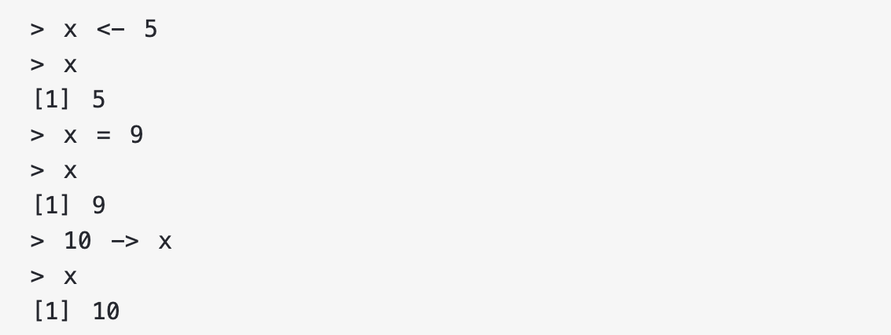
Assignment Operators

Slide 23
The very basic: variables & functions
ax²+bx+c=0
> a <- 1
> b <- 1
> c <- -1
> (-b + sqrt(b^2 - 4*a*c) ) / ( 2*a )
 [1] 0.618
> (-b + sqrt(b^2 - 4*a*c) ) / ( 2*a )
 [1] -1.62
## Code to compute solution to quadratic equation of the form ax^2 + bx + c
## define the variables
a <- 3
b <- 2
c <- -1
## now compute the solution
Sol1 <- (-b + sqrt(b^2 - 4*a*c)) / (2*a)
Sol2 <- (-b - sqrt(b^2 - 4*a*c)) / (2*a)

Slide 24
Data types
> a <- 1
> class(a)
 [1] “numeric”
> print a
 [1] 1

Slide 25
Vectors
In R, the most basic objects available to store data are vectors. As we have seen, complex datasets can usually be broken down into components that are vectors. For example, in a data frame, each column is a vector.

Slide 26
Create vectors
> codes <- c(380, 124, 818)
#> [1] 380 124 818
> country <- c("italy", "canada", "egypt")
> codes <- c(italy = 380, canada = 124, egypt = 818)
#> italy canada egypt
#> 380 124 818
> class(codes)
#> [1] "numeric"]
> names(codes)
#> [1] "italy" "canada" "egypt"
We can create vectors using the function c, which stands for concatenate.

Slide 27
Create vectors
> codes <- c(380, 124, 818)
#> [1] 380 124 818
> country <- c("italy", "canada", "egypt")
> codes <- c(italy = 380, canada = 124, egypt = 818)
#> italy canada egypt
#> 380 124 818
> class(codes)
#> [1] "numeric"]
> names(codes)
#> [1] "italy" "canada" "egypt"
> seq(1, 10)
#> [1] 1 2 3 4 5 6 7 8 9 10
Another useful function for creating vectors generates sequences:

Slide 28
Create vectors
> codes <- c(380, 124, 818)
#> [1] 380 124 818
> country <- c("italy", "canada", "egypt")
> codes <- c(italy = 380, canada = 124, egypt = 818)
#> italy canada egypt
#> 380 124 818
> class(codes)
#> [1] "numeric"]
> names(codes)
#> [1] "italy" "canada" "egypt"
> seq(1, 10)
#> [1] 1 2 3 4 5 6 7 8 9 10
> codes[2]
#> canada
#> 124
> codes[c(1,3)]
#> italy egypt
#> 380 818
> codes[1:2]
#> italy canada
#> 380 124
Subsetting a vector

Slide 29
Vectors
The object murders$population is not one number but several.
We call these types of objects vectors.
A single number is technically a vector of length 1, but in general we use the term vectors to refer to objects with several entries.
> class(murders$population)
 [1] " numeric "
> length(murders$population)
 [1] 51
> class(murders$states)
 [1] " character "
> class(murders$region)
 [1] " factor "
> levels(murders$region)
[1] "Northeast" "South" "North Central" "West"
> z <- 3 == 2
[1] FALSE
> class(z)
 [1] " logical "

Slide 30
Coercion
In general, coercion is an attempt by R to be flexible with data types. When an entry does not match the expected, some of the prebuilt R functions try to guess what was meant before throwing an error. This can also lead to confusion. Failing to understand coercion can drive programmers crazy when attempting to code in R since it behaves quite differently from most other languages in this regard.
> x <- c(1, "canada", 3)
You expected an error message!

Slide 31
Coercion
In general, coercion is an attempt by R to be flexible with data types. When an entry does not match the expected, some of the prebuilt R functions try to guess what was meant before throwing an error. This can also lead to confusion. Failing to understand coercion can drive programmers crazy when attempting to code in R since it behaves quite differently from most other languages in this regard.
> x <- c(1, "canada", 3)
> x
#> [1] "1" "canada" "3"
> class(x)
#> [1] "character "
R coerced the data into characters.

Slide 32
Coercion
In general, coercion is an attempt by R to be flexible with data types. When an entry does not match the expected, some of the prebuilt R functions try to guess what was meant before throwing an error. This can also lead to confusion. Failing to understand coercion can drive programmers crazy when attempting to code in R since it behaves quite differently from most other languages in this regard.
> x <- c(1, "canada", 3)
> x
#> [1] "1" "canada" "3"
> class(x)
#> [1] "character "
R coerced the data into characters.
> x <- 1:5
> y <- as.character(x)
> y
#> [1] "1" "2" "3" "4" "5"
> as.numeric(y)
#> [1] 1 2 3 4 5
R also offers functions to change from one type to another.

Slide 33
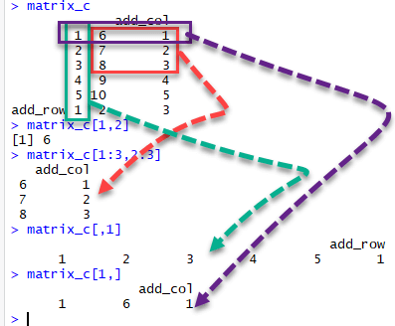
Matrices
> mat <- matrix(1:12, 4, 3)
#> [,1] [,2] [,3]
#> [1,] 1 5 9
#> [2,] 2 6 10
#> [3,] 3 7 11
#> [4,] 4 8 12
> mat[2, 3]
#> [1] 10
> mat[2, ]
#> [1] 2 6 10
> mat[, 3]
#> [1] 9 10 11 12
> mat[, 2:3]
#> [,1] [,2]
#> [1,] 5 9
#> [2,] 6 10
#> [3,] 7 11
#> [4,] 8 12
> as.data.frame(mat)
Matrices are similar to data frames in that they are two-dimensional: they have rows and columns.
However, like numeric, character and logical vectors, entries in matrices have to be all the same type.
Yet matrices have a major advantage over data frames: we can perform a matrix algebra operations, a powerful type of mathematical technique.
Notes:
matrix_c[1,2] selects the element at the first row and second column.
matrix_c[1:3,2:3] results in a R slice matrix with the data on the rows 1, 2, 3 and columns 2, 3,
matrix_c[,1] selects all elements of the first column.
matrix_c[1,] selects all elements of the first row.

Slide 34
Lists
> mylist = list(name='Charles',age=28,married=TRUE)
> mylist
## $name
## [1] "Charles"
## $age
## [1] 28
## $married
## [1] TRUE
> out = t.test(1:10, y = c(7:20))
> out
 ## Welch Two Sample t-test
## data: 1:10 and c(7:20)
## t = -5.4349, df = 21.982, p-value = 1.855e-05
## alternative hypothesis: true difference in means is not equal to 0
## 95 percent confidence interval:
## -11.052802 -4.947198
## sample estimates:
## mean of x mean of y
## 5.5 13.5
Lists are objects able to store information of different types. All functions return lists, so it is important to be able to manipulate them!

Slide 35
data frame
> library(dslabs)
> data(murders)
> class(murders)
 [1] "data.frame"

Slide 36
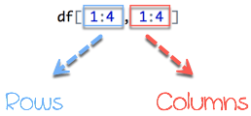
How to Create a Data Frame
We can create a dataframe in R by passing the variable a,b,c,d into the data.frame() function. We can R create dataframe and name the columns with name() and simply specify the name of the variables.
data.frame(df, stringsAsFactors = TRUE)
# Create a, b, c, d variables
a <- c(10,20,30,40)
b <- c('book', 'pen', 'textbook', 'pencil_case’)
c <- c(TRUE,FALSE,TRUE,FALSE)
d <- c(2.5, 8, 10, 7)
# Join the variables to create a data frame
df <- data.frame(a,b,c,d)
df
## a b c d
## 1 10 book TRUE 2.5
## 2 20 pen FALSE 8.0
## 3 30 textbook TRUE 10.0
## 4 40 pencil_case FALSE 7.0

Slide 37
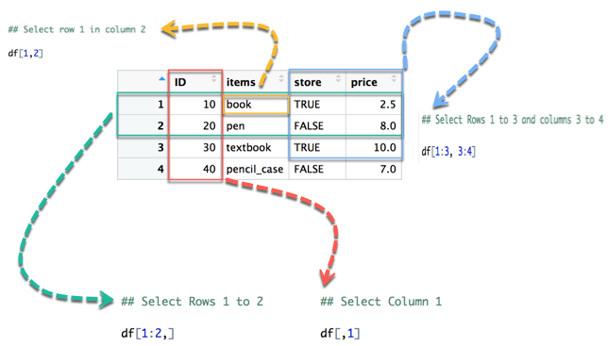
Slice Data Frame
## [1] book
## Levels: book pen pencil_case textbook
## store price
## 1 TRUE 2.5
## 2 FALSE 8.0
## 3 TRUE 10.0
## ID items store price
## 1 10 book TRUE 2.5
## 2 20 pen FALSE 8.0
## [1] 10 20 30 40

Slide 38
Append a Column to Data Frame
# Create a new vector
quantity <- c(10, 35, 40, 5)
# Add `quantity` to the `df` data frame
df$quantity <- quantity
df
Output:
## ID items store price quantity
## 1 10 book TRUE 2.5 10
## 2 20 pen FALSE 8.0 35
## 3 30 textbook TRUE 10.0 40
## 4 40 pencil_case FALSE 7.0 5

Slide 39
Subset a Data Frame
We use the subset() function.
subset(x, condition)
arguments:
- x: data frame used to perform the subset
- condition: define the conditional statement
# Select price above 5
subset(df, subset = price > 5)
Output:
ID items store price
2 20 pen FALSE 8
3 30 textbook TRUE 10
4 40 pencil_case FALSE 7

Slide 40
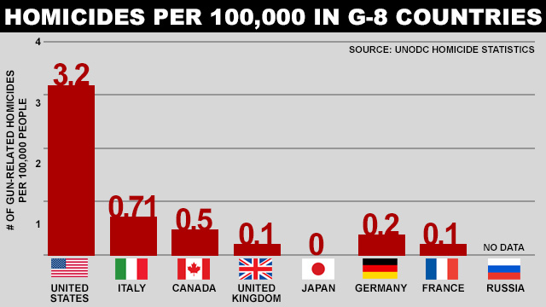
The data frame “murders”
(Source: Ma’ayan Rosenzweigh/ABC News, Data from UNODC Homicide Statistics)

Slide 41
Examining data frame
The function str is useful for finding out more about the structure of an object:
> str(murders)
We can show the first six lines using the function head:
> head(murders)
To reveal the names for each of the variables stored in this table we use the function names :
> names(murders)
To access the different variables represented by columns included in this data frame, we use the accessor operator $
> murders$population

Slide 42
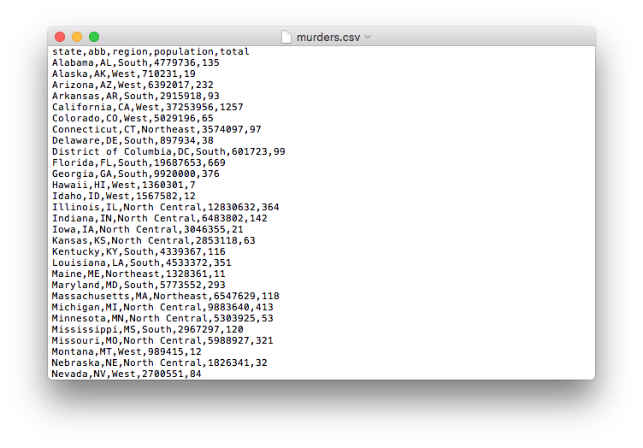
Importing data
When creating spreadsheets with text files, like the ones created with a simple text editor, a new row is defined with return and columns are separated with some predefined special character. The most common characters are comma (,), semicolon (;), space (`) and tab ( or`, a preset number of spaces).
Notes:
We have been using data sets already stored as R objects. A data scientist will rarely have such luck and will have to import data into R from either a file, a database, or other sources. Currently, one of the most common ways of storing and sharing data for analysis is through electronic spreadsheets. A spreadsheet stores data in rows and columns. It is basically a file version of a data frame. When saving such a table to a computer file, one needs a way to define when a new row or column ends and the other begins. This in turn defines the cells in which single values are stored. When creating spreadsheets with text files, like the ones created with a simple text editor, a new row is defined with return and columns are separated with some predefined special character. The most common characters are comma (,), semicolon (;), space (`) and tab ( or`, a preset number of spaces).

Slide 43
The readr and readxl packages
readr
readxl
Function | Format | Typical suffix
read_table | white space separated values | txt
read_csv | comma separated values | csv
read_csv2 | semicolon separated values | csv
read_tsv | tab delimited separated values | tsv
read_delim | general text file format, must define delimiter | txt
Function | Format | Typical suffix
read_excel | auto detect the format | xls, xlsx
read_xls | original format | xls
read_xlsx | new format | xlsx
> library(readr)
> read_lines("murders.csv", n_max = 3)
#> [1] "state,abb,region,population,total" "Alabama,AL,South,4779736,135"
#> [3] "Alaska,AK,West,710231,19 »
> dat <- read_csv(filename)
> head(dat)
R-base also provides import functions. These have similar names to those in the tidyverse, for example read.table, read.csv and read.delim

Slide 44
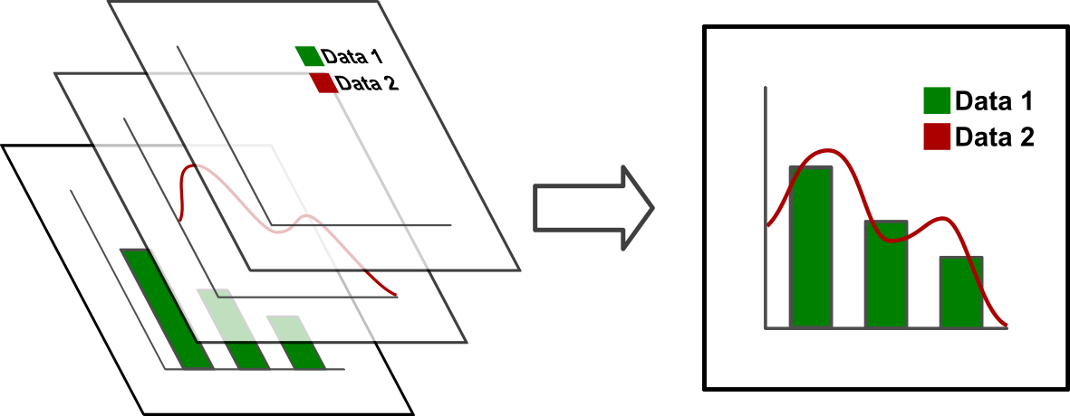
The R Painters Model
Plot area
Base plot
Overlays

Slide 45
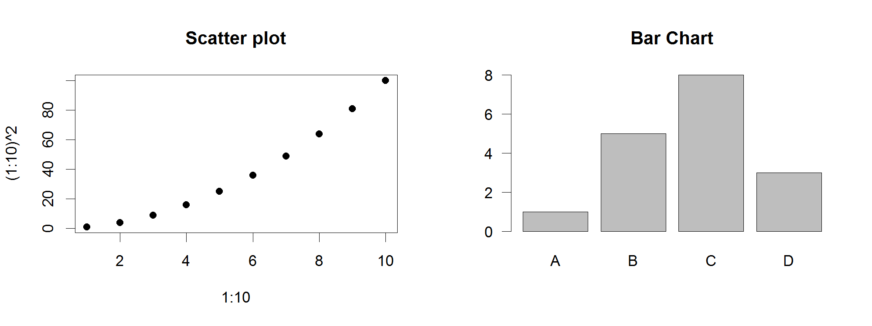
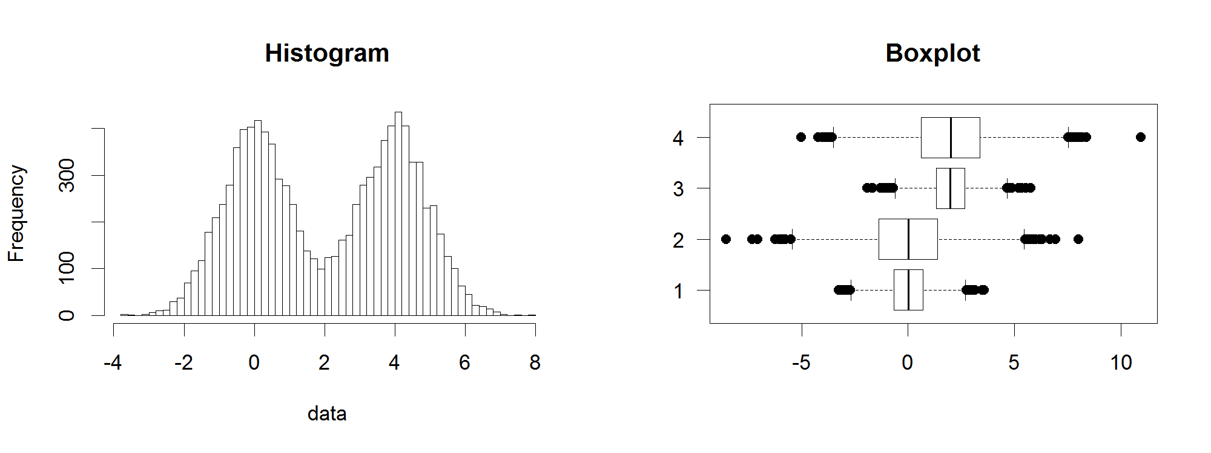
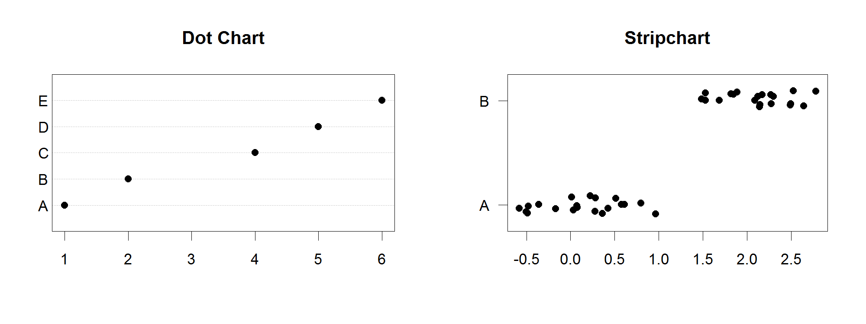
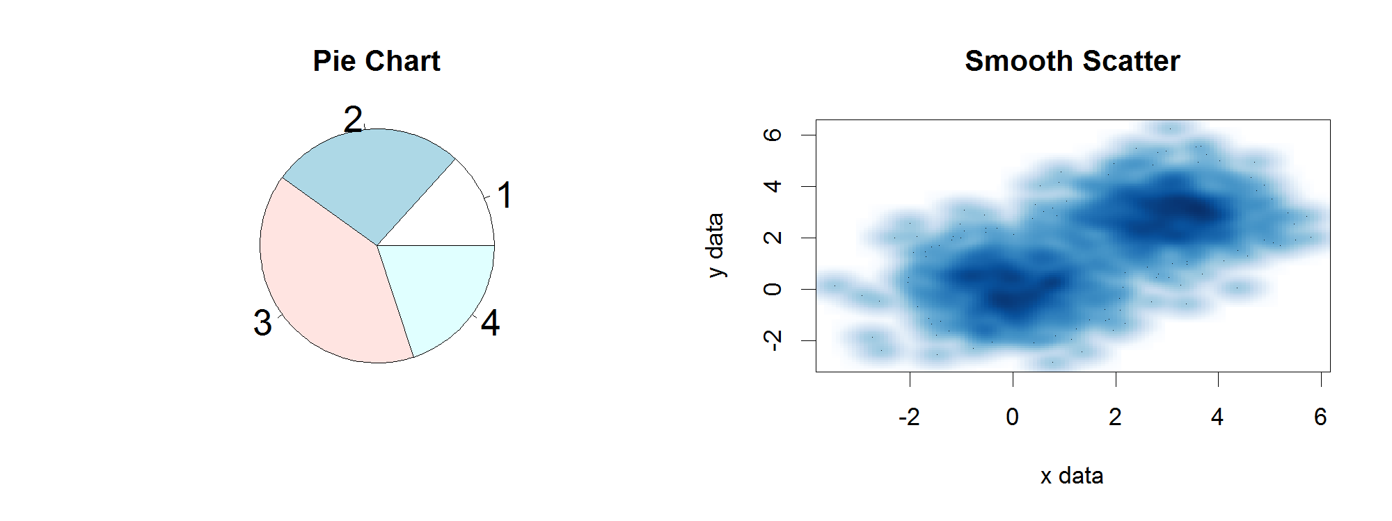
Core Graph Types
Local options to change a specific plot
Global options to affect all graphs

Slide 46
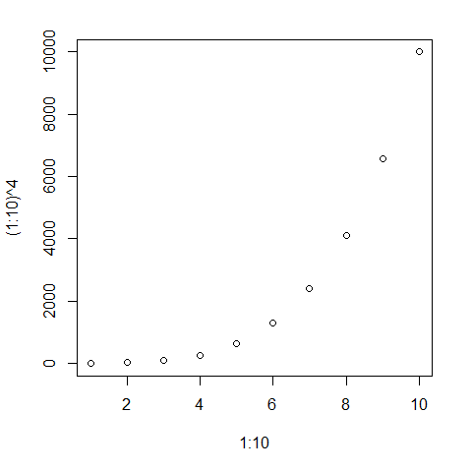
Figures are configured based on the options passed to them
plot(
1:10,(1:10) ^ 4
)

Slide 47
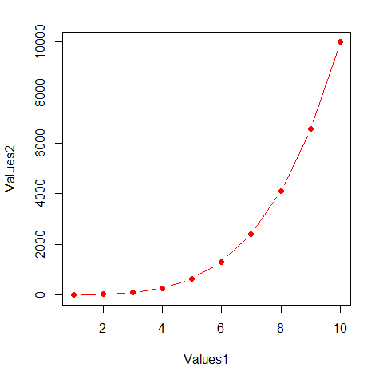
Figures are configured based on the options passed to them
plot(
1:10,(1:10) ^ 4,
pch=19,
type="b",
xlab="Values1",
ylab="Values2",
col="red"
)

Slide 48
Some options are common to many plot types
Axis scales
xlim c(min,max)
ylim c(min,max)
Axis labels
xlab(text)
ylab(text)
Plot titles
main(text)
sub(text)
Plot characters
pch(number)
cex(number)

Slide 49
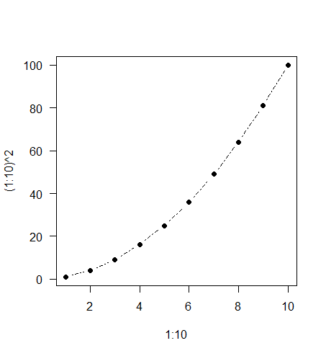
Some options take 'magic' numbers
plot(
1:10,
(1:10)^2,
type="b",
lty=2,
pch=19
)

Slide 50
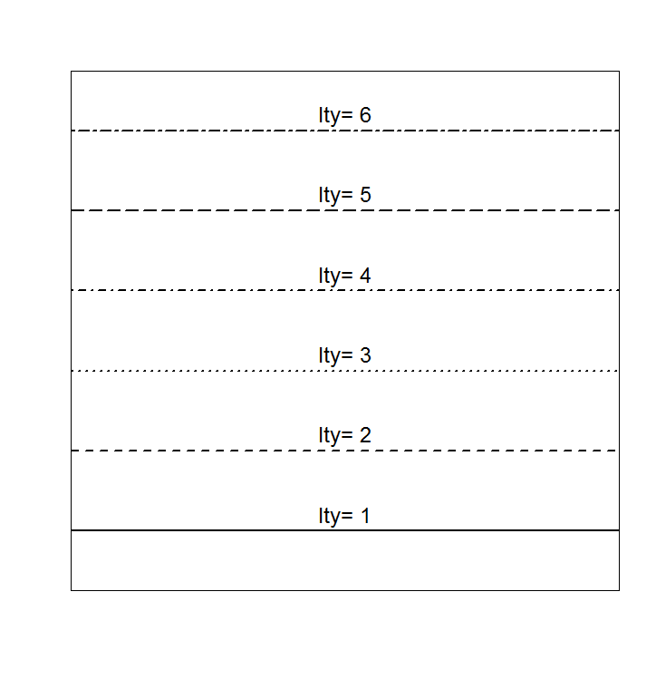
Line types

Slide 51
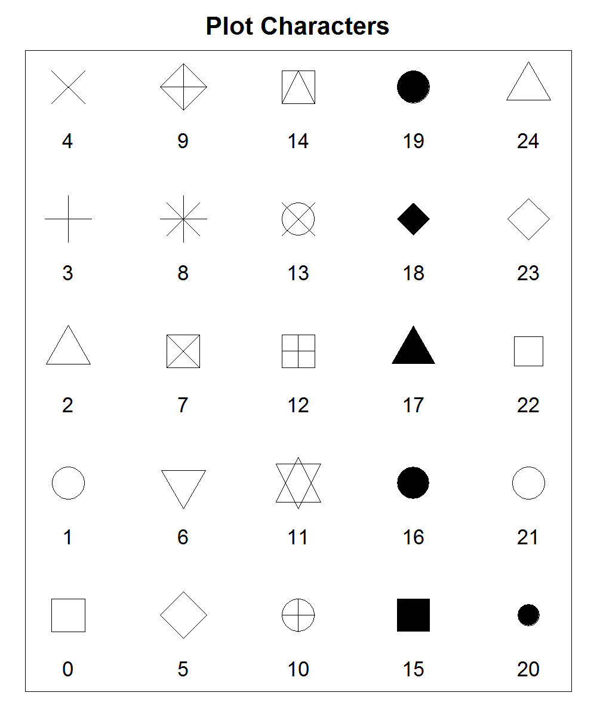
Plot Characters

Slide 52
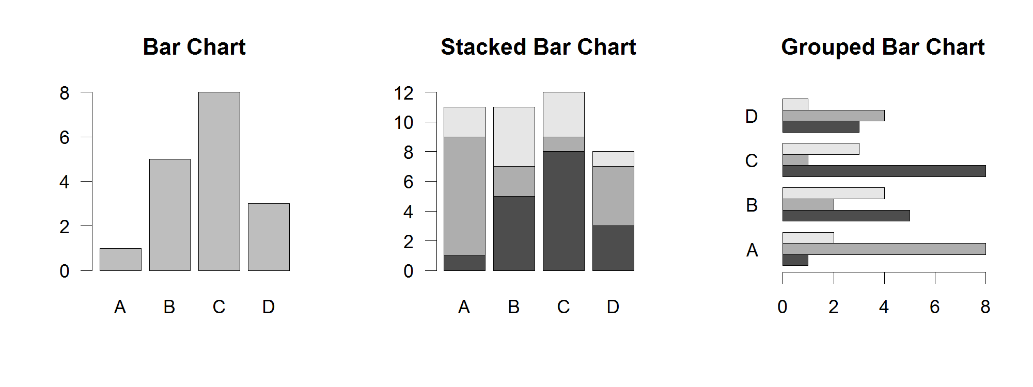
Some options are specific to one graph type (eg barplot)
Options:
names.arg Bar labels (if not from data)
horiz=TRUE Plot horizontally
beside=TRUE Plot multiple series as a group rather than stacked

Slide 53
Par
The par function controls global parameters affecting all plots in the current plot area
Changes affect all subsequent plots
Many par options can also be passed to individual plots

Slide 54
Par examples
Reading current value
par()$cex
Setting a value
par(cex=1.5) -> old.par
Restoring a value
par(old.par)
dev.off()

Slide 55
Par options
Margins
mai (set margins in inches)
mar (set margins in number of lines)
mex (set lines per inch)
4 element vector (bottom, left, top, right)
Warning
Error in plot.new() : figure margins too large

Slide 56
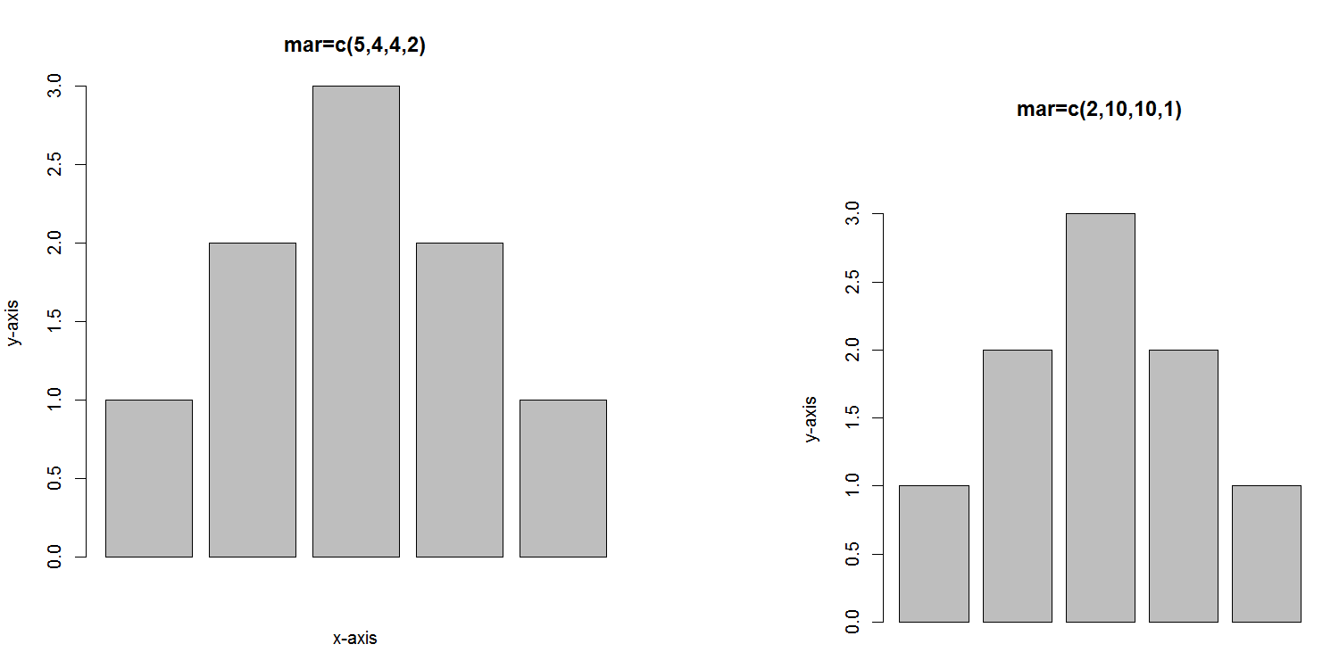

Slide 57
Par options
Fonts and labels
cex – global char expansion
cex.axis
cex.lab
cex.main
cex.sub

Slide 58
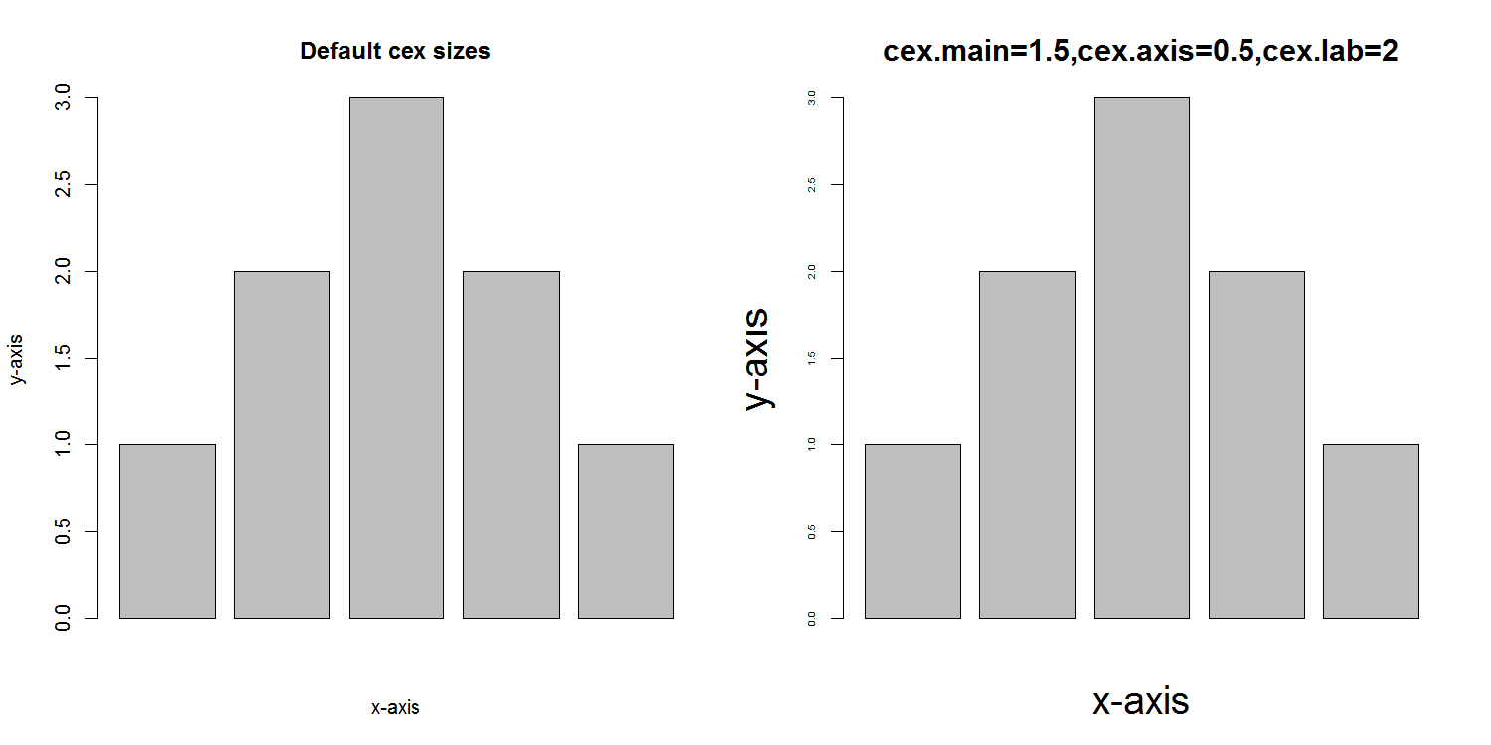

Slide 59
Par options
Font style
font (font.axis,font.main,font.sub,font.lab)
1 = Plain text
2 = Bold text
3 = Italic text
4 = Bold italic text
las (label orientation)
0 = Parallel to axis
1 = Horizontal
2 = Perpendicular
3 = Vertical

Slide 60
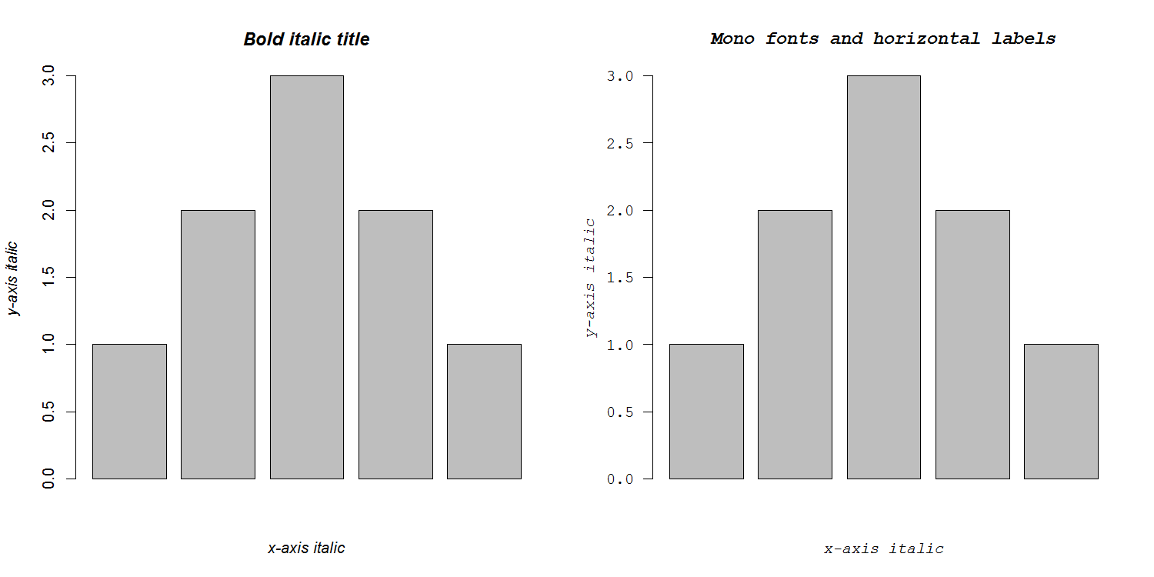

Slide 61
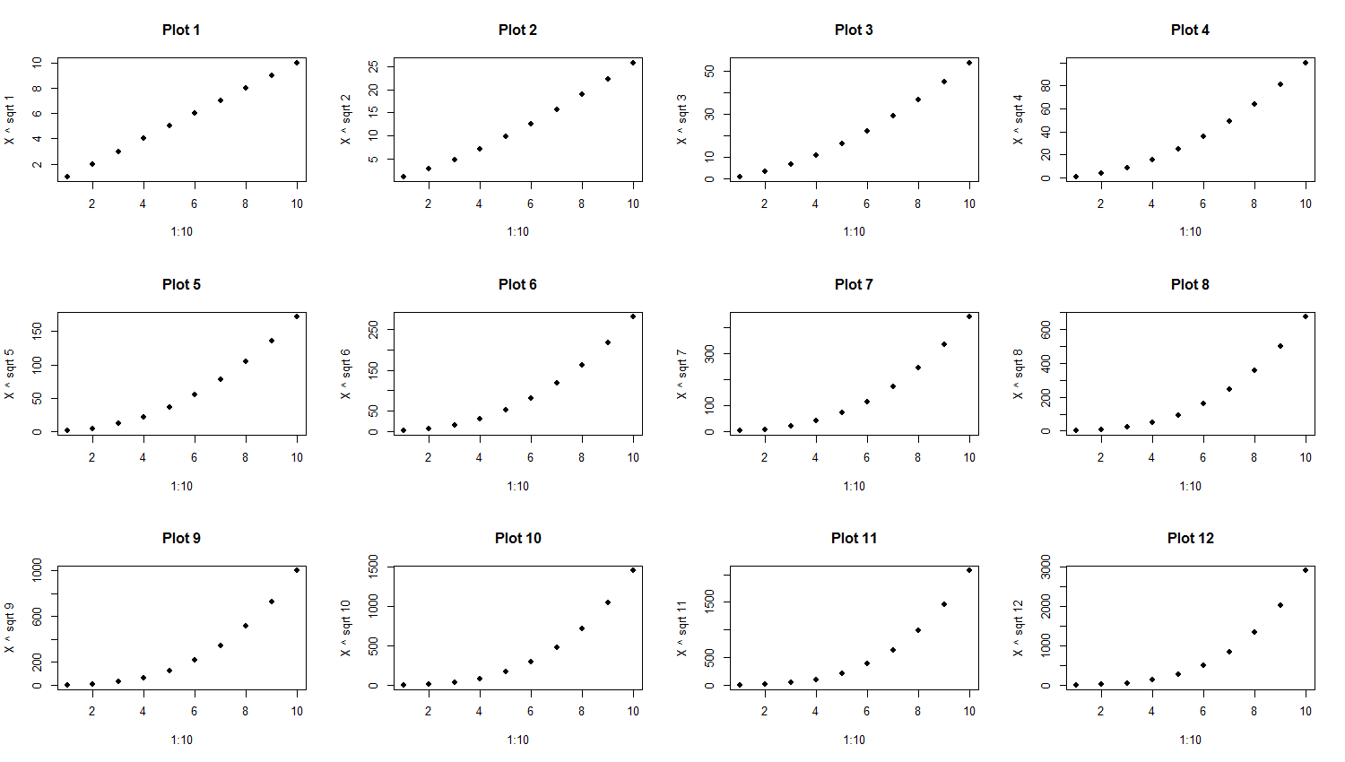
Par options
Multi-panel
mfrow(rows,cols)
Not supported by some packages

Slide 62
Specifying colours
Hexadecimal strings
#FF0000 (red)
#0000FF (blue)
#CC00CC (purple)
Controlled names
“red” “green” etc.
colors()

Slide 63
Built in colour schemes
Functions to generate colours
Pass in number of colours to make
Functions:
rainbow
heat.colors
cm.colors
terrain.colors
topo.colors

Slide 64
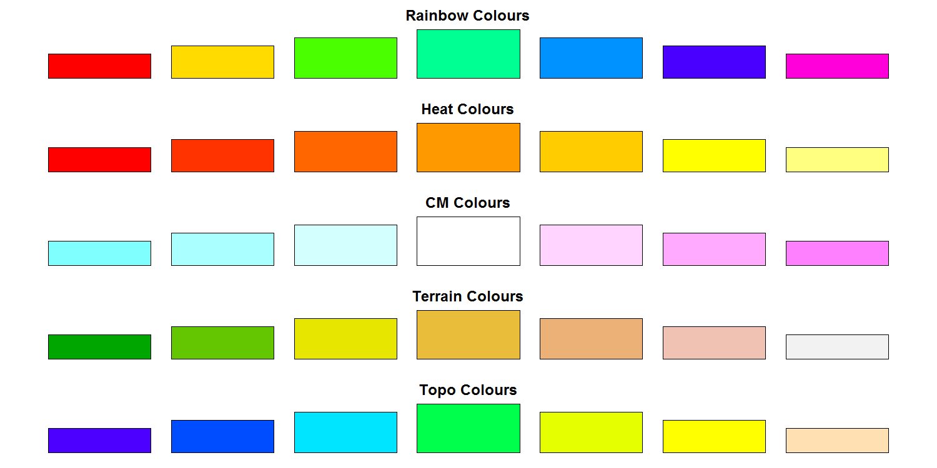

Slide 65
Colour Packages
Color Brewer
Set of pre-defined, optimised palettes
library(RColorBrewer)
brewer.pal(no colours, palette)
ColorRamps
Create smooth palettes for ramped colour
Generates a function to make actual colour vectors
colorRampPalette(c(“red”,”white”,”blue”))
colorRampPalette(c(“red”,”white”,”blue”))(5)

Slide 66
Applying Colour to Plots
Vector of colours passed to the col parameter
Vector of factors used to divide the data
Colours taken from palette
Can read or set using palette function
palette()
palette(brewer.pal(9,”Set1”)
Ordered by levels of factor vector

Slide 67
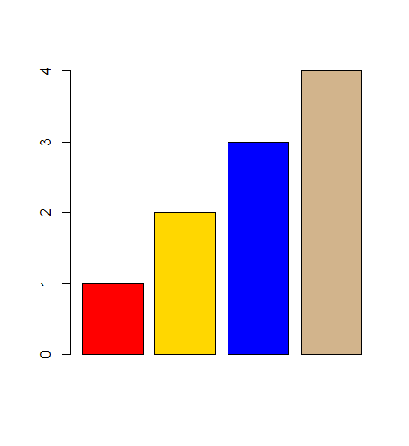
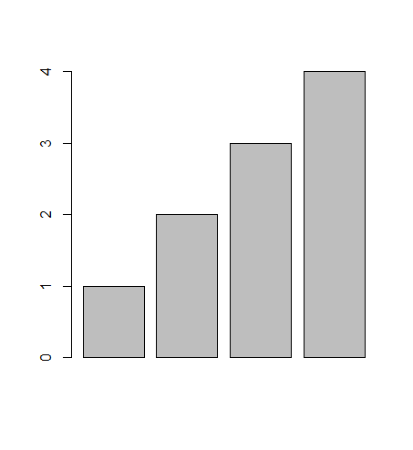
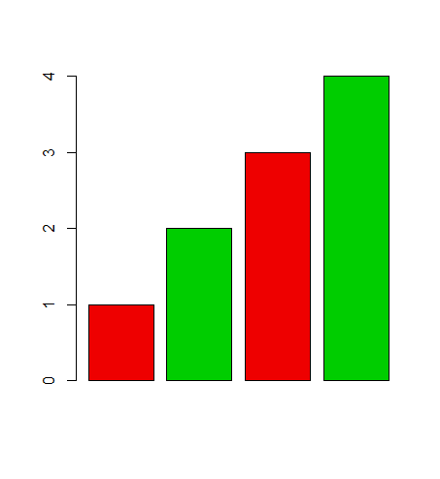
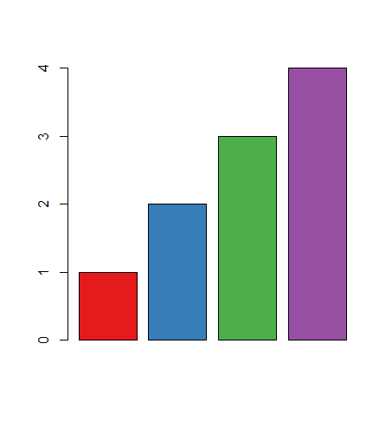
Applying Colour to Plots
barplot(1:4)
barplot(
1:4,
col=c("red","gold","blue","tan")
)
barplot(
1:4,
col=c("red2","green3")
)
library(RColorBrewer)
barplot(
1:4,
col=brewer.pal(4,"Set1")
)

Slide 68
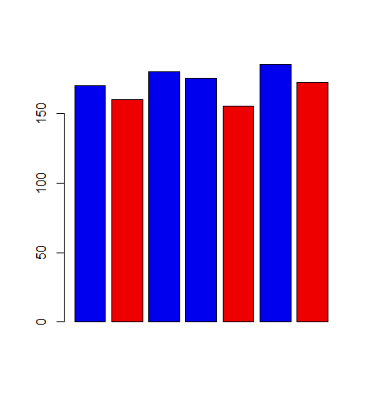
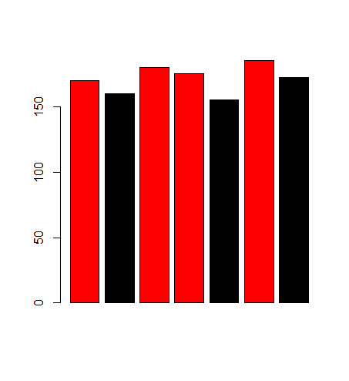
Applying Colour to Plots
barplot(height.data$height,col=height.data$sex)
> height.data
height sex
1 170 M
2 160 F
3 180 M
4 175 M
5 155 F
6 185 M
7 172 F
> palette()
[1] "black" "red" "green3" "blue"
[5] "cyan" "magenta" "yellow" "gray"
> levels(height.data$sex)
[1] "F" "M"
> palette(c("red2","blue2"))

Slide 69
Dynamic use of colour
Colouring by density
Pass data and palette to densCols
Vector of colours returned
Colouring by value
Need function to map values to colours

Slide 70
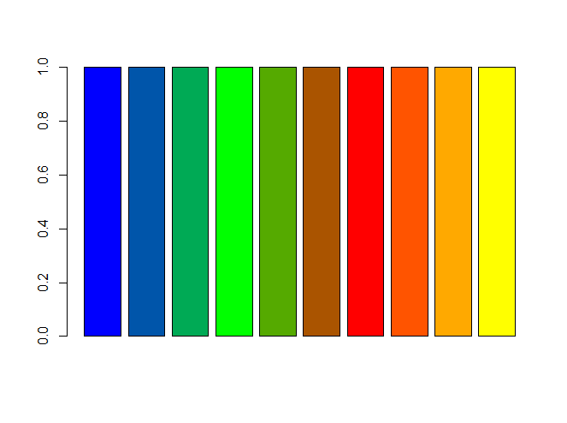
Making colour ramps
> colorRampPalette(c("blue","green","red","yellow"))
function (n)
{
x <- ramp(seq.int(0, 1, length.out = n))
if (ncol(x) == 4L)
rgb(x[, 1L], x[, 2L], x[, 3L], x[, 4L], maxColorValue = 255)
else rgb(x[, 1L], x[, 2L], x[, 3L], maxColorValue = 255)
}
> colorRampPalette(c("blue","green","red","yellow"))(10)
[1] "#0000FF" "#0055AA" "#00AA55" "#00FF00" "#55AA00" "#AA5400" "#FF0000" "#FF5400" "#FFA900" "#FFFF00"
> barplot(
rep(1,10),
col=colorRampPalette(
c("blue","green","red","yellow")
)(10)
)

Slide 71
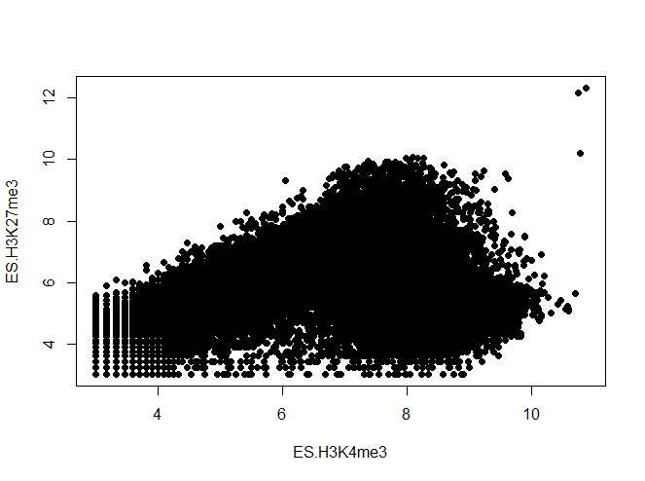
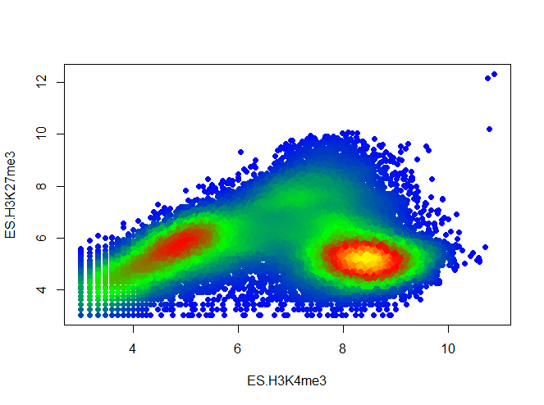
Using colour to plot density
plot(lots.of.data, pch=19)
plot(
lots.of.data,
pch=19,
col=densCols(
lots.of.data,
colramp=colorRampPalette(c(
"blue","green","red","yellow")
)
)
)

Slide 72
Colour Mapping Function
map.colours <- function(values,palette) {
range <- range(values)
proportion <- (values-range[1])/(range[2]-range[1])
index <- round((length(palette)-1)*proportion)+1
return(palette[index])
}

Slide 73
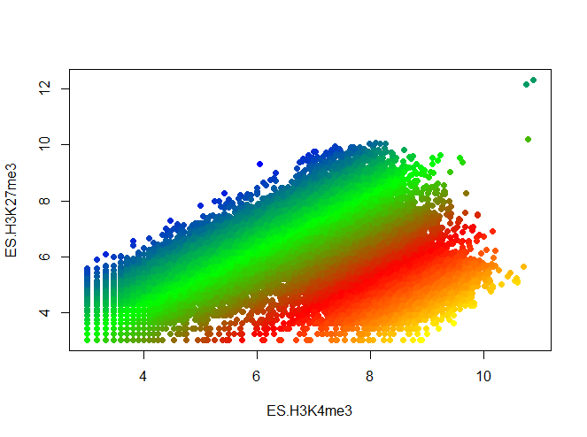
Plotting Quantitative Colour
plot(lots.of.data, pch=19)
plot(
lots.of.data,
pch=19,
col=map.colours(
lots.of.data$K4 - lots.of.data$K27,
colorRampPalette(c(
"blue","green","red","yellow")
)(100)
)
)

Slide 74
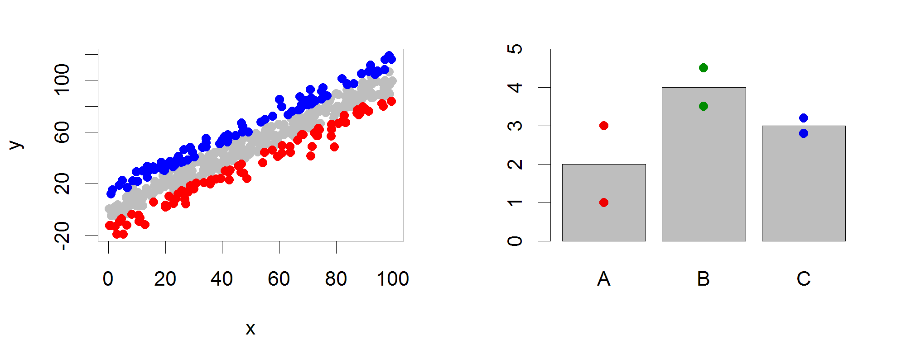
Points
Input: 2 Vectors (x and y positions)
Options:
pch
cex

Slide 75
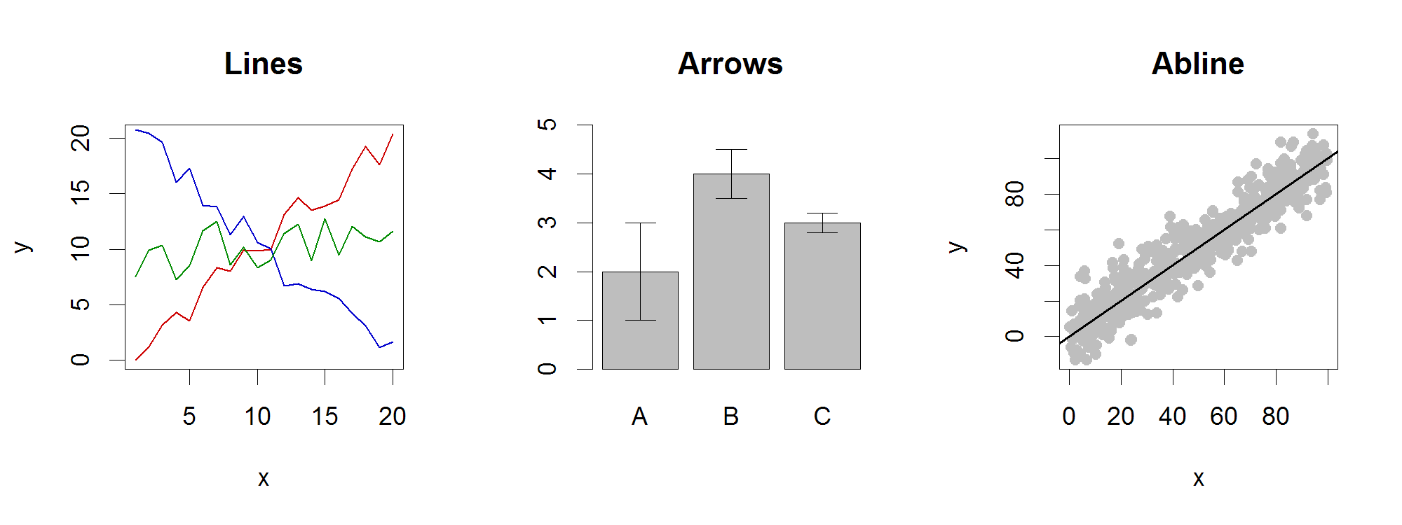
Lines / Arrows / Abline
Input:
Lines 2 vectors (x and y)
Arrows 4 vectors (x0,y0,x1,y1)
Abline Intercept and slope (or correlation object)
Options:
lwd
angle (arrows)

Slide 76
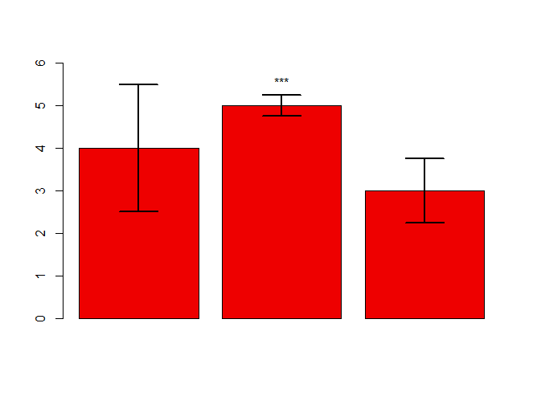
Example multi-layer plot
barplot(
error.data$values,
col="red2",
ylim=(c(0,6))
) -> bar.centres
arrows(
x0=bar.centres,
y0=error.data$values - error.data$sem,
x1=bar.centres,
y1=error.data$values + error.data$sem,
angle=90,
code = 3,
lwd=2
)
text(
bar.centres[2],
y = error.data$values[2] + error.data$sem[2],
labels = "***",
pos=3
)
> error.data
values sem
1 4 1.50
2 5 0.25
3 3 0.75

Slide 77
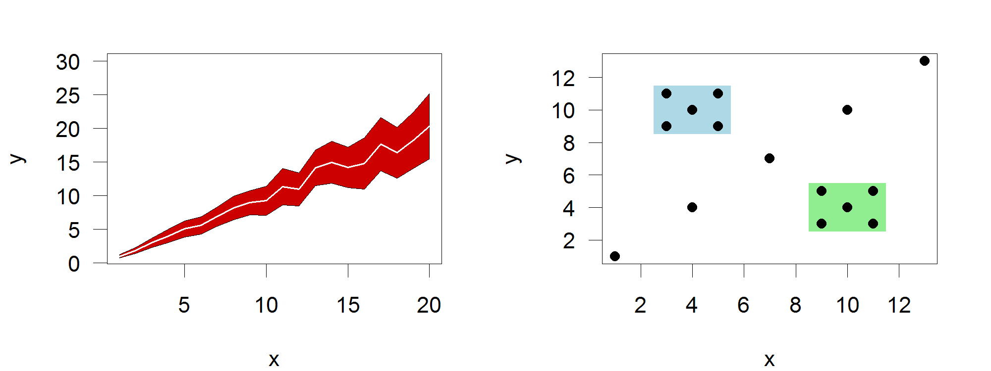
Polygon (shaded areas)
Input:
2 vectors (x and y) for bounding region
Options:
col

Slide 78
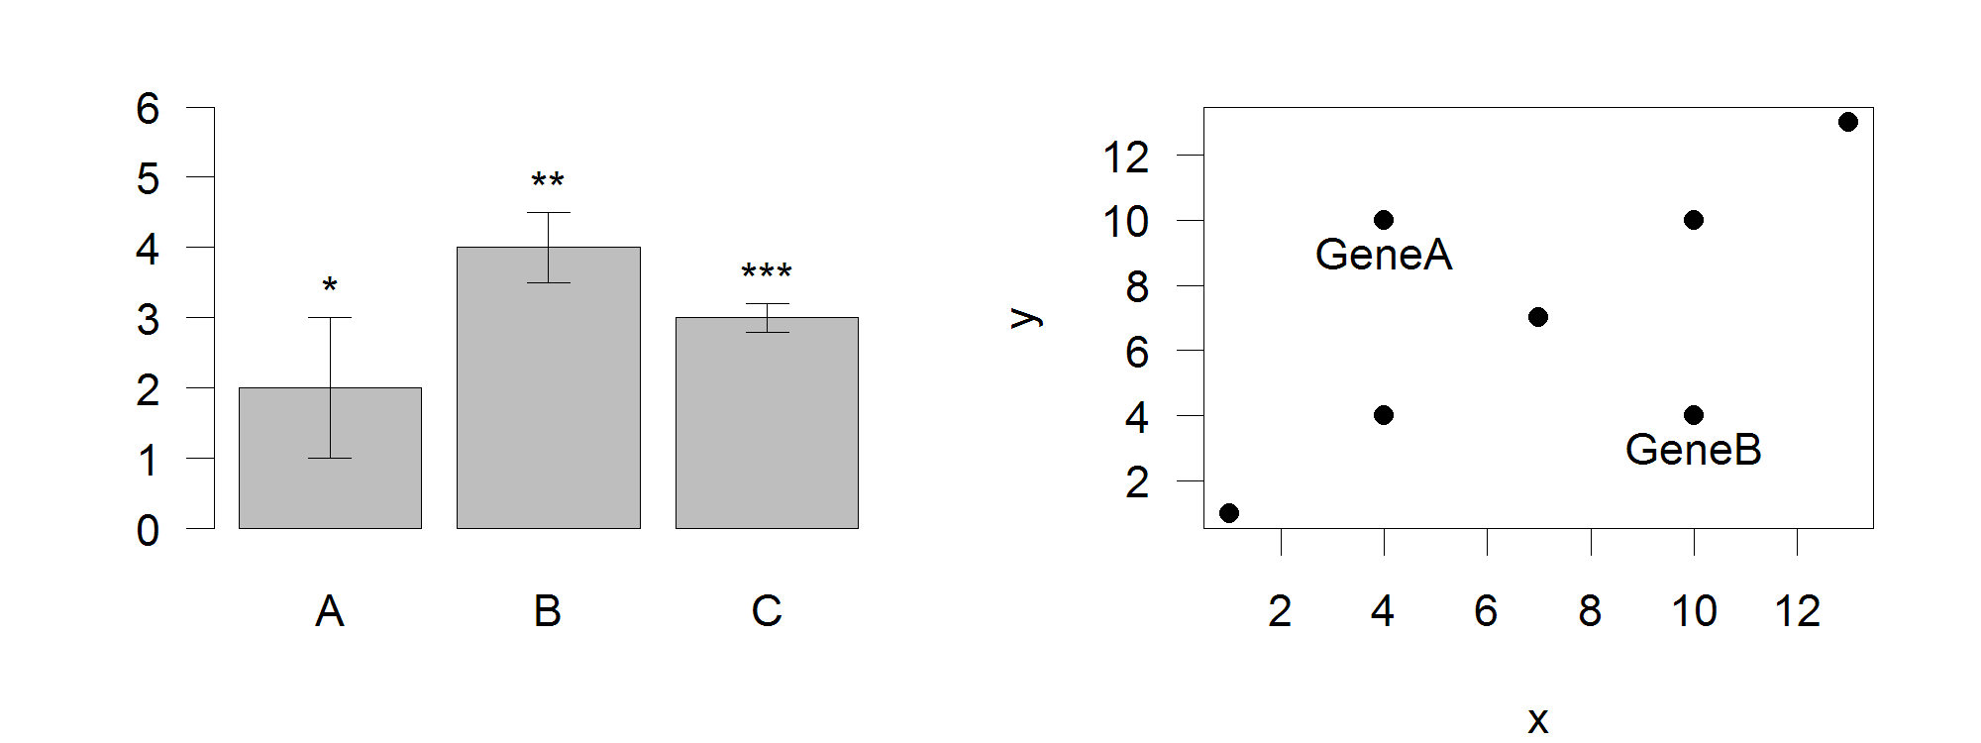
Text (in plot text)
Input:
Text, x, y
Options:
adj (x and y offsets)
pos (auto offset 1=below,2=left,3=above, 4=right)

Slide 79
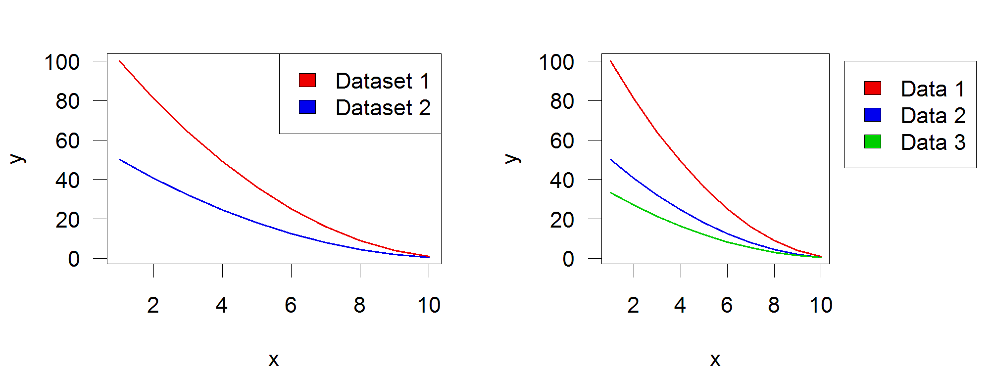
Legend
Input:
Position (x,y or “topright”,”bottomleft” etc)
Text labels
Options:
fill (colours for shaded boxes)
xpd=NA (draw outside plot area)

Slide 80
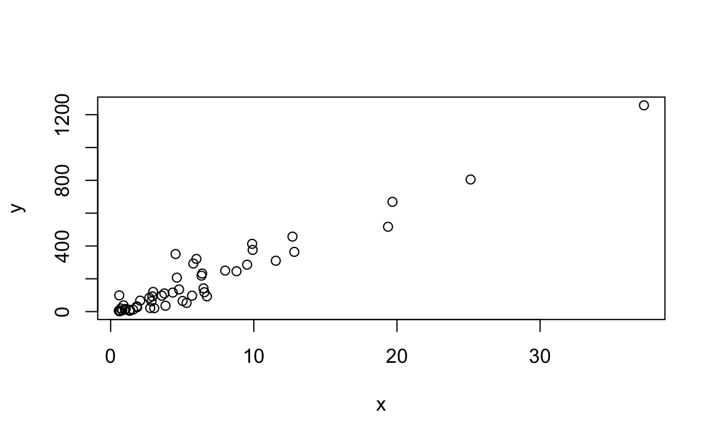
Scatterplot
The plot function can be used to make scatterplots.
> x <- murders$population / 10^6
> y <- murders$total
> plot(x, y)

Slide 81




Scatterplot
> plot(x, y, xlim=c(0, 40), ylim=c(0,1300))
> plot(x, y, xlim=c(0, 40), ylim=c(0,1300), pch=19)
> plot(x, y, xlim=c(0, 40), ylim=c(0,1300), pch=19, xlab="population", ylab="total", main="Murder")
> legend("bottomright", legend = 'my points',col=1,pch=19)
> plot(x, y, xlim=c(0, 40), ylim=c(0,1300), pch=19, xlab="population", ylab="total", main="Murder")
> legend("bottomright", legend = 'my points',col=1,pch=19)
> abline(a=0,b=30,lty=2, lwd=2,col='red')

Slide 82

boxplots
We can use boxplots to compare the murder rates of different regions:
> murders$rate <- with(murders, total / population * 100000)
> boxplot(rate~region, data = murders)
Notes:
They provide a more terse summary than histograms, but they are easier to stack with other boxplots.

Slide 83

histograms
We can make a histogram of our murder rates by simply typing:
> x <- with(murders, total / population * 100000)
> hist(x)
> murders$state[which.max(x)]
#> [1] "District of Columbia"
Notes:
we will simply note that histograms are a powerful graphical summary of a list of numbers that gives you a general overview of the types of values you have.

Slide 84

Histograms
x = runif(100,0,1)
par(mfrow=c(1,2))
hist(x,breaks=2)
hist(x,breaks=100)

Slide 85

Density plot
x = c(rnorm(100,2,1),rgamma(50,shape = 1))
hist(x,freq = FALSE)
f = density(x)
lines(f,lwd=2,col='red',lty=2)

Slide 86

Compare distributions
x = c(rnorm(100,2,1),rgamma(50,shape = 1))
qqnorm(x)

Slide 87
Piecharts
Finally, for categorical variables, you can draw pie plots:
> pie(summary(murders$region))

Slide 88


Pairplot
> x<-murders[,4:6]
> pairs(x)
> x<-murders[,4:6]
> pairs(x, col=as.numeric(murders$region), pch=as.numeric(murders$region))

Slide 89
Control Structures
Control structures in R allow you to control the flow of execution of a series of R expressions. Basically, control structures allow you to put some “logic” into your R code, rather than just always executing the same R code every time. Control structures allow you to respond to inputs or to features of the data and execute different R expressions accordingly.
Commonly used control structures are
if and else: testing a condition and acting on it
for: execute a loop a fixed number of times
while: execute a loop while a condition is true
repeat: execute an infinite loop (must break out of it to stop)
break: break the execution of a loop
next: skip an iteration of a loop
Most control structures are not used in interactive sessions, but rather when writing functions or longer expressions. However, these constructs do not have to be used in functions and it’s a good idea to become familiar with them before we delve into functions.

Slide 90

if-else
The if-else combination is probably the most commonly used control structure in R (or perhaps any language). This structure allows you to test a condition and act on it depending on whether it’s true or false.
if(<condition>) {
## do something
}
## Continue with rest of code
You can have a series of tests by following the initial if with any number of else ifs.
if(<condition1>) {
## do something
} else if(<condition2>) {
## do something different
} else {
## do something different
}

Slide 91
If – else: example
## Generate a uniform random number
x <- runif(1, 0, 10)
if(x > 3) {
y <- 10
} else {
y <- 0
}
y <- if(x > 3) {
10
} else {
0
}
The value of y is set depending on whether x > 3 or not. This expression can also be written a different, but equivalent, way in R.

Slide 92

for Loops
For loops are pretty much the only looping construct that you will need in R. While you may occasionally find a need for other types of loops, in my experience doing data analysis, I’ve found very few situations where a for loop wasn’t sufficient.
In R, for loops take an interator variable and assign it successive values from a sequence or vector. For loops are most commonly used for iterating over the elements of an object (list, vector, etc.)
> for(i in 1:10) {
+ print(i)
+ }
[1] 1
[1] 2
[1] 3
[1] 4
[1] 5
[1] 6
[1] 7
[1] 8
[1] 9
[1] 10
This loop takes the i variable and in each iteration of the loop gives it values 1, 2, 3, …, 10, executes the code within the curly braces, and then the loop exits.

Slide 93
for Loops
> x <- c("a", "b", "c", "d")
>
> for(i in 1:4) {
+ ## Print out each element of 'x'
+ print(x[i])
+ }
[1] "a"
[1] "b"
[1] "c"
[1] "d"
The seq_along() function is commonly used in conjunction with for loops in order to generate an integer sequence based on the length of an object (in this case, the object x).
> ## Generate a sequence based on length of 'x'
> for(i in seq_along(x)) {
+ print(x[i])
+ }
[1] "a"
[1] "b"
[1] "c"
[1] "d"
It is not necessary to use an index-type variable.
> for(letter in x) {
+ print(letter)
+ }
[1] "a"
[1] "b"
[1] "c"
[1] "d"
For one line loops, the curly braces are not strictly necessary.
> for(i in 1:4) print(x[i])
[1] "a"
[1] "b"
[1] "c"
[1] "d"

Slide 94
For Loop over a list
# Create a list with three vectors
fruit <- list(Basket = c('Apple', 'Orange', 'Passion fruit', 'Banana’),
Money = c(10, 12, 15), purchase = FALSE)
for (p in fruit) { print(p) }
Output:
## [1] "Apple" "Orange" "Passion fruit" "Banana"
## [1] 10 12 15
## [1] FALSE

Slide 95
Nested for loops
Nested loops are commonly needed for multidimensional or hierarchical data structures (e.g. matrices, lists). Be careful with nesting though. Nesting beyond 2 to 3 levels often makes it difficult to read/understand the code. If you find yourself in need of a large number of nested loops, you may want to break up the loops by using functions (discussed later).
x <- matrix(1:6, 2, 3)
for(i in seq_len(nrow(x))) {
for(j in seq_len(ncol(x))) {
print(x[i, j])
}
}

Slide 96
For Loop over a matrix
A matrix has 2-dimension, rows and columns. To iterate over a matrix, we have to define two for loop, namely one for the rows and another for the column.
# Create a matrix
mat <- matrix(data = seq(10, 20, by=1), nrow = 6, ncol =2)
# Create the loop with r and c to iterate over the matrix
for (r in 1:nrow(mat))
for (c in 1:ncol(mat))
print(paste("Row", r, "and column",c, "have values of", mat[r,c]))
Output:
## [1] "Row 1 and column 1 have values of 10"
## [1] "Row 1 and column 2 have values of 16"
## [1] "Row 2 and column 1 have values of 11"
## [1] "Row 2 and column 2 have values of 17"
## [1] "Row 3 and column 1 have values of 12"
## [1] "Row 3 and column 2 have values of 18"
## [1] "Row 4 and column 1 have values of 13"
## [1] "Row 4 and column 2 have values of 19"
## [1] "Row 5 and column 1 have values of 14"
## [1] "Row 5 and column 2 have values of 20"
## [1] "Row 6 and column 1 have values of 15"
## [1] "Row 6 and column 2 have values of 10"

Slide 97

while Loops
While loops begin by testing a condition. If it is true, then they execute the loop body. Once the loop body is executed, the condition is tested again, and so forth, until the condition is false, after which the loop exits.
> count <- 0
> while(count < 10) {
+ print(count)
+ count <- count + 1
+ }
[1] 0
[1] 1
[1] 2
[1] 3
[1] 4
[1] 5
[1] 6
[1] 7
[1] 8
[1] 9
While loops can potentially result in infinite loops if not written properly. Use with care!

Slide 98
while Loops
Sometimes there will be more than one condition in the test.
> z <- 5
> set.seed(1)
>
> while(z >= 3 && z <= 10) {
+ coin <- rbinom(1, 1, 0.5)
+
+ if(coin == 1) { ## random walk
+ z <- z + 1
+ } else {
+ z <- z - 1
+ }
+ }
> print(z)
[1] 2
Conditions are always evaluated from left to right. For example, in the above code, if z were less than 3, the second test would not have been evaluated.

Slide 99
repeat Loops
repeat initiates an infinite loop right from the start. These are not commonly used in statistical or data analysis applications but they do have their uses. The only way to exit a repeat loop is to call break.
One possible paradigm might be in an iterative algorithm where you may be searching for a solution and you don’t want to stop until you’re close enough to the solution. In this kind of situation, you often don’t know in advance how many iterations it’s going to take to get “close enough” to the solution.
x0 <- 1
tol <- 1e-8
repeat {
x1 <- computeEstimate()
if(abs(x1 - x0) < tol) { ## Close enough?
break
} else {
x0 <- x1
}
}
Note that the above code will not run if the computeEstimate() function is not defined (I just made it up for the purposes of this demonstration).
The loop above is a bit dangerous because there’s no guarantee it will stop. You could get in a situation where the values of x0 and x1 oscillate back and forth and never converge. Better to set a hard limit on the number of iterations by using a for loop and then report whether convergence was achieved or not.

Slide 100
next, break
break is used to exit a loop immediately, regardless of what iteration the loop may be on.
next is used to skip an iteration of a loop.
for(i in 1:100) {
print(i)
if(i > 20) {
## Stop loop after 20 iterations
break
}
}
for(i in 1:100) {
if(i <= 20) {
## Skip the first 20 iterations
next
}
## Do something here
}

Slide 101
Example: Find the factorial of a number
The factorial of a number is the product of all the integers from 1 to that number. For example, the factorial of 6 (denoted as 6!) is 1*2*3*4*5*6 = 720.
Factorial is not defined for negative numbers and the factorial of zero is one, 0! = 1.
This example finds the factorial of a number normally. However, you can find it using recursion as well.
# take input from the user
num = as.integer(readline(prompt="Enter a number: "))
factorial = 1
# check is the number is negative, positive or zero
if(num < 0) {
print("Sorry, factorial does not exist for negative numbers") }
else if(num == 0) {
print("The factorial of 0 is 1") }
else {
for(i in 1:num) {
factorial = factorial * i }
print(paste("The factorial of", num ,"is",factorial)) }
> factorial(8)
[1] 40320

Slide 102
R Notebooks

Slide 103

Code
Comments
Text output
Graphical output

Slide 104
Problems with conventional scripts
Only the code is generally distributed
Output not included – users have to run it again
No collation of output
Can’t see which bit of code generated what output
No automated saving of results
Limited commenting
Text comments, no formatting or structure

Slide 105
R Notebooks
Alternative document format to conventional scripts
Collates into a single document
Code
Formatted commentary
Output (text and graphical)
Exported to HTML, PDF or Word

Slide 106


Code
Output

Slide 107
Notebook Structure
Single overall text document, split into sections
Header (mostly preferences)
Body
Commentary (default)
R Code
Output (graphical and text)

Slide 108


Creating a Notebook in RStudio
You may need to install some packages (Rstudio will prompt you if you do)
Opens a default template which you can then edit

Slide 109

Notebook sections
Header
Commentary
Code
Sections are marked by special quotes
---
--- for header
```{r}
``` for R code
Default for unquoted text is commentary

Slide 110



Notebook workflow
Create new notebook document
Save it straight away (use a .Rmd extension)
Add commentary in Markdown format
Add R sections using Insert > R
Run code blocks to generate output
Knit document to HTML / PDF / Word
Be careful not to delete any of the section markers added by ‘insert’ or the header

Slide 111

Running R code in a notebook
Control + Return runs one line
Output goes below
Output replaces any previous block output
Control + Shift + Return runs the block
Multiple outputs put into clickable windows
Will be interspersed in compiled document
Can also press the ‘play’ button at top right

Slide 112
Exercise
Exercise 1: Simple Calculations
Use R to calculate the following:
31 * 78
697 / 41
Assign the value of 39 to x
Assign the value of 22 to y
Make z the value of x - y
Display the value of z in the console
Calculate the square root of 2345, and perform a log2 transformation on the result.

Slide 113
Exercise
Exercise 2: Working with Vectors
Create a vector called vec1 containing the numbers 2,5,8,12 and 16
Use [lower]:[upper] notation to make a second vector called vec2 containing the numbers 5 to 9
Subtract vec2 from vec1 and look at the result
Use seq() to make a vector of 100 values starting at 2 and increasing by 3 each time and store it in a new variable
Extract the values at positions 5,10,15 and 20 in the vector of 100 values you made
Extract the values at positions 10 to 30 in the vector of 100 values you made

Slide 114
Exercise 3
Load the US murders dataset.
Use the accessor $ to extract the state abbreviations and assign them to the object a. What is the class of this object?
Now use the square brackets to extract the state abbreviations and assign them to the object b. Use the identical function to determine if a and b are the same.
The function table takes a vector and returns the frequency of each element. You can quickly see how many states are in each region by applying this function. Use this function in one line of code to create a table of states per region.

Slide 115
Exercise
Exercise 4: Reading in data from a file
Set your working directory to where the data files are stored. Make sure that the folder of data files has been unzipped. e.g. setwd("D:/Data_folder")
4a
Read the file ‘small_file.txt’ into a new data structure. This is a tab delimited file so you should use read.delim(). Remember to assign a name to the data that you read in using the assignment operator, e.g.
my.small.file <- read.delim(“small_file.txt”)
View the data set to check that it has imported correctly.
4b
Read the file ‘Child_Variants.csv’ into a new data structure. This is a comma separated file so you should use read.csv(). Again, remember to assign a name to the data when you import it.
Use head and View to look at the data set to check that it has imported correctly.
Calculate the mean of the column named MutantReadPercent. Think about how you are going to access a single column first (probably by using the $ notation), then once you can access the data pass it to the mean function.

Slide 116
Exercises 5
Using the dataset murder:
A. Create a histogram of the state populations.
B. Generate boxplots of the state populations by region.

Slide 117
Exercise 6: basic plots
Read in the file ‘brain_bodyweight.txt’. This is a tab delimited file so you can use read.delim(). The first column contains species names, not data, so use row.names=1 to set these up correctly in your data frame.
Log transform the data (base 2).
Create a scatterplot with default parameters with the log transformed data.

Slide 118
EX 7
Multiplication Table: print the multiplication table of a number (entered by the user) from 1 to 10.
Hints:
Here, we ask the user for a number which is stored in num variable.
Then, the for loop is iterated 10 times from i equals to 1 to i equals to 10.

Slide 119
Exercise 8
Write a program to check if the input number is prime or not
Hints
Here, we take an integer from the user and check whether it is prime or not. Numbers less than or equal to 1 are not prime numbers.
Hence, we only proceed if the num is greater than 1. We check if num is exactly divisible by any number from 2 to num – 1.
If we find a factor in that range, the number is not prime. Else the number is prime.
We can decrease the range of numbers where we look for factors.
In the above program, our search range is from 2 to num – 1.
We could have used the range, [2, num / 2] or [2, num ** 0.5]. The later range is based on the fact that a composite number must have a factor less than square root of that number. Otherwise the number is prime.

