Slide 1
TP2: Practical experimentation of algorithms for multi-omics integration for sample stratification
13/02/2024

Slide 2
Sample stratification
Group A: i.e.,
cancer samples
Group B: i.e.,
healthy samples

Slide 3

Goal
To classify patients based on omics profiles and identify new cancer biomarkers.
BUT HOW ?

Slide 4
Workflow
Omics data

Slide 5
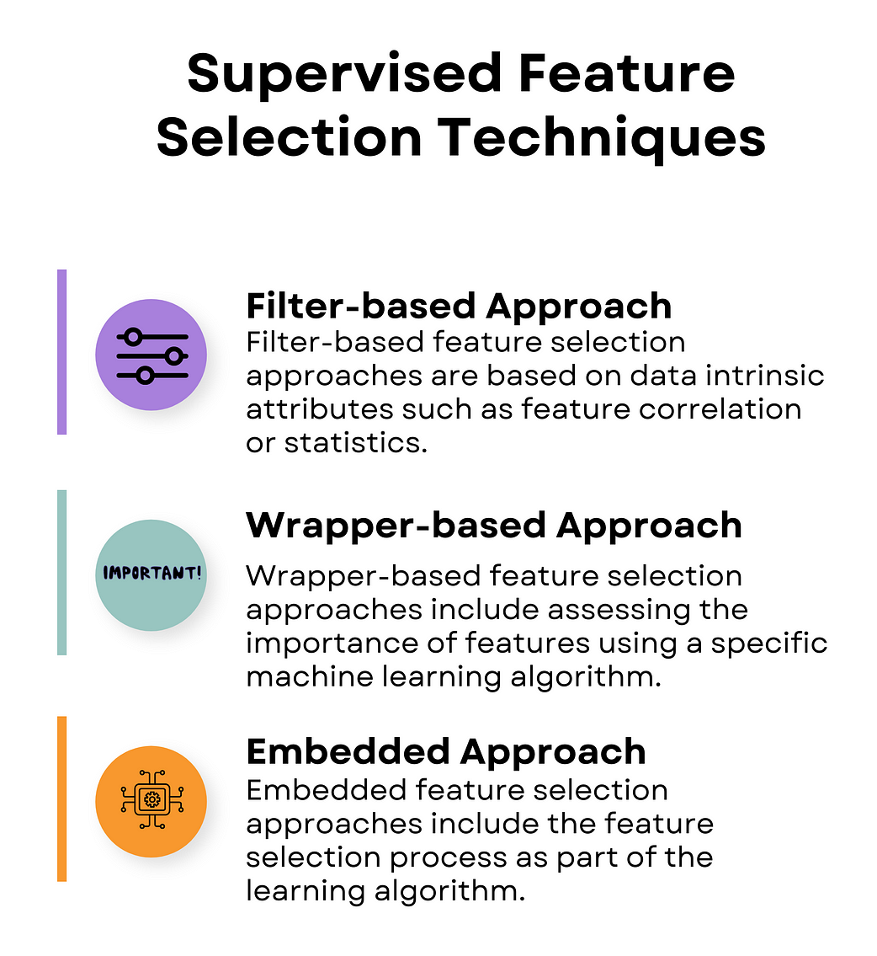
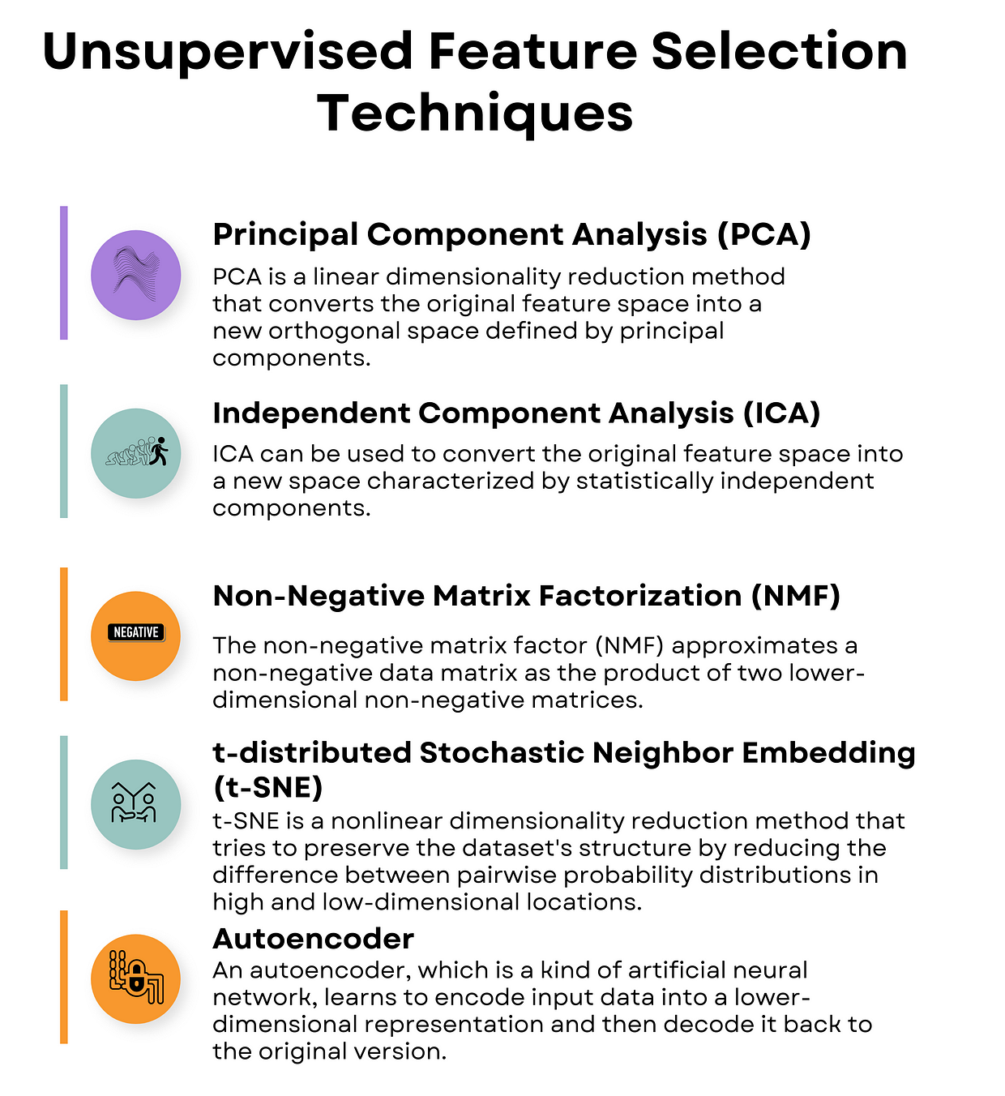
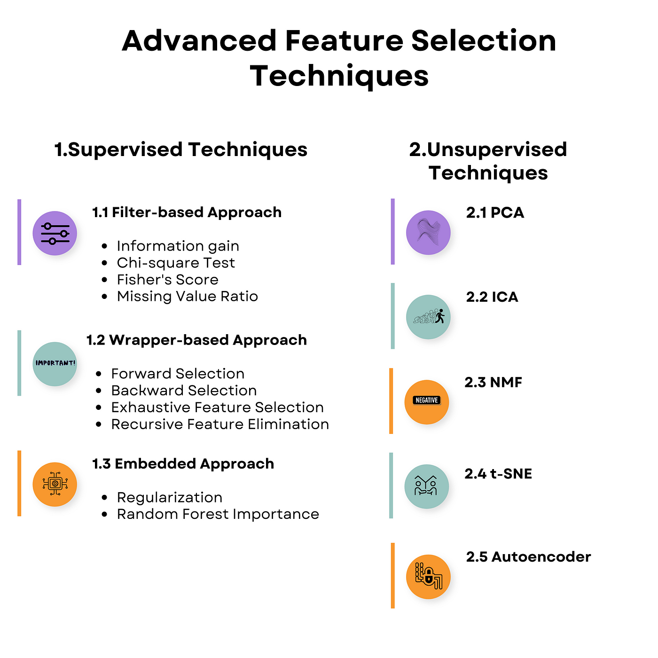
Step 1: Feature Selection
Feature selection = selection of a subset of relevant features from the original set of features
2 mains categories :
- supervised = use labeled data
- non-supervised = use unlabeled data

Slide 6
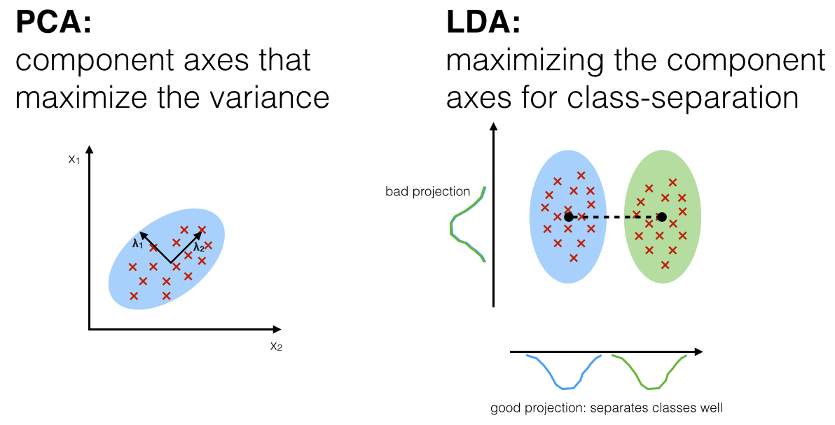
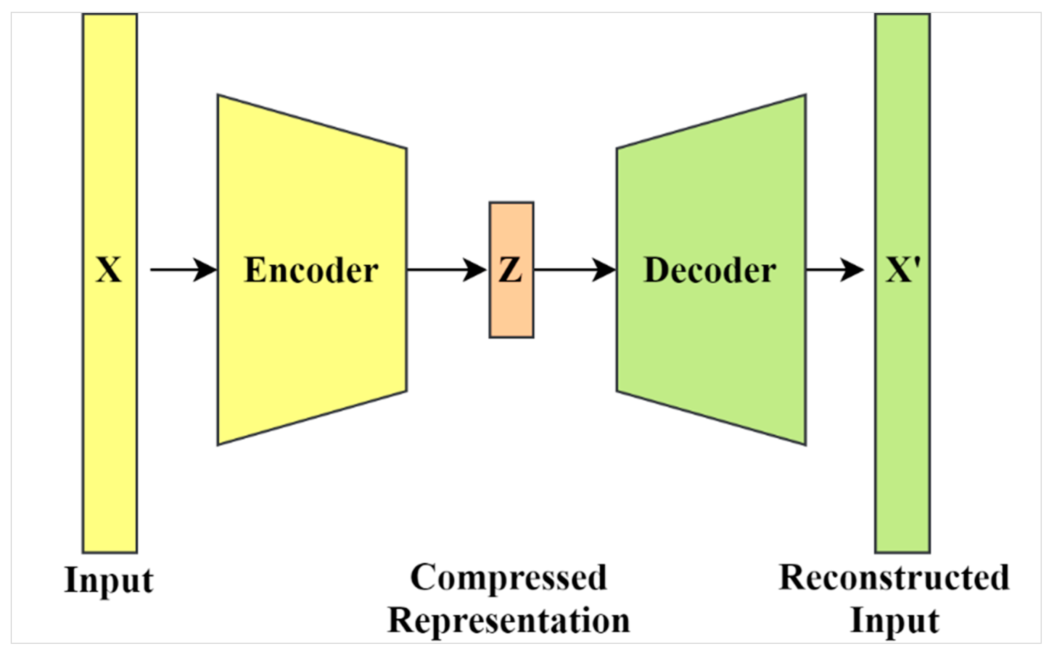
Step 2: Feature Extraction
Feature extraction = extraction of relevant information from original data variables to create a novel reduced and more informative representation of data, also called latent representation.
Examples of linear methods:
High dimensional discriminant analysis (HDDA)
Principal Component Analysis (PCA)
Mixture of probalistic PCA (MPPCA)
Factor analysis (FA)
Linear Discriminant Analysis (LDA)
Partial Least Squares Discriminant Analysis (PLS-DA)
Examples of non-linear methods:
Gaussian Process Latent Variable Modeling (GPLVM)
Kernel PCA (KPCA)
Variational AutoEncoder (VAE)
Autoencoders

Slide 7


Step 3: Classification
2 possible cases:
Feature Extraction methods have their own classification method
To perform classification, you can use algorithms as:
- XGBoost
- Random Forest
- …
Compute metrics to asses model performances

Slide 8




Omics data
Transcriptomics
Proteomics
Metabolomics
Gene expression
Protein quantification
Metabolite quantification
Find biomarkers

Slide 9
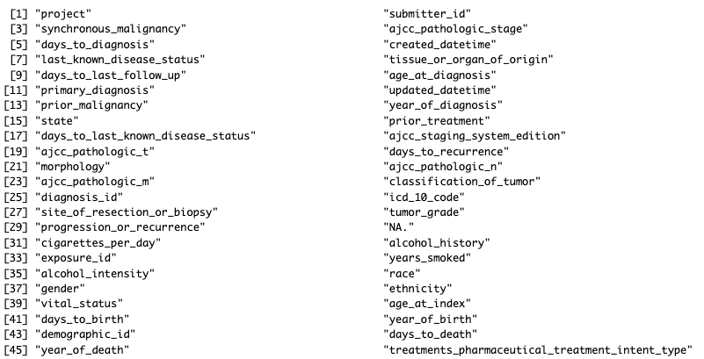
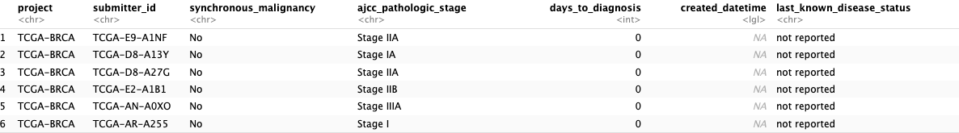
Query the TCGA database with R
Example: I would like to download TCGA data on breast cancer.
After some research, I discovered that data on invasive breast carcinoma are available and that the project identifier is TCGA-BRCA.
Get clinical information on BRCA project
library(TCGAbiolinks)
library(SummarizedExperiment)
library(dplyr)
clinical <- GDCquery_clinic("TCGA-BRCA")
head(clinical)
colnames(clinical)

Slide 10
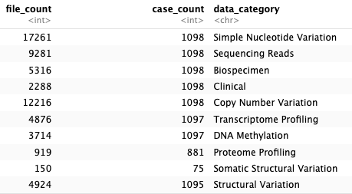
Query the TCGA database with R
Get the BRCA project summary
TCGAbiolinks:::getProjectSummary("TCGA-BRCA")
We get a table taht resume number of files and cases by data category.
Get all the files corresponding to transcriptomics data :
query_TCGA = GDCquery(
project = "TCGA-BRCA",
data.category = "Transcriptome Profiling",
experimental.strategy = "RNA-Seq",
workflow.type = "STAR - Counts")

Slide 11
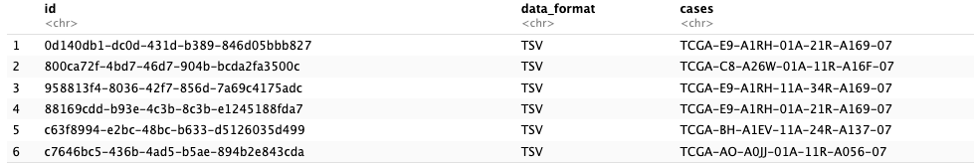
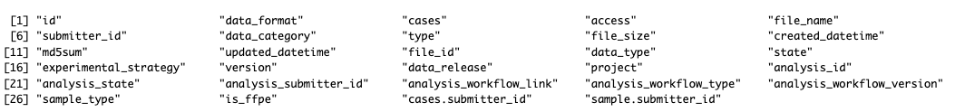
Query the TCGA database with R
View query results
brca_res = getResults(query_TCGA)
head(brca_res)
We get a table containing all the files to be downloaded corresponding to the query.
colnames(brca_res)
File information

Slide 12


Query the TCGA database with R
Play with information
summary(factor(brca_res$sample_type))
summary(factor(brca_res$data_type))

Slide 13
Query the TCGA database with R
Specify the query to get only the files concerning primary tumors and normal tissues and corresponding to gene expression quantification
query_TCGA = GDCquery(
project = "TCGA-BRCA",
data.category = "Transcriptome Profiling",
experimental.strategy = "RNA-Seq",
workflow.type = "STAR - Counts",
sample.type = c("Primary Tumor", "Solid Tissue Normal"),
data.type = "Gene Expression Quantification")
Download the files (do not run this command)
GDCdownload(query = query_TCGA)

Slide 14
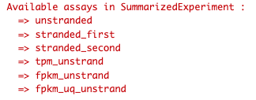
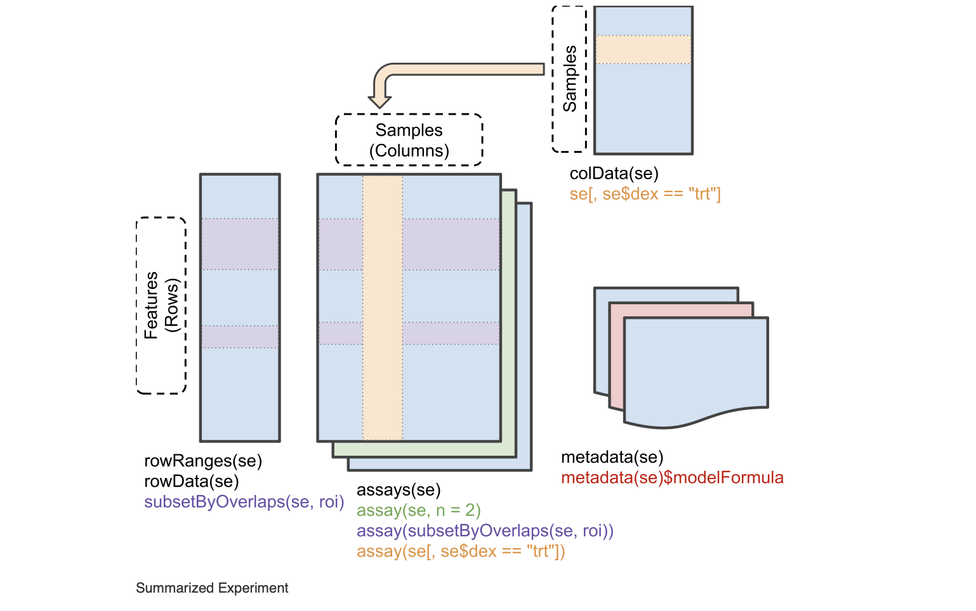
Query the TCGA database with R
Once the download is complete, prepare the data so that you have a matrix containing all the gene expressions from all the samples.
tcga_data = GDCprepare(query_TCGA)
colData(tcga_data)
You can save tcga_data in a RDS file instead of repeating previous steps.
rowData(tcga_data)
saveRDS(object = tcga_data,
file = "tcga_data.RDS",
compress = FALSE)
assay(tcga_data)

Slide 15
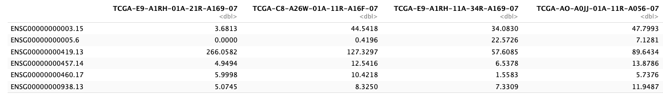
Query the TCGA database with R
Load your RDS file
tcga_data = readRDS(file = "tcga_data.RDS")
Several gene expression matrices are available, but we want to select only tpm matrix (normalized gene expression matrix)
tpm_matrix <- as.data.frame(assays(tcga_data)$tpm_unstrand)
head(matrix)
Samples
Genes
Expression value

Slide 16
Query the TCGA database with R
Then, a pre-processing step is necessary before starting any analysis.
Filter low-expressed genes
Add sample labels and transform them into binary factor
Transpose the data to have genes in columns and samples in rows
You can download the final version of the file on Moodle: breast_tcga_gene_expression_matrix.csv

Slide 17
Query the TCGA database with R
Get all the files corresponding to proteomics data and concerning only primary tumors and normal samples :
query_TCGA = GDCquery(
project = "TCGA-BRCA",
data.category = "Proteome Profiling",
sample.type = c("Primary Tumor", "Solid Tissue Normal")
)
Download files (do not run this command)
GDCdownload(query = query_TCGA)
Prepare the data
tcga_data = GDCprepare(query_TCGA)

Slide 18
Query the TCGA database with R
Here again, a pre-processing step is necessary before starting any analysis
Remove annotation columns from the expression matrix
Choose an unique id to represent proteins which will be used as features
Filter low-expressed or unexpressed proteins
Replace NA values by 0
Add sample labels and transform them into binary factor
Transpose the data to have genes in columns and samples in rows

Slide 19
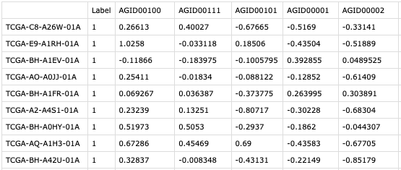
Query the TCGA database with R
You can download the final version of the file on Moodle: breast_proteomics_expression.csv
0: normal sample
1: cancer sample
Label
Proteins
Quantification value
Samples

Slide 20
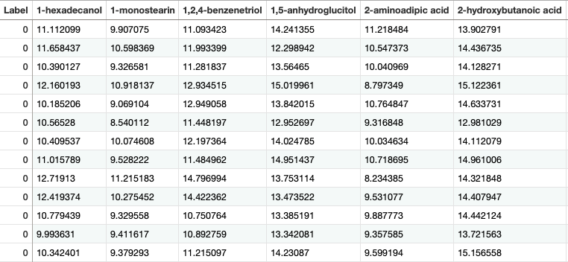
Metabolomics data
Metabolomics data are from Budczies et al (https://doi.org/10.1016/j.jprot.2013.10.002).
They concern estrogen receptor positive (ER+) and estrogen receptor negative (ER-) breast cancer.
The data are made up of 271 samples, 204 ER+ (labeled 1) and 67 ER- (labeled 0).
Metabolites
Label
0: ER- sample
1: ER+ sample

Slide 21

Summary
BREAST Cancer
TCGA
Litterature
Transcriptomics
Proteomics
Metabolomics
1’225 patients
48’405 features
914 patients
465 features
271 patients
163 features
Beware of class imbalance!

Slide 22
Your turn to play!
Apply the workflow on your data:
Feature selection (2 methods to compare)
Feature extraction (2 methods to compare)
Classification
Feature importance ?
Feature extraction methods
Examples of linear methods:
High dimensional discriminant analysis (HDDA)
Principal Component Analysis (PCA)
Mixture of probalistic PCA (MPPCA)
Factor analysis (FA)
Partial Least Squares Discriminant Analysis (PLS-DA)
Examples of non-linear methods:
Gaussian Process Latent Variable Modeling (GPLVM)
Kernel PCA (KPCA)
Variational AutoEncoder (VAE)

