Slide 1










TP 1: OMICS databases
15/01/2023

Slide 2
Table of contents
TCGA database
GTEX database
Finding data in GEO
Protein data in Proteome Exchange
Metabolomic data in Metabolomics workbench

Slide 3
1. TCGA database

Slide 4

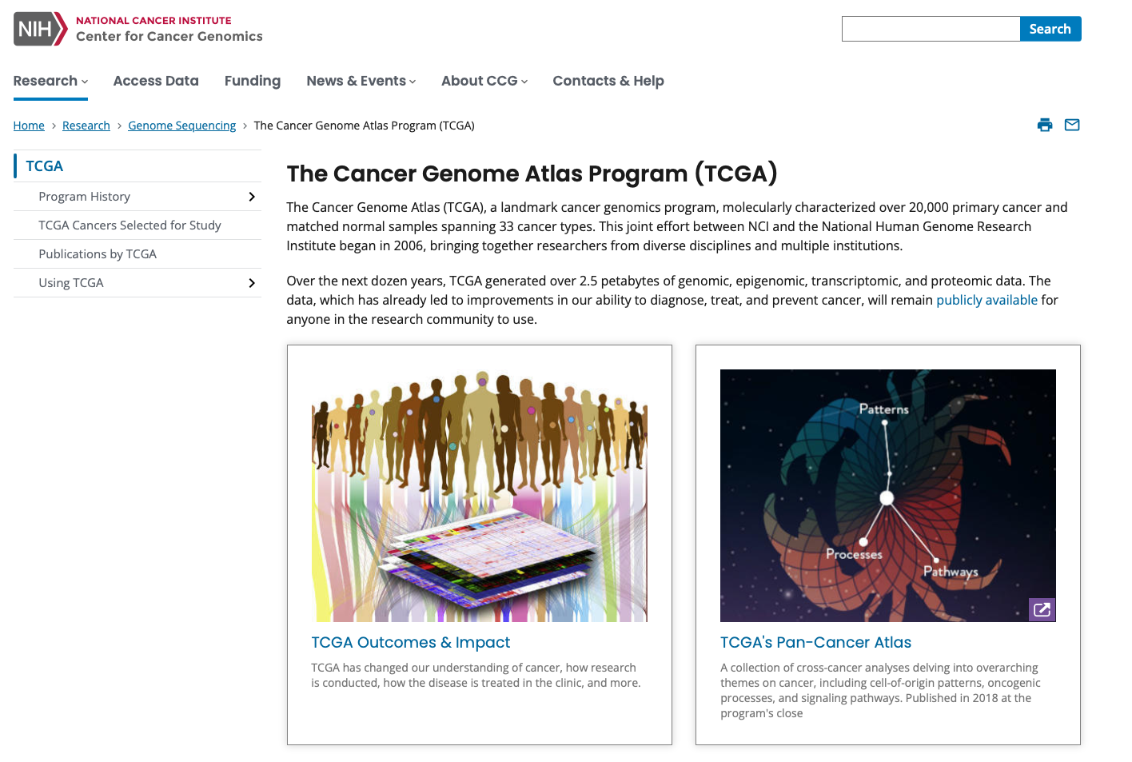
TCGA database
https://www.cancer.gov/ccg/research/genome-sequencing/tcga
The Cancer Genome Atlas (TCGA) molecularly characterized over 20,000 primary cancer and matched normal samples spanning 33 cancer types. Genomic, epigenomic, transcriptomic, and proteomic data are available.

Slide 5
TCGA database
Step 1: Select projects in TCGA.
Step 2: Select projects about prostate gland.
Step 3: Select the TCGA project on prostate gland which studies 3 types of disease (hint : click on the project ID).
Step 4: You should have the project summary. How many patients are involved in this project and what types of data are available? Genomic, transcriptomic, etc ... ?
Step 5: Return to the table of all prostate projects and click on the number of cases in the TCGA-PRAD project.
You should obtain the list of all patients included in the project.
Step 6: Select only open-access data.
Step 7: Now, we will select the omics data for this cohort. First select CNV (genomic data) but select only gene level copy number and ASCAT2 workflow and add the data to the Cart.
Step 8: Select gene expression data (transcriptomic data) and add them to the Cart.
Step 9: Select DNA methylation values (epigenetic data) and add them to the Cart.
Step 10: Select proteome profiling data (proteomic data) and add them to the Cart.
Step 11: Go the the Cart. How many files do you have to download? What is the total size of all files?

Slide 6
2. GTEX database

Slide 7
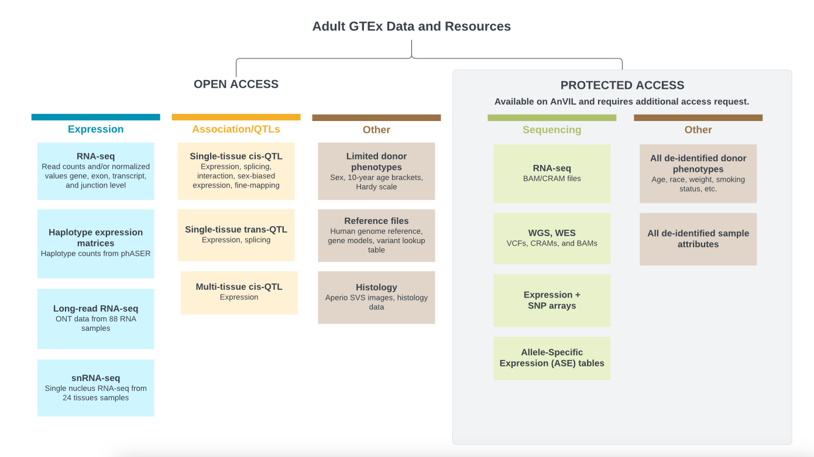
GTEX database
The Adult Genotype-Tissue Expression (GTEx) project is a comprehensive public resource for the study of tissue-specific gene expression and regulation. Samples were collected from 54 non-diseased tissue sites across nearly 1000 individuals, primarily for molecular assays including WGS, WES, and RNA-Seq.

Slide 8
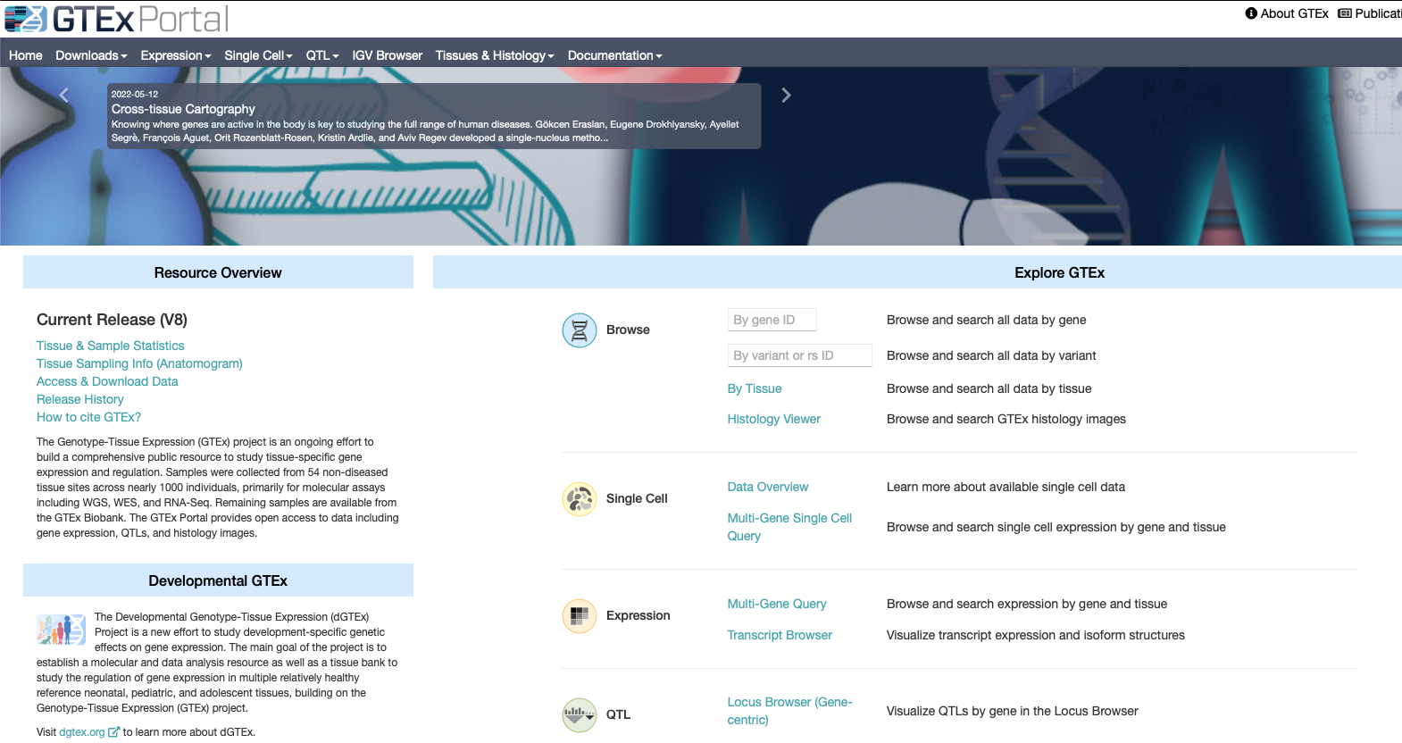
GTEX database
https://www.gtexportal.org/home/

Slide 9
GTEX database
Step 1: Answer the following questions
What is the current version of GTEX database ?
What is the total number of tissues available in GTEX
and the number of donors?
3. Which tissue contains the largest number of samples ?
4. What information do we have about donors?
Step 2: Download expression data from lung tissue.

Slide 10
3. Finding data in GEO

Slide 11

GEO database
https://www.ncbi.nlm.nih.gov/geo/
The Gene Expression Omnibus (GEO) is a public repository which contains gene expression data from various platforms (microarray, next-generation sequencing, etc…) and experimental conditions.
You can find data directly in GEO. But in most cases the route to getting to the data is finding a paper which describes an interesting piece of biology you want to pursue. We can search for interesting papers in the pubmed database (https://pubmed.ncbi.nlm.nih.gov/)
We are going to look for information relating to the Prox1 gene, specifically we’d like to find out what effect knocking this gene out in embryonic tissue has.

Slide 12
GEO database
Step 1: In pubmed, search for “prox1 embryonic knockout transcriptome” and find a paper which is obviously based around RNA-Seq data and which includes all of these terms.
Step 2: Follow the link to the paper and see if you can get the full text. See if they give a GEO accession (GSEXXXX) for the data they use. If they do is it data they created, or public data they re-analysed?
Step 3: Search for the accession code you find in GEO (https://www.ncbi.nlm.nih.gov/geo/) and find the details for the dataset. Is the paper you found the original paper for this dataset? If not which paper first published it?

Slide 13
GEO database
Step 4: Answer the questions
- How many samples are included in this dataset?
- What experimental conditions do they represent?
- How many replicates of each condition are there?
Step 5: From the GEO entry find the SRA database accession for this data. Take this and search for it in sra explorer:
https://sra-explorer.info.
Can you see all of the runs you saw in the SRA run selector?
Add the runs to your basket and then generate a list of download URLs where you could get the data if you wanted to download it all.
Step 6: Put the GSE accession number into the text search (not the accession search) of https://www.ebi.ac.uk/ena/.
Find the relevant study page and check that you can see the samples. See that you could click on the links to the individual fastq files to download them (but don’t actually download them).

Slide 14
4. Protein Data in ProteomeExchange

Slide 15
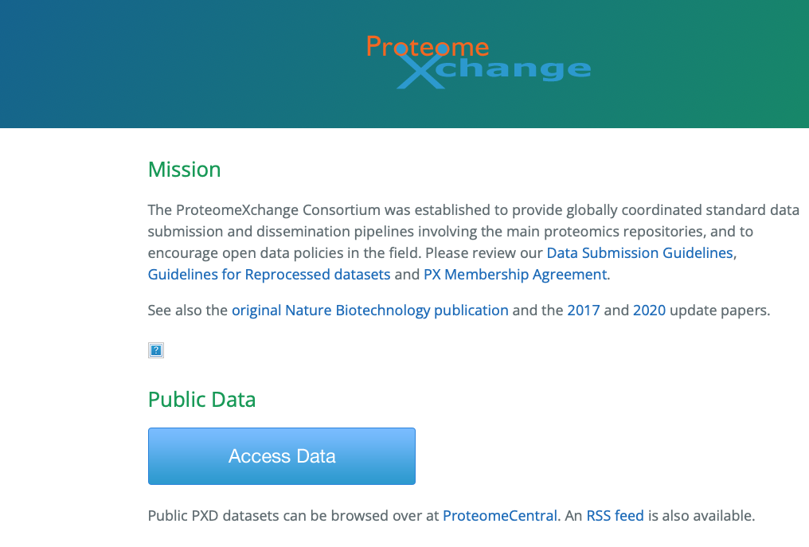
ProteomeExchange database
http://www.proteomexchange.org/
ProteomeXchange is a consortium for sharing mass spectrometry-based proteomics data. It provides a centralized platform to submit, access, and disseminate proteomics datasets generated by different laboratories and research groups.

Slide 16
ProteomeExchange database
Step 1: Go to http://www.proteomexchange.org/ and select the option to Access public data.
You should see an interactive plot which shows you how many datasets have been deposited from different species, and using different types of spectrometer. How many studies are there from Rat?
Step 2: Use the search to find datasets coming from pituitary and find a dataset from human which profiled this in 2019.
Step 3: Which of the underlying hosting databases contains the full dataset for this study?
Step 4: Find the entry for this data in the underlying repository.
Step 5: Answer the following questions:
1. What type of Mass Spectrometer generated this data?
2. Which publication is associated with the data?
Step 6: Have a look at the samples which were submitted as part of the study and see what information was recorded about each of them.
Step 7: Click through to the FTP site associated with this data and check how many files you can see and what format they are in.

Slide 17
5. Metabolomic data in Metabolomics Workbench

Slide 18
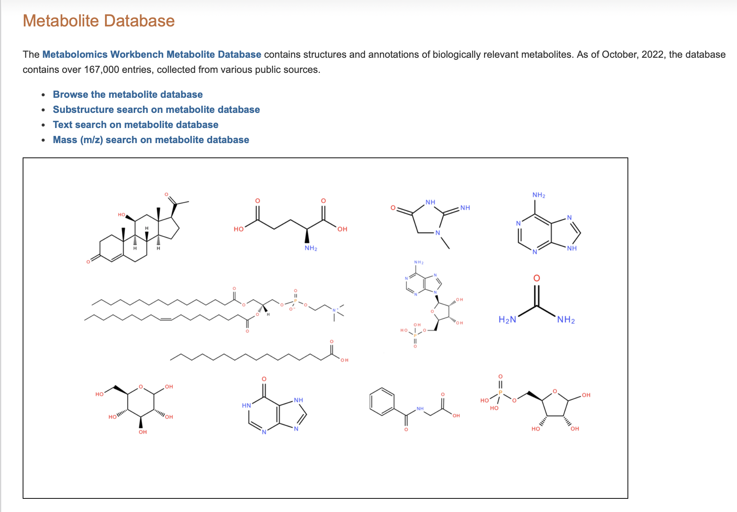
Metabolomics Workbench
https://www.metabolomicsworkbench.org
The Metabolomics Workbench Metabolite Database contains structures and annotations of biologically relevant metabolites. The database contains over 167,000 entries, collected from various public sources.

Slide 19
Metabolomics Workbench
Step 1: Go to the main metabolomics workbench page at https://www.metabolomicsworkbench.org.
In the quick search at the top, search for the accession ST000899.
You should find one match – click through so you can see it.
Step 2: Answer the following questions
- What was the purpose of this study?
- What biological material was collected for it?
- What experimental conditions does it contain and how many samples from each condition are there?
Step 3: Select the option to Show Named Metabolites to see what compounds were detected in the study, remembering that these will be metabolites rather than proteins.
Note that the list of molecules is divided into sections based on the type of Ionisation which was used to detect them. Different molecules are efficiently detected using different types of ionisation (positive and negative) in different runs of the spectrometer.

Slide 20
Metabolomics Workbench
Step 4: From the list of metabolites find adipoylcarnitine.
Select it then press the button at the top to show the values for this metabolite and then draw a bar graph.
Remembering that the samples are in groups of 20, does it look like something interesting might be happening with this metabolite?
Step 5: Go back and draw a boxplot by factor. Which of the conditions does this metabolite seem to be downregulated in?
20

Slide 21
Metabolomics Workbench
Step 6: We can do a larger scale analysis of the differential abundance of all metabolites between different conditions.
Go back to the main study page and select Performance statistical analysis.
We will construct a volcano plot of the results of a pairwise comparison of two conditions.
This plots the p-value (y-axis) against the magnitude of change (x-axis).
Select the volcano tool, and choose the Control as Group1 and Crohn disease as group 2 and run the analysis with the default options.
Have a look at the results, there is a table of results at the bottom of the page and you can click through to see the volcano plot and other summaries of the results. You should be able to see the adipoylcarnitine as an outlier along with several other metabolites.
Step 7: Repeat the analysis on the same groups using the negative ion mode data instead of positive ion mode.
Note how you get a different set of hits. In negative ion mode you should see that sucrose is a strong positive hit.
Step 8: Go back to the original full list of metabolites and find sucrose on the list and draw the barplot for it and check that you can see a strong increase in the crohn disease samples (21-40).

