Slide 1
The ATM System Machine
Kajal Rawat (MT20131)
Prabal Jain (MT20115)
Notes:
ID=d924773e-9a16-4d6d-9803-8cb819e99682 Recipe=text_billboard Type=TextOnly Variant=0 FamilyID=AccentBoxWalbaum_Zero

Slide 2
Project Description
Our Project, "The ATM System Machine," is written purely in Python Programming Language. This is a simple Console Based Application, which is very easy to Use. Our project mainly focuses on Object Oriented Programming in which we have used different classes for the respective tasks. We have implemented the three principles - SRP (single responsibility principle), OCP (open-closed principle) and LSP (Liskov’s substitution principle).
Core Functionalities of the ATM System Machine:
Amount Withdrawal: Users can withdraw a significant amount less than the current balance.
Transaction Summary: This class will allow User to see all the transactions made by the User from starting date to the end date.
Balance Enquiry: The user will be able to check the remaining amount.
Amount Deposit: The user can deposit certain amount in the account.
Change PIN: An Authenticated user is allowed to change his/her PIN.
The authenticity of User: User can only perform certain tasks if she/he is an authenticated user.

Slide 3
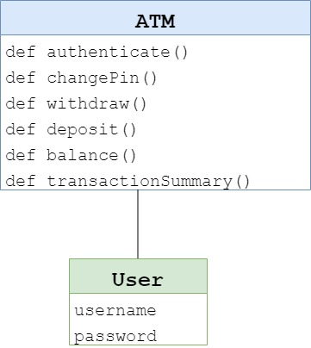
Identification of initial OO design from the problem statement
A naïve design of the problem statement consist of two main classes:-
ATM – It consist of methods which have different functionalities. authenticate(), changePin(), withdraw(), deposit(), balance() and transactionSummary().
User – Class for users which have two attributes username and password of the user.
In this design class User inherits the class ATM and hence we can use various methods of ATM class.

Slide 4
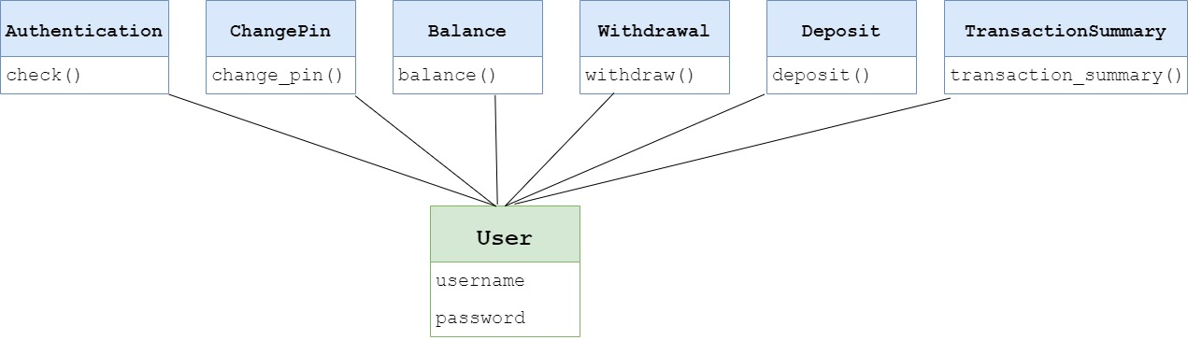
OO design resulting from SRP, OCP, and LSP

Slide 5
SRP, OCP and LSP
From our Object-oriented design the three principles are fully satisfied.
SRP (single responsibility principle) – Each of the class we implemented has single functionality/role.
For e.g. – Authentication class checks the authenticity of the user.
OCP (open-closed principle) – All the classes which we have implemented are closed, but also open for the class “User” to inherit them. All the classes are inherited by class “User” (Multiple Inheritance).
LSP (Liskov’s substitution principle) – If S is a subtype of T, then objects of type T may be replaced with objects of type S without altering the correctness of the program. In our implementation we have different class for each task hence LSP is already satisfied.

Slide 6
Object Oriented Design
Following are the classes and their methods which we have implemented :-
Class Authentication() – def check(self, username, password)
Class ChangePin() – def change_pin(self, pin, u)
Class Balance() – def balance(self, act, u)
Class Withdrawal() – def withdraw(self, amount, date, act, u)
Class Deposit() – def deposit(self, amount, date, act, u)
Class TransactionSummary() - def transaction_summary(self, act, start_date, end_date, u)
Parameters
“username and password” - username and 4 digit PIN of a particular user
“amount” - the amount enter by user to deposit or withdraw
“pin and u” - the PIN and user identity
“act” - the account type i.e savings or current
“start_date, end_date” – starting and end date choosen for showing the transaction

Slide 7
Code flow
Since it’s a console-based application, it starts with a Welcome Message "THE ATM SYSTEM MACHINE“.
It asks for card (username) and 4-digit PIN.
If the user is authenticate:
Welcoming the user ,it will display various options :
Enter 1 for Balance Enquiry
Enter 2 for Amount Withdrawal
Enter 3 for Amount Deposit
Enter 4 for Transaction summary
Enter 5 for Change PIN
Enter 0 to quit
We can choose any of these options.
If the user is unauthorized:
Terminate displaying the appropriate message.

Slide 8
Code flow (continue)
Separate authentication csv file and user files have been created. All the data getting modified in the code is being saved to these csv file which is acting as a storage file for all the data.
For every options:
User have to enter the type of account ‘S’ for savings and ‘C’ for current account.
The other option inside these options is to quit (‘Q’)
Ask the user to enter the amount (the amount should be less than the current balance and also there should be a minimum amount of Rs.1000 in the account)
Ask the user to enter the amount (the amount should be less than Rs.25000 i.e. the max credit limit.)
Ask the user to enter the start date and enter date

Slide 9
Contribution of each member
Group member 1 (MT20115) :
Implemented following classes:
authentication()
change_pin()
transaction_summary()
User()
Group member 2 (MT20131) :
Implemented following classes:
balance()
withdrawal()
deposit()
ppt

