Slide 1
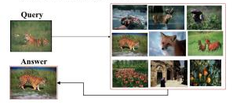
Content Based Image Retrieval
group 9
Akhil Mahajan (MT20107)
Anjali (MT20082)
Shradha Sabhlok (MT20069)
Prabal Jain (MT20115)

Slide 2
Problem Statement
Exponential growth in Image Data in the world of Instagram, Facebook, Twitter to name a few.
Text query doesn’t have relevant results in most cases.
The similar images should be retrieved in less time and with better accuracy.
Conventional database schemes will not be able to retrieve the required results in real time because of the huge volumes of data.

Slide 3

Motivation
A few CBIR systems have already been in place, but the major challenge involved is the trade-off between the system’s efficiency in terms of time and accuracy.
The current CBIR systems involve a higher computation cost, and hence there is a need to work on its performance improvement.
Enormous growth in Image data.
The methods of searching using text based content are not efficient because mostly the lots of information cannot be expressed textually.

Slide 4
Literature Survey :
Beginners to content-based image retrieval
The author experimented with different features and their combinations like Gray Histogram (representing the distribution of intensity of color in the image), Color Histogram, Color Mean (mean of pixel colors), using color and texture, etc. For similarity matching, the author used Euclidean Distance.
ImageNet classification with deep convolutional neural networks
This paper has tried to use deep Convolutional Neural Network (CNN) architecture for Computer Vision. It was the first break-through in the ImageNet classification challenge (LSVRC-2010, having 1000 classes).
Aggregating deep convolutional features for image retrieval
The authors paper have considered descriptors based on activations of pre-trained deep CNNs.They have also compared the distribution proper-
ties of deep convolutional features and SIFTs and proposed a new global image descriptor that avoids the embedding step necessary for SIFTs.

Slide 5
Literature Survey :
4. An effective web content-based image retrieval algorithm by using SIFT feature
This paper proposes an image retrieval algorithm based on SIFT feature.
The concept of ROI is used for feature extraction and then Euclidean distance is used for feature matching.
5. Image based search engine using deep learning
The authors investigated an architecture of deep learning for CBIR systems applying an advanced deep learning system, that is, CNNs for studying feature representations from picture data.
6. One-class SVM for learning in image retrieval
This paper has developed a novel scheme based on one-class SVM, which fits a tight hyper-sphere in the nonlinearly transformed feature space to include most of the target images based on the positive examples.

Slide 6
Literature Survey :
7. An integrated approach to content based image retrieval
The author has implemented CBIR system by using Color Moment (CM) and LBP for feature extraction and Euclidean distance to compare database images and query image.
8. Comparative study and optimization of feature-extraction techniques for CBIR
This paper has implemented CBIR by using Average RGB, Color Moments, Co-occurrence, Local Color Histogram, Global Color Histogram, Geometric Moments as feature extraction techniques and Euclidean distance to find the similarity between images. It tries to optimize the above process resulting in much better accuracy

Slide 7
Literature Survey :
9. Very deep convolutional networks for large-scale image recognition
Authors used convolution network known as VGG16. They have tried to use very small convolution filters and evaluated convolution networks of high depth of around 16 to 19 weight layers. The dataset used by authors is ImageNet having about 1000 class labels spread over about 15 million images. The authors concluded that VGG16 is an easy to use and implement model for image classification along with providing significant improvements over the traditional models and accuracy improves by using higher depth convolution networks. The major drawbacks experience with this model is its very slow rate of training.
10. Inception-v3 for flower classification
In this Paper Authors used Inceptionv3 for Flower Classification Where they Used Transfer Learning and their model achieved an accuracy of 95% and 94% on Oxford-I7 and Oxford-102 Flower Dataset Respectively we chose this paper of Classification because there were more number of Classes in Flower Dataset (28 kinds of Flower)
11. An analysis of CNNs for image classification
Authors have performed classification task on CIFAR10 and CIFAR100 dataset using deep convolutional neural network ResNet50 which stands for Residual Learning. It performs better for CIFAR10 as it has only 10 classes and average for CIFAR100 because of presence of more classes.

Slide 8
Dataset Exploration
We used 3 Datasets for our Image retrieval Task :
CBIR-50: It consists of 10,000 images, which are clustered into 50 categories namely Mobiles, India Gate, Kangaroo, Jeans etc. , each category has 200 images of varying sizes.
Oxford: The Oxford Buildings Dataset consists of 5062 images collected from Flickr by searching for particular Oxford landmarks. The collection has been manually annotated to generate a comprehensive ground truth for 11 different landmarks, each represented by 5 possible queries.
Paris: The Paris Dataset consists of 6412 images collected from Flickr by searching for particular Paris landmarks in 12 categories.The Paris Dataset consists of images provided by Flickr
Notes:
In other words, two pairs have the same encoder network. This strategy enables the common encoder to find and learn the similarity between two sets of face images, which are relatively unchallenging because faces normally have similar features such as eyes, nose, mouth positions

Slide 9
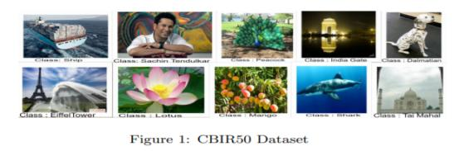
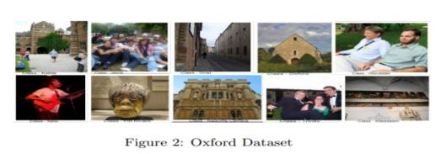
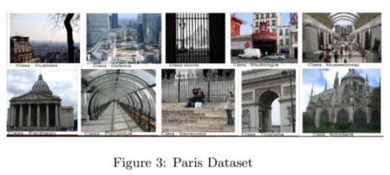
Dataset Visualisation :
Notes:
In other words, two pairs have the same encoder network. This strategy enables the common encoder to find and learn the similarity between two sets of face images, which are relatively unchallenging because faces normally have similar features such as eyes, nose, mouth positions

Slide 10
Preprocessing
Images Resized to 224*224
Below techniques applied for feature extraction:
HOG,
SIFT,
KAZE and
SURF
Normalization followed by PCA and LDA - reduces dimensions
PCA n-component value deduced from variance components graphs

Slide 11
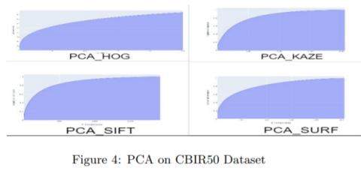
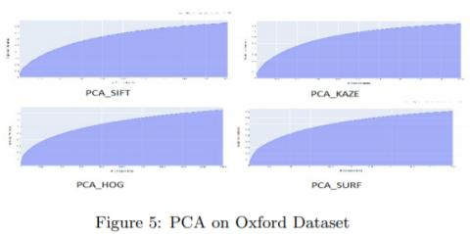
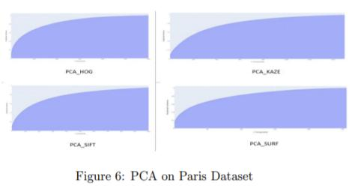
PCA graphs

Slide 12
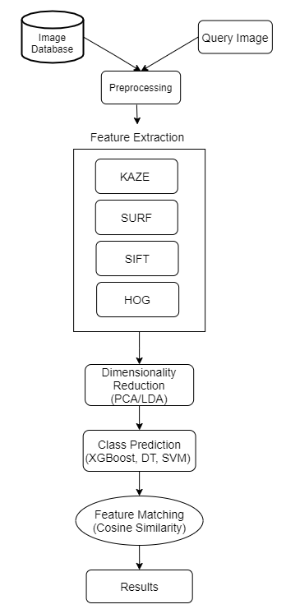
Implemented Method:
The implemented method follows the following algorithm:
All the images in the image database are reshaped to the size 224*224*3.
Features are extracted using feature extraction techniques like KAZE, SURF, SIFT and HOG.
PCA and LDA is applied to reduce the dimensions of the extracted features.
All these feature vectors are then combined to form a single feature vector.
Query image is taken as an input and all the steps from 1-4 are applied on query image as well.
Class to which the query image belongs is predicted using 3 models namely XGBoost, Decision Tree and SVM.
Once a class is predicted, cosine distances are calculated between the query image and all the images belonging to the predicted class.
All the distances are then sorted in an ascending order (since image with least distance will have the highest similarity) and first N images with the least distances are stored/printed.
Notes:
In other words, two pairs have the same encoder network. This strategy enables the common encoder to find and learn the similarity between two sets of face images, which are relatively unchallenging because faces normally have similar features such as eyes, nose, mouth positions

Slide 13
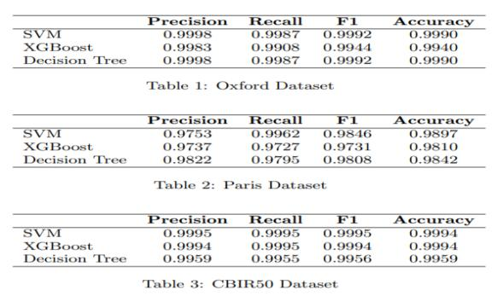
Baseline results : Classification

Slide 14
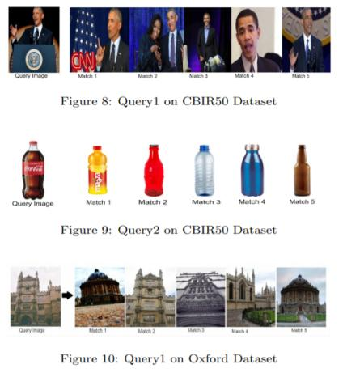
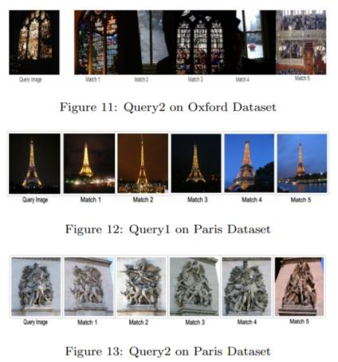
BASELINE RESULTS : Testing on Query Image

Slide 15
Limitations :
Our model pipeline results depend heavily on the quality of features extracted using different Feature Extraction Techniques.
Data Cleaning is required as most of the class contains false images which leads to incorrect image retrieval.
Expensive Image Annotators.

Slide 16
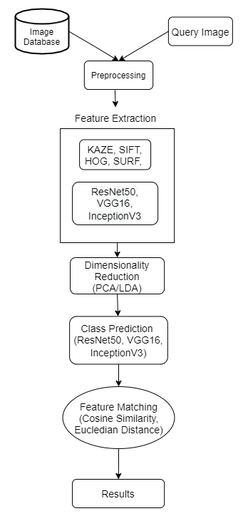
Proposed System
1. Data Preprocessing : All the images in the image database and the query image are reshaped to the size 224*224*3.
2. Feature Extraction : Through feature extraction techniques like KAZE, SIFT, SURF and HOG. Also, Through Pre Trained Deep Convolutional Neural Network : ResNet, VGG16, InceptionV3.
3. Ensembling Features: Here, we will Combine Features obtained from above feature extraction techniques used.
5. Class Prediction : Instead of using XGBoost and SVM, we will use Deep Convolutional Neural Network models like ResNet50, VGG16 and InceptionV3 to predict the class.
6. Feature matching : Perform feature matching between the query image and the images of the predicted class.
7. Image Retrieval : Retrieve first N images based on the least distances or maximum similarities.

Slide 17
Proposed System
Things we tried that didn’t work :
1. Approach -1 : Classification -> Retrieval
Here we tried to use the advantage of Deep Pretrained model Trained on ImageNet dataset to extract fine Features from the Image to performs Classification with the help of Transfer Learning but these models were taking a lot of time to train and very less classification accuracy between 60-70 Percent on VGG16 and Drastically Dropped on other two models that is Inceptionv3, and ResNet50.
2. Approach -2 : Using feature extraction techniques like KAZE, SIFT, SURF and HOG Combining them would lead to Large feature vector which takes a lot of time during matching of features of Query image.
3. Approach 3 : LDA Dimensionality Reduction : We thought of Applying LDA but it seems it needs Class Labels but in order to Generalize our CBIR System we Pooled our images of all class into a single folder. Hence we don’t need Annotations as Annotating a Dataset will be a time consuming task, Thus we made it Generalized.

Slide 18
Proposed System
Things that worked for us :
1. Methodology :
Step 1 : Creating Full Dataset : Here we pooled all our images so get rid of classification then retrieval task which was time consuming.
Step 2 : Data Cleaning : In Paris Dataset there were some false images/Corrupted images we performed Data Cleaning.
Step 3 : Data Preprocessing : Images were pre processed according to the model Requirements i.e (224x224x3) .
Step 4 : Feature Extraction : For all Three Datasets All 3 Models were applied and Features were extracted from the last layer.
(Note : ImageNet weights were used for initialization)

Slide 19
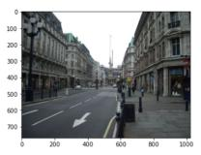
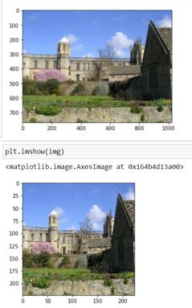
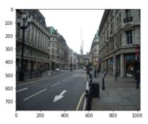
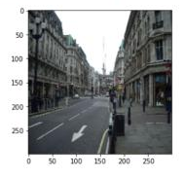
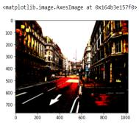
Methodology :
Step 3 : Data Preprocessing : Images were pre processed according to the model Requirements i.e (224x224x3) .
VGG16 Inceptionv3 ResNet50

Slide 20
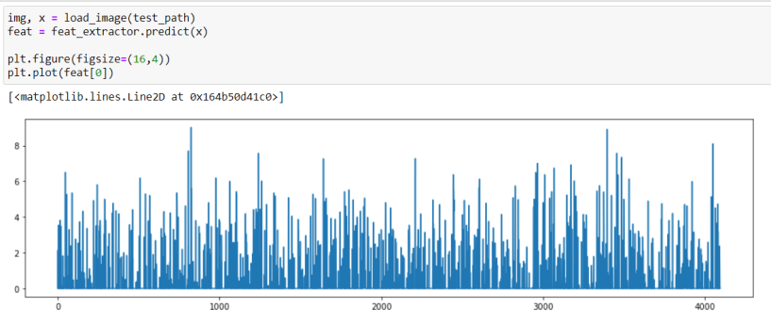
mathodology
Step 4 : Feature Extraction : For all Three Datasets All 3 Models were applied and Features were extracted from the last layer.
(Note : ImageNet weights were used for initialization)
For example : 4096 Features were extracted from VGG16 as shown in Figure below.

Slide 21
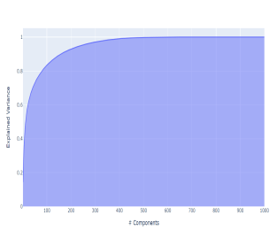
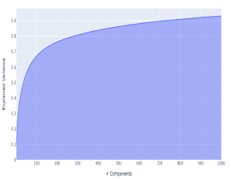
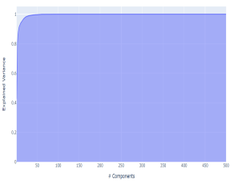
Methodology
Step 5 : PCA Feature Reduction : For Efficient Matching and To ensure we don’t lose Features property to define the particular image we plotted PCA explained Variance ratio Graph which helped us deciding the Dimension of Feature Vector for VGG (n_components = 300 was optimal ).
As shown in Below figures PCA explained variance ratio Graph For VGG16, Inceptionv3 and ResNet.
(On Oxford Dataset)

Slide 22

Methodology
Step 6: Saving Appropriate Features and Model : In this Step We saved Features and Appropriate Model
Step 7 : Testing on Single Query Image : Top 5 Images were retrieved in order to test our Model we defined two things Accuracy and Time for each of the Retrieval.
Step 8 : Final Testing and Plotting : Taking 5 images from each class and Analysing the Results which includes Accuracy and Time .

Slide 23
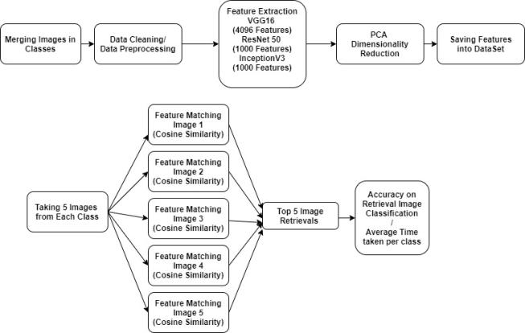
Methodology : Final Architecture

Slide 24
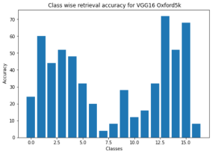
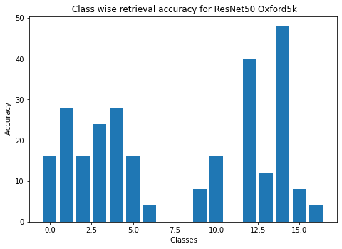
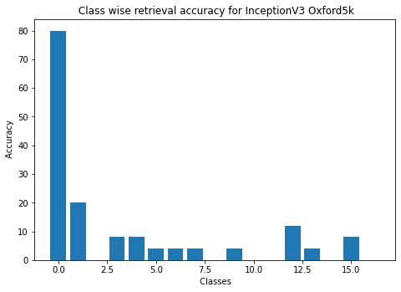
Analysis : Oxford Dataset
Class Wise Retrieval Accuracy :
Hence For Oxford VGG16 (72 Accuracy) Extracted Good Quality of Features and resulted into Good Image Retrieval and Beats the other Two model in terms of Class Image Retrieval Accuracy

Slide 25
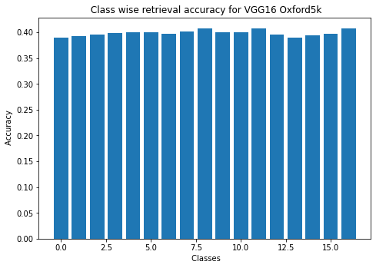
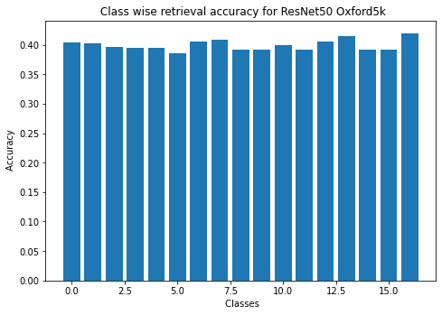
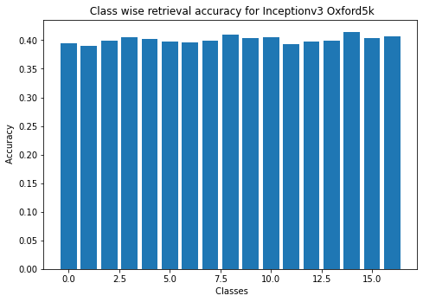
Analysis : Oxford Dataset
2. Class Wise Retrieval Average Time :
Hence For Oxford Dataset On a Average it took 0.39 Seconds Per Retrieval Which is efficient as Our Baselines took around (1-2 Seconds on an Average )

Slide 26
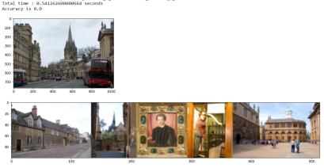
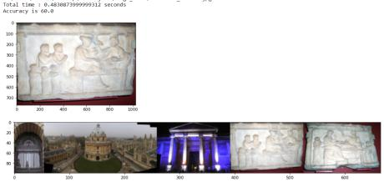
Analysis : Oxford Dataset
3. Limitation of other Two Models :
In case of Inceptionv3 on Oxford Dataset we analysed that it is retrieving False images as shown below
Figure 1 : Retrieved Images are not Relevant only First image can be Considered as Relevant Consider image 3 as it consist of a Picture of a Person which is not a Good Retrieval
Figure 2 : In this Case an Ancient Image is given as a Query and we can see we got Retrieved Images in which only Last two were correct and Top 3 Images that we retrieved were of Building.
Analysis : Hence we can see InceptionV3 are mostly Retrieving Images that consists of Buildings.
Figure 1 Figure 2

Slide 27
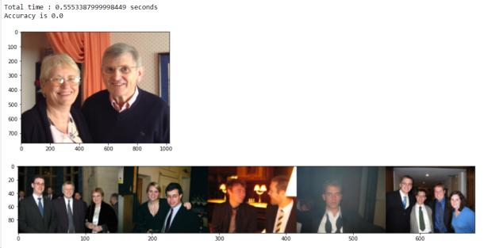
Analysis : Oxford Dataset
3. Limitation of other Two Models :
In case of ResNet50 on Oxford Dataset we analysed that it is retrieving good images on an average as shown below But Most of the time on Oxford Dataset it is Retrieving Similar images that belongs to Different Classes Hence Lead to Less Classification Accuracy
Figure 1 : Figure One shows Good Retrieval but Bad Accuracy.
Figure 1

Slide 28
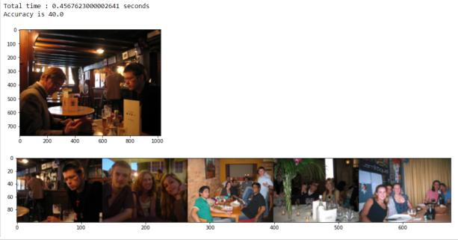
Analysis : Oxford Dataset
3. Limitation of other Two Models :
In case of ResNet50 on Oxford Dataset we analysed that it is retrieving good images on an average as shown below But Most of the time on Oxford Dataset it is Retrieving Similar images that belongs to Different Classes Hence Lead to Less Classification Accuracy
Figure 2 : Figure One shows Good Retrieval but Bad Accuracy.
Figure 2

Slide 29
Analysis : Oxford Dataset
3. Limitation of other Two Models :
In case of ResNet50 on Oxford Dataset we analysed that it is retrieving good images on an average as shown below But Most of the time on Oxford Dataset it is Retrieving Similar images that belongs to Different Classes Hence Lead to Less Classification Accuracy
Figure 2 : Figure One shows Good Retrieval but Bad Accuracy.
Figure 2

Slide 30
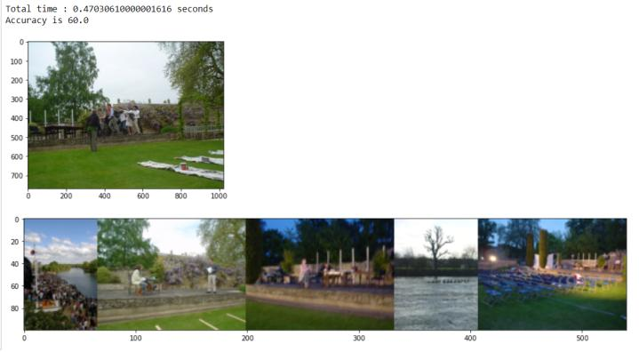
Analysis : Oxford Dataset
4.Good Retrievals :

Slide 31
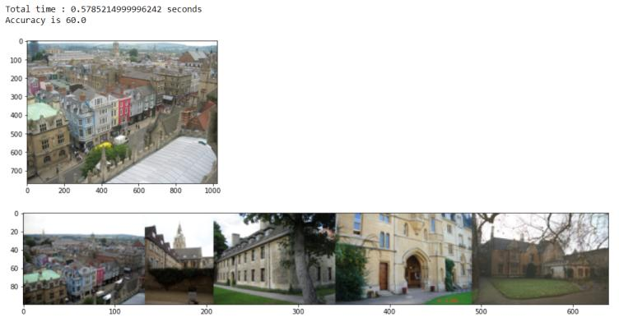
Analysis : Oxford Dataset
4.Good Retrievals :

Slide 32
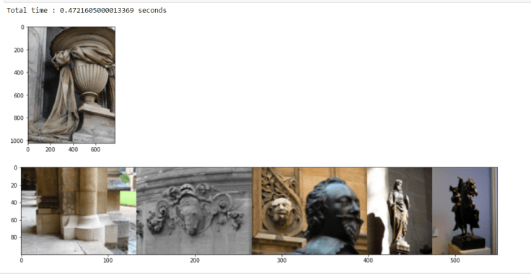
Analysis : Oxford Dataset
5.Bad Retrievals :

Slide 33
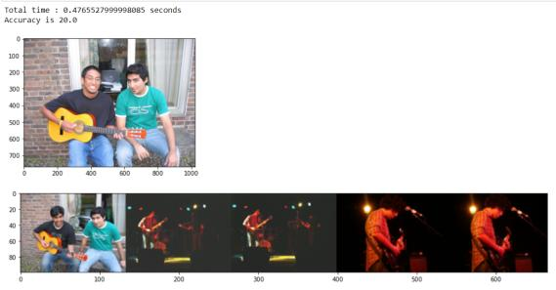
Analysis : Oxford Dataset
6. Is Retrieval really Bad ? :
So in case of InceptionV3 Retrievals are Bad But in case of ResNet50 It was not Always Bad we can see Classification Accuracy of 20 Percent only But Still this is a Good Retrieval as it Extracted the Features of “man holding a guitar”.

Slide 34
Analysis : Oxford Dataset
7. DataSet Limitations :
Let us have a Look in our Dataset and define the BottleNeck of our Dataset :
Oxford Dataset contains 5063 High Resolution (1024x768) Images.
It consist of Different Landmark Images in the corresponding landmark folders Our goal is to retrieve Top 5 similar images from a given landmark Query image . We analysed the Oxford Dataset and On the Basis of Similarity Task, we found that in class “Trinity” there are more number of Images of People as compared to different Landmark Images. There are Very Few Classes that contains Similar Images. So Here we Decided to Visualize our Retrievals rather than Deciding on Classification Accuracy.

Slide 35
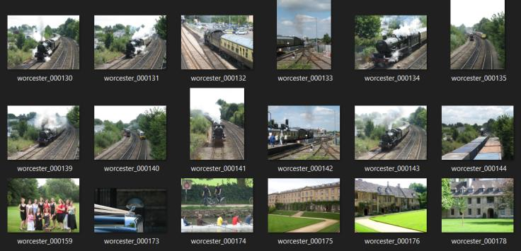
Analysis : Oxford Dataset
7. DataSet Limitations :

Slide 36
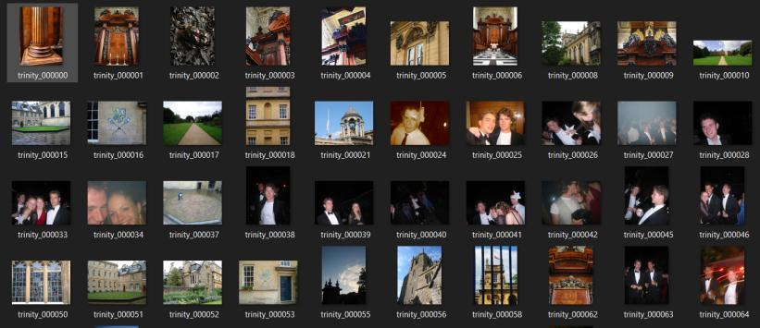
Analysis : Oxford Dataset
7. DataSet Limitations :

Slide 37
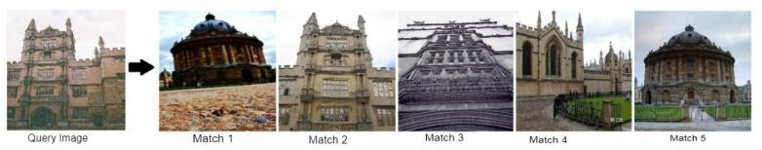
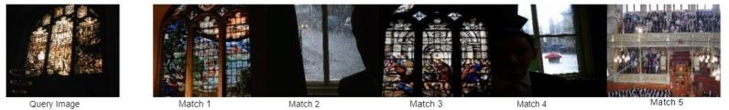
Comparison: Oxford Dataset
Comparison of Proposed Model with Baseline :
2. Limitations : As Seen from above Retrievals that for Query Image 1 , Match 2 and 3 are relevant. And for Query Image 2 Match 2,4 and 5 are relevant Now we tried using the Image of Same class and all 5 retrieved images were similar.

Slide 38
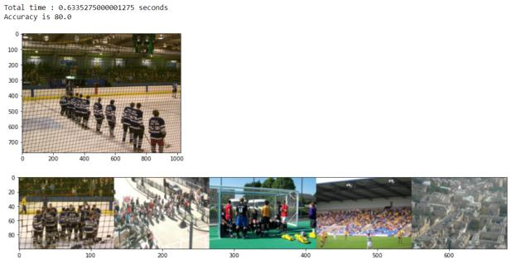
Comparison: Oxford Dataset
Comparison of Proposed Model with Baseline :
2. Limitations : As Seen from above Retrievals that for Query Image 1 , Match 2 and 3 are relevant. And for Query Image 2 Match 2,4 and 5 are relevant Now we tried using the Image of Same class and 4 out of 5 retrieved images were similar.

Slide 39
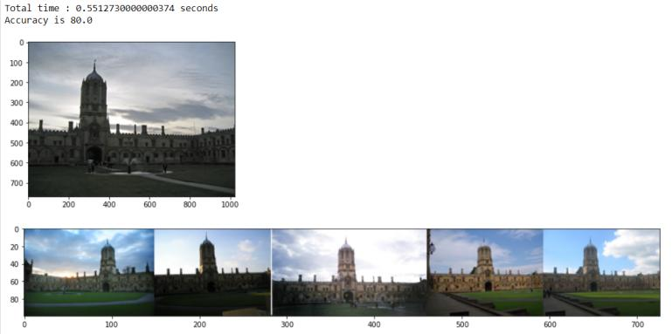
Comparison: Oxford Dataset
Comparison of Proposed Model with Baseline :

Slide 40
Comparison: Oxford Dataset
Comparison with State of Art Approach :
Paper Link
(https://openaccess.thecvf.com/content_ICCV_2017_workshops/papers/w18/Seddati_Towards_Good_Practices_ICCV_2017_paper.pdf)
We have Achieved Highest Accuracy of 72 on VGG16 Model Also Our Model take on an average 0.393 Seconds per Retrieval on Oxford Dataset.

Slide 41
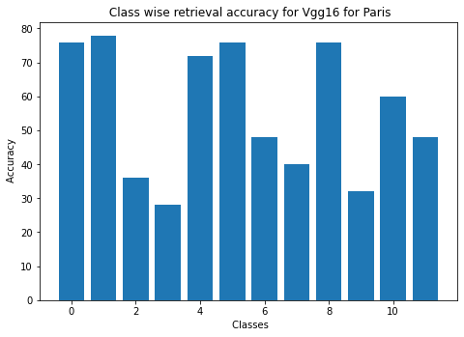
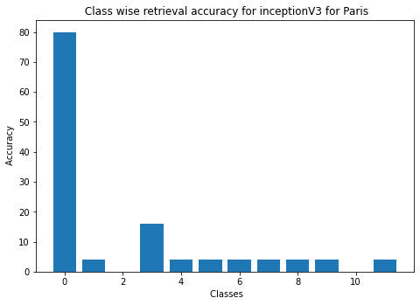
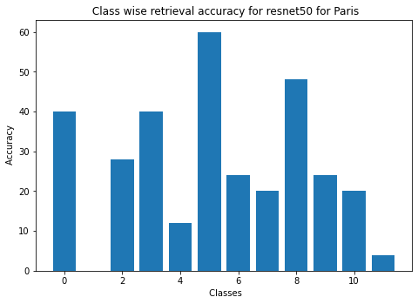
Analysis : Paris Dataset
Class Wise Retrieval Accuracy :

Slide 42
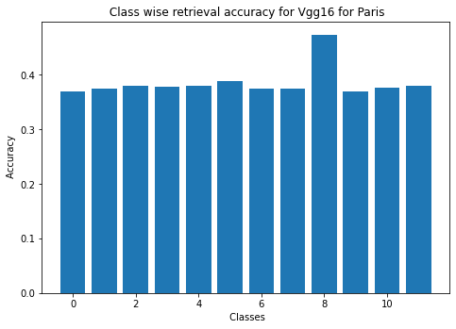
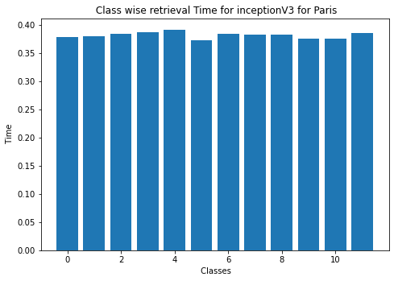
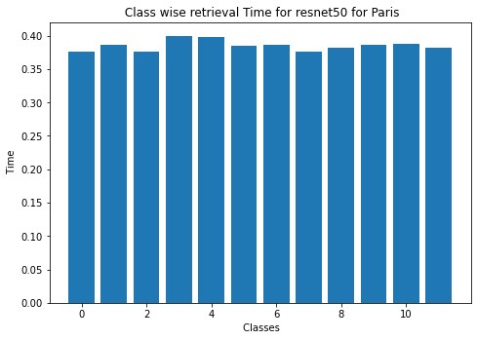
Analysis : Paris Dataset
2. Class Wise Retrieval Average Time :

Slide 43
Analysis : Paris Dataset
3.Limitation of Models :
Inception_V3 and ResNet50 are not performing at par with what VGG16 is doing wrt Paris dataset. Inception having less parameters than VGG16, can’t perform well on images with not much in-depth information. On the other hand, ResNet50 is a providing many False Negative Results due to Dataset issues. Many results having less accuracies were the perfect matches. But as Paris dataset had few images in a class named “General” that matched more than the actual class objects for some images. So, this lead to have many False Negative results.

Slide 44
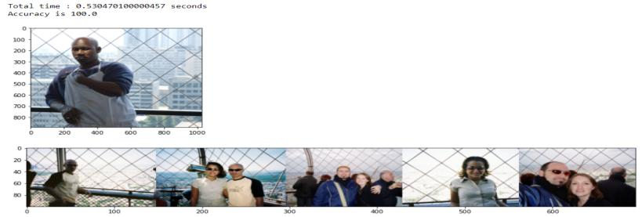
Analysis : Paris Dataset
4.Good Retrievals :
Achieved best results with perfect matches
Mostly having all 5 retrieved images the most relevant ones
Even got results matching the exact parameters like object count, shape, size and color with the query image, unlike the previously implemented method.

Slide 45
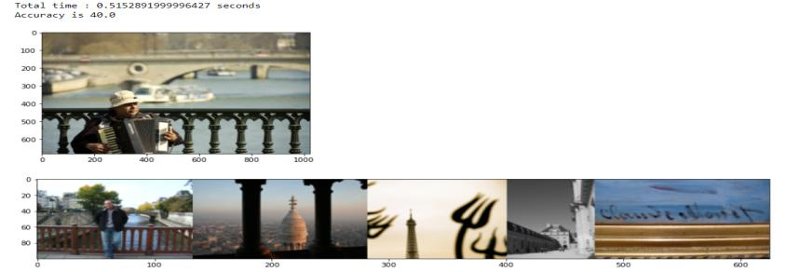
Analysis : Paris Dataset
5.Bad Retrievals :
Mainly for images belonging to Hard to retrieve category
Due to viewing conditions that are difficult to match

Slide 46

Analysis : Paris Dataset
6. Is Retrieval really Bad ? :
For Paris Dataset in particular, all bad or low accuracy results were not really bad.
These were simply the False Negatives.
Due to “General” class in dataset having many images that were great matches from images of other classes.
Below are great matches but still low accuracy results

Slide 47
Analysis : Paris Dataset
7. DataSet Limitations :
Paris Dataset has known issues and hence affect the image retrieval process significantly.
Presence of broken images and hence the code execution broke which interfered with feature and label mapping.
So, we had to handle such error scenarios and update our feature and label mapping accordingly.
Also, the annotation errors are present in Paris Dataset, making it contain False Positive and False Negative samples.
Small size of dataset (i.e., 6392 images) is often a con when considering better feature extraction.

Slide 48

Analysis : Paris Dataset
7. DataSet Limitations :

Slide 49



Analysis : paris Dataset
8. Comparison : Baseline vs Proposed Retrievals

Slide 50



Analysis : CBIR Dataset
Class Wise Retrieval Accuracy :
As visible from the plots, VGG16 performs best for CBIR50 in terms of extracting features and giving good class-wise retrievals

Slide 51



Analysis : CBIR Dataset
2. Class Wise Retrieval Average Time :
In terms of time ResNet50 gives good retrievals in lesser time than VGG16.

Slide 52


Analysis : CBIR Dataset
4.Limitation of other Two Models : InceptionV3
Above results are the retrievals of InceptionV3 which are not as goo as compared to other models.

Slide 53


Analysis : CBIR Dataset
4.Limitation of other Two Models : RESNET50
Though in terms of time, ResNet50 takes performs better but sometimes gives inaccurate retrievals.

Slide 54


Analysis : CBIR Dataset
5.Good Retrievals :

Slide 55


Analysis : CBIR Dataset
5.Good Retrievals :

Slide 56


Analysis : CBIR Dataset
6.Bad Retrievals :

Slide 57




Analysis : CBIR Dataset
9. Comparison :

Slide 58

Final Evaluation Baseline and SOTA:
Evaluation Metric : Retrieval Time, Retrieval Accuracy
From Baselines Perspective : Image Retrieval Accuracy Improve on Best Models as shown in previous slides.
From SOTA Perspective : They considered below paper in which they Showed the Analysis of 8 Test Images and they retrieved corresponding (<= 76 Images from each) and Computed Accuracy
M. N. Munjal and S. Bhatia, "A Novel Technique for Effective Image Gallery Search using Content Based Image Retrieval System," 2019 International Conference on Machine Learning, Big Data, Cloud and Parallel Computing (COMITCon), 2019, pp. 25-29, doi: 10.1109/COMITCon.2019.8862206.
Link : (https://ieeexplore.ieee.org/document/8862206)

Slide 60
Final Evaluation Baseline and SOTA:
Evaluation Metric : Retrieval Time, Retrieval Accuracy
From Baselines Perspective : Image Retrieval Accuracy Improve on Best Models as shown in previous slides.
From SOTA Perspective : They considered below paper in which they Showed the Analysis of 8 Test Images and they retrieved corresponding (<= 76 Images from each) and Computed Accuracy
Link : (https://ieeexplore.ieee.org/document/8862206)
In our Case we tested on 5 images from each class.
(Maximum Image Classification Accuracy)
Oxford VGG 16 : 72%, Time = 0.39
Paris VGG16 : 78%, Time = 0.37
CBIR VGGI6 / CBIR ResNet50 : 80%, Time = 0.5

Slide 61
Analysis : Contributions
Akhil Mahajan : Proposed Architecture, Perform Analysis on Approach 1, 2, Methodology, Literature Survey Inceptionv3, ResNet50 and VGG16, worked on Baselines and Paris Dataset, Report.
Anjali Jain : Worked on CBIR Dataset, Performing Data Preprocessing, Model Training, Analysis, Evaluation, plotting, Baselines, Report.
Prabal Jain : Worked on Oxford Dataset, Performing Data Preprocessing, Model Training, Analysis, Evaluation, Plotting,Baselines,Report.
Shradha Sabhlok : Worked on Paris Dataset, Performing Data Preprocessing, Model Training, Analysis, Evaluation, plotting, Baselines, Data Cleaning,Report.

Slide 62
Thank You !

