Slide 1
JOINS
TEAM 2 CODE BLACK

Slide 2
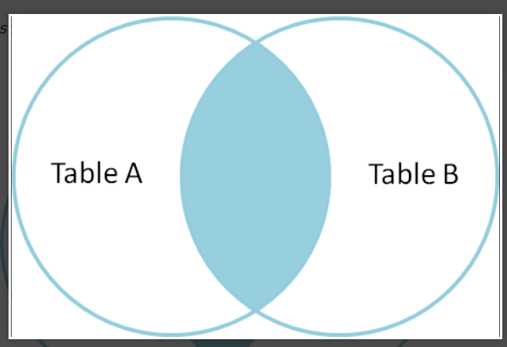
SQL Join statement is used to combine data or rows from two or more tables based on a common field between them. Different types of Joins are as follows:
INNER JOIN
LEFT JOIN
RIGHT JOIN
Cross JOIN
A. INNER JOIN
The INNER JOIN keyword selects all rows from both the tables as long as the condition is satisfied. This keyword will create the result-set by combining all rows from both the tables where the condition satisfies i.e value of the common field will be the same.
INNER JOIN Syntax
SELECT column_name(s) FROM table1 INNER JOIN table2;

Slide 3
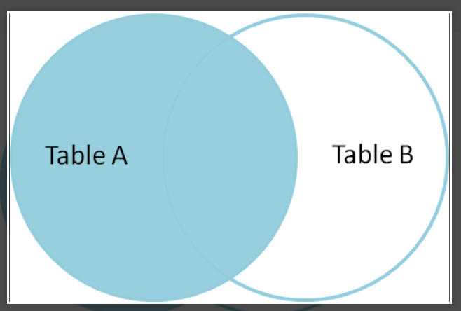
B. LEFT JOIN
This join returns all the rows of the table on the left side of the join and matches rows for the table on the right side of the join. For the rows for which there is no matching row on the right side, the result-set will contain null. LEFT JOIN is also known as LEFT OUTER JOIN.
Syntax:
SELECT table1.column1,table1.column2,table2.column1,.... FROM table1 LEFT JOIN table2 ON table1.matching_column = table2.matching_column;
table1: First table. table2: Second table matching_column:
Column common to both the tables.

Slide 4
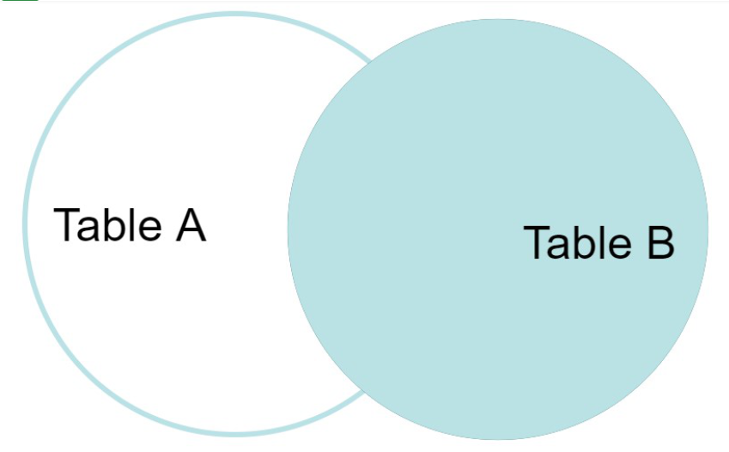
C. RIGHT JOIN
RIGHT JOIN is similar to LEFT JOIN. This join returns all the rows of the table on the right side of the join and matching rows for the table on the left side of the join. For the rows for which there is no matching row on the left side, the result-set will contain null. RIGHT JOIN is also known as RIGHT OUTER JOIN.
Syntax:
SELECT table1.column1,table1.column2,table2.column1,.... FROM table1 RIGHT JOIN table2 ON table1.matching_column = table2.matching_column;
table1: First table.
table2: Second table matching_column:
Column common to both the tables.

Slide 5
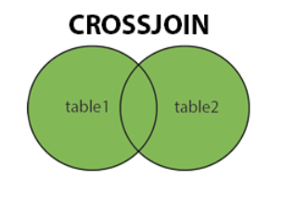
D. CROSS JOIN
The CROSS JOIN keyword returns all records from both tables (table1 and table2).
CROSS JOIN Syntax
SELECT column_name(s) FROM table1 CROSS JOIN table2;

