Slide 1
DATA STRUCTURES AND ALGORITHMS – 3
25CS2103E
STATISTICAL
ANALYTICS
DASHBOARD
Using Parallel Reduction & Parallel Prefix Sum Algorithms
TEAM 23
P. Sasi Kumar • 2520030505
P. Revanth • 2520030292
Under the Esteemed Guidance of • DSA-3 Faculty
2026

Slide 2
Contents
OVERVIEW
A concise roadmap of the project and implementation.
01
Abstract
06
Results
Purpose and capabilities
Correctness and benchmark evidence
02
Introduction
07
Hardware & Software
Why parallel analytics matters
Execution environment
03
Literature Survey
08
Conclusion
Sequential vs. parallel computation
What the project demonstrates
04
Problem & Objectives
09
Future Scope
Challenge and measurable goals
Potential extensions
05
Flow Chart
End-to-end processing pipeline
TEAM 23 • DSA-3 • 25CS2103E
02

Slide 3
Abstract
01
A dashboard-oriented implementation of parallel statistical analytics.
PROJECT IDEA
KEY OUTPUTS
• Analyze large numerical datasets using sequential and parallel algorithms.
• Use Fork/Join based parallel reduction and prefix-sum processing.
• Present statistics, frequency distributions and execution-time comparisons in one dashboard.
• Mean, variance, minimum and maximum.
• Cumulative / prefix sums.
• Frequency distribution.
• Sequential vs. parallel benchmark results.
• CSV export and graphical performance reports.
CORE THEME: PARALLEL ALGORITHMS + DATA ANALYTICS
TEAM 23 • DSA-3 • 25CS2103E
03

Slide 4
Introduction
02
From one-at-a-time processing to scalable numerical computation.
WHY THIS PROJECT?
SEQUENTIAL
• Large datasets increase the cost of repeated statistical scans.
• Reduction is naturally parallel for sum, minimum and maximum.
• Prefix sum supports cumulative analytics and demonstrates a second parallel pattern.
• The dashboard makes algorithmic results and performance visible.
1
2
3
4
5
6
One stream of computation
Simple • predictable • limited parallelism
PARALLEL
Multiple workers process independent portions
TEAM 23 • DSA-3 • 25CS2103E
04

Slide 5
Literature Survey
03
Concepts that motivate the chosen algorithmic approach.
Sequential statistics
Traditional loops are straightforward for mean, variance, min and max; cost grows linearly.
1
Parallel reduction
Reduction combines partial results such as sum/min/max across independent partitions.
2
Parallel prefix sum
Prefix operations compute cumulative results and are a standard parallel pattern.
3
Fork/Join execution
Java Fork/Join supports recursive decomposition and work stealing for multi-core computation.
4
DESIGN CHOICE: FORK/JOIN FOR PRACTICAL PARALLEL EXECUTION
TEAM 23 • DSA-3 • 25CS2103E
05

Slide 6
Problem Statement & Objectives
04
The implementation targets both correctness and measurable performance.
PROBLEM STATEMENT
Processing large numerical datasets sequentially can become time-consuming. The project implements statistical analytics using parallel algorithms and compares sequential and parallel execution.
01
Compute descriptive statistics
02
Compute cumulative results
03
Analyze frequency
Mean, variance, minimum and maximum.
Generate prefix sums over the dataset.
Count occurrences and expose distributions.
04
Measure performance
05
Visualize results
Compare execution time and calculate speedup.
Export CSV data and present graphical reports.
TEAM 23 • DSA-3 • 25CS2103E
06

Slide 7
Flow Chart
05
End-to-end processing pipeline implemented in Java.
INPUT
VALIDATE
SEQUENTIAL
PARALLEL
ANALYZE
REPORT
Numerical dataset
Load & verify data
Statistics + prefix sum
Reduction + prefix sum
Frequency + timing
CSV + graphs + dashboard
Parallel paths are executed after loading; correctness is verified against sequential results.
FORK/JOIN • THRESHOLDED RECURSION • RESULT VERIFICATION
TEAM 23 • DSA-3 • 25CS2103E
07

Slide 8
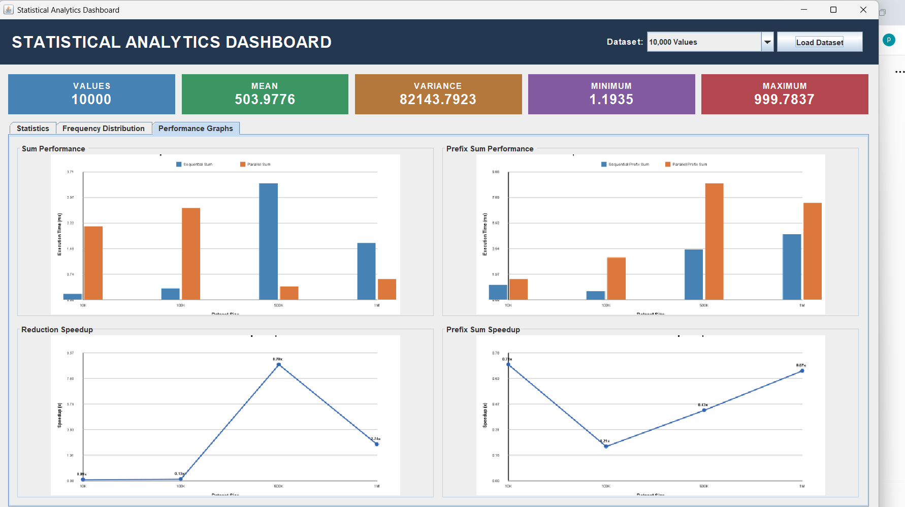
Results
06
Correctness verified and benchmarked across datasets from 10K to 1M values.
SAMPLE DATASET
Values
10
Mean
33.0000
Variance
231.0000
Minimum
10.0000
Maximum
60.0000
SEQUENTIAL = PARALLEL (verified)
Benchmark report: execution time and speedup across 10K, 100K, 500K and 1M datasets.
TEAM 23 • DSA-3 • 25CS2103E
08

Slide 9
Hardware & Software Requirements
07
Practical execution environment for the Java implementation.
HARDWARE
SOFTWARE
• Computer / laptop.
• Multi-core processor for parallel execution.
• Minimum 4 GB RAM recommended.
• Sufficient storage for datasets and reports.
• Windows / Linux operating system.
• Java Development Kit (JDK).
• Visual Studio Code / IntelliJ IDEA.
• Java Swing for the dashboard UI.
• CSV files for datasets and exported results.
IMPLEMENTATION LANGUAGE: JAVA
TEAM 23 • DSA-3 • 25CS2103E
09

Slide 10
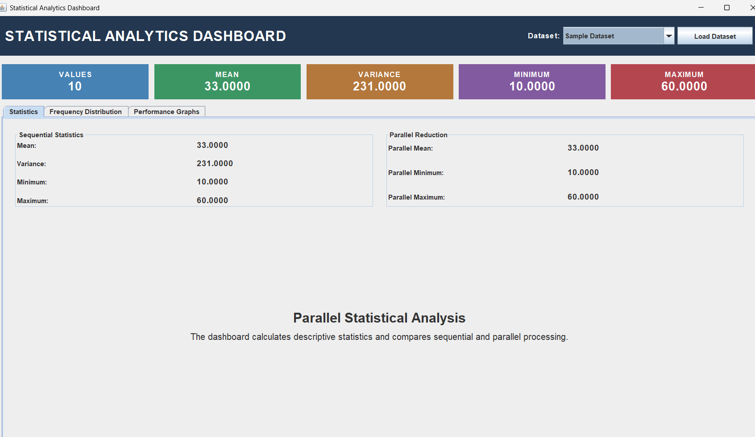
Dashboard & Graphical Reports
06
The final UI combines analytics, validation and visual performance evidence.
DASHBOARD FEATURES
• Dataset selector and one-click loading.
• Live cards for values, mean, variance, min and max.
• Sequential vs. parallel statistics.
• Frequency distribution tab.
• Performance graphs tab.
INTERACTIVE SWING DASHBOARD
TEAM 23 • DSA-3 • 25CS2103E
10

Slide 11
Conclusion
08
What the completed implementation demonstrates.
PROJECT OUTCOME
• A complete Java-based statistical analytics dashboard was implemented.
• Descriptive statistics, prefix sums and frequency distributions are computed correctly.
• Parallel reduction and parallel prefix-sum algorithms were implemented using Fork/Join.
• Sequential and parallel outputs were verified for correctness.
• Benchmark results are exported to CSV and converted into graphical reports.
• Measured speedup depends on dataset size, workload and parallelization overhead.
KEY TAKEAWAY: PARALLELISM IS A TRADE-OFF BETWEEN WORK AND OVERHEAD
TEAM 23 • DSA-3 • 25CS2103E
11

Slide 12
Future Scope
09
Potential extensions for a stronger analytics platform.
1
Larger & real-time datasets
2
Advanced statistics
3
Richer dashboard
Stream or process continuously arriving data.
Median, standard deviation, percentiles and correlation.
Interactive charts, filters and export controls.
4
Cloud / distributed processing
5
GPU acceleration
6
Automated benchmarking
Move beyond a single machine for very large data.
Explore data-parallel computation for suitable workloads.
Repeatable runs across hardware and dataset sizes.
TEAM 23 • READY FOR EXTENSION
TEAM 23 • DSA-3 • 25CS2103E
12

Slide 13
THANK YOU
Statistical Analytics Dashboard
TEAM 23
P. Sasi Kumar • 2520030505
P. Revanth • 2520030292
Data Structures and Algorithms – 3 | 25CS2103E
Questions?

