Slide 1

Scope of Disclosure | TSIP Team
Confidential period | Indefinite
Head of information owner section | Training Division Head
Handling restriction | “No Copying” , “No Printing” “No transferring”, “No re-disclosure” “No circulation” , “Do not duplicate”
Activity Diagrams

Slide 2
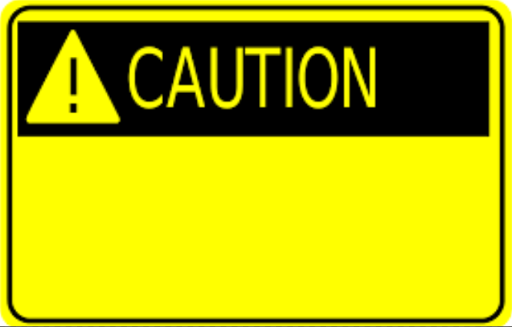


UML 2.5 discussions have been known to cause or induce sleep among participants.
Necessary precautions to prevent injuries due to participants falling off chairs ,resulting from UML-induced stupor is highly advised ☺
Please do not fall off the chair !

Slide 3
Actions

Slide 4
Actions
An Action is the fundamental unit of behavior specification in UML
An Action may take a set of inputs and produce a set of outputs, though either or both of these sets may be empty
Actions are contained in Behaviors, specifically Activities and Interactions
Actions are very dependent on Activities, because they specialize elements and semantics from Activities to accept inputs and provide outputs and to define Actions that coordinate other Actions
*

Slide 5
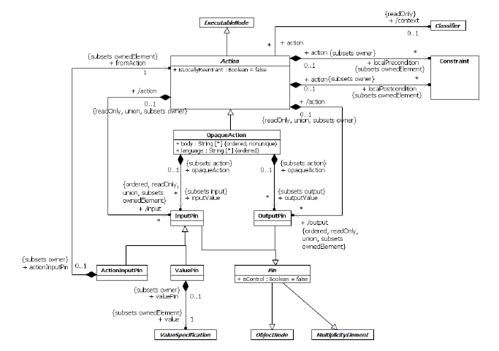
Actions
*

Slide 6
Actions
If the Behavior containing an Action has a context BehavioredClassifier, then that BehavioredClassifier is also the context Classifier for the Action. When the Action executes, it executes in the context of an instance of the context Classifier or, if there is no context Classifier, than directly in the context of the execution instance of the Behavior.
An Action may accept inputs and produce outputs, as specified by InputPins and OutputPins of the Action, respectively
Each Pin on an Action specifies the type and multiplicity for a specific input or output of that Action
*

Slide 7
Actions
An Action is a fundamental unit of executable functionality contained, directly or indirectly, within a Behavior
The execution of an Action represents some transformation or processing in the modeled system
An Action execution may also result in the invocation of another Behavior
An Action is therefore simple from the point of view of the Behavior containing it but may be complex in its effect and not atomic.
*

Slide 8
Actions
Once it has been determined that an Action will execute, the general steps for that execution are as follows :
The Action execution consumes input data on all InputPins on the Action up to the upper multiplicity for each InputPin. If the Action is an invocation of a Behavior with streaming Parameters then the Action execution may consume additional data supplied to InputPins corresponding to streaming input Parameters.Otherwise, once an Action execution has started, any additional data on InputPins has no effect on it.
An Action continues executing until it has completed
When completed, an Action execution provides any output data on the OutputPins of the Action, and it terminates. However, if the Action is an invocation of a Behavior with streaming Parameters, then the Action execution may also post data to OutputPins corresponding to streaming output Parameters before completion of the execution
*

Slide 9
Actions
Behaviors may reuse the same kind of Action multiple times, and the semantics of the Action applies to each usage separately. For example, Activities may have multiple nodes that are instances of the same Action metaclass, and each instance has its own values for the properties described below, affecting the execution of that particular usage of the Action only
“An Action” refers to a single instance of an Action metaclass
If an Action is not locally reentrant (isLocallyReentrant=false, the default), then no more than one execution of it may exist at any given time within a single execution of the containing Behavior
If an Action is locally reentrant (isLocallyReentrant=true), then a new execution of it may begin any time the normal rules above allow it, even if there are one or more executions already ongoing within the same Behavior execution
*

Slide 10
Actions
The localPrecondition and localPostcondition for an Action are Constraints that should hold when an execution of an Action starts and completes, respectively.
An OpaqueAction is an Action whose specification may be given in a textual concrete syntax other than UML. An OpaqueAction has a body that consists of a sequence of text Strings representing alternative means of specifying the behavior of the Action
*

Slide 11
Pins
A Pin represents an input to an Action or an output from an Action. An InputPin represents an input, while an OutputPin represents an output.
A Pin is a kind of ObjectNode ; so it holds object tokens that contain values of a specified Type
*

Slide 12
Pins
Values held in the tokens of the InputPins of an Action provide the input data for executions of the Action, and the output data from Action executions are placed on the OutputPins of the Action wrapped in object tokens
A Pin is also a MultiplicityElement. The multiplicity bounds on a Pin constrain the total number of values that may be input or output by a single execution of an Action, not the number of tokens it contains
Pin inherits both an ordering attribute from ObjectNode and an isOrdered attribute from MultiplicityElement. If isOrdered is true, then the ordering of values on the Pin considered as a MultiplicityElement is the order in which the values were placed onto the Pin. The value of the ordering attribute, however, determines the order in which values are taken from the Pin. For example, if isOrdered is true and the ordering is FIFO, then values will be taken from the Pin in the same order as the MultiplicityElement ordering
*

Slide 13
Pins
An InputPin is a Pin that holds input values to be consumed by its Action. An Action cannot start execution if one of its InputPins has fewer values than the lower multiplicity of that InputPin.
Tokens consumed by an Action are immediately removed from its InputPins when the action begins an execution
An OutputPin is a Pin that holds output values produced by an Action
For each execution, an Action cannot terminate itself unless it can put at least as many values into its outputs as required by the multiplicity lower bounds on those OutputPins
ValuePins and ActionInputPins are InputPins
*

Slide 14
Pins
When the Action is enabled by other means, values are computed as specified for the ValuePins and ActionInputPins owned by an Action, and the results are provided as inputs to the Action when it begins execution
A ValuePin provides a value by evaluating a ValueSpecification. When the Action is enabled by other means, the ValueSpecification of the ValuePin is evaluated, and the result is provided as an input to the Action when it begins execution
An ActionInputPin provides values by executing another Action.
*

Slide 15
Actions and Pins in Activities
Activities include ControlFlows between ExecutableNodes
Pins are ObjectNodes that may hold tokens accepted and offered according to the semantics of ObjectFlows between ObjectNodes
Executing an Action in an Activity requires all of its InputPins to be offered all necessary tokens, as specified by their minimum multiplicity. When the Action begins executing, all the InputPins accept tokens offered to them at once, up to the maximum multiplicity allowed on each InputPin
When an Action in an Activity completes execution, object tokens for output data placed on its OutputPins may be offered on any outgoing ObjectFlows from those Pins. Control tokens shall be offered on any outgoing ControlFlows from the Action
*

Slide 16
Actions and Pins in Activities
If an Action is not locally reentrant (isLocallyReentrant=false), then once it starts executing, the Action and its InputPins do not accept any tokens offered to them until the execution has finished
If the Action is locally reentrant (isLocallyReentrant=true), then it may begin a new execution any time
*

Slide 17
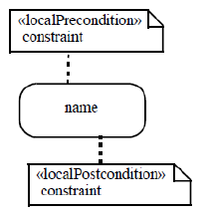

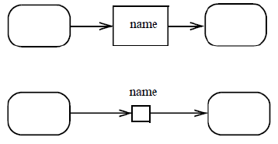
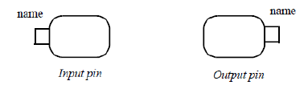
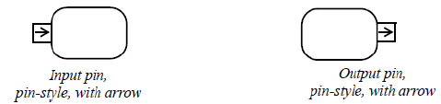
Notation
*

Slide 18

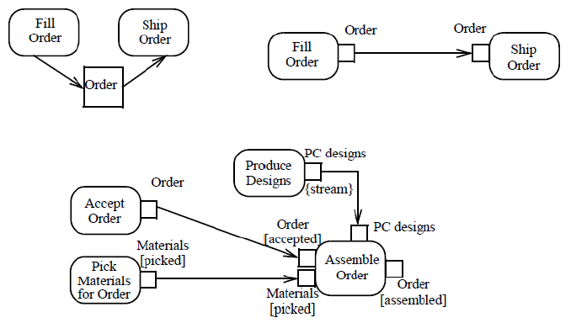
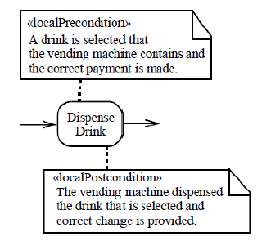
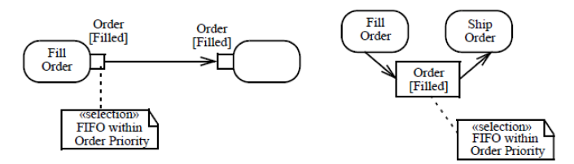
Examples

Slide 19
Invocation Actions
An InvocationAction is an Action that results, directly or indirectly, in the invocation of a Behavior
InvocationActions include the CallActions for calling Operations or Behaviors and for starting Behaviors that have been previously instantiated
Additional kinds of InvocationActions allow for the sending of signals and other objects and the ability for broadcasting signals to available receivers
*

Slide 20
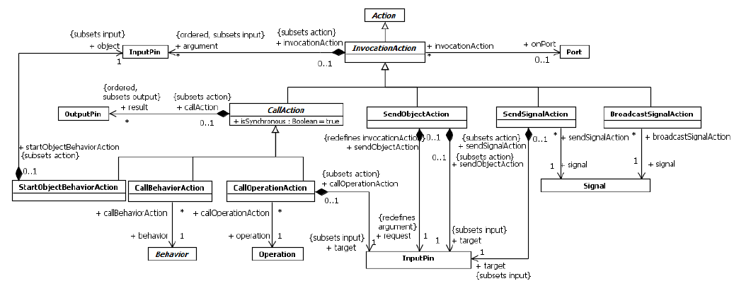
Invocation Actions
*

Slide 21
Invocation Actions
A CallAction is an InvocationAction that calls a Behavior or an Operation.
A CallBehaviorAction is a CallAction that invokes a Behavior directly
A CallOperationAction is a CallAction that transmits an Operation call request message to the target object, where it may cause the invocation of an associated Behavior
A CallAction may result in either a synchronous or asynchronous Behavior invocation, either directly or through an Operation call.
If the call is synchronous (isSynchronous=true), then the execution of the Action does not complete until the execution of the invoked Behavior completes, normally or otherwise
If the call is asynchronous (isSynchronous=false), then the execution of the Action completes as soon as the Behavior has been invoked. When an asynchronous call is complete, execution of the Behavior containing the CallAction proceeds independently of and concurrently with the execution of the invoked Behavior.
*

Slide 22
Invocation Actions
If the Behavior invoked by a CallAction is not reentrant, then no more than one execution of it shall exist at any given time
The type, ordering, and multiplicity of the argument and result pins of a CallAction shall be the same as the corresponding Parameters
When a CallAction executes, it passes the values on its argument Pins to the invoked Behavior or Operation on the corresponding input Parameters. If the call is synchronous, then values returned on output Parameters are placed in tokens on the corresponding result Pins of the CallAction. If an output Parameter has no values, then a null token is placed on the corresponding result Pin. If the call is asynchronous, then result values cannot be returned.
*

Slide 23
Invocation Actions
If any of the Parameters are streaming (isStreaming=true), then the call must be synchronous
the CallAction continues to accept tokens offered to the argument Pins corresponding to streaming input Parameters, up to the upper multiplicity of each Pin, which are consumed by the Action and posted to the executing Behavior as they arrive
Following rules also apply to a CallAction invoking a Behavior or Operation with streaming Parameters:
All InputPins for the CallAction shall have been offered a number of values equal to or greater than the lower multiplicity of each Pin before the CallAction can execute, per the usual rules.
A number of values equal to or greater than the lower multiplicity of each argument Pin of the CallAction corresponding to a streaming Parameter must be accepted before the CallAction can complete execution normally
Before an invoked Behavior execution completes normally, a number of values equal to at least the lower multiplicity of each result Pin of the CallAction shall be posted by the time the execution completes
*

Slide 24
Send Actions
A send Action is an action that transmits an object asynchronously to one or more target objects. As a send Action is always asynchronous, it may have argument inputs, but it has no result outputs. The Action completes as soon as the object is sent, whether or not it has been received yet
A SendSignalAction is an InvocationAction that creates a Signal instance and transmits the instance to the object given on its target InputPin.
BroadcastSignalAction is an InvocationAction that creates a Signal instance using values from its argument InputPins, similarly to a SendSignalAction. However, instead of sending the Signal instance to a single target object, it transmits the instance potentially to all available target objects in the system
A SendObjectAction is an Invocation action that transmits any kind of object to the object given on its target InputPin. The object to be transmitted is given on the single request InputPin of the SendObjectAction
*

Slide 25
Invocation Actions and Ports
A CallOperationAction, SendSignalAction, or SendObjectAction may send a request through a Port by targeting an object having the Port and identifying the Port with the Action’s onPort attribute.
If onPort is given, then the Port shall be an owned or inherited feature of the type of the target InputPin of the Action. When the Action executes, rather than sending a message to the target object itself, it sends the message through the given Port of the target object.
An Action is said to execute inside an object if the context object of the Behavior execution within which the Action is executing is either the same as or is directly or indirectly owned by the given object.
In the case of a CallOperationAction, a provided or required Interface of the given Port shall have the called Operation as a feature
*

Slide 26
Invocation Actions and Ports
If the invoked BehavioralFeature is on a provided Interface but not on any required Interface, then, when the InvocationAction is executed, the invocation is made into the object given on the target InputPin through the given Port
If the invoked BehavioralFeature is on a required Interface but not on any provided Interface, then, if the InvocationAction is being executed inside the object given on the target InputPin, the invocation is forwarded out of the target object through the given Port
*

Slide 27



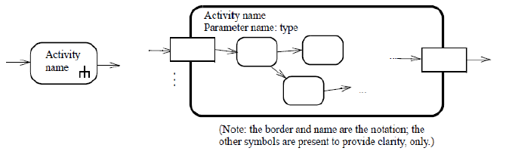

Notation
*

Slide 28

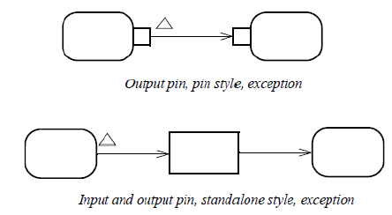




Notation
*

Slide 29
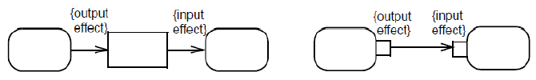

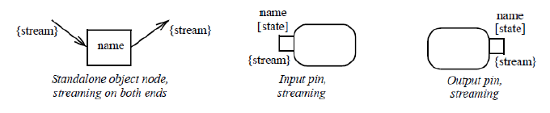
Notation
*

Slide 30
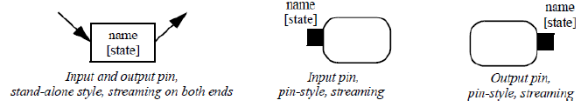
Notation
*

Slide 31



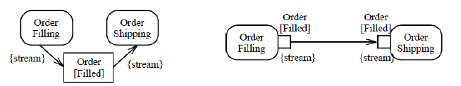
Examples
*

Slide 32
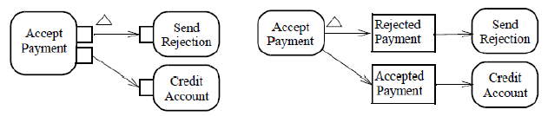
Examples
*

Slide 33
Accept Event Action
An AcceptEventAction waits for the occurrence of one or more Events. If an accepted Event occurrence is for a CallEvent, then a ReplyAction may be used to reply to it. If an accepted Event occurrence is for a SignalEvent, then the received Signal instance may either be unmarshalled immediately into its attribute values
AcceptEventAction is an Action with Triggers for one or more Events
When an AcceptEventAction is executed, it waits for an Event occurrence to be dispatched from the event pool of the context object for its execution that matches one of its Triggers
The context object for an AcceptEventAction is the context object of the Behavior execution within which the AcceptEventAction is executing
*

Slide 34
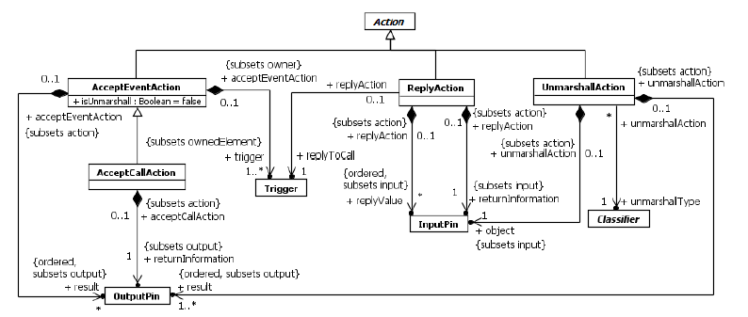
*

Slide 35
Accept Event Action
An AcceptEventAction is a wait point in the sense the AcceptEventAction waits, rather than the whole Activity (Activities can have other Actions executing while AcceptEventActions are waiting).
If a matching Event occurrence for an AcceptEventAction is dispatched from the event pool, then the AcceptEventAction is enabled to continue. However, if the containing Behavior execution has more than one waiting Trigger that matches the Event occurrence, only one of them will be selected to actually trigger.
An AcceptEventAction with a trigger for a SignalEvent is informally called an accept signal action.
*

Slide 36
Accept Event Action
If an accept signal action has isUnmarshall=false, then it must have a single result OutputPin on which the Signal instance associated with an accepted SignalEvent occurrence is placed. If it has isUnmarshall=true, then it must have result OutputPins corresponding to each of the attributes of the Signal of the SignalEvent (in order), and the attribute values of the Signal instance associated with an accepted SignalEvent occurrence are placed on these OutputPins.
An AcceptEventAction with a trigger for a TimeEvent is informally called a wait time action. A wait time action must have a single result OutputPin. When it accepts a TimeEvent occurrence, then the time value of when the occurrence transpired is placed on the result OutputPin
If the triggers of an AcceptEventAction are all for ChangeEvents and/or CallEvents, then the AcceptEventAction has no result OutputPins
*

Slide 37
Accept Event Action
If one of the triggers of an AcceptEventAction is an AnyReceiveEvent, and the Event occurrence is for a message that is not matched by a SignalEvent or CallEvent trigger on the same AcceptEventAction, then the Event occurrence matches the trigger for the AnyReceiveEvent
If the AcceptEventAction has no incoming edges, by the usual rules, it is enabled when its immediately containing Activity (or StructuredActivityNode) begins execution.
An AcceptEventAction with no incoming edges remains enabled after it accepts an Event occurrence. That is, it does not terminate after accepting an Event occurrence and outputting any values (as described above), but continues to wait for another Event occurrence. Such an AcceptEventAction is terminated when its immediately containing Activity (or StructuredActivityNode) is terminated.
*

Slide 38

Notation
*

Slide 39



Examples
*

Slide 40
Activities

Slide 41
Activities
An Activity is a kind of Behavior that is specified as a graph of nodes interconnected by edges.
executable nodes embody lower-level steps in the overall Activity
Object nodes hold data that is input to and output from executable nodes, and moves across object flow edges
Control nodes specify sequencing of executable nodes via control flow edges.
Activities are essentially what are commonly called “control and data flow” models
Such models of computation are inherently concurrent
An Activity is a Behavior specified as sequencing of subordinate units, using a control and data flow model
*

Slide 42
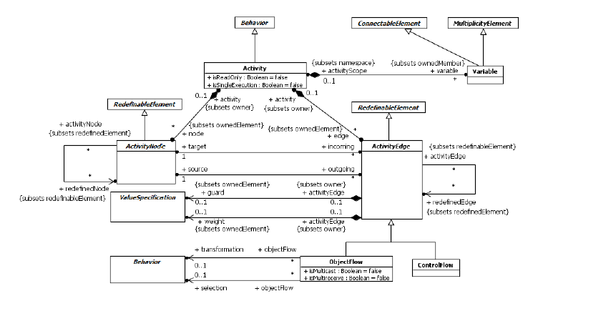
Activities
*

Slide 43
Activities
Subordinate behaviors coordinated by these models may be initiated because other behaviors in the model finish executing, because objects and data become available or because events occur externally to the flow
An ExecutableNode can be the execution of a subordinate behavior, such as an arithmetic computation, a call to an operation, or manipulation of object contents
ActivityNodes also include flow-of-control constructs, such as synchronization, decision, and concurrency control
*

Slide 44
Activities
Effect of one ActivityNode on another is specified by the flow of tokens over the ActivityEdges between the ActivityNodes
An object token is a container for a value that flows over ObjectFlow edges
An object token with no value in it is called a null token
A control token affects execution of ActivityNodes, but does not carry any data, and flows only over ControlFlow edges
ActivityEdges are directed, with tokens flowing from the source ActivityNode to the target ActivityNode
However, tokens offered to an ActivityEdge by the source ActivityNode may not immediately flow along the edge. Instead, the tokens only move when the offer is accepted by the ActivityEdge, which requires at least the target ActivityNode to accept them also, which in turn might depend on acceptance of cascading offers of the same tokens to edges and nodes further downstream of the target
*

Slide 45
Activities
Object tokens shall only be accepted by ObjectNodes
Control tokens shall only be accepted by ExecutableNodes
ControlNodes are used to control the routing of offers through a network of ActivityEdges, controlling the flow of accepted tokens.
Activities are Classes ; and may support Properties
.
*

Slide 46
Activity Nodes
ActivityNodes are used to model the individual steps in the behavior specified by an Activity.
An ActivityNode is enabled to begin execution when specified conditions are satisfied on the tokens offered to it on incoming ActivityEdges
When an ActivityNode begins execution, tokens are accepted from some or all of its incoming ActivityEdges and a token is placed on the node
When a node completes execution, a token is removed from the node and tokens are offered to some or all of its outgoing ActivityEdges
If two ActivityNodes are not ordered by ActivityEdge relationships, they may execute concurrently
An ActivityNode may be the source for multiple ActivityEdges, the same token can be offered to multiple targets
.
*

Slide 47
Activity Nodes
The same token can only be accepted at one target at a time
If a token is offered to multiple ActivityNodes at the same time, it shall be accepted by at most one of them
There are three kinds of ActivityNodes :
ControlNodes act as “traffic switches” managing the flow of tokens across ActivityEdges. Tokens cannot “rest” at ControlNodes (with exceptions for InitialNodes and ForkNodes).
ObjectNodes hold object tokens accepted from incoming ObjectFlows and may subsequently offer them to outgoing ObjectFlows (with a modeler-specified exception for ControlFlows).
ExecutableNodes* actually carry out the desired behavior of an Activity. If an ExecutableNode has incoming ControlFlows, then there must be tokens offered on all these flows that it accepts before beginning execution. While executing, an ExecutableNode is considered to hold a single control token indicating it is executing. When it completes execution, it offers control tokens on all outgoing ControlFlows. All incoming and outgoing ActivityEdges of an ExecutableNode must be ControlFlows.
* Actions, which are the only kind of ExecutableNode, use special attached ObjectNodes called Pins to accept input and produce output object tokens
*

Slide 48
Activity Edges
An ActivityEdge is a directed connection between two ActivityNodes along which tokens may flow, from the source ActivityNode to the target ActivityNode.
Tokens are offered to an ActivityEdge by the source ActivityNode of the edge.
Offers propagate through ActivityEdges and ControlNodes, until they reach an ObjectNode (for object tokens) or an ExecutableNode
Each kind of ObjectNode and ExecutableNode has rules for when offered tokens may be accepted ; If an ObjectNode or ExecutableNode accepts an offered token, then that token flows from its original offering ActivityNode to the accepting ActivityNode
An ActivityEdge may have a guard, which is a ValueSpecification that is evaluated for each token offered to the edge. An offer shall only pass along an ActivityEdge if the guard for the edge evaluates to true for the offered token. An ActivityEdge without a guard is equivalent to one with a guard that evaluates to true for every token.
*

Slide 49
Activity Edges
Any number of tokens can pass along an ActivityEdge, in groups at one time, or individually at different times
The weight property dictates the minimum number of tokens that must traverse the edge at the same time. It is a ValueSpecification that is evaluated every time a new token is offered by the source ActivityNode. It must evaluate to a positive LiteralUnlimitedNatural and may be a constant. Once the minimum number of tokens are offered, all the tokens offered by the source are offered to the target all at once. The minimum number of tokens must then be accepted before any tokens shall traverse the edge. If the ActivityEdge has a guard, the guard must evaluate to true for each token offered to the edge that counts towards the minimum. If the guard fails for any of the tokens, and this reduces the number of tokens that can be offered to the target to less than the weight, then all the tokens fail to be offered. An unlimited weight means that all the tokens offered by the source must be accepted before any of them shall traverse the edge. If a weight is not specified for an ActivityEdge, this is equivalent to specifying a weight of 1.
*

Slide 50
Activity Edges
Two kinds of ActivityEdges :
A ControlFlow is an ActivityEdge that only passes control tokens. ControlFlows are used to explicitly sequence execution of ActivityNodes, as the target ActivityNode cannot receive a control token and start execution until the source ActivityNode completes execution and produces the token.
An ObjectFlow is an ActivityEdge that can have object tokens passing along it. ObjectFlows model the flow of values between ObjectNodes. Tokens are offered to the target ActivityNode in the same order as they are offered from the source
*

Slide 51
Object Flows
Object tokens pass over ObjectFlows, carrying data through an Activity via their values, or carrying no data
A null token can still be passed along an ObjectFlow and used like any other token
An ObjectFlow may have a transformation Behavior that has a single input Parameter and a single output Parameter ; If a transformation Behavior is specified, then the Behavior is invoked for each object token offered to the ObjectFlow, with the value in the token passed to the Behavior as input (for a null token, the behavior is invoked but no value is passed). The output of the Behavior is put in an object token that is offered to the target ActivityNode instead of the original object token
An ObjectFlow may have a selection Behavior that has a single input Parameter and a single output Parameter; Whenever a new token is offered to the ObjectFlow, or an offer is withdrawn, the selection Behavior is invoked with the values from all the object tokens currently being offered to the ObjectFlow passed to the Behavior input Parameter. The selection Behavior should then select one of the input values and produce it as output. This output value is put in an object token and passed to the target ActivityNode.
*

Slide 52
Variables
ObjectFlows provide the primary means for moving data within an Activity.
Variables provide an alternate means for passing data indirectly.
There are Actions to write values to Variables and to subsequently read values from those Variables. The Variables of an Activity are ownedMembers of the Activity considered as a Namespace, but they are local to the Activity and are not visible outside it.
*

Slide 53
Activity Execution
An Activity may have precondition and postcondition Constraints, as inherited from Behavior
As a Behavior, an Activity may have Parameters For each such Parameter, the Activity has a corresponding ActivityParameterNode (two in the case of an inout Parameter, one for input and one for output).
An ActivityParameterNode is an ObjectNode that makes Parameter values accessible within the Activity ; When an Activity is invoked, any values passed to its input Parameters are put in object tokens and placed on the corresponding input ActivityParameterNodes for the Activity
ActivityParameterNodes then offer their tokens to outgoing ActivityEdges
When an Activity is first invoked, none of its nodes other than input ActivityParameterNodes will initially hold any tokens. However, nodes that do not have incoming edges and require no input data to execute are immediately enabled. A single control token is placed on each enabled node and they begin executing concurrently. Such nodes include ExecutableNodes with no incoming ControlFlows and no mandatory input data and InitialNodes
*

Slide 54
Activity Execution
On each subsequent invocation of the Activity, the isSingleExecution property indicates whether the same execution of the Activity handles tokens for all invocations, or a separate execution of the Activity is created for each invocation
If a single execution of the Activity is used for all invocations, the modeler must consider the interactions between the multiple streams of tokens moving through the ActivityNodes and ActivityEdges. Tokens may reach bottlenecks waiting for other tokens ahead of them to move downstream, they may overtake each other due to variations in the execution time of invoked behaviors, and most importantly, may abort each other with constructs such as ActivityFinalNodes
If a separate execution of the Activity is used for each invocation (this is the default), tokens from the various invocations do not interact.
However, if an Activity has streaming Parameters, then additional tokens may flow into and out of the Activity (via the corresponding ActivityParameterNodes) even during the course of a single execution
*

Slide 55
Activity Execution
The execution of an Activity with no streaming Parameters completes when it has no nodes executing and no nodes enabled for execution, or when it is explicitly terminated using an ActivityFinalNode
The execution of an Activity with streaming input Parameters shall not terminate until the cumulative number of values posted to each of those input Parameters (by the invoker of the Activity) is at least equal to the Parameter multiplicity lower bound. The execution of an Activity with streaming output Parameters shall not terminate until the cumulative number of values posted to each of those output Parameters (by the Activity itself) is at least equal to the Parameter multiplicity lower bound.
When the execution of an Activity completes, all ActivityParameterNodes corresponding to non-streaming output Parameters shall hold at least as many non-null object tokens as given by the corresponding Parameter multiplicity lower bound.
An output Parameter may also be identified as an exception Parameter by having isException=true. An output posted to an exception Parameter precludes outputs from being posted to other output Parameters of a Behavior. If an object token arrives at an output ActivityParameterNode associated with an exception Parameter, then the execution of the Activity is immediately terminated.
*

Slide 56
Activity Execution
The value on the token is then passed to the exception Parameter as usual, but any tokens on other output ActivityParameterNodes associated with non-streaming Parameters are lost and their values are not passed to the associated Parameters. Values posted to streaming output Parameters before the termination of the Activity are not affected.
Use exception Parameters on Activities only if it is desired to abort all flows in the Activity. Arrange for separate invocations of the Activity to use separate executions of the Activity (i.e., isSingleExecution=false) when employing exception Parameters, so flows from separate executions will not affect each other.
*

Slide 57
Activity Generalization
An Activity is a Classifier and, as such, may participate in Generalization relationships
A specialized Activity inherits the nodes and edges of its general Activities.
The effective sets of nodes and edges used in executing a specialized Activity consists of the unions of the inherited nodes and edges (which do not include redefined nodes and edges) and any additional nodes and edges defined in the specialized Activity (including any redefining nodes and edges). The execution of the specialized Activity then proceeds as usual, but using a graph of nodes and edges constructed from the union sets.
*

Slide 58
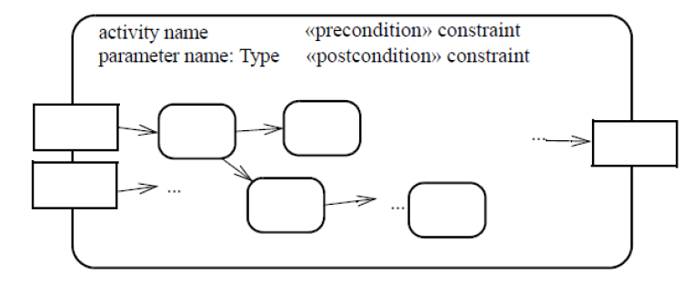

Notation
*

Slide 59
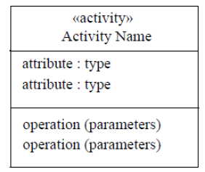

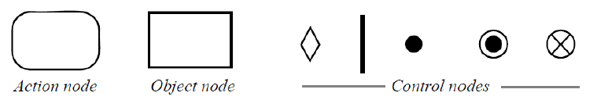

Notation
*

Slide 60
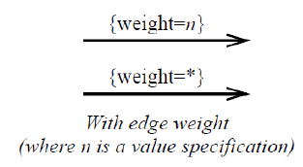
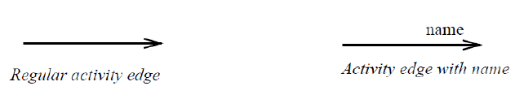
Notation
*

Slide 61
Notation
*

Slide 62
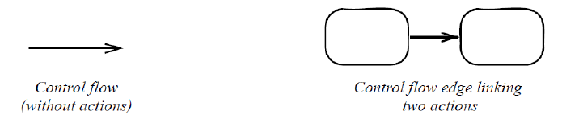

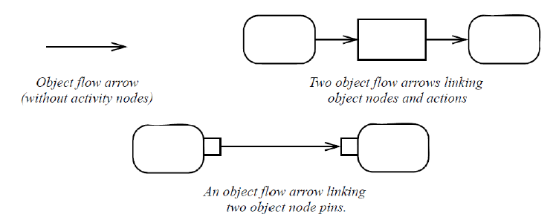

Notation

Slide 63
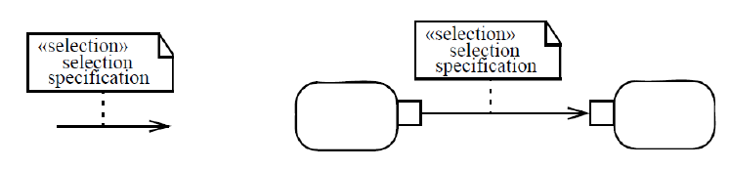
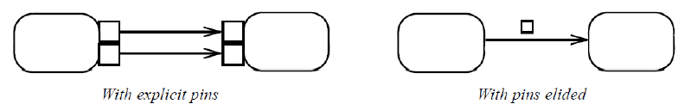

Notation

Slide 64
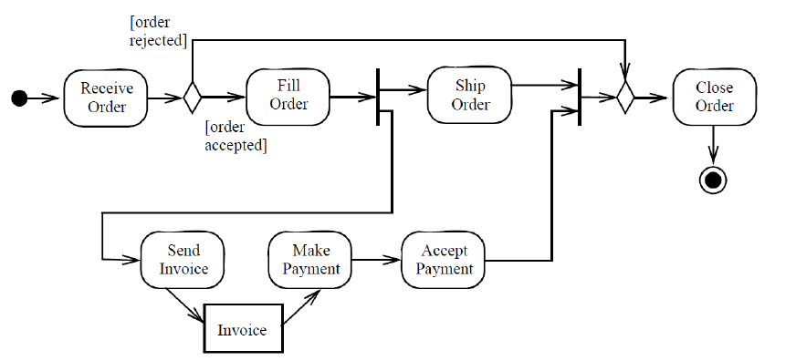

Examples

Slide 65
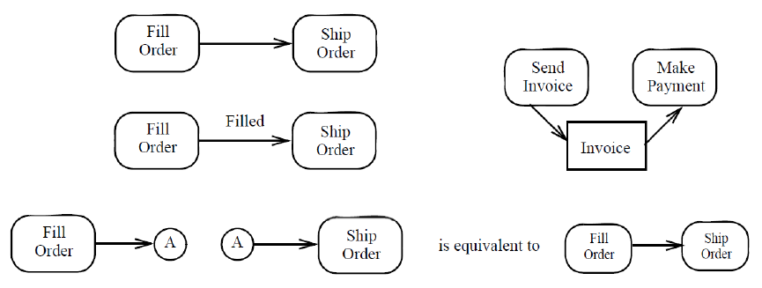

Examples

Slide 66


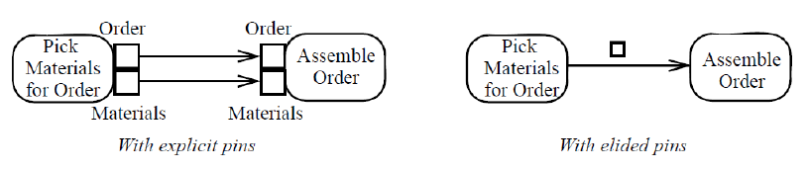
Examples

Slide 67
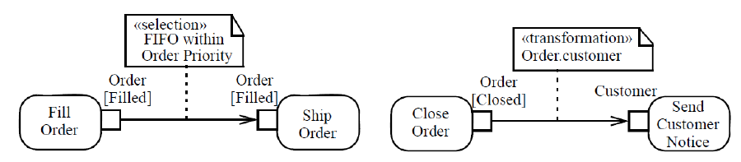
Examples

Slide 68
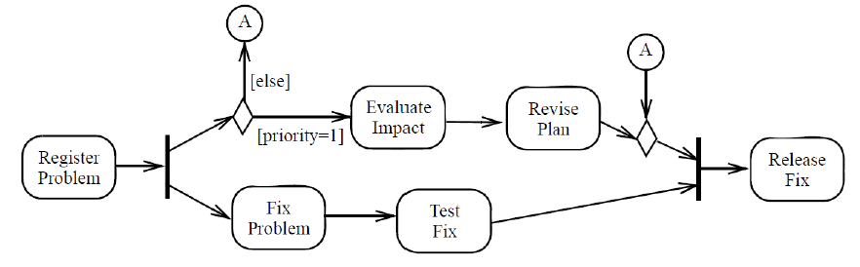

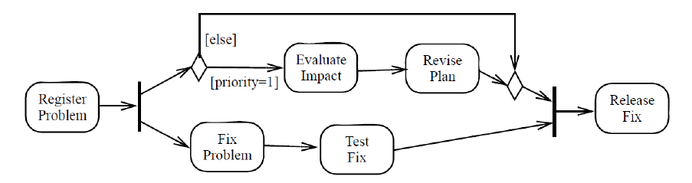
Examples

Slide 69
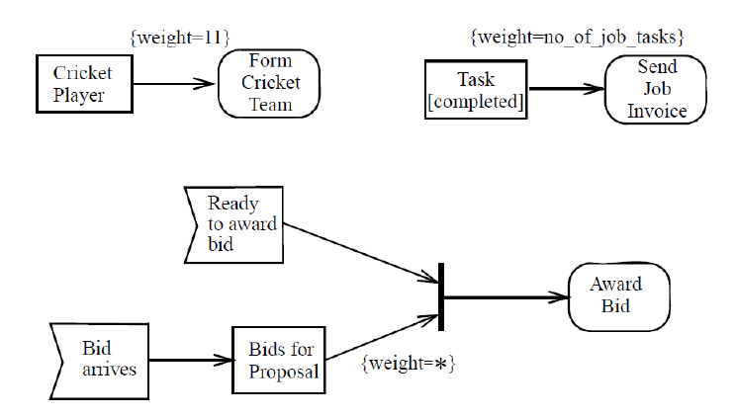

Examples

Slide 70
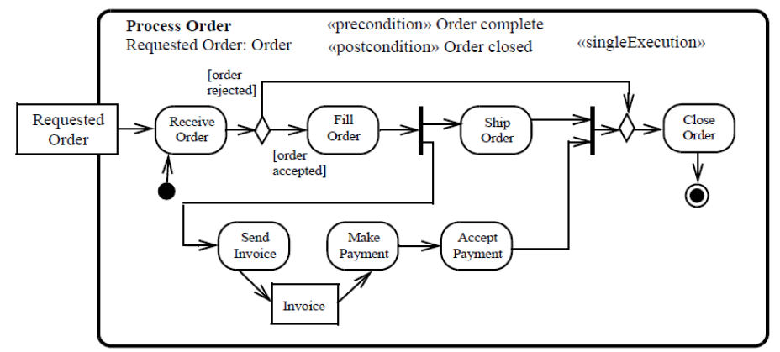
Examples

Slide 71
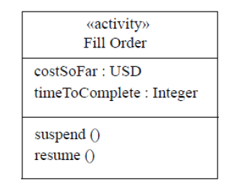
Examples

Slide 72
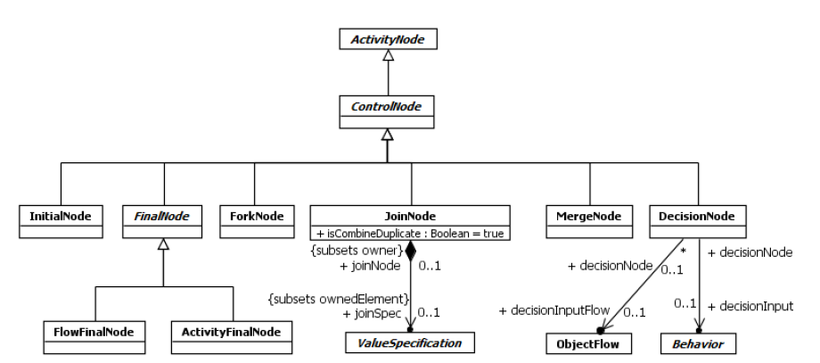
Control Nodes
A ControlNode is a kind of ActivityNode used to manage the flow of tokens between other nodes in an Activity.
*

Slide 73
Initial Node
An InitialNode is a ControlNode that acts as a starting point for executing an Activity
An Activity may have more than one InitialNode
If an Activity has more than one InitialNode, then invoking the Activity starts multiple concurrent control flows, one for each InitialNode; Additional concurrent flows may begin at input ActivityParameterNodes and enabled ExecutableNodes
An InitialNode shall not have any incoming ActivityEdges, which means the InitialNodes owned by an Activity will always be enabled when the Activity begins execution and a single control token is placed on each such InitialNode when Activity execution starts
The outgoing ActivityEdges of an InitialNode must all be ControlFlows; The control token placed on an InitialNode is offered concurrently on all outgoing ControlFlows
InitialNodes are an exception to the rule that ControlNodes cannot “hold” tokens, but only manage their flow. If the token offered by an InitialNode is not immediately accepted, or is otherwise blocked from moving downstream, then it remains on the InitialNode
*

Slide 74
Final Node
A FinalNode is a ControlNode at which a flow in an Activity stops
A FinalNode shall not have outgoing ActivityEdges
A FinalNode accepts all tokens offered to it on its incoming ActivityEdges
There are two kinds of FinalNode :
A FlowFinalNode is a FinalNode that terminates a flow. All tokens accepted by a FlowFinalNode are destroyed. This has no effect on other flows in the Activity
An ActivityFinalNode is a FinalNode that stops all flows in an Activity. A token reaching an ActivityFinalNode owned by an Activity terminates the execution of that Activity. If an Activity owns more than one ActivityFinalNode, then the first one to accept a token (if any) terminates the execution of the Activity, including the execution of any other ActivityFinalNodes. The termination of Activity execution shall destroy all tokens held in any ObjectNodes other than output ActivityParameterNodes and shall terminate the execution of any behaviors synchronously called from the Activity.
*

Slide 75
Activity Final Node
A FinalNode is a ControlNode at which a flow in an Activity stops
A FinalNode shall not have outgoing ActivityEdges
A FinalNode accepts all tokens offered to it on its incoming ActivityEdges
There are two kinds of FinalNode :
A FlowFinalNode is a FinalNode that terminates a flow. All tokens accepted by a FlowFinalNode are destroyed. This has no effect on other flows in the Activity
An ActivityFinalNode is a FinalNode that stops all flows in an Activity. A token reaching an ActivityFinalNode owned by an Activity terminates the execution of that Activity.
If an Activity owns more than one ActivityFinalNode, then the first one to accept a token (if any) terminates the execution of the Activity, including the execution of any other ActivityFinalNodes. The termination of Activity execution shall destroy all tokens held in any ObjectNodes other than output ActivityParameterNodes and shall terminate the execution of any behaviors synchronously called from the Activity. However, the execution of Behaviors invoked asynchronously from the Activity shall not be affected
* If it is not desired to abort all flows in an Activity, use a FlowFinalNode, not an ActivityFinalNode.
Using a FlowFinalNode will simply consume the tokens reaching it without aborting other flows
*

Slide 76
Fork Nodes
A ForkNode is a ControlNode that splits a flow into multiple concurrent flows
A ForkNode shall have exactly one incoming ActivityEdge, though it may have multiple outgoing ActivityEdges
If the incoming edge is a ControlFlow, then all outgoing edges shall be ControlFlows and, if the incoming edge is an ObjectFlow, then all outgoing edges shall be ObjectFlows
Tokens offered to a ForkNode are offered to all outgoing ActivityEdges of the node
If at least one of these offers is accepted, the offered tokens are removed from their original source and the acceptor receives a copy of the tokens
Any other offer that was not accepted on an outgoing edge due to the failure of the target to accept it remains pending from that edge and may be accepted by the target at a later time.
These edges effectively accept separate copies of the offered tokens, and offers made to the edges shall stand to their targets in the order in which they were accepted by the edge (first in, first out). This is an exception to the rule that ActivityEdges cannot “hold” tokens if they are blocked from moving downstream. The ActivityEdges going out of ForkNodes continue to hold the tokens they accept until all pending offers have been accepted by their targets.
Any outgoing ActivityEdges that fail to accept an offer due to the failure of their guard, rather than their target, shall not receive copies of those tokens
*

Slide 77
Join Nodes
A JoinNode is a ControlNode that synchronizes multiple flows
A JoinNode shall have exactly one outgoing ActivityEdge but may have multiple incoming ActivityEdges
If any of the incoming edges of a JoinNode are ObjectFlows, the outgoing edge shall be an ObjectFlow. Otherwise the outgoing edge shall be a ControlFlow
Join nodes may have a joinSpec, which is a ValueSpecification that determines the condition under which the join will emit a token. If a JoinNode has a joinSpec, then this ValueSpecification is evaluated whenever a new token is offered to the JoinNode on any incoming ActivityEdge
If a JoinNode does not have a joinSpec, then this is equivalent to a joinSpec Expression with the Boolean operator “and.” That is, the implicit default joinSpec condition is that there is at least one token offered on each incoming ActivityEdge.
*

Slide 78
Join Nodes
If the (implicit or explicit) joinSpec of a JoinNode evaluates to true, then tokens are offered on the outgoing ActivityEdge of the JoinNode according to the following rules:
If all the tokens offered on the incoming edges are control tokens, then one control token is offered on the outgoing edge.
If some of the tokens offered on the incoming edges are control tokens and others are object tokens, then only the object tokens are offered on the outgoing edge. Tokens are offered on the outgoing edge in the same order they were offered to the join. If isCombinedDuplicate is true for the JoinNode, then before object tokens are offered to the outgoing edge, those containing objects with the same identity are combined into one token.
If any tokens are offered to the outgoing ActivityEdge of a JoinNode, they shall be accepted by the target or rejected for traversal over the edge (e.g., due to a failed guard) before any more tokens are offered to the outgoing edge.
*

Slide 79
Merge Nodes
A MergeNode is a control node that brings together multiple flows without synchronization.
A MergeNode shall have exactly one outgoing ActivityEdge but may have multiple incoming ActivityEdges. If the outgoing edge of a MergeNode is a ControlFlow, then all incoming edges must be ControlFlows, and, if the outgoing edge is an ObjectFlow, then all incoming edges must be ObjectFlows.
All tokens offered on the incoming edges of a MergeNode are offered to the outgoing edge
There is no synchronization of flows or joining of tokens.
*

Slide 80
Decision Nodes
A DecisionNode is a ControlNode that chooses between outgoing flows.
A DecisionNode shall have at least one and at most two incoming ActivityEdges, and at least one outgoing ActivityEdge.
If it has two incoming edges, then one shall be identified as the decisionInputFlow, the other being called the primary incoming edge.
If the DecisionNode has only one incoming edge, then it is the primary incoming edge.
If the primary incoming edge of a DecisionNode is a ControlFlow, then all outgoing edges shall be ControlFlows and, if the primary incoming edge is an ObjectFlow, then all outgoing edges shall be ObjectFlows.
A DecisionNode accepts tokens on its primary incoming edge and offers them to all its outgoing edges. However, each token offered on the primary incoming edge shall traverse at most one outgoing edge. Tokens are not duplicated.
*

Slide 81
Decision Nodes
If any of the outgoing edges of a DecisionNode have guards, then these are evaluated for each incoming token. The order in which guards are evaluated is not defined and may be evaluated concurrently.
If the primary incoming edge of a DecisionNode is an ObjectFlow, and the DecisionNode does not have a decisionInput or decisionInputFlow, then the value contained in an incoming object token may be used in the evaluation of the guards on outgoing ObjectFlows
If a DecisionNode has a decisionInputFlow, then a token must be offered on both the primary incoming edge and the decisionInputFlow before the token from the primary incoming edge is offered to the outgoing edges.
If the DecisionNode does not have a decisionInput, then the value contained in the object token on the decisionInputFlow is made available to the guards on each outgoing edge, regardless of whether the primary incoming flow is a ControlFlow or an ObjectFlow
If a DecisionNode has a decisionInput, then this must be a Behavior with a return Parameter and no other output Parameters This Behavior is invoked for each incoming (control or object) token, and the result returned from the Behavior is available in the evaluation of the guards on outgoing edges.
*

Slide 82
Decision Nodes
If the primary incoming edge of a DecisionNode is a ControlFlow, and the DecisionNode has a decisionInput but not a decisionInputFlow, then the decisionInput shall have no input Parameters. However, if the DecisionNode has both a decisionInput and a decisionInputFlow, then the decisionInput shall have a single in Parameter, and the value contained in the object token offered on the decisionInputFlow shall be passed via this Parameter when the Behavior is invoked
If the primary incoming edge of a DecisionNode is an ObjectFlow, and the DecisionNode has a decisionInput but not a decisionInputFlow, then the decisionInput shall have an in Parameter and the value contained in an object token offered on the primary incoming edge is passed via this Parameter when the Behavior is invoked for the token. However, if the DecisionNode has both a decisionInputFlow and a decisionInput, then the decisionInput shall have two in Parameters, with the value contained in the object token offered on the primary incoming edge passed via the first Parameter and the value contained in the object token offered on the decisionInputFlow passed via the second Parameter when the Behavior is invoked
*

Slide 83
Decision Nodes
A token offered on the primary incoming edge of a DecisionNode shall not traverse any outgoing edge for which the guard evaluates to false. If there are multiple outgoing edges that either have no guard or that have a guard that evaluates to true, then the incoming token shall traverse at most one of these edges. If exactly one target of an unblocked outgoing edge accepts the token, then the token traverses the corresponding edge and all other offers are withdrawn. If multiple targets accept the token simultaneously, then the token traverses only one of the edges corresponding to the accepting targets, but which one is not determined by this specification.
In order to avoid non-deterministic behavior, the modeler should arrange that at most one guard evaluate to true for each incoming token.
For use only with DecisionNodes, a predefined guard “else” (represented as an Expression with “else” as its operator and no operands) may be used for at most one outgoing edge. This guard evaluates to true only if the token is not accepted by any other outgoing edge from the DecisionNode
*

Slide 84

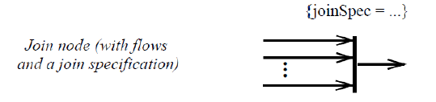



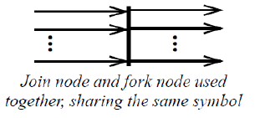
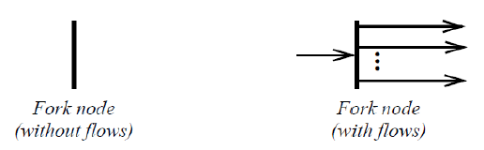

Notation
*

Slide 85
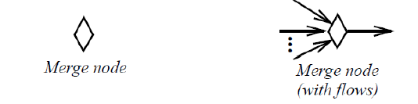

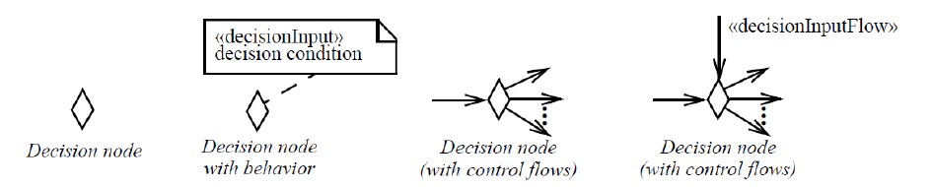

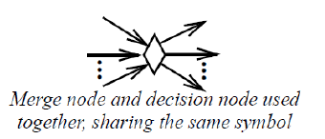
Notation

Slide 86
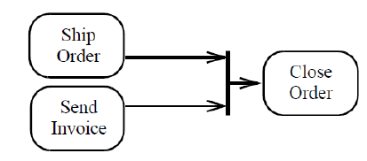
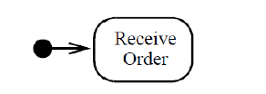


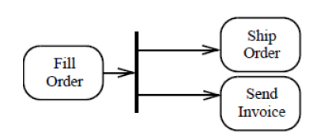
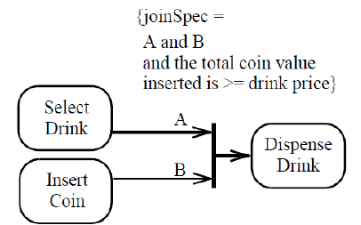


Examples

Slide 87
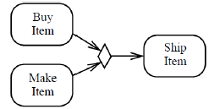
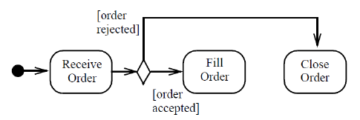


Examples

Slide 88


Examples

Slide 89




Examples

Slide 90

Examples

Slide 91

Examples

Slide 92

Object Nodes
An ObjectNode is a kind of ActivityNode used to hold value-containing object tokens during the course of the execution of an Activity
Three concrete kinds of ObjectNodes :
ActivityParameterNodes, CentralBufferNodes and DataStoreNodes
*

Slide 93
Object Nodes
An ObjectNode holds object tokens during the course of the execution of an Activity
A token may traverse only one of the outgoing edges
An ObjectNode may contain multiple object tokens with the same value
ObjectNodes are TypedElements. If an ObjectNode has a type specified, then any object tokens held by the ObjectNode shall have values that conform to the type of the ObjectNode. If no type is specified, then the values may be of any type
An ObjectNode may not contain more tokens than specified by its upperBound, if any . The upperBound is evaluated each time a token is offered to or removed from the ObjectNode. If the number of tokens already held by the ObjectNode is greater than or equal to the evaluated upperBound, then the ObjectNode shall not accept any further tokens until some of the ones it is holding are removed.
The ordering of an ObjectNode specifies the order in which tokens held by the node are offered to its outgoing ActivityEdges :
unordered – The order in which tokens held by the ObjectNode are offered to outgoing edges is not defined
FIFO – Tokens held by the ObjectNode are offered to outgoing edges in the order in which they were accepted by the ObjectNode (i.e., “First In First Out”)
LIFO – Tokens held by the ObjectNode are offered to outgoing edges in the reverse order to which they were accepted by the ObjectNode (i.e., “Last In First Out”).
ordered – The ordering is modeler-defined using a selection Behavior
*

Slide 94
Object Nodes
An ObjectNode shall have a selection Behavior if and only if ordering=ordered. The selection Behavior of an ObjectNode is executed whenever a token is to be offered to the outgoing edges of the node. The values contained in all the object tokens held by the Object Node are passed as input to the Behavior invocation. The Behavior should choose one of these values and return it. An object token containing this value is then offered to the outgoing edges of the ObjectNode.
If isControlType=true for an ObjectNode, ControlFlows may be incoming to and outgoing from the ObjectNode, objects tokens can come into or go out of the ObjectNode along ControlFlows, and these tokens can flow along ControlFlows reached downstream of the ObjectNode
*

Slide 95
Object Nodes
An Activity may have Parameters
When the Activity is invoked, values may be passed into the Activity execution on input Parameters (i.e., those with direction in or inout) and values may be passed out of the Activity execution on output Parameters (i.e., those with direction inout, out or return).
Within an Activity, inputs to and outputs from an Activity are handled using ActivityParameterNodes
An ActivityParameterNode shall have either all incoming or all outgoing ActivityEdges. An ActivityParameterNode with outgoing edges is an input ActivityParameterNode, while an ActivityParameterNode with incoming edges is an output ActivityParameterNode.
An Activity shall have one ActivityParameterNode corresponding to each in, out, or return Parameter and two ActivityParameterNodes for each inout Parameter.
*

Slide 96
Object Nodes
If an input ActivityParameterNode is associated with a non-streaming Parameter, then, when the containing Activity is invoked, any values passed on that Parameter are wrapped in object tokens and placed on the ActivityParameterNode at the start of the Activity execution
If an output ActivityParameterNode is associated with a non-streaming Parameter, then, when the execution of the containing Activity completes, the values contained in the object tokens held by the ActivityParameterNode are passed out of the execution on the Parameter
If an input ActivityParameterNode is associated with a streaming Parameter, then, whenever a new value is posted to the Parameter, that value is wrapped in an object token, placed on the ActivityParameterNode and offered to all outgoing edges. If an output ActivityParameterNode is associated with a streaming Parameter, then, whenever a new object token is accepted by the ActivityParameterNode, the token is immediately removed from the ActivityParameterNode and the value it contains is immediately posted to the Parameter
*

Slide 97
Object Nodes
A CentralBufferNode acts as a buffer between incoming ObjectFlows and outgoing ObjectFlows. It accepts all object tokens offered to it on all incoming flows, which are then held by the node. Held object tokens are offered to outgoing flows according to the general ordering rules for ObjectNodes. When an offer for a token is accepted by a downstream object node, that token is removed from the CentralBufferNode and moved to the accepting object node, as for any object node.
A DataStoreNode is a CentralBufferNode that holds its object tokens persistently while its activity is executing. When an offer for an object token held by a DataStoreNode is accepted by a downstream object node, the offered token is removed from the DataStoreNode, per the usual CentralBufferNode semantics. However, a copy is made of the removed object token, with the same value, and this is immediately placed back onto the DataStoreNode. Thus, the values held by a DataStoreNode appear to persist for the duration of each execution of its containing activity, even as tokens move downstream from the node. Unlike a regular CentralBufferNode, a DataStoreNode contains objects uniquely.
*

Slide 98


Notation
*

Slide 99



Notation

Slide 100


Notation

Slide 101


Notation

Slide 102

Examples

Slide 103

Examples

Slide 104

Examples

Slide 105


Examples

Slide 106

Executable Nodes
An ExecutableNode is a kind of ActivityNode that may be executed as a step in the overall desired behavior of the containing Activity
The ControlNodes and ObjectNodes in an Activity are largely there to control the sequencing and to manage the flow of data between the ExecutableNodes of the Activity.
*

Slide 107
Executable Nodes
An ExecutableNode is a kind of ActivityNode that may be executed as a step in the overall desired behavior of the containing Activity
The ControlNodes and ObjectNodes in an Activity are largely there to control the sequencing and to manage the flow of data between the ExecutableNodes of the Activity.
All the incoming and outgoing ActivityEdges of an ExecutableNode shall be ControlFlows.
An ExecutableNode may also consume and produce data, but it must do so through related ObjectNodes
An ExecutableNode shall not execute until all incoming ControlFlows (if any) are offering tokens =>there is an implicit join on the incoming Control Flows.
Before an ExecutableNode begins executing, it accepts all tokens offered on incoming ControlFlows
If multiple tokens are being offered on a ControlFlow, they are all consumed
Multiple concurrent executions of an ExecutableNode may be ongoing at one time. In this case, the ExecutableNode holds one control token for each concurrent execution.
*

Slide 108
Executable Nodes
When an ExecutableNode completes an execution, the control token representing that execution is removed from the ExecutableNode and control tokens are offered on all outgoing ControlFlows of the ExecutableNode => there is an implicit fork of the flow of control from the ExecutableNode to its outgoing ControlFlows.
*

Slide 109
Exception & Exception Handlers
An exception is a value used to identify a non-normal completion mode of an execution.
If an exception is raised within the execution of an ExecutableNode and not handled within that execution, then the execution is terminated and the exception is propagated out of the ExecutableNode.
An ExecutableNode may have one or more ExceptionHandlers that are used to deal with exceptions that may be propagated out of the ExecutableNode
If an exception is propagated out of the protectedNode, then the set of handlers is examined for a handler that matches the exception. A handler matches if the type of the exception is the same as, or a (direct or indirect) subtype of, one of the exceptionTypes of the handler. If there is a match, the handler catches the exception. If there are multiple matches, exactly one handler catches the exception, but it is not defined which does.
*

Slide 110
Exception & Exception Handlers
If an ExceptionHandler catches an exception, the exception is wrapped in an object token that is placed on the exceptionInput ObjectNode for the handler
The handlerBody of the ExceptionHandler is then executed.
If an ExecutableNode propagates an exception and the node either has no handlers, or no handler matches the propagated exception, then the exception continues to propagate outward. If the exception is not caught at all within the execution of the containing Activity, then the Activity execution terminates and the exception is propagated out of the Activity. If the Activity was invoked synchronously, then the exception is propagated to the caller. If the Activity was invoked asynchronously, then the exception is lost and not propagated further
*

Slide 111




Notations
*

Slide 112

Examples
*

