Slide 1

Scope of Disclosure | OCUP Team
Confidential period | Indefinite
Head of information owner section | PGM of SS-1
Handling restriction | None
UML Certification – 15B

Slide 2
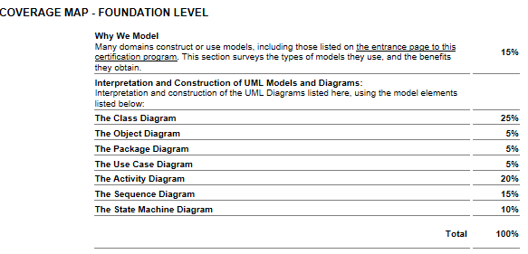
OCUP Foundation Exam

Slide 3
References : Papers
IBM Software Group, The Value of Modeling
Joshua M. Epstein, Why Model?
Business Modeling: A Practical Guide to Realizing Business Value David Bridgeland and Ron Zahavi - MK/OMG Press, 2008. Excerpt from Chapter 7: Model Value Analysis
Rebecca Wirfs-Brock, Why Domain Modeling, blog posting, Feb 2013. Wirfs-Brock, a pioneer in object-oriented design, writes in this post about the value of domain modeling.
J.D. Baker, Model Organization with Packages and the Package Diagram, White Paper, May 2013.
Filip Stachecki, Concurrency in UML, White Paper, March 2014.
Various Authors, What's New in UML 2.5 (White Paper, Coming Soon)

Slide 4
References : Books
UML 2.0 in a Nutshell Dan Pilone, Neil Pitman - O'Reilly Media, 2005 [ISBN 978-0-596-00795-9]
UML 2 for Dummies Michaell J Chonoles, James A. Schardt - Wiley, 2003 [ISBN 978-0-7645-2614-5]

Slide 5
References : Standard
OMG Specification :
[ Unified Modeling Language (UML), V2.5 ]

