Slide 1



Revolutionizing Crowdfunding with Blockchain
A secure, Transparent, and Decentralized Platform

Slide 2

What is Crowdfunding ?
Imagine you have a killer idea for a project or a buisness. But you dont have enough fund to execute your idea.
Crowdfunding is a way to raise money for a project by asking many people to contribute small amounts.

Slide 3



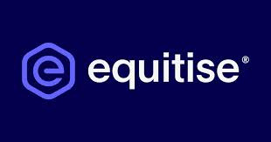

Traditional Crowdfunding Websites in New Zealand

Slide 4

The Problem
Lack of Transparency
High Fees
Trust Issues
Limited Access
Notes:
1. Lack of Transparency: Donors often can't see how their money is being used.
2. High Fees: Platforms and intermediaries can charge high fees, reducing the funds that go to the project.
3. Trust Issues: Donors may worry about scams or projects that don't deliver on their promises.
4. Limited Access: Traditional platforms may restrict who can participate, limiting global reach.

Slide 5
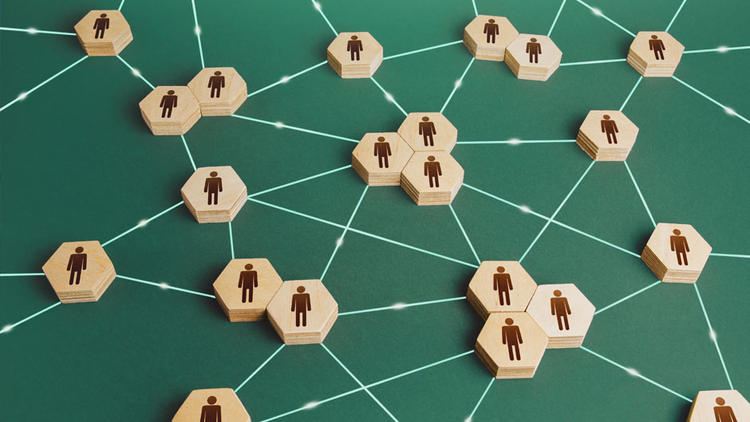
The Solution
A Blockchain-Based Crowdfunding Platform
Lack of Transparency > Immutable Ledge
High Fees > Decentralization
Trust Issues > Smart Contracts
Limited Access > Global Accessiblity
Notes:
1.Lack of Transparency:
-Feature: Immutable Ledger
-Solution: Blockchain’s immutable ledger ensures that all transactions are recorded transparently and cannot be altered, providing complete visibility to all stakeholders.
2.High Fees:
-Feature: Decentralization
-Solution: By removing intermediaries, blockchain reduces the need for traditional banking fees, lowering the overall cost of transactions.
3.Trust Issues:
-Feature: Smart Contracts
-Solution: Smart contracts automatically enforce agreements, ensuring that funds are only released when predefined conditions are met, eliminating the need for trust in a third party.
4.Limited Access:
-Feature: Global Accessibility
-Solution: Blockchain allows anyone with internet access to participate, breaking down geographical barriers and making crowdfunding more inclusive.

Slide 6

Key Features
Smart Contracts:
Automate agreements
Secure & Transparent transactions without intermediaries
User Interface:
Intuitive and user-friendly design
Secure System:
Blockchain’s inherent security features
Decentralization:
Removes the need for centralized control
Notes:
1. Lack of Transparency: Donors often can't see how their money is being used.
2. High Fees: Platforms and intermediaries can charge high fees, reducing the funds that go to the project.
3. Trust Issues: Donors may worry about scams or projects that don't deliver on their promises.
4. Limited Access: Traditional platforms may restrict who can participate, limiting global reach.

Slide 7
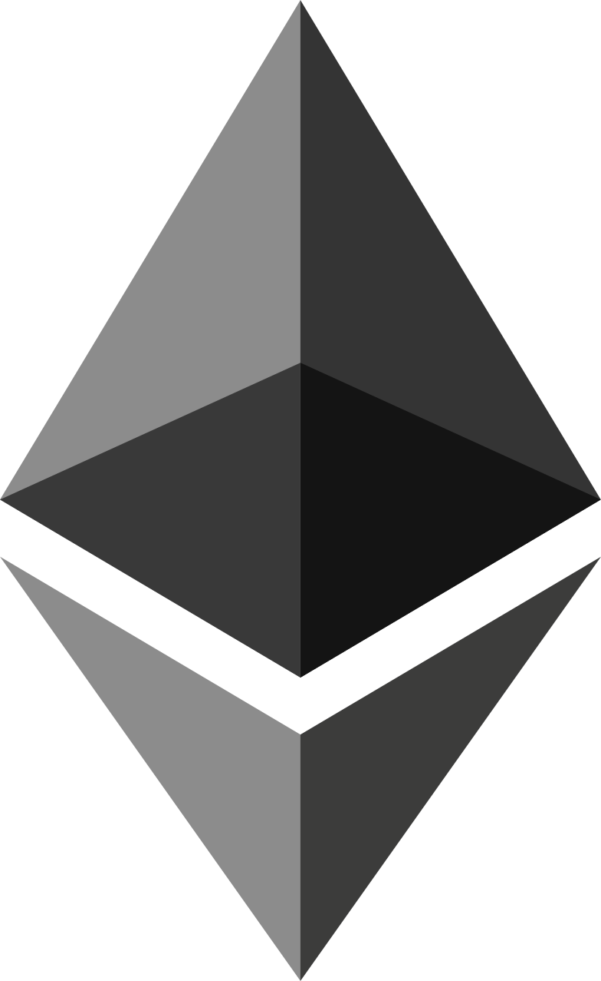

Technology Stack
Blockchain Layer:
Blockchain Platform: Ethereum
Smart Contract Language: Solidity
Backend:
Node.js
MongoDB
Frontend:
React, HTML, CSS, jS
Blockchain Interactio: MetaMask
Notes:
1. Lack of Transparency: Donors often can't see how their money is being used.
2. High Fees: Platforms and intermediaries can charge high fees, reducing the funds that go to the project.
3. Trust Issues: Donors may worry about scams or projects that don't deliver on their promises.
4. Limited Access: Traditional platforms may restrict who can participate, limiting global reach.

Slide 8
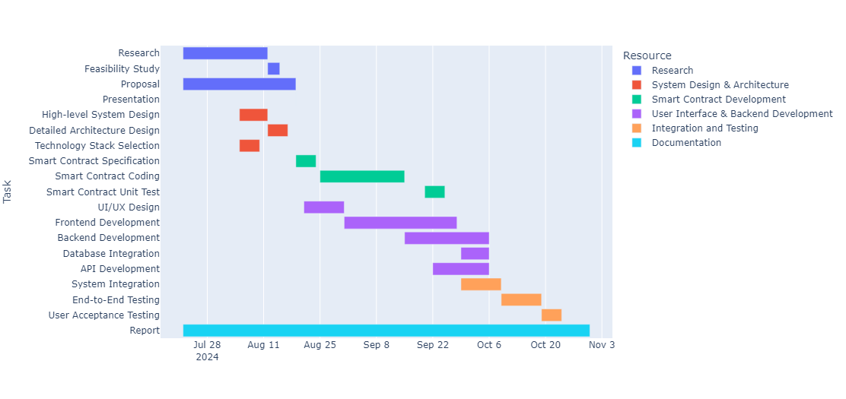
Development Phases
Notes:
1. Lack of Transparency: Donors often can't see how their money is being used.
2. High Fees: Platforms and intermediaries can charge high fees, reducing the funds that go to the project.
3. Trust Issues: Donors may worry about scams or projects that don't deliver on their promises.
4. Limited Access: Traditional platforms may restrict who can participate, limiting global reach.

Slide 9
Expected Outcome
A Blockchain-Based Crowdfunding Platform that is:
Easy to use and navigate
Secure and robust
Transparent
Accessible to everyone
Notes:
1.Lack of Transparency:
-Feature: Immutable Ledger
-Solution: Blockchain’s immutable ledger ensures that all transactions are recorded transparently and cannot be altered, providing complete visibility to all stakeholders.
2.High Fees:
-Feature: Decentralization
-Solution: By removing intermediaries, blockchain reduces the need for traditional banking fees, lowering the overall cost of transactions.
3.Trust Issues:
-Feature: Smart Contracts
-Solution: Smart contracts automatically enforce agreements, ensuring that funds are only released when predefined conditions are met, eliminating the need for trust in a third party.
4.Limited Access:
-Feature: Global Accessibility
-Solution: Blockchain allows anyone with internet access to participate, breaking down geographical barriers and making crowdfunding more inclusive.

Slide 10
Thank you

