Slide 1


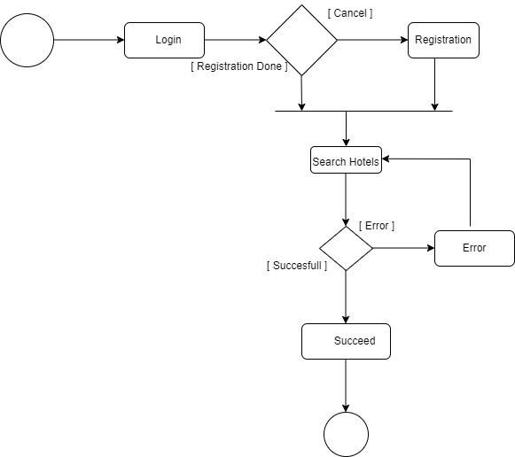
GetHotel
Pravesh Karki | University Id : 2050243 | Supervisor : Mr. Oman Pradhan | Reader : Mr. Sumanta Silwal
Herald College Kathmandu, University of Wolverhampton
Introduction
Scope and Limitations of Project
GetHotel is a website which is suppose help people make a choice in rooms according to their choice.
Hotel has been a necessary thing in today’s time because of the increasing tourism in every part of any region around the world.
People come to visit a certain place and they do not have place to spend overnight or several days where Hotel can be a best idea for the people travelling.
This system is built for the people to choose a particular category of room checking the availability.
This is a website which will automate the main things that are to be operated by a hotel such as from choosing hotel to booking and canceling the booked room.
As this system maintains the hotel and rooms in the sequential booking order from choosing the hotel and choosing category of rooms to booking a room and cancel the booked room itself.
And the authority for the modification and other changing credentials in the hotel website is provided to the admin only which could be possible only fi the access is to the admin panel.
In making a booking the user must get access through the login portal if not registered then they can register themselves with a email and username with their other credentials which gets in use to access to the booking sections as room details view and room list view booking view and the cancelation page.
Academic Question
Why is this system efficient for the people to find their hotel for their destination and how can it be helpful to user finding hotels?
Project Methodology
Aims
Product Process
Booking a hotel online can be an overwhelming task with thousands of hotels to choose from, for every destination. Motivated by the importance of these situations, we decided to work on the task of recommending hotels to users.
Those who are regardless of time or location, frequently utilize social media technologies to communicate and share their views or experiences have become increasingly reliant on online media as the Internet has grown rapidly in recent years.
Tourism is one of the domains where these tools are widely used. Finding a suitable hotel for travelers is one of the most difficult chores
Planning is necessary in development of any project a proper plan as planning ensures that the objectives be expressly explained so that they may be used as a guideline for identifying what course of action to take and in what direction.
It needs holding on to the decisions since it includes selecting a choice from alternative ways of performance.
Develop an online system of finding hotels of own choice.
Users will be able to see the details in every place they go through.
People get into compromising in choosing hotels for their particular trip if they do not find a stay in 1 or 2 times as per their wish or choice. And that is what this system solves because rooms and hotels with different location enlisting their category of room type is contained.
Problem Domain
Objectives
Need internet access which cannot be available everywhere
As being a website access to the internet for the working is an essential factor which can be counted as a problem which could be faced by a user regarding no internet.
Can get confused with various properties in various hotels
Confusion can be created to the user due to the category list because if one or more category with the users Wishlist is found in the list of our category then staying in dilemma can be seen
To encourage the people and the travelers in having a easiness in finding the places for the stay.
To prove that finding and managing a hotel for your trip of your own choice is not difficult.
In today's context as there are many hotel websites for planning a stay for your trip and their all motto is to make their clients stay at a particular destination better. Listening to word managing hotel for a group sounds a huge responsibility and to prove this wrong this website gives a fluent working for the managing a hotel room for the stay at particular available destination.
Figure 6 Activity Diagram
Solutions
Consumes less time than searching around for hotel
As focusing on the availability of rooms in the hotel the choosing of category of the hotels can be less time consuming which has the less internet consuming if the duration of booking process in less.
Find hotel of your own interest and taste.
In case of suggesting a room from the particular list available from the availability of room the category enlisted can be among the choice of the user which might help them get hotel of their own interest.
Literature Review
Conclusion and Critical Evaluation
One of the first steps in planning a vacation is to choose a good place to stay. Booking a hotel online may be a difficult task with dozens of hotels to choose from for each trip.(Rishab Mishra)
The variety and type of services supplied are frequently reflected in the category and quality of hotels. They employ a variety of computer applications for bookings, transmission, protection, and remittance, among other things related to a hotel management system.( Mounika Nandiraju)
A service of hospitality as a facility is considered out of listed particular time and chaotic if it does not employ some form of modern technology system in its performance. Indeed, according to James Bardi, a well renowned management system helps and makes hotels to assure a consistent flow of users and clients into their premises.
“Tesone“ defines a reservation as a former appointment to book a gap for a specific time and day .A reservation is considered a booking remittance since the time-of-service purchase differs from the time of utilization. (Adina Negrusa)
The purpose of this research is to determine how hotels use online reserving systems. And decision was made to float a survey on hotel websites in order to reach the aim for the research.(Adina Negrusa)
Also found that the hotel pricing and list of available on each negotiator’s web enabled, as well as hand-operated modernize reserving and making the reservation cancel in the base of management system,the hotel will have many distributions mechanism in working.
Based on the findings, The system is having most of the benefits through the users. As In home page the user can get a view of certain hotels according to the top booking list and through every hotel section, they can get redirected to another page which is a hotels page where the hotels according to the particular list in the database driven through the admin panel of the website is viewed.
In a total this project is done for the improvement and to raise the believe on people regarding making their stay at a destination through a pre booking with a finding of a better hotel or other stay able place throughout a period of time.
Also the working is seen in the hotels page as a search bar is given where the user can input their destination and get a hotel displayed according to their destination through which you get redirected to the pages of the booking details.
In my point of view during this whole report writing mostly I researched on many of other hotel website to evaluate the credentials and relatable information.
The most annoying part of my journey through tasking this project was getting messed up with the data that I collected through different sites. I ruined through different research that I have made during the management system for my website.
Most of the systems were with a provide to ease of access where one of among key goals should be a one instrument panel that lets your users to cooperate and maintain without making mistakes.
Finding out different category of systems related to hotel and knowing the genres in deep was a real good experience while tasking this project.

