Slide 1
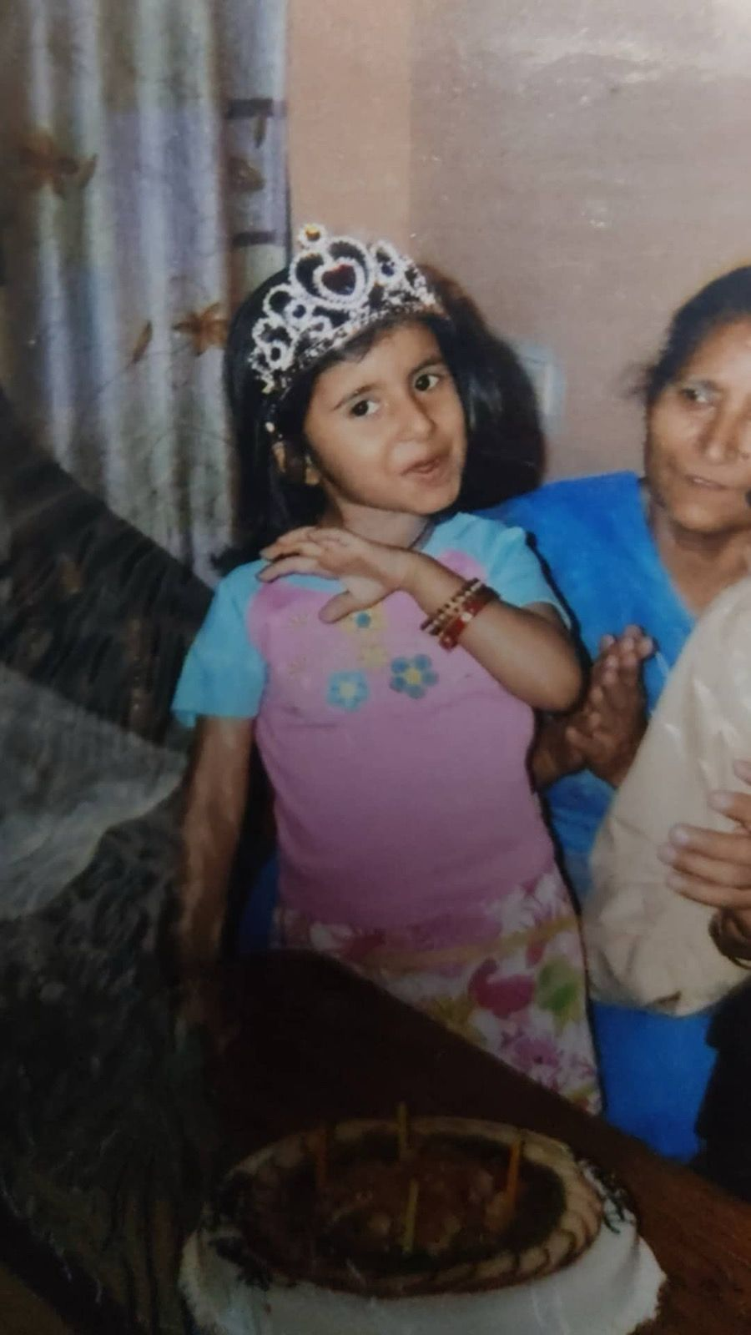
29 MAY
Happy Birthday,
Devi Prianshi
What I love or like about you — it's a thousand of things.
But to be honest, the Prianshi I have seen? I don't know if anyone has seen her like I have.
Or I'd say — my life's golden chance, that I met a legendary creature on this planet.

Slide 2
You Are Not A Single Person
Dude, you have 1000 personalities inside you
You are not a single person. You are a civilization.
Bhar se pathar, andar se naram — the rarest combo. Tere innocence, tere harkatein, tera aura, tere baatien.
Your aura of being a therapist — an unpaid therapist. Hai app malik! And the best part — a singer.
A supportive friend jo duniya se ladh jaye apke liye — if she's real to you, or you're her hommie.
The spirit of winning. Those titles.

Slide 3
One Day You Lost Yourself
"Who am I?" — you asked.
I have an answer to that.
And the answer is simply this —
Prianshi is all of them.
Every. Single. One.
I have seen every version. All 1000 of them.

Slide 4
Memorable Moments
I have plenty of them 🫠
😂 The Shamshan Business Idea
🫠 Friend In Need
And the 'friend in need' wala — us josh se, bandi mere liye chal ke gayi strangers' DMs mein. Itni door. Just to get my phone back. 🫠
My dumbness — but a saviour. 🫶
The full story is on the next page →
For telling you — I think the best is your shamshan business idea.
Only you could come up with something like this and make it completely logical.
Peak chaotic energy. Certified iconic.

Slide 5
The Phone Rescue 📱
Friend In Need — the one I'll never forget
Us josh se — bandi mere liye chal ke gayi DMs mein. Itni door gayi. Just to get my phone back.
My dumbness… but you? A saviour, Prianshi. I never can forget that.
It was genuinely a big thing for me — what you did.
Someone listening would say "kya hi ho gaya" — but I know how big that is.
Because you chose that over what you needed. You invested your time on my problem.
That's not a friend. That's a saviour.

Slide 6
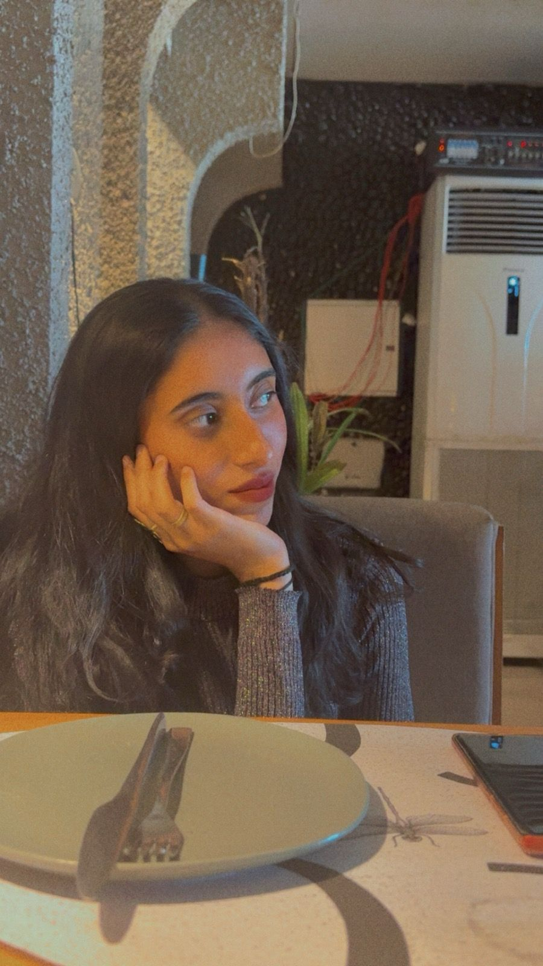
"O Phulla Wargi Hai"
There are plenty of songs — I can't name them, I don't remember — but I can say this small poetic line:
Jagdi rehendi hai raata nu, jugnu ban, har halat ch — apne aap nu sambhaldi, apne aap nu banaondi, oo aage vaddhdi jaandi hai.
She is a warrior. Mysterious. Yet here to rule the world.
When I feel alone, I always remember — only the buddy is the one who can, just by her presence, change samne wale ka mood.
Achha khana explore karte hoye — kyunki she is a foodie. Achhe kapde dekh jaye — because a baddie should own that. Koi trip offer karo? Bas! This lady is 'ghumi-ghumi karo' — Dora the Explorer.
Bas kabhi kabhi khud ke potential explore karte karte khud ke nuksan explore kar leti — she creates the problem, then solves it. She'll be like: "Hum hi sab hain."

Slide 7
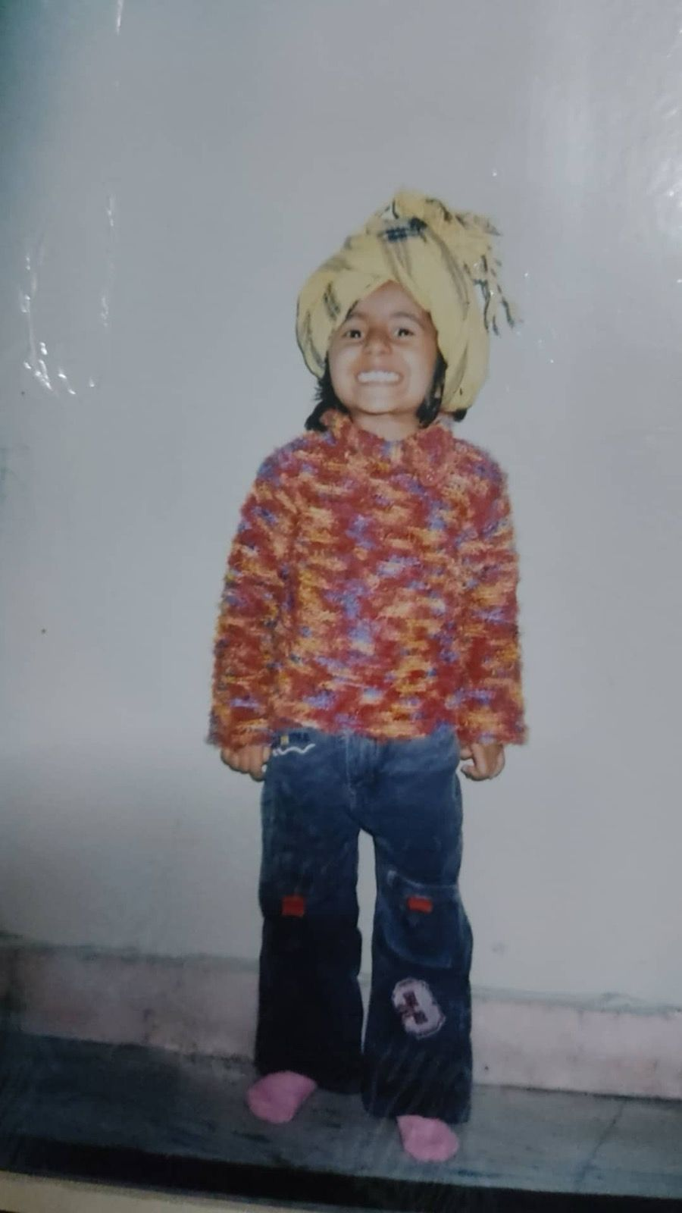
Your PRIME
Fav version of her — when she is winning, when she is real. I have 2 fav versions, but I'll tell one (only one needed for now):
Bro, winning. Bro, confidence. Bro, doing everything — she being a ninja, without any loss. Victory, not overthinking. Becoming a 'tea', abs-wali tea — double oyee-hoyee-hoyee, bhot mast aandi hai, bro, in prime! 🔥
Yaar, tu bhot suljhi hoye, pyari si ladki hai — dil se har cheez karne wali. Kabhi kabhi duniya samajh nahi paati tujhe, but tu apne se pehle samne wale ke liye khadi ho jaati — bhi dekha maine.
If someone gets important to you, oss ki life badal de gi yeh ladki. The kind of efforts you put 🫠 is unbelievable.
But kabhi kabhi log kadar nahi daalte, gussa aata hai — because you're living a dream, bro, and you don't understand it. Prianshi ke list mein aisi jagah milna is heaven.
In short — your prime is your best version.

Slide 8
Every Moment With Her
Every moment — because with Prianshi, har waqt tumhe motivation milegi, ik next-level energy milegi. Kuch ukhadna hai life mein? Yeh jasba aa hi jayega.
And her life thoughts tumhe insaan bana denge.
Tere saath har waqt hi insane hota — bachodi se leke funny stories. Tu gussa bhi unhi se hoti jo tujhe apne lagte.
Even if you get rude sometimes, it feels like — "haan bhai, list mein ho." 😂
Haan, matlab rude bhi 3–4 tareeke ka hai tera — but good rude ki baat kar raha. Ab dictionary kaise aur din — "4 Types of Rudeness." 😂

Slide 9
Her Efforts
Prianshi is an unpaid therapist, yaar. Tere bachodi se leke tere baatien, tere saath bitaya samma — just can't explain, bro.
Tu jab really insaan ko chunti — "haan, mujhe iss mehfil mein rehna hai" — tu mehfilon ke shaan ban jaati.
Every time I have met you, I have got so much epic-level fun, bachodi, and kya kya cheezein hoti hain. Tu choti se choti cheez ka dhyan rakhte, yaar.
Simple bolo — having you in life is worthy than having 1 million friends. You are above that one million.
So at any cost, I would save this friendship — because bhagwan bhi kabhi kabhi dayalu hoke aise diva-level log deta.

Slide 10
Then & Now
Always iconic. Always legendary. Always her.
Mini Prianshi
The Energy
Present Day
With the crown.
Always royalty.
That smile.
Chaos queen.
Bhar se pathar,
andar se naram.

Slide 11
A Few More Moments
Kuch aur lamhe — tere saath. 🩷

Slide 12
🎂
Happy Birthday,
Devi Prianshi
Not a gift you can hold — but everything I feel.
The rarest creature I ever met. 🫶
— 29 May

