Slide 1
HTML TOPICS
Elements:
hgroup
ins
kbd
mark
meter
main
nav
optgroup
tfoot
Input type:
url

Slide 2
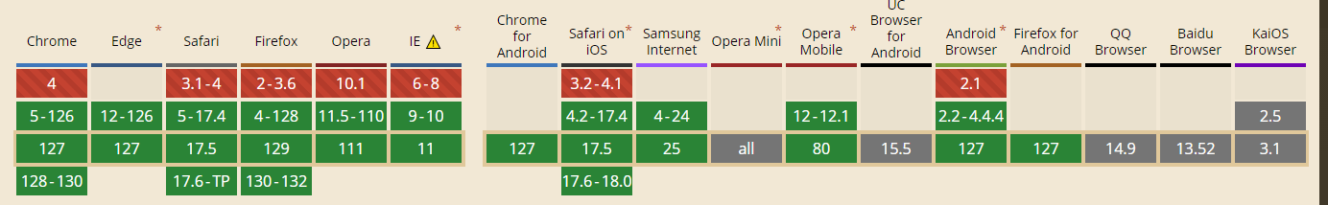
Element - hgroup
Purpose:
The hgroup element is used to group a heading with related content like subheadings, alternative titles, or taglines. Subheadings are denoted using the p tag element.

Slide 3
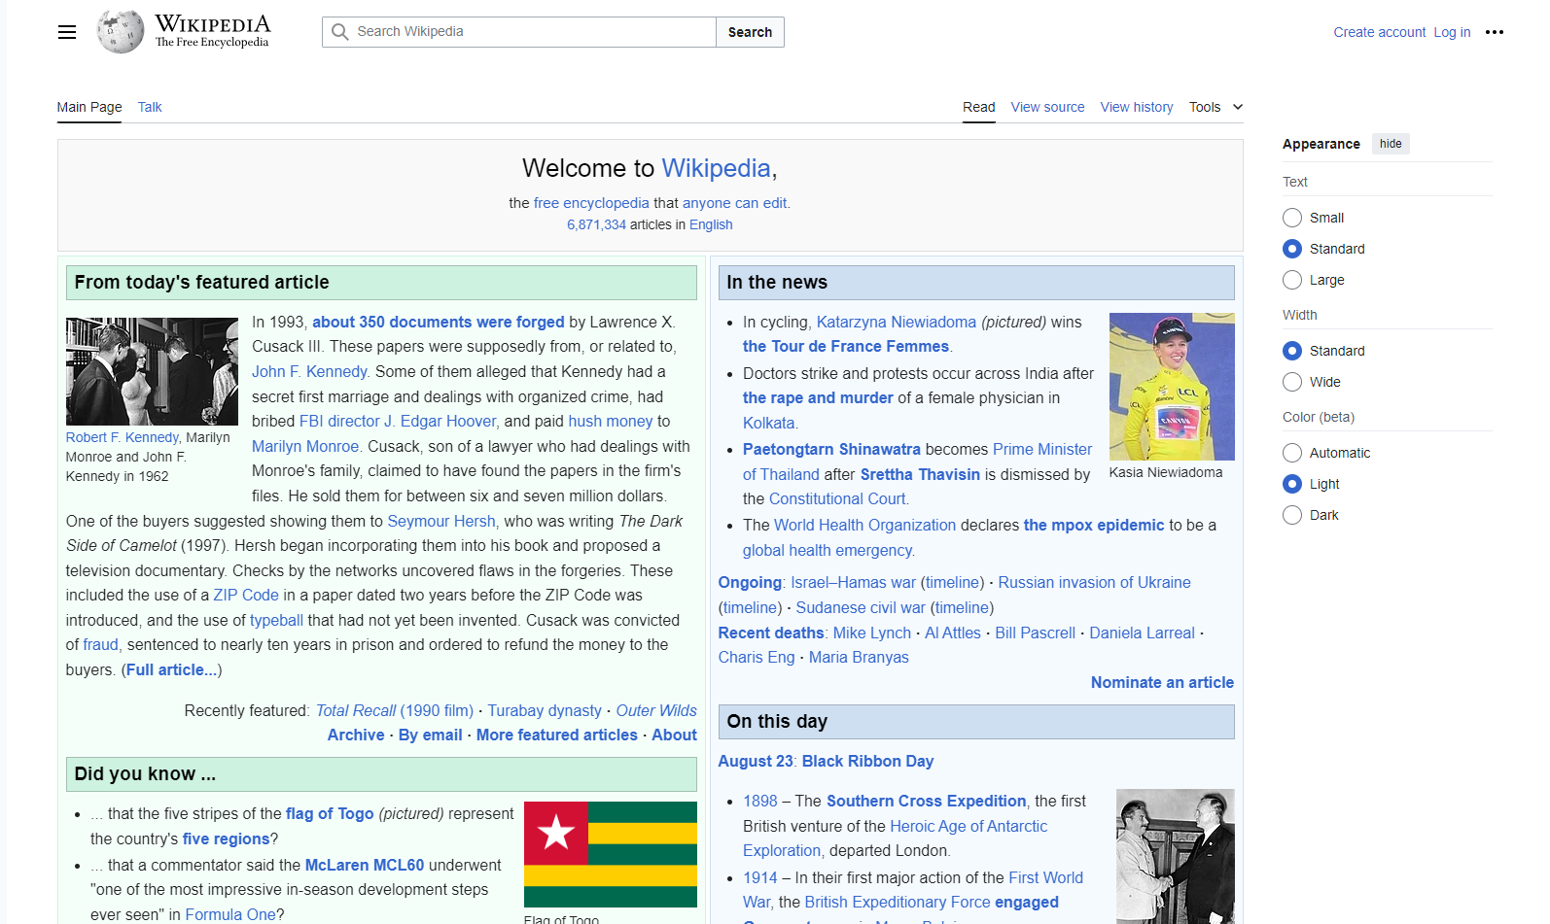
Element - hgroup

Slide 4
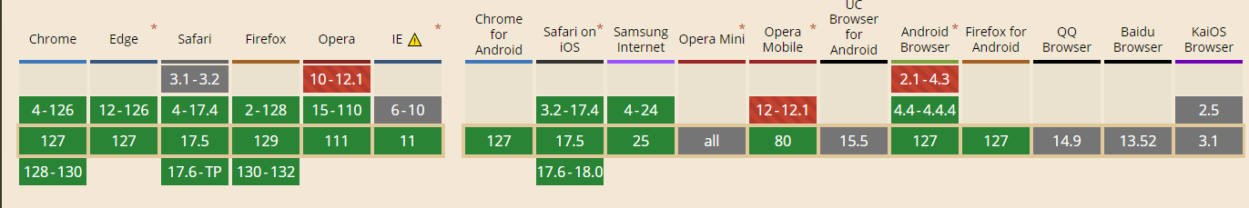
Element - ins
Purpose:
The ins tag in HTML represents inserted text, with attributes cite specifying a related URL and datetime recording the exact time of insertion.

Slide 5
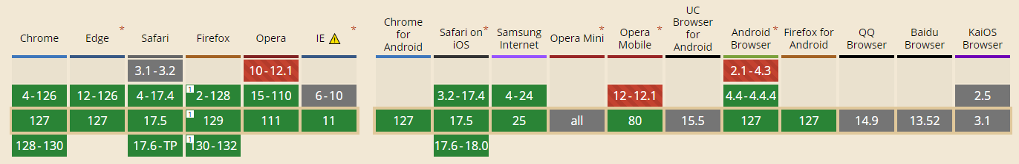
Element - kbd
Purpose:
Used to define keyboard shortcuts.
The content inside the kbd tag is displayed as monospace font.

Slide 6
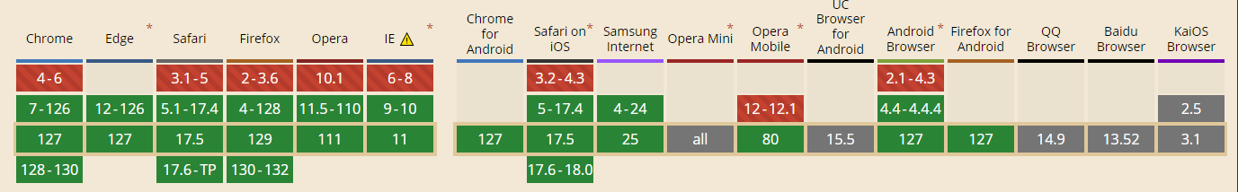
Element - mark
Purpose:
The mark tag is used to define the marked text. By default it will highlight the text in yellow color.

Slide 7
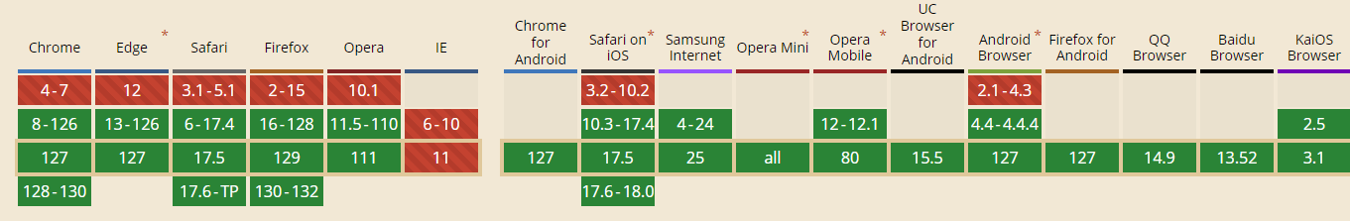
Element - meter
Purpose:
The meter tag defines a scalar measurement within a known range, or a
fractional value.
Presentation in Browser:
Displayed as a progress bar.

Slide 8
Element - meter
Attributes:
Value: Specifies the current value of the gauge.
Min:Specifies the minimum value of the range (default is 0).
Max:Specifies the maximum value of the range (default is 1).
low: Specifies the range that is considered to be a low value
high:Specifies the range that is considered to be a high value
optimum: Specifies what value is the optimal value for the gauge.

Slide 9
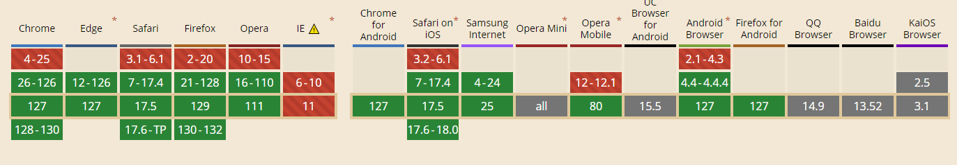
Element - main
Purpose:
The main tag represents the dominant content of a webpage, containing unique content specific to that page, excluding repeated elements like menus or logos.

Slide 10
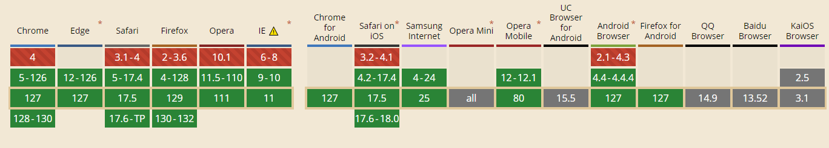
Element - nav
Purpose:
The nav element is for main navigation links, organizing them without
default styling in the browser. Other links like footer links are usually not included.

Slide 11
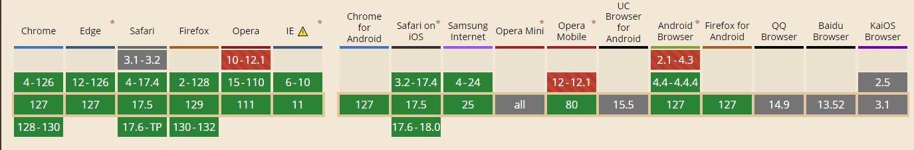
Element - optgroup
Purpose:
The optgroup tag groups related options within a <select> element.
It typically displays as a grouped section in a dropdown menu.

Slide 12
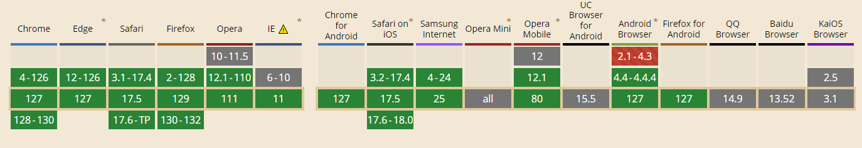
Element - tfoot
Purpose:
It is used with thead and tbody to structure a table into semantic sections and is displayed as the table's footer.

Slide 13
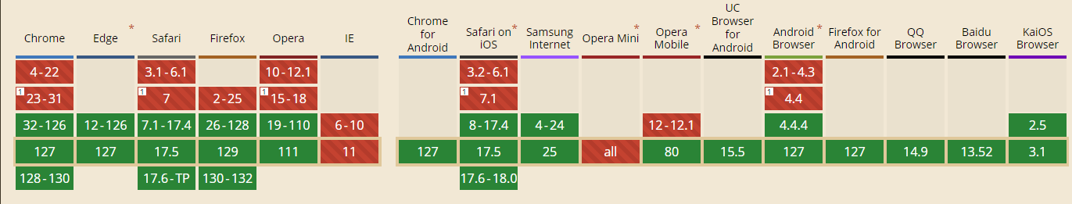
Input type – url
Purpose:
Used to create a field that accepts a website address (URL) as an input.
Automatic Validation:
The input value is automatically validated before URLs to ensure they're formatted correctly.

Slide 14
Input type – url
Attributes:
maxlength/minlength: Sets maximum and minimum character limits.
pattern: Validates the URL format using a regex pattern.
placeholder: Provides a hint for the expected input.
required: Ensures the field is not empty before submission.

Slide 15
EVENTS
Onclick
Onload
OnBlur
Onkeyup
Onkeydown

Slide 16
Thank You

