Slide 1

Mobile Sales Performance Analytics Report
Using Power BI
Presented By – Prabha Burman

Slide 2
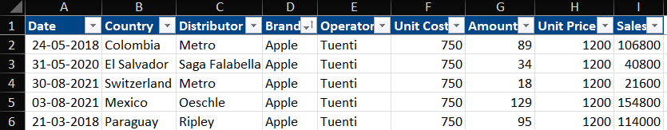
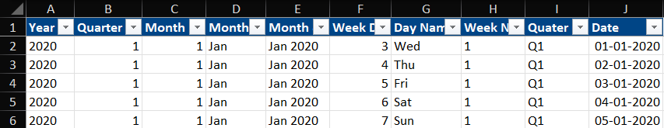
INTRODUCTION
End-to-end Interactive business intelligence report analyzing mobile brand sales, profitability, geographical performance and forecasting using Power BI.
Data sourced from FP20 Analytics Challenge platform (Dataset : Challenge 05).
Key Data Fields : - Country, Distributor, Brand, Unit Cost, Sales, Date(Month/Year).
Focused on analyzing sales, profit, inventory cost, top countries and brand and geographical performance.

Slide 3

OBJECTIVES
Identify top performing brands.
Analyze sales and profit trends over time.
Compare country-wise revenue, profit %, units sold contribution.
Evaluate inventory allocation efficiency.
Track distributor and operator performance.
Forecast based on historical data.
Generate actionable business insights.

Slide 4
DATA PREPROCESSING & PREPARATION
Performed Exploratory Data Analysis (EDA) to uncover key business patterns and generate meaningful insights .
Applied data wrangling techniques to clean, structure, and standardize the dataset.
Built a data model to establish relationships between tables for efficient analysis.
Implemented DAX functions, calculated measures, and calculated columns for KPI calculations and advanced metrics.

Slide 5

KEY AREAS TO EXPLORE
From 2018–2021, which country and distributor achieved the best sales performance?
What are the seasonal sales trends across countries and distributors?
How do inventory costs vary seasonally by country and distributor?
What are the seasonal net profit trends for each country and distributor?
Each year, which brand was the top seller in each country and distributor?
Who were the most successful sales representatives and distributors in each country?
Which countries recorded the lowest and highest inventory costs from 2018–2021?
Which countries recorded the lowest and highest net profits from 2018–2021?
Can sales trends for 2023 be predicted based on historical data?
What recommendations can be made to optimize net sales based on top-performing countries?

Slide 6
Dashboard architecture
DATA ARCHITECTURE
Sales & Profit Performance Overview
Brand Performance Overview
Detailed Brand Insights
Geographical Overview
Forecast & Recommendations
This page showing total sales, profit, units sold, and profit margin, along with monthly sales trends and top revenue-generating countries.
Analyzes brand-wise sales, inventory cost, and distributor contribution to identify the most profitable brands.
Provides deeper insights into brand contribution, growth trends, and operator performance across different periods.
Examines country-wise revenue, profit distribution, and regional performance to highlight high and low performing markets.
Uses historical sales trends to forecast future performance and provide strategic business recommendations.

Slide 7

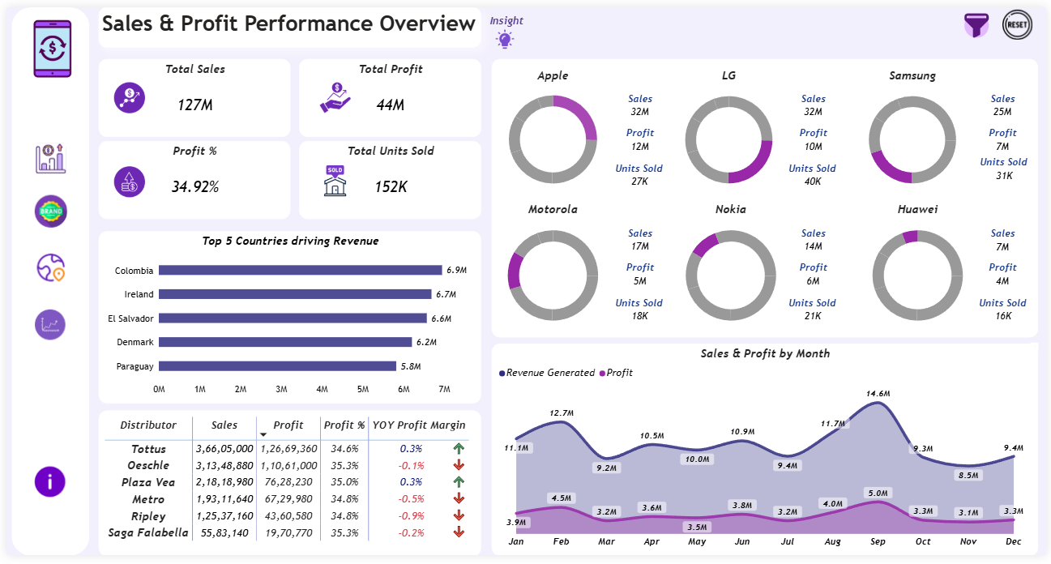
Sales & Profit Performance Overview
Apple and LG lead in overall sales and profit contribution.
Colombia and Ireland appear as top revenue-generating markets.
Tottus shows strong distributor-level sales performance.
Sales trend indicates peak demand around mid-year and early Q4.

Slide 8

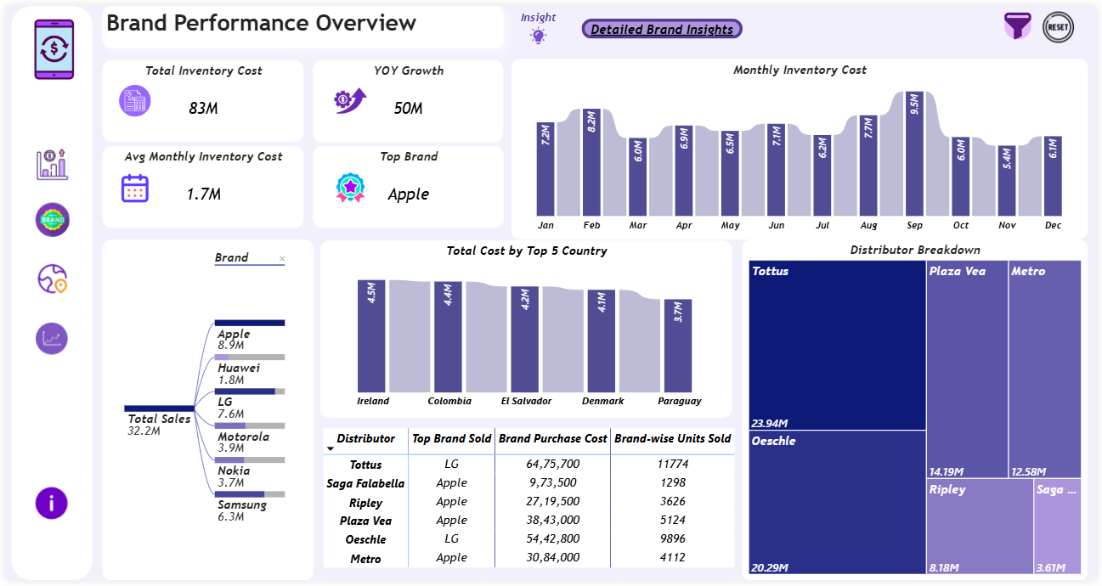
Brand Performance Overview
Apple records the highest brand sales among all mobile brands.
LG appears as the most frequently sold brand across multiple distributors.
Tottus shows the highest brand purchase cost and units sold.
Ireland leads in overall inventory cost allocation.

Slide 9

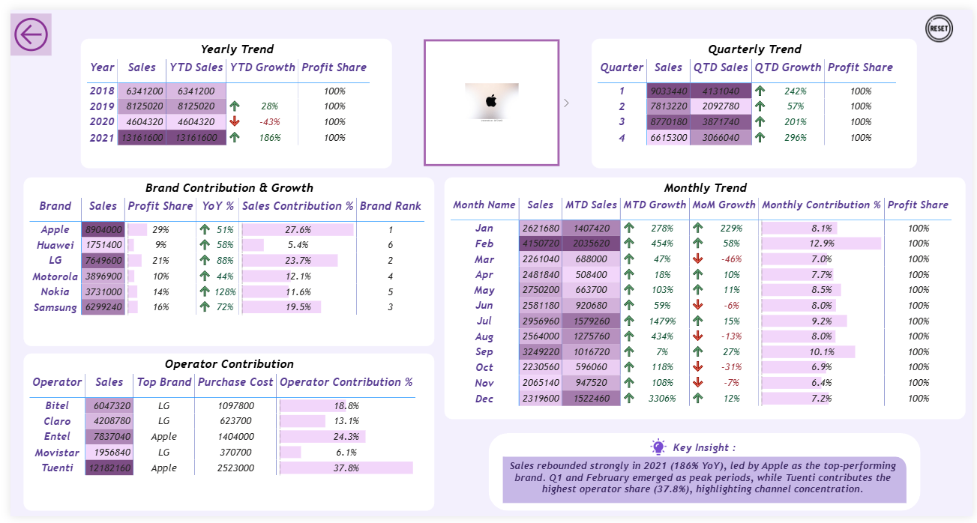
Detailed Brand Insights
LG and Samsung also show strong contribution across total sales.
Q1 and February emerge as peak sales periods in the yearly and monthly trend.
Tuenti records the highest operator contribution among all operators.

Slide 10
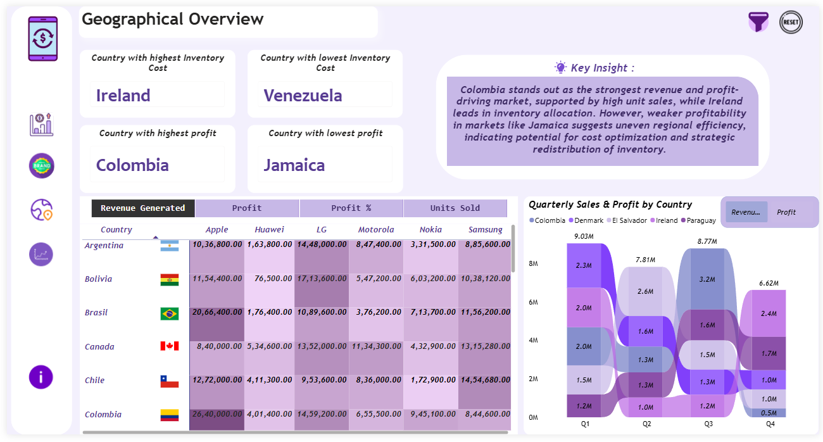
Geographical Overview
Colombia records the highest profit among all countries.
Ireland shows the highest inventory cost allocation.
Venezuela has the lowest inventory cost, while Jamaica records the lowest profit.

Slide 11
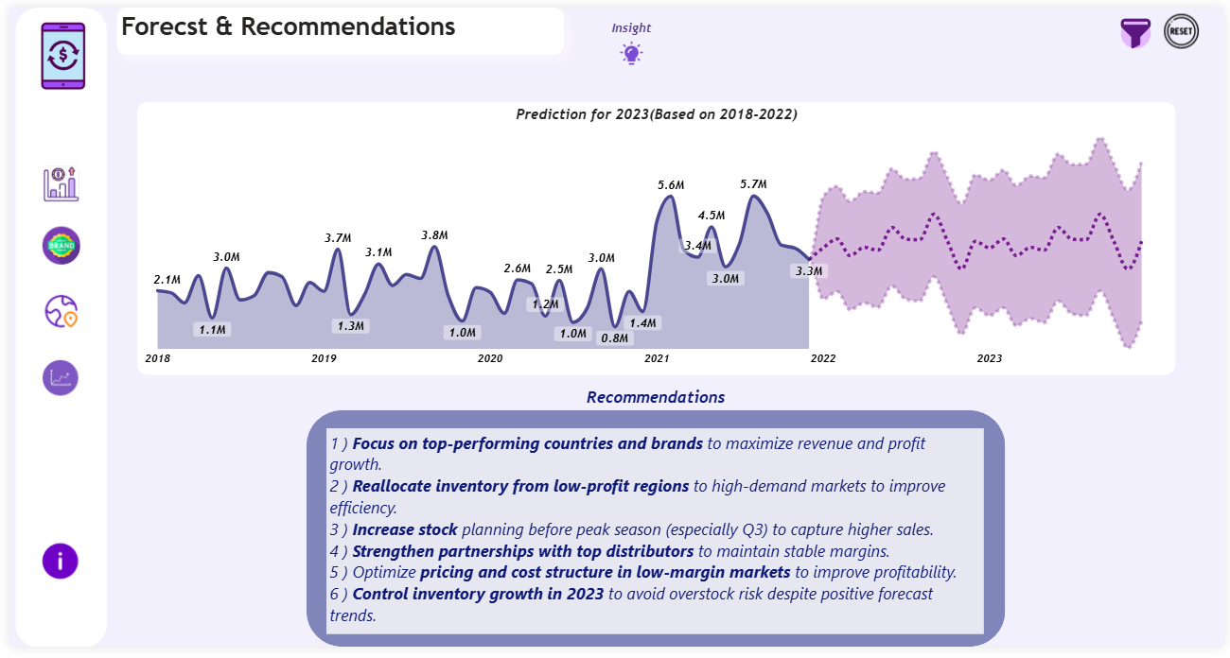
Forecast & Recommendations
Sales trend analysis indicates continued growth potential in 2023 based on historical data.
Forecast model highlights stable demand with possible seasonal fluctuations in upcoming periods.
Business recommendations have already been provided in the dashboard to support strategic decision-making.

Slide 12



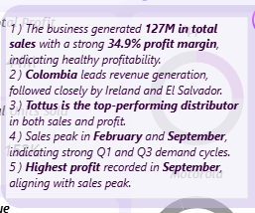
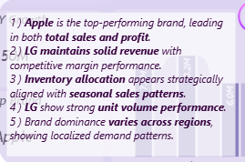
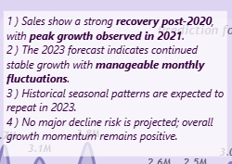
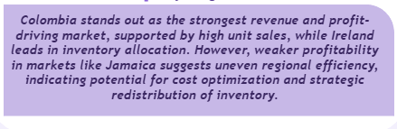

INSIGHTS

Slide 13

CONCLUSION

