Slide 1
NIFTY 50
Data Analysis
using Python
Presented by
Prabha Burman

Slide 2




Introduction
About Nifty 50
50 Companies
Covers every major Indian sector across NSE
NIFTY 50 represents India's top 50 blue-chip companies
Covers diverse sectors like IT, Banking, FMCG, and Energy
High Relevance
Highly liquid and widely tracked by global investors
Benchmark for Indian equity markets worldwide
Perfect for studying real-world financial patterns
Pattern Rich
Strong personal interest in stock market behaviour
Daily OHLCV data ideal for EDA & visualization

Slide 3


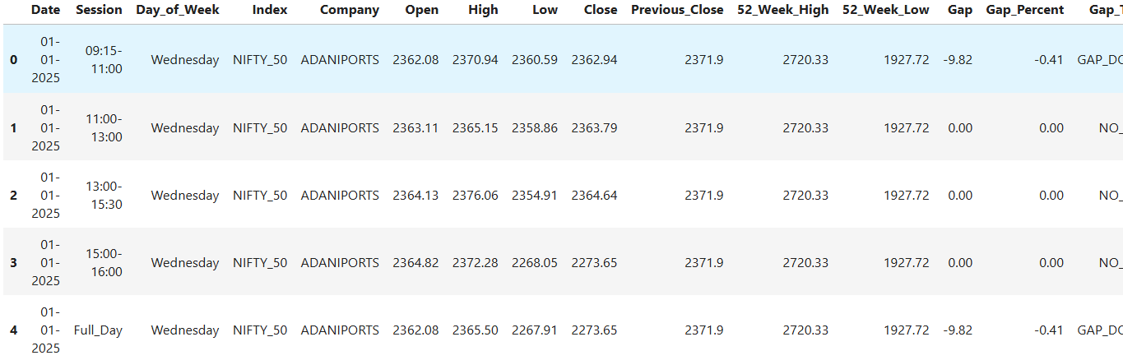
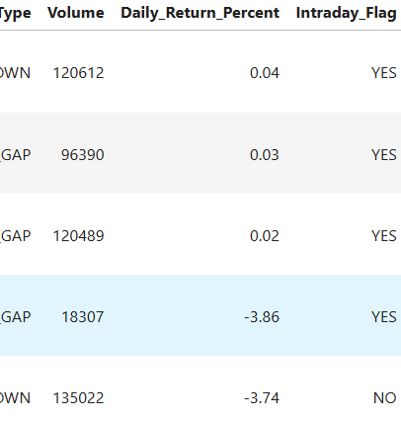
Data Source
NIFTY_50_2025_Dataset
NIFTY_50_2025
2025 dataset containing daily and intraday OHLCV records for 50 NSE-listed companies
62,500 Rows • 50 Companies • Daily Records

Slide 4
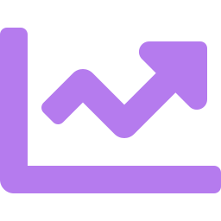



Project Objectives
This project aims to uncover key volatility trends and behavioral patterns across NIFTY 50 companies.
Volatility Patterns
Return Trends
Volume Distribution
Analyze how intraday and monthly volatility changes over time across NIFTY 50 companies.
Examine daily and monthly return distributions to identify performance patterns.
Understand volume behaviour, identify skewness, and detect unusual trading activity.
Gap Analysis
Weekday & Monthly Patterns
Risk Assessment
Identify frequency and magnitude of gap-up and gap-down openings.
Detect seasonal and weekday-level effects on returns and volatility.
Quantify risk exposure and support better investment decision-making.

Slide 5
Problem Statements
1.
01
1. Which companies show highest intraday volatility?
Intraday Volatility Analysis
02
2. Which companies have most daily trading activity?
Top Volume Companies
03
3. Which session has highest volume activity?
Volume By Session
04
4. Which companies have largest daily price ranges?
Price Ra
Price Range By Company
05
5. Which companies give best/worst returns?
Returns By Company
06
6. What percentage of days are bullish vs bearish?
Positive VS Negative Days
07
7. Which months have highest trading activity?
Month Wise Volume

Slide 6
Problem Statements
1.
08
8. Which companies have most extreme daily gains/losses?
Company Consistency
09
9. How frequently do Gap Up and Gap Down occur?
Gap Up-Gap Down Analysis
10
10. Which days have best/worst average returns?
Day-of-Week Effect
11
11. Which months show best/worst performance?
Price Ra
Monthly Return Trends
12
12. What percentage distance is price from 52-week extremes?
Price VS 52-Week Range
13
13. How does volatility change across the month?
Volatility Trend
14
14. What's the distribution of trading volumes?
Volume Distribution

Slide 7

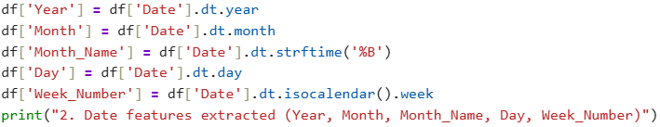
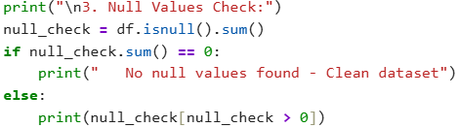
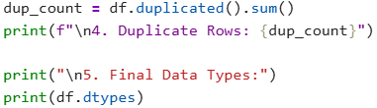
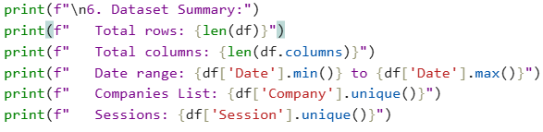
Data Cleaning
Pre-processed Date column to extract Date features
Checked all columns for missing / null values
Checked for duplicate rows
Generated Dataset Summary
Computed statistical summary for core numerical features
Ensured data consistency through logical validation checks

Slide 8
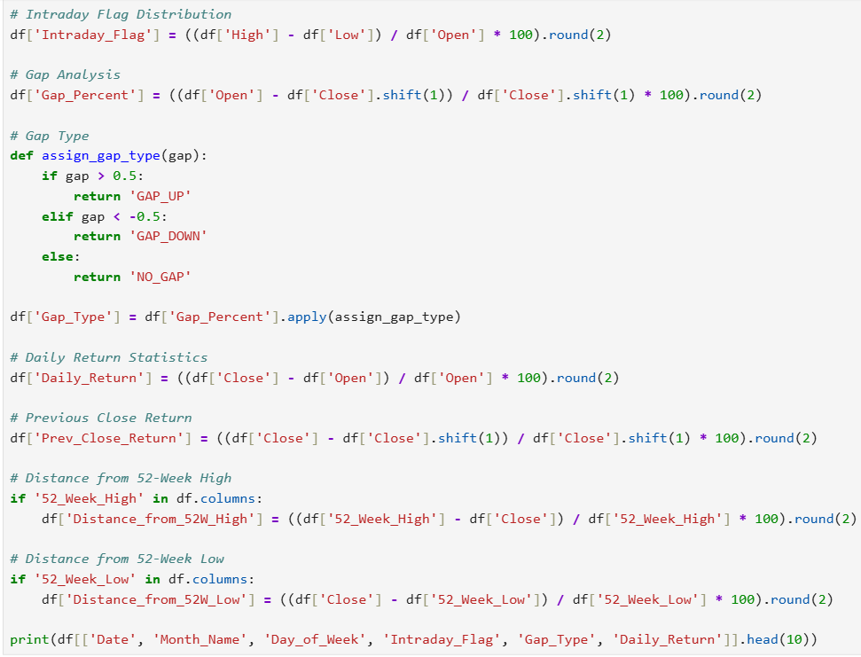
Feature Engineering
Derived features unlock deeper insights beyond raw OHLCV data
Created Intraday movement feature
Calculated gap percentage between sessions
Classified gap types (Up / Down / No Gap)
Computed daily return (%)
Calculated previous close return
Measured distance from 52-week high
Measured distance from 52-week low

Slide 9
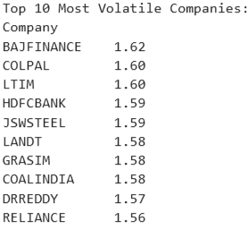
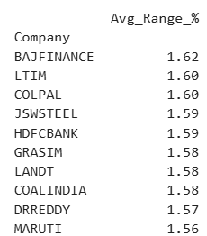
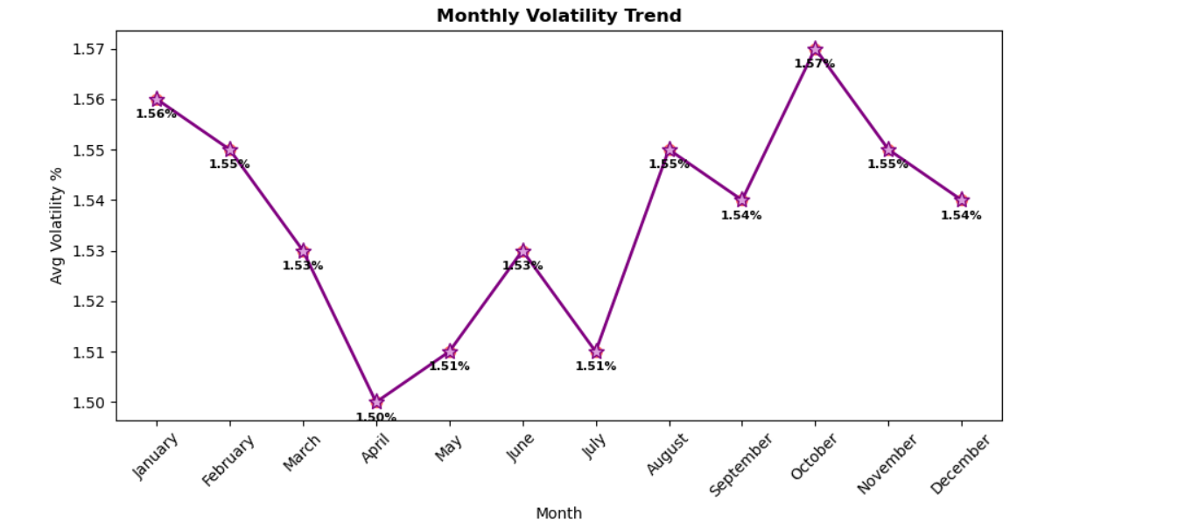
Execution
Volatility & Price Movement wise problem statements
1. Which companies show highest intraday volatility?
Calculated intraday volatility.
Aggregated company-wise average.
Identified top volatile stocks.
Core logic used
4. Which companies have largest daily price ranges?
Calculated daily price range %
Compared company-wise averages
Identified highest range stocks
Core logic used
13. How does volatility change across the month?
Core logic used
Monthly Volatility trend evaluated

Slide 10
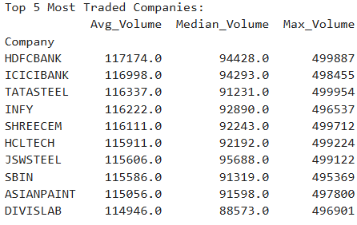
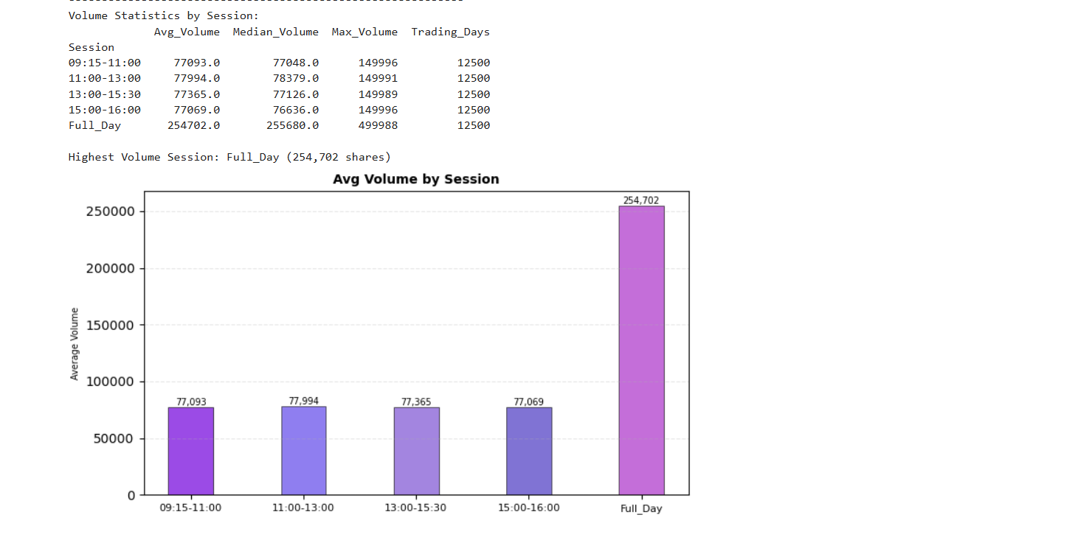
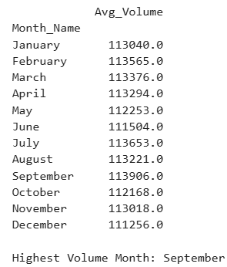
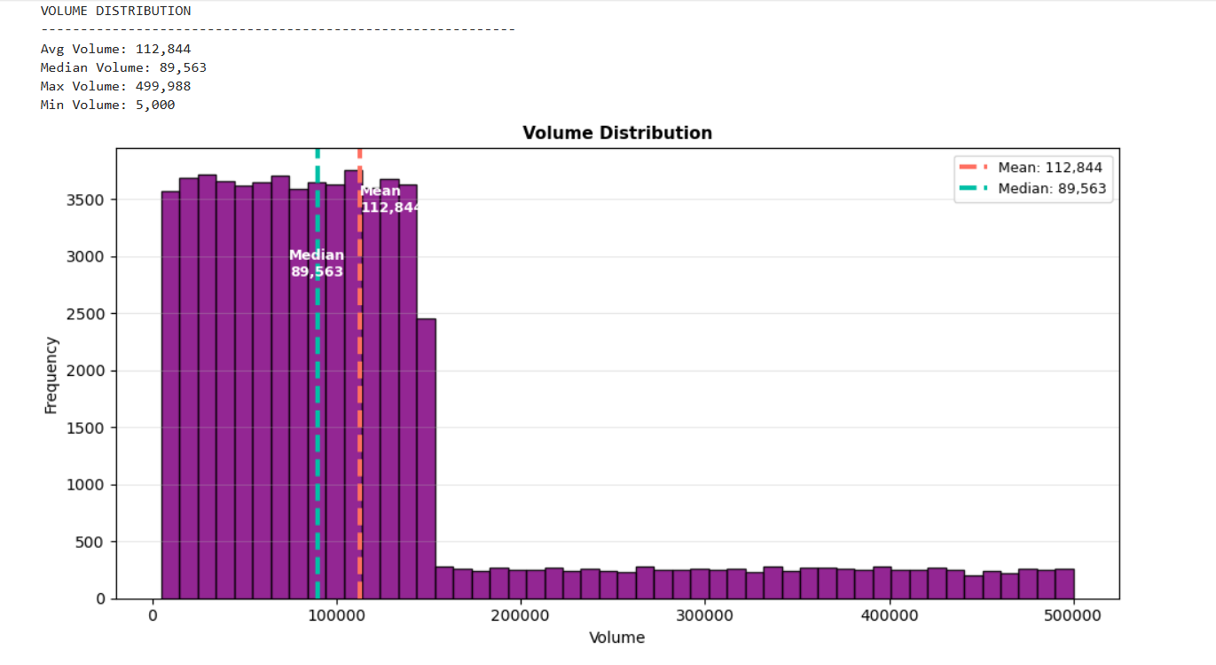

Trading activity & Volume wise problem statements
2. Which companies have most daily trading activity?
Core logic used
3. Which session has highest volume activity?
Core logic used
7. Which months have highest trading activity?
Core logic used
Aggregated monthly trading volume
Compared activity across months
Identified highest activity month
14. What's the distribution of trading volumes?
Core logic used
Calculated mean & median
Identified skewness in data

Slide 11
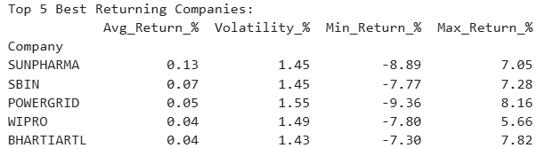
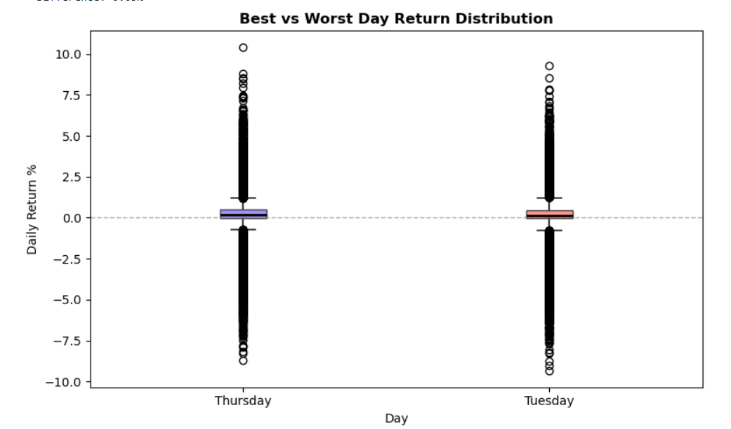


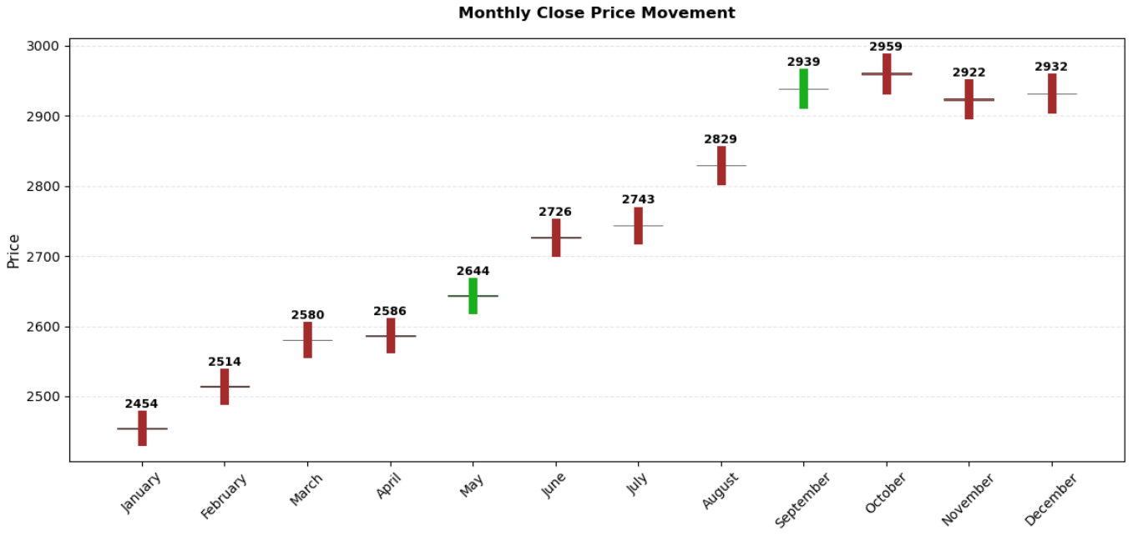


Returns & Performance wise problem statements
5. Which companies give best/worst returns?
Core logic used
10. Which days have best/worst average returns?
Core logic used
Calculated average returns across different weekdays
Identified best (Thursday) and worst (Tuesday) performing days
Compared return distribution to observe consistency and variability
11. Which months show best/worst performance?
Core logic used
Identified best & worst months using returns
Visualized monthly trend using candlestick chart

Slide 12
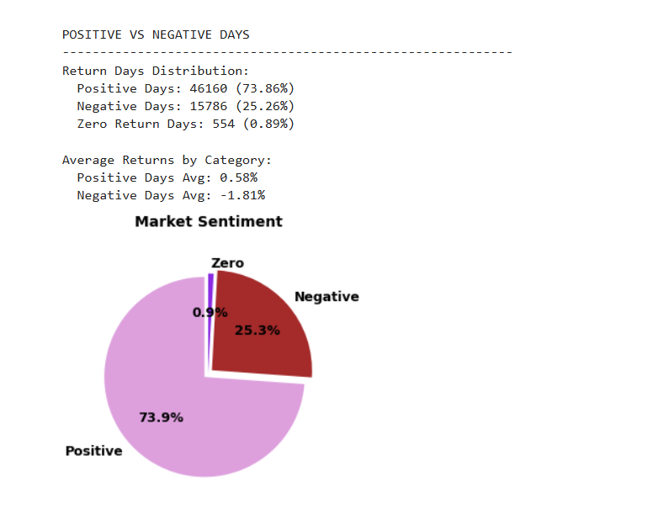

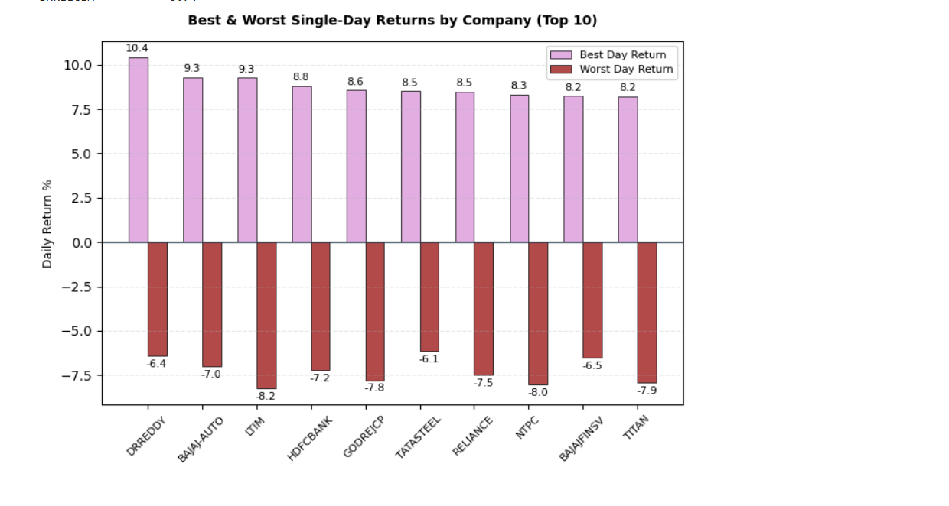
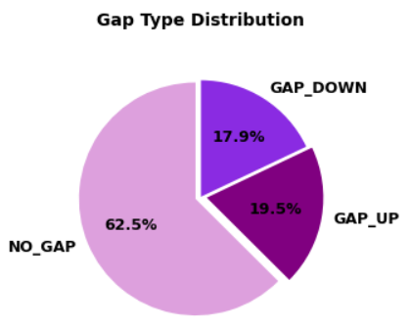
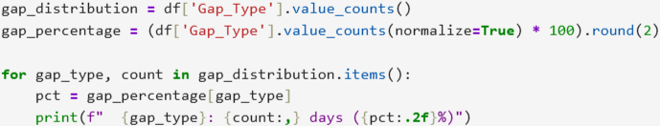

Market Behaviour & Patterns wise problem statements
6. What percentage of days are bullish vs bearish?
Core logic used
8. Which companies have most extreme daily gains/losses?
Core logic used
9. How frequently do Gap Up and Gap Down occur?
Core logic used

Slide 13
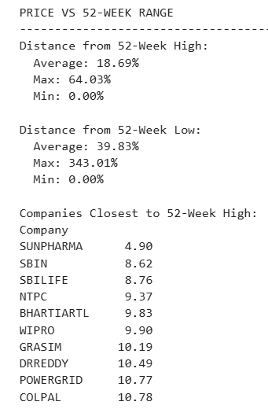
Price Position (52-Week Analysis)
12. What percentage distance is price from 52-week extremes?
Core logic used
Calculated price distance from 52-week high and low
Evaluated current price positioning relative to extremes
Identified stocks trading near 52-week highs (bullish signal)
Detected stocks near 52-week lows (potential risk/opportunity)
Highlighted overall market positioning trend across companies

Slide 14
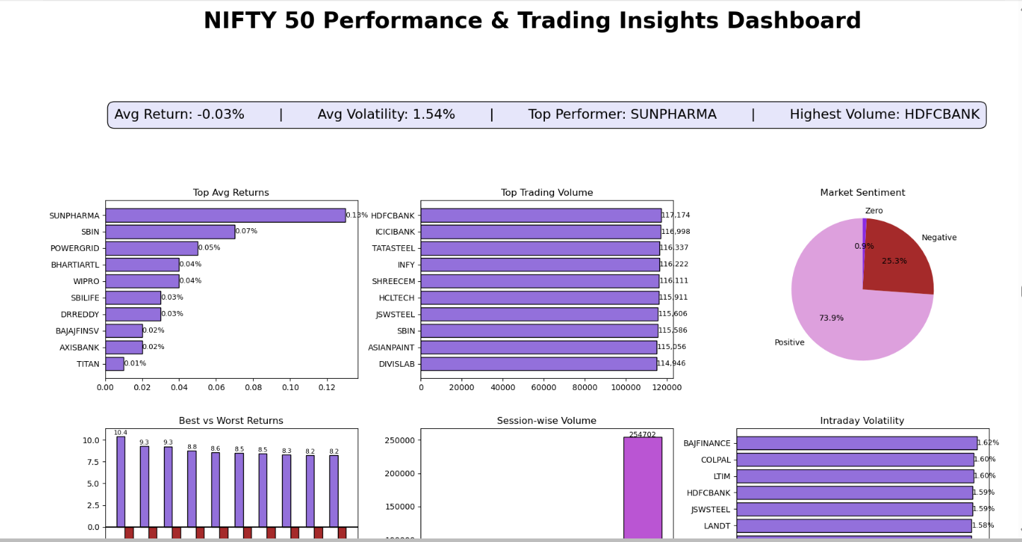
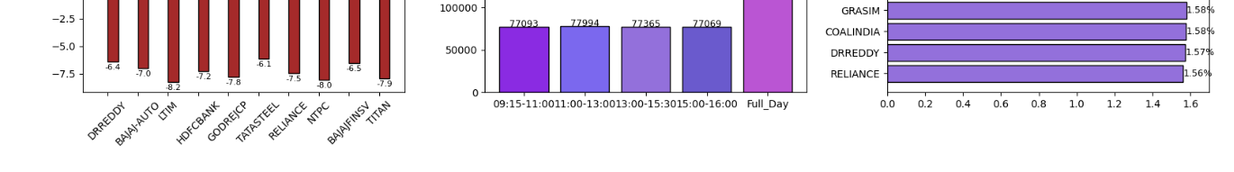
DASHBOARD - 1

Slide 15
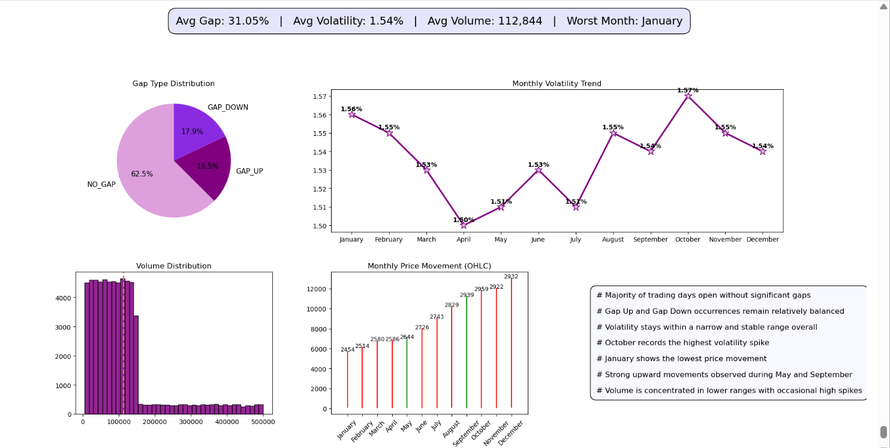
DASHBOARD - 2

Slide 16


Key Insights
NIFTY 50 stocks show stable overall volatility with notable seasonal spikes
What the Data Reveals — Volatility & Volume , Monthly Returns, Weekday Effects & Gap Behaviour
October — Peak Volatility
September
January
Thursday
~55%
HIGH RISK
Best Month
Worst Month
Best Weekday
No Gap Days
October exhibits the highest intraday volatility spike across all months, likely driven by quarterly earnings season and global market uncertainty.
Highest avg. returns
Lowest avg. returns
Highest daily returns
Majority open neutral
Volume is Right-Skewed
SKEWED
Most trading sessions have low-to-moderate volume. A few extremely high-volume days pull the mean significantly above the median.
September — Best Month
January — Worst Month
Gap Behaviour
Consistently shows highest average daily returns
Lowest average monthly returns across the dataset
~30% Gap Up openings — bullish overnight signals
April — Lowest Volatility
LOW RISK
April shows the most stable price action, coinciding with the start of a new financial year and lower institutional repositioning activity.
Post-monsoon recovery and pre-festive demand boost sentiment
Year-start profit-booking after December rally
~15% Gap Down openings — risk events or bad news
IT and FMCG sectors contribute most to Sept. outperformance
Global macroeconomic uncertainty weighs on sentiment
Most days open near previous close — no gap dominates
STABLE
Overall Volatility — Consistent
Except for October, volatility levels remain relatively stable across the year, indicating steady market conditions for most stocks.

Slide 17
Actionable Recommendations
Data-Driven Strategies for Traders & Investors
01
Trade During Stable Periods
02
Risk Management
Caution in October
Volatility Alert
Focus strategy execution during low-volatility months (e.g., April, May) to reduce unexpected risk. Avoid chasing momentum in high-volatility windows without a stop-loss strategy.
Conservative strategies should scale back exposure in October. Historical data shows significantly elevated volatility — wider spreads, higher slippage risk, and larger intraday swings.
03
Leverage Weekday Patterns
04
Calendar Effect
Monitor Volume Spikes
Volume Strategy
Thursday shows statistically higher average daily returns. Short-term traders can use this pattern to bias entries toward mid-week setups for favorable risk-reward ratios.
Since volume is right-skewed, abnormal spikes above the 90th percentile often signal institutional activity or news-driven moves — potential breakout or reversal opportunities.

Slide 18



Conclusion
What we achieved and what comes next
Data analysis reveals clear, actionable market patterns in NIFTY 50 — from volatility cycles to seasonal return anomalies.
Python (Pandas + Matplotlib) proves a powerful, self-sufficient toolkit for financial EDA — no complex frameworks needed.
Project demonstrates real-world analytics applicability — bridging raw data and investment intelligence.
Future scope: Machine Learning predictions, interactive dashboards, real-time data integration, and sector-level drill-down.
Thank You

