Slide 1

Analysis of Car Crashes in Montgomery County, Maryland
ALY 6110
College of Professional Studies, Northeastern University
ALY 6110 Data Management & Big Data
Dr. Donhoffner
February 13, 2025
Eunah Choi, Mallika Choudhari, Prabhakar Elavala, Nikhil Gade, Tejashwini Nagendra Singh

Slide 2
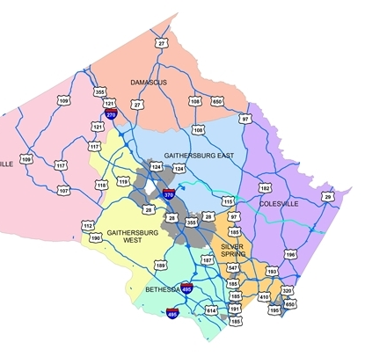
Introduction
Montgomery County, Maryland
Car Crashes collected by an Automated Crash Reporting System (ACRS) of the Maryland State Police
we aim to identify actionable insights that can lead to significant improvements in road safety

Slide 3

Real World Problem
How do lighting conditions impact traffic collisions in Montgomery County, and which locations require immediate streetlight installations to enhance road safety?
H₀ (Null Hypothesis): Lighting conditions have no significant impact on crash severity.
H₁ (Alternative Hypothesis): Lighting conditions significantly affect crash severity.
By analyzing high-risk crash zones, we aim to determine how lighting contributes to collision severity and identify priority areas where streetlight installation can mitigate accident risks.

Slide 4

Dataset
Crash Reporting – Drivers Data
Format: CSV
Structured Data
Numerical, Text, Location Variables
192k Rows, 39 distinctive columns
Time: January 1st, 2015 – January 21st, 2025
Location, Crash Severity, type of crash, weather conditions, traffic conditions, Driver at Fault(?)

Slide 5
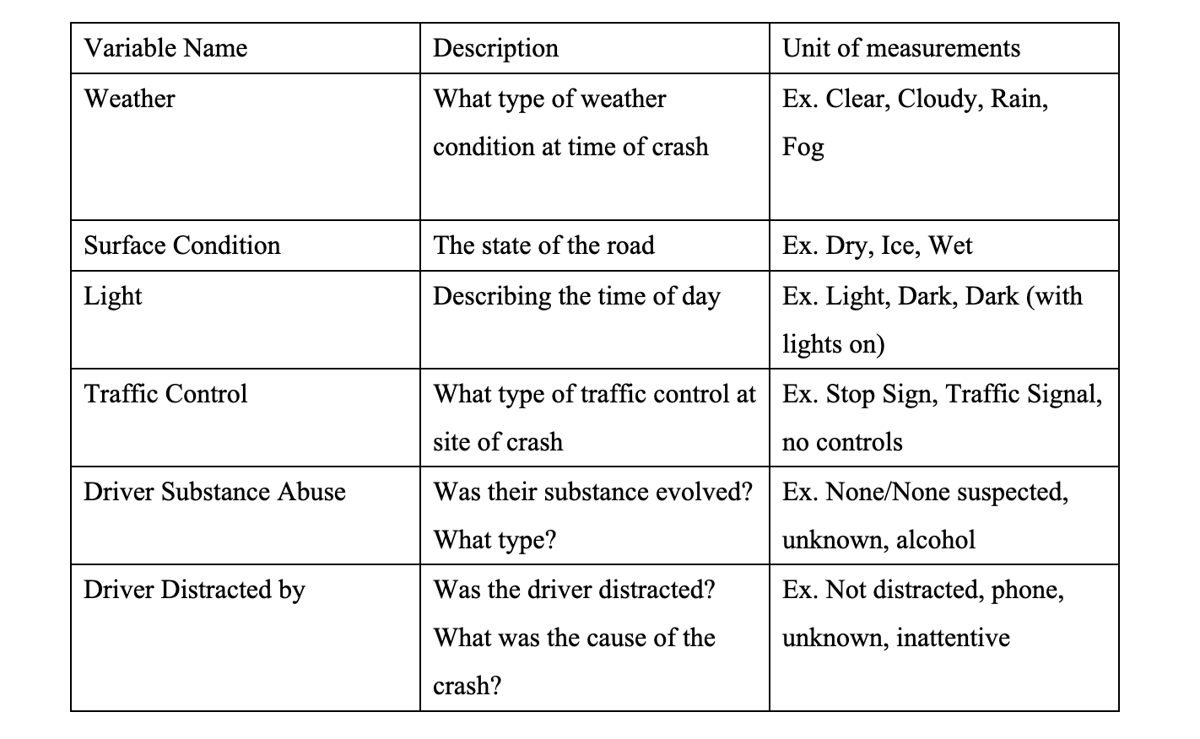
Data Acquisition
Montgomery County Police, Gaithersburg Police, Rockville Police, or the Maryland-National Capital Park Police
Worked in Python
Feature Engineering:
Weather Road Condition Interaction
Combines weather conditions and road surface data
Time of Day Classification
Morning, Afternoon, Evening, & Night
Severity Index
Severity metric using injury levels, vehicle damage, and road conditions

Slide 6
Methodology
Python
Data Cleaning & Analysis
Critical Values: Lighting Conditions & Road Surface Conditions
Clustering Techniques:
K-Means
DBSCAN
Utilized to identify high-risk crash zones
Statistical Hypothesis Testing
Chi-Square Test
Significance of lighting conditions on crash severity

Slide 7
Methodology cont.
K-Means clustering was implemented to segment crash-prone areas into high, moderate, and low-risk zones based on accident severity and frequency.
DBSCAN clustering was used to detect high-density crash hotspots in poorly lit areas, identifying locations where street lighting improvements are most needed.
Chi-Square testing confirmed a significant correlation between lighting conditions and crash severity, reinforcing the need for infrastructure upgrades in identified zones.
Geospatial visualizations, including heatmaps and scatter plots, were generated to illustrate patterns in accident distribution and pinpoint areas requiring intervention.

Slide 8


Slide 9
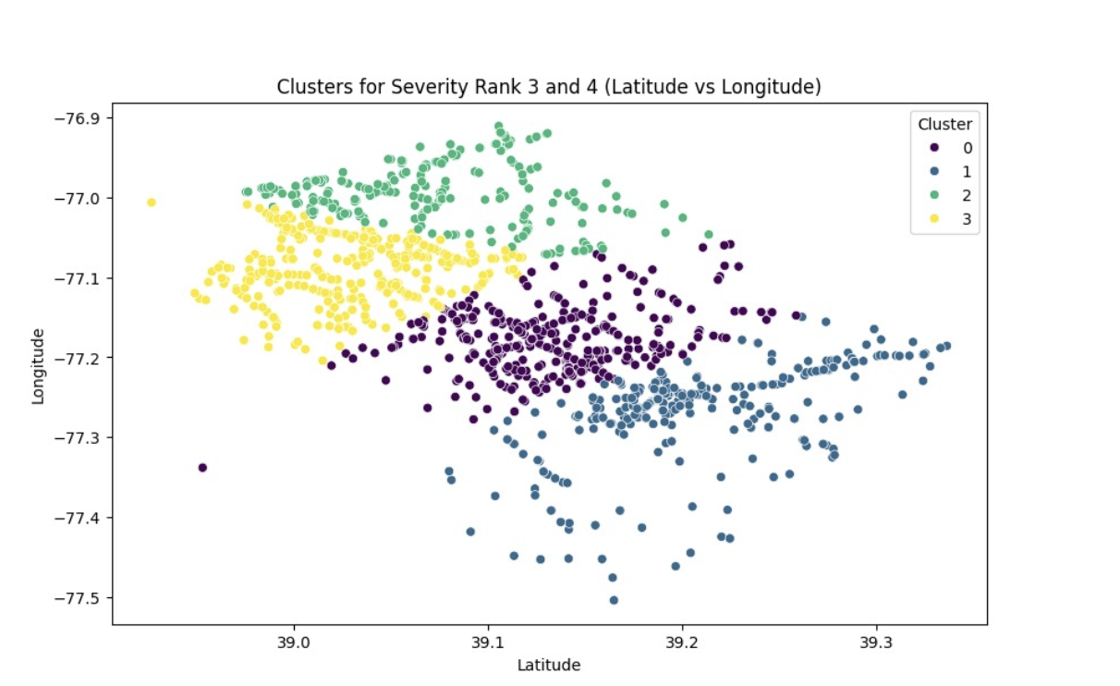
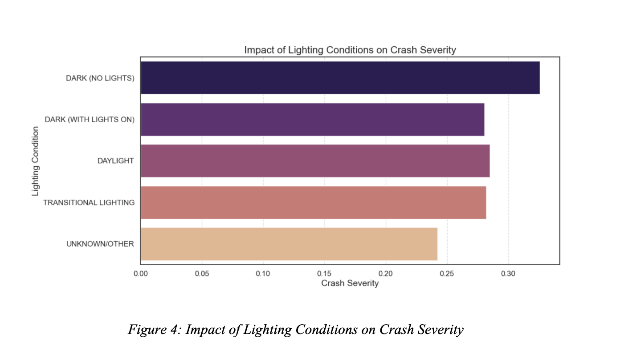
K Means Clustering
Figure 2: Clustering
K-Means & DBSCAN clustering identified high-risk zones based on severity and frequency.
Dark purple clusters indicate severe crashes, guiding resource allocation for lighting, law enforcement, and infrastructure improvements.
Figure 4: Impact of Lighting Conditions on Crash Severity
Dark (No Lights) zones show the highest crash severity, proving inadequate lighting worsens accidents.
Chi Square Test
P-value = 4.6
This extremely low p-value indicate statistically significant relationship between lighting conditions and crash severity.

Slide 10
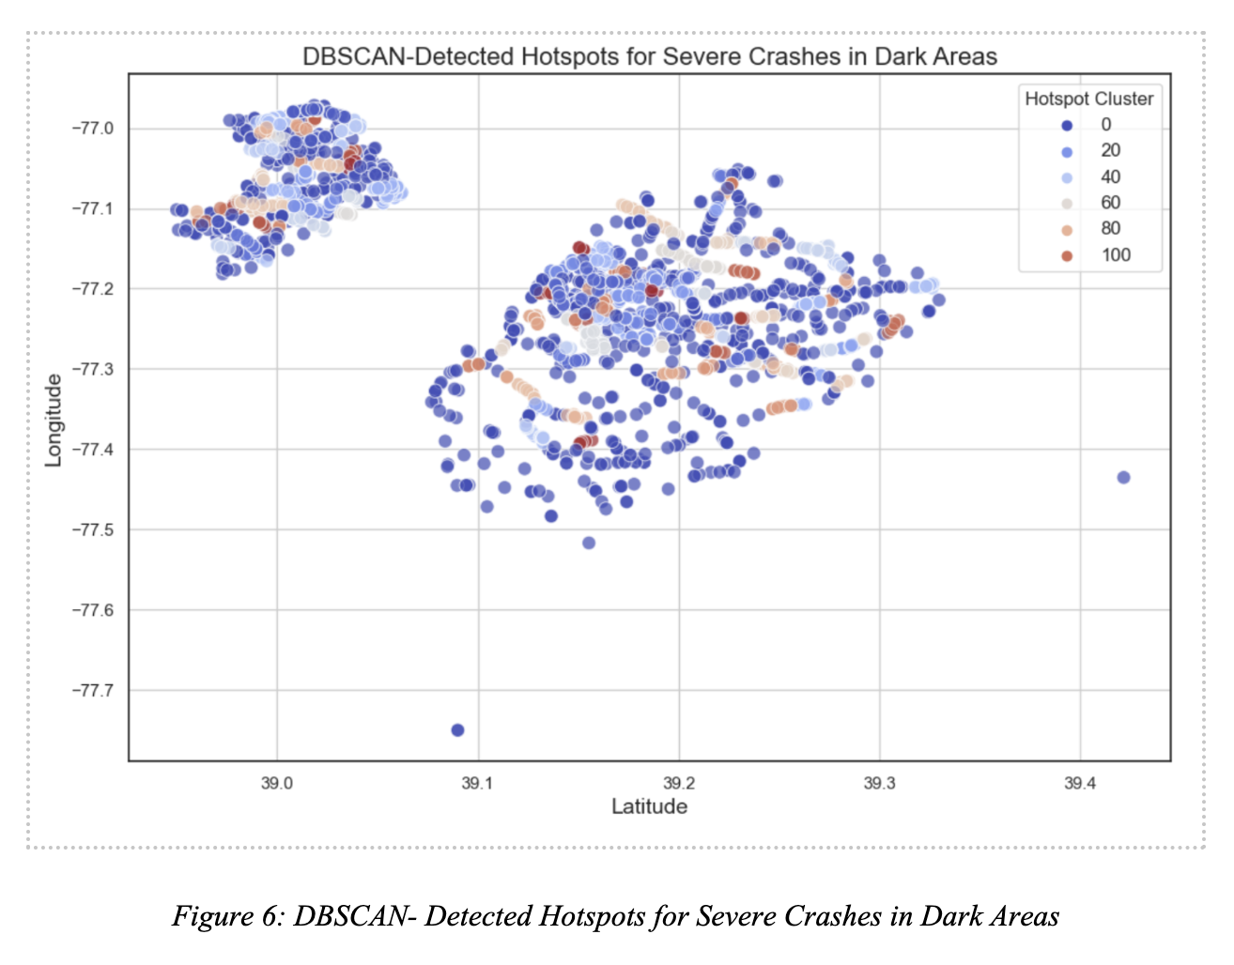
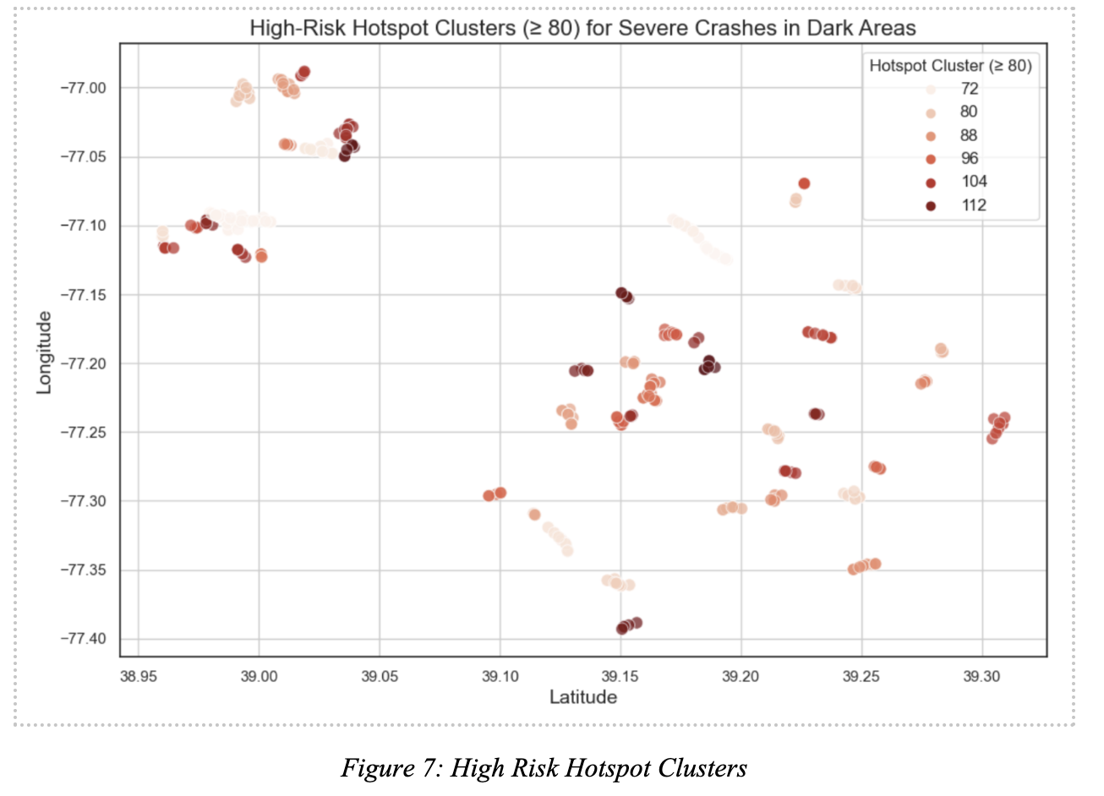
DBSCAN Clustering
Figure 6: DBSCAN-Detected Hotspots
DBSCAN clustering identified severe crash hotspots in dark areas, highlighting high-density accident zones requiring immediate intervention.
Red and orange points indicate the most dangerous locations, reinforcing the need for improved street lighting and infrastructure upgrades.
Figure 7: High-Risk Hotspot Clusters (≥80)
Filtered DBSCAN clusters (severity ≥ 80) pinpoint the most critical crash zones, ensuring targeted safety measures.
Findings emphasize the urgency of strategic lighting installations in these high-risk areas to reduce severe crashes and improve road safety.

Slide 11
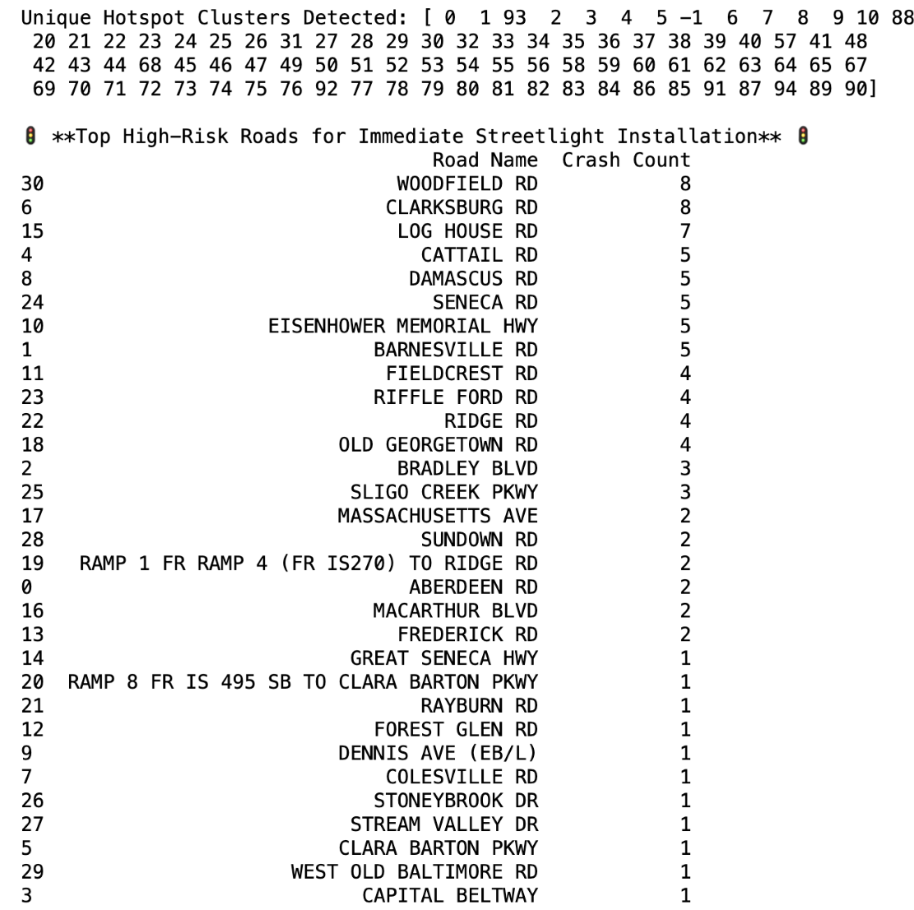


Top High-Risk Roads
Woodfield Road (8)
Clarksburg Road (8)
Log House Road (7)
Cattail Road (5)
Damascus Road (5)

Slide 12
Results
Lighting conditions significantly impact crash severity; dark areas have the highest accident rates.
K-Means and DBSCAN clustering identified high-risk zones, prioritizing areas for intervention.
Key roads with severe crashes need urgent streetlight installation and traffic control improvements.
Findings validate targeted infrastructure upgrades, optimizing resource allocation for road safety enhancements.
Structured intervention plans for high, moderate, and low-risk zones will help reduce severe crashes and fatalities.

Slide 13
Conclusion
Data-driven insights confirmed lighting conditions significantly impact crash severity.
K-Means and DBSCAN clustering effectively identified high-risk zones for targeted interventions.
Streetlight installations and traffic control improvements are critical to reducing severe crashes.
Future work includes evaluating post-intervention crash data and integrating smart lighting solutions.
Collaboration with authorities and urban planners ensures sustainable road safety enhancements.

Slide 14
References
Data Montgomery. Crash Reporting - Drivers Data. (2025, February 7). Crash Reporting Drivers Data | Open Data Portal. Data Montgomery. https://data.montgomerycountymd.gov/Public-Safety/Crash-Reporting-Drivers-Data/mmzv-x632/about_data
Data.Gov. (2025, February 7). Crash Reporting – Drivers Data. Data.Gov. https://catalog.data.gov/dataset/crash-reporting-drivers-data
Montgomery Planning. (2022, July). Predictive Safety Analysis Final Report. Montgomery
County. https://montgomeryplanningboard.org/wp-content/uploads/2022/07/Attachment-A.-PSA-Final-Report-July-2022.pdf

