Slide 1


Team Details
TwinOps: a rehearsal space for network repairs
AI tests a fix in a separate network. An engineer decides what to apply.
HackSmith / Prabhakar Srivastava (leader) / Shivam Anand
Theme: Future of Work & Enterprise Productivity
Notes:
Registered team and names confirmed by the project owner on 16 October 2026. Project: TwinOps. The network topology and incidents are synthetic. Contact email addresses are intentionally omitted from this public deck.

Slide 2
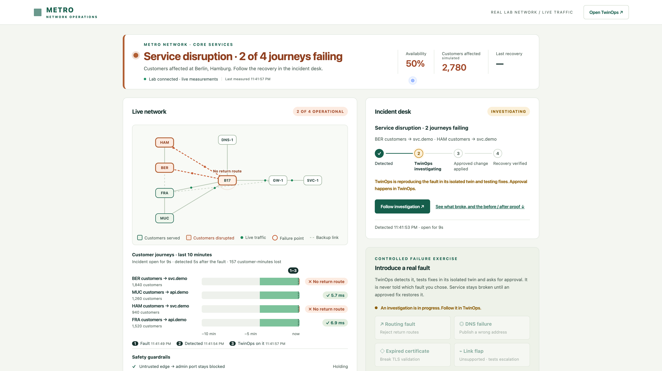
Brief about the idea
Two branch sites lose access. Which repair can we trust?
The engineer’s problem
A quick rollback might restore access
while breaking another connection.
TwinOps rehearses the repair
A digital twin is a separate copy of the
affected network. AI tests alternatives
there and gives the engineer evidence
before asking for approval.
Metro is our synthetic application network. A “journey” is a site-to-service connectivity check.
Notes:
Real application screenshot from the recorded routing incident on 15 October 2026. BER means Berlin and HAM means Hamburg. Two of four journeys fail when a route filter blocks their return routes. The prototype serves network operations engineers, SREs and change approvers. Source: https://github.com/prabhakarcs786/twinops/blob/main/docs/evidence/recorded-demo.json.

Slide 3
Opportunities
TwinOps sits between an incident and an approved change.
Read observations
Experiment on the twin
Authorize writes to the target
Network symptoms
What is failing?
TwinOps
Test repairs in isolation
Engineer review
Inspect the evidence
Approved change
Verify recovery
Different approach
Test competing repairs and challenge them before change review.
Problem solved
A fix that restores access can still fail another required check.
Unique value
One reviewable record links the exact change, tests and rollback.
Notes:
This diagram explains TwinOps’s role in an operations workflow. The implemented target is the synthetic Metro application lab, not a production carrier network. Evidence passes to the human reviewer before authorized apply. Sources: https://github.com/prabhakarcs786/twinops/blob/main/docs/TECHNICAL_GUIDE.md and https://github.com/prabhakarcs786/twinops/blob/main/docs/evidence/recorded-demo.json.

Slide 4
List of features offered by the solution
TwinOps explains why one repair survives and another fails.
Gemini proposes repairs. Twin tests and fixed policy checks decide which can proceed.
Recorded candidate | Access restored | IPv6 check | Decision
Remove one bad route rule | Yes | Pass | Passed tests
Roll back the full configuration | Yes | Fail | Stopped
Both restored the initial journeys. Only the narrow repair preserved IPv6 reachability.
The workbench retains rejected alternatives, the exact diff and a rehearsed rollback for review.
Notes:
An editable summary of candidates A and B from the actual hosted run. Candidate B was superseded after a failed IPv6 challenge. Additional revisions and a restart candidate also failed. The chosen repair removes B17 route-filter entry 30. Sources: https://github.com/prabhakarcs786/twinops/blob/main/docs/evidence/recorded-demo.json and the recorded workbench comparison. Supported exercises include routing, DNS and TLS.

Slide 5
Process flow diagram
One routing incident, from failed access to verified recovery
Steps 1–5: TwinOps reads the application and experiments only on its twin.
1 Observe
Two journeys fail
2 Investigate
Gemini ranks causes
3 Reproduce
Copy the affected slice
4 Compare
Test candidate repairs
Continue with the surviving evidence
8 Apply + verify
Four journeys recover
7 Approve
Bind change + state
6 Review
Read diff and rollback
5 Challenge
Check for regressions
Missing evidence blocks a proposal. Failed recovery triggers rollback handling and escalation.
Notes:
Follow the top row left to right, then the bottom row right to left. The selected exercise fault is never sent to the planner. Step 5 challenges the alternatives before the engineer reviews evidence. The apply gateway rechecks evidence age and target drift. Recorded outcome: four journeys and three safety controls healthy, with 11 of 11 recovery checks across three windows. Source: https://github.com/prabhakarcs786/twinops/blob/main/docs/evidence/recorded-demo.json.

Slide 6
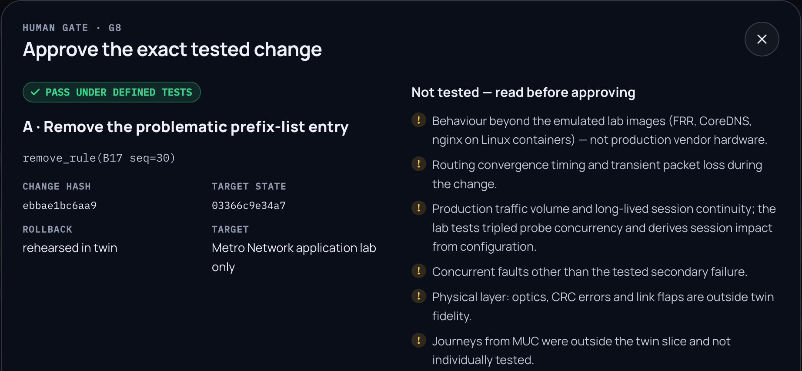
Wireframes / interface: the implemented workbench
The engineer approves a specific, tested change.
Exact change
Remove rule 30
on router B17.
Tested rollback
Rehearse reversal
before approval.
Visible limits
Show what the twin
did not test.
Recorded workbench, 15 October 2026. Passing tests alone does not authorize a network change.
Notes:
Actual screenshot from the hosted recording, cropped to the evidence panel. The credential form is outside the crop. The operator sees the tested action, content and target-state hashes, rehearsed rollback and explicit limits. The private approval credential is never included in submission materials. Public evidence: https://github.com/prabhakarcs786/twinops/blob/main/docs/evidence/recorded-demo.json.

Slide 7
Architecture diagram of the proposed solution
Engineer in the browser
React workbench
Vertex AI
Gemini 2.5 Flash
Google-managed AI
Proposes structured repairs
Cloud Run runtime
Test fixes
Metro application lab
Measures connectivity
FastAPI orchestrator
Validates proposals
Isolated digital twin
Runs repair experiments
Symptoms
Proof Gate + apply gateway
Human approval required
Approved apply + fresh checks
Measured evidence
FRR / CoreDNS / nginx run the protocols. SQLite stores evidence on the instance.
Secret Manager supplies credentials. Cloud Build + Artifact Registry deliver the container.
Notes:
Logical architecture of the deployed prototype. Blue lines show observations, structured AI requests and experiments. Green lines show evidence-gated and human-authorized writes, followed by verification. The model has no direct network-write tool. Metro and the twin use separate Linux network namespaces inside one Cloud Run instance. SQLite and lab state are ephemeral. Sources: https://github.com/prabhakarcs786/twinops/blob/main/backend/twinops/cloudrun.py, https://github.com/prabhakarcs786/twinops/blob/main/deploy/cloudrun-lab.Dockerfile and https://github.com/prabhakarcs786/twinops/blob/main/docs/TECHNICAL_GUIDE.md.

Slide 8
Technologies used in the solution
Technology | Role in the working prototype
Cloud Run (second generation) | Hosts TwinOps, Metro and isolated Linux namespace networks
Gemini 2.5 Flash / Vertex AI | Hypotheses, repair proposals, challenges and bounded revisions
Google Gen AI SDK | Structured model requests with schema and catalogue validation
Secret Manager | Provides the private operator approval credential
Cloud Build / Artifact Registry | Builds and stores the deployment container
React / FastAPI / SQLite | Review interface, orchestration and instance-local evidence
FRR / CoreDNS / nginx | Real routing, DNS, IPv4/IPv6 and TLS experiments
Firebase and Firestore are not used. Cloud Run provides the deployment path.
Notes:
Sources: https://github.com/prabhakarcs786/twinops/blob/main/backend/pyproject.toml, https://github.com/prabhakarcs786/twinops/blob/main/frontend/package.json, https://github.com/prabhakarcs786/twinops/blob/main/deploy/cloudrun-lab.sh. Technology eligibility clarification supplied by the owner on 16 October 2026: Firebase and Firestore are not mandatory when using Cloud Run.

Slide 9
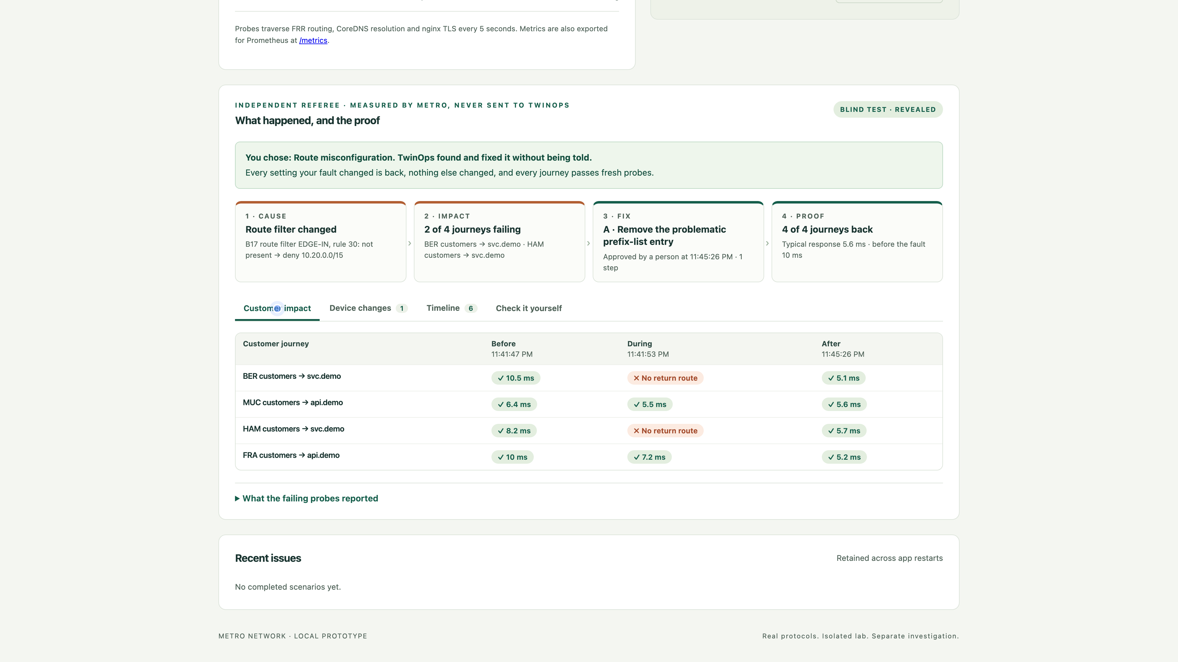
Snapshots of the prototype
Two failed journeys. One rule removed. Four journeys healthy.
Independent check
Metro probes the
network again.
Berlin and Hamburg
recover. Munich and
Frankfurt stay healthy.
The planner does not
score its own success.
Actual hosted run, 15 October 2026. Synthetic sites and customer counts. Timings are illustrative.
Notes:
Cropped actual Metro screen from the same incident as the video. The before/during/after rows are independent connectivity measurements. BER = Berlin, HAM = Hamburg, MUC = Munich, FRA = Frankfurt. Selected repair: remove B17 prefix-list entry 30. All four journeys and three safety controls were healthy afterward. This is one lab run, not a production reliability or latency improvement claim. Source: https://github.com/prabhakarcs786/twinops/blob/main/docs/evidence/recorded-demo.json.

Slide 10
Prototype performance report / benchmarking
Evidence scope | Observed result
Hosted Gemini repair 15 October 2026 | 10 model calls, 0 fallbacks and 0 diagnosis writes
Candidate experiments Same hosted repair | 5 experiments, 13 challenges and 79 probes
Post-change recovery Same hosted repair | 11/11 checks passed in each of 3 observation windows
Deterministic evaluation 13 October 2026 | 320 cases: 200 verified repairs, 120 abstentions, 0 unsafe passes; 13/13 controls passed
The 320-case suite uses a deterministic model twin and makes zero Gemini calls.
Production reliability and operator time savings still need separate evaluation.
Notes:
Sources: https://github.com/prabhakarcs786/twinops/blob/main/docs/evidence/recorded-demo.json and https://github.com/prabhakarcs786/twinops/blob/main/docs/evidence/foundation-evaluation.json. The evidence scopes are distinct; no model-versus-runbook superiority is claimed. All results are scoped to the recorded protocol-lab run or deterministic model cases. Human productivity trials are pending. The video shortens waiting and review time and is not a repair-time benchmark.

Slide 11
Additional details / future development
Today: a shared prototype
Routing, DNS and TLS exercises on synthetic topology.
One lab instance, ephemeral evidence and a shared approval credential.
Next: operator evaluation
Compare investigation and review effort against a baseline.
Measure escalation, rollback outcomes and decision quality.
Then: a read-only shadow pilot
Validate network adapters and twin coverage against real environments
before enabling operational change.
For wider deployment
Durable evidence storage, individual identity, per-target isolation,
owned monitoring and tested recovery are required.
Notes:
Sources: https://github.com/prabhakarcs786/twinops/blob/main/docs/TECHNICAL_GUIDE.md#limits-and-next-steps and https://github.com/prabhakarcs786/twinops/blob/main/docs/SUBMISSION.md. These are planned steps, not implemented production capabilities. Physical hardware, routing convergence at production scale and arbitrary concurrent faults remain outside validated fidelity.

Slide 12
Public repository, demo video and final product
GitHub public repository
https://github.com/prabhakarcs786/twinops
Demo video
https://youtu.be/0LjDHiUBy0Y
Final product: TwinOps workbench
https://twinops-live-705406130795.europe-west1.run.app/workbench
Connected application: Metro Network
https://twinops-live-705406130795.europe-west1.run.app/metro/
Review access and walkthrough: GitHub / docs / JUDGE_GUIDE.md
Notes:
Public links checked on 16 October 2026. The current public video preserves the hosted repair described in this presentation. Waiting and review time are shortened. Approval access is provided privately by the project host; no credential is included in this deck.

Slide 13


