Slide 1
Team Name: Crazy Brains Team Size:1 Team Leader: Prabhanjan Kumar Team Members : 1.Prabhnajan Kumar
IBM HACK CHALLENGE 2020

Slide 2
Problem Statment
Predicting the Energy output of Wind Turbine based on Weather Conditions

Slide 3
Description
Wind Energy plays an inceasing role in supply of the energy world wide
The Energy output of wind farm is highly dependent on the wind conditions
To Avoid costly production we need to predict power more accurately

Slide 4
Solution
To Develop a Time Series model to predict the power output based on the weather condition
We need to predict wind power from 1 hour to 72 hours in future

Slide 5
Why Time Series model
To predict the power in future doesn’t depend on current weather conditions it require previous values of the weather conditions.
LSTM’s give better results for this type of Sequential problems.

Slide 6
LSTM(Long Short Term Memory)
LSTM is a type of neural network well-suited to time series data.
LSTM’s allows past information at later time
LSTM process a time series step-by-step, maintaining an internal state summarizing the information they've seen so far.

Slide 7
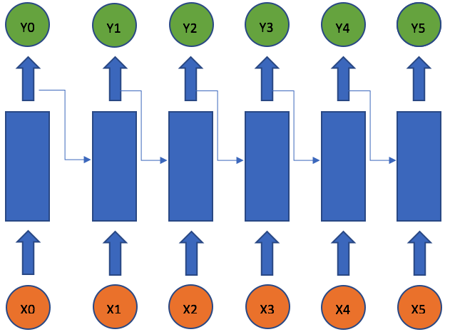
LSTM’s

Slide 8
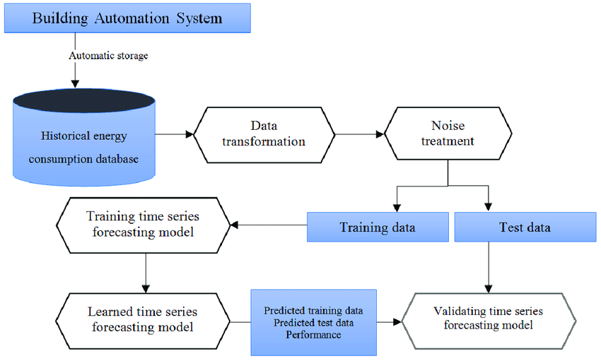
Flow chart of the model

Slide 9
Software Requirments
Language : Python
Packages : tensorflow,sklearn,matplotlib,
numpy,pandas
installation:
pip install <name of package>

Slide 10
tensorflow
TensorFlow :bundles together a slew of machine learning and deep learning models and algorithms and makes them useful it helps to build models easily.
It is easy to build models with tensorflow.

Slide 11
Pandas
Pandas is used for data analysis and manipulation includes loading data,deleting coloums,etc..

Slide 12
Numpy
NumPy is a general-purpose array-processing package.It provides a high-performance multidimensional array object, and tools for working with the arrays.

Slide 13
matplotlib
matplotlib is used to visualization of data. visualizing data is important to understand easily.

Slide 14
Hardware Requirment
GPU :4GB(NVIDIA-CUDA Compatible)
RAM :4GB

Slide 15
dataset
dataset=pd.read_csv('T1.csv')
dataset.head(10)

Slide 16
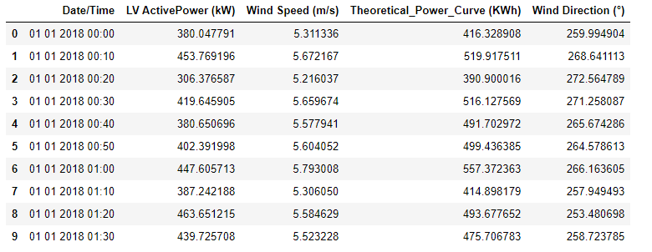
data

Slide 17
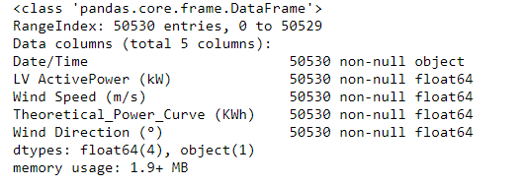
Data information

Slide 18
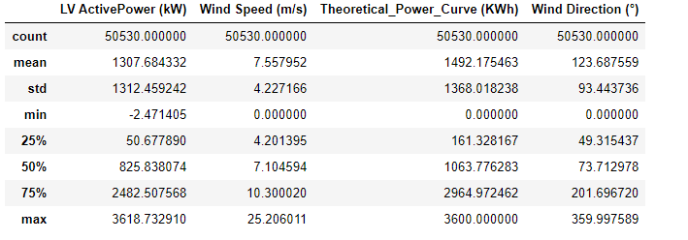
Data Description

Slide 19
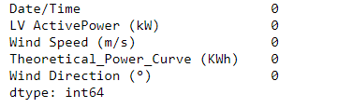
Checking Null Values

Slide 20
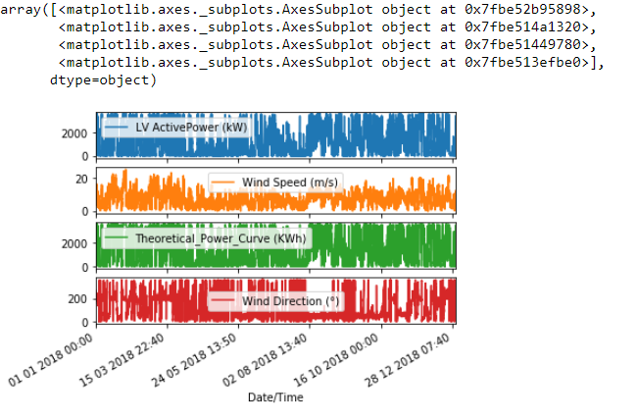
Features Plot

Slide 21
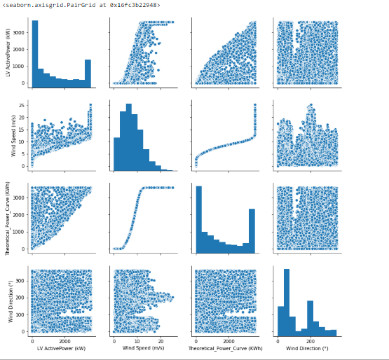
Pair plot

Slide 22
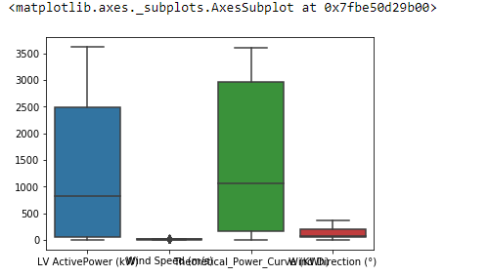
Box plot

Slide 23
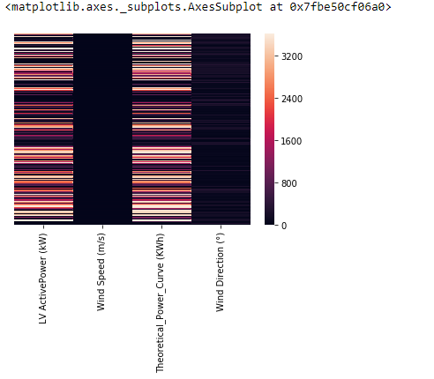
Heatmap

Slide 24
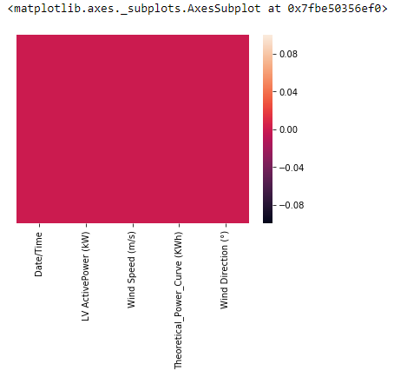
Heatmap of null values

Slide 25
Data Preprocessing
from sklearn.preprocessing import MinMaxScaler
scale=MinMaxScaler(feature_range=(0,1))
data_in=scale.fit_transform(data_in)
data_out=scale.fit_transform(data_out)

Slide 26

Spliting data to train,test sets

Slide 27
Model
model =Sequential()
model.add(LSTM(120,input_shape=x_train_single.shape[-2:],return_sequences=True))
model.add(Dropout(0.25))
model.add(LSTM(72, activation='relu',return_sequences=True))
model.add(Dropout(0.35))
model.add(LSTM(32, activation='relu'))
model.add(Dropout(0.3))
model.add(Dense(72,activation='linear'))
model.compile(optimizer=tf.keras.optimizers.Adam(lr=3e-4), loss='mae')

Slide 28
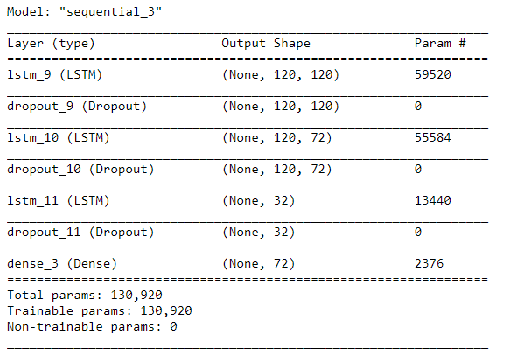
Model summary

Slide 29
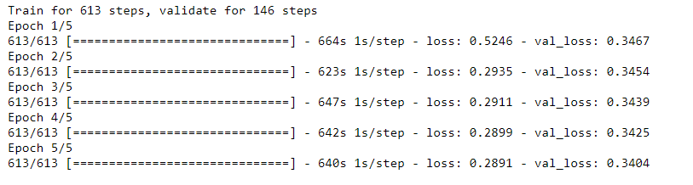
Model results

Slide 30
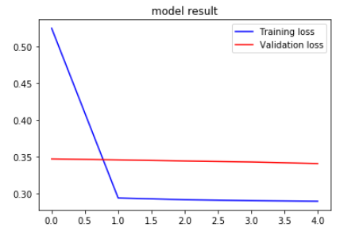
Ploting results

Slide 31
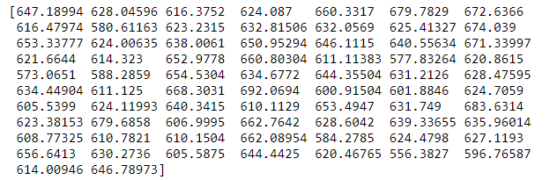
Predictions

Slide 32
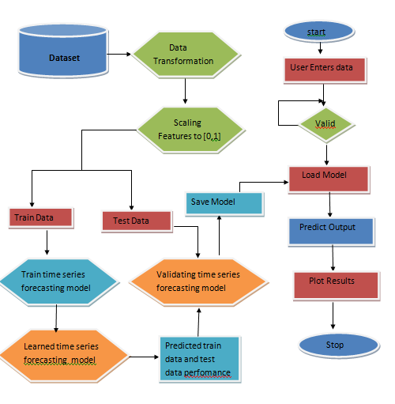
Flow Chart

Slide 33

User Interface

Slide 34

UI

Slide 35
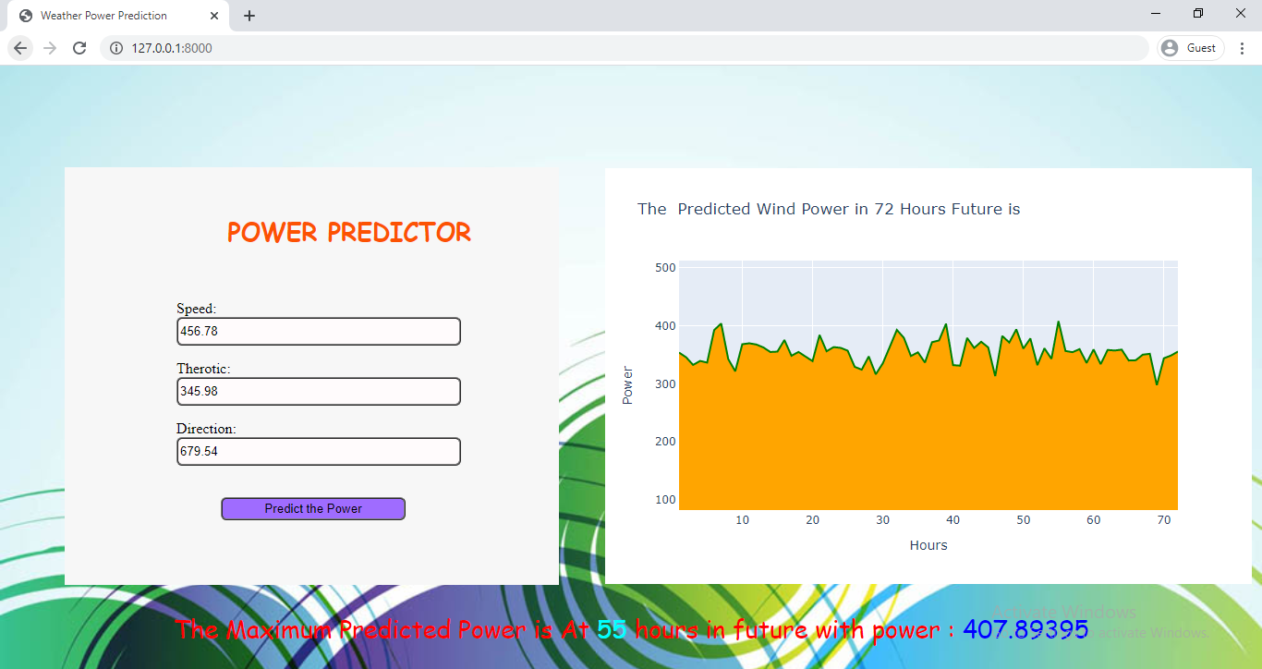
UI

Slide 36
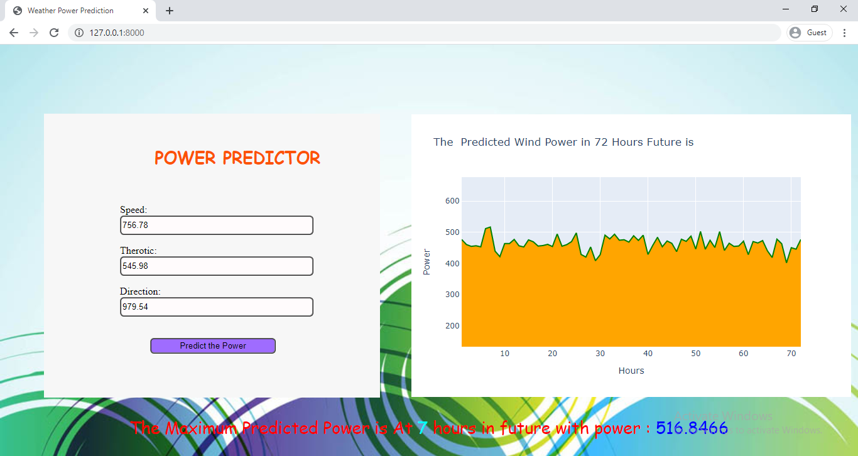
UI

