Slide 1
Pancake Flipping Analysis
A case study by PayPal

Slide 2
Data and challenge intro
Summary:
Arielle and Boris compete in the little-known sport of pancake flipping and have both been nominated for this season's "best pancake flipper" award. Half the people in the pancake flipping league office think Arielle is the better pancake flipper, and the other half think Boris is, so they have retained a data scientist to help solve the issue.
Variables from the data:
match_day - numerical day of the match
name - flipper's name
hand - hand used (right or left)
attempts - number of attempts/flips for the match in that day
score - succesful no of flips for the match in that day
What to determine?:
Is Arielle or Boris the better pancake flipper? Justify your decision. Do both sides have a case here?

Slide 3
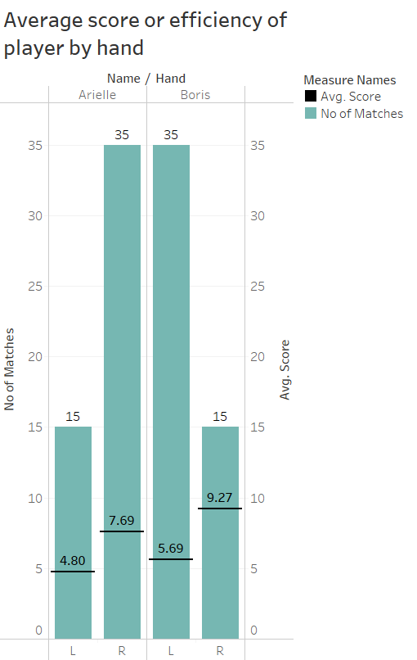
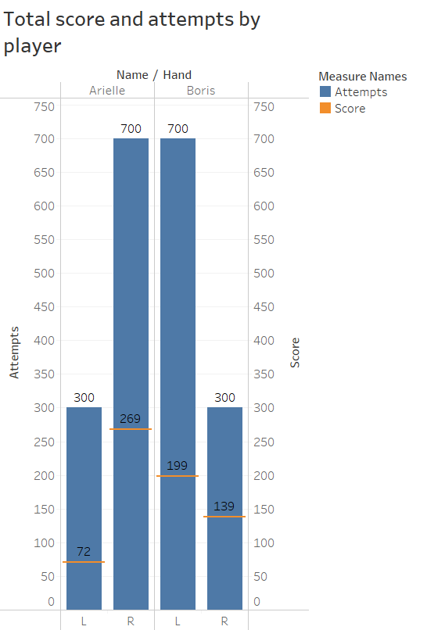
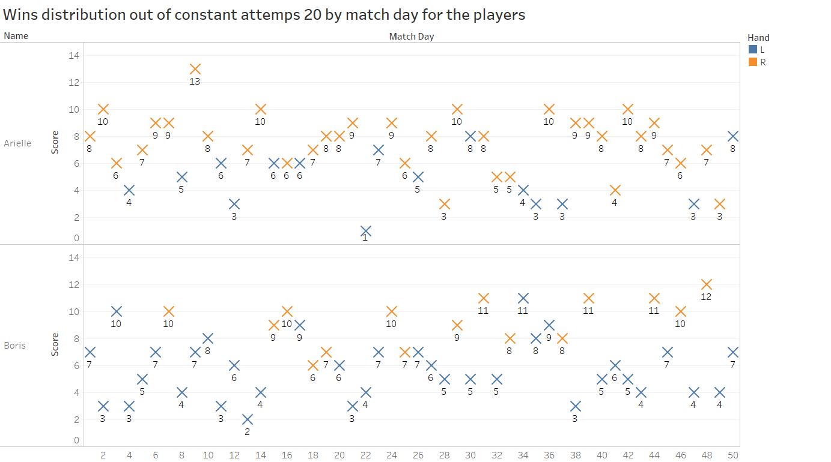
EDA-1
Few Observations:
Number of matched played by each player are same - 50
Arielle is a right hand favorite while Boris is left-handed base don the number of matches played
Even though Boris is left hand favorite, he's proven good with right hand too with average score of ‘9.27’ from the played 15 matches
Distribution of scores with progressing match day has no significant raise or fall – no relation between match day and score

Slide 4
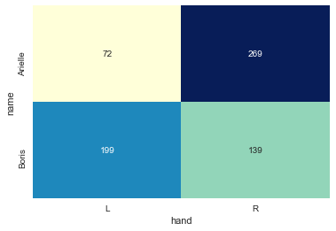
Chi-square
A 2X2 contingency table of Person vs Hand with total score as value
Performed a chi-square test to see if there is relation between the person and hand used for better success rate in the match
The chi-square test of independence works by comparing the categorically coded data that you have collected (known as the observed frequencies) with the frequencies that you would expect to get in each cell of a table by chance alone (known as the expected frequencies)
For the test to be effective, at least five observations are required in each cell of the contingency table.
We can interpret the test statistic in the context of the chi-squared distribution with the requisite number of degrees of freedom as follows:
If Statistic >= Critical Value: significant result, reject null hypothesis (H0), dependent.
If Statistic < Critical Value: not significant result, fail to reject null hypothesis (H0), independent
In terms of a p-value and a chosen significance level (alpha), the test can be interpreted as follows:
If p-value <= alpha: significant result, reject null hypothesis (H0), dependent.
If p-value > alpha: not significant result, fail to reject null hypothesis (H0), independent.
Result and interpretation:
Defining Hypothesis-
Ho: No relation between hand used and the person to flip
H1: significant relationship between hand used and person to flip
Obtained p-value is 2.1069426430623087e-23, result: Dependent (reject H0)
For an alpha of .05, the result is a dependent relation is found between the person and his favorite hand leading to win more game for him
It seems both the persons have their strength of winning getting enhanced by choosing their favorite to flip the pancake

Slide 5
Conclusion: With almost equal overall performance by both flippers, Boris is slightly more efficient with both hands compared to Arielle!
From the chi-square it is observed the influence of hand played on success rate is understood
With p>0.05 in two sample t-test we can say the means of players are similar have a closer to equal performance.
Plots of score distribution, mean and median of each player by hand also show a closer to equal performance by both players
With varied distribution of no of matches played by each hand, Boris has a very slight better efficiency over Arielle in Right hand tackle of flipping
The ratio of Boris with right hand is interesting with 139 score out of 15 matches this is 51% of Arielle score (269) within 42% of Arielle total matches (35) with right hand. this shows his efficacy with right hand
On the other hand, Arielle with left hand scored 72, which is 32% of Boris left-handed matches score (199) of similar ratio of matches as right hand above
In the overall performance (total score) even though Arielle is 3 points ahead of Boris with almost equal performance due to influence of hand, Boris is slightly a better performer over Arielle as per point 4 and 5

