Slide 1

Front End Engineering-I Project
Team Details :
Group/Team No: 26/PG-4
Parmeet Kaur, 2310992254
Parthav Chauhan, 2310992255
Prabhasees Singh Madaan (Team Leader), 2310992256
Faculty Coordinator:
Mrs. Preeti Saini
Chitkara University Institute of Engineering and Technology, Chitkara University, Punjab

Slide 2
Table of Contents
Introduction
Problem Statement
Technical Details
Key Features
Project Highlights
Conclusion

Slide 3
Introduction
Introducing Drawing Tool: A creative masterpiece crafted by a team of developers, Parmeet Kaur, Parthav Chauhan, Prabhasees Singh Madaan. This innovative drawing tool, built using HTML, CSS, and Java, empowers artists of all levels to unleash their imagination. With an intuitive interface and a wide range of features, This is set to revolutionize digital artistry.

Slide 4
Problem Statement
With this tool, artists can unlock their full potential. This tool offers a seamless blend of creativity and technology, providing a wide range of pen sizes, colors, and effects to elevate their artwork. Its intuitive design allows artists to focus on their craft, Say goodbye to limitations and hello to boundless artistic expression with this!

Slide 5
Technical Details
The following HTML code serves as the fundamental structure for a web-based drawing application. It comprises various essential components that collectively form the user interface:
Canvas: Located within the "paintArea" div, the "canvas" element acts as the central drawing surface. Users can directly create artwork or sketches on this canvas.
Tools: The page incorporates a selection of tools within the "options" section. These tools empower users to personalize their drawings:
Pen Size: Users can modify the pen size using a range input called "pen-slider." –
Color Selection: A color input named "color-input" enables users to choose their desired drawing color.
Background Color: Another color input labeled "color-background" allows users to select the canvas background color.
3. Functionality: The page includes buttons for specific actions: -
Clear erases all content from the canvas.
Pen" selects the drawing pen tool.
Erase" activates the eraser tool.
4. External Resources: To enhance aesthetics and provide interactive features, the page links to external resources such as a stylesheet named "16.css" for styling.
In summary, this HTML code establishes the foundation for a versatile digital drawing platform, offering users a wide range of tools and options to create and customize their artwork.

Slide 6
Technical Details
This CSS code is designed to style elements for a web-based drawing tool:
It utilizes a universal selector to reset default styling, ensuring elements have no padding or margins and follow the"Poppins" font.
The "#paintArea" is styled with a relative position, an 8-pixel solid border of #788eff, and takes up 70% of the viewport height while spanning the entire width.
3. The ".options" section features a background color of #788eff, 30 pixels of padding, and a height of 30% of the
viewport.
4. ".tools-row" organizes its child elements in a three-column grid with 20 pixels of gap and a 40-pixel bottom margin.
5. Customized styles for headings, buttons, range inputs, and color pickers enhance the drawing tool's aesthetics and
usability.

Slide 7
Technical Details
This JavaScript code sets up a simple drawing application on an HTML canvas. Here's a brief explanation of the code:
1. Initial Setup:
- The code starts by getting references to various HTML elements, such as buttons, sliders, and the canvas itself.
- It initializes some variables to keep track of the drawing state (e.g., whether the eraser is active, whether the user is currently drawing).
- The context of the canvas is obtained, which is used for drawing on the canvas.
2. Initialization Function (`init`):
- Sets initial values for the canvas, such as its size, background color, and the default pen color and size.
3. Touch Device Detection:
- The `is_touch_device` function checks whether the device is a touch device or not.
4. Mouse/Touch Position Handling:
- The `getXY` function calculates the exact x and y positions of the mouse or touch event relative to the canvas.
5. Drawing Functions:
- `startDrawing`: Initiates the drawing process when the user starts pressing the mouse button or touching the screen.
- `drawOnCanvas`: Handles the actual drawing process as the mouse or touch moves.
6. Event Listeners:
- Event listeners are set up for various mouse and touch events to trigger the drawing functions.
- Mouse down, touch start, mouse move, touch move, mouse up, touch end, and mouse leave events are all handled.
7. Pen and Eraser Mode:
- Buttons for switching between pen and eraser modes are provided.
- The pen size can be adjusted using a slider.
- Color can be changed using an input element of type color.
8. Background Color and Clearing:
- The background color of the canvas can be changed using an input element of type color.
- A "Clear" button is provided to clear the canvas.
9. Window Load Event:
- The `init` function is called when the window is fully loaded to initialize the drawing application.
In summary, this code sets up a drawing application where users can draw on a canvas, switch between pen and eraser modes, adjust pen size and color, change the background color, and clear the canvas. The application supports both mouse and touch input.

Slide 8
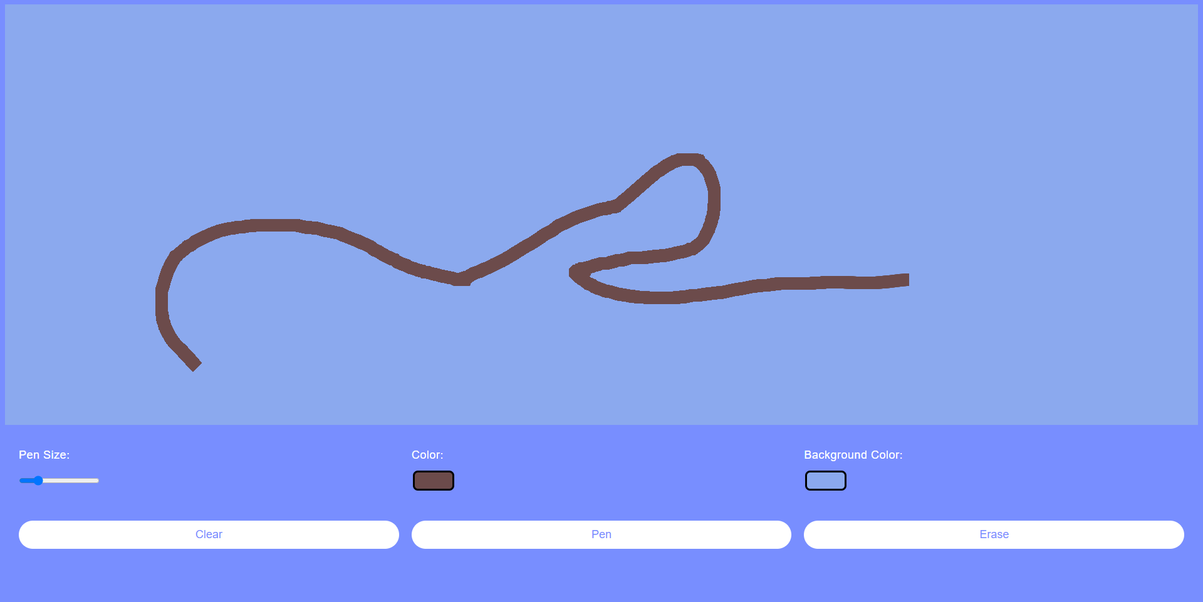
Key Features
Highlights of a drawing tool project created using HTML, CSS, and JavaScript include:
1. Interactive Canvas: An interactive canvas where users can draw, sketch, and paint digitally.
2. Customizable Brushes: Options to customize brush size and color.
3. Cross-Platform Compatibility: Compatibility with different devices and browsers for accessibility.
4. Responsive Design: A responsive design that adapts to various screen sizes.
5. Continuous Updates: Regular updates and improvements to enhance functionality and fix bugs.
6. Open Source: The option to make the project open-source, encouraging collaboration and contributions from the
developer community.

Slide 9
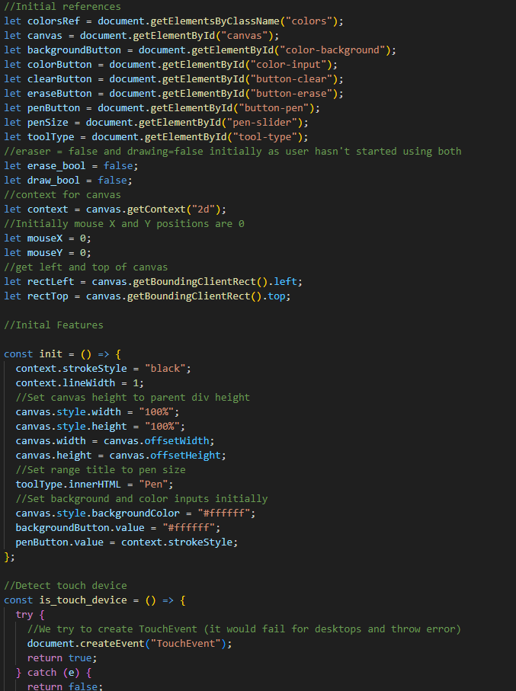
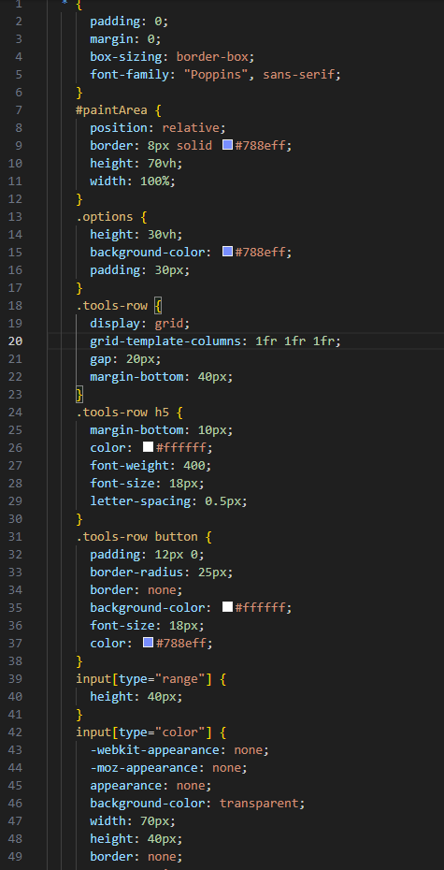
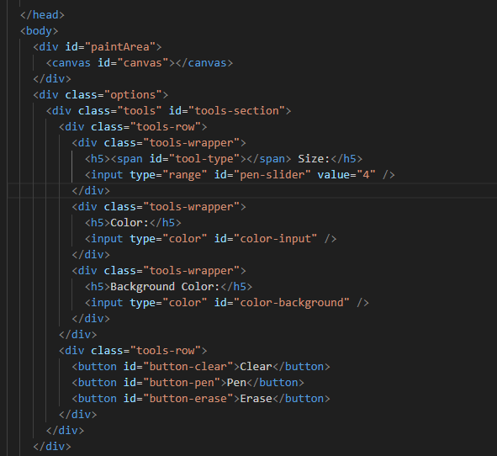
Project Highlights
CSS
HTML
JAVASCRIPT

Slide 10
Conclusion
In short, this drawing tool project demonstrates the dynamic combination of HTML, CSS, and JavaScript to create a flexible and accessible platform for digital artists. With an intuitive user interface, customizable brushes, and real-time drawing capabilities, it allows artists of all levels to unleash their creativity. Additionally, its accessibility features and cross-browser compatibility make it suitable for a diverse user base.
The project's potential for real-time collaboration and community engagement fosters a sense of belonging and collective creativity. As the project evolves with continuous improvements and updates, it is a testament to the power of web technology to facilitate artistic expression and digital art. Whether for professional artists or amateurs, this drawing tool project provides a canvas for limitless creativity and artistic exploration.

Slide 11


