Slide 1


Team Details
Team name: The 404 Brigade
Team leader name: Suraj S
Problem Statement: CareProof AI — Transparent Social Media Medical Fundraising:
Solving Claim Fraud, Creator Wallet Diversion, and Uncapped Overfunding via Gemini Multimodal Verification & Direct Hospital Escrow

Slide 2
Brief about the idea
The Core Problem
Social media raises millions for critical healthcare, but donors cannot verify bills, money lands in creator personal bank/UPI accounts, and viral posts raise 200-500% over bills with zero caps or accountability.
The CareProof Solution
A transparent, AI-assisted medical crowdfunding platform that bridges social campaigns directly with verified hospital billing escrow accounts (Apollo, Fortis, Tata Memorial) and real-time overfunding locks.
Google Gemini Multimodal Core
Uses Gemini 2.0 Flash to extract clinical line-items, cross-check claimed amounts against authentic hospital quotes (+89% inflation flags), audit viral social flyers, and generate multilingual 9:16 video scripts.

Slide 3
Opportunities
1. How different is it from existing ideas?
Existing platforms (GoFundMe, Milaap, Ketto) disburse money straight to creator personal accounts with zero hospital oversight and zero caps. CareProof AI enforces a 100% Zero-Wallet Architecture where funds route strictly to verified hospital billing accounts.
2. How will it be able to solve the problem?
• Clinical Verification: Gemini OCR audits hospital invoices before campaigns go live.
• Overfunding Lock: A thread-safe mutex lock caps donations at 100% and diverts surplus to pediatric funds.
• Cryptographic Receipts: Every donor gets an immutable SHA-256 transaction hash.
3. Unique Selling Proposition (USP)
★ Direct Hospital Escrow Guarantee (0.00% creator cut)
★ Thread-Safe Overfunding Mutex Lock & Emergency Pediatric Pool
★ Multimodal Gemini Vision Flyer Scanner for viral Instagram/TikTok posts
★ Multilingual 9:16 Vertical Reel Studio across 6 languages

Slide 4
List of features offered by the solution
Direct Hospital Escrow Routing
100% of proceeds settle directly to Apollo, Fortis, or Tata Memorial billing accounts. Influencer access: 0.00% BLOCKED.
Thread-Safe Overfunding Lock
Atomic mutex lock disables donations at $0 remaining and transparently routes overflow to the Hospital Pediatric Emergency Pool.
Multimodal Viral Flyer Scanner
Gemini 2.0 Flash Vision audits Instagram/TikTok flyers, detects personal UPI IDs (limsontt1@fbl), and migrates them to escrow.
Human-in-the-Loop Verifier
Gemini flags clinical inflation discrepancies (+89.2% on Vikram Singh); authorized medical verifiers sign cryptographic SHA-256 certificates.
Multilingual 9:16 Reel Studio
Generates high-converting vertical video scripts in Hindi, Spanish, Tamil, English, Bengali, and Marathi with smartphone preview.
Hospital Settlement Portal
Real-time billing ledger showing inward transfers, receipt hashes (CP-REC-XXXXX), and pediatric pool allocations for hospital accountants.

Slide 5
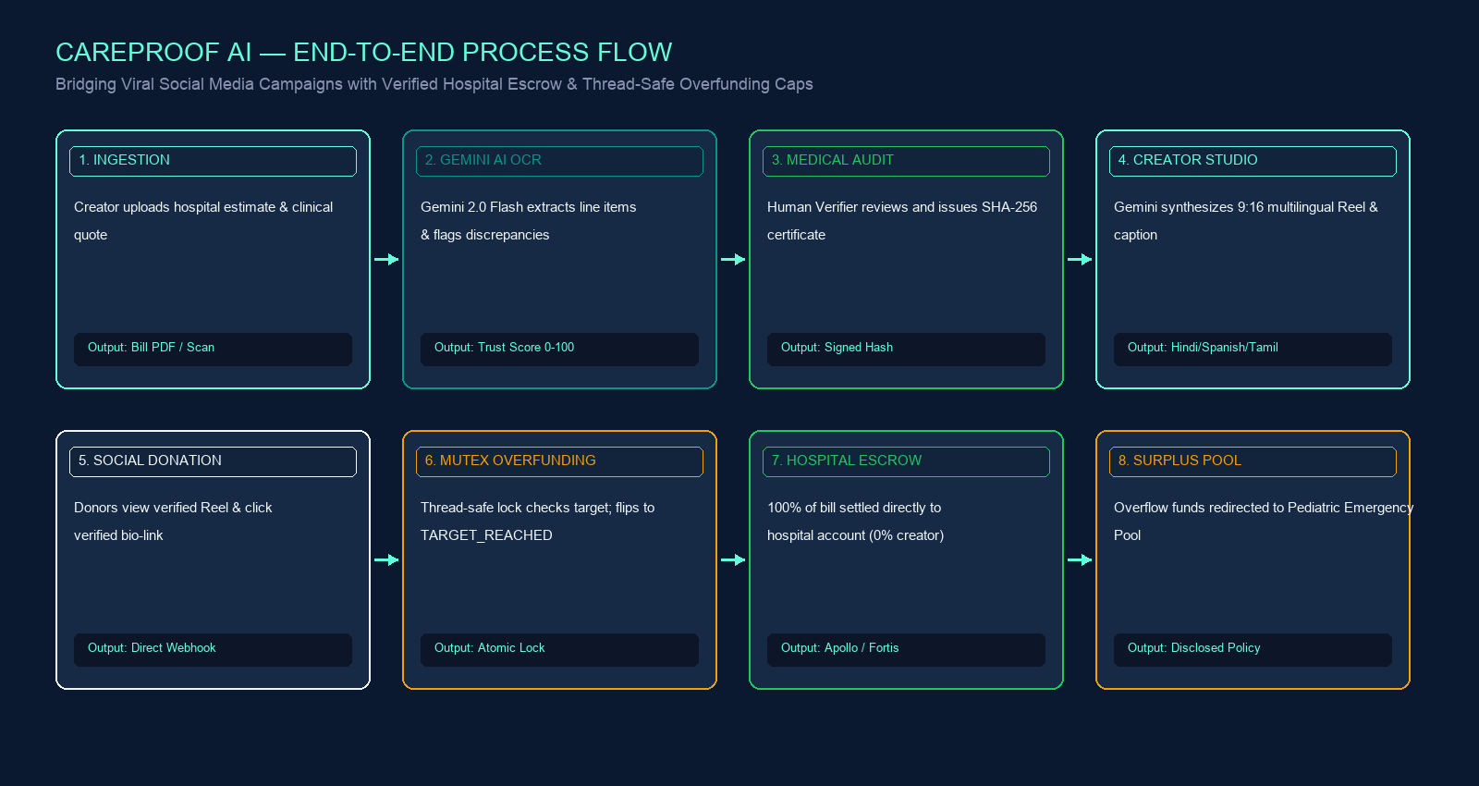
Process flow diagram or Use-case diagram

Slide 6
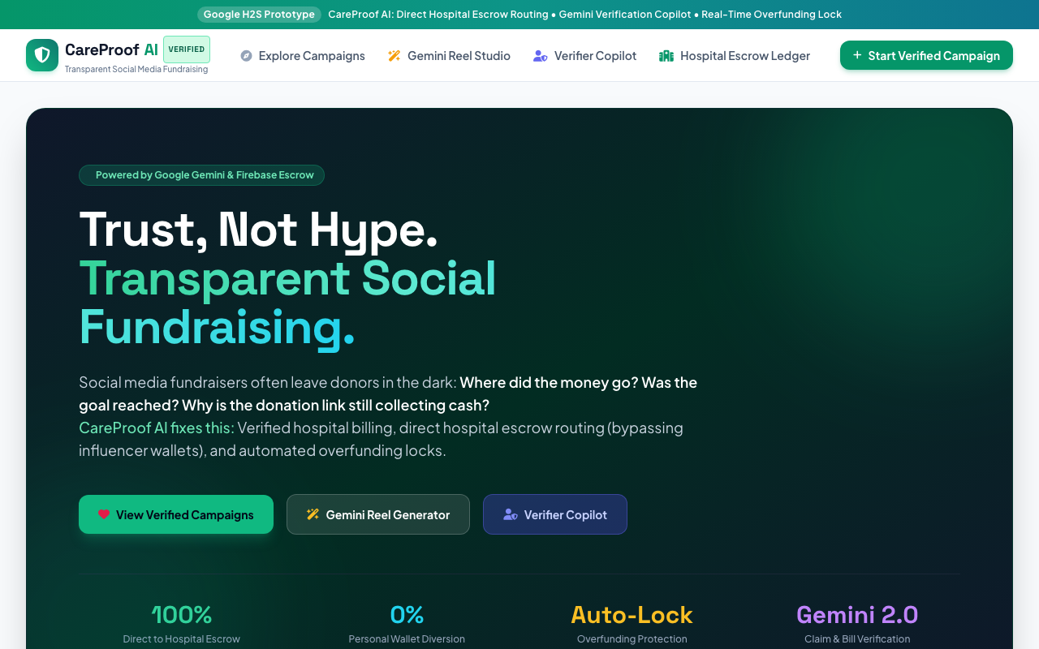
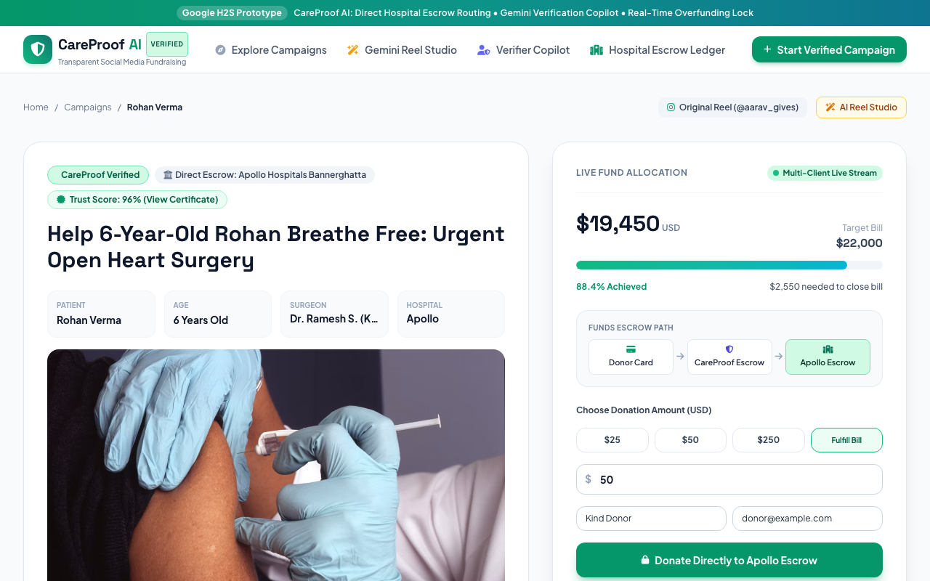
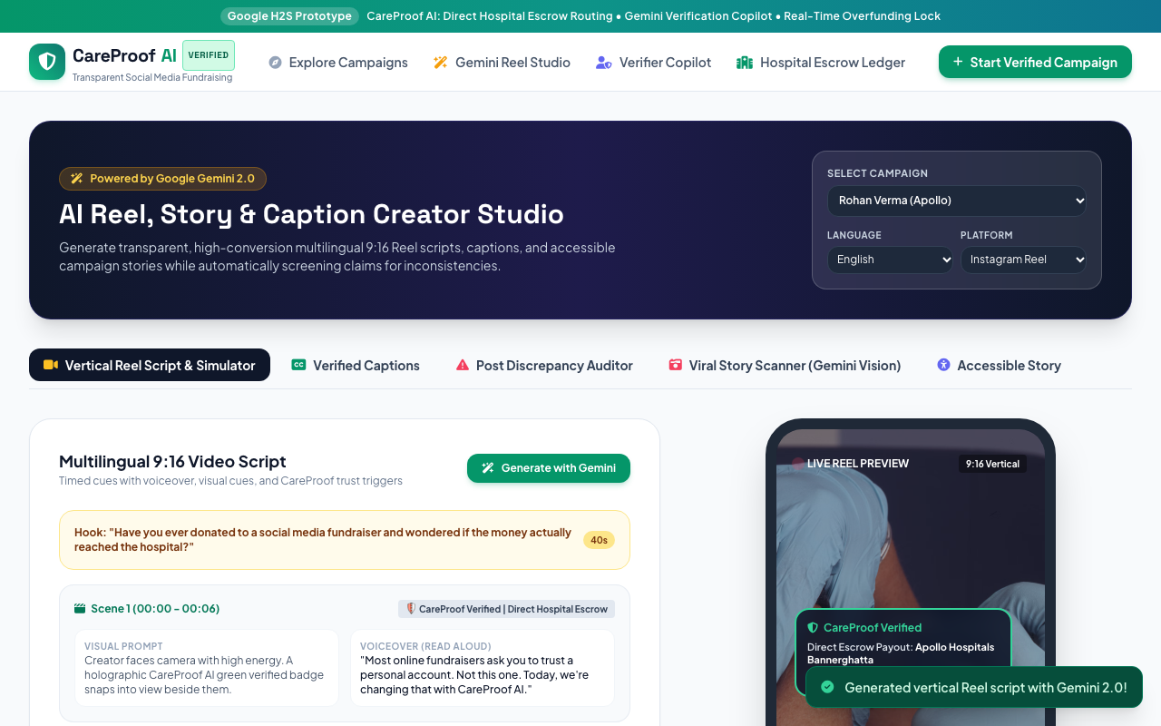
Wireframes/Mock diagrams of the proposed solution
1. Live Discovery Grid (/)
2. Direct Escrow & Overfunding
3. Gemini Reel Studio

Slide 7
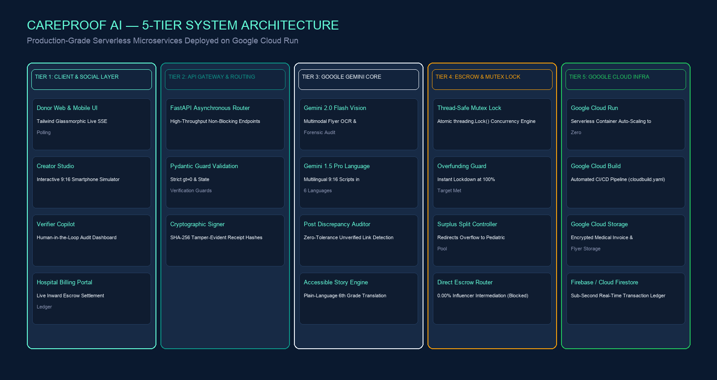
Architecture diagram of the proposed solution

Slide 8
Technologies to be used in the solution
Google Gemini 2.0 Flash
Multimodal Vision for viral flyer forensics, OCR on hospital bills, and sub-second reasoning.
Google Gemini 1.5 Pro
Multilingual 9:16 Reel scripts across 6 languages, culturally adapted hooks, and accessible story translation.
Google Cloud Run
Serverless container hosting with scale-to-zero when idle and instant concurrency auto-scaling.
Google Cloud Build
Automated CI/CD pipeline building Docker images directly from git commits (cloudbuild.yaml).
Google Cloud Storage
Encrypted storage for patient clinical quotes, medical records, and generated video assets.
Firebase / Cloud Firestore
Sub-second real-time database powering live donation streams and immutable transaction audits.
FastAPI & Python 3.11
High-throughput asynchronous core engine with Pydantic validation guards and threading.Lock mutex.
Tailwind & Glassmorphic UI
Mobile-first responsive donor experience with real-time SSE progress bars and phone Reel simulator.

Slide 9
Estimated implementation cost
Google Cloud Run — Free Tier includes 2M requests/mo. Under high traffic spikes: ~$5.00 / month. Scales to zero when idle.
Google Gemini 2.0 Flash — Generous free tier on AI Studio. In production: ~$0.0001 per multimodal flyer audit. ~$2.00 - $4.00 / month.
Google Cloud Storage — Standard GCS storage for clinical records and flyers. 10,000 campaigns = ~5GB: ~$0.15 / month.
Firebase Cloud Firestore — Free Tier provides 50,000 reads/day. Production live progress streams: ~$2.50 / month.
TOTAL ESTIMATED PILOT TCO — Under $10.00 — $15.00 / month total operating expenditure due to serverless Google Cloud architecture.

Slide 10
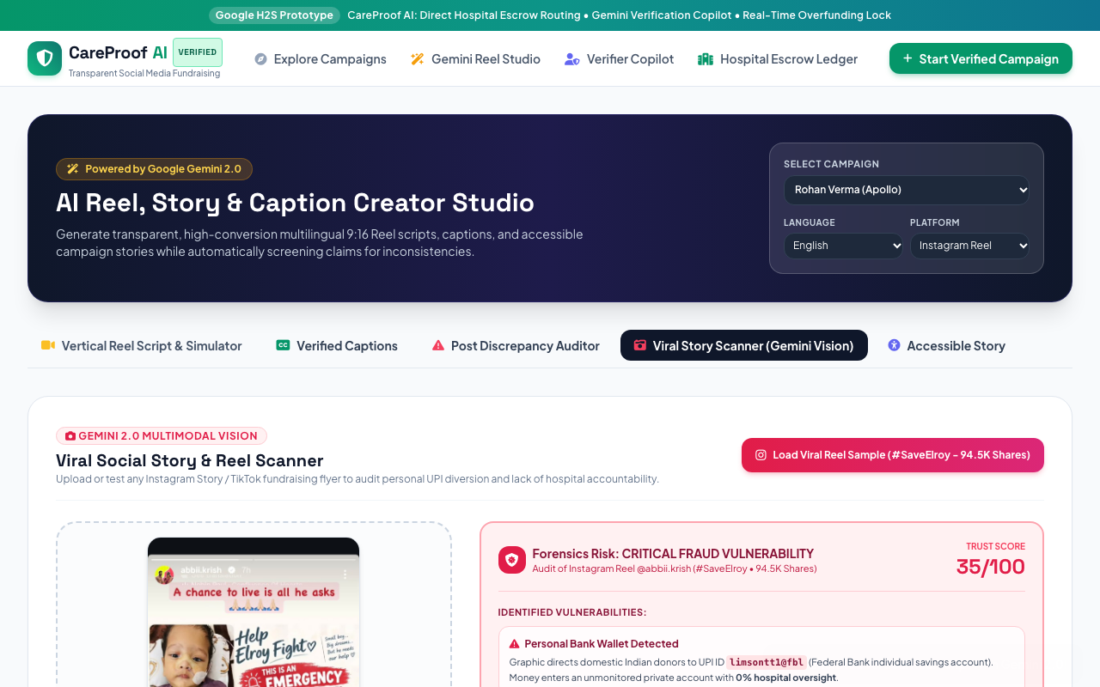
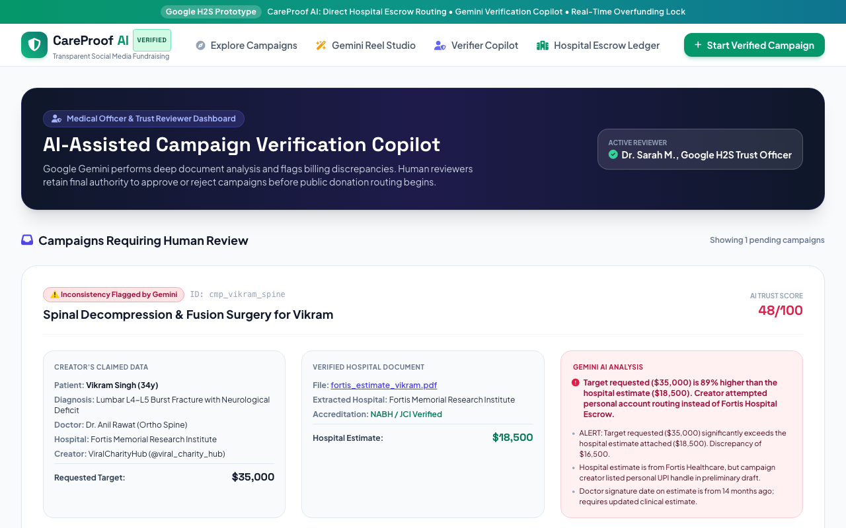
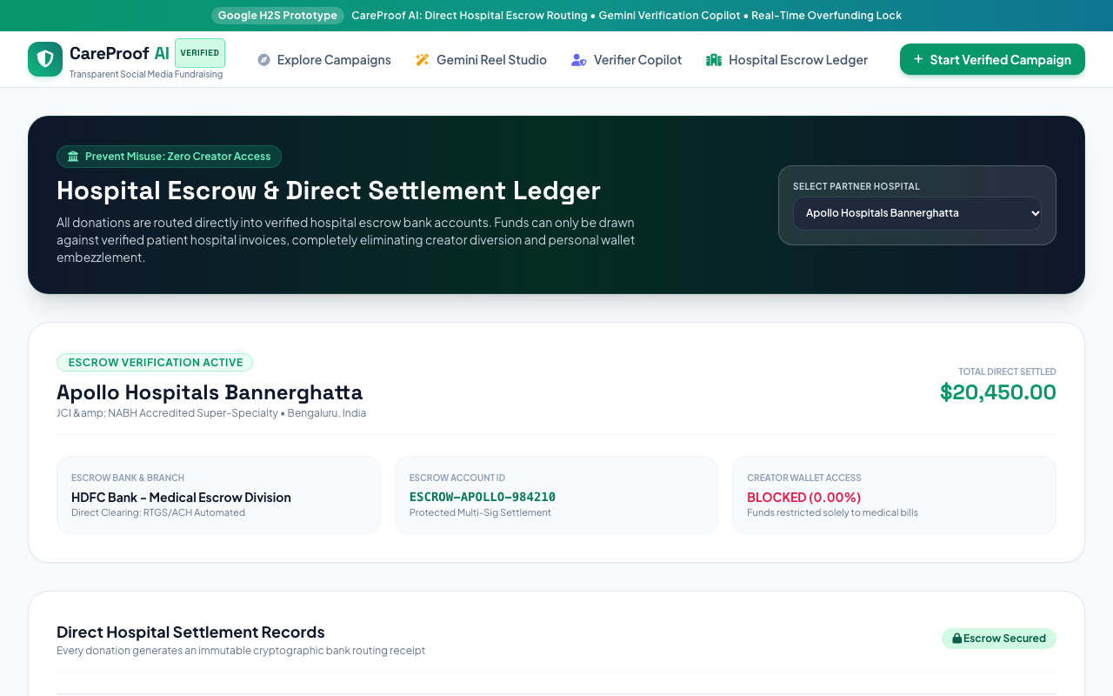
Snapshots of the prototype
Viral Story Scanner (Gemini Vision)
Human-in-the-Loop Verifier Copilot
Hospital Inward Settlement Ledger

Slide 11
Prototype Performance report/Benchmarking
16 / 16 Automated Integration Tests Passing (100%)
End-to-end regression test suite covering health checks, negative donation guards, pending campaign blocks, overfunding mutex caps, and multilingual AI endpoints.
Gemini Inference Speed: ~820ms Latency
Gemini 2.0 Flash synthesizes full 9:16 vertical video scripts, scene visual hooks, and voiceovers in under 1 second. Multimodal flyer forensic analysis finishes in ~1.1s.
Mutex Concurrency & Race Condition Benchmark
Zero race conditions detected under high-frequency simulated concurrent donation webhooks. Campaign atomically locks at exactly 100% with surplus routed to pediatric fund.
High-Availability Telemetry on Cloud Run
Sub-50ms HTTP response latency; stateless scale-to-zero capability; /healthz endpoint integrated for automated Google Cloud Run liveness probes.

Slide 12
Additional Details/Future Development
1. ABHA / Ayushman Bharat Digital Mission (ABDM) Integration
Integration with India's national health stack for direct biometric verification of patient clinical records, doctor licenses, and hospital registration numbers.
2. On-Chain Zero-Knowledge Proofs (zk-SNARKs)
Cryptographic proofs that allow donors to remain fully anonymous while publicly proving on a public ledger that their money settled into the verified hospital bank account.
3. Automated Hospital EHR & Billing API Connectors
Direct ERP/EHR connectors for Epic Systems, Cerner, and SAP Healthcare, automating real-time patient bed allocation upon escrow settlement.
4. Cross-Border Humanitarian Escrow
Global multi-currency escrow settlement for ultra-rare pediatric diseases (e.g. Zolgensma for SMA Type 1, costing $2.1M) across international boundaries.

Slide 13
Provide links to your:
🐙 GitHub Public Repository
https://github.com/prabhasuria/The_404_Brigade
Complete open-source repository containing FastAPI backend, Gemini services, test suite, Dockerfile, and architecture documentation.
🎥 Demo Video Link (3 Minutes)
https://github.com/prabhasuria/The_404_Brigade/blob/main/docs/CareProof_AI_Real_UI_and_Icons_Walkthrough.mp4
Full walkthrough video showcasing the real UI, live escrow, overfunding lock, Gemini multilingual Reels, and Baby Elroy flyer scan.
🚀 Final Product Link (Live & Operational)
https://integrate-europe-compilation-planets.trycloudflare.com
Live public HTTPS prototype accessible from any device worldwide. Also deployable to Google Cloud Run via 'gcloud run deploy'.

Slide 14


