Slide 1
Previous Lecture
groundwater and aquifers
Pressure
storage properties
questions?

Slide 2
Today*
Darcy‘s law (1D)
hydraulic conductivity
intrinsic permeability
velocities, travel time and pore volume

Slide 3
Darcy‘s Law (1D)

Slide 4
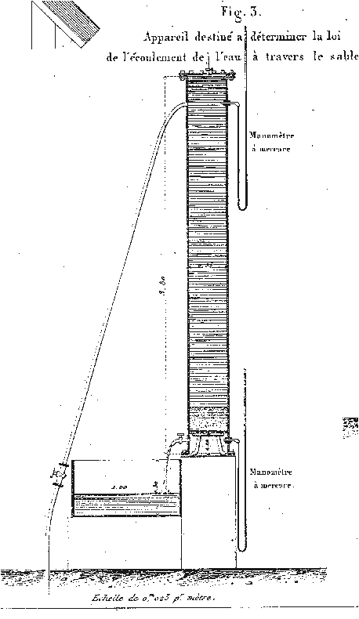
Darcy’s Experiment
column with constant cross section (A = const.)
sand as filling material (“porous medium“)
voids between sand grains completely filled with water (saturated conditions)
constant discharge through the column (Q = const.)
Purpose:
to quantify the relationship between discharge, flow velocity, pressure difference, flow distance, and cross section
Brown G. O. (2002):
Henry Darcy and the making of a law,
Water Resour. Res. 38(7), doi:10.1029/2001WR000727.

Slide 5
A Quick Reminder on Pressure Head
z
ψ(L) = ψ_{L}
z = L
pressure head
ψ(z) [L]
elevation
head z [L]
ψ(0) = ψ_{L}+ L
z = 0
From previous considerations we know that pressure head differences will not allow to fully quantify water flow.
In fact, elevation head differences have to be considered as well.
In the above figure, the increase of pressure head with depth is compensated by an according decrease of elevation head. As a consequence, there is no water flow.
Water flow requires changes of the sum of both heads.

Slide 6
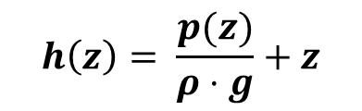
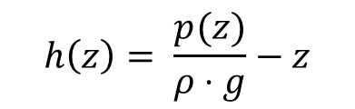
Hydraulic Head I
Hydraulic head or piezometric head is the sum of hydrostatic pressure head and elevation head:
$$h\left(z\right)= \frac{p(z)}{ρ⋅g}+z$$
hydraulic
head [L]
elevation
head [L]
= ψ(z)
= pressure
head [L]
In this equation it is assumed that the z-axis is oriented upward.
If the z-axis points downward, we have:
$$h\left(z\right)= \frac{p(z)}{ρ⋅g}−z$$
Water flow is governed by differences in hydraulic head (not by differences in pressure head alone!).

Slide 7




Hydraulic Head II
z
ψ(L) = ψ_{L}
z = L
pressure head
ψ(z) [L]
elevation
head z [L]
ψ(0) = ψ_{L}+ L
z = 0
hydrostatic pressure:
hydraulic
head
$$ψ\left(z\right)=ψ_{L}+(L−z)$$
hydraulic head (piezometric head):
$h\left(z\right)=\frac{p\left(z\right)}{ρ⋅g}+z=$
$$h\left(z\right)=ψ\left(z\right)+z=ψ_{L}+\left(L−z\right)+z=ψ_{L}+L=\text{const}$$
hydraulic head difference between observation points:
$$= ψ\left(z\right)+z$$
$$Δh=0$$
Notes:
At point z = L, H1 = ψ(L) + L , at point z = 0, H2 = ψ(L) + L + 0, Δh =ψ(L) + L - (ψ(L) + L ) = 0

Slide 8
Hydraulic Heads in Darcy‘s Experiment
column with water flow (Q ≠ 0), arbitrarily oriented
measurement points (“standpipes“ or “piezometers“) for hydrostatic pressure head ψ = p/(ρ∙g) and hydraulic head (piezometric head) h at distance L
measured hydraulic heads:
cross-sectional
area A
here: h₁ < h₂
Thus, flow is from cross section 2 to-wards cross secti-on 1.
Differences of hy-draulic head are in-dependent from the position of the origin of the z-axis!
cross
section 1
z₁
distance L
z₂
cross
section 2
z = 0
(reference
level)

Slide 9
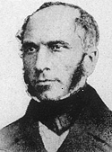
Darcy‘s Law for 1D Groundwater Flow
The volumetric flow rate or discharge is – proportional to the cross-sectional area, – proportional to the difference in hydraulic head, – inversely proportional to the travel distance.
Groundwater flow is directed from regions with high hydraulic head to regions with low hydraulic head.
Equation (Darcy, 1856):
Henry Darcy
(1803 – 1858)
negative sign!
hydraulic head
difference
[L]
discharge
[L³/T]
total cross-
sectional area
[L²]
distance
[L]
hydraulic
conductivity
[L/T]
Notes:
Why negative because flow is from high pressure towards low: Q = AK (h_h – h_L)/(0 – L) = AK(h_h – h_L)/L: This will give –ve Discharge, which makes no sense. So add –ve.

Slide 10
Hydraulic Conductivity

Slide 11
Some Basics
The ratio Δh/L is called hydraulic gradient.
The hydraulic gradient is dimensionless [-].
The value of hydraulic conductivity corresponds to the volumetric flow rate through a unit cross section under a unit hydraulic gradient.
The dimension of hydraulic conductivity is L/T.
Hydraulic conductivity depends on properties of the fluid (density, viscosity, temperature) and on properties of the porous medium (effective porosity, grain size distribution).
typical values for hydraulic conductivity:
gravel 10⁻² m/s – 10⁻¹ m/s
coarse sand ≈ 10⁻³ m/s
medium sand 10⁻⁴ m/s – 10⁻³ m/s
fine sand 10⁻⁵ m/s – 10⁻⁴ m/s
silty sand 10⁻⁷ m/s – 10⁻⁵ m/s
silt 10⁻⁹ m/s – 10⁻⁶ m/s
clay < 10⁻⁹ m/s
Tendency: K increases with grain size.
Notes:
K = Q/(A*Dh/DL)

Slide 12
Obtaining Hydraulic Conductivities
Hydraulic conductivity can be obtained in the laboratory or in the field.
Laboratory methods can be based on
– the evaluation of sieve analysis data (“indirect method“), – some version of Darcy‘s experiment (“direct method“).
Field methods include pump tests which will be covered later in this semester.
Advantages of laboratory methods: controlled conditions, small sample size (easy handling), lower costs, larger number of experiments
Disadvantages of laboratory methods: disturbed samples, additional pathways at column walls, small sample size (randomly high or low K), flushing of fine material
Field experiments are more complicated and expensive than laboratory tests. Resulting hydraulic conductivities represent averages over an aquifer volume which is covered by the experiment. The size of this volume depends on subsurface properties and on the experimental method used.

Slide 13


Estimating Hydraulic Conductivity from Sieve Analysis Data
Sieve analysis data can be evaluated to estimate hydraulic conductivity of unconsolidated media.
There are several empirical methods.
The simplest one dates back to Hazen (1892):
$$K=0.0116⋅d_{10}^{2}$$
with K = hydraulic conductivity (m/s) d₁₀ = grain diameter (mm) corresp. to 10% of cumulative mass fraction
NOTE:
Hazen‘s equation is only valid for the indicated units. Conversion of units may be necessary before using this formula.
In an extended version (see Excel sheet/JUPYTER notebook entitled “sieve analysis“) the effect of temperature θ is considered:
$$K=0.0116⋅d_{10}^{2}⋅( 0.7+0.03⋅θ)$$
with θ = temperature (°C)

Slide 14
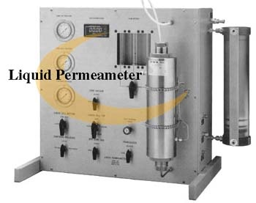
Permeameter
Permeameter = instrument to determine hydraulic conductivity
The design of permeameters is based on Darcy‘s experiment.
Permeameters are used to determine hy-draulic conductivities of soil samples in the laboratory.
Two types: – constant-head permeameter – falling-head permeameter
Constant-head permeameter: Hydraulic heads at inflow and outflow of the Darcy column are constant in time. As a consequence, the discharge is not changing with time.
Falling-head permeameter: The hydraulic head at the outflow of the Darcy column is not changing, but the hydraulic head at the inflow is decreasing with time. As a result, the discharge also decreases with time.
Larger experimental time periods are needed for the falling-head permeameter, in particular if hydraulic conductivity is low. On the other hand, no measurement of discharge or water volume is required.

Slide 15
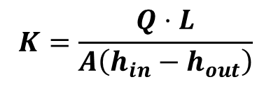
Constant-Head Permeameter
inflow
Δ
overflow
h
$$K=\frac{Q⋅L}{A\left(h_{in}−h_{out}\right)}$$
overflow
with
Q = discharge [L³/T]
L = length of sample [L]
A = cross-sectional area of sample [L²]
h_{in} = hydraulic head at column inlet [L]
h_{out} = hydraulic head at column outlet [L]
L
h_{out} can be set equal to zero as only head differences are important.

Slide 16
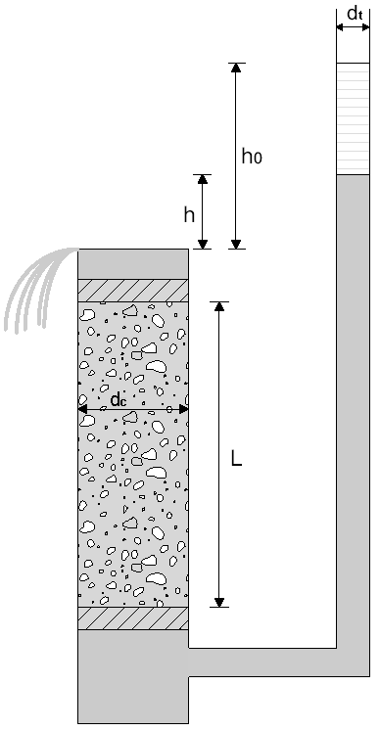
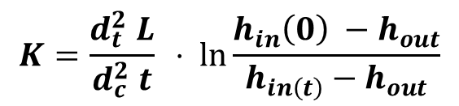
Falling-Head Permeameter
$$K=\frac{d_{t}^{2} L}{d_{c}^{2} t} ⋅ \ln{\frac{h_{in}\left(0\right) −h_{out}}{h_{in\left(t\right)}−h_{out}}}$$
falling
head
with
L = length of sample [L]
d_{c} = diameter of sample cylinder [L]
d_{t} = tube diameter [L]
t = time interval [T]
h_{in}(0)= initial hydraulic head at column inlet [L]
h_{in}(t)= final hydraulic head at co-lumn inlet [L]
h_{out} = hydraulic head at column outlet [L]
over-
flow
h_{out} can be set equal to zero as only head differences are important.

Slide 17
Intrinsic Permeability

Slide 18

Hydraulic Conductivity and Intrinsic Permeability
As indicated before, hydraulic conductivity depends on properties of the fluid (density, viscosity, temperature) and on properties of the porous medium (effective porosity, grain size distribution).
When fluids other than water have to be considered (e.g., in oil exploration) it is important to separate the two types of properties (porous medium and liquid).
Experimental results showed that hydraulic conductivity is – proportional to fluid density, – proportional to gravitational acceleration, – inversely proportional to dynamic fluid viscosity:
fluid density
[M/L³]
gravitational
acceleration
[L/T²]
hydraulic
conductivity
[L/T]
$$K=k⋅\frac{ρ⋅g}{η}$$
intrinsic
permeability [L²]
dynamic fluid
viscosity [M/L/T]

Slide 19

Density and Viscosity of Water
The table below provides densities and viscosities of water for different temperatures (10 °C ≈ field conditions, 20 °C ≈ laboratory conditions in regions with moderate climate):
 | 10 °C | 20 °C
density (kg/m³) | 999.7 | 998.2
kinematic viscosity (m²/s) | 1.3101·10⁻⁶ | 1.0105·10⁻⁶
dynamic viscosity (Pa·s) | 1.3097·10⁻³ | 1.0087·10⁻³
Kinematic and dynamic viscosities are related by:
$$η=ρ⋅v$$
dynamic
viscosity
[M/L/T]
kinematic
viscosity
[L²/T]
density
[M/L³]

Slide 20
Properties of Intrinsic Permeability
Intrinsic permeability only depends on properties of the porous medium.
The dimension of intrinsic permeability is L².
Intrinsic permeability of unconsolidated porous media is roughly proportional to the square of the pore diameter.
The unit “Darcy“ (symbol: D) is sometimes used for intrinsic permeability. Conversion to SI units: 1 D = 0.987·10⁻¹² m²
Intrinsic permeability for – weakly permeable aquifers: 10⁻⁴ – 10⁻¹ D, – well permeable aquifers: 10⁻¹ – 10² D, – highly permeable aquifers: > 10² D.
Notes:
k = nK/(rho*g)

Slide 21
Velocities,
Travel Time
and Pore Volume

Slide 22

Cross-sectional Area
identical total
cross-sectional
area A
column without porous medium – pipe flow
column with porous medium – Darcy experiment
Pipe flow: The cross-sectional area of flow coincides with the total cross-sectional area A.
Darcy experiment: Only part of the total cross-sectional area A is available for flow.
Cross-sectional area of flow in a porous medium
$${=η}_{e}⋅A$$
effective
porosity
[-]
total cross-
sectional area
[L²]

Slide 23
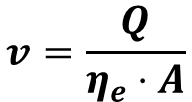
Darcy Velocity and Linear Velocity
In groundwater hydraulics, the ratio Q/A is termed Darcy velocity or specific discharge. Frequently, the symbols v_{f} or q are used.
The Darcy velocity is different from the actual velocity of water in the pore space.
The average flow velocity of water in the pore space is termed (average) linear velocity.
Linear velocity v is related to the cross-sectional area of flow via
$$v=\frac{Q}{η_{e}⋅A}$$
As a consequence, the relationship between Darcy velocity and linear velocity is given by ν = ν_{f}/η_{e}
Linear velocity is never smaller than Darcy velocity.
Sometimes the symbol v_{a} is used to denote linear velocity.

Slide 24
Some Values for Linear Velocity
Typical values for linear velocities in unconsolidated aquifers: sand: 0.5 m/d – 1 m/d gravel: 30 m/d – 300 m/d
Roughly speaking, linear velocity in unconsolidated aquifers is increasing with grain size.
Linear velocities in fractured or karstified aquifers can be rather high along fractures or conduits: fractures: 200 m/d – 1.2 km/d karst conduits: 3 km/d – 14 km/d
On the contrary, linear velocities are very low in the rock matrix of consolidated aquifers (1 cm/d or even less).

Slide 25
Travel Time and Pore Volume
The travel time of water through a column of length L is given by t = L/v. (The linear velocity v has to be used here, not the Darcy velocity!)
The travel time may also be called residence time.
The travel time through a column is termed pore volume. It can be understood as the time needed to replace the water in the column.
In this sense, the pore volume is not a volume but a time! 1 PV corresponds to the ratio L/v.
The pore volume (PV) is frequently used for normalisation purposes in order to better compare column experiments conducted under different flow velocities. This is mostly done for studying the transport behaviour of chemicals dissolved in water and their arrivals at the column outlets.

Slide 26

Quick check what we have understood?
Pls. scan the QR- code
or
click link the link:
https://partici.fi/44956728

