Slide 1
Previous Lecture
Darcy‘s law (1D)
hydraulic conductivity
intrinsic permeability
velocities, travel time and pore volume
questions?
Notes:
1

Slide 2
Today
aquifer heterogeneity
layered systems
aquifer anisotropy
Notes:
2

Slide 3
Aquifer Heterogeneity
Notes:
3

Slide 4
Motivation
(Klingbeil, 1998)
In contrast to Darcy columns, aquifers represent three-dimensional (3D) systems.
Properties like hydraulic conductivity, storativity or porosity vary in space.
Variations of hydraulic conductivity are dominant in most cases.
In the figure above, the three-dimensional spatial variability of aquifer properties is illustrated by a two-dimensional vertical cross-section.
Notes:
4

Slide 5
Heterogeneity
A solid or a porous medium is homogeneous if its properties do not vary in space.
A solid or a porous medium is heterogeneous (inhomogeneous) if at least one of its properties varies in space.
As far as aquifers are concerned, heterogeneity or homogeneity is usually related to hydraulic conductivity.
As a consequence, K = K(x,y,z) for a heterogeneous aquifer. In special cases, spatial dependency can be restricted to one or two coordinates.
In many practical applications, storativity and porosity are treated as spatially constant. This is usually done for two reasons:
– The variability of hydraulic conductivity is much more pronounced.
– Data about variability of storativity or porosity are scarce.
Of course, groundwater flow is affected by aquifer heterogeneity as will be demonstrated in the next lecture.
The impact of aquifer heterogeneity is even more relevant with regard to the transport of solutes in groundwater.
Notes:
5

Slide 6
Effective Hydraulic Conductivity
Frequently, people wish to represent the spatial distribution of hydraulic conductivity in a heterogeneous aquifer by an average value such that steady-state groundwater discharge remains the same as in the heterogeneous case.
This average K value is termed effective hydraulic conductivity.
In other words: The effective hydraulic conductivity characterises a fictitious homogeneous aquifer with the same discharge and the same overall head difference under steady-state conditions as some heterogeneous aquifer to be investigated.
The concept of effective hydraulic conductivity is illustrated next for a perfectly layered system which can be seen as an idealised representation of natural layering.
It is also possible to determine effective K values for more complex aquifers but cumbersome mathematical derivations would be required.
Notes:
6

Slide 7
Layered Systems
Notes:
7

Slide 8
Flow Parallel to Layering I
Δh
L
We consider a confined aquifer consisting of n layers. Layer boundaries are parallel to each other and flow is parallel to the layering.
Data for entire aquifer: width w (extension perpendicular to cross section not shown), flow distance L with corresponding total head loss Δh, total discharge Q
Data for layer i (i = 1,2,…,n): thickness m_{i}, hydraulic conductivity K_{i}
What is the effective hydraulic conductivity K?
layer 1
layer 2
layer 3
Q
layer i
layer n
Notes:
8

Slide 9
Flow Parallel to Layering II
total thickness:
Δh
L
volumetric budget:
layer 1
head loss in layer i:
layer 2
layer 3
Darcy‘s law for layer i:
Q
Darcy‘s law for the homogeneous aquifer to replace the layered system:
layer i
replace discharges in the volumetric budget by Darcy‘s law:
layer n
Notes:
9

Slide 10
Flow Parallel to Layering III
As a result, the effective hydraulic conductivity of a layered system equals
Δh
L
layer 1
layer 2
if flow is parallel to the layering.
layer 3
In the above equation, effective hydraulic con-ductivity K is obtained as the weighted arithme-tic average of layer conductivities K_{i}. Weights correspond to relative thicknesses m_{i}/m.
The largest term in the sum contributes most to the arithmetic average. The above equation can therefore be approximated by
Q
layer i
layer n
Notes:
10

Slide 11
Flow Perpendicular to Layering I
Q
Δh
We consider a confined aquifer consisting of n layers. Layer boundaries are parallel to each other and flow is perpendicular to the layering.
Data for entire aquifer: total cross-sectional area A, total head loss Δh, total discharge Q
Data for layer i (i = 1,2,…,n): thickness m_{i}, hydraulic conductivity K_{i}
What is the effective hydraulic conductivity K?
layer 1
layer 2
layer 3
layer i
layer n
Notes:
11

Slide 12
Flow Perpendicular to Layering II
total thickness:
Q
Δh
equation of continuity:
layer 1
cross-sectional area for layer i:
layer 2
decomposition of head loss:
layer 3
Darcy‘s law for layer i:
or
layer i
Darcy‘s law for the homogeneous aquifer to replace the layered system:
or
layer n
replace expressions for head losses in the above decomposition:
Notes:
12

Slide 13
Flow Perpendicular to Layering III
As a result, the effective hydraulic conductivity of a layered system equals
Q
Δh
layer 1
layer 2
if flow is perpendicular to the layering.
layer 3
In the above equation, effective hydraulic con-ductivity K is obtained as the weighted harmonic average of layer conductivities K_{i}. Weights correspond to relative thicknesses m_{i}/m.
The largest term in the sum contributes most to the harmonic average. The above equation can therefore be approximated by
layer i
layer n
Notes:
13

Slide 14
Effective Conductivity of Layered Aquifers: Summary
Flow parallel to layering:
Effective hydraulic conductivity equals the weighted arithmetic mean of layer conductivities.
Flow perpendicular to layering: Effective hydraulic conductivity equals the weighted harmonic mean of layer conductivities.
Weights are given by relative layer thicknesses.
It can be mathematically shown that the harmonic mean of a set of positive numbers cannot exceed the arithmetic mean of the same set.
Both means are identical only if all numbers in the set are identical. Apart from this very special case, we have “harmonic mean < arithmetic mean“.
This implies that the flow direction perpendicular to the layering is associated with a smaller effective hydraulic conductivity than the flow direction parallel to the layering.
For other flow directions, the effective hydraulic conductivity of a layered aquifer will be given in the section on aquifer anisotropy.
Notes:
14

Slide 15
Hydraulic Resistance I
Hydraulic resistance is the reciprocal of hydraulic conductivity.
Large hydraulic conductivities (K) correspond to small hydraulic resistances (1/K) and vice versa.
Considerations about effective hydraulic conductivities of layered aquifers can be transferred to hydraulic resistances by recalling that the arithmetic mean of positive numbers coincides with the harmonic mean of reciprocal numbers and vice versa.
Flow parallel to layering:
Effective hydraulic conductivity equals the weighted arithmetic mean of layer conductivities.
Effective hydraulic resistance equals the weighted harmonic mean of layer resistances.
Flow perpendicular to layering:
Effective hydraulic conductivity equals the weighted harmonic mean of layer conductivities.
Effective hydraulic resistance equals the weighted arithmetic mean of layer resistances.
Notes:
15

Slide 16
Hydraulic Resistance II
If all layer thicknesses are identical (m_{i} = const.) and flow is parallel to layering, the largest discharge passes through the layer with highest hydraulic conductivity (smallest hydraulic resistance).
In this case, the discharge through each layer is proportional to layer conductivity or inversely proportional to layer resistance.
If all layer thicknesses are identical (m_{i} = const.) and flow is perpendicular to layering, the largest hydraulic gradient is across the layer with lowest hydraulic conductivity (highest hydraulic resistance).
In this case, the head gradient across each layer is proportional to layer resistance or inversely proportional to layer conductivity.
Notes:
16

Slide 17
Examples
The accompanying worksheet allows to study steady-state groundwater flow through a three-layer system.
Layer thicknesses may be different.
Flow parallel and perpendicular to layering is considered.
The worksheet provides effective hydraulic conductivities (including approximations) and effective hydraulic resistances.
If flow is parallel to layering, the percentages of discharge passing through each layer are computed.
If flow is perpendicular to layering, the relative head loss across each layer is given.
K_{eff}
Notes:
17

Slide 18
Aquifer Anisotropy
Notes:
18

Slide 19
Anisotropy
A solid or a porous medium is isotropic if its properties are independent of direction.
A solid or a porous medium is anisotropic if at least one of its properties is dependent on direction.
Anisotropy of aquifers is associated with hydraulic conductivity. Other aquifer properties like storativity or porosity cannot depend on direction.
Groundwater flow is affected by anisotropy (see next lecture). However, in unconsolidated aquifers the impact of heterogeneity is usually more important.
Notes:
19
Psi, rho*g = unit weight

Slide 20
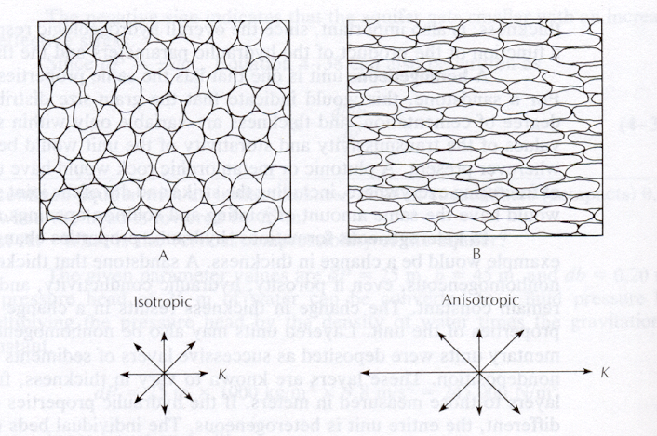
Anisotropy and Scale Effects
As shown in the previous section, effective hydraulic conductivity of layered aquifers depends on the orientation of the flow direction relative to the layering (parallel vs. perpendicular).
On a larger scale, it may not be pos-sible to identify or resolve inhomogeneities like thin layers, small lenses, shape and orientation of grains (see figure) etc.
Nevertheless, hydraulic conductivity appears to be direction-dependent when groundwater flow is quantified at the larger scale.
In these cases, small-scale heterogeneity (e.g. due to layering) expresses itself as anisotropy of hydraulic conductivity at the larger scale.
Notes:
20

Slide 21
Indices and Function Arguments
While function arguments point towards heterogeneity, indices are used to express that hydraulic conductivity depends on direction.
K_{x}, K_{y}, and K_{z} stand for hydraulic conductivity in parallel with the x-, y-, and z-axis, resp.
Frequently, horizontal and vertical hydraulic conductivities differ from each other but there is no anisotropy with regard to horizontal directions (“2D anisotropy“).
In this case, symbols K_{h} and K_{v} may be used to denote horizontal and vertical hydraulic conductivity, resp. If x and y represent the horizontal coordinates, we have K_{x} = K_{y} = K_{h} and K_{z} = K_{v}.
Notes:
21

Slide 22
Hydraulic Conductivity Ellipse
Lets consider an aquifer with hori-zontal hydraulic conductivity K_{h} and vertical hydraulic conductivity K_{v}.
Flow is assumed to be in some (ar-bitrary) direction which is characte-rised by the angle θ between the flow direction and the horizontal plane.
What is the corresponding effective hydraulic conductivity K?
It can be shown that
Q
√K_{v}
√K
θ
√K_{h}
If the angle θ is varied, this equation defines an ellipse (“hydraulic conductivity ellipse“) with semi-axes equal to √K_{h} and √K_{v}, resp. The square root of K can be visualised by the length of a line segment parallel to the direction of flow. This line segment extends from the centre to the perimeter of the ellipse.
Notes:
22

Slide 23
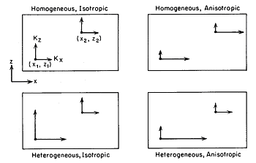
Combining Heterogeneity and Anisotropy
The figure below illustrates the possible combinations of heterogeneity and anisotropy with respect to a vertical cross-section (coordinates x and z).
Notes:
23

Slide 24

Quick check what we have understood?
Pls. scan the QR- code
or
click link the link:
https://partici.fi/77693338

