Slide 1
Previous Lecture
steady-state 3D groundwater flow in three dimensions:
Darcy‘s law in isotropic aquifers
streamlines and flow nets
isochrones and protection zones
Darcy‘s law in anisotropic aquifers
questions?
Notes:
1

Slide 2
Today
quantification of three-dimensional groundwater flow
two-dimensional groundwater flow in confined aquifers
two-dimensional groundwater flow in unconfined aquifers
complete formulation of groundwater flow problems
Notes:
2

Slide 3
Quantification of Three-dimensional Groundwater Flow
Notes:
3

Slide 4
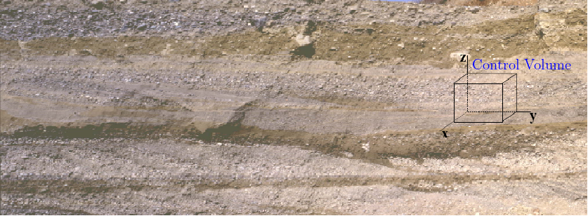
Control Volume
• A control volume is a (fictitious) portion of an aquifer which is – much smaller than the region of investigation – much bigger than individual grains or pores (such that Darcy‘s law can be applied)
• The shape of the control volume is advantageously adjusted to the coordinate system used (e.g. rectangular for Cartesian coordinates)
Notes:
4

Slide 5
Classification
Groundwater flow regimes / aquifers can be classified according to - 1D, 2D or 3D - steady-state or transient - homogeneous or heterogeneous - isotropic or anisotropic - confined or unconfined - with or without sources / s
This amounts to 96 possible combinations. (And further scenarios may exist.)
Each combination corresponds to a certain equation governing groundwater flow. Sometimes these versions only differ with respect to details
It is important to keep in mind that all of them are based on just two principles: the conservation of volume and Darcy‘s law. (Things can be quite a bit more complicated in consolidated systems which are not covered in detail in this course.)
Only these two principles are therefore needed to quantify groundwater flow in unconsolidated settings.
Notes:
5

Slide 6
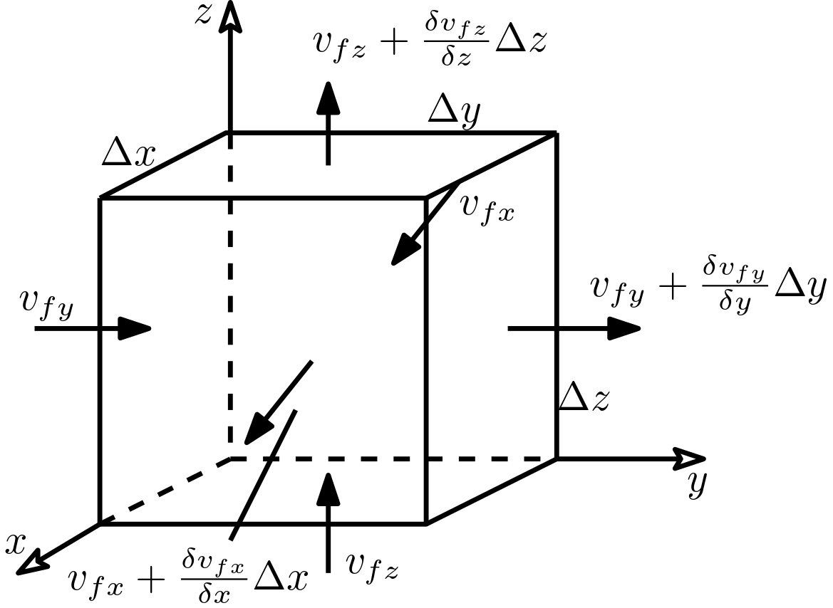
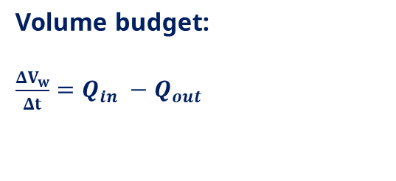
Conservation of volume
Scenario considered here:
3D
Transient
Isotropic
Heterogeneous
Confined
without sources /sinks
Volume budget:
$\frac{ΔV_{w}}{Δt}=Q_{in} −Q_{out}$
Notes:
6

Slide 7


Darcy‘s Law
The generalized Darcy’s law is
$$v_{f}=−K \text{grad}h$$
With K =
$$\left[\begin{matrix}K_{xx} & K_{xy} & K_{xz} \\ K_{yx} & K_{yy} & K_{yz} \\ K_{zx} & K_{zy} & K_{zz}\end{matrix}\right]$$
The gradient vector [-] is oriented in the direction of the steepest increase in hydraulic head.
The minus sign indicates that groundwater flow is directed from “large“ to “small“ head values.
Hydraulic conductivity is a scalar for isotropic aquifers but a tensor for anisotropic aquifers
Notes:
7

Slide 8

Inflow and Outflow
As stated before, the control volume is assumed to be small as compared to the region of investigation
Changes of Darcy velocity components across the control volume can therefore be regarded linear.
Linear changes are obtained by multiplying first-order derivatives with corresponding distances
$Q_{in}=v_{fx} Δy Δz+v_{fy} Δx Δz$+ $v_{fz}Δx Δy$
$$Q_{out}=\left(v_{fx}+ \frac{∂ v_{fx}}{∂ x}Δx \right)Δy Δz+\left(v_{fy}+ \frac{∂ v_{fy}}{∂ y}Δy\right)Δx Δz+\left(v_{fz}+ \frac{∂ v_{fz}}{∂ z}Δz\right)Δx Δy$$
$${Q_{in} − Q}_{out}=\frac{∂ v_{fx}}{∂ x}Δx Δy Δz−\frac{∂ v_{fy}}{∂ y}Δx Δy Δz−\frac{∂ v_{fz}}{∂ z}Δx Δy Δz$$
Difference:
Notes:
8

Slide 9


Temporal Change in Water Volume
$$\frac{ΔV_{w}}{Δx Δy Δz}∝Δh$$
$$Δ V_{w}=S_{s} Δh Δx Δy Δz$$
The value of the specific storage coefficient corresponds to the change in water volume within a unit control volume if hydraulic head is increased/decreased by one unit.
Notes:
9

Slide 10
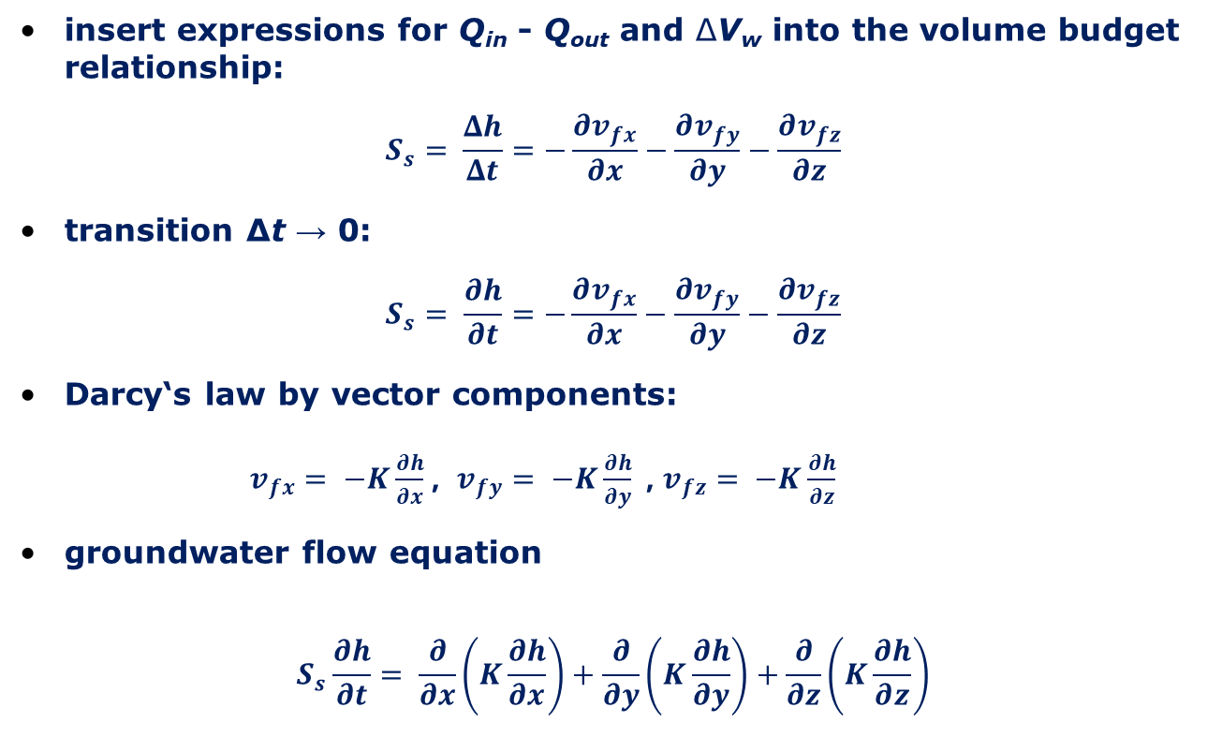
Budgeting
insert expressions for Q_{in} - Q_{out} and ΔV_{w} into the volume budget relationship:
$$S_{s}= \frac{Δh}{Δt}=−\frac{∂v_{fx}}{∂x}−\frac{∂v_{fy}}{∂y}−\frac{∂v_{fz}}{∂z}$$
transition Δt → 0:
$$S_{s}= \frac{∂h}{∂t}=−\frac{∂v_{fx}}{∂x}−\frac{∂v_{fy}}{∂y}−\frac{∂v_{fz}}{∂z}$$
Darcy‘s law by vector components: $v_{fx}= −K\frac{∂h}{∂x}$ , $v_{fy}= −K\frac{∂h}{∂y}$ , $v_{fz}= −K\frac{∂h}{∂z}$
groundwater flow equation
$$S_{s}\frac{∂h}{∂t}= \frac{∂}{∂x}\left(K\frac{∂h}{∂x}\right)+\frac{∂}{∂y}\left(K\frac{∂h}{∂y}\right)+\frac{∂}{∂z}\left(K\frac{∂h}{∂z}\right)$$
Notes:
10

Slide 11
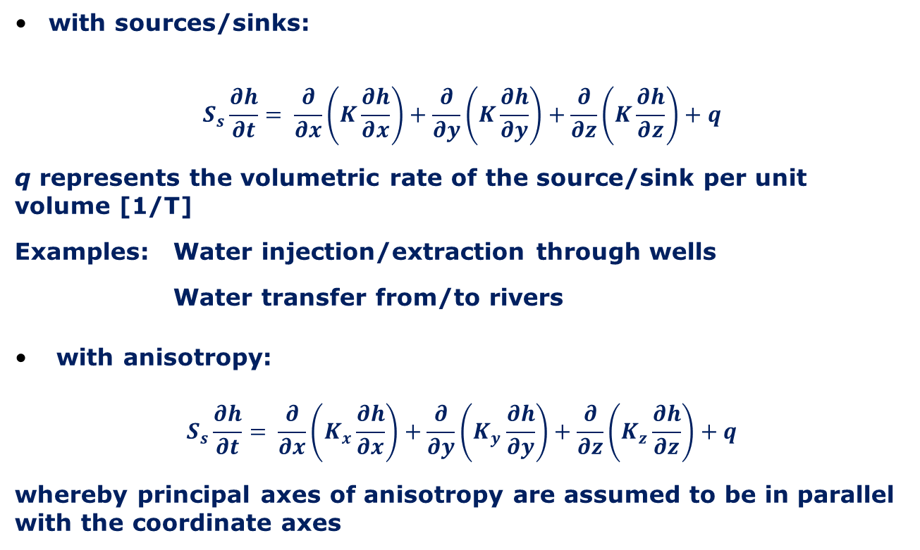
Further Versions of the 3D Groundwater Flow Equation
with sources/sinks:
$$S_{s}\frac{∂h}{∂t}= \frac{∂}{∂x}\left(K\frac{∂h}{∂x}\right)+\frac{∂}{∂y}\left(K\frac{∂h}{∂y}\right)+\frac{∂}{∂z}\left(K\frac{∂h}{∂z}\right)+q$$
q represents the volumetric rate of the source/sink per unit volume [1/T]
Examples: Water injection/extraction through wells
Water transfer from/to rivers
with anisotropy:
$$S_{s}\frac{∂h}{∂t}= \frac{∂}{∂x}\left(K_{x}\frac{∂h}{∂x}\right)+\frac{∂}{∂y}\left(K_{y}\frac{∂h}{∂y}\right)+\frac{∂}{∂z}\left(K_{z}\frac{∂h}{∂z}\right)+q$$
whereby principal axes of anisotropy are assumed to be in parallel with the coordinate axes
Notes:
11

Slide 12
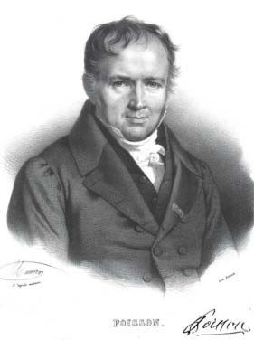
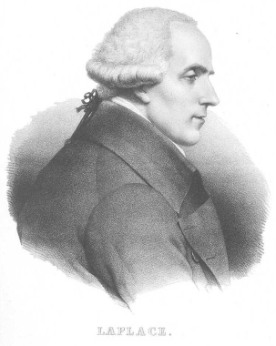
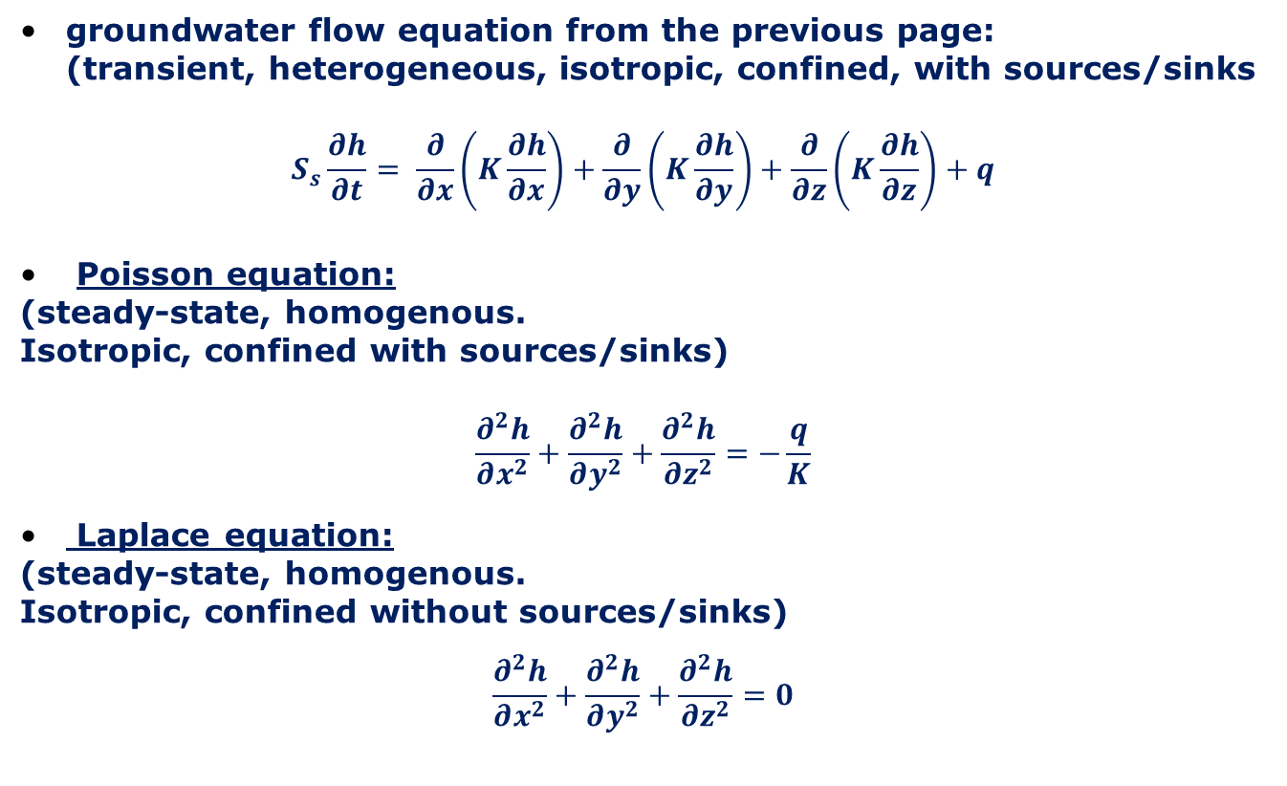
Special Cases
groundwater flow equation from the previous page: (transient, heterogeneous, isotropic, confined, with sources/sinks
$$S_{s}\frac{∂h}{∂t}= \frac{∂}{∂x}\left(K\frac{∂h}{∂x}\right)+\frac{∂}{∂y}\left(K\frac{∂h}{∂y}\right)+\frac{∂}{∂z}\left(K\frac{∂h}{∂z}\right)+q$$
Poisson equation:
(steady-state, homogenous.
Isotropic, confined with sources/sinks)
$$\frac{∂^{2}h}{∂x^{2}}+\frac{∂^{2}h}{∂y^{2}}+\frac{∂^{2}h}{∂z^{2}}=−\frac{q}{K}$$
Laplace equation:
(steady-state, homogenous.
Isotropic, confined without sources/sinks)
$$\frac{∂^{2}h}{∂x^{2}}+\frac{∂^{2}h}{∂y^{2}}+\frac{∂^{2}h}{∂z^{2}}=0$$
Siméon-Denis Poisson (1781 – 1840)
Pierre-Simon Marquis de Laplace (1781 – 1840)
Notes:
12

Slide 13
Two-dimensional Groundwater Flow in Confined Aquifers
Notes:
13

Slide 14
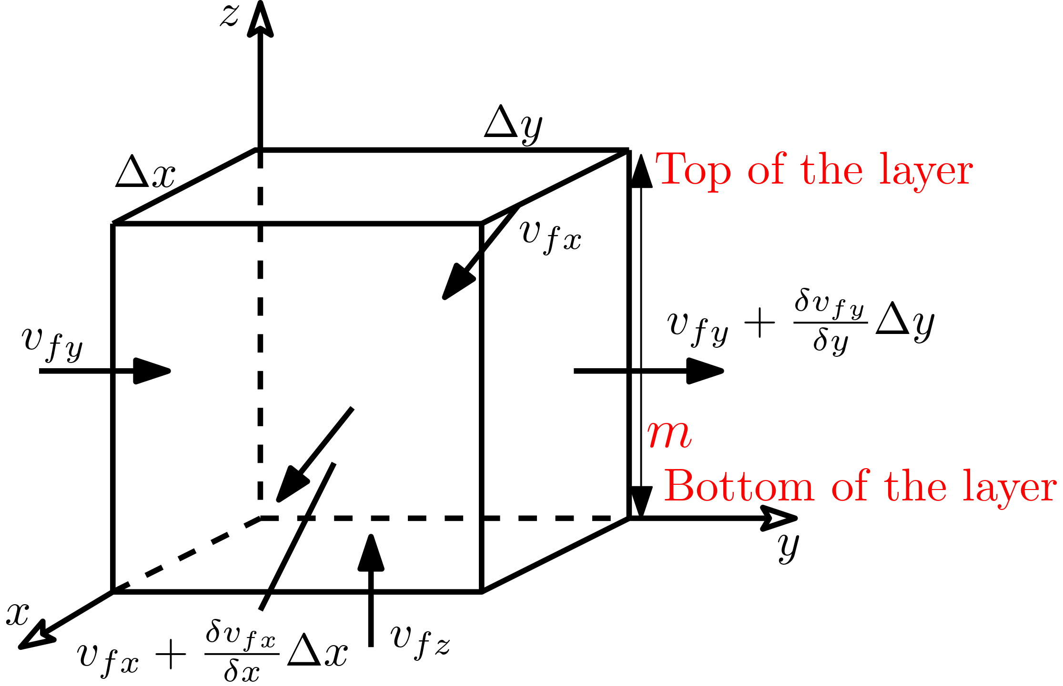
Control Volume
For most unconsolidated aquifers it is observed that groundwater flow components perpendicular to layering are negligible.
Accordingly, groundwater flow problems are frequently treated as two-dimensional, i.e. employing only two space coordinates.
If an aquifer consists of several distinct major layers, the two-dimensional approach is used for each layer separately and, in addition, water transfer between layers is handled by appropriate source / sink terms (not shown in figure).
In this case the control volume extends over the entire layer thickness m
Notes:
14

Slide 15
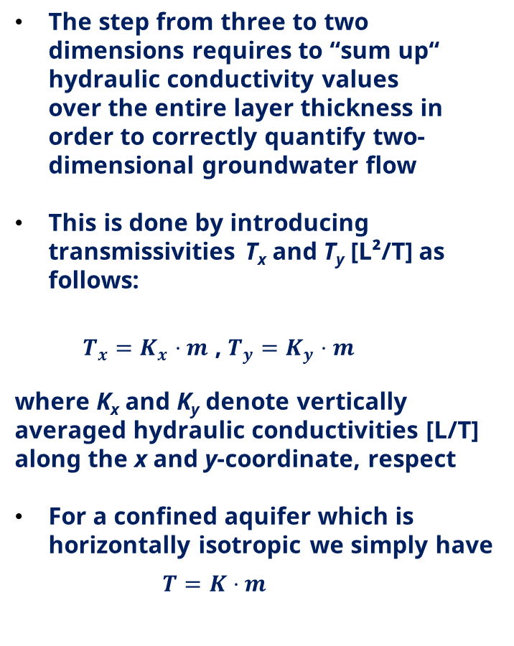
Transmissivity
The step from three to two dimensions requires to “sum up“ hydraulic conductivity values over the entire layer thickness in order to correctly quantify two-dimensional groundwater flow
This is done by introducing transmissivities T_{x} and T_{y} [L²/T] as follows:
$T_{x}=K_{x}⋅m$ , $T_{y}=K_{y}⋅m$
where K_{x} and K_{y} denote vertically averaged hydraulic conductivities [L/T] along the x and y-coordinate, respect
For a confined aquifer which is horizontally isotropic we simply have
$T=K⋅m$
Notes:
15

Slide 16
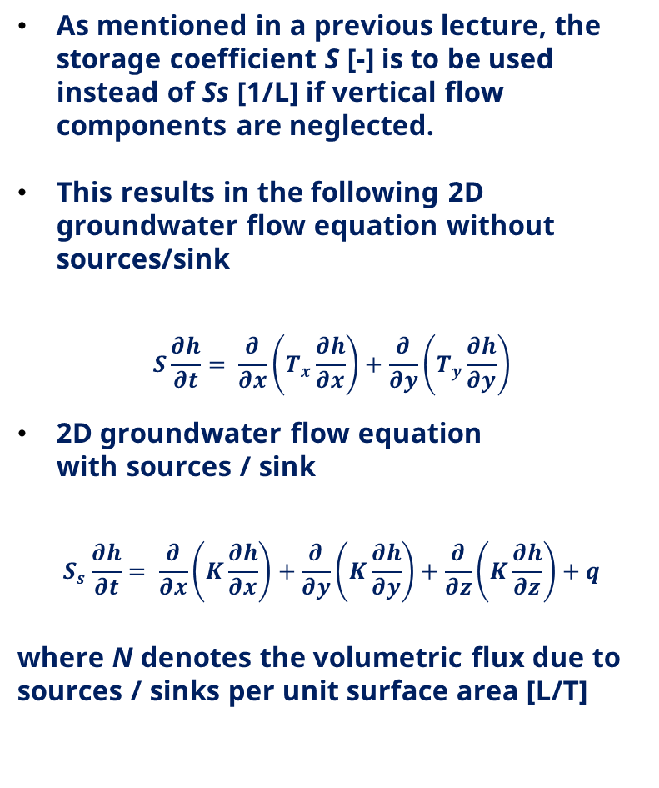
Transmissivity
As mentioned in a previous lecture, the storage coefficient S [-] is to be used instead of Ss [1/L] if vertical flow components are neglected.
This results in the following 2D groundwater flow equation without sources/sink
$$S\frac{∂h}{∂t}= \frac{∂}{∂x}\left(T_{x}\frac{∂h}{∂x}\right)+\frac{∂}{∂y}\left(T_{y}\frac{∂h}{∂y}\right)$$
2D groundwater flow equation with sources / sink
$$S_{s}\frac{∂h}{∂t}= \frac{∂}{∂x}\left(K\frac{∂h}{∂x}\right)+\frac{∂}{∂y}\left(K\frac{∂h}{∂y}\right)+\frac{∂}{∂z}\left(K\frac{∂h}{∂z}\right)+q$$
where N denotes the volumetric flux due to sources / sinks per unit surface area [L/T]
Notes:
16

Slide 17
Two-dimensional Groundwater Flow in Unconfined Aquifers
Notes:
17

Slide 18
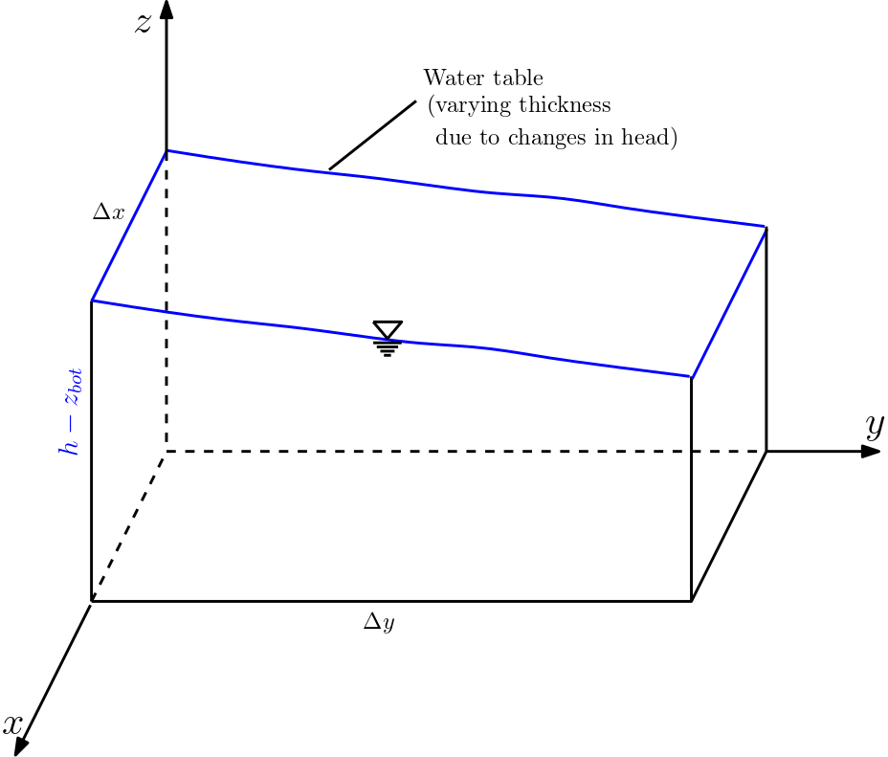
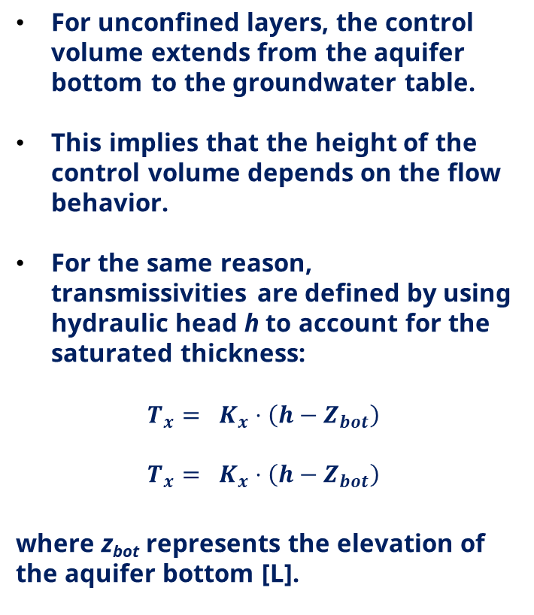
Control volume
For unconfined layers, the control volume extends from the aquifer bottom to the groundwater table.
This implies that the height of the control volume depends on the flow behavior.
For the same reason, transmissivities are defined by using hydraulic head h to account for the saturated thickness:
$$T_{x}= K_{x}⋅\left(h−Z_{bot}\right)$$
$$T_{x}= K_{x}⋅\left(h−Z_{bot}\right)$$
where z_{bot} represents the elevation of the aquifer bottom [L].
Notes:
18

Slide 19
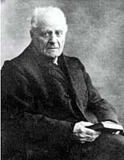
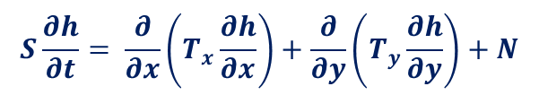
2D Groundwater Flow Equation for Unconfined Conditions
Joseph Boussinesq (1842 – 1929)
Formally, the 2D groundwater flow equation for unconfined aquifers is the same as for confined conditions, i.e.,
$$S\frac{∂h}{∂t}= \frac{∂}{∂x}\left(T_{x}\frac{∂h}{∂x}\right)+\frac{∂}{∂y}\left(T_{y}\frac{∂h}{∂y}\right)+N$$
However, transmissivities are computed in a different way!
The above equation is also termed Boussinesq equation.
Notes:
19

Slide 20
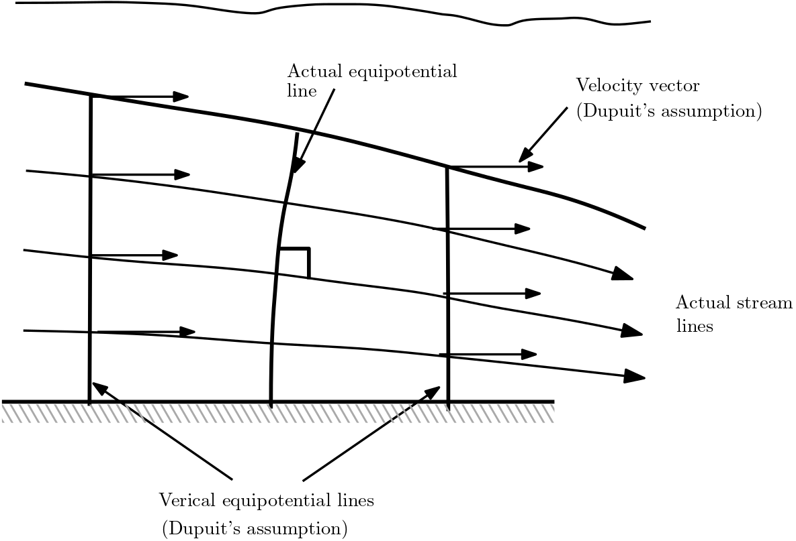
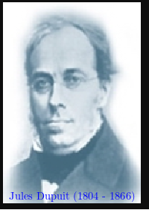
Dupuit Assumptions
The Boussinesq equation for 2D groundwater flow in unconfined aquifers is based on the following assumptions which are due to Dupuit (1863):
Groundwater flow is horizontal (no vertical flow component).
The flow velocity does not vary with depth.
Darcy‘s law also holds at the water table
Notes:
20

Slide 21
Complete Formulation of Groundwater
Flow Problem
Notes:
21

Slide 22
Steps
Specify the geometric properties of the region of interest (dimensionality, shape)
specify values of aquifer parameters (hydraulic conductivity, storage coefficient) by considering spatial variability and anisotropy, if necessary
select the appropriate flow equation
specify the initial condition (IC): - head values at time t = 0 - This step is not required for steady-state problems.
specify boundary conditions (BCs):
- BCs have to be given along the complete boundary (also at infinity if regions are assumed to be unbounded). - BCs may be time-dependent. - There are three major types of BCs (see next page).
Notes:
22

Slide 23
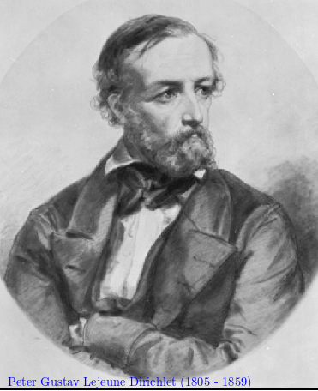
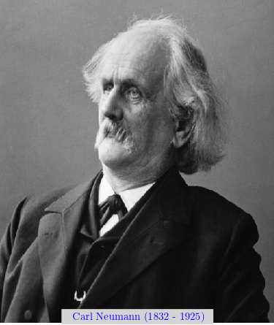
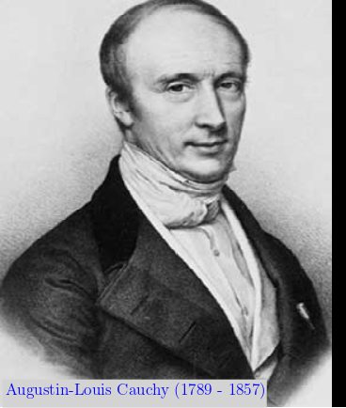
Steps
The number of boundary conditions required corresponds to the highest space derivative for each coordinate in the flow equation.
Boundary condition of the first kind or Dirichlet boundary condition: The head value is given
Boundary condition of the second kind or Neumann boundary condition: The component of the head gradient, which is perpendicular to the boundary, is given.
Boundary condition of the third kind or Cauchy boundary condition or Robin boundary condition (for completeness only): A relationship between the head value and the component of the head gradient, which is perpendicular to the boundary, is given.
Notes:
23

Slide 24
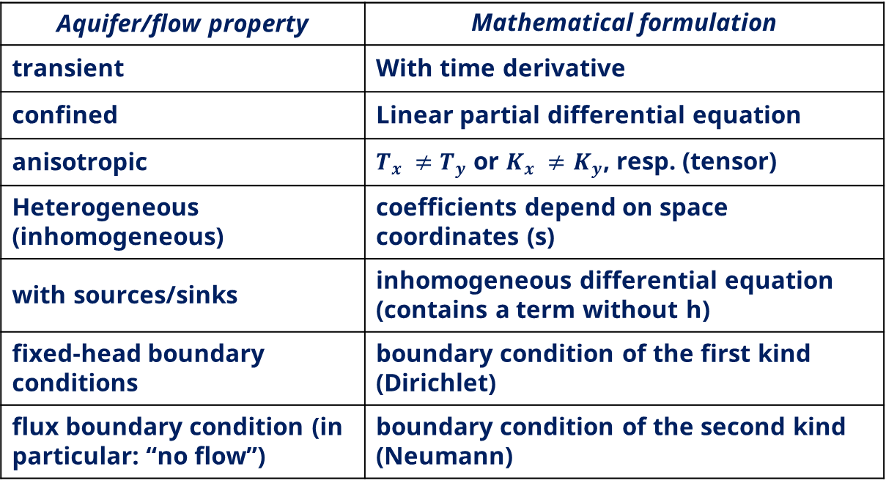
Relationships
Aquifer/flow property | Mathematical formulation
transient | With time derivative
confined | Linear partial differential equation
anisotropic | $T_{x} ≠T_{y}$ or $K_{x} ≠K_{y}$, resp. (tensor)
Heterogeneous (inhomogeneous) | coefficients depend on space coordinates (s)
with sources/sinks | inhomogeneous differential equation (contains a term without h)
fixed-head boundary conditions | boundary condition of the first kind (Dirichlet)
flux boundary condition (in particular: “no flow”) | boundary condition of the second kind (Neumann)
Notes:
24

Slide 25

Quick check what we have understood?
Pls. scan the QR- code
or
click link the link:
https://partici.fi/53931048

