Slide 1
Previous Lecture
quantification of three-dimensional groundwater flow
two-dimensional groundwater flow in confined aquifers
two-dimensional groundwater flow in unconfined aquifers
complete formulation of groundwater flow problems Questions?
Notes:
1

Slide 2
Today
transmissivity
wells – overview
groundwater flow near wells operated at steady state
aquifer characterisation by pumping tests
* The lecture texts/contents are originally from Prof. R. Liedl. Only minimal modifications have been made to the original texts/contents.
Notes:
2

Slide 3
Transmissivity
Notes:
3

Slide 4
Motivation
Aquifers are frequently treated as 2D systems (see storage properties) because lateral extension is usually much bigger than vertical extension.
This concept can also be applied to conductivity properties.
In this case, vertical variations in hydraulic conductivity are neglected. Rather, vertically averaged values are employed.
The product of a vertically averaged conductivity with the saturated thickness (= distance from aquifer bottom to a level up to which all pores are filled with water) is termed transmissivity.
Transmissivity is usually abbreviated by the symbol T. The dimension of transmissivity is L²/T.
Quantitative relationships between transmissivity T and (vertically averaged) hydraulic conductivity K can be more easily understood by separately treating confined and unconfined aquifers (see next pages).
Notes:
4

Slide 5
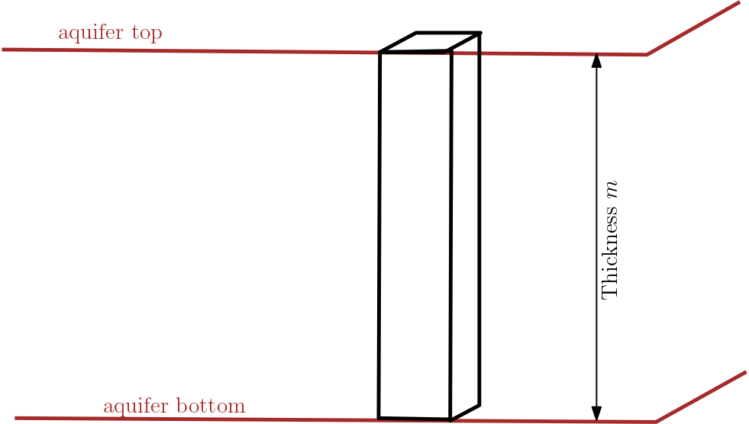


Transmissivity (Confined Aquifer)
In confined aquifers, saturated thickness equals aquifer thickness m.
Transmissivities in a confined aquifer are calculated by
$$T_{x}=K_{x}⋅m$$
$$T_{y}=K_{y}⋅m$$
where K_{x} and K_{y} denote vertically averaged hydraulic conductivities [L/T] along the x- and y-coordinate, respectively.
For a horizontally isotropic confined aquifer we simply have T = K·m.
Notes:
5

Slide 6
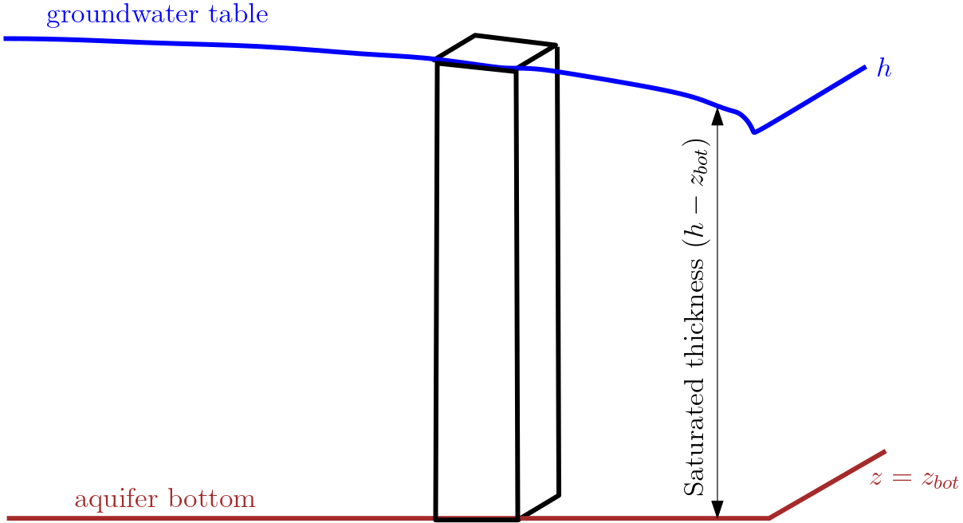


Transmissivity (Unconfined Aquifer)
In unconfined aquifers, saturated thickness equals the difference between the hydraulic head h and the elevation head z_{bot} of the aquifer bottom.
Transmissivities in unconfined aquifers:
$$T_{x}=K_{x}⋅(h−Z_{bot})$$
$$T_{y}=K_{y}⋅(h−Z_{bot})$$
If the aquifer bottom is horizontal, it is convenient to use this level as reference level (z = 0). In this case we have T_{x} = K_{x}·h and T_{y} = K_{y}·h (or simply T = K·h for an isotropic unconfined aquifer).
Notes:
6

Slide 7
Wells – Overview
Notes:
7

Slide 8
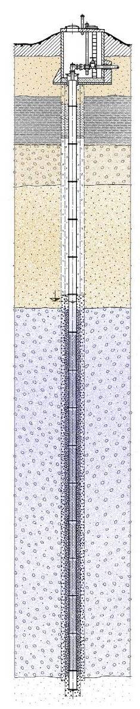
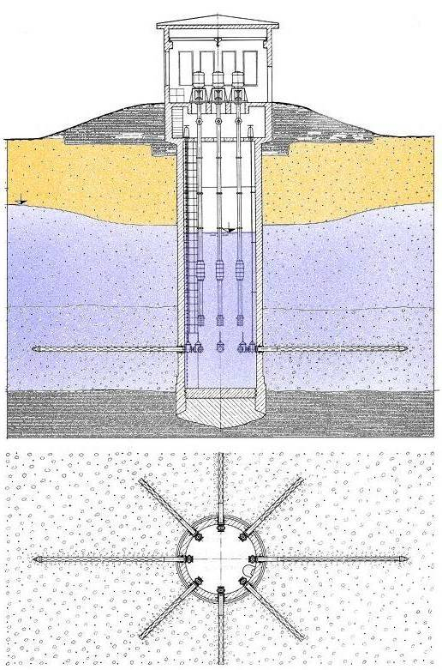
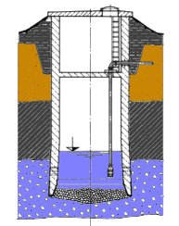
Using Wells
A well is a shaft or a hole that has been sunk, dug or drilled into the earth to extract water (Int. Glossary of Hydrology).
perforated
casing or
screen
gravel
pack
Int. Glossary of Hydrology:
http://www.cig.ensmp.fr/
~hubert/glu/HINDENT.HTM
pump
Notes:
8

Slide 9
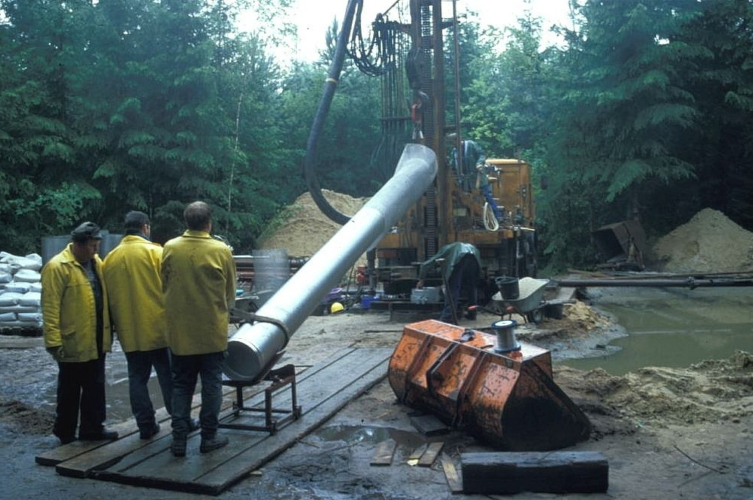
Inflow and Outflow
Wells can be used for
water supply (households, agriculture, industry)
lowering the groundwater level (excavations, open-pit mining)
remediation of aquifer con-tamination (“pump and treat“)
aquifer characterisation (pumping tests)
Apart from aquifer characteri-sation, wells are usually operated at steady state (constant pumping rate).
Notes:
9

Slide 10
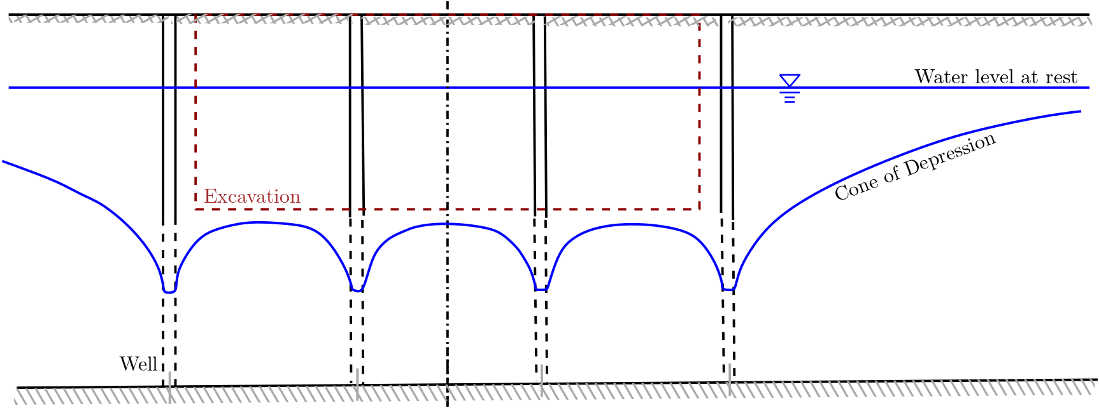
Example: Lowering the Groundwater Level
Notes:
10

Slide 11
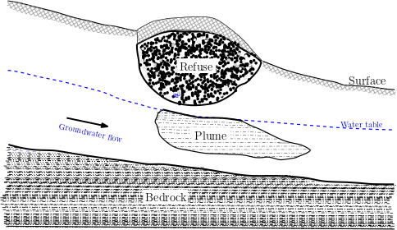
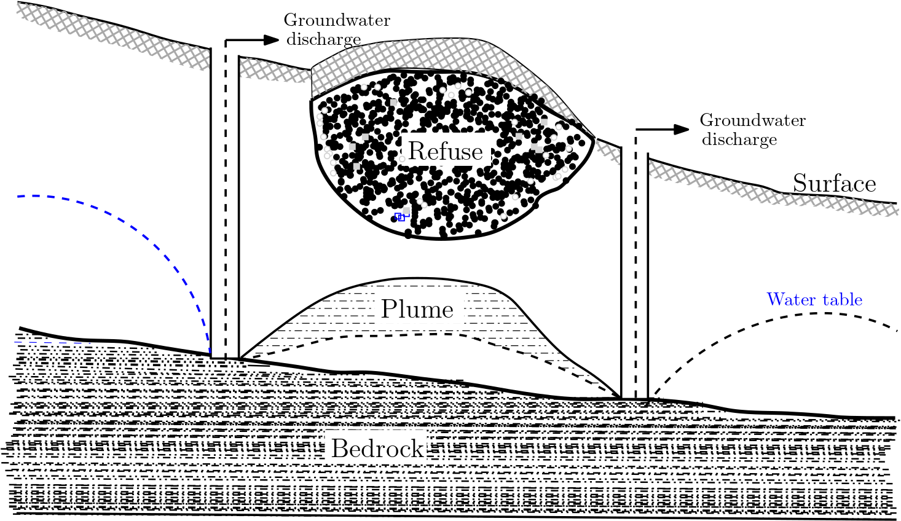
Example: Pump and Treat at Contaminated Sites
Notes:
11

Slide 12
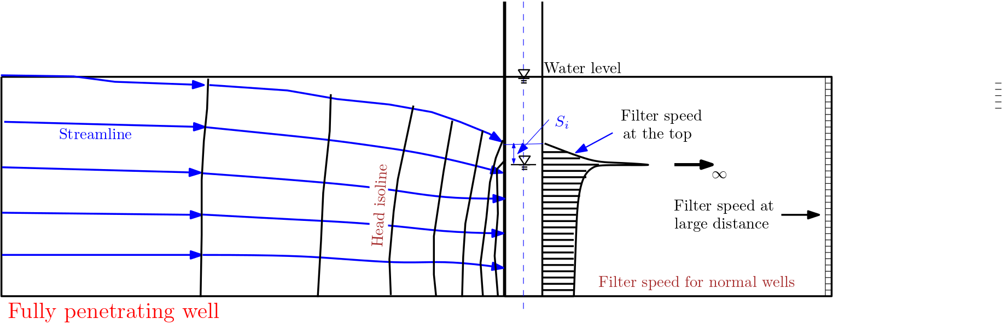
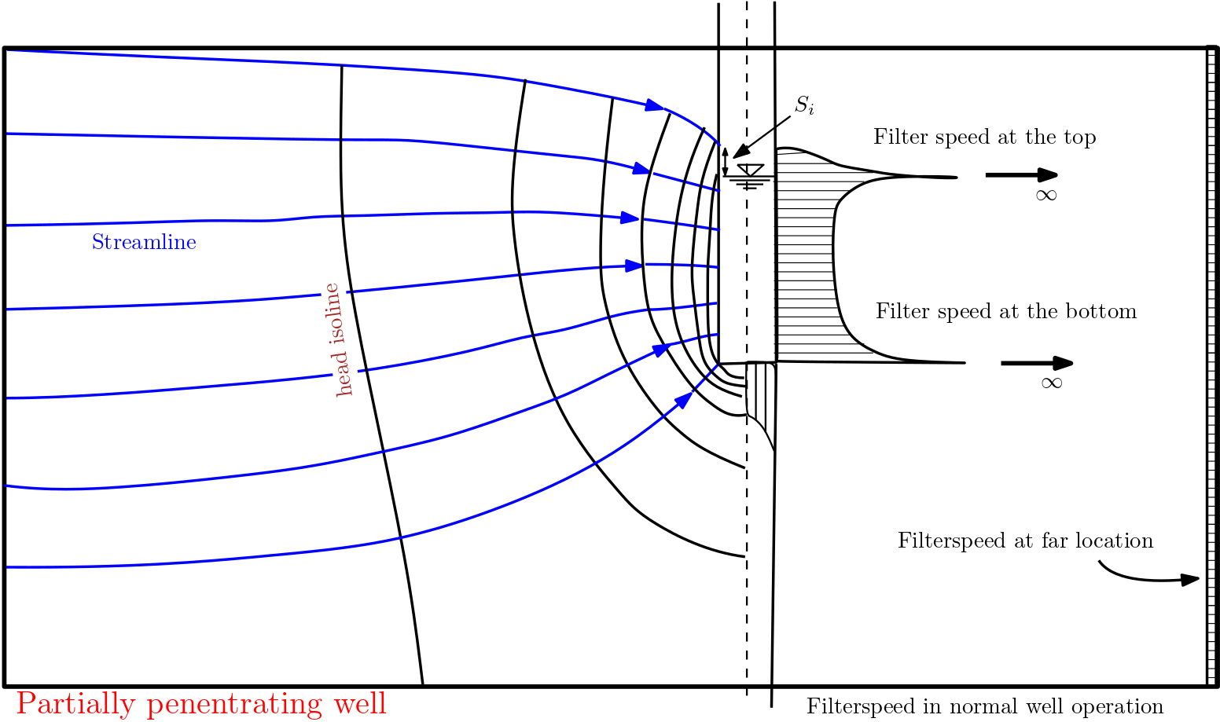
Fully vs. Partially Penetrating Wells
fully penetrating well = well which extends through the whole saturated depth of an aquifer and is constructed in such a manner that water is permitted to enter the well screen over its length (Int. Glossary of Hydrology)
Notes:
12

Slide 13
Groundwater Flow Near Wells Operated at Steady State

Slide 14
Basic Questions and General Approach
Which relevant quantities are needed to describe steady-state flow towards a well?
What is the quantitative relationship between the hydraulic parameters under steady-state conditions?
In order to answer these questions the law of continuity (conservation of volume) and Darcy‘s law have to be applied.
It is convenient to study the confined and the unconfined cases separately.
Notes:
14

Slide 15
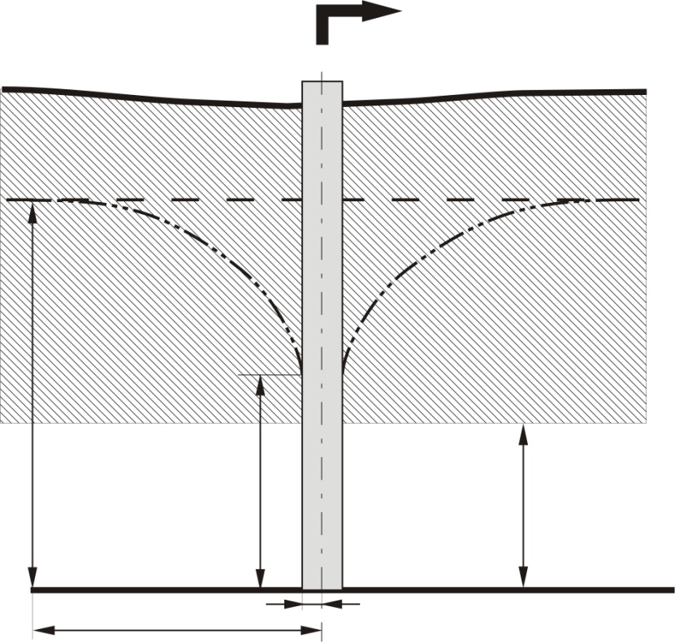
Cone of Depression in a Confined Aquifer
Q
Relevant quantities:
pumping rate Q [L³/T]
thickness m [L]
hydraulic conductivity K [L/T]
water level at rest H [L]
water level in the pumping well h [L]
radius of influence R [L] *
well radius r_{w} (incl. gravel pack!) [L]
drawdown s = H – h [L]
s
impermeable
H
h
K
m
R
r_{w}
* The radius of influence is the distance from the well axis at which the drawdown becomes negligible or unobservable.
Notes:
15

Slide 16
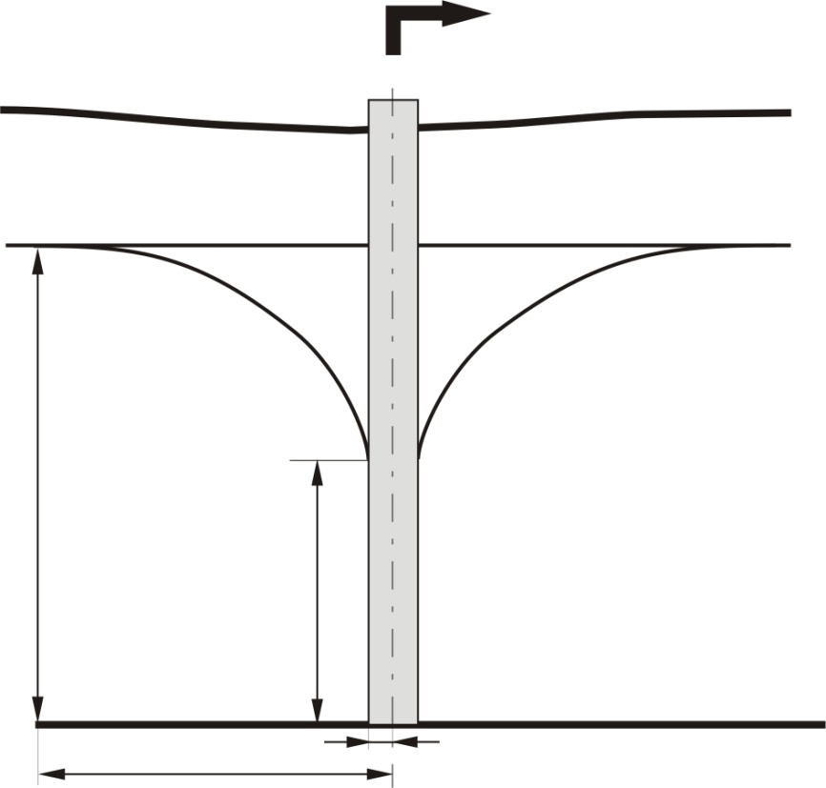
Cone of Depression in an Unconfined Aquifer
Q
Relevant quantities:
pumping rate Q [L³/T]
hydraulic conductivity K [L/T]
water level at rest H [L]
water level in the pumping well h [L]
radius of influence R [L]
well radius r_{w} (incl. gravel pack!) [L]
drawdown s = H – h [L]
s
H
K
h
R
r_{w}
Notes:
16

Slide 17
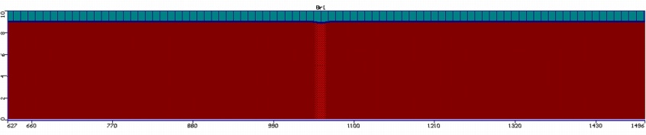
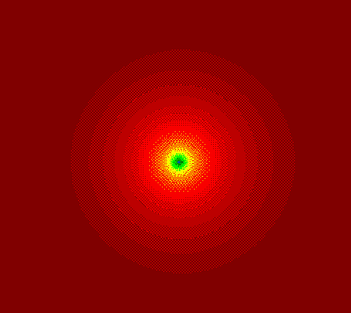
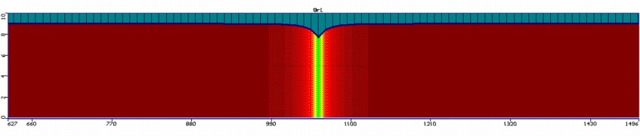
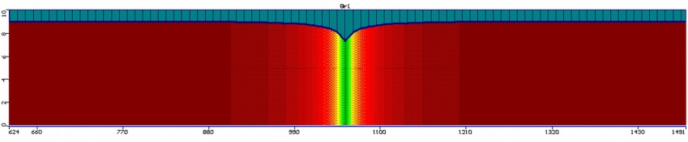
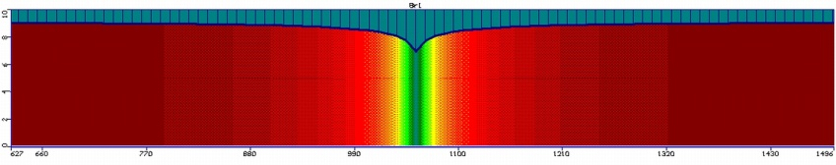
Computer Simulation of a Cone of Depression
top view (14 d)
6 min
1.5 h
3 d
14 d
~900m
Notes:
17

Slide 18
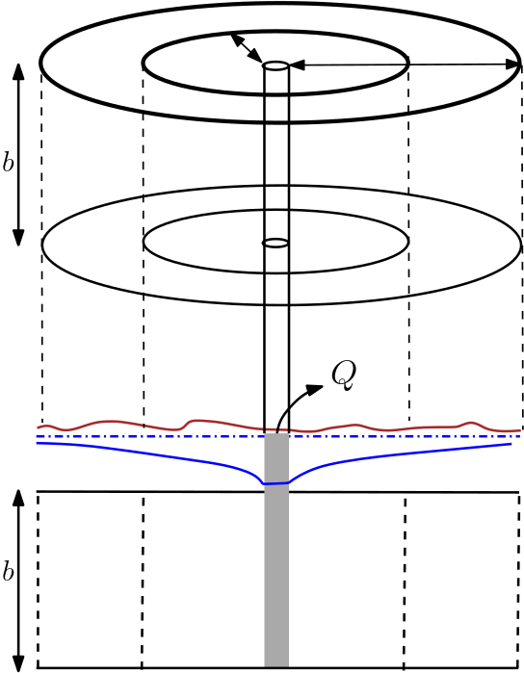
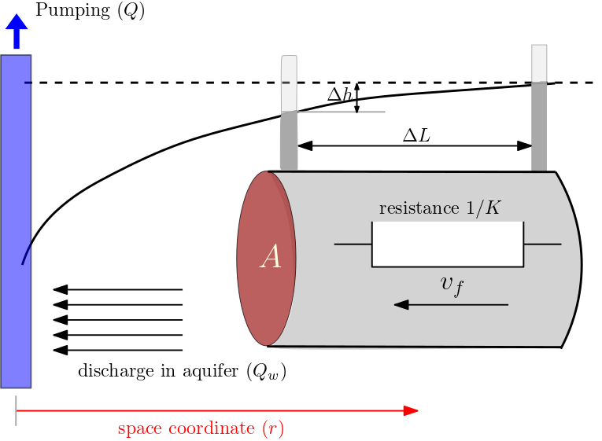
Law of Continuity
Under steady-state conditions, the law of continuity implies that the pumping rate Q corresponds to the discharge Q_{w} near the well.
In addition, under steady-state conditions the law of continuity implies that there is the same discharge at all cross sections which completely surround the well (“mantle of a cylinder“).
Mathematically speaking: Q_{w} = const.
Notes:
18

Slide 19
Darcy‘s Law for Flow Towards a Well I
The coordinate r is introduced to denote the radial distance from the well axis.
In general, Darcy‘s law relates the Darcy velo-city v_{f} and the hydraulic gradient i.
If the hydraulic gradient was constant in spa-ce, we would obtain: i = Δh/Δr.
However, the hydraulic gradient i depends on the distance r within a cone of depression (see figure).
Qualitatively speaking, i is decreasing with increasing distance from the well.
If the hydraulic gradient is not constant in space, the ratio Δh/Δr has to be replaced by the derivative dh/dr.
Notes:
19

Slide 20



Darcy‘s Law for Flow Towards a Well II
hydraulic gradient:
$$i\left(r\right)=\frac{dh}{dr}(r)$$
Darcy‘s law:
$$v_{f}\left(r\right)=−K⋅i\left(r\right)=−K⋅\frac{dh}{dr}(r)$$
discharge in the aquifer:
$$Q_{w}=A⋅v_{f}=−A⋅K⋅\frac{dh}{dr}(r)$$
Notes:
20

Slide 21




Flow Towards a Well in a Confined Aquifer I
discharge in the aquifer:
Q
$$Q_{w}=A⋅v_{f}=−A⋅K⋅\frac{dh}{dr}(r)$$
area A of a cross section at distance r from the well axis:
s
$$A=2⋅π⋅r⋅m$$
impermeable
insert in the equation for the discharge:
H
$$Q_{w}=−2⋅π⋅r⋅m⋅K⋅\frac{dh}{dr}(r)$$
h
K
m
This relationship is a first-order differential equation for hydraulic head h(r). It can be solved by separation of variables:
R
r_{w}
$$dh(r)=−\frac{Q_{w}}{2⋅π⋅m⋅K}⋅\frac{dr}{r}$$
Notes:
21

Slide 22


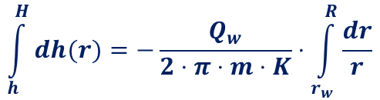

Flow Towards a Well in a Confined Aquifer II
after separation of variables:
Q
$$dh(r)=−\frac{Q_{w}}{2⋅π⋅m⋅K}⋅\frac{dr}{r}$$
integration from r_{w} to R (right-hand side) and from h to H (left-hand side):
s
$$\int_{h}^{H}{dh(r)}=−\frac{Q_{w}}{2⋅π⋅m⋅K}⋅\int_{r_{w}}^{R}{\frac{dr}{r}}$$
impermeable
H
indefinite integrals:
h
K
m
$${\left[h(r)\right]}_{h}^{H}=−\frac{Q_{w}}{2⋅π⋅m⋅K}{⋅\left[\text{ln} (r)\right]}_{r_{w}}^{R}$$
R
r_{w}
insert limits of integration:
$$H −h=−\frac{Q_{w}}{2⋅π⋅m⋅K}⋅(\text{ln} R −\text{ln} r_{w})$$
Notes:
22

Slide 23




Flow Towards a Well in a Confined Aquifer III
after inserting the limits of integration:
Q
$$H −h=−\frac{Q_{w}}{2⋅π⋅m⋅K}⋅(\text{ln} R −\text{ln} r_{w})$$
solving for Q_{w}:
$$Q_{w} =−\frac{2⋅π⋅m⋅K⋅(H−h)}{\text{ln} R −\text{ln} r_{w}}$$
s
The negative sign on the right-hand side indicates that flow is anti-parallel to the di-rection of the coordinate axis.
Frequently, the pumping rate Q is used in-stead of Q_{w} and the negative sign is omitted:
impermeable
H
h
K
m
$$Q=\frac{2⋅π⋅m⋅K⋅(H−h)}{\text{ln} R −\text{ln} r_{w}}=\frac{2⋅π⋅m⋅K⋅(H−h)}{\text{ln} (R/r_{w})}$$
R
r_{w}
with decadic logarithm:
$$Q=\frac{2⋅π⋅m⋅K⋅(H−h)}{2.3 ⋅\text{(}\text{l}\text{og} R −\text{l}\text{og} r_{w})}=\frac{2⋅π⋅m⋅K⋅(H−h)}{2.3⋅\text{l}\text{og} (R/r_{w})}$$
Notes:
23

Slide 24




Flow Towards a Well in an Unconfined Aquifer I
discharge in the aquifer:
Q
$$Q_{w}=A⋅v_{f}=A⋅K⋅\frac{dh}{dr}(r)$$
area A of a cross section at distance r from the well axis:
$$A=2⋅π⋅r⋅h\left(r\right)$$
s
insert in the equation for the discharge:
H
$$Q_{w}=2⋅π⋅r⋅h\left(r\right)⋅K⋅\frac{dh}{dr}(r)$$
K
h
This relationship is a first-order differential equation for hydraulic head h(r). It can be solved by separation of variables:
R
r_{w}
$$h\left(r\right)⋅dh(r)=−\frac{Q_{w}}{2⋅π⋅K}⋅\frac{dr}{r}$$
Notes:
24

Slide 25

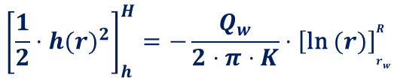


Flow Towards a Well in an Unconfined Aquifer II
after separation of variables:
Q
$$h\left(r\right)⋅dh(r)=−\frac{Q_{w}}{2⋅π⋅K}⋅\frac{dr}{r}$$
integration from r_{w} to R (right-hand side) and from h to H (left-hand side):
s
$$\int_{h}^{H}{h\left(r\right)⋅dh(r)}=−\frac{Q_{w}}{2⋅π⋅K}⋅\int_{r_{w}}^{R}{\frac{dr}{r}}$$
H
K
h
indefinite integral:
$${\left[\frac{1}{2}{⋅h(r)}^{2}\right]}_{h}^{H}=−\frac{Q_{w}}{2⋅π⋅K}{⋅\left[\text{ln} (r)\right]}_{r_{w}}^{R}$$
R
r_{w}
insert limits of integration:
$${\frac{1}{2}(H}^{2} −h^{2})=−\frac{Q_{w}}{2⋅π⋅m⋅K}⋅(\text{ln} R −\text{ln} r_{w})$$
Notes:
25

Slide 26




Flow Towards a Well in an Unconfined Aquifer III
after inserting limits of integrations:
Q
$$H^{2} −h^{2}=−\frac{Q_{w}}{π⋅K}⋅(\text{ln} R −\text{ln} r_{w})$$
Solving for Q_{w}:
$$Q_{w} =−\frac{π⋅K⋅(H^{2}−h^{2})}{\text{ln} R −\text{ln} r_{w}}$$
s
The negative sign on the right-hand side indicates that flow is anti-parallel to the di-rection of the coordinate axis.
Frequently, the pumping rate Q is used in-stead of Q_{w} and the negative sign is omitted:
H
K
h
$$Q=\frac{π⋅K⋅(H^{2}−h^{2})}{\text{ln} R −\text{ln} r_{w}}=\frac{2⋅π⋅K⋅(H^{2}−h^{2})}{\text{ln} (R/r_{w})}$$
R
r_{w}
with decadic logarithm:
$$Q=\frac{π⋅K⋅(H^{2}−h^{2})}{2.3 ⋅\text{(}\text{l}\text{og} R −\text{l}\text{og} r_{w})}=\frac{π⋅K⋅(H^{2}−h^{2})}{2.3⋅\text{l}\text{og} (R/r_{w})}$$
Notes:
26

Slide 27
Radius of Influence
Lembke (1886, 1887) | R = H (K / 2 N)^{1/2}
Weber (Schultze, 1924) | R = 2.45 (H K t / S)^{1/2}
Kusakin (Aravin and Numerov, 1953) | R = 1.9 (H K t / S)^{1/2}
Siechardt (Certousov, 1962) | R = 3000 s K^{1/2}
Kusakin (Certousov, 1949) | R = 575 s (H K)^{1/2}
s = drawdown in pumping well, t = pumping time, N = groundwater recharge, S = storage coefficient, K = hydraulic conductivity, H = water level at rest (unconfined aquifer). In confined aquifers, H has to be replaced by the aquifer thickness m.
There are several (semi-)empirical equations to estimate the radius of influence. (The above table is incomplete.)
Practitioners appear to prefer the equations of Siechardt and Kusakin.
In both equations, K has to be expressed in m/s and all other quantities in m!
R depends on drawdown s = H – h in both equations. Try-and-error or iterative strategies have to be used to determine R and h.
Notes:
27

Slide 28
Aquifer Characterisation by Pumping Tests

Slide 29
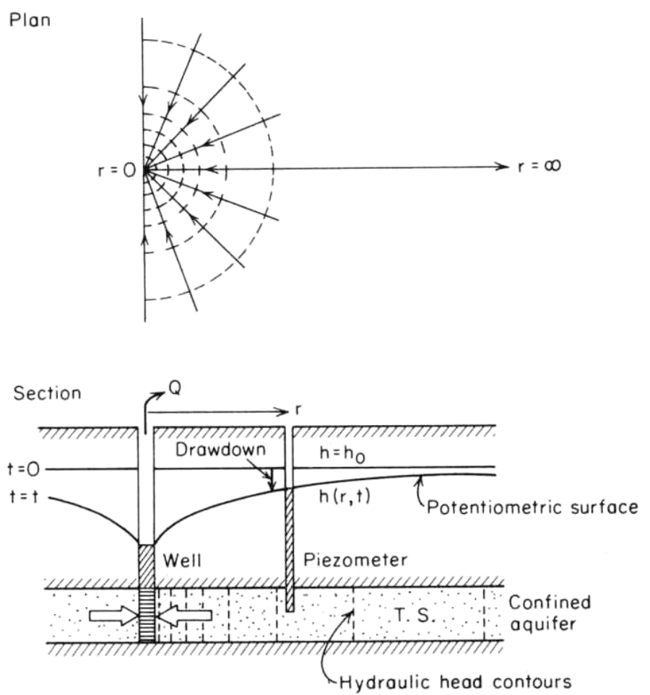
Some General Remarks on Pumping Tests
Pumping tests are used to estimate aquifer properties: hydraulic conductivity (K), transmissivity (T) or storativity (S).
Pumping results in an evolving cone of depression.
The decrease in hydraulic head (or increase in drawdown) with time is recorded in one or more observation wells (and sometimes also in the pumping well itself).
A variety of different schemes exist to evaluate pumping test data. The appropriate method has to be selected according to the specific setting (confined or unconfined, layered system, horizontal or inclined aquifer bottom etc.).
A well known approach to derive T and S from pumping test data was developed by Theis.
Notes:
29

Slide 30
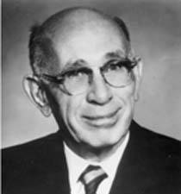
Applicability of the Theis Method
Pumping test data can be evaluated according to Theis (1935) if the following assumptions are (approximately) justified:
The aquifer is confined, homogeneous and isotropic.
The aquifer thickness is uniform.
The aquifer bottom is horizontal.
The well is fully penetrating.
The well radius is very small as compared to the radius of influence.
The pumping rate is constant within the measurement period.
There is no vertical flow component.
The evolution of the cone of depression is not influenced by other hydraulic factors (surface water, impermeable bounda-ries etc.).
Charles V. Theis (1900 – 1987)
Notes:
30

Slide 31


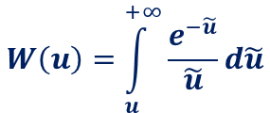
Drawdown According to Theis
The time-dependent (t) drawdown s in an observation well, which is a distance r apart from the pumping well, is given by
pumping
rate [L³/T]
drawdown [L]
“well function“ [-]
$$s\left(r,t\right)=\frac{Q}{4πT}⋅W(u)$$
transmissivity [L²/T]
with the well function
$$W\left(u\right)=\int_{u}^{+∞}{\frac{e^{−\tilde{u}}}{\tilde{u}}d\tilde{u}}$$
and the dimensionless variable
storage coefficient [-]
$$u =\frac{Sr^{2}}{4Tt}$$
Notes:
31

Slide 32
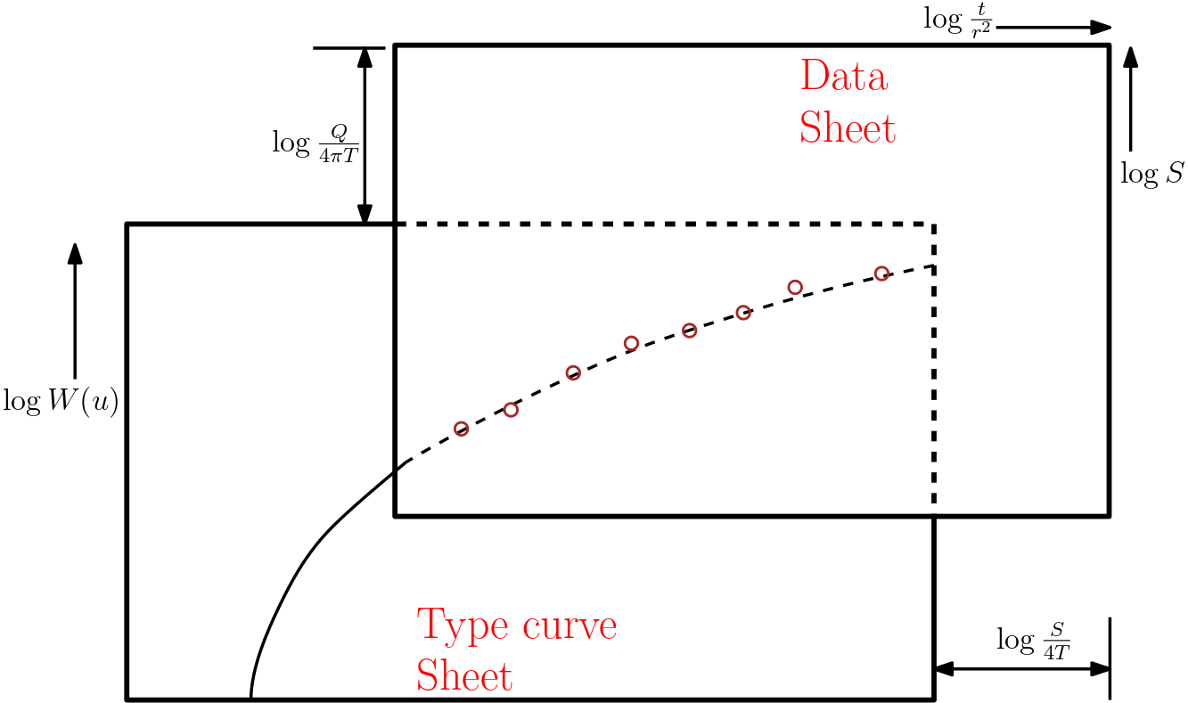




Logarithmic Representation
The decadic logarithm of the equations
$$s\left(r,t\right)=\frac{Q}{4πT}⋅W(u)$$
$$u =\frac{Sr^{2}}{4Tt}$$
is taken. This yields, together with a slight rearrangement of the second equation:
$$\text{log} s=\text{log}\frac{Q}{4πT}+\text{log} W(u)$$
$$\text{log} \frac{t}{r^{2}}= \text{log}\frac{S}{4T}+\text{log}\frac{1}{u}$$
These two equations are used to derive T and S from drawdown data.
This can either be done by applying spe-cial computer software or manually by a graphical method which is illustrated in the figure.
Notes:
32

Slide 33
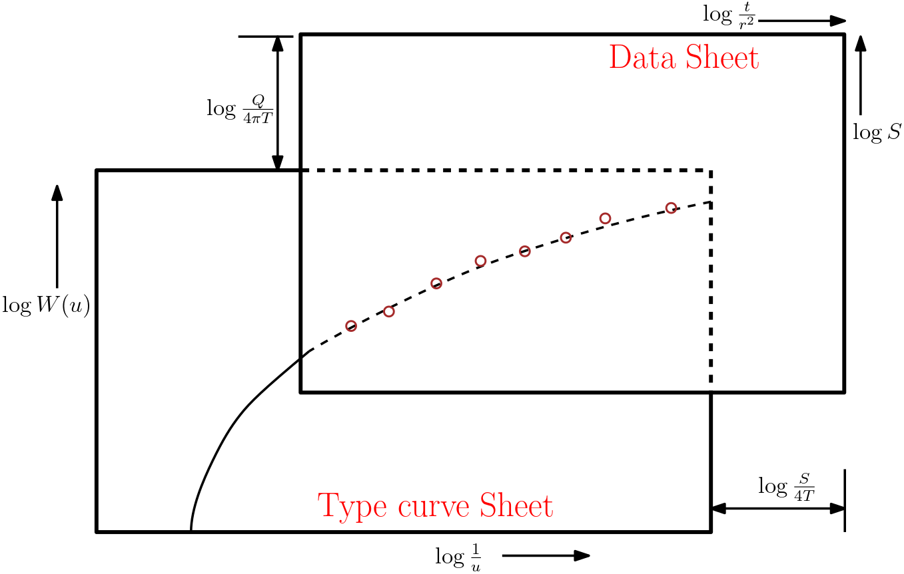



Manual Comparison of Data and Type Curve
The logarithm of drawdown, logs, is plotted against log(t/r²) in the data sheet.
The logarithm of the well function, logW, is plotted against log(1/u) in a type curve sheet. (This curve is independent from aquifer properties!)
Both sheets are put on top of each other such that the data coincide with some part of the type curve.
The shifts along the vertical and the horizontal axes correspond to the constant terms in the equations
$$\text{log} s=\text{log}\frac{Q}{4πT}+\text{log} W(u)$$
$$\text{log} \frac{t}{r^{2}}= \text{log}\frac{S}{4T}+\text{log}\frac{1}{u}$$
The constant term in the upper equation can then be solved for T.
Finally, the constant term in the lower equation can be solved for S.
Notes:
33

Slide 34
Example
The practical application of the Theis method is facilitated by selecting a match point in the range of the data such that corresponding values W_{A} and 1/u_{A} are “simple“.
In the example:
W_{A} = 10⁰ = 1, 1/u_{A} = 10² = 100
Next, values for s and t/r² at the match point are determined.
In the example: s = 0.2, t/r² = 0.57
Notes:
34

Slide 35


Previous results: W_{A} = 10⁰ = 1,
1/u_{A} = 10² = 100
s = 0.2
t/r² = 0.57
Next, we get T via
Example
$$T =\frac{Q}{4πs}⋅W_{A}$$
For Q = 26.7 l/s we ob-tain T = 1.06·10⁻² m²/s.
Finally, S is obtained from
$$S =\frac{4 T⋅t/r^{2}}{1/u_{A}}$$
In the example:
S = 2.42·10⁻⁴
Notes:
35

Slide 36
Computer-Based Comparison of Data and Type Curve
Of course, measured data and type curve can be favourably compared with the help of computer programs.
These programs work pretty much the same as shown for the manual comparison. In particular, results are again displayed in a double-logarithmic diagram.
Theis
Notes:
36

Slide 37

Quick check what we have understood?
Pls. scan the QR- code
or
click link the link:
https://partici.fi/21488247

