Slide 1
Previous Lecture
transmissivity
wells – overview
groundwater flow near wells operated at steady state
aquifer characterisation by pumping tests
Questions?
Notes:
1

Slide 2
Today
conservative solute transport processes
joint action of transport processes
concentration profiles and breakthrough curves
* The lecture texts/contents are originally from Prof. R. Liedl. Only minimal modifications have been made to the original texts/contents.
Notes:
2

Slide 3
Conservative Solute Transport Processes
Notes:
3

Slide 4
Contaminants in Groundwater – Schematic Overview
ground surface
contaminant
phase
vadose zone
water (ground-
water recharge)
vadose zone
contaminant in solution
groundwater
table
contaminant in solution
saturated zone
(pore
diffusion)
dispersion
advection/convection →
aquifer bottom
contaminant phase
Fetter C. W. (1994): Applied hydrogeology, Prentice Hall, 3rd ed.
Notes:
4

Slide 5
Conservative Solute Transport Processes)
This section is intended to cover some basics related to the processes of
– advection,
– mechanical dispersion,
– pore diffusion.
The above processes are summarised as conservative transport processes.
A chemical in groundwater is subject to conservative transport processes if there is
– no interaction with the solid material,
– no interaction with other chemicals,
– no interaction with microbes.
These interactions constitute reactive processes.
For convenience, conservative processes are discussed in the following with regard to 1D scenarios (e.g., Darcy column).
Notes:
5

Slide 6
Advection (Convection)
Advection (or convection) is the transport of matter or energy with the movement of a moving medium.
The moving medium can be termed carrier. It is usually a fluid.
Examples:
– convection of heat (heating circuits, sailplaning)
– advection of dissolved chemicals or suspended particles in surface or subsurface water or with the wind.
It seems that the term “convection“ is more frequently used with regard to transport of energy (heat, in particular), while the term “advection“ is more frequently used in connection with the transport of matter.
Notes:
6

Slide 7

1D Scenario (Advection)
1D flow of a fluid, e.g. water in a lab column filled with a porous medium
steady-state flow with discharge Q [L³/T]
cross-sectional area A = const. [L²]
equation of continuity: Q = n_{e}·A·v = const.
with v = linear velocity [L/T] and n_{e} = effective porosity [-]
As an immediate consequence, v = const. in this scenario.
v
advection / convection
$$J_{adv}=Q⋅C$$
advective
mass flow
[M/T]
solute
concentration
[M/L³]
discharge
[L³/T]
Notes:
7

Slide 8
Variable Cross Section)
v₂
v₁
Q₁ = Q₂
A₁·v₁ = A₂·v₂
equation of continuity: Q = n_{e}·A·v = const.
According to the equation of continuity, the linear velocity has to be inversely proportional to the cross-sectional area (assuming that effective porosity is spatially constant).
The mass, which is shown in red, is the same in both flow sections.
During the transition from the smaller to the larger cross section, the area covered by the solute mass expands laterally and its extension along the flow direction is reduced accordingly.
The solute concentration is not changed in the red area!
Notes:
8

Slide 9
Advection is not Enough…,
averaged solute spreading
Plan view!
actual solute spreading
advection
+
dispersion
(longitudinal and transverse)
advection
transverse dispersion is
not relevant for
1D problems
(e.g., laboratory column)
Notes:
9

Slide 10
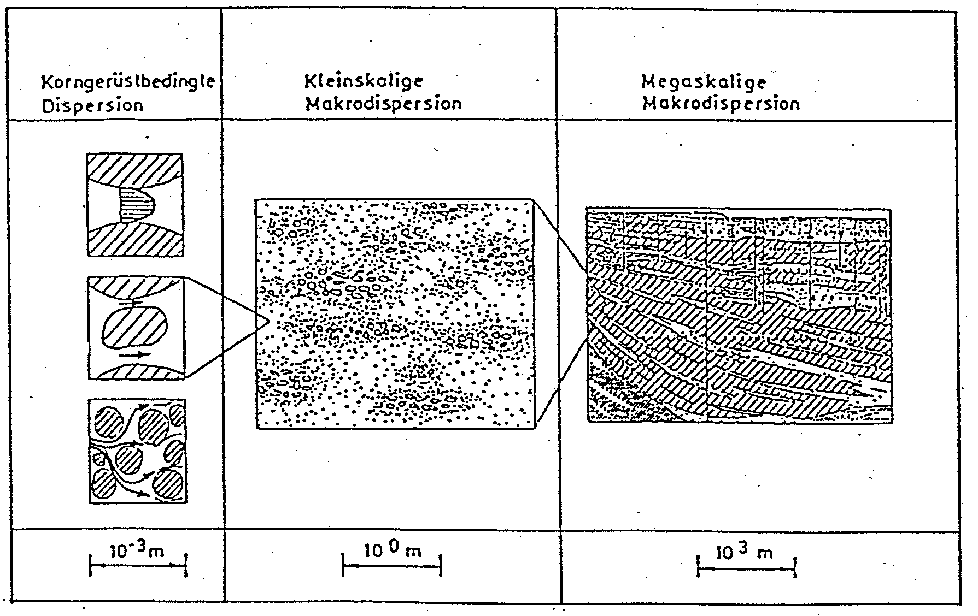
Mechanical Dispersion
Mechanical dispersion is a consequence of
different groundwater flow velocities across each individual pore (“parabolic velocity profile“),
different groundwater flow velocities in different pores,
the movement of water around the solids along different flowpaths.
These effects result in different transport distances and different transport times, respectively, for individual solute particles.
(Kinzelbach, 1992)
Notes:
10

Slide 11
Example: Lowering the Groundwater Level
The dispersive mass flow due to mechanical dispersion in porous media is
– proportional to the cross-sectional area,
– proportional to the linear velocity,
– proportional to the difference in concentration,
– inversely proportional to the transport distance.
The dispersive mass flow is oriented from regions with higher concentrations to regions with lower concentrations.
Equation:
negative sign!
concentration
difference
[M/L³]
dispersive
mass flow
[M/T]
cross-sectional
area [L²]
transport
distance
[L]
dispersivity
[L]
linear velocity
[L/T]
Notes:
11

Slide 12
Dispersivity and Mechanical Dispersion Coefficient
The ratio ΔC/L is termed concentration gradient [M/L⁴].
The dispersivity value equals the value of the dispersive mass flow through a unit cross-sectional area for a unit concentration gradient and a unit linear velocity.
The dimension of dispersivity is length [L]. Dispersivity is a property of the porous medium alone and does not depend on the fluid or the flow behaviour.
The product of dispersivity and linear velocity is called mechanical dispersion coefficient:
The dimension of the mechanical dispersion coefficient is L²/T. The mechanical dispersion coefficient depends on properties of the porous medium and on the flow behaviour.
Dispersive mass flow due to mechanical dispersion can therefore be expressed as:
Notes:
12

Slide 13
Hydrodynamic Dispersion
In addition to mechanical dispersion, concentration gradients are also responsible for solute spreading by diffusion.
The superposition of mechanical dispersion and diffusion is termed hydrodynamic dispersion.
The diffusive mass flow in porous media is not adequately represented by the diffusion coefficient D [L²/T], which is valid for a “free“ fluid.
Rather, the restriction of diffusion by the solids has to be considered.
This is done by introducing the pore diffusion coefficient D_{p} [L²/T].
General relationship: D_{p} < D
It is frequently assumed that D_{p} = n_{e}·D (with n_{e} = effective porosity) but several other empirical formulae relating D and D_{p} can be found in literature.
Hydrodynamic dispersion coefficient:
Notes:
13

Slide 14
Some Reminders on 1D Diffusion
1D diffusion of a dissolved chemical in a fluid, e.g. in water
no fluid flow, i.e. Q = 0 (and consequently v = 0)
Concentration differences are gradually levelled.
time level 1
time level 2
time level 3
Notes:
14

Slide 15
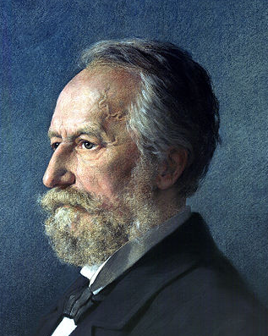
Diffusion – Fick‘s First Law
The mass flow due to 1D diffusion is
– proportional to the cross-sectional area,
– proportional to the concentration difference,
– inversely proportional to the transport distance.
The mass flow is oriented from regions with higher concen-trations to regions with lower concentrations.
Fick‘s first law (Fick, 1855):
Adolf Fick
(1829 – 1901)
negative sign!
concentration
difference
[M/L³]
diffusive
mass flow
[M/T]
cross-sectional
area [L²]
transport
distance
[L]
diffusion
coefficient
[L²/T]
Notes:
15

Slide 16
Diffusion Coefficient
The dimension of the diffusion coefficient is L²/T.
The value of the diffusion coefficient equals the value of the diffusive mass flow through a unit cross section for a unit concentration gradient.
Diffusion coefficients for diffusion of dissolved chemicals in water are mostly in the range from 10⁻¹⁰ m²/s to 10⁻⁹ m²/s.
Diffusion coefficients for diffusion of dissolved chemicals in gases are larger by about four orders of magnitude, i.e. in the range from 10⁻⁶ m²/s to 10⁻⁵ m²/s.
Notes:
16

Slide 17
Joint Action of Transport Processes
Notes:
17

Slide 18
Advection and Dispersion – Mass Flow
Spreading of a conservative solute in an unconsolidated aquifer can be understood as a superposition of advection, mechanical dispersion and pore diffusion.
Equations for the mass flow:
or, alternatively:
The spreading of solutes due to advection and dispersion can be quantified by combining a mass budget and the corresponding laws of motion.
This results in a transport equation (advection-dispersion or convection-dispersion equation) which is discussed a bit in one of the modelling lectures.
The solution of the transport equation is given by the solute concentration C(x,t) which varies in space and time.
Notes:
18

Slide 19
Solute Spreading due to Advection and Dispersion
advection
dispersion
time level 1
time level 2
time level 3
Notes:
19

Slide 20
Relative Importance of Mass Flow Contributions
cross-sectional area n_{e}·A = 1 m²
linear velocity v = 1 m/d
concentration C = 1 mg/l = 1 g/m³
transport distance L = 1 m
concentration gradient ΔC/L = 1 g/m⁴
dispersivity α = 0.1 m
(α = L/10 is a rough estimate which is frequently used without checking)
pore diffusion coefficient D_{p} = 10⁻¹⁰ m²/s
contribution of advection:
n_{e}·A·v·C = 1 m² · 1 m/d · 1 g/m³ = 1 g/d
contribution of mechanical dispersion:
n_{e}·A·α·v·ΔC/L = 1 m² · 0.1 m · 1 m/d · 1 g/m⁴ = 0.1 g/d
contribution of pore diffusion:
n_{e}·A·D_{p}·ΔC/L = 1 m² · 10⁻¹⁰ m²/s · 1 g/m⁴ = 10⁻¹⁰ g/s ≈ 10⁻⁵ g/d
advection > mech. dispersion or advection ≈ mech. dispersion
mech. dispersion >> pore diffusion (Pore diffusion is usually negligible in unconsolidated aquifers.)
C
1 mg/l
concentration gradient
1 m
x
Notes:
20

Slide 21
Concentration Profiles and Breakthrough Curves
Notes:
21

Slide 22
Concentration Profiles I
Concentration profiles are representations of the solute concentration as a function of a space coordinate at fixed time levels.
C
x
time level 1
Notes:
22

Slide 23
Concentration Profiles II
C
advection only
x
time level 2
C
advection only
x
time level 3
Notes:
23

Slide 24
Breakthrough Curves
Breakthrough curves are representations of the solute concentration as a function of time at specified observation locations.
C
advection only
observation locations
O1
O1
O2
time
level 2
time
level 3
t
time
level 1
C
advection only
O2
t
time
level 1
time
level 2
time
level 3

Slide 25
Simulation tool (spreadsheet and JUPYTER notebook file)
1D solute transport in a porous medium (e.g., laboratory column)
uniform cross section
time-invariant water flow
injection of a tracer
spreading of the tracer due to advection and mechanical dispersion
computation and graphical representation of a breakthrough curve based on solutions of the advection-dispersion equation (mass budget & laws of motion)
comparison with measured data
Notes:
25

Slide 26

Quick check what we have understood?
Pls. scan the QR- code
or
click link the link:
https://partici.fi/32885851

