Slide 1
Previous Lecture
dispersive mass flow in 3D
equilibrium sorption
degradation
joint action of conservative transport and reactive processes (1D)
Questions?

Slide 2
Today:
Groundwater Modelling I:
introduction
example of a groundwater model

Slide 3
Introduction

Slide 4
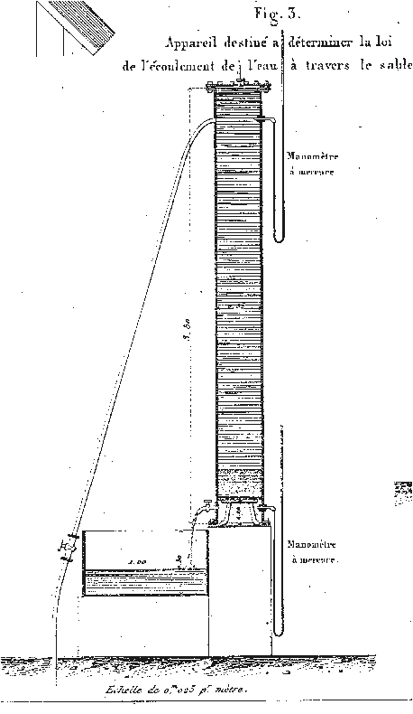
What is a Model?
A model is a representation, an image or a de-scription of a real system.
example for a real system: porous medium with water flowing through the pores (Darcy experiment)
corresponding model: Darcy‘s Law (flow rate ~ hydraulic gradient)
Each model is subject to simplifications (as it is “only an image“ of the real system).
Darcy‘s Law, for instance, does not provide an exact representation of flow through individual pore channels. Rather, average flow behaviour through “many“ pore channels is represented.
Brown G. O. (2002):
Henry Darcy and the making of a law,
Water Resour. Res. 38(7), doi:10.1029/2001WR000727.

Slide 5
Process-Based and Empirical Models
Models can be classified with respect to different criteria.
One criterion is based on the consideration of physical principles.
A physically based model (process-based model) is a model that exclusively relies on physical principles. In most cases, these principles represent conser-vation laws (e.g. for mass, volume, momentum, electric charge or energy).
On the contrary, an empirical model describes the real system by using data only (e.g. via regression analysis, see plot).
Hybrids may occur (“semi-empirical mo-dels“).
Actually, Darcy‘s Law is a semi-empirical model: On the one hand, it is based on momen-tum conservation. On the other hand, it is not possible to strictly deduce the direct proportionality between flow rate and hydraulic gradient by averaging the flow behaviour over all pores.

Slide 6
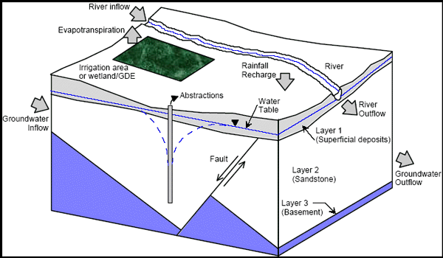
Conceptual Models
Another criterion for model classification distinguishes the qualitative from the quantitative description of a real system.
A conceptual model provides a qualitative representation of the relevant system components, processes and impacts in the area of investigation.
This representation is usually shown graphically, e.g. as block model (see below), horizontal or vertical cross sections (see page 10).
(Middlemis, 2001: Groundwater flow modelling guideline)

Slide 7
Mathematical Models
A mathematical model provides a quantitative representation of the relevant system components, processes and impacts in the area of investigation. The quantitative representation is based on mathematical equations.
The most simple mathematical model in hydrogeology is Darcy‘s Law for one-dimensional steady-state groundwater flow in a confined aquifer: v_{f} = –K·Δh/L
Solutions of the mathematical equations can be grouped as analytical and numerical.
analytical solution: There are exact mathematical expressions solving the model equations.
numerical solution or numerical method: There is no exact mathematical expression which solves the model equations. Rather, it is only possible to obtain a large set of numbers approximating the exact solution.

Slide 8
Example for an Analytical Solution
h
conceptual model
recharge rate N
h = h(x) = ?
h₀
K
h_{L}
x = 0
x = L
x
mathematical model (1D groundwater flow equation + 2 boundary conditions):
analytical solution:

Slide 9
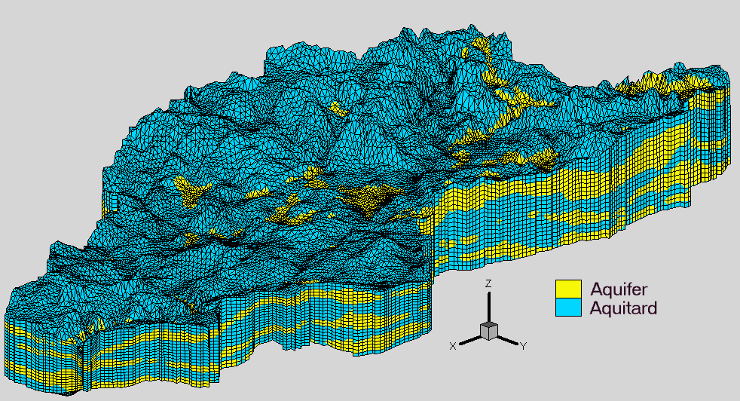
Example for a Model Without Analytical Solution
University of Waterloo,
Dept. of Earth Sciences
Parameter heterogeneity and irregular model domain boundaries lead to more sophisticated versions of the underlying groundwater flow equation: → analytical solutions no longer possible → (approximative) numerical methods required

Slide 10
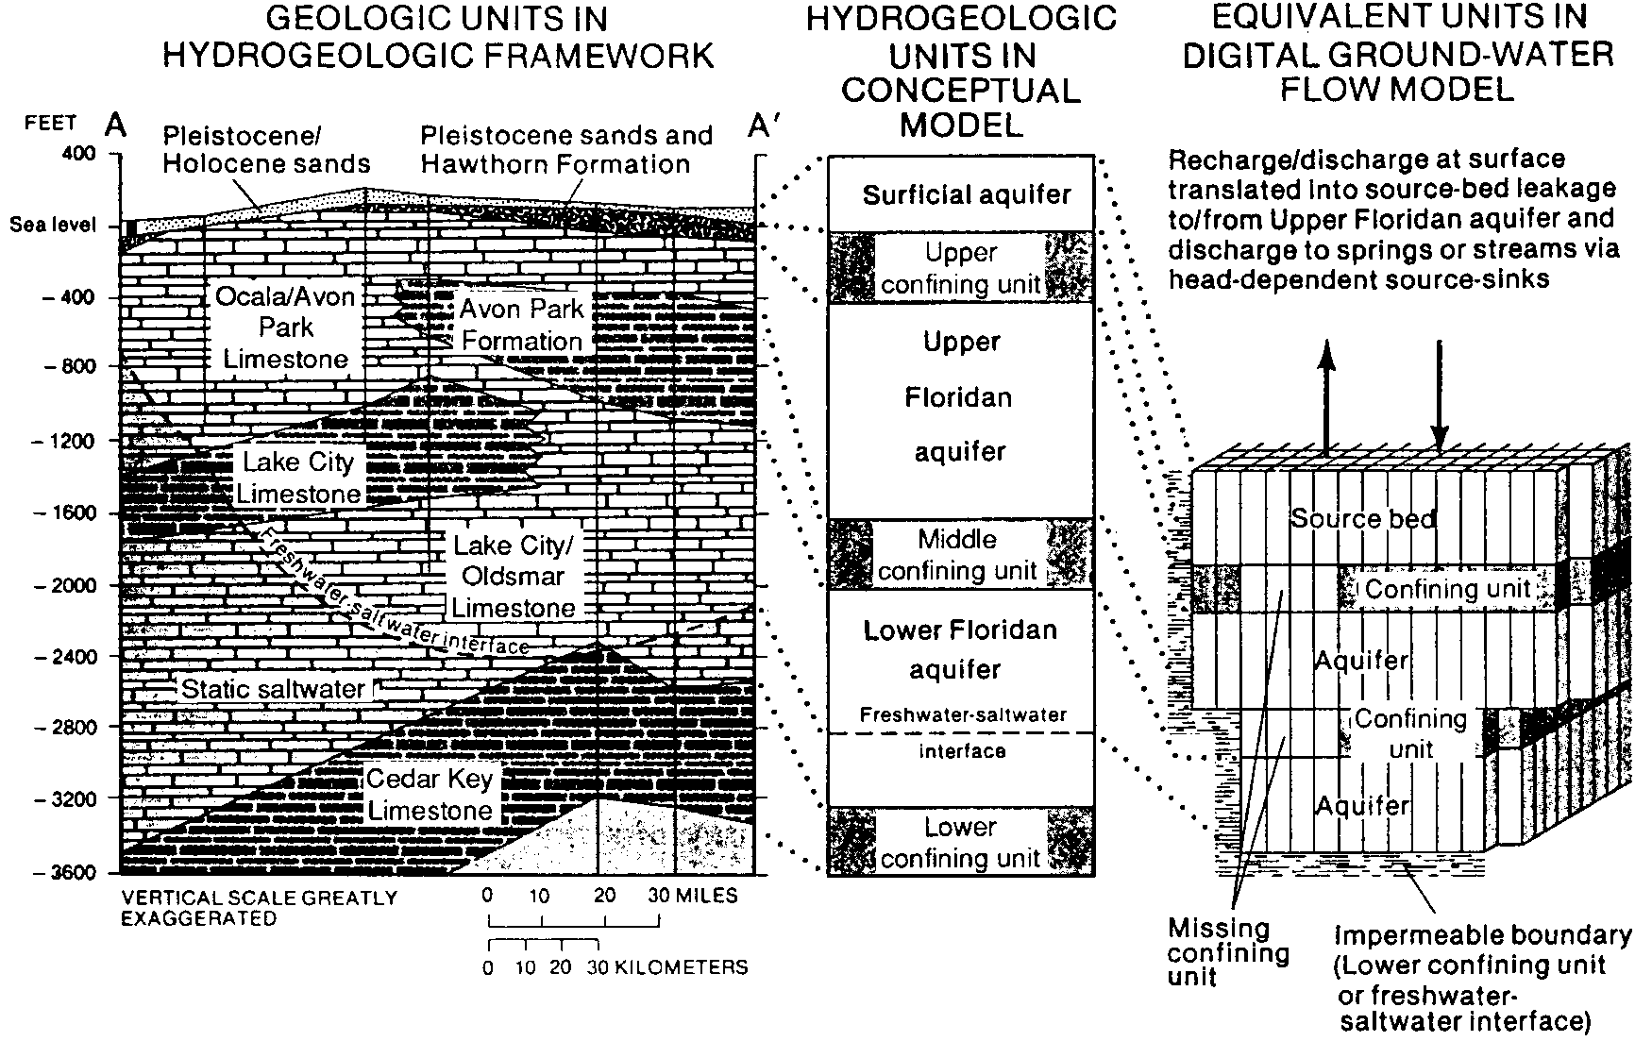
From the Conceptual Model to the Numerical Approach
(from Anderson and Woessner: Applied Groundwater Modeling, 1992)

Slide 11
Data Requirements
topographical maps (with surface waters and water divides)
geological maps, geological profiles (see preceding example)
maps with isolines of aquifer bottoms / thicknesses , aquitard bottoms / thicknesses
maps indicating vertical extensions of sediments under rivers and lakes
hydrogeological maps (hydraulic head isolines)
water level time series in observation wells and rivers
time series of spring discharges
maps and profiles of hydraulic conductivity or transmissivity (also for river / lake sediments mentioned above)
maps and profiles of storage coefficients
information on spatial and temporal variability of inflow / outflow due to – groundwater recharge – evapotranspiration – interaction between groundwater and surface water – groundwater abstraction – natural groundwater flow

Slide 12
Example of a Groundwater Model

Slide 13
Spatial Extension
horizontal extension: 4000 m in x-direction, 2500 m in y-direction
vertical extension: horizontal aquifer bottom at z = 250 m a.s.l. , aquifer thickness = 15 m
groundwater recharge
z = 265 m
2500 m
z = 250 m
4000 m
The corresponding groundwater model is horizontally two-dimensional (2D). Vertical flow components are neglected.

Slide 14
Hydraulic Properties
effective porosity (n_{e}) in the model domain: 0.2 or 20 %
two zones with different hydraulic conductivities (K)
two zones with different groundwater recharge
A section of a river (“river reach“) is in hydraulic contact with the aquifer. i.e. there may be water transfer from the river to the aquifer (“influent conditions“) or vice versa (“effluent conditions“).
inflow boundary with prescribed hydraulic heads
outflow boundary with prescribed hydraulic heads
two impermeable boundaries
Please note: All this corresponds to a highly simplified setup!

Slide 15
2D Scenario and Model Purpose
head =
254 m a.s.l.
impermeable
y = 2500 m
K = 0.002 m/s
linear
interpolation
N = 150 mm/a
W1
head =
260 m a.s.l.
W2
K = 0.005 m/s
river reach
N = 200 mm/a
head =
256 m a.s.l.
x = y = 0
impermeable
x = 4000 m
gw model
Abstraction of groundwater through wells is planned in the area with an overall pumping rate of 7000 m³/d.
Water extraction is to be distributed between two wells located at (x,y) = (3050 m, 1550 m) and (x,y) = (3050 m, 1450 m), resp.
The model purpose is to outline the 50-days isochrone for both wells.

