Slide 1
Previous Lecture
Groundwater Modelling II:
Finite-difference method for 1D groundwater flow
Finite-difference method for 2D groundwater flow
Questions?

Slide 2
Today:
Groundwater Modelling III:
functioning and relevant components of iterative methods
overview of iterative methods and tests
river boundary condition

Slide 3
Functioning and Relevant Components of Iterative Methods

Slide 4
Motivation
A system of equations (e.g. finite-difference equations) has to be solved to simulate groundwater flow by computer models. The solution consists of head values for each model cell.
Each equation is based on the conservation of volume (for each cell) and Darcy‘s Law (for flow between adjacent cells).
Gauß elimination is not appropriate in most cases due to the large number of equations and the associated huge amount of required computer memory.
Therefore iterative solution methods are employed.
These methods require special input parameters to control the iterative procedure. “Optimal“ parameter selection would lead to an acceptable approximate solution within only few iterative steps. However, there is no warranty to achieve this goal in any case.

Slide 5
Schematic Representation of an Iterative Method
The system of FD equations is not solved in a single step (as with Gauß elimination) but as a result of a sequence of similar (iterative) steps.
Within each iterative step the approximative solution for the present time level is assumed to be improved.
This “update“ is based on the intermediate result of the pre-vious iterative step.
For the sake of bookkeeping:
– fourth index ν counting iterati- ve steps)
– usually written as superscript in parentheses
time

Slide 6
Ingredients of an Iterative Method
time
starting values
algorithm to update the approximate solution (transition ν – 1 → ν)
error criterion

Slide 7
Starting Values
iteration count ν = 0
For transient problems, starting values are usually identical with the results of the previous time level (or with initial values).
exception: cells with fixed head boundary condition (heads are known at time level k, no “update“ necessary)
For steady-state problems, star-ting values need to be pre-estima-ted via – default values provided by the software – experience – transient modelling subse- quently approaching the stea- dy state
time

Slide 8
Error Criterion
Option 1: Iteration is finished if a maximum number of iterative steps ν_{max} has been reached.
Option 2: Iteration is finished if differences of results obtained at two subse-quent iterative steps are below a pre-defined error tolerance ε, i.e.
time
ε
Groundwater software tools in-clude both options.

Slide 9
Convergence
An iterative method is convergent, if
Convergence does not (always) imply high quality of the solution!
solution
of FD
equations
head
error to-
lerance ε
Plausibility of results can be checked, for instance, via the volumetric budget (= result offered by many available software tools).

Slide 10
General Procedure
at nodes with fixed heads: corresponding head value is used
at other nodes:
– define starting values:
– perform iterative steps: ν = 1,2,…,ν_{max}
update heads:
terminate iteration if
– issue warning message if iteration does not converge

Slide 11
How to Select ...
Decreasing (increasing) the error tolerance leads to a larger (smaller) number of iterative steps and larger (smaller) computer time.
The smaller the error tolerance, the more accurate the solution of the FD equations is approximated (in most cases). This is only true if the iterative method remains convergent. Sometimes it is simply sufficient to adapt ν_{max} to reobtain convergence.
Exception: An error tolerance close to the precision of the computer may lead to rounding errors and correspondingly reduced quality of the solution.
Rule of thumb: Error tolerance should be one order of magnitude less than the desired accuracy.
Example: Computation of h with an accuracy of 0.01 m requires ε = 0.001 m.
However, strong hydraulic contrasts may require a smaller error tolerance.
selection of the maximum number of iterations: – use default provided by the software – increase default if convergence cannot be achieved

Slide 12
Overview of Iterative Methods and Tests

Slide 13
Some Iterative Methods
There is no iterative method with an overall warranty of convergence!
Therefore, groundwater modelling tools usually contain a set of different iterative methods.
incomplete overview:
method | abbrev.
alternating-direction implicit method | ADI
pre-conditioned conjugate gradient method | PCG
strongly implicit procedure | SIP
successive over-relaxation | SOR

Slide 14
2D Scenario
head =
254 m a.s.l.
impermeable
y = 2500 m
K = 0.002 m/s
linear
interpolation
N = 150 mm/a
head =
260 m a.s.l.
K = 0.005 m/s
river reach
N = 200 mm/a
head =
256 m a.s.l.
x = y = 0
impermeable
x = 4000 m
Itera-tion

Slide 15
River Boundary Condition
Figures on pages 17 – 22 are taken from M^{c}Donald M. G., Harbaugh A. W. (1988): A modular three-dimensional finite-difference ground-water flow model – Techniques of water-resources investigations of the United States Geological Survey, Book 6, Chapter A1.

Slide 16
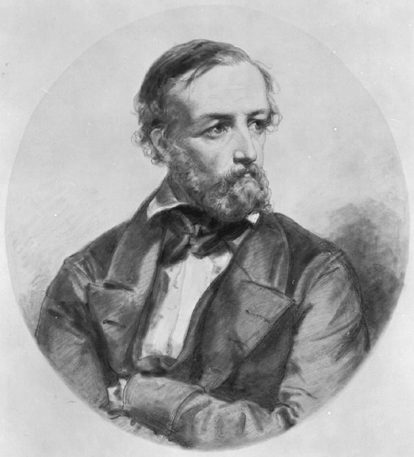
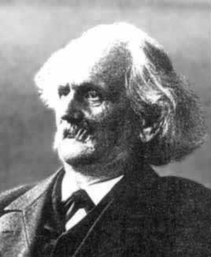
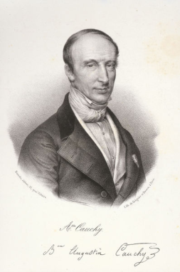
Boundary Conditions
Modellers distinguish three kinds of boun-dary conditions.
With regard to groundwater flow model-ling, boundary conditions involve hydraulic heads and hydraulic head gradients (which are proportional to discharges according to Darcy‘s law).
Boundary condition of the first kind or Diri-chlet boundary condition: The head value is given.
Peter Lejeune Dirichlet (1805 – 1859)
Carl Neumann (1832 – 1925)
Boundary condition of the second kind or Neumann bounda-ry condition: The component of the head gradient, which is perpendicular to the boundary of the model domain, is given.
Boundary condition of the third kind or Cauchy boundary condition or Robin boundary condition: A relationship between the head value and the component of the head gradient, which is perpendicular to the boundary, is given.
Augustin Cauchy (1789 – 1857)

Slide 17
Hydraulic Interaction Between Groundwater and Surface Water
In MODFLOW, hydraulic interaction between groundwater and surface water is treated by employing the “river boundary condition“, which represents a boundary condition of the third kind (= relationship between hydraulic head and discharge at the boundary, see previous page).
The corresponding relationship needs values for river stage, river bottom ele-vation, and streambed conductance (to be explained later).
From this, the software is able to deter-mine the hydraulic head and the specific discharge.
In a first step, rivers are subdivided into segments called “reaches“.
Each of them corresponds to a model cell.
Very short segments can be neglected (see figure).

Slide 18
Conceptual Model
Sketches on the right are valid for each model cell which is connected to a river reach.
For now, it is assumed that there is no unsaturated zone between the ri-ver and the groundwater table, i.e. both are in direct hydraulic contact.
The presence of an unsaturated zone will be discussed later.

Slide 19
Relationship Between Discharge and Hydraulic Head I
In the same way as for Darcy‘s law, it is assumed that
with
Q_{Riv} = discharge through river sediment [L³/T]
h = hydraulic head of groundwater [L]
h_{Riv} = river stage [L]
W = river width [L]
L = length of river reach [L]
M = thickness of river sedi-ment [L]
K = hydraulic conducitivity of river sediment [L/T]
Q_{Riv}

Slide 20
Relationship Between Discharge and Hydraulic Head II
In the equation
the grouped parameter KLW/M re-presents the “streambed conduc-tance“ C_{Riv}, i.e.
Properties of C_{Riv}:
input parameter for ground-water models,
dimension L²/T,
frequently determined via model calibration (= fitting model results to measured values, usually groundwater levels).
Q_{Riv}

Slide 21
Considering the Unsaturated Zone
with
r_{bot} = river bottom elevation [L]

Slide 22
Graph Illustrating the River Boundary Condition
For each cell with ground-water-surface water inter-action, numerical model-ling tools determine one point on the graph (snap-ped line).
Vertical projections of this point onto the coordinate axes yield hydraulic head h and flow rate Q_{Riv}.

