Slide 1
Previous Lecture
Groundwater Modelling III:
functioning and relevant components of iterative methods
overview of iterative methods and tests
river boundary condition
Questions?

Slide 2
Today:
Groundwater Modelling IV:
Eulerian and Lagrangian approaches in solute transport modelling
Particle Tracking method (incl. example)

Slide 3
Eulerian and Lagrangian Approaches in Solute Transport Modelling

Slide 4
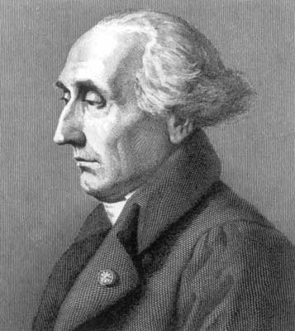
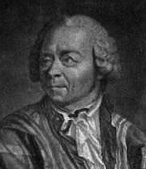
Basic Ideas
Joseph-Louis Lagrange (1736 – 1813)
streamline (here only advection)
Leonhard Euler (1707 – 1783)
Lagrange:
moving with the fluid, constant concentration (if only advection is active)
Euler:
fixed position,
concentration varies
in space and time
Flow and solute transport can be treated by two general approaches going back to Euler and Lagrange.
Euler: observer at rest
Lagrange: observer moves with the fluid

Slide 5
Purely Advective Solute Transport
According to the Lagrangian approach, solute concentration remains constant due to advection alone in a control element moving with the fluid.
According to the Eulerian approach, solute concentration changes in a control element with fixed position due to advection.
corresponding breakthrough curve:
C
only advection
t

Slide 6
Overview About Simulation Techniques
Eulerian and Lagrangian approaches can be extended to cover dispersion.
Techniques to simulate solute transport were developed by employing both approaches.
In addition, mixed approaches are available (see table).
approach | simulation technique
Eulerian | Finite Differences (FD)* Finite Elements (FE)
Lagrangian | Particle Tracking (PT)* Random Walk (RW)
mixed | method of characteristics (MOC)* modified method of characteristics (MMOC)* hybrid method of characteristics (HMOC)*
* implemented in MODPATH and MT3D, resp.
Among the abovementioned techniques, only Particle Tracking is not able to consider dispersion.

Slide 7
Particle Tracking Method (incl. Example)

Slide 8
Introduction
Particle Tracking (PT) allows to simulate advective solute spreading.
For this purpose, virtual particles are inserted at pre-defined locations of a flow field and their pathways (or trajectories) are recorded.
Particle movement allows to obtain information about advective solute transport (travel paths and times).
Technically, the following information is needed: – time-dependent particle coordinates x_{p}(t) and y_{p}(t), – linear velocity v at each particle location (x- and y-components), – starting time of each particle (only if flow is transient!).

Slide 9
Particle Tracking in Steady-State Flow Fields
linear velocity
streamline
Particles follow streamlines (particle trajectory = streamline).
Streamlines and trajectories are tangential to the vectors of the velocity field.
If two particles are inserted into the flow field at different times, their trajectories are identical and same travel times are needed for identical pathways.
Trajectories do not depend on the starting time of the particle.

Slide 10
Particle Tracking in Transient Flow Fields
linear velocity (time 1)
linear velocity (time 2)
streamline (time 1)
streamline (time 2)
Streamlines are tangential to the vectors of the (time-variant!) flow field.
Particles follow the “instantaneous“ flow direction (trajectory ≠ streamline!).
If two particles are inserted into a transient flow field at the same location but at different times, their trajectories are not identical.
Trajectories depend on the starting time of the particle.

Slide 11
Forward Tracking and Backward Tracking
Previous transparencies illustrated a PT version called Forward Tracking.
Forward Tracking is used to track (virtual) particles in groundwater flow direction (“Where does the solute go?“).
Forward Tracking requires numerical solution of the equations of motion
with v_{x}, v_{y} = components of linear velocity vector.
As opposed to this, Backward Tracking allows to track (virtual) particles against the direction of groundwater flow (“Where does the solute come from?“).
Backward Tracking is of particular interest when water protection zones around extraction wells are to be delineated.
Corresponding equations of motions are given by simply employing negative components of linear velocity:

Slide 12
2D Scenario
head =
254 m a.s.l.
impermeable
y = 2500 m
K = 0.002 m/s
linear
interpolation
N = 150 mm/a
W1
head =
260 m a.s.l.
W2
K = 0.005 m/s
river reach
N = 200 mm/a
head =
256 m a.s.l.
x = y = 0
PT
impermeable
x = 4000 m
Two pumping wells are planned at shown locations.
Total water abstraction rate should be 7000 m³/d.
Where is the 50-days isochrone?
SOFTWARE INSTALLATION

