Slide 1
Today:
tutorial problems on aquifer storage properties
homework problems on aquifer storage properties

Slide 2
Tutorial Problems on
Aquifer Storage Properties

Slide 3
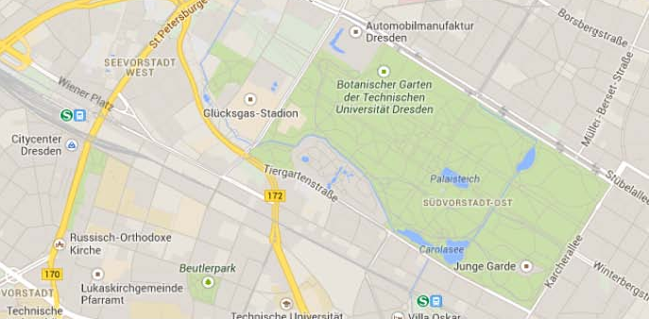
Tutorial Problem 1:
The park called „Großer Garten“ in Dresden is underlain by an unconfined aquifer consisting of alluvial deposits.
How much additional water is stored under the park if groundwater levels rise by 3 m during a wet period?
Großer Garten
2 km
1 km

Slide 4
Tutorial Problem 1 – Solution
basic configuration of an unconfined aquifer:
increased groundwater table
change in pressure head Δψ
initial groundwater table
pressure head ψ
low permeable layer
park area: A = 2 km ∙ 1 km = 2 km² = 2∙10⁶ m²
increase in total volume: ΔV_{T} = A∙∆ψ = 2∙10⁶ m² ∙ 3 m = 6∙10⁶ m³
assumption for total porosity of alluvial deposits in the park: n = 30 % = 0.3
additional water volume: ΔV_{w} = n∙ΔV_{T} = 0.3∙6∙10⁶ m³ = 1.8∙10⁶ m³

Slide 5
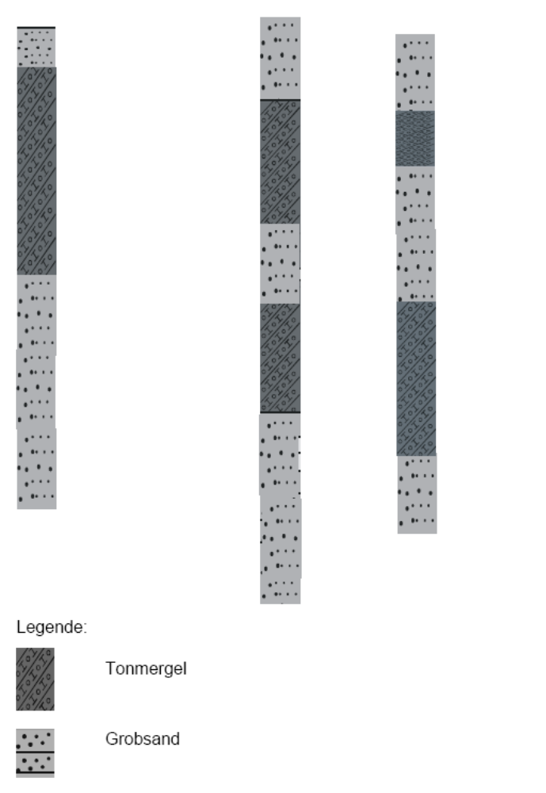

Tutorial Problem 2:
Legend:
clay
sand
The lithological in-formation derived from three boreho-les is given in the fi-gure.
Try to correlate the layers to obtain a 2D cross section of the subsurface structure.

Slide 6
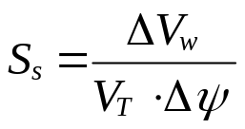
Tutorial Problem 3:
This problem addresses a confined aquifer with a thickness of 61 m and a specific storage of 1.2·10⁻⁵ 1/m. Due to water injection the pressure head rises by 0.75 m on average over an area 230 m in diameter.
How much water is injected?
basic configuration of a confined aquifer:
increased pressure line
change in pressure head Δψ
low permeable layer
initial pressure line
pressure head ψ
aquifer thickness m
low permeable layer
specific storage:
with ΔV_{w} = change in water volume [L³] V_{T} = total volume [L³] Δψ = change in pressure head [L]

Slide 7
Tutorial Problem 3 – continued
circular area for diameter d = 230 m:
A = π∙(d/2)² =
= π∙(115 m)² = 4.15∙10⁴ m²
total volume:
V_{T} = A∙m =
= 4.15∙10⁴ m² ∙ 61 m = 2.53∙10⁶ m³
additional water volume:
ΔV_{w} = S_{s}∙V_{T}∙Δψ =
= 1.2∙10⁻⁵ m⁻¹ ∙ 2.53∙10⁶ m³ ∙ 0.75 m = 22.8 m³

Slide 8
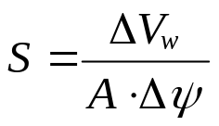
Tutorial Problem 4:
We consider an unconfined aquifer with a storage coefficient of 0.19. During a dry period the following water level drawdowns are observed in four sub-areas:
sub-area | size (km²) | drawdown (m) | change in water volume (m³)
a | 36 | 0.85 | 5.8∙10⁶
b | 18 | 1.09 | 3.7∙10⁶
c | 72 | 1.65 | 22.6∙10⁶
d | 85 | 2.37 | 38.3∙10⁶
Total: 70.4∙10⁶ m³
What is the total water volume represented by the drawdown?
storage coefficient:
with ΔV_{w} = change in water volume [L³] A = area of domain [L²] Δψ = change in pressure head [L]
change in water volume: ΔV_{w} = S∙A∙Δψ

Slide 9

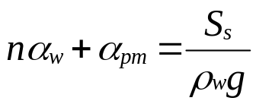
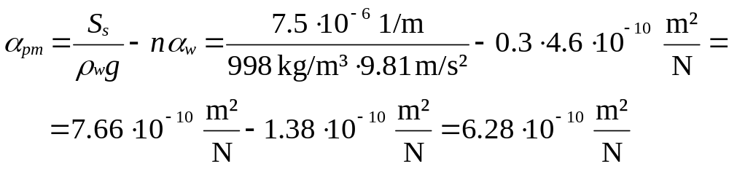
Tutorial Problem 5:
A confined aquifer is considered in this problem. Specific storage and total porosity equal 7.5·10⁻⁶ 1/m and 30 %, respectively.
What is the compressibility of the porous medium? (compressibility of water: 4.6·10⁻¹⁰ m²/N, density of water: 998 kg/m³)
specific storage:
with n = total porosity [-] α_{w} = compressibility of water [LT²/M] α_{pm} = compressibility of porous medium [LT²/M] ρ_{w} = density of water [M/L³] g = acceleration of gravity [L/T²]
solve for α_{pm}:

Slide 10



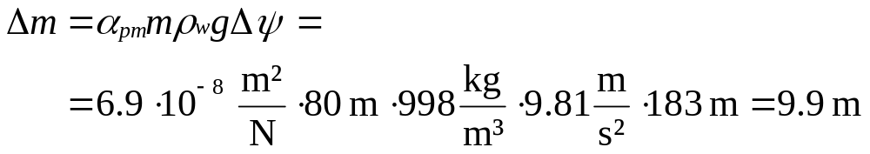
Tutorial Problem 6:
Due to intense water extraction from a confined aquifer the pressure head is lowered by 183 m. The following aquifer parameters are available: storage coefficient = 5·10⁻⁴, total porosity = 0.33, thickness (before water extraction) = 80 m, compressibility of the porous medium = 6.9·10⁻⁸ m²/N.
What is the amount of land subsidence resulting from the water extraction?
change in total volume due to Δp_{pm}:
with α_{pm} = compressibility of porous medium [LT²/M] V_{T} = total volume [L³] ρ_{w} = density of water [M/L³] g = acceleration of gravity [L/T²] Δψ = change in pressure head [L]
with A = area of aquifer [L²] m = thickness of aquifer [L]
land subsidence:

Slide 11
Homework Problems on
Aquifer Storage Properties
There is no obligation to solve homework problems!
If you decide to provide solutions, please submit until November 16!

Slide 12
Homework Problem 1
The pressure head in an aquifer extending over 200 km² is decreased by 1.60 m.
Determine the loss of groundwater in the aquifer for two scenarios:
The aquifer is unconfined (storage coefficient 0.13).
The aquifer is confined (storage coefficient 0.0005).

Slide 13
Homework Problem 2
Conduct a sieve analysis for a dried soil sample (see data in the table below):
Draw the granulometric curve (cumulative mass distribution) and briefly characterise the sediment with regard to its major constituent(s).
What is the coefficient of uniformity?
mesh size [mm] | residue in the sieve [g] | ∑total | ∑/∑ total
6.3 | 11
2 | 62
0.63 | 288
0.2 | 189
0.063 | 42
< 0.063 (cup) | 8

Slide 14
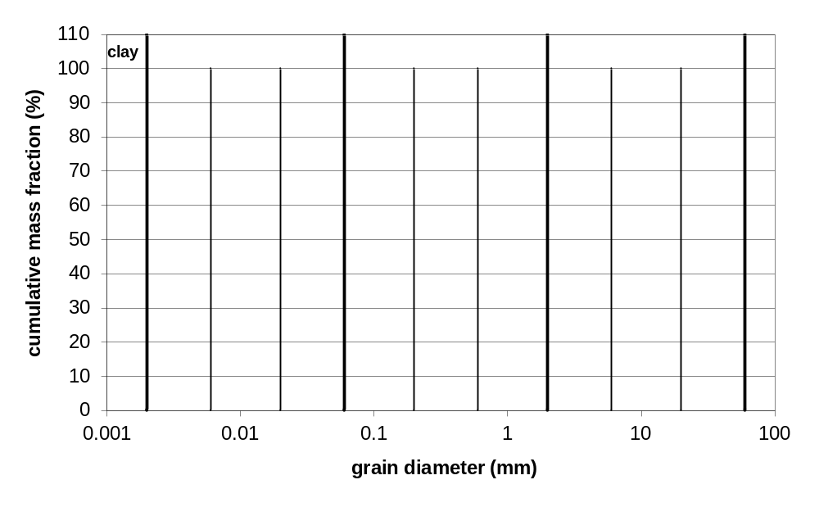
Homework Problem 2 – continued
silt
sand
gravel
de-
bris
0.002
0.006
0.02
0.06
0.2
0.6
2
6
20
60

