Slide 1
Today
tutorial problems on Darcy‘s law and intrinsic permeability
homework problems on Darcy‘s law and intrinsic permeability

Slide 2
Tutorial Problems on
Darcy‘s Law and
Intrinsic Permeability

Slide 3
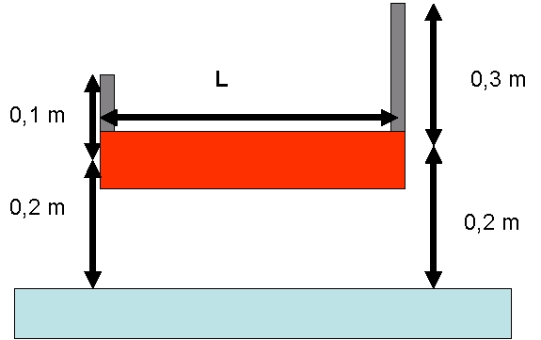
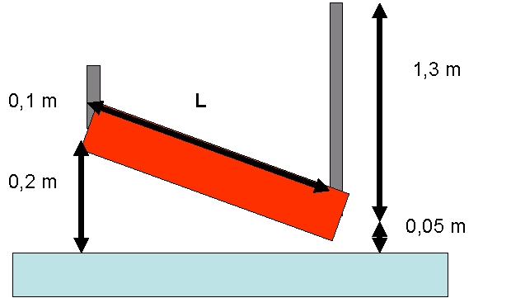
Tutorial Problem 7: Flow Direction and Hydraulic Gradient
Indicate the direction of flow and determine the hydraulic gradient for a Darcy column with length L = 50 cm! (Figures not to scale.)
a)
b)
flow
flow
z = 0.2 m
z = 0.2 m
elevation heads
z = 0.2 m
z = 0.05 m
ψ = 0.1 m
ψ = 0.3 m
pressure heads
ψ = 0.1 m
ψ = 1.3 m
h = ψ + z = 0.3 m
hydraulic heads
h = ψ + z = 0.3 m
h = ψ + z = 0.5 m
h = ψ + z = 1.35 m
Δh = 0.5 m – 0.3 m = 0.2 m
hydraulic head difference
Δh = 1.35 m – 0.3 m = 1.05 m
i = Δh/L = 0.2 m / 0.5 m = 0.4
hydraulic gradient
i = Δh/L = 1.05 m / 0.5 m = 2.1

Slide 4
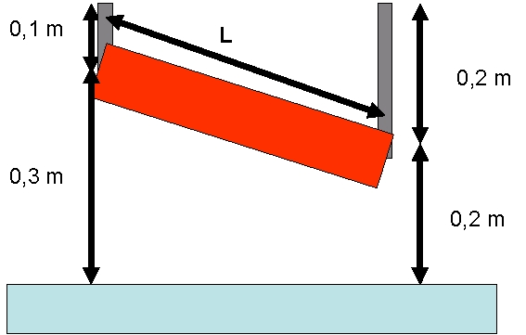
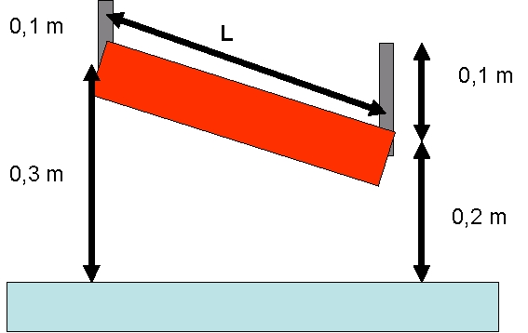
Tutorial Problem 7 – Continued:
Indicate the direction of flow and determine the hydraulic gradient for a Darcy column with length L = 50 cm! (Figures not to scale.)
c)
d)
no flow
flow
z = 0.3 m
z = 0.2 m
elevation heads
z = 0.3 m
z = 0.2 m
ψ = 0.1 m
ψ = 0.2 m
pressure heads
ψ = 0.1 m
ψ = 0.1 m
h = ψ + z = 0.4 m
hydraulic heads
h = ψ + z = 0.4 m
h = ψ + z = 0.4 m
h = ψ + z = 0.3 m
Δh = 0.4 m – 0.4 m = 0 m
hydraulic head difference
Δh = 0.3 m – 0.4 m = –0.1 m
i = Δh/L = 0 m / 0.5 m = 0
hydraulic gradient
i = Δh/L = –0.1 m / 0.5 m = –0.2

Slide 5
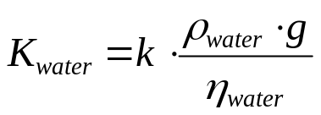
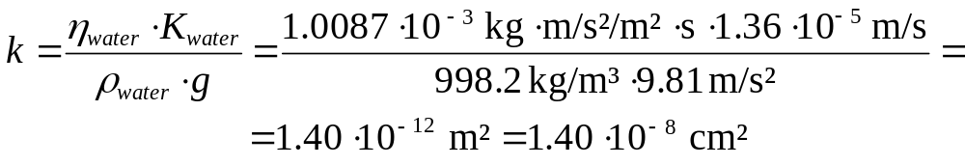
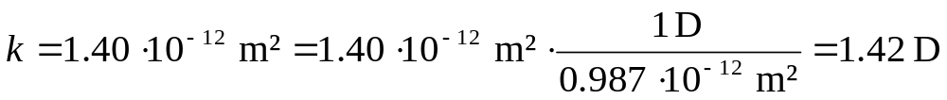
Tutorial Problem 8: Intrinsic Permeability
The hydraulic conductivity of a fine sand sample was found to be equal to 1.36·10⁻⁵ m/s in a Darcy experiment using water at a temperature of 20 °C.
What is the intrinsic permeability of this sample? Give results in cm² and D.
(density of water at 20 °C: 998.2 kg/m³; dynamic viscosity of water at 20 °C: 1.0087·10⁻³ Pa·s; 1 D = 0.987·10⁻¹² m²)
relationship between hydraulic conductivity K and intrinsic permeability k from lecture notes:
solve for k:
unit conversion:

Slide 6
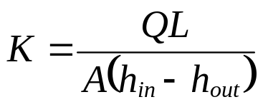
Tutorial Problem 9: Constant-Head Permeameter
inflow
Δ
overflow
h
Derive the expression for K given abo-ve.
The hydraulic conductivity of a medium sand sample (length 15 cm, cross-sec-tional area 25 cm²) is to be determi-ned. The hydraulic head difference is 5 cm and a water volume of 100 cm³ pas-sed the sample during an experimental period of 12 min.
How long would 100 cm³ diesel (densi-ty: 0.85 g/cm³, dynamic viscosity: 3.5·10⁻³ Pa·s at 20 °C) need to pass the sample under a head difference of 5 cm (density and dynamic viscosity of water at 20 °C: 998.2 kg/m³ and 1.0087·10⁻³ Pa·s, resp.)?
overflow
L

Slide 7
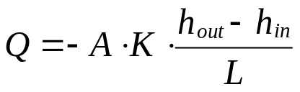
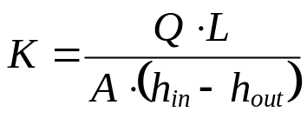
Tutorial Problem 9: Solution for a)
Darcy‘s law:
inflow
with
Q = discharge [L³/T]
L = column length [L]
A = cross-sectional area of column [L²]
K = hydraulic conductivity [L/T]
h_{in} = hydraulic head at column inlet [L]
h_{out} = hydraulic head at column outlet [L]
Δ
overflow
h
overflow
L
solve for K:
If the reference level (z = 0) is located at the downgradient overflow, then set h_{out} = 0.

Slide 8
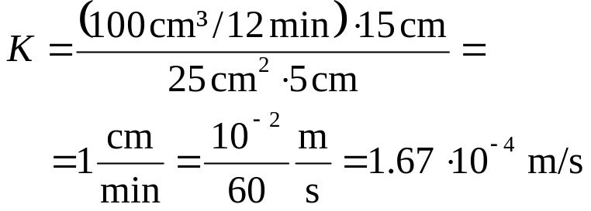
Tutorial Problem 9: Solution for b)
inflow
Δ
overflow
h
L = 15 cm, A = 25 cm², h_{in} – h_{out} = 5 cm, Q = 100 cm³ / 12 min
overflow
L
→ fine-to-medium sand

Slide 9
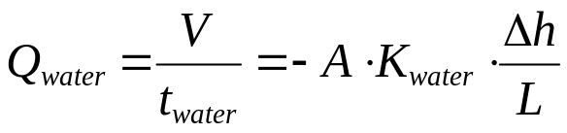
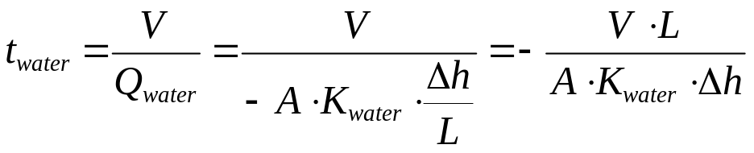
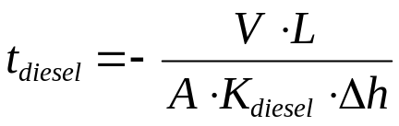
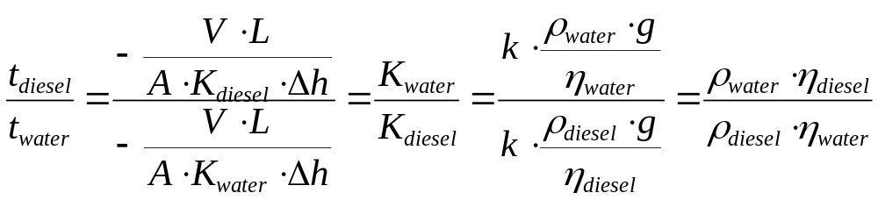
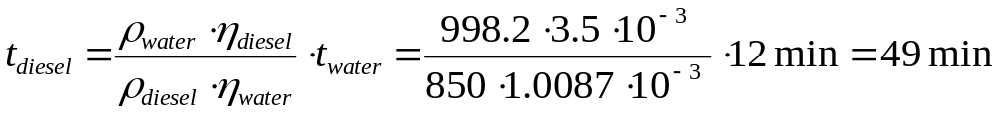
Tutorial Problem 9: Solution for c)
discharge and Darcy‘s law:
solve for t_{water}:
same steps for t_{diesel}:
time ratio:
use relationship between con-ductivity K and permeability k from lecture notes!
solve for t_{diesel}:

Slide 10
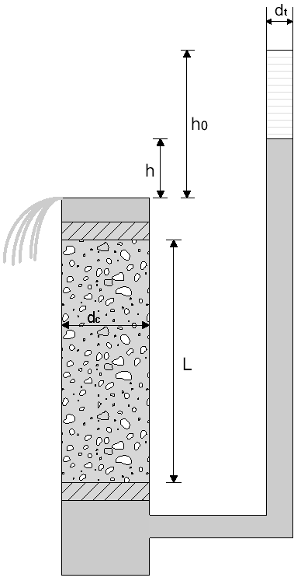
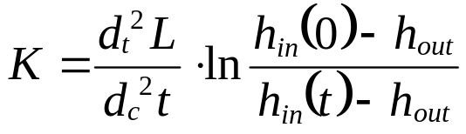
Tutorial Problem 10: Falling-Head Permeameter
falling
head
over-
flow
Derive the expression for K given above.
The hydraulic conductivity of a fine sand sample (length 15 cm, diame-ter 10 cm) is to be determined. The hydraulic head difference at the be-ginning and at the end of the expe-riment after 528 min is 5 cm and 0.5 cm, resp. The inner tube diame-ter is 2 cm.

Slide 11
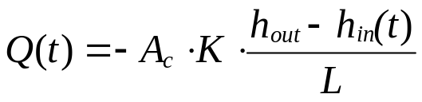
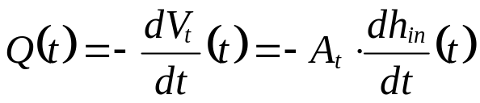
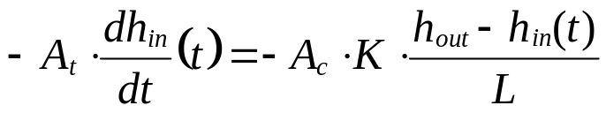
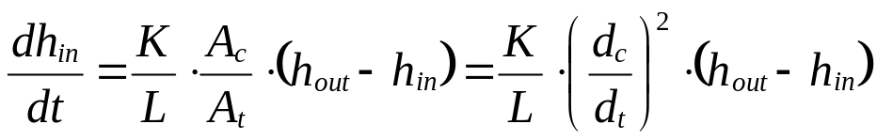
Tutorial Problem 10: Solution for a)
Darcy‘s law:
falling
head
volumetric budget for standpipe:
with
A_{t} = cross-sectional area of standpipe [L²]
V_{t} = water volume in standpipe [L³]
over-
flow
combine Darcy‘s law and the volumetric budget:
solve for dh_{in}/dt:

Slide 12
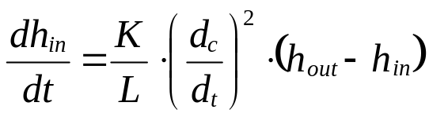
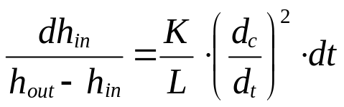
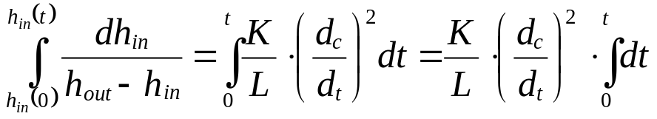
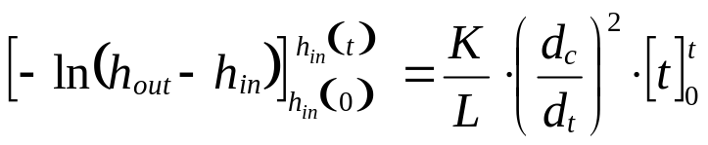
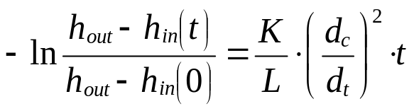
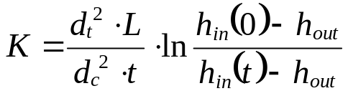
Tutorial Problem 10: Solution for a) – Continued
equation for falling head:
This equation is an ordinary differential equation of first order. Providing hydraulic head h_{in}(0) at the beginning of the experiment (t = 0), it may be solved by separation of variables:
integrations on both sides by considering the initial condition:
determine integral functions:
insert limits of integration:
solve for K:

Slide 13
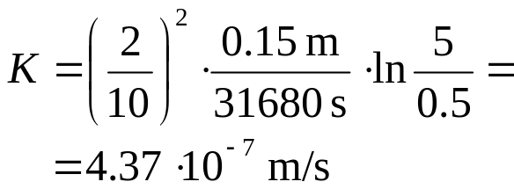
Tutorial Problem 10: Solution for b)
falling
head
L = 15 cm, d_{c} = 10 cm, d_{t} = 2 cm, h_{in}(0) – h_{out} = 5 cm, h_{in}(t) – h_{out} = 0.5 cm, t = 528 min = 31680 s
over-
flow
→ silt or silty sand

Slide 14
Homework Problems on
Darcy‘s Law and
Intrinsic Permeability
There is no obligation to solve homework problems!
If you decide to provide solutions, please submit until November 23!

Slide 15
Homework Problem 3
Derive an expression for hy-draulic conductivity K for the constant-head permeameter shown in the figure.
The hydraulic conductivity of a sample (length 10 cm, dia-meter 4 cm) is to be determi-ned. The water depths a₁ and a₂ equal 6 cm and 3 cm, resp. A water volume of 250 ml passed the sample during an experimental period of 36 s.
Which material could be con-tained in the sample?
Q
a₁
L
a₂

Slide 16
Homework Problem 4
A Darcy experiment is performed by a fall-ing-head permeameter using water at 20 °C. Length and diameter of the sample are 20 cm and 6 cm, resp. The inner tube dia-meter is 4 cm. The following data are available for the time-dependent hydraulic head difference Δh:
Δh(0)
Δh(t)
t (min) | 0 | 5 | 18 | 23 | 27 | 29
Δh (cm) | 36.9 | 33.6 | 26.3 | 23.9 | 22.1 | 21.3
Convert times to seconds and plot the logarithm of the ratios of head differences ln(Δh(0)/Δh(t)) vs. time t. (Use the coordinate system on next page).
Determine the slope of the correspon-ding regression line.
Determine hydraulic conductivity K.
Determine intrinsic permeability k.

Slide 17
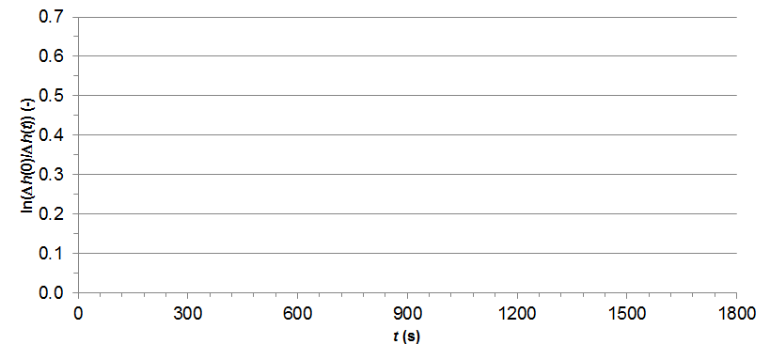
Homework Problem 4 – Continued

