Slide 1
Today
solutions for homework problems 1 – 4
tutorial problems on effective conductivity and flow nets
homework problems on effective conductivity and flow nets

Slide 2
Solutions for
Homework Problems 1 – 4

Slide 3
Solution for Homework Problem 1
A = 1
aquifer top
Given: aquifer with area A = 200 km² and head decrease Δh = 1.6 m
What is the corresponding change in water volume?
thick-
ness m
aquifer bottom
unconfined aquifer with storage coefficient (storativity) S = 0.13
S = ΔV_{w} / (A·Δh) according to verbal definition given in the lecture
ΔV_{w} = A·S·Δh = 200·10⁶ m² · 0.13 · 1.6 m = 41.6·10⁶ m³
b) confined aquifer with storage coefficient (storativity) S = 0.0005
ΔV_{w} = A·S·Δh = 200·10⁶ m² · 0.0005 · 1.6 m = 0.16·10⁶ m³

Slide 4
Solution for Homework Problem 2
Conduct a sieve analysis for a dried soil sample (see data in the table below):
Draw the granulometric curve (cumulative mass distribution) and briefly characterise the sediment with regard to its major constituent(s).
What is the coefficient of uniformity?
mesh size [mm] | residue in the sieve [g] | ∑total | ∑/∑ total
20 | 0 | 600 | 1
6.3 | 11 | 589 | 0.982
2 | 62 | 527 | 0.878
0.63 | 288 | 239 | 0.398
0.2 | 189 | 50 | 0.083
0.063 | 42 | 8 | 0.013
< 0.063 cup | 8

Slide 5
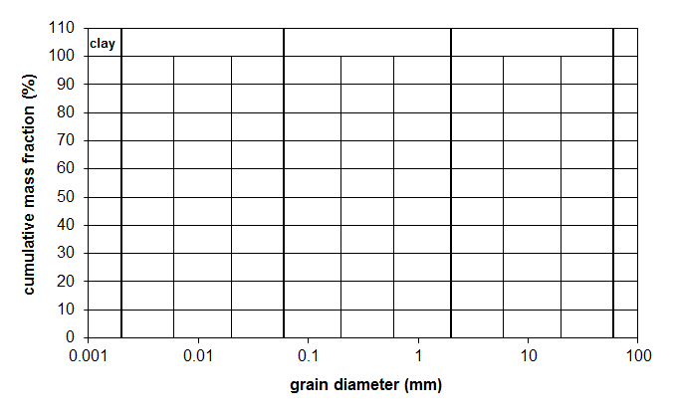
Solution for Homework Problem 2 – Continued
silt
sand
gravel
de-
bris
d %
20 | 1
6.3 | 0.982
2 | 0.878
0.63 | 0.398
0.2 | 0.083
0.063 | 0.013
0,002
0,006
0,02
0,06
0,2
0,6
2
6
20
60
major constituents: coarse sand / medium sand
from the figure: d₁₀ ≈ 0.22 mm
d₆₀ ≈ 1.0 mm
coefficient of uniformity:
U = d₆₀/d₁₀ ≈ 1.0/0.22 ≈ 4.5

Slide 6
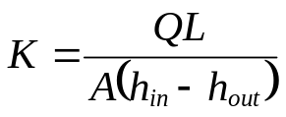
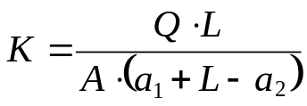
Homework Problem 3
Q
general formula for con-stant-head permeameter:
a₁
z = L
Problem 3a:
The column outlet is chosen as the reference level z = 0 with the z-axis pointing up-ward. As a consequence, we have z = L at the inlet.
L
a₂
z = 0
at the outlet: pressure head = a₂ elevation head = 0 h_{out} = a₂
at the inlet: pressure head = a₁ elevation head = L h_{in} = a₁ + L
head difference: h_{in} – h_{out} = a₁ + L – a₂
hydraulic conductivity:

Slide 7
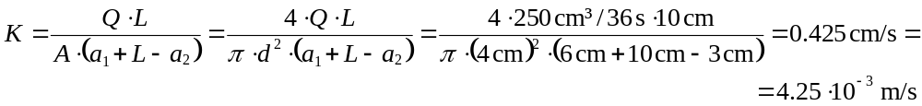
Homework Problem 3 – continued
Q
Problem 3c:
coarse sand – fine gravel
a₁
L
a₂
Problem 3b:
L = 10 cm, a₁ = 6 cm, a₂ = 3 cm, d = 4 cm
Q = 250 ml / 36 s = 250 cm³ / 36 s
A = π·(d/2)² = π/4·d²

Slide 8
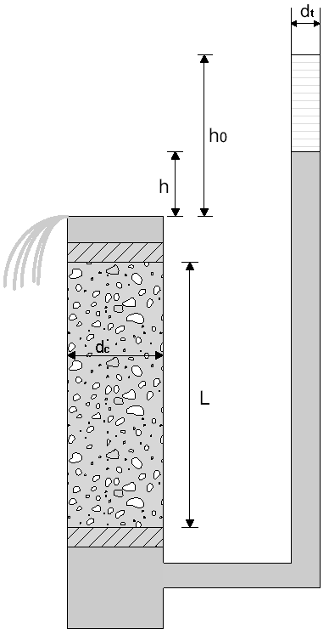
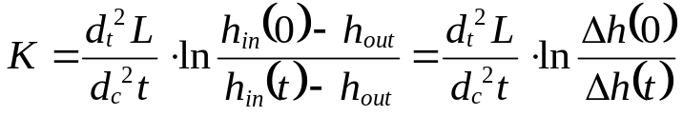
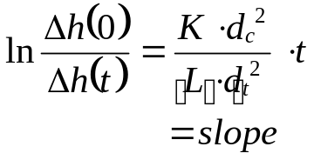
Homework Problem 4
formula for variable-head permeameter:
Δh(0)
Rearrangement shows that the natural logarithm of Δh(0)/Δh(t) depends linear-ly on time t:
Δh(t)
Problems 4a and 4b:
4a 4b

Slide 9
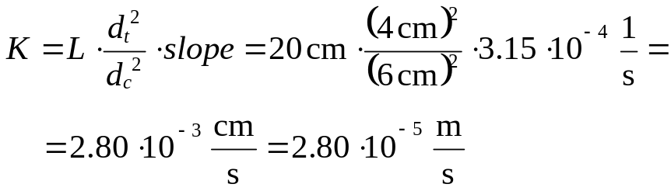
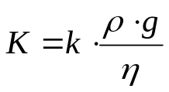
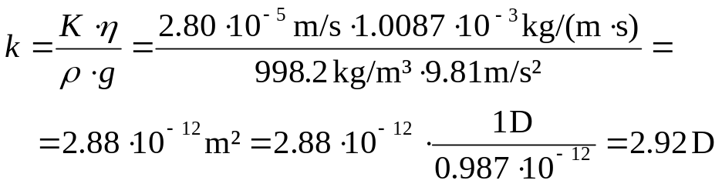
Homework Problem 4 – continued
Problem 4c:
log-linear relationship
Δh(0)
hydraulic conductivity:
Δh(t)
Problem 4d:
relationship between hydraulic conducti-vity and intrinsic permeability:
solve for k and insert parameter values :

Slide 10
Tutorial Problems on
Effective Conductivity
and Flow Nets

Slide 11
Tutorial Problem 11: Effective Hydraulic Conductivity
A sandy layer with a thickness of 2.5 m is embedded between two gravel layers. Both gravel layers have a thickness of 1.5 m and a hydraulic conductivity of 3.7·10⁻³ m/s. Steady-state groundwater flow is in parallel to the layering. A hydraulic gradient of 0.001 and an overall discharge of 1 m³/d per unit width have been determined.
Determine the effective hydraulic conductivity.
What is the hydraulic conductivity of the sand layer?
Which effective hydraulic conductivity would be obtained if flow was assumed perpendicular to the layering?
Calculate effective hydraulic conductivity if the angle between the flow direction and the layering equals 45°.

Slide 12
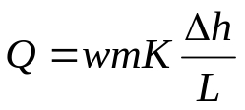
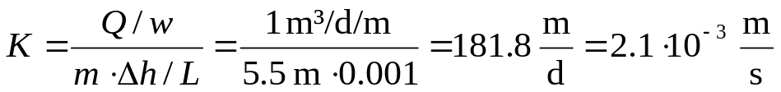
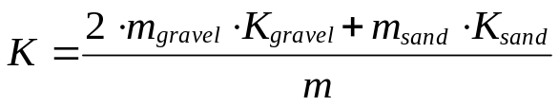
Tutorial Problem 11: Solutions for a) and b)
Problem 11a:
Δh
L
total thickness: m = 2∙m_{gravel} + m_{sand} = = 2∙1.5 m + 2.5 m = 5.5 m
gravel
m_{gravel} = 1.5 m
Q
employ Darcy‘s law to determine effective hydraulic conductivity:
sand
m_{sand} = 2.5 m
gravel
m_{gravel} = 1.5 m
solve for K:
Problem 11b:
employ weighted arithmetic mean to determine hydraulic conductivity for sand:
solve for K_{sand}:

Slide 13
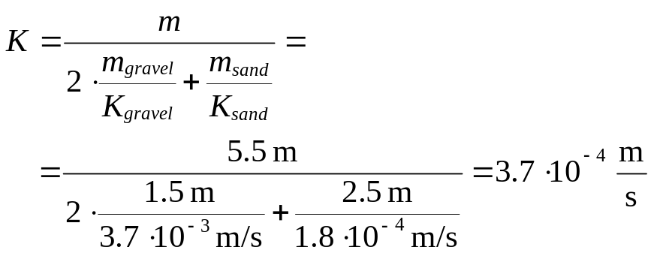
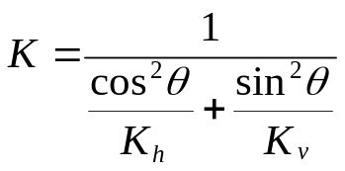
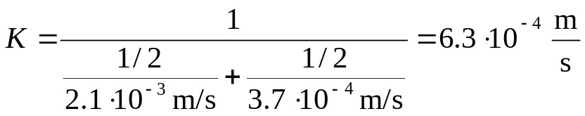
Tutorial Problem 11: Solutions for c) and d)
Problem 11c:
Q
employ weighted harmonic mean to deter-mine effective conductivity:
gravel
m_{gravel} = 1.5 m
sand
m_{sand} = 2.5 m
gravel
m_{gravel} = 1.5 m
Problem 11d:
Q
with θ = 45°, K_{h} = 2.1∙10⁻³ m/s (from a), K_{v} = 3.7∙10⁻⁴ m/s (from c).
√K_{v}
√K
θ
√K_{h}
as cos²45° = sin²45° = 1/2.

Slide 14
Tutorial Problem 12: Hydrologic Triangle
The figure below shows the position of four groundwater observation wells with measured hydraulic heads in m a.s.l.
Sketch head isolines for intervals of 1 m by applying the hydrologic triangle method.
Indicate the flow direction.
63.0
62
60.5
61
64
62
head isolines (m)
61
63
flow direction
65
64
65
66.0
65
64
63
62.0

Slide 15
Tutorial Problem 13: Flow Nets
Sketch head isolines and streamlines for the two configurations a) and b) of a well doublette shown below. In both cases flow nets should be sketched without and with the uniform flow component.
a) withdrawal at both wells:
b) withdrawal and injection:
×
×
×
×
-Q
-Q
+Q
-Q

Slide 16
Homework Problems on
Effective Conductivity
and Flow Nets
There is no obligation to solve homework problems!
If you decide to provide solutions, please submit until December 14!

Slide 17
Homework Problem 5: Effective Hydraulic Conductivity
A gravel layer with a thickness of 2.5 m is embedded between two sand layers. Both sand layers have a thickness of 1.5 m and a hydraulic conductivity of 3.7·10⁻⁴ m/s. Steady-state groundwater flow is perpendicular to the layering. An overall head difference of 5.5 cm and a discharge of 500 l/d per unit area have been determined.
Determine the effective hydraulic conductivity.
What is the hydraulic conductivity of the gravel layer?
Which effective hydraulic conductivity would be obtained if flow was assumed to be in parallel with the layering?
Calculate effective hydraulic conductivity if the angle between the flow direction and the layering equals 30°.

Slide 18
Homework Problem 6: Hydrologic Triangle
The figure below shows the position of five groundwater observation wells with measured hydraulic heads in m a.s.l.
Sketch head isolines for intervals of 1 m by applying the hydrologic triangle method.
Indicate the flow direction.
26.7
26.0
24.3
23.1
22.8

Slide 19
Homework Problem 7: Flow Nets
Sketch head isolines and streamlines for the well doublette shown below. In this case, injection and withdrawal of groundwater is superimposed to a uniform flow component.
×
×
+Q
-Q

