Slide 1
Today:
tutorial problems on pumping test evaluation
homework problem on pumping test evaluation

Slide 2
Tutorial Problems on
Pumping Test Evaluation

Slide 3
Tutorial Problem 14
A pumping test was conducted with a constant water withdrawal rate of 9 m³/h. The table shows the time-drawdown series recorded at an observation well which is located 9.85 m apart from the pumping well. The aquifer thickness is 5 m.
Determine the storage coefficient, the transmissivity and the hydraulic conducti-vity by using the Theis method.
To this end, it is necessary to complete the table on the right such that data are made available for further steps (see next page).
t (min) | s (m) | t/r² (s/m²)
1 | 0.01 | 0.62
2 | 0.03 | 1.24
3 | 0.05 | 1.86
4 | 0.06 | 2.47
5 | 0.07 | 3.09
7 | 0.09 | 4.33
9 | 0.12 | 5.57
12 | 0.14 | 7.42
18 | 0.16 | 11.13
23 | 0.17 | 14.22
33 | 0.18 | 20.41
41 | 0.19 | 25.35
56 | 0.2 | 34.63
126 | 0.22 | 77.92
636 | 0.3 | 393.31
1896 | 0.32 | 1172.5

Slide 4
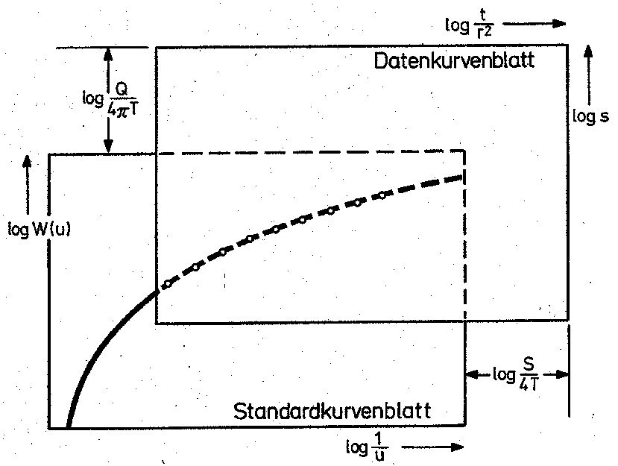
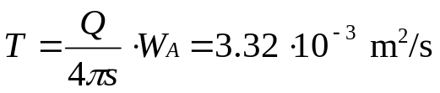
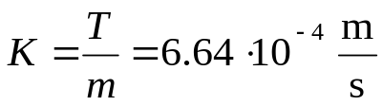
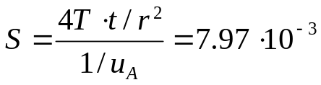
Tutorial Problem 14 – Continued
As a first approach, the graphical solution of the problem is to be determined, i.e. double-logarithmic data and type curve sheets are compared as follows:
Plot data for s vs. t/r² in the data sheet.
Determine coordinates of the match point A on the type curve sheet, e.g. 1/u_{A} = 1 and W_{A} = 1.
Put the data sheet on top of the type curve sheet and shift it in parallel to the coordinate axes until data points fall on the type curve as close as possible.
Determine coordinates of the match point A on the data sheet: t/r² = 0.6 s/m² and s = 0.06 m
Compute T, K:
Compute S:
data sheet
match point
type curve sheet
Second approach: worksheet
Tut. Prob. 14

Slide 5
Tutorial Problem 15
t (min) | s (m) | t/r² (s/m²)
3 | 0.0915 | 2.85E-03
5 | 0.2135 | 4.75E-03
8 | 0.3965 | 7.60E-03
12 | 0.6405 | 1.14E-02
20 | 0.976 | 1.90E-02
24 | 1.098 | 2.28E-02
30 | 1.2505 | 2.85E-02
38 | 1.4335 | 3.61E-02
47 | 1.5555 | 4.46E-02
50 | 1.6165 | 4.75E-02
70 | 1.8605 | 6.65E-02
80 | 1.9215 | 7.60E-02
90 | 2.0435 | 8.55E-02
100 | 2.135 | 9.50E-02
130 | 2.2875 | 1.23E-01
160 | 2.5315 | 1.52E-01
200 | 2.5925 | 1.90E-01
260 | 2.806 | 2.47E-01
320 | 2.9585 | 3.04E-01
380 | 3.111 | 3.61E-01
500 | 3.3245 | 4.75E-01
A pumping test is conducted in a confined aquifer with thickness m = 14.65 m. The pumping rate is kept constant at Q = 50 m³/h and the corresponding drawdown s is recorded in an observation well at a dis-tance r = 251.32 m from the pumping well (see table).
Determine storage coefficient S, transmissivity T and hydraulic con-ductivity K by employing the Theis method (graphical solution).
What is the drawdown in the pumping well (radius including gravel pack: r_{w} = 0.3 m) after 500 min? (Hint: Use the approximation W(u) ≈ –0.5772 – lnu + u which is valid for u << 1)
How big is the radius of influence ac-cording to Siechardt‘s equation?

Slide 6
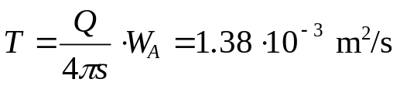
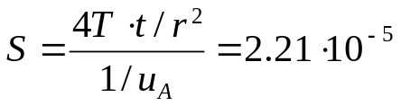
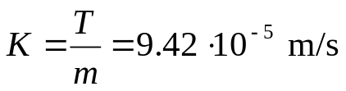
Tutorial Problem 15 – Continued
Determine storage coefficient S, transmissivity T and hydraulic con-ductivity K by employing the Theis method (graphical solution).
data sheet
match point
type curve sheet
match point coordinates (type curve sheet): 1/u_{A} = 1, W_{A} = 1
match point coordinates (data sheet): t/r² = 0.004 s/m², s = 0.8 m
transmissivity:
storage coefficient:
hydraulic conductivity:

Slide 7
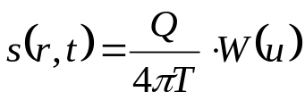
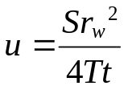
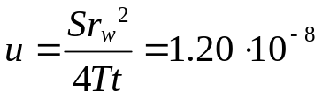

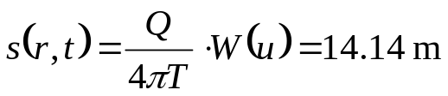
Tutorial Problem 15 – Continued
What is the drawdown in the pumping well after 500 min? (Hint: Use the approximation formula W(u) ≈ –0.5772 – lnu + u which is valid for u << 1)
drawdown in the pumping well (Theis):
with
compute u:
compute W(u):
compute s:
How big is the radius of influence according to Siechardt‘s equation?
R = 3000∙s∙√K = 3000 ∙ 14.14 ∙ √ (9.42∙10⁻⁵) = 411.7 m

Slide 8
Homework Problem on
Pumping Test Evaluation
There is no obligation to solve homework problems!
If you decide to provide solutions, please submit
until December 14!

Slide 9
Homework Problem 8: Pumping Test Evaluation
A pumping test is conducted to determine hydraulic properties of a confined aquifer. For this purpose, a constant pumping rate of 1219 m³/d is established and drawdown is recorded in an observation well. This problem is to be solved with the Theis method implemented in the worksheet “Homework_8_Theis“.
Enter your date of birth into cell B14 of the sheet “model“ to create the time-drawdown data in sheet “data“. In addition, the cells for aquifer thickness and for the distance between pumping and observation wells are filled.
Based on these data determine the storage coefficient S, the transmissivity T and the hydraulic conductivity K of the aquifer.
Hmw. Prob. 8

