Slide 1
Today:
solutions for homework problems 5 – 8
tutorial problems on sorption and degradation
homework problems on sorption and degradation

Slide 2
Solutions of
Homework Problems 5 – 8

Slide 3
Homework Problem 5: Effective Hydraulic Conductivity
A gravel layer with a thickness of 2.5 m is embedded between two sand layers. Both sand layers have a thickness of 1.5 m and a hydraulic conductivity of 3.7·10⁻⁴ m/s. Steady-state groundwater flow is perpen-dicular to the layering. An overall head difference of 5.5 cm and a discharge of 500 l/d per unit area have been determi-ned.
Q/A = 0.5 m³/d/m²
Δh = 0.055 m
m₁ = 1.5 m K₁ = 3.7∙10⁻⁴ m/s
m₂ = 2.5 m K₂ = ?
m₃ = m₁ K₃ = K₁
Determine the effective hydraulic conductivity.
Darcy‘s Law: Q/A = K_{eff} ∙ ∆h/m where m denotes total thickness, i.e. m = 2∙m₁ + m₂ = 2∙1.5 m + 2.5 m = 3 m + 2.5 m = 5.5 m
Effective hydraulic conductivity is obtained from Darcy‘s Law via K_{eff} = Q/A ∙ m/∆h = 0.5 m³/d/m² ∙ 5.5 m / 0.055 m = 50 m/d = 5.79∙10⁻⁴ m/s

Slide 4
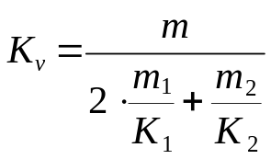
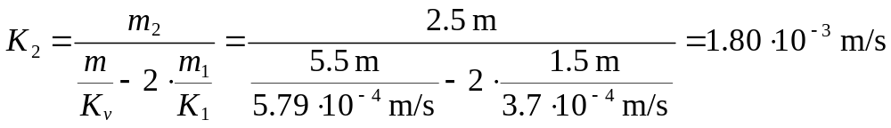
Homework Problem 5 – Continued
What is the hydraulic conductivity of the gravel layer?
Flow perpendicular to layering: Effective conductivity equals the weighted harmonic mean of layer conductivities.
Q/A = 0.5 m³/d/m²
Δh = 0.055 m
m₁ = 1.5 m K₁ = 3.7∙10⁻⁴ m/s
m₂ = 2.5 m K₂ = ?
m₃ = m₁ K₃ = K₁
Solve for K₂:

Slide 5
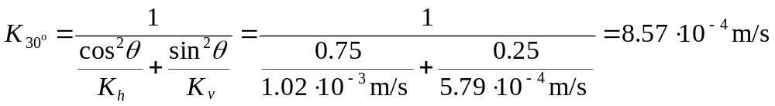
Homework Problem 5 – Continued
m₁ = 1.5 m K₁ = 3.7∙10⁻⁴ m/s
Which effective hydraulic conductivity would be obtained if flow was assumed to be in parallel with the layering?
Q
m₂ = 2.5 m K₂ = 1.80∙10⁻³ m/s
Flow parallel to layering: Effective conductivity equals the weighted arithmetic mean of layer conductivities.
m₃ = m₁ K₃ = K₁
Calculate effective hydraulic conductivity if the angle between the flow direction and the layering equals 30°.
Q
√K_{v}
√K
Θ = 30°
√K_{h}

Slide 6
Homework Problem 6: Hydrologic Triangle
The figure below shows the position of five groundwater observation wells with measured hydraulic heads in m a.s.l.
Sketch head isolines for intervals of 1 m by applying the hydrologic triangle method.
Indicate the flow direction.
26.7
26.0
26
head isolines
25
25
25
25
flow direction
24.3
24
24
24
23
23.1
23
22.8

Slide 7
Homework Problem 8: Pumping Test Evaluation
A pumping test is conducted to determine hydraulic properties of a confined aquifer. For this purpose, a constant pumping rate of 1219 m³/d is established and drawdown is recorded in an observation well. This problem is to be solved with the Theis method implemented in the worksheet “Theis_Homework8“.
Enter your date of birth into cell B14 of the sheet “model“ to create the time-drawdown data in sheet “data“. In addition, the cells for aquifer thickness and for the distance between pumping and observation wells are filled.
Based on these data determine the storage coefficient S, the transmissivity T and the hydraulic conductivity K of the aquifer.
Hmw. Prob. 8

Slide 8
Tutorial Problems on
Sorption and Degradation

Slide 9
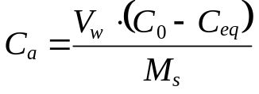

Tutorial Problem 16
A series of batch experiments were performed to quantify adsorption of Cr(VI) at bed soil of River Elbe (solid density ρ = 2.7 g/cm³, effective porosi-ty n_{e} = 30 %). For each experiment 10 g of bed soil was equilibrated in 25 mL of water with initial Cr(VI) concentrations C₀ ranging from 50 to 250 mg/L (see table).
C₀ (mg/L) | C_{eq} (mg/L) | C_{a} (mg/g)
50 | 15 | 0.09
75 | 28 | 0.12
100 | 40 | 0.15
150 | 61 | 0.22
200 | 82 | 0.30
250 | 104 | 0.37
Calculate the mass ratio C_{a} of adsorbate vs. adsorbent for each batch experiment by employing the mass budget
with V_{w} = water volume, M_{s} = solid mass.
Determine the distribution coefficient K_{d} graphically by assuming that sorption of Cr(VI) can be described by a linear isotherm.
What is the retardation factor of Cr(VI) migrating through River Elbe bed soil? Briefly interpret your result.

Slide 10
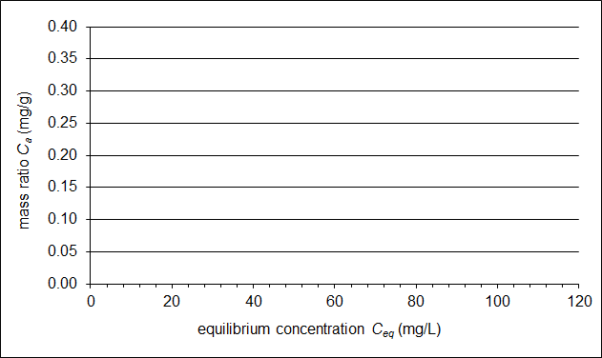
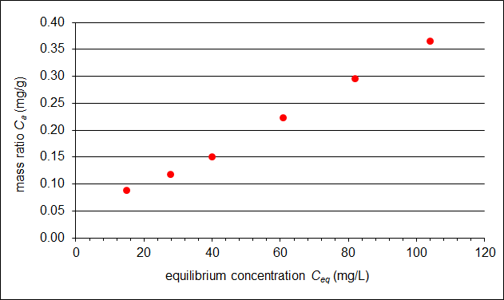
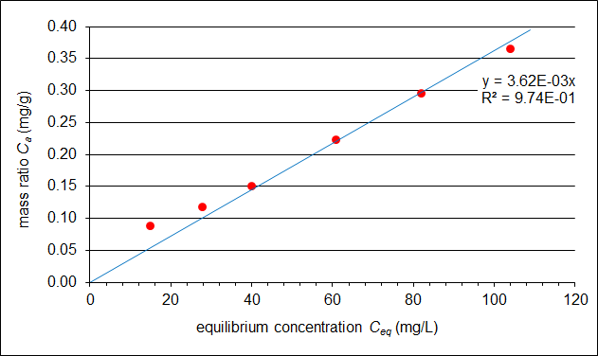
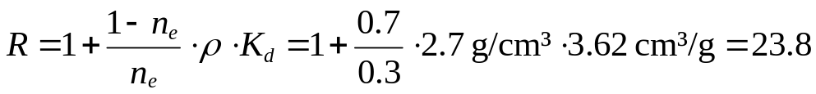
Tutorial Problem 16 – Solutions for b) and c)
b)
The linear iso-therm is the re-gression line through the ori-gin of the C_{a}-vs.-C_{eq} plot.
Its slope is the distribution coef-ficient K_{d}.
Here:
K_{d} = 3.62∙10⁻³ L/g = 3.62 cm³/g
c)
Retardation of Cr(VI) in the bed soil is quite strong and, as a consequence, spreading is slow. If water polluted with Cr(VI) infiltrates from the river, subsurface contamination will mostly affect the immediate vicinity of the riverbed and the sediment will be highly loaded with Cr(VI) in this zone!

Slide 11
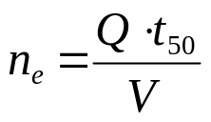
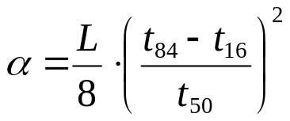
Tutorial Problem 17
NaCl is used to conduct a conservative tracer test in a Darcy column (length: 85 cm, diameter: 7.5 cm). The volumetric flow rate is 10 mL/min and the NaCl is continuously injected (concentration: 55 mg/L). The table shows NaCl concentrations measured at the column outlet at different times.
time (min) | conc. (mg/L) | rel. conc. (-)
15 | 0 | 0
30 | 0 | 0
45 | 0 | 0
60 | 2.5 | 0.05
75 | 5.4 | 0.10
90 | 10.6 | 0.19
105 | 21.0 | 0.38
120 | 29.1 | 0.53
135 | 40.8 | 0.74
150 | 51.7 | 0.94
165 | 55.0 | 1
180 | 55.0 | 1
Normalise outlet concentration with regard to injection concentration.
Plot normalized concentration as a function of time.
Determine graphically t₁₆, t₅₀, and t₈₄, where t_{x} denotes the time when x % of the injection concentration is reached at the column outlet.
Determine effective porosity via
with V = total volume of the column.
e) Determine dispersivity via .

Slide 12
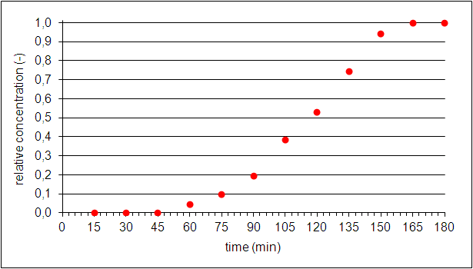
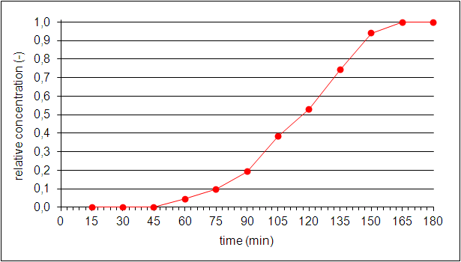
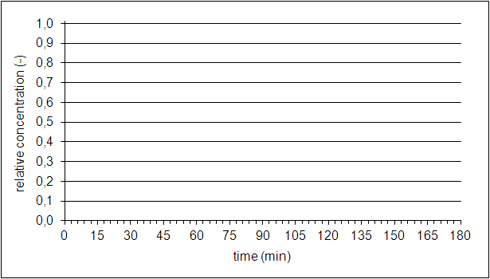
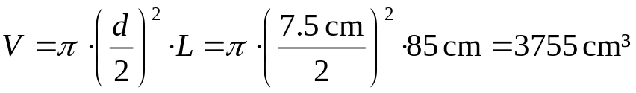
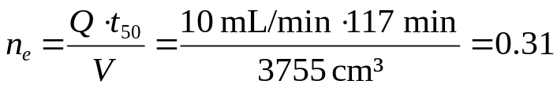
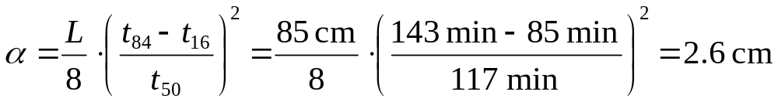
Tutorial Problem 17 – Solutions for b) – e)
b)
c)
t₁₆ = 85 min
t₅₀ = 117 min
t₈₄ = 143 min
d)
e)

Slide 13
Tutorial Problem 18
A conservative tracer experiment was performed under following conditions:
steady uniform flow in an aquifer with thickness m = 10 m and effective porosity n_{e} = 0.2
linear velocity: v_{x} = 2·10⁻⁵ m/s, v_{y} = 0
dispersivities α_{L} = 0.5 m, α_{T} = 0.2 m
At t = 0, a tracer mass of M = 985 kg was injected at (x₀, y₀) = (0, 250 m).
The tracer is not subject to sorption or degradation, i.e., R = 1, λ = 0.
y
t = 5 a
C* = 4.43 mg/l
b
a
x
Where is the centre of the tracer mass after a period of t = 5 a?
Where is the concentration isoline C* = 4.43 mg/L at that time?
Hint: Follow instructions given on next page to solve a) and b).

Slide 14
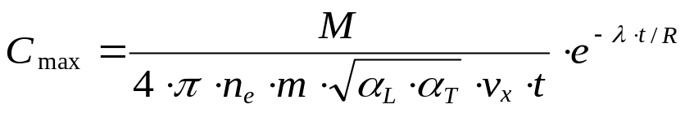


Tutorial Problem 18 – contd.
v_{x}
a
concentration isoline, C = C*
y
injection point
y₀
x
b
(0,0)
x₀
x_{max}
x
Concentration isolines are elliptic in the given scenario. Four steps are to be performed to answer problems a) and b):
Step 1: Find centre of ellipse given by x_{max} = x₀ + v_{x}·t/R and y_{max} = y₀
Step 2: Find peak concentration
Step 3: Calculate concentration ratio f = C*/C_{max}
Step 4: Determine lengths of semi-axes

Slide 15
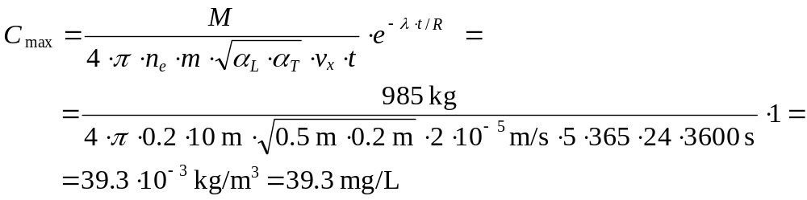
Tutorial Problem 18 – Solution
y
Step 1:
x_{max} = x₀ + v_{x}·t/R = = 0 m + + 2·10⁻⁵ m/s · 5·365·24·3600 s / 1 = = 3153.60 m
y_{max} = y₀ = 250 m
Step 2:
t = 5 a
C* = 4.43 mg/l
b
a
x
Step 3: f = C*/C_{max} = 4.43 / 39.3 = 0.1127
Step 4:

Slide 16
Homework Problems on
Sorption and Degradation
There is no obligation to solve homework problems!
If you decide to provide solutions, please submit
until January 18!

Slide 17
Homework Problem 9
The same series of batch experiments as in tutorial problem 16 are considered. However, experimental findings are now to be evaluated by assuming a Freundlich isotherm.
Plot decadic logarithm of mass ratio C_{a} vs. decadic logarithm of equilibrium concentration C_{eq} in a diagram.
Determine the Freundlich coefficient K_{Fr} and the Freundlich exponent n_{Fr}.

Slide 18
Homework Problem 10
y
A reactive tracer experiment was performed under following conditions:
steady uniform flow in an aquifer with thickness m = 10 m and effective porosity n_{e} = 0.2
linear velocity: v_{x} = 2·10⁻⁵ m/s, v_{y} = 0
dispersivities α_{L} = 0.5 m, α_{T} = 0.2 m
At t = 0, a tracer mass of M = 985 kg was injected at (x₀, y₀) = (0, 250 m).
The tracer is subject to sorption and degradation with R = 4.75 and λ = 1 a⁻¹.
t = 5 a
C* = 4.43 mg/l
b
a
x
Where is the centre of the tracer mass after a period of t = 5 a?
Where is the concentration isoline C* = 4.43 mg/L at that time?

