Slide 1
Today:
tutorial problems on sorption and degradation – Part 2
homework problems on sorption and degradation – Part 2
Notes:
‹#›

Slide 2
Tutorial Problems on
Sorption and Degradation – Part 2
Notes:
‹#›

Slide 3
Tutorial Problem 19
A laboratory experiment is planned in order to study the degradation of nitrate (NO₃⁻) in the subsurface. For this purpose, it is intended to add 200 mL of water with an initial nitrate concentration of 150 mg/L to a sediment sample in a glass vessel. From previous investigations, degradation may be assumed to follow a first-order rate law with a rate constant λ = 0.2 a⁻¹.
Sketch the nitrate concentration based on this first estimate of the rate constant.
What is the nitrate concentration to be expected after 3 weeks?
How much nitrate will have been degraded during this period?
In the experiment, a nitrate concentration of 146.7 mg/L was determined after 3 weeks. Recalculate the rate constant and briefly comment on the result.
Notes:
‹#›

Slide 4
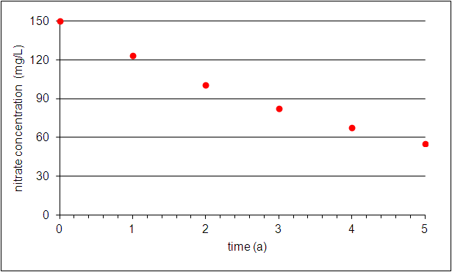
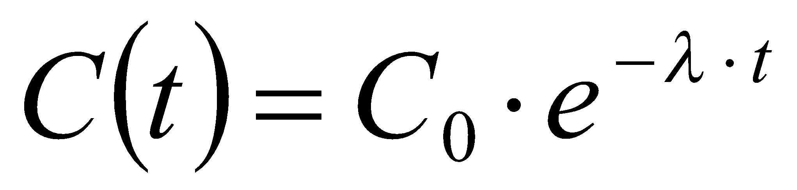
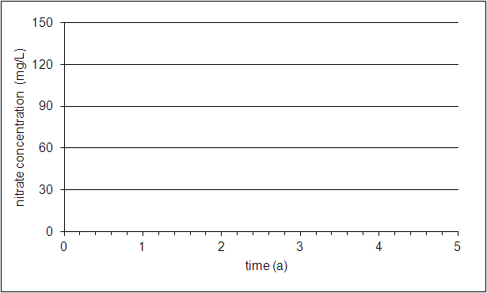
Tutorial Problem 19 – Solution for a) and b)
a)
time (a) | C (mg/L)
0 | 150
1 | 122.8
2 | 100.5
3 | 82.3
4 | 67.4
5 | 55.2
b)
Notes:
‹#›

Slide 5
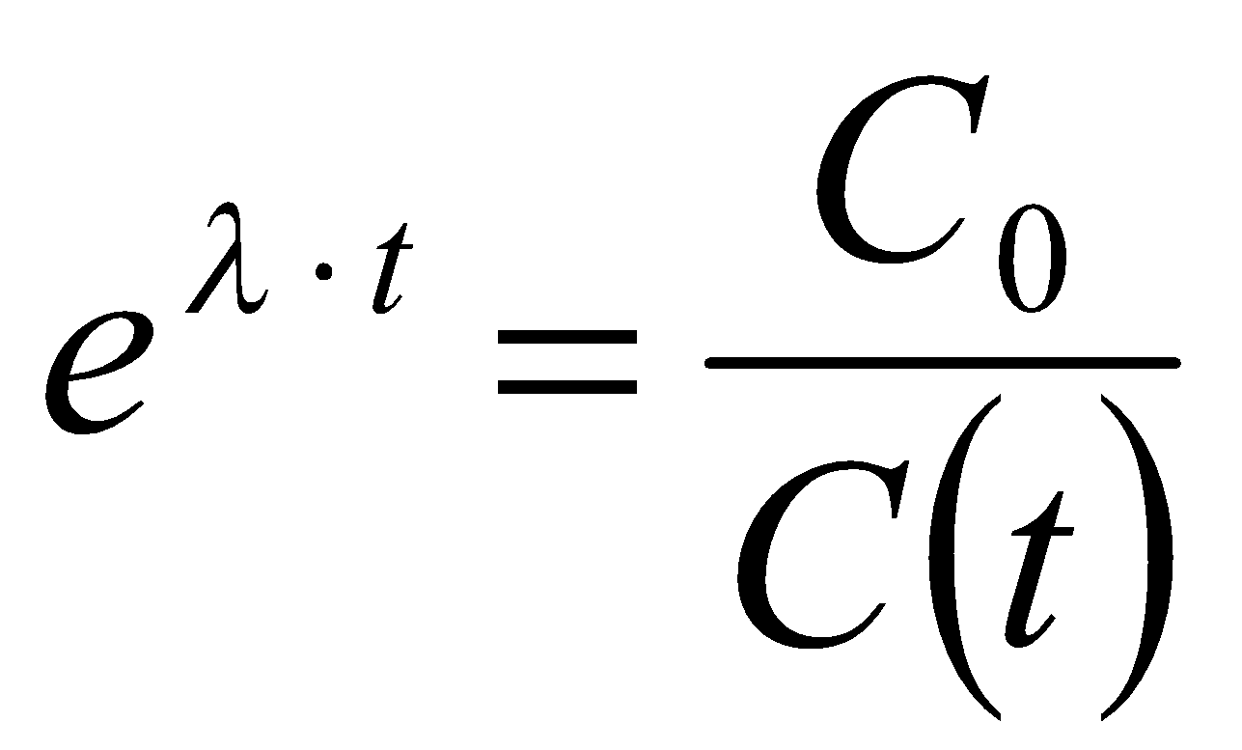
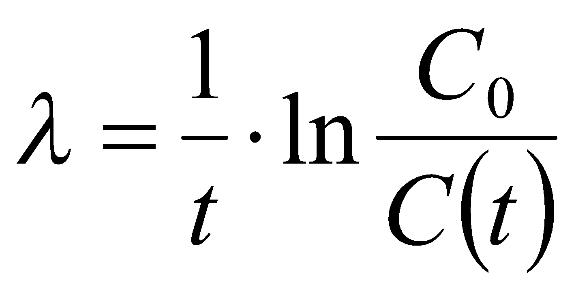
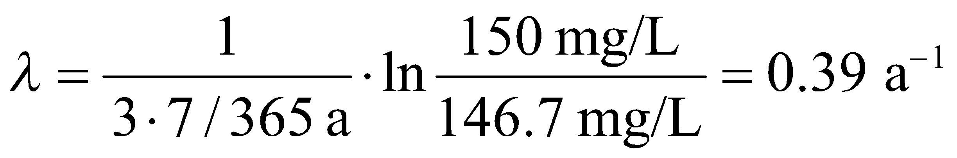
Tutorial Problem 19 – Solution for c) and d)
c)
initial mass = C₀∙V_{w} = 150 mg/L ∙ 200 mL = 30 mg
mass after 3 weeks = C(t)∙V_{w} = 148.3 mg/L ∙ 200 mL = 29.66 mg
degraded mass = 30 mg – 29.66 mg = 0.34 mg
d) C(t) = 146.7 mg/L
exponential decrease of concentration:
multiply by e^{λ∙t} and divide by C(t):
take logarithm and divide by t:
compute λ:
Slight decrease in concentration after 3 weeks leads to doubling of the rate constant. Measurements must therefore either be carried out with high reliability or a longer measurement period is required to get robust results as half-life is between 3 a and 4 a (see figure / table on previous page).
Notes:
‹#›

Slide 6
Tutorial Problem 20
A rectangular concentration distribution is given at time t₀ (black rectangle in upper diagram). Sketch concentration profiles and breakthrough curves for 1D solute spreading by subsequently considering the following processes:
advection
advection + degradation (first-order, in water phase only)
advection + degradation + sorption (linear isotherm)
advection + degradation + sorption + dispersion
t=t
t=t
t=t
C
0
1
2
max
🡪
🡪
C[mg/l]
injection interval
obs. pt. 1
obs. pt. 2
distance
obs. pt. 1
obs. pt. 2
C
max
C [mg/l]
t
t
t
time t
0
1
2
Notes:
‹#›

Slide 7
Tutorial Problem 21
The figure shows a landfill scenario that is to be investigated with regard to contaminant spreading in case of leakage. In particular, it is intended to estimate the travel time of a contaminant to reach a downgradient observation well.
In a first approach, it is assumed that spreading is due to pore diffusion only. (Hint: Make use of the equation x² = 2∙D_{p}∙t that relates travel distance x with travel time t for diffusive spreading; D_{p} = pore diffusion coefficient)
Compare this result with the travel time obtained by considering advection and retardation.
obs. well
parameters:
K = 3.5∙10⁻⁵ m/s
i = 0.002
n_{e} = 0.23
D_{aq} = 10⁻⁹ m²/s
R = 2.35
Landfill
potential contaminant release
L = 15 m
Notes:
‹#›

Slide 8
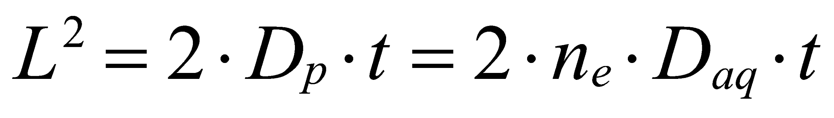
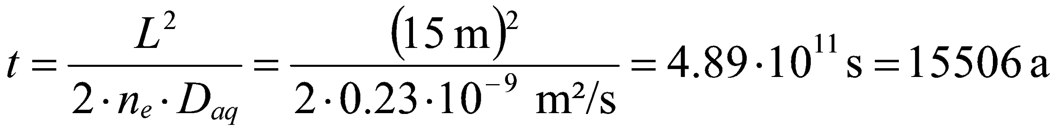
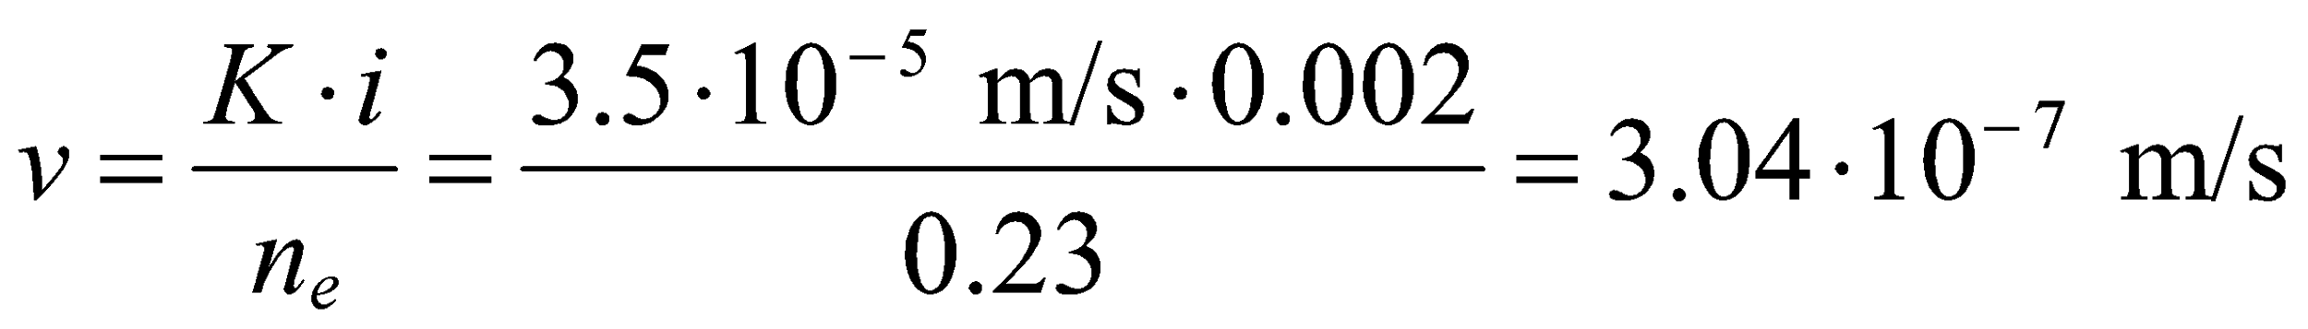
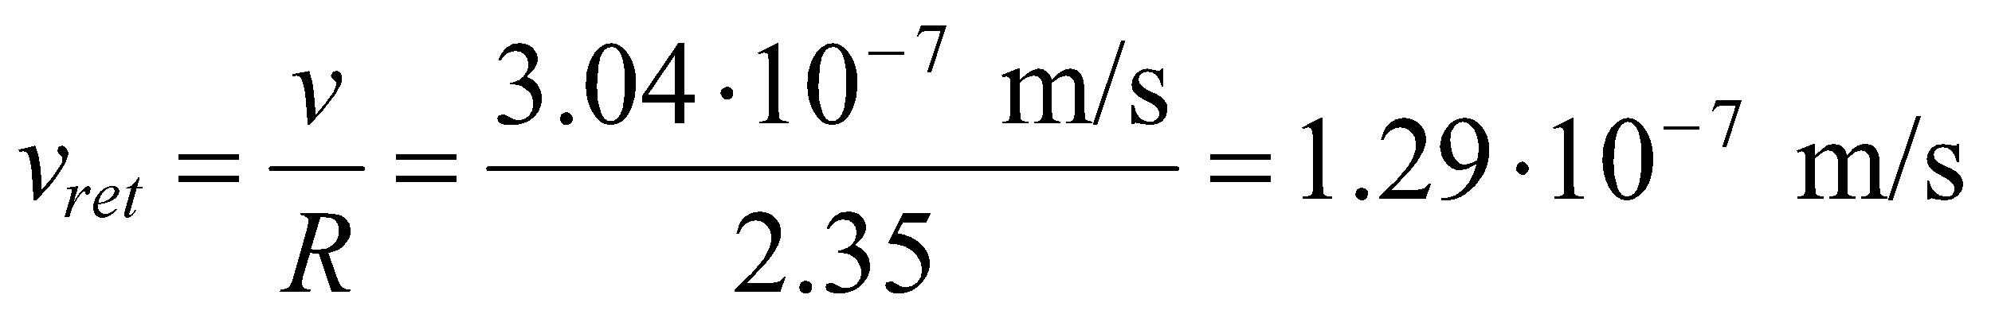
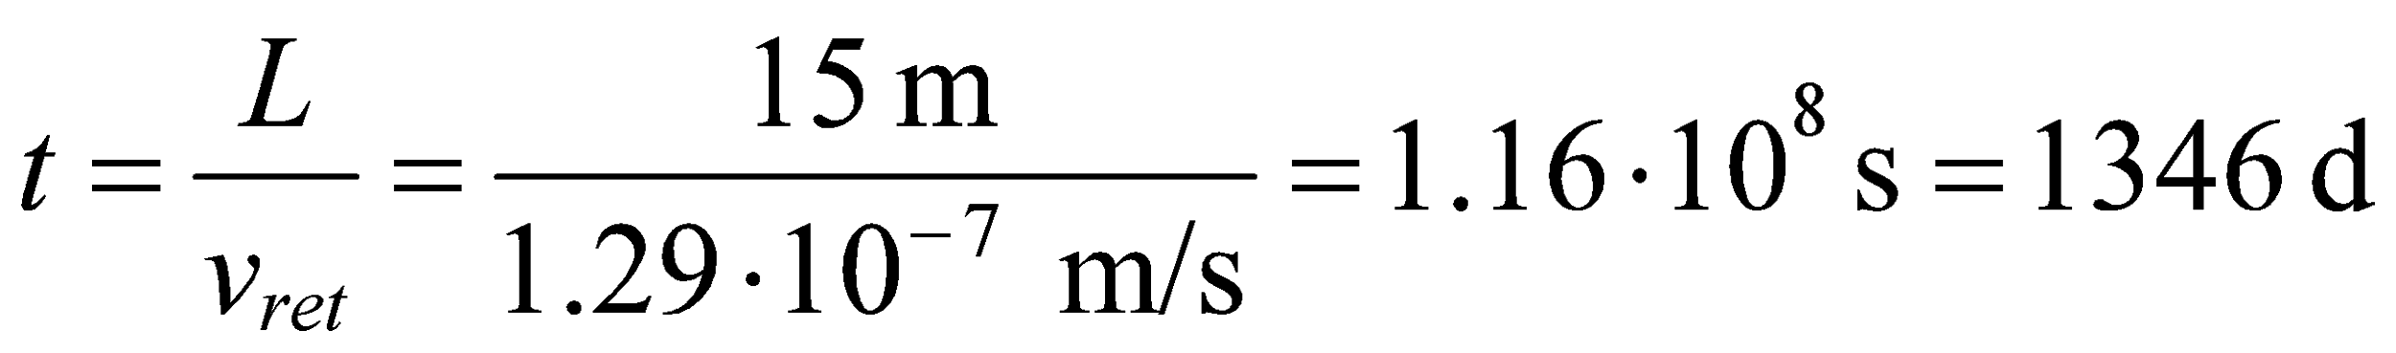
Tutorial Problem 21 – Solution
a)
relate square of travel distance to aqueous diffusion coefficient via D_{p} = n_{e}∙D_{aq}:
solve for t:
b)
linear velocity:
retarded velocity:
travel time of contaminant:
From this result it is concluded that diffusive spreading can be neglected in order to assess groundwater pollution for the given scenario. (This is typical for many – not all – situations in unconsolidated aquifers.)
Notes:
‹#›

Slide 9
Homework Problems on
Sorption and Degradation – Part 2
There is no obligation to solve homework problems!
If you decide to provide solutions, please submit
until January 25!
Notes:
‹#›

Slide 10
Homework Problem 11:
Groundwater age can be determined by applying the ¹⁴C method to organic carbon contained in the water. ¹⁴C is an unstable (= radioactive) carbon isotope with a half-life of 5730 a.
Determine the degradation rate constant.
Estimate the age of the groundwater in the sample for C₀ = 91 %mod. and C_{today} = 54.6 %mod.
Hint: 100 %mod. (“modern“) correspond to an activity of 0.226 Bq per gram of carbon (1 Bq = 1 Becquerel)
Notes:
‹#›

Slide 11
Homework Problem 12:
Sketch concentration profiles and breakthrough curves for a continuous solute injection by subsequently considering the following processes:
advection
advection + degradation (first-order, in water phase only)
advection + degradation + sorption (linear isotherm)
advection + degradation + sorption + dispersion
t=t
obs. pt.
1
C
C
max
max
C[mg/l]
C[mg/l]
injection point
obs. pt.
distance
t
time t
1
Notes:
‹#›

